Slide 1
CSS 2

Slide 2
CSS 2
Prep Work
Finish CSS 1 In-Class and Homework exercises and post to web server public_html/class-samples (email the link to instructor)
Continue Treehouse How to make a website or CSS Basics https://teamtreehouse.com/library/css-basics
https://teamtreehouse.com/library/how-to-make-a-website

Slide 3
CSS 2
Today’s Class:
Review and Coding Exercise from last class
Additional Coding Exercise
Styling Lists
Styling Tables
Styling Forms and Form Elements
Structure and Layout

Slide 4
CSS 2
Create part of the Cartoon Network website in the next slide using HTML 5 and CSS- (Instructor will send images)
Name the page cartoon.html and save it to public_html/class-samples/
Link the CSS page to an external stylesheet called stylesheet.css and save it to public_html/class-samples/css
Upload the images, cartoon.css and cartoon.html files up to the web server and send the instructor the link

Slide 5
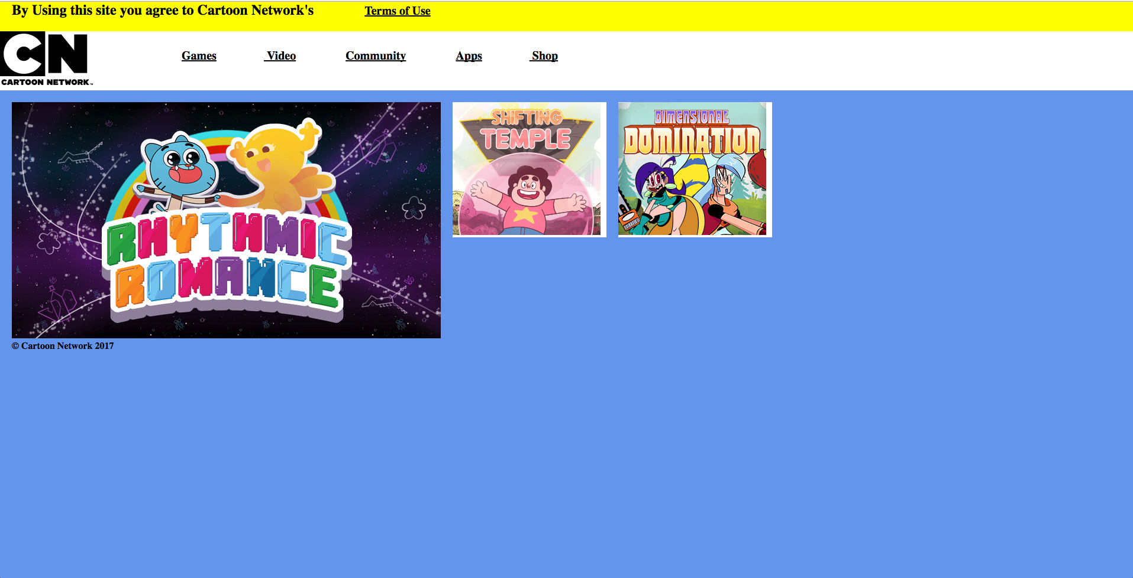
CSS 2

Slide 6
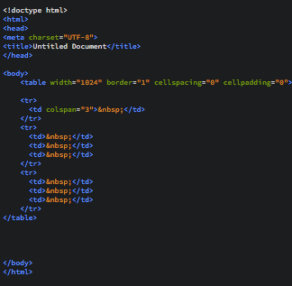
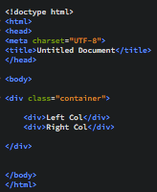
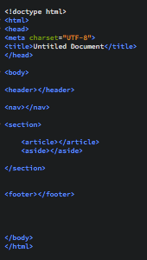
CSS 2
Summary of Page Layout Methods:
Tables (old method) Normal Flow Divs (still used) Normal Flow HTML5 (new)

Slide 7
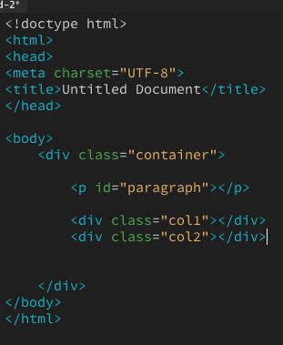
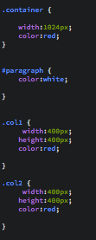
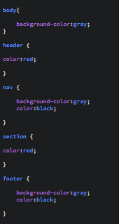
CSS 2
CSS Selectors:
HTML Tags #IDs and .Classes HTML5 Tags

Slide 8
Coding Exercise

Slide 9
CSS 2
Create the City Gallery webpage in the next slide using Divs and CSS (Instructor will send the text)
Name the page city-css.html and save it to public_html/class-samples/
Link the CSS page to an external stylesheet called city.css and save it to public_html/class-samples/css
Whole page should be centered and links should hover red
Upload the city-css.html files up to the web server and send the instructor the link

Slide 10
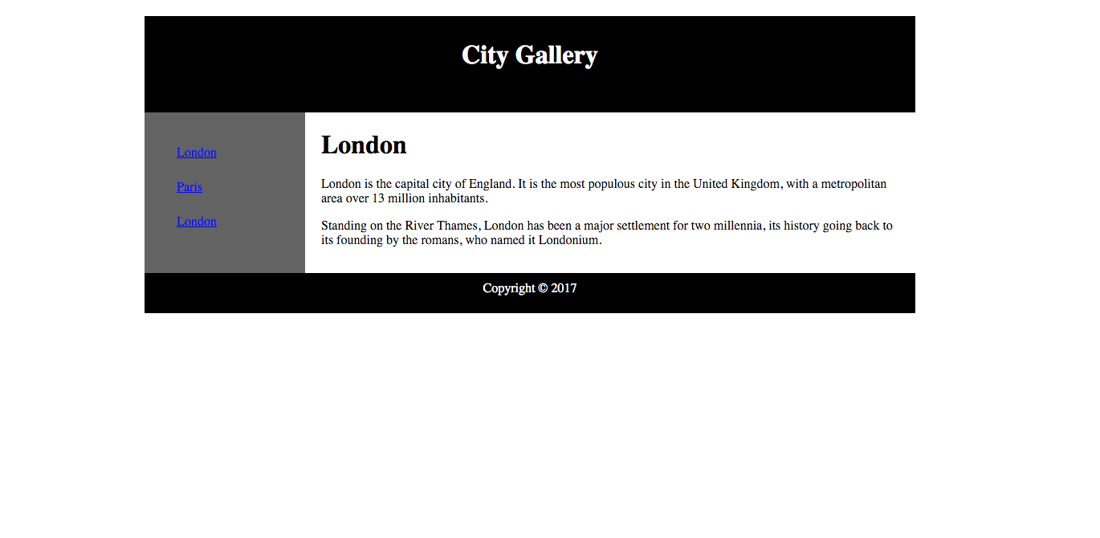
CSS 2

Slide 11
Lists

Slide 12
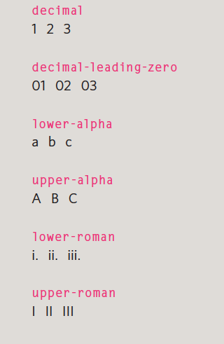
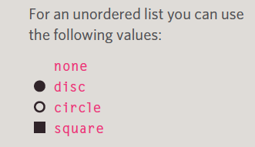
Styling Lists
For Ordered
Numbers and Letters
list-style-type:(options)
For Unordered
disc (default)
circle
square
none
Images
E.g. list-style-image: url( … );

Slide 13
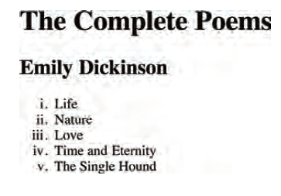
Lists
HTML
External CSS
Result
<h1>The Complete Poems</h1>
<h2>Emily Dickinson</h2>
<ol>
<li>Life</li>
<li>Nature</li>
<li>Love</li>
<li>Time and Eternity</li>
<li>The Single Hound</li>
</ol>
ol {
list-style-type: lower-roman; }

Slide 14
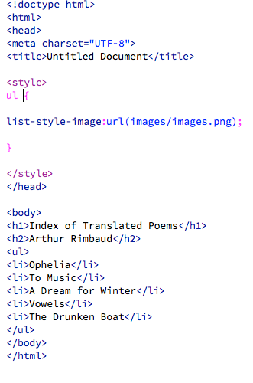
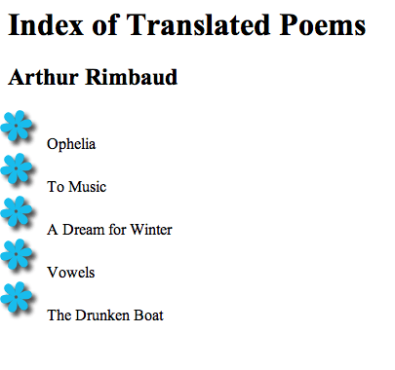
Lists-Images
HTML/ Internal CSS
Result
Note: if you are using an External CSS stylesheet the file/folder path is list-style-image:url(../images/images.png);

Slide 15
CSS In Class Project
Construct a page icons.html with the following bullets using external stylesheet: Save the CSS as icons.css in the public_html/class-samples/css
3 Bullets: Apple, Orange, Banana
Style the bullets with 3 icons provided save them in the public_html/class-samples/images folder
Save the page as icons.html in the public_html/class-samples folder

Slide 16
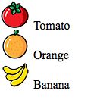
CSS In Class Project

Slide 17
Tables

Slide 18
CSS
Styling Tables
External CSS
body {
font-family: Arial, Verdana, sans-serif;
color: #111111;}
table {
width: 600px;}
th, td {
padding: 7px 10px 10px 10px;}
th {
text-transform: uppercase;
letter-spacing: 0.1em;
font-size: 90%;
border-bottom: 2px solid #111111;
border-top: 1px solid #999;
text-align: left;}
tr {
background-color: #efefef;}
td:hover {
background-color: #c3e6e5;}
Can use much of what we have already covered
color
background-color
width
padding
text-transform
text-align
font-size
hover
Can also use class or id in combination to affect specific areas of the table

Slide 19
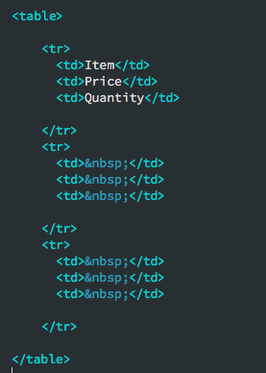
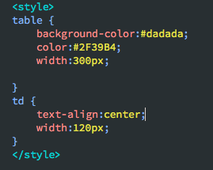
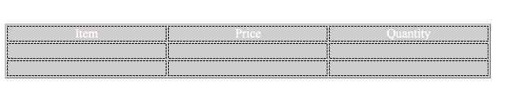
CSS
HTML
CSS(internal)
Result

Slide 20
CSS In Class Project
Construct a table page with the following using external styling:
A table with 3 rows and 3 columns (see next slide for example)
Make the table 360 pixels wide, and cells 120 pixels wide
Place “Item” “Price” “Quantity” inside the cells across the top of the table
Style the table with a gray background
Make the text color blue
Align the text in the center of the cells Extra Credit: make the cells change when you hover
Save the page as css-table.html in the public_html/class-samples folder
Name the css file tablestyle.css and save the css stylesheet to public_html/class-samples/css
Upload the page to your public_html/class-samples directory on the web server

Slide 21

CSS In Class Project

Slide 22
Forms

Slide 23
CSS
Styling Forms
Can use much of what we have already covered
color
background-color
border-radius
padding
hover
focus
background-image
Can also use classes or ids in combination to affect specific areas of a form

Slide 24
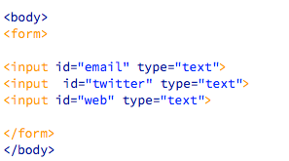
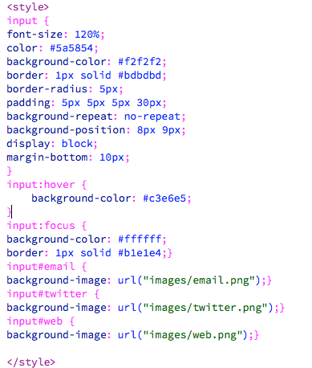
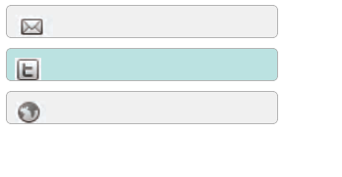
CSS
HTML
Internal CSS
Result

Slide 25
CSS
Rendering
-Moz and -Webkit are a web browser rendering, rendering engine used by Safari and Chrome (among others, but these are the popular ones). The -webkit prefix on CSS selectors are properties that only this engine is intended to process, very similar to -moz properties.
These are the vendor-prefixed properties offered by the relevant rendering engines (-webkit for Chrome, Safari; -moz for Firefox, -o for Opera, -ms for Internet Explorer). Typically they're used to implement new, or proprietary CSS features, prior to final clarification/definition by the W3.
This allows properties to be set specific to each individual browser/rendering engine in order for inconsistencies between implementations to be safely accounted for. The prefixes will, over time, be removed (at least in theory) as the unprefixed, the final version, of the property is implemented in that browser.

Slide 26
CSS
Rendering Syntax for Browsers
.elementClass {
-moz-border-radius: 2em; /* Mozilla Firefox */
-ms-border-radius: 2em; /* Microsoft */
-o-border-radius: 2em; /* Opera */
-webkit-border-radius: 2em; /* Chrome */
border-radius: 2em;
-webkit-box-shadow: 1px 10px 100px 0px rgba(102, 51, 153, 0.75);
-moz-box-shadow: 1px 10px 100px 0px rgba(102, 51, 153, 0.75);
box-shadow: 1px 10px 100px 0px rgba(102, 51, 153, 0.75);
}
NOTE: Be sure to include all in code for support on every browser.
Visit https://border-radius.com/ to use a WYSIWYG border radius generator.
Visit https://www.cssboxshadow.com/ to use a WYSIWYG box shadow generator.

Slide 27
CSS
Styling Buttons
input#submit {
color: #444444;
text-shadow: 0px 1px 1px #ffffff;
border-bottom: 2px solid #b2b2b2;
background-color: #b9e4e3;
background: -webkit-gradient(linear, left top,
left bottom, from(#beeae9), to(#a8cfce));
background:
-moz-linear-gradient(top, #beeae9, #a8cfce);
background:
-o-linear-gradient(top, #beeae9, #a8cfce);
background:
-ms-linear-gradient(top, #beeae9, #a8cfce);}
input#submit:hover {
color: #333333;
border: 1px solid #a4a4a4;
border-top: 2px solid #b2b2b2;
background-color: #a0dbc4;
background: -webkit-gradient(linear, left top,
left bottom, from(#a8cfce), to(#beeae9));
background:
-moz-linear-gradient(top, #a8cfce, #beeae9);
background:
-o-linear-gradient(top, #a8cfce, #beeae9);
background:
-ms-linear-gradient(top, #a8cfce, #beeae9);}
Webkit is a web browser rendering rendering engine used by Safari and Chrome (among others, but these are the popular ones). The -webkit prefix on CSS selectors are properties that only this engine is intended to process, very similar to -moz properties.
SITE LINK
http://css3buttongenerator.com/

Slide 28
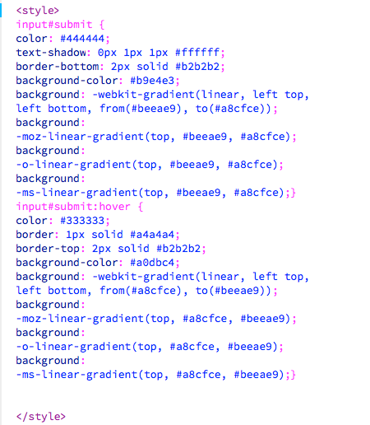
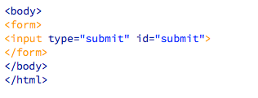

CSS
Styling Buttons
HTML
Internal CSS
Result

Slide 29
CSS
Styling Fieldsets
Similar Declarations
border
padding
border radius
text-align
text-transform

Slide 30
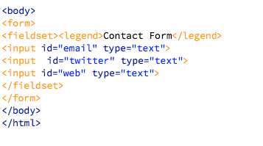
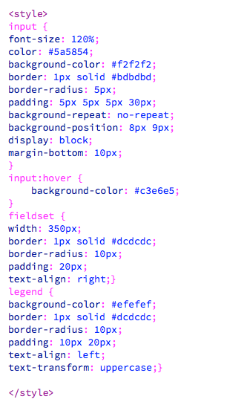
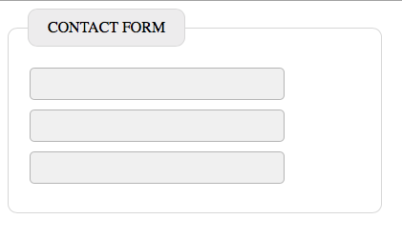
CSS
HTML
Internal CSS
Result

Slide 31
CSS In Class Project
Construct a form with the following fields :
First Name
Last Name
Phone Number
Style the form with a fieldset and legend using external styling. (colors used: #f2f2f2, #c3e6e5, #bdbdbd,#efefef,#dcdcdc
Name the html file css-form.html and save the form to your public_html/class-samples directory Name the css file formstyle.css and save the css stylesheet to public_html/class-samples/css
Upload to your web server and email instructor the link.

Slide 32
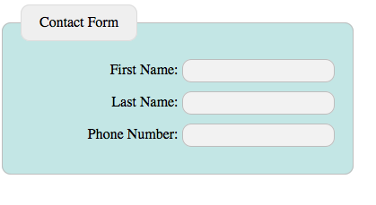
CSS In Class Project

Slide 33
Structures & Layout

Slide 34
CSS Structure
Setting Up Structure and arranging boxes
Declaration Statement (Property and Value):
float:left;
float:right;
clear:both;
width, height, padding, margin
(Example File in next two slides)

Slide 35
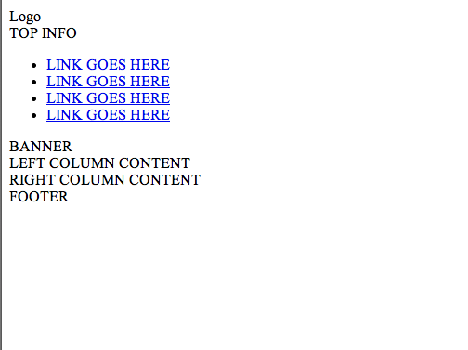
CSS Structure
Setting Up A Basic Div Structure No Styling

Slide 36
CSS Structure
Setting Up A Basic Div Structure (HTML)
<!doctype html>
<html>
<head>
<meta charset="UTF-8">
<title>Divs</title>
</head>
<body>
<!--Container -->
<div id="container">
<!--Header -->
Setting Up A Basic Div Structure (HTML)
<div id="header">
<div id="logo">Logo</div>
<div id="top_info">TOP INFO</div>
</div>
<!--Header End-->
<div id="navbar">
<ul>
<li><a href="URL">LINK GOES HERE</a></li>
<li><a href="URL">LINK GOES HERE</a></li>
<li><a href="URL">LINK GOES HERE</a></li>
<li><a href="URL">LINK GOES HERE</a></li>
</ul>
</div>
<!--Nav End-->
<!--Content Area -->
<div id="content_area">
<div id="banner">BANNER</div>
<div id="left_col">LEFT COLUMN CONTENT</div>
<div id="right_col"> RIGHT COLUMN CONTENT</div>
</div>
<!--Content Area End-->
<!--Footer -->
<div id="footer">FOOTER</div>
</div>
<!--End Container -->
</body>
</html>

Slide 37
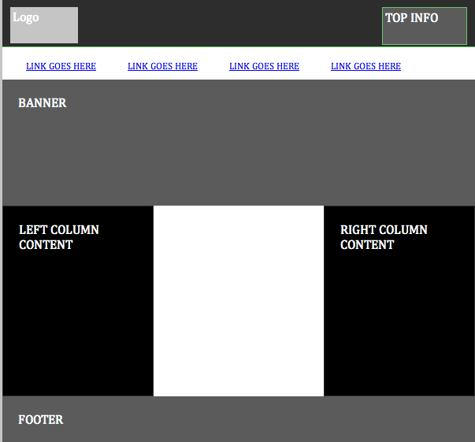
CSS Box
Setting Up A Basic Div Structure - With Styling

Slide 38
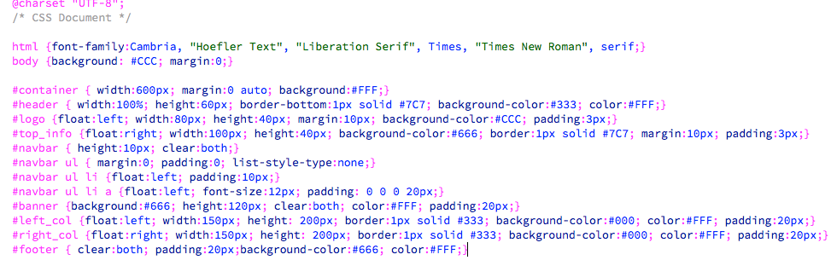
CSS Box
Setting Up A Basic Div Structure - With CSS Styling Using HTML Structure

Slide 39
CSS
3
Exercise

Slide 40
CSS In Class Project
Construct the following page using Div Method using classes or ids and linking to an external CSS stylesheet.
Use px for widths, margin, and cellpadding. Use px for height
Upload the page to your public_html/class-samples directory and name the page div-exercise2.html
Upload your css to public_html/class-samples/css and name it div-style2.css
Email instructor a link to your files

Slide 41
CSS Box
Setting Up A Basic Div Structure - With Styling

Slide 42
CSS In Class Project
Construct/Convert the following page using HTML 5 Method using classes or ids and linking to an external CSS stylesheet.
Use % for widths, margin, and cellpadding. Use px for height
Upload the page to your public_html/class-samples directory and name the page html5-exercise2.html
Upload your css to public_html/class-samples/css and name it html5-style2.css
Email instructor a link to your files

Slide 43
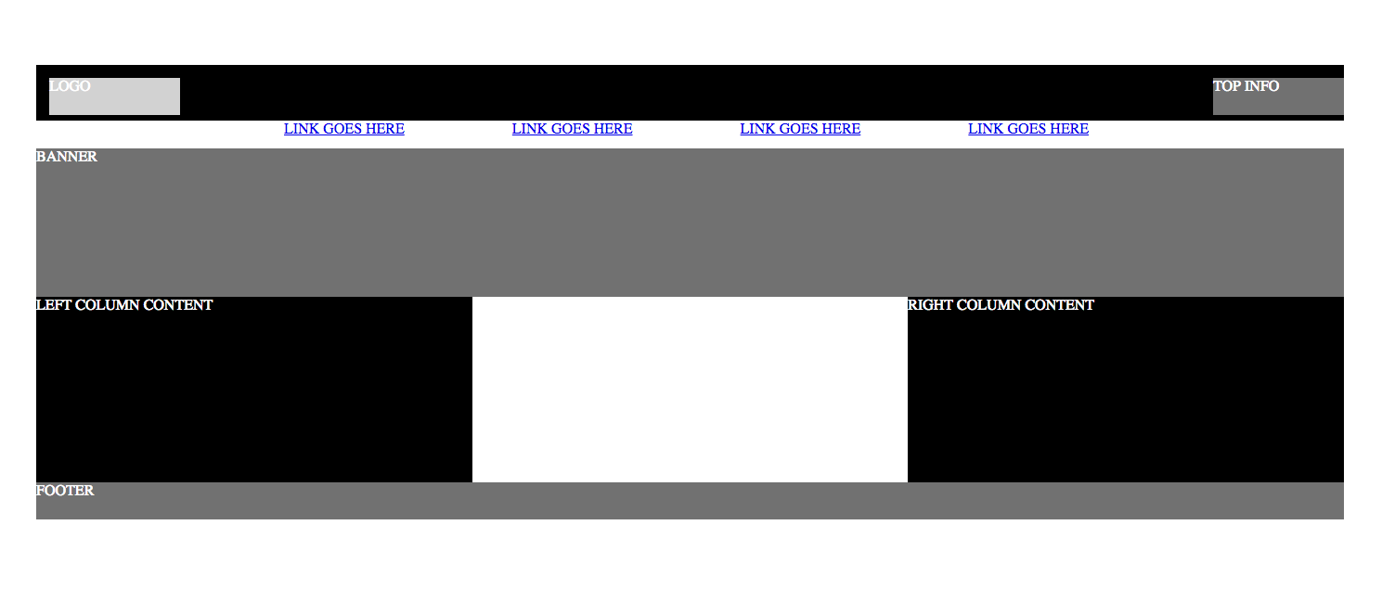
CSS In Class Project

Slide 44
CSS In Class Project
Add content provided by instructor and adjust styling to look like the screenshot. Links in both navs should hover
Upload the page to your public_html/class-samples directory and name the page html5-exercise3.html
Upload the images to public_html/class-samples/images
Upload your css to public_html/class-samples/css and name it html5-style3-css
Email instructor a link to your files

Slide 45
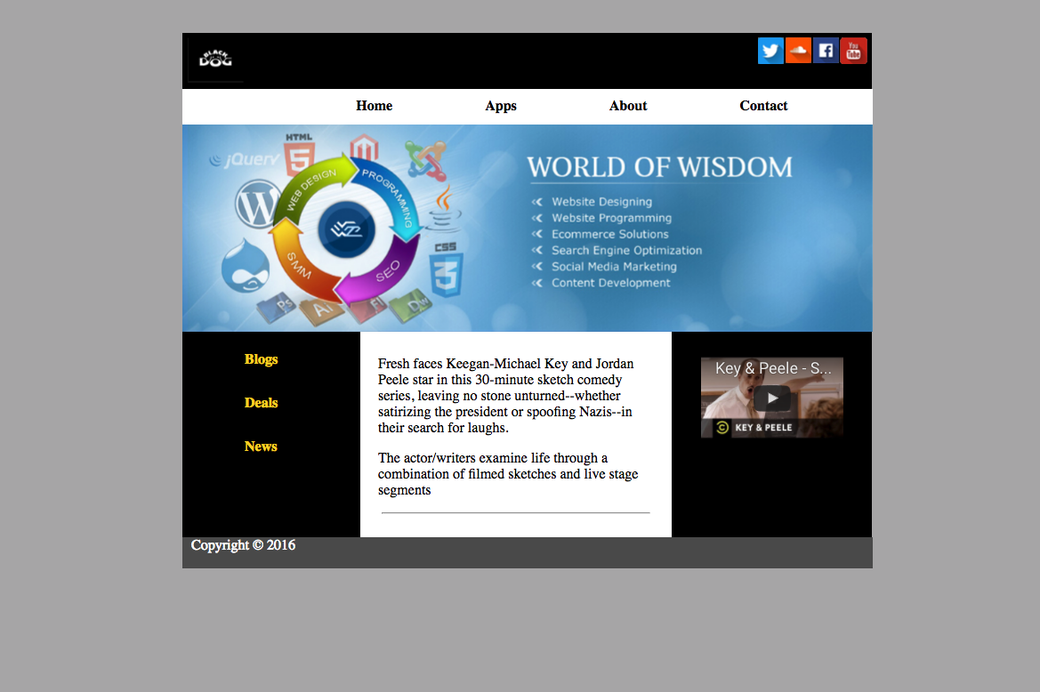
CSS In Class Project

Slide 46
Homework
Complete and Upload exercises to web server samples folder
Read through CSS Materials
Treehouse
https://teamtreehouse.com/library/css-basics
https://teamtreehouse.com/library/how-to-make-a-website
Finish All HTML and Sample CSS projects, upload them and send links to instructor

Slide 47
End
3

