Slide 1
CSS 3

Slide 2
CSS 3
Prep Work
Finish all HTML5 and Sample CSS homework
Finish and Upload css sample World of Wisdom to web server public_html/class-samples folder
Work through: https://teamtreehouse.com/tracks/front-end-web-development
https://teamtreehouse.com/library/css-basics
https://teamtreehouse.com/library/how-to-make-a-website

Slide 3
CSS 3
Today’s Class
Recap from CSS2 (Cover WOW Site design)
Advanced CSS3 topics (Animation, Transitions, Backgrounds)
Review some CSS 3 Coding Samples and try some examples from slides and items emailed to students
CSS-Complete the Portfolio Website that looks like the screenshot and link to your Resume, Photoshop (Fitness), HTML +project, and (Safety) files make sure the page is called index.html)- All projects for every language going forward will link from this page as well!
Construct your Digital Resume (HTML Version) that looks like the screenshot and link to it from your portfolio page

Slide 4
Backgrounds, Transitions & Animation

Slide 5
CSS 3
Inserting Backgrounds - background:url(../images/tree.png)
Changing Cursors - style="cursor:type of cursor"
Transform-Rotating and Skewing Images-transform: translate(100px,50px) skew(20deg) scale(2) rotate(45deg);
Positioning
Z-index img { z-index: -1;}
Gradients-background: -webkit-linear-gradient
Animation using Keyframes -@-webkit-keyframes example
Using Hover and Opacity -opacity: 0.4;filter: alpha(opacity=40);
Transitions - transition-timing-function
transition: width 2s, height 4s;

Slide 6
CSS 3
Styling & Inserting Backgrounds(Example File)
The background-image property specifies an image to use as the background of an element.
By default, the image is repeated so it covers the entire element or screen size.
The background image for a page can be set like this:
You can use background-repeat: repeat-x; or background-repeat: repeat-y; to repeat vertically or horizontally
Declarations
background-image: url("image name and location");
background-repeat: no-repeat;
background-attachment:fixed;
background-position: right top;
Shorthand:
body {
background: #ffffff url("../images/img_tree.png") no-repeat right top;
}

Slide 7
CSS 3
Cursor Changes
The cursor property specifies the type of cursor to be displayed when pointing on an element.
<link rel="stylesheet" href="cursor.css">
...
<div class="cursor-wait">
Your order is being processed.
</div>
See example files "cursor.html" and "cursor.css".
alias
all-scroll
auto
cell
col-resize
context-menu
copy
crosshair
default
e-resize
ew-resize
help
move
n-resize
ne-resize
nesw-resize
no-drop
none
not-allowed
ns-resize
nw-resize
nwse-resize
pointer
progress
row-resize
s-resize
se-resize
sw-resize
text
vertical-text
w-resize
wait

Slide 8
CSS 3
TRANSFORM PROPERTY
Transform Options/Declarations (do not work with I.E. 9 or earlier)
The transform property applies a 2D or 3D transformation to an element.
This property allows you to rotate, scale, move, skew, etc., elements.
Can be combined with transitions to animate items.
Can transform things like images using:
X, Y Coordinates
Skew
Scale
Rotate
div {
-ms-transform: rotate(7deg); /* IE 9 */
-webkit-transform: rotate(7deg); /* Chrome, Safari, Opera */
transform: rotate(7deg);
}

Slide 9
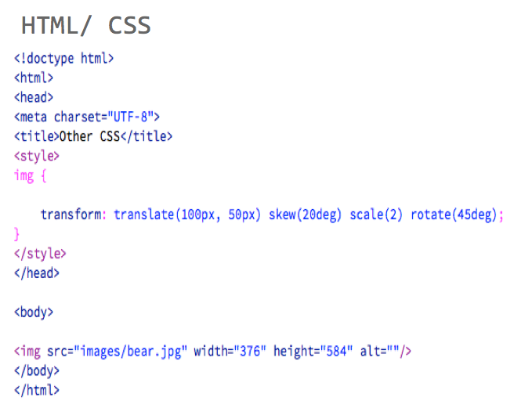

CSS 3
Result
NOTE-if you change the order of properties will change picture use any picture you like. https://www.w3schools.com/cssref/css3_pr_transform.asp
Notes:
<!DOCTYPE html>
<html>
<head>
<style>
div {
width: 200px;
height: 100px;
background-color: yellow;
/* Rotate div */
-ms-transform: rotate(7deg); /* IE 9 */
-webkit-transform: rotate(7deg); /* Chrome, Safari, Opera */
transform: rotate(7deg);
}
</style>
</head>
<body>
<div>Hello</div>
<br>
<p><b>Note:</b> Internet Explorer 8 and earlier versions do not support the transform property.</p>
<p><b>Note:</b> Internet Explorer 9 supports an alternative, the -ms-transform property. Newer versions of IE support the transform property (do not need the ms prefix).</p>
<p><b>Note:</b> Chrome, Safari and Opera supports an alternative, the -webkit-transform property.</p>
</body>
</html>

Slide 10
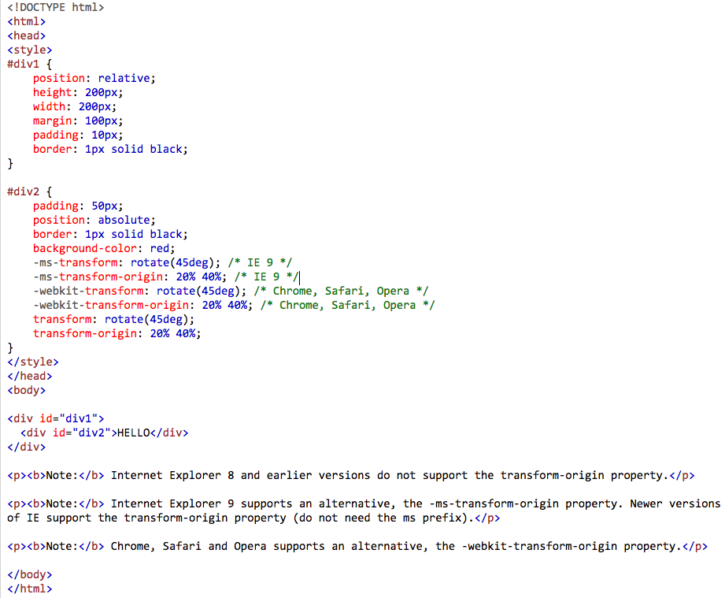
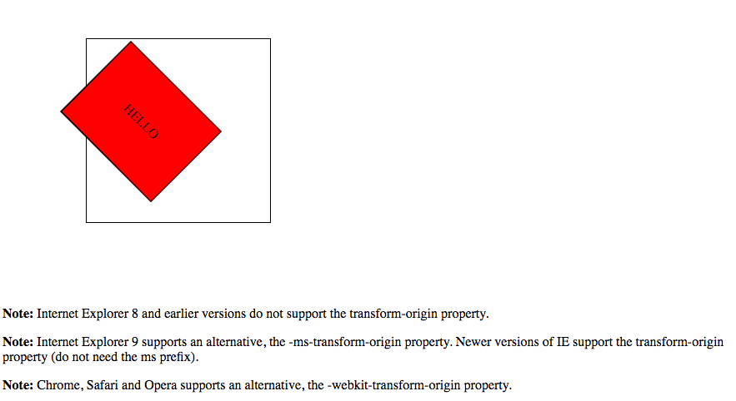
CSS 3
TRANSFORM ORIGIN
The transform-origin property allows you to change the position of transformed elements.
2D transformations can change the x- and y-axis of an element. 3D transformations can also change the z-axis of an element.
Note: This property must be used together with the transform property.
Notes:
<!DOCTYPE html>
<html>
<head>
<style>
div {
width: 200px;
height: 100px;
background-color: yellow;
/* Rotate div */
-ms-transform: rotate(7deg); /* IE 9 */
-webkit-transform: rotate(7deg); /* Chrome, Safari, Opera */
transform: rotate(7deg);
}
</style>
</head>
<body>
<div>Hello</div>
<br>
<p><b>Note:</b> Internet Explorer 8 and earlier versions do not support the transform property.</p>
<p><b>Note:</b> Internet Explorer 9 supports an alternative, the -ms-transform property. Newer versions of IE support the transform property (do not need the ms prefix).</p>
<p><b>Note:</b> Chrome, Safari and Opera supports an alternative, the -webkit-transform property.</p>
</body>
</html>

Slide 11
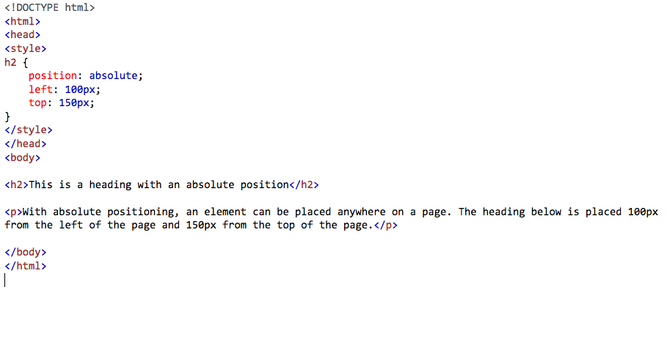
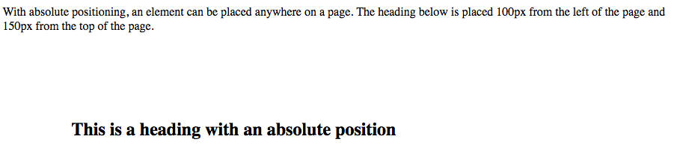
CSS 3
Positioning
The position property specifies the type of positioning method used for an element (static, relative, absolute or fixed).
http://www.w3schools.com/css/css_positioning.asp
Notes:
<!DOCTYPE html>
<html>
<head>
<style>
h2 {
position: absolute;
left: 100px;
top: 150px;
}
</style>
</head>
<body>
<h2>This is a heading with an absolute position</h2>
<p>With absolute positioning, an element can be placed anywhere on a page. The heading below is placed 100px from the left of the page and 150px from the top of the page.</p>
</body>
</html>

Slide 12
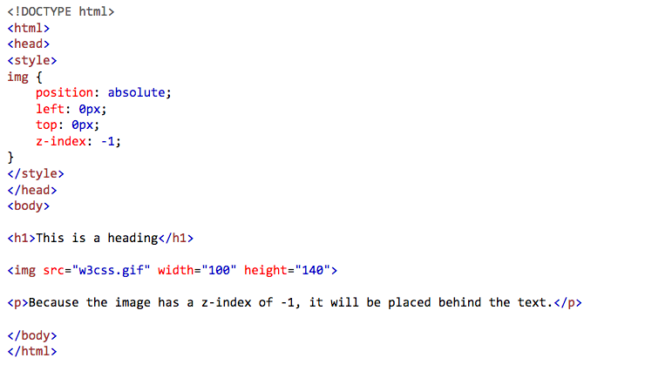
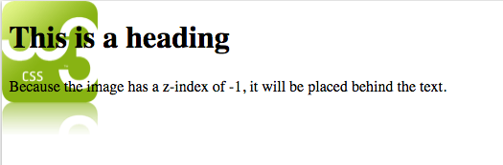
CSS 3
Z-Index PROPERTY
The z-index property specifies the stack order of an element.
An element with greater stack order is always in front of an element with a lower stack order. I.e. it controls the vertical stacking order of elements that overlap. As in, which one appears as if it is physically closer to you.
Note: z-index only works on positioned elements (position:absolute, position:relative, or position:fixed).
Notes:
<!DOCTYPE html>
<html>
<head>
<style>
img {
position: absolute;
left: 0px;
top: 0px;
z-index: -1;
}
</style>
</head>
<body>
<h1>This is a heading</h1>
<img src="w3css.gif" width="100" height="140">
<p>Because the image has a z-index of -1, it will be placed behind the text.</p>
</body>
</html>

Slide 13
CSS 3
CSS3 Gradients
CSS3 gradients let you display smooth transitions between two or more specified colors.
CSS3 defines two types of gradients:
Linear Gradients (goes down/up/left/right/diagonally)
Radial Gradients (defined by their center)
Repeating Gradients (Is a function used to repeat gradients:)
NOTE: the use of background vs background-color is how specific you want to be and what specific conditions are of your style declarations
Online CSS gradient generator: http://www.colorzilla.com/gradient-editor/

Slide 14
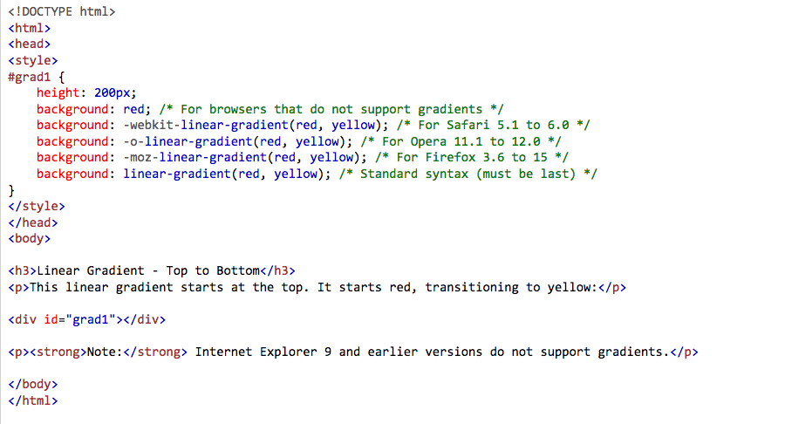
CSS 3
Linear
Notes:
<!DOCTYPE html>
<html>
<head>
<style>
#grad1 {
height: 200px;
background: red; /* For browsers that do not support gradients */
background: -webkit-linear-gradient(red, yellow); /* For Safari 5.1 to 6.0 */
background: -o-linear-gradient(red, yellow); /* For Opera 11.1 to 12.0 */
background: -moz-linear-gradient(red, yellow); /* For Firefox 3.6 to 15 */
background: linear-gradient(red, yellow); /* Standard syntax (must be last) */
}
</style>
</head>
<body>
<h3>Linear Gradient - Top to Bottom</h3>
<p>This linear gradient starts at the top. It starts red, transitioning to yellow:</p>
<div id="grad1"></div>
<p><strong>Note:</strong> Internet Explorer 9 and earlier versions do not support gradients.</p>
</body>
</html>

Slide 15
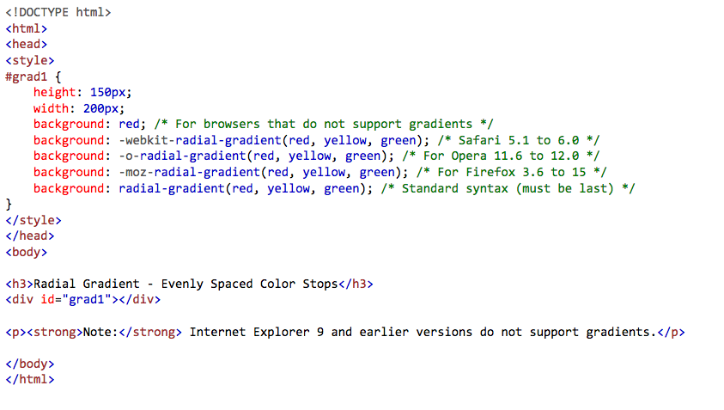
CSS 3
Radial
Notes:
<!DOCTYPE html>
<html>
<head>
<style>
#grad1 {
height: 150px;
width: 200px;
background: red; /* For browsers that do not support gradients */
background: -webkit-radial-gradient(red, yellow, green); /* Safari 5.1 to 6.0 */
background: -o-radial-gradient(red, yellow, green); /* For Opera 11.6 to 12.0 */
background: -moz-radial-gradient(red, yellow, green); /* For Firefox 3.6 to 15 */
background: radial-gradient(red, yellow, green); /* Standard syntax (must be last) */
}
</style>
</head>
<body>
<h3>Radial Gradient - Evenly Spaced Color Stops</h3>
<div id="grad1"></div>
<p><strong>Note:</strong> Internet Explorer 9 and earlier versions do not support gradients.</p>
</body>
</html>

Slide 16

CSS 3
Repeating Gradient
<!DOCTYPE html>
<html>
<head>
<style>
#grad1 {
height: 200px;
background: -webkit-repeating-linear-gradient(red, yellow 10%, green 20%); /* For Safari 5.1 to 6.0 */
background: -o-repeating-linear-gradient(red, yellow 10%, green 20%); /* For Opera 11.1 to 12.0 */
background: -moz-repeating-linear-gradient(red, yellow 10%, green 20%); /* For Firefox 3.6 to 15 */
background: repeating-linear-gradient(red, yellow 10%, green 20%); /* Standard syntax (must be last) */
}
</style>
</head>
<body>
<h3>Repeating Linear Gradient</h3>
<div id="grad1"></div>
<p><strong>Note:</strong> Internet Explorer 9 and earlier versions do not support gradients.</p>
</body>
</html>
Notes:
<!DOCTYPE html>
<html>
<head>
<style>
#grad1 {
height: 150px;
width: 200px;
background: red; /* For browsers that do not support gradients */
background: -webkit-radial-gradient(red, yellow, green); /* Safari 5.1 to 6.0 */
background: -o-radial-gradient(red, yellow, green); /* For Opera 11.6 to 12.0 */
background: -moz-radial-gradient(red, yellow, green); /* For Firefox 3.6 to 15 */
background: radial-gradient(red, yellow, green); /* Standard syntax (must be last) */
}
</style>
</head>
<body>
<h3>Radial Gradient - Evenly Spaced Color Stops</h3>
<div id="grad1"></div>
<p><strong>Note:</strong> Internet Explorer 9 and earlier versions do not support gradients.</p>
</body>
</html>

Slide 17
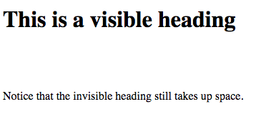
CSS 3
Visibility
<!DOCTYPE html>
<html>
<head>
<style>
h1.visible {
visibility: visible;
}
h1.hidden {
visibility: hidden;
}
</style>
</head>
<body>
<h1 class="visible">This is a visible heading</h1>
<h1 class="hidden">This is an invisible heading</h1>
<p>Notice that the invisible heading still takes up space.</p>
</body>
</html>
The visibility property specifies whether or not an element is visible.
Tip: Even invisible elements take up space on the page. Use the display property to create invisible elements that do not take up space!

Slide 18
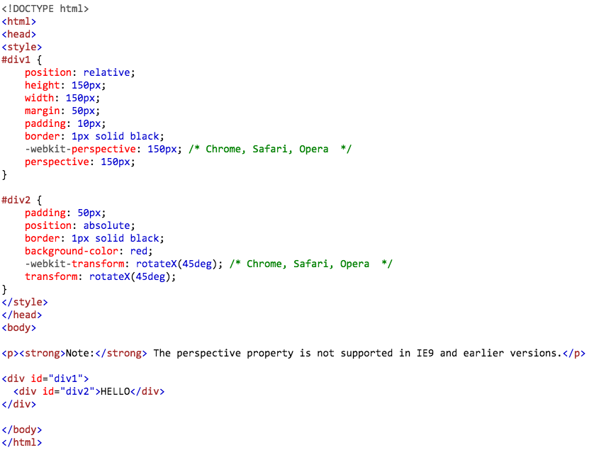
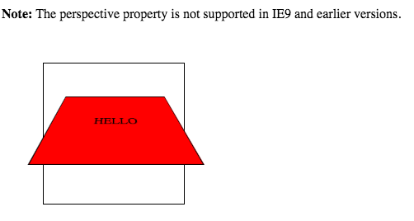
CSS 3
Perspective
Notes:
<!DOCTYPE html>
<html>
<head>
<style>
#div1 {
position: relative;
height: 150px;
width: 150px;
margin: 50px;
padding: 10px;
border: 1px solid black;
-webkit-perspective: 150px; /* Chrome, Safari, Opera */
perspective: 150px;
}
#div2 {
padding: 50px;
position: absolute;
border: 1px solid black;
background-color: red;
-webkit-transform: rotateX(45deg); /* Chrome, Safari, Opera */
transform: rotateX(45deg);
}
</style>
</head>
<body>
<p><strong>Note:</strong> The perspective property is not supported in IE9 and earlier versions.</p>
<div id="div1">
<div id="div2">HELLO</div>
</div>
</body>
</html>

Slide 19
CSS 3
@keyframes
The @keyframes rule specifies the animation code.
The animation is created by gradually changing from one set of CSS styles to another.
During the animation, you can change the set of CSS styles many times.
Specify when the style change will happen in percent, or with the keywords "from" and "to", which is the same as 0% and 100%. 0% is the beginning of the animation, 100% is when the animation is complete.

Slide 20
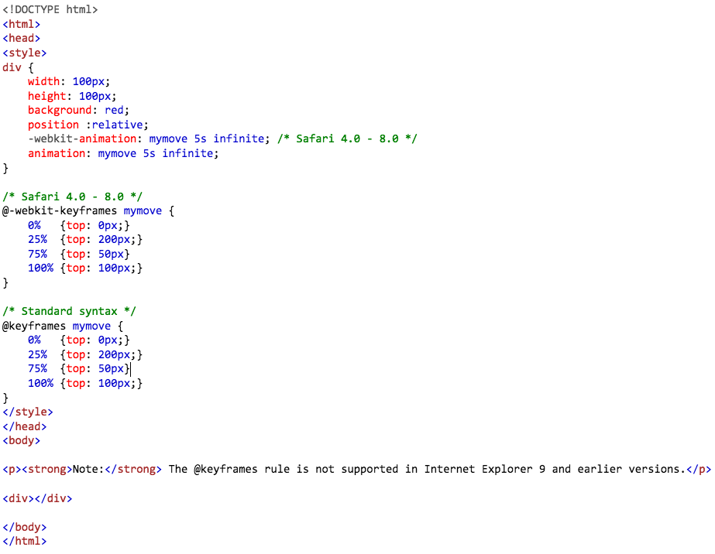
CSS 3
@keyframes
Notes:
<!DOCTYPE html>
<html>
<head>
<style>
div {
width: 100px;
height: 100px;
background: red;
position :relative;
-webkit-animation: mymove 5s infinite; /* Safari 4.0 - 8.0 */
animation: mymove 5s infinite;
}
/* Safari 4.0 - 8.0 */
@-webkit-keyframes mymove {
0% {top: 0px;}
25% {top: 200px;}
75% {top: 50px}
100% {top: 100px;}
}
/* Standard syntax */
@keyframes mymove {
0% {top: 0px;}
25% {top: 200px;}
75% {top: 50px}
100% {top: 100px;}
}
</style>
</head>
<body>
<p><strong>Note:</strong> The @keyframes rule is not supported in Internet Explorer 9 and earlier versions.</p>
<div></div>
</body>
</html>

Slide 21
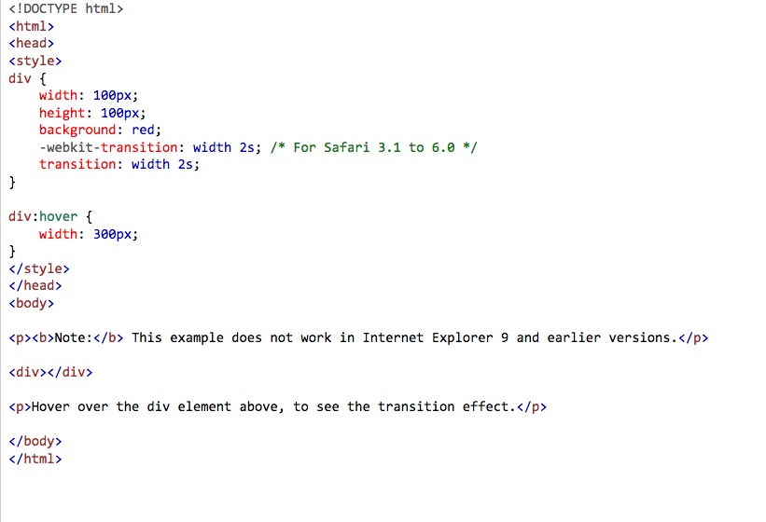
CSS 3
CSS3 Transitions
CSS3 transitions allows you to change property values smoothly (from one value to another), over a given duration.
Example: Mouse over the element below to see a CSS3 transition effect: https://www.w3schools.com/cssref/css3_pr_transition.asp
Notes:
<!DOCTYPE html>
<html>
<head>
<style>
div {
width: 100px;
height: 100px;
background: red;
-webkit-transition: width 2s; /* For Safari 3.1 to 6.0 */
transition: width 2s;
}
div:hover {
width: 300px;
}
</style>
</head>
<body>
<p><b>Note:</b> This example does not work in Internet Explorer 9 and earlier versions.</p>
<div></div>
<p>Hover over the div element above, to see the transition effect.</p>
</body>
</html>

Slide 22
CSS 3
Transform with Transition for doing animations
(do not work with I.E. 9 or earlier)
Can animate things like buttons:
Set with a duration and delay
Combined with scale or rotate
Using hover for interactivity (Example in next slide)
Animations:
Transform -transition: transform .5s;
Transform with delay - transition: transform .5s .25s;
Ease-in or Ease-out- transition: transform .5s .25s ease-in-out;
Using hover - transform: scale(1.2);

Slide 23
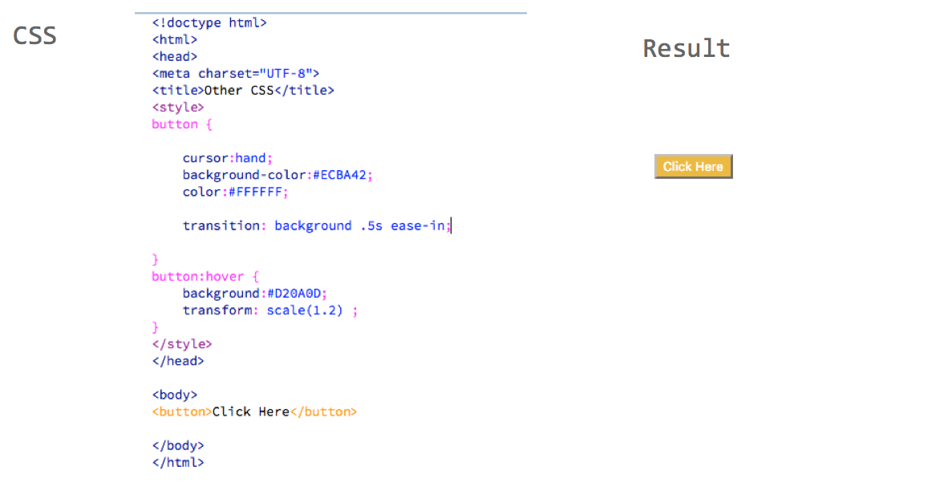
CSS 3

Slide 24
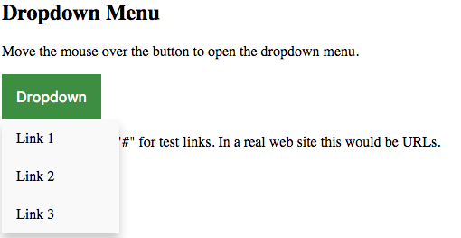
CSS 3
CSS Dropdown
https://www.w3schools.com/css/tryit.asp?filename=trycss_dropdown_button

Slide 25
CSS 3
Cross Browser /Version Check
https://www.browserling.com/
Browser Support Table:
http://www.w3schools.com/cssref/css3_browsersupport.asp
PX to EM Converter
https://www.w3schools.com/cssref/css_pxtoemconversion.asp

Slide 26
CSS 3
Syntax Reference
http://www.w3schools.com/cssref/default.asp
Templates
http://csszengarden.com/
Cool Buttons
http://css3buttongenerator.com/
Enjoy CSS
http://enjoycss.com/

Slide 27
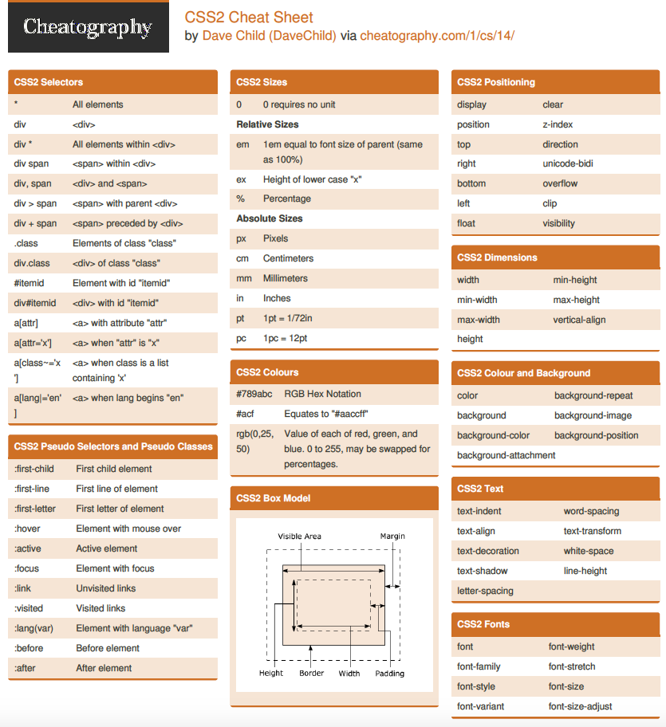
CSS 3
http://www.cheatography.com/explore/search/?q=CSS

Slide 28
CSS 3
Check Out Examples:
https://www.w3schools.com/howto/howto_css_parallax.asp
https://www.w3schools.com/w3css/w3css_templates.asp

Slide 29
CSS
CSS 3
Project

Slide 30
CSS In Class Project
1- Complete the Portfolio Website that looks like the screenshot and link to your Resume, Photoshop (Fitness), HTML +project (Safety) files.Make the rest of the project links stay on the page (#)
Create your portfolio.html in the public_html folder
Create an external stylesheet named portfolio.css in the public_html/css folder
All projects going forward will link from this page as well (Fitness and Safety so far)!
Images, and Verbiage were provided - (HTML 2 Class- was provided)
Make the links to the safety and photoshop/fitness page/projects open a new tab
2- Construct your Digital Resume that looks like the screenshot and link to it from your portfolio
Name the file resume.html and save it in the public_html root folder
Create an External stylesheet resume.css save it to the public_html/css folder
Link to the resume page from your portfolio page
Verbiage will be provided but you can and should update it with your information
Make the link to resume.html open a new tab
3- Upload the pages to the Web Server root public_html directory and corresponding folders inside it. (you should be able to browse to http://pbcs.us/~yourname and reach the portfolio site)
Notes:
Specifically asked for portfolio.html, not index.html, so they don’t get lost and can still browse the directory listing to find things in their public_html

Slide 31

Portfolio Website

Slide 32
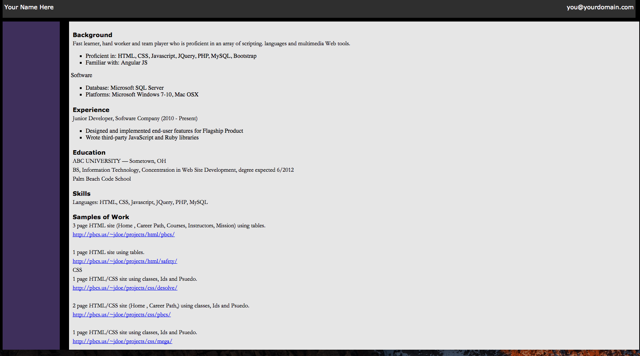
Resume Page

Slide 33
Homework
Finish CSS portfolio and Resume web pages Upload it to the Web server and send instructor a link
Work through (One or All): https://teamtreehouse.com/tracks/front-end-web-development
https://teamtreehouse.com/library/css-basics
https://teamtreehouse.com/library/how-to-make-a-website

Slide 34
End
3

