Slide 1

Question 1

Slide 2

Question 2

Slide 3

Question 3

Slide 4
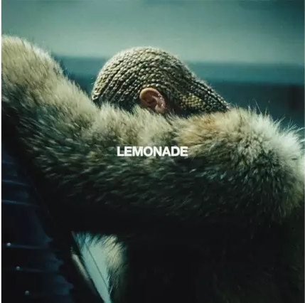
Question 4

Slide 5

Question 5

Slide 6
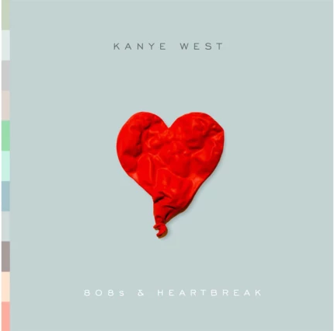
Question 6

Slide 7

Question 7

Slide 8

Question 8

Slide 9

Question 9

Slide 10

Question 10

