Slide 1

YOUR
LOGO
AlgoRythm
Team Members:
Sukhavasi Balasri (CSE – 4th Year)
Swargam Vishnu Priya (CSE – 4th Year)
Tadikonda Sonika (CSE – 4th Year)

Slide 2
YOUR
LOGO
Introduction
AI-Based Mood Music Player is a smart system that detects the user’s emotional state using Artificial Intelligence.
It identifies mood through facial expressions (or user input)
Based on the detected emotion, the system automatically selects and plays suitable music
The main aim is to enhance user experience and improve emotional well-being

Slide 3
YOUR
LOGO
Problem Statement
Existing music apps do not understand user emotions effectively.
Users manually select music based on their current mood
This process is time-consuming and not always accurate
Music playlists are not personalized according to real-time emotional state
There is no automatic system that adapts music based on user emotions in real-time

Slide 4
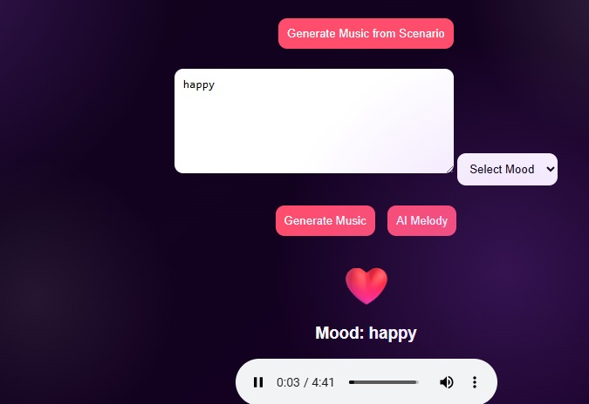
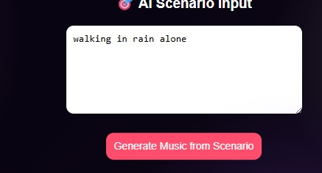
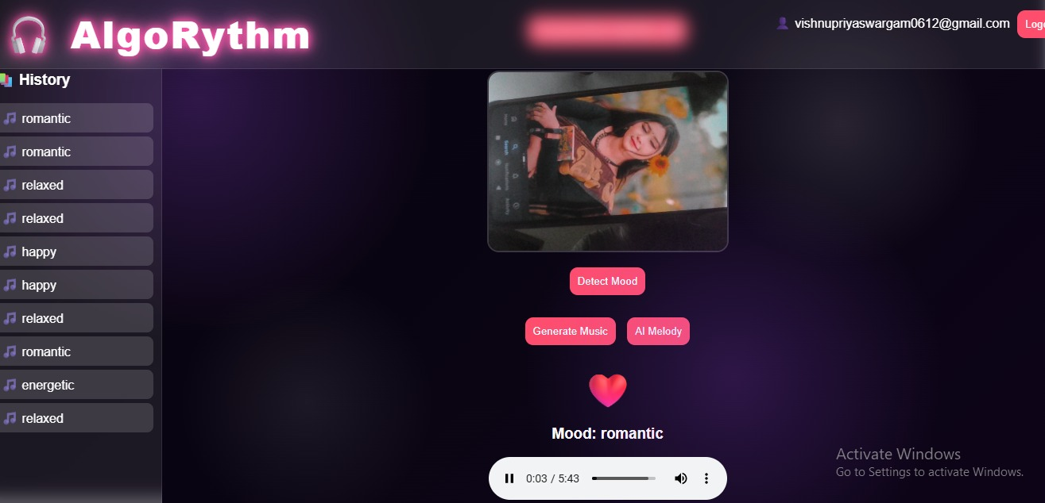
Proposed Solution
The proposed system uses Artificial Intelligence to automatically detect user emotions and recommend suitable music.
The AI system detects the user’s mood automatically using facial expressions or input data
It classifies emotions into different categories such as:
😊 Happy 😢 Sad 😡 Angry 😐 Neutral
Based on the detected emotion, the system plays a matching playlist automatically
This provides a personalized and real-time music experience for the use

Slide 5
Technologies Used
HTML, CSS, JavaScript (Frontend)
MIDI Libraries
AI MUSIC
Audio Processing, AI Algorithms
FastAPI,Python

Slide 6
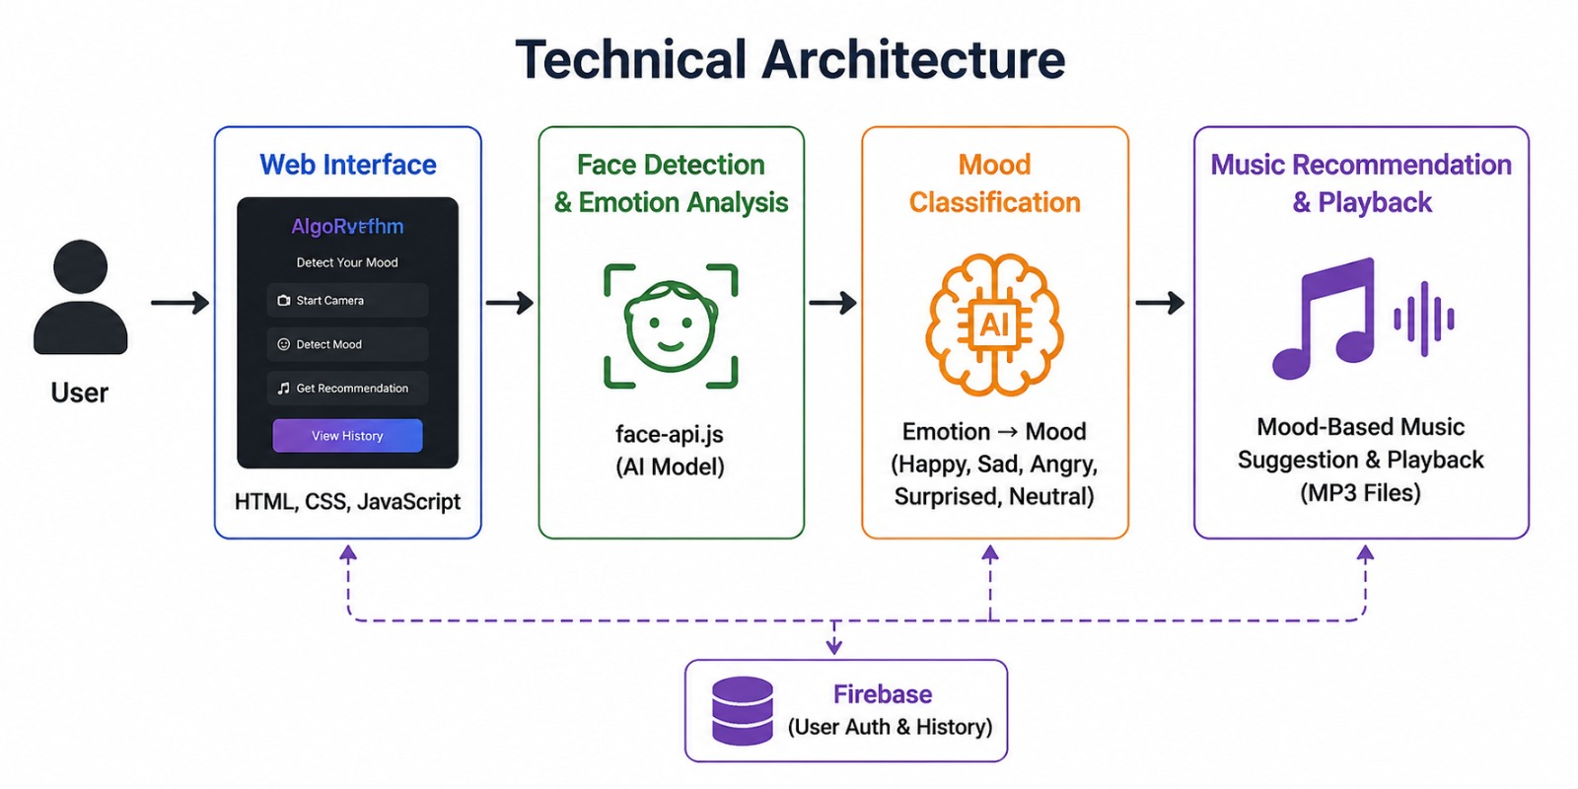
System Architecture
Webcam captures the user’s face in real-time
Face detection module identifies and processes facial expressions
AI model predicts the user’s emotion based on the input
Flask backend processes the prediction and manages system logic
Music player selects and plays songs based on the detected mood

Slide 7
Features
Real-time mood detection using AI
Automatic music switching based on detected emotion
Simple and user-friendly interface
Fast and efficient response system
Personalized music experience for each user

Slide 8
Advantages
Reduces time spent on manual music selection
Enhances user emotional experience
Smart AI-based automation system
Easy to use with minimal user effort

Slide 9
YOUR
LOGO
Applications
Music streaming applications
Mental health and relaxation apps
Study and concentration music tools
Entertainment and smart assistant systems

Slide 10

Conclusion
The AI-based mood music player improves personalization of music experience
It automatically adapts music based on user emotions
The system is useful for both entertainment and mental well-being

Slide 11
YOUR
LOGO
THANKS FOR
WATCHING

