Slide 1



Web programming – project 1
Srija Chitikesi - 002762691
Shreya Tadipaneni - 002766825
Krishna Sai Gandi - 002731547

Slide 2
Catch ALL Ghosts
Game demo - https://codd.cs.gsu.edu/~kgandi1/WP/PW/1/
UX design – Srija Chitikesi
CSS animations and transformations – Shreya Tadipaneni
Linking it to the HTML and Testing the Visual Implementation - Krishna Sai Gandi

Slide 3
UX design
As the game revolves around capturing all the ghosts, we decided on a spooky graveyard as the background.
We believed it would add a dramatic touch if we incorporated the game's name alongside the ghost-catching theme.
We planned a scorecard for each caught ghost in the top right corner, with green text to signify success.
We've also included clear instructions for capturing all the ghosts and included a timer that starts running as soon as the game begins.

Slide 4
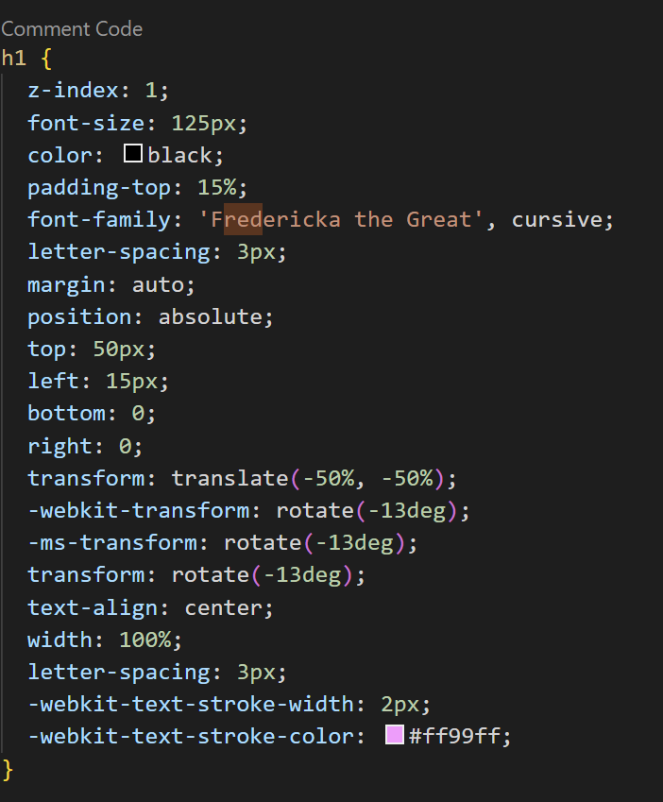
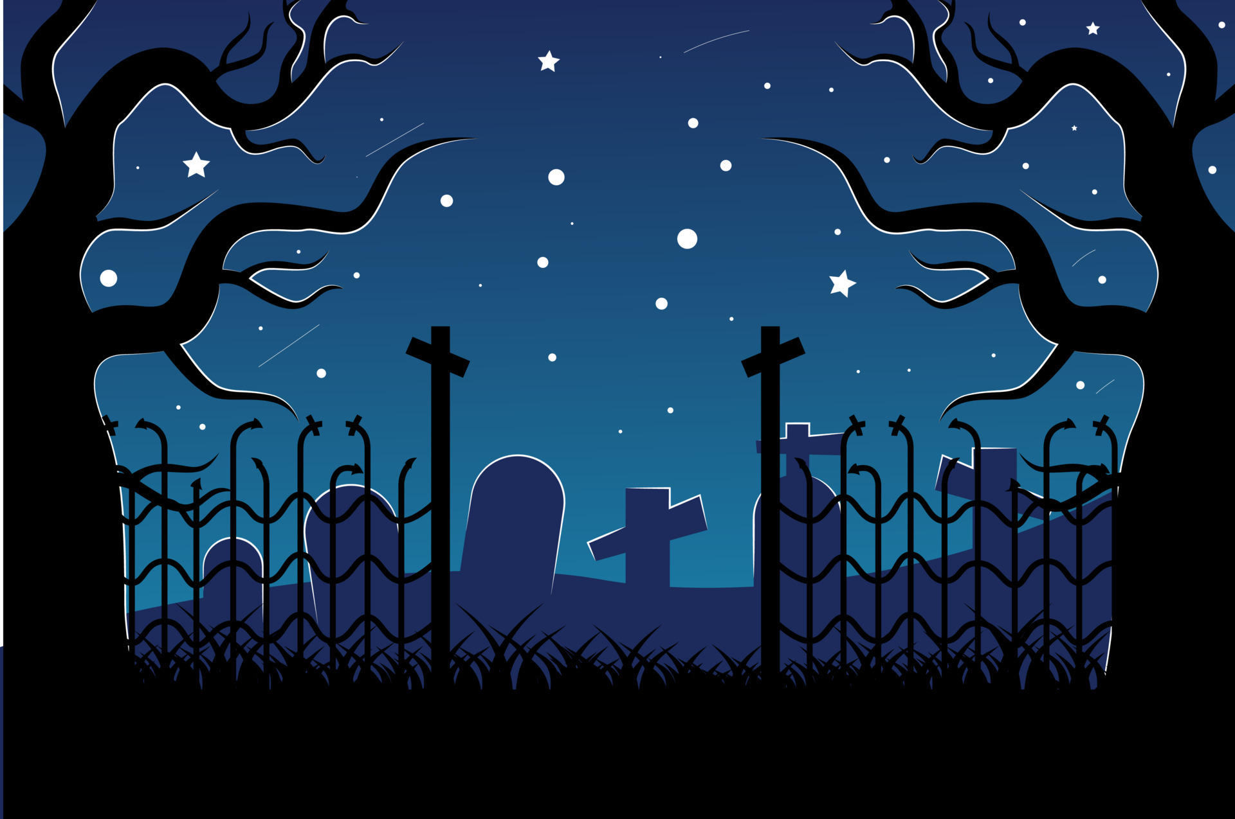
Background

Slide 5
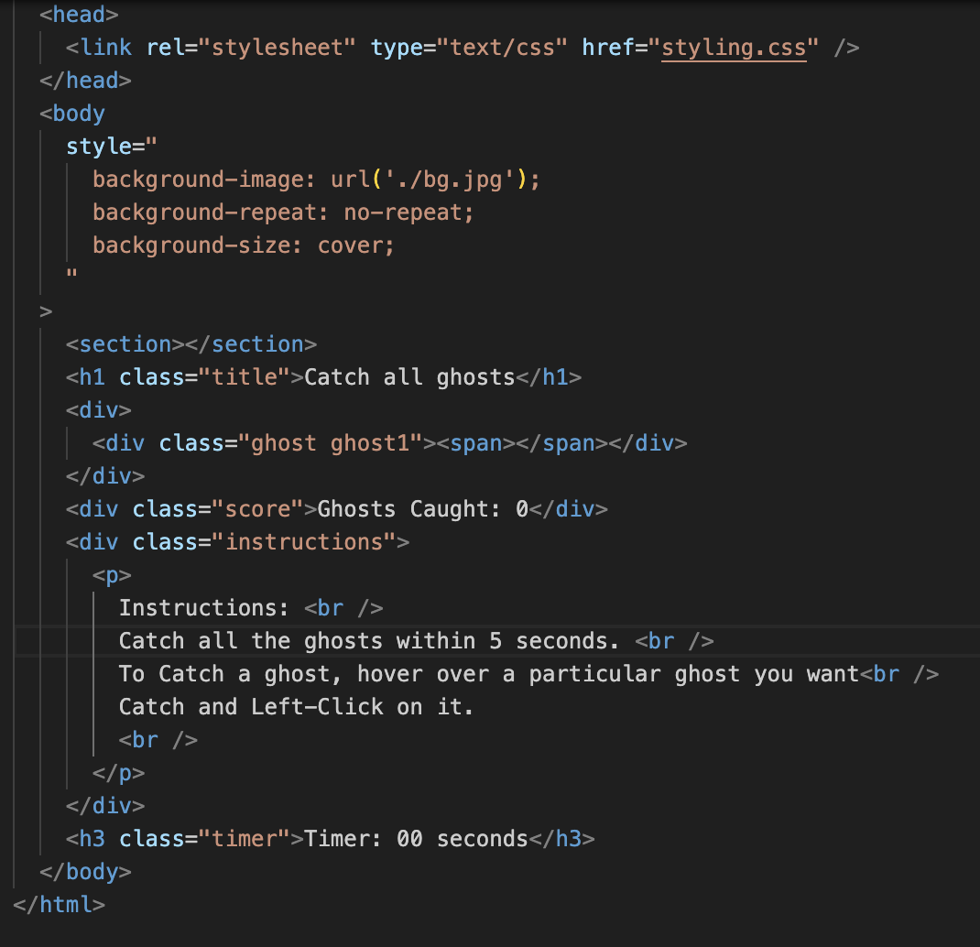
Code structure

Slide 6
Ghosts
Now all we need are some "Ghosts" flying around in the dark.
Tried some gifs of different ghosts from internet and finally fixed on the below gif to make our game more interesting.
Initially, this gif is having a white background color, we used an online tool to remove the background of this gif completely.

Slide 7
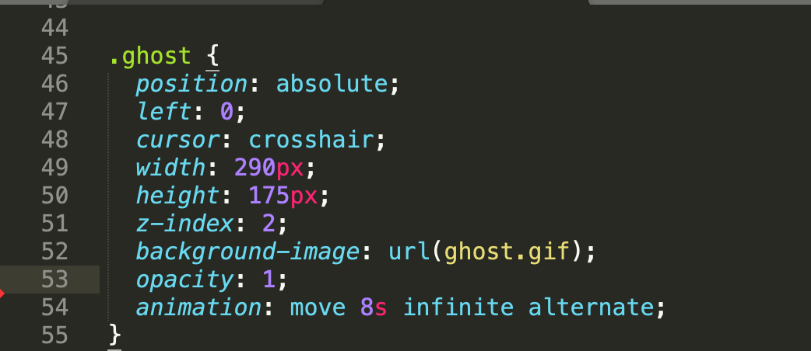
Movement of the ghosts

Slide 8
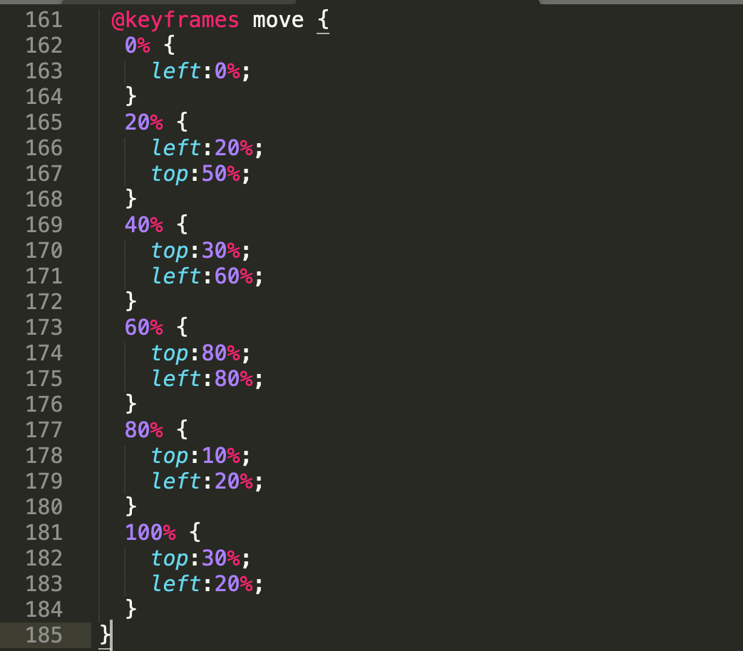
Continue...

Slide 9


Thank you !

