Slide 1

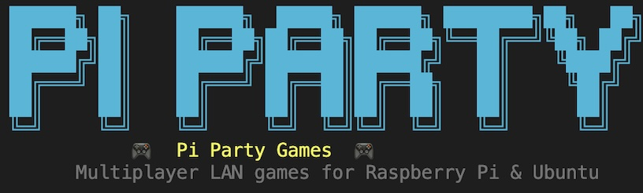
Gabrielle , Micah , Thomas, and Izaiah

Slide 2
How the system operates
Client-Server Architecture: One Raspberry Pi acts as the Host (the brain), while all other Pis connect as Clients (the controllers).
Star Topology: Every player communicates directly with the Host, ensuring all participants see the exact same game state at the same time.
TCP/IP Networking: Uses "Transmission Control Protocol" to ensure game data (like moves and scores) arrives reliably and in the correct order across the local network.
Terminal Rendering: Instead of heavy graphics, the system uses the Curses library to "draw" game boards and animations using text characters and colors.
Non-Blocking Input: The system is programmed to keep the game moving (like ghosts chasing you) even if a player isn't pressing any buttons.
Automated Logic: The Host runs pathfinding algorithms (BFS) for enemies, ensuring the game provides a consistent challenge for all connected players.

Slide 3
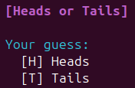
Game 1: Heads or Tails
Purpose: A quick-fire test of the network's ability to handle rapid-response binary choices and synchronized resolution.
Python Functions & Logic:
random.choice(['Heads', 'Tails']): Used by the server to determine the winning outcome.
input().strip().upper(): Captures the player's choice and cleans the data before sending.
send_data() / recv_data(): Custom wrapper functions for socket.send() and socket.recv() to exchange JSON packets between the Pi and the Host.

Slide 4
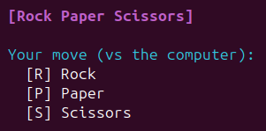
Game 2: Rock, Paper, Scissors
Purpose: Demonstrates server-side logic validation where the Host must compare multiple client inputs against a central "AI" move.
Python Functions & Logic:
Logic Mapping: Uses a Dictionary or Nested if/elif statements to define win/loss/tie conditions (e.g., if user == 'R' and computer == 'S').
time.sleep(): Orchestrates the "Rock... Paper... Scissors... Shoot!" countdown across all connected terminals.
json.dumps(): Converts the player's move into a string format that can be transmitted over the TCP socket.

Slide 5

Game 3: Number Guessing Game
Purpose: Showcases mathematical processing and "Shortest Distance" algorithms to determine a winner among multiple participants.
Python Functions & Logic:
random.randint(1, 100): Generates the secret target number on the Host machine.
abs(target - guess): The Absolute Value function calculates how far each player is from the target, regardless of whether they guessed too high or too low.
min(): Applied to a list of player distances to identify the "closest" guess and declare the round winner.

Slide 6
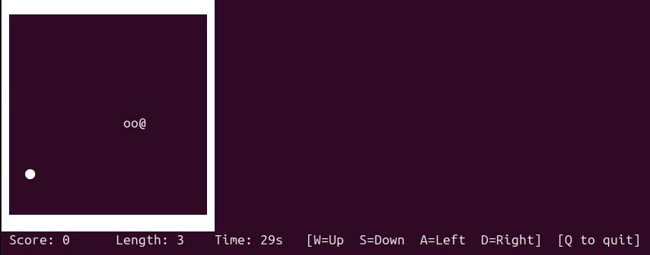
GAME 4: Snake
Purpose: Demonstrates real-time coordination tracking and collision detection within a terminal environment.
Python Functions & Logic:
curses.wrapper(): Switches the terminal into a "game window" that allows for colored graphics and exact positioning of characters.
Coordinate Management: Stores the snake's body as a list of (x, y) points to track every segment on the 28 X 14 grid.
_is_wall(): A boundary check that ends the game instantly if the snake's head hits the edge of the grid.
_spawn_apple(): scans for empty spaces to ensure new apples don't appear inside walls or the snake's body.
stdscr.timeout(): Sets the game speed (0.12s), which determines how fast the snake moves and how often the screen refreshes.

Slide 7
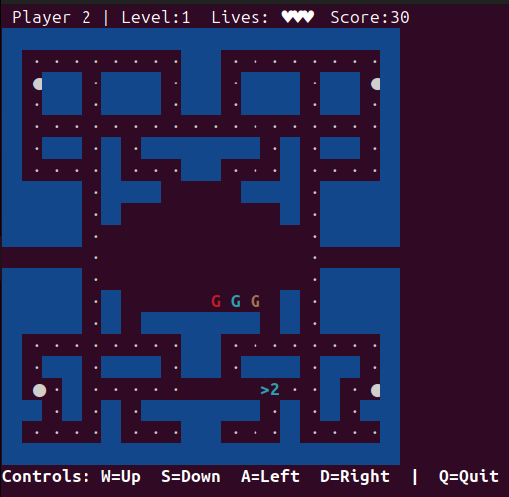
Game 5: Pacman chase
Purpose: The technical centerpiece. It demonstrates real-time hardware interaction, collision detection, and automated enemy intelligence.
Python Functions & Logic:
curses.initscr(): Initializes the terminal into "window mode" to allow for coordinate-based graphics rather than scrolling text.
BFS Algorithm (Breadth-First Search): A custom function that calculates the shortest path from the ghost to the player's coordinates through the maze.
stdscr.nodelay(True): Sets the terminal to "non-blocking" mode, allowing the game loop (and ghosts) to keep moving even if no key is pressed.
stdscr.getch(): Captures real-time keyboard hits (Arrow keys) to update the player's X and Y coordinates on the grid.

Slide 8
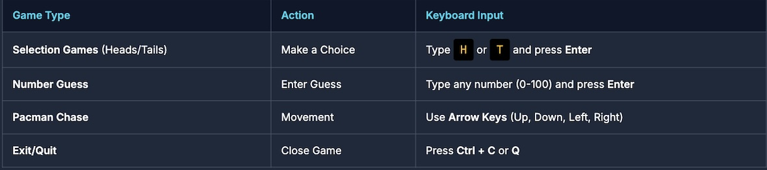
How to Play
Ensure that all raspberry pis are on the same network and that python is installed on hardware
Launch the game (host): open the terminal and navigate to the game folder
launch the game (player): open the terminal and navigate to the game folder. When prompted type the host’s ip address to join the game.
5. Let’s play!

