Slide 1

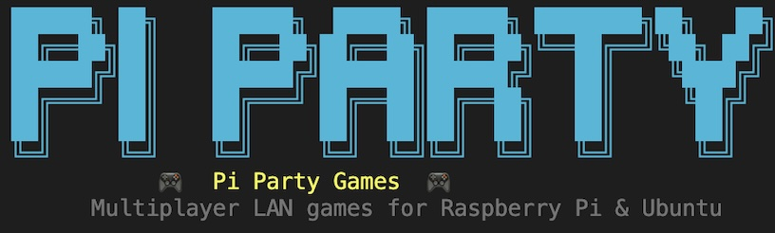
Gabrielle , Micah , Thomas, and Izaiah

Slide 2
How the system operates
Client-Server Architecture: One Raspberry Pi acts as the Host (the brain), while all other Pis connect as Clients (the controllers).
Star Topology: Every player communicates directly with the Host, ensuring all participants see the exact same game state at the same time.
TCP/IP Networking: Uses the Transmission Control Protocol (TCP) over port 65432 to ensure game data, player actions, and scores arrive reliably and in the correct order across the local network.
Terminal Rendering: Instead of heavy graphics, the system uses the Curses library to "draw" game boards and animations using text characters and colors.
Non-Blocking Input: The system is programmed to keep the game moving (like ghosts chasing you) even if a player isn't pressing any buttons.
Automated Logic: The Host runs pathfinding algorithms (BFS) for enemies, ensuring the game provides a consistent challenge for all connected players.

Slide 3
Authentication Security
Purpose: Demonstrates secure authentication and credential handling across the LAN.
Python Functions & Logic:
SHA-256 Hashing (hashlib.sha256()): Converts session passwords into fixed-length cryptographic hashes before transmission.
Client Authentication: Players must enter the correct session password before joining the host server.
Secure Credential Handling: Plain-text passwords are never transmitted or stored directly by the application.
Replay Resistance: Entering a previously intercepted hash directly will fail because the client hashes all input before transmission.

Slide 4
Network Defense
Purpose: Demonstrates defensive networking protections and security monitoring features.
Python Functions & Logic:
IP-Based Rate Limiting: Repeated failed authentication attempts permanently block the offending IP address for the remainder of the host session.
Over-sized Packet Protection: Incoming messages exceeding the maximum allowed packet size are rejected safely to reduce denial-of-service and memory abuse risks.
Security Event Logging: Successful joins, failed login attempts, rate-limit triggers, and disconnect events are persistently written to security.log.
Defensive Socket Handling: Invalid join requests and malformed packets are rejected without crashing the server.
Remaining Security Limitation: Replay-style attacks may still be possible if an attacker modifies the Python client or crafts custom packets using intercepted hash values.

Slide 5
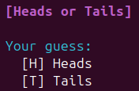
Game 1: Heads or Tails
Purpose: A quick-fire test of the network's ability to handle rapid-response binary choices and synchronized resolution.
Python Functions & Logic:
random.choice(['Heads', 'Tails']): Used by the server to determine the winning outcome.
input().strip().upper(): Captures the player's choice and cleans the data before sending.
send_data() / recv_data(): Custom wrapper functions for socket.send() and socket.recv() to exchange JSON packets between the Pi and the Host.

Slide 6
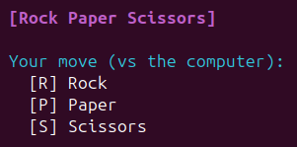
Game 2: Rock, Paper, Scissors
Purpose: Demonstrates server-side logic validation where the Host must compare multiple client inputs against a central "AI" move.
Python Functions & Logic:
Logic Mapping: Uses a Dictionary or Nested if/elif statements to define win/loss/tie conditions (e.g., if user == 'R' and computer == 'S').
json.dumps(): Converts the player's move into a string format that can be transmitted over the TCP socket.

Slide 7

Game 3: Number Guessing Game
Purpose: Showcases mathematical processing and "Shortest Distance" algorithms to determine a winner among multiple participants.
Python Functions & Logic:
random.randint(1, 100): Generates the secret target number on the Host machine.
abs(target - guess): The Absolute Value function calculates how far each player is from the target, regardless of whether they guessed too high or too low.
min(): Applied to a list of player distances to identify the "closest" guess and declare the round winner.

Slide 8
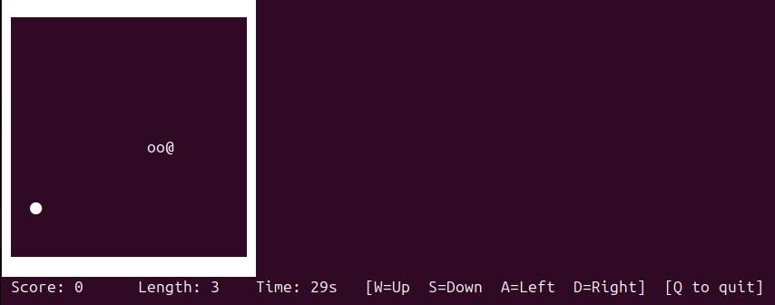
GAME 4: Snake
Purpose: Demonstrates real-time coordination tracking and collision detection within a terminal environment.
Python Functions & Logic:
curses.wrapper(): Switches the terminal into a "game window" that allows for colored graphics and exact positioning of characters.
Coordinate Management: Stores the snake's body as a list of (x, y) points to track every segment on the 28 X 14 grid.
_is_wall(): A boundary check that ends the game instantly if the snake's head hits the edge of the grid.
_spawn_apple(): scans for empty spaces to ensure new apples don't appear inside walls or the snake's body.
stdscr.timeout(): Sets the game speed (0.12s), which determines how fast the snake moves and how often the screen refreshes.

Slide 9
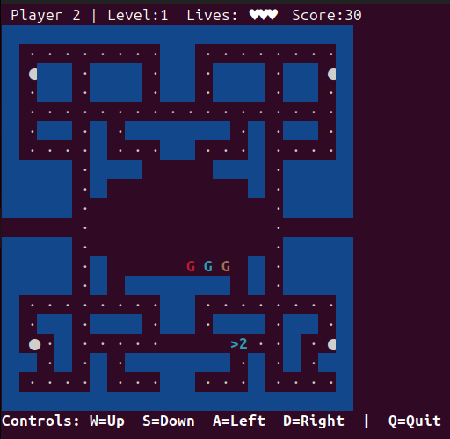
Game 5: Pacman chase
Purpose: The technical centerpiece. It demonstrates real-time hardware interaction, collision detection, and automated enemy intelligence.
Python Functions & Logic:
curses.initscr(): Initializes the terminal into "window mode" to allow for coordinate-based graphics rather than scrolling text.
BFS Algorithm (Breadth-First Search): A custom function that calculates the shortest path from the ghost to the player's coordinates through the maze.
stdscr.nodelay(True): Sets the terminal to "non-blocking" mode, allowing the game loop (and ghosts) to keep moving even if no key is pressed.
stdscr.getch(): Captures real-time keyboard hits (Arrow keys) to update the player's X and Y coordinates on the grid.

Slide 10
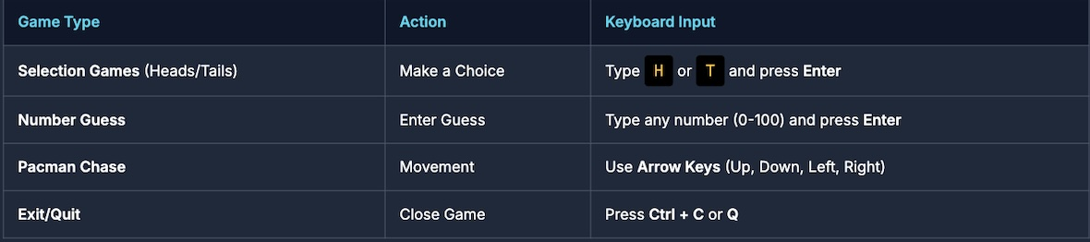
How to Play
Ensure that all raspberry pis are on the same network and that python is installed on hardware
Launch the game (host): open the terminal and navigate to the game folder
launch the game (player): open the terminal and navigate to the game folder. When prompted type the host’s IP address to join the game.
PacMan Chase and the Snake Game
Use WASD to move
5. Let’s play!

