Slide 1
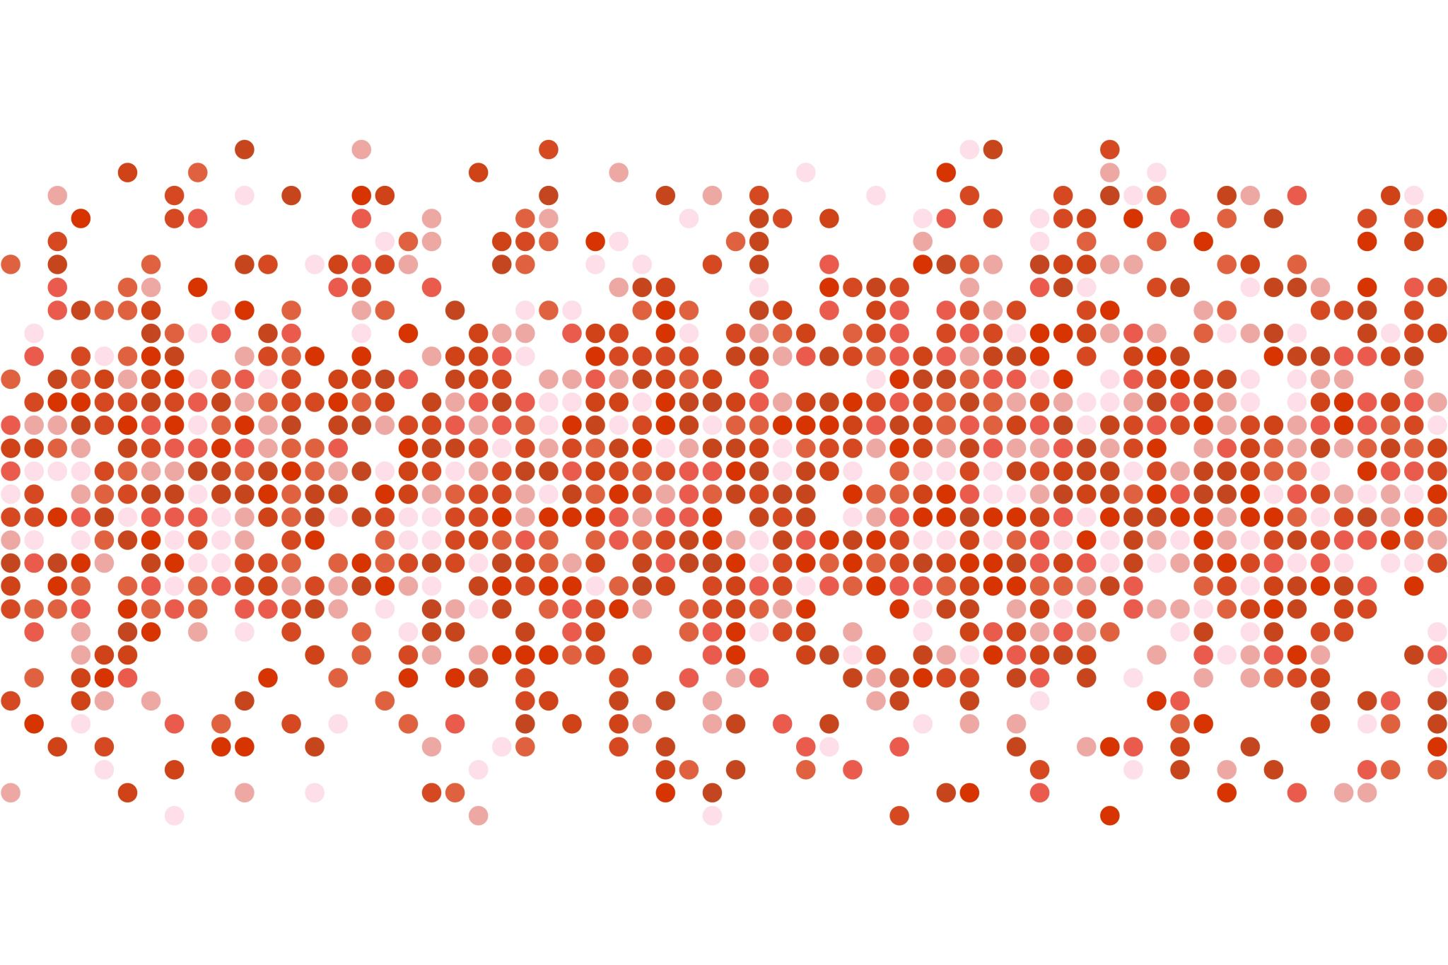
Data Storytelling Final Project
Mounika Tadanki

Slide 2

Who is the client?
Texas Workforce Commission (TWC)

Slide 3
Texas Workforce Commission (TWC)
State agency charged with overseeing and providing workforce development services to employers and job seekers of Texas.
28 workforce development boards across Texas
Provides grants to workforce development boards that plan and administer various workforce and support services.

Slide 4
Why did they need a dashboard?
To gain an insight into grant utilization

Slide 5

TWC Data
Workforce Board | Program/Grant | Year | Alpha | Straight Line Target | Grant Period Start | Grant Period End | Total Grant Award | Total Served | Percent Expended | Federal Average
Amount Expended | Target Amount | No. of months in grant period | No. of months elapsed | Percentage time into the grant | Spending Average
(Table Calculations)

Slide 6
Who is the audience?
Managers at TWC

Slide 7
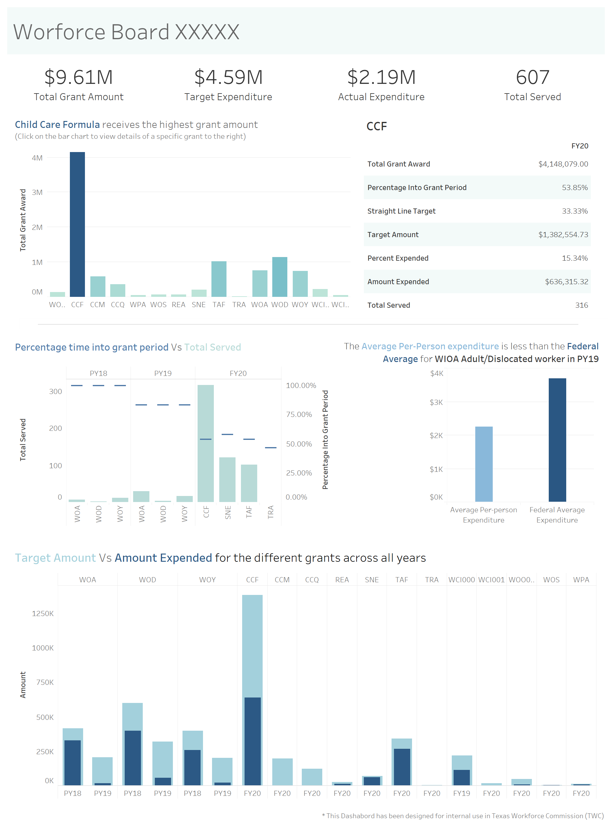

Slide 8
Thank you!
I would like to thank Professor Andrea Cato for a wonderful learning experience throughout the semester and for her valuable feedback and support to help me complete the project.
Also, a big thank you to everyone in this course and for your valuable feedback on my short presentation and project draft.

