Slide 1

Simulating 2D Role-Playing Game (RPG) with Ruby
Group 4
Tạ Đức Duy - 1624634
Trương Thanh Hùng - 1624817
Đào Nguyên Khôi – 1624717
Lecturer: AProf. Han Dinh Nguyen

Slide 2
Contents
Introduction
Design and Implementation
Demo

Slide 3
Introduction

Slide 4
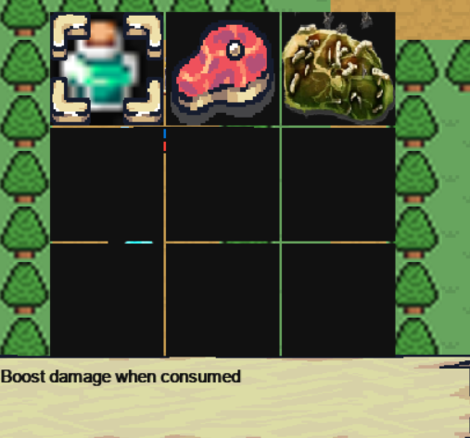
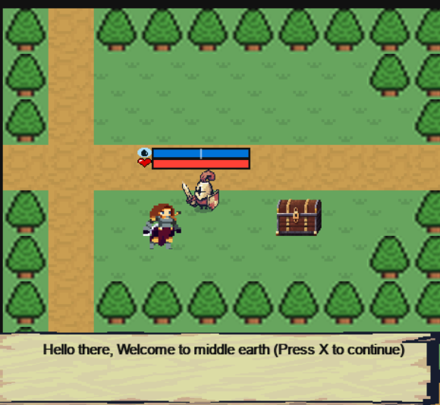
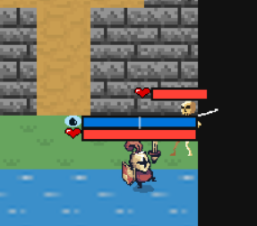
Game Context
Simulating 2D Role-Playing Game (RPG) with Ruby is:
The game will spawn player in a world that call “middle earth”.
Where there are Tiles that player can interact with.
The Hero has to fight all the monsters in order to win the game.
Or loose when the monsters slain the player.
There will be item in the game that might help or hurt the
Player.

Slide 5


The Player
Movement:
We will play as the Hero, direct the hero with “AWSD” button.
Attacking:
Normal attacking (does not break stance of the monster) when pressing “J”.
Special skill (does break stance of the monster) when pressing “K”.

Slide 6




The Monsters
Movement:
Random move.
Pursue move.
Attacking:
When player in range they will try to attack the player.
Behavior:
At normal situation they will try to move, when the player in the attack range of itself, it will always try to attack the player.

Slide 7

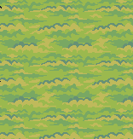
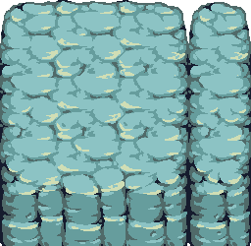


The Map
The map itself contained tiles:
Wall tile.
Fire tile.
Water tile.
Grass tile.
Tree tile.
Ground tile.
Special tile:
Wall tile: prevent player and monsters from entering.
Fire tile: will damage the player.
Water tile: will heal the player.

Slide 8





The Items
The items can be obtained by:
Talking to NPC
Opening chests
Items in the game:
Meat: will heal player when consumed.
Spoiled Meat: will hurt the player when being consumed.
Potion: will raise the attack damage of the player.

Slide 9
Why Ruby
The ruby language it self is a close to human language, so it is very easy to code and understand.
Ruby is an object-oriented language which help us in developing class in the game easily.
The language came with the ruby2d, it help a lot when comes to handle game loop, animation, interaction between monster and player.

Slide 10
Design and Implementation

Slide 11
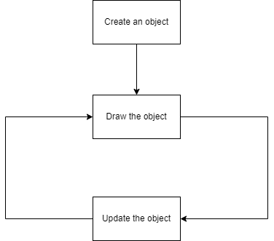
Game Loop

Slide 12
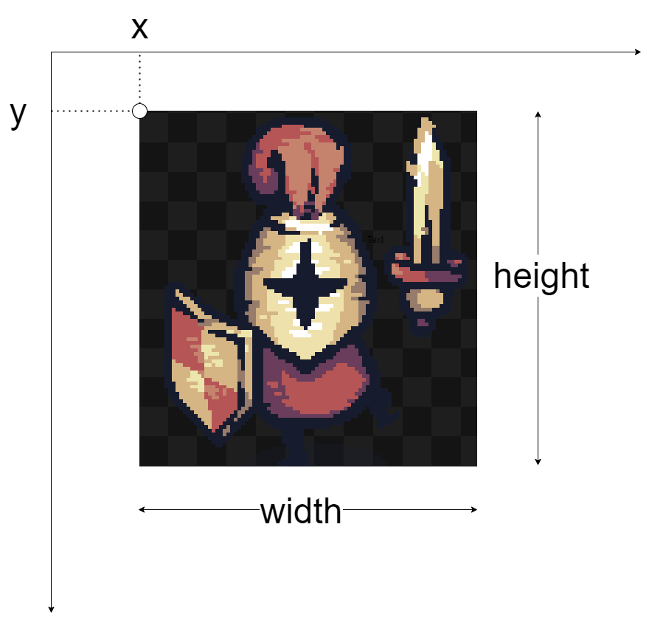
Collision Detection
Structure of every entity (Hero, Monsters, NPCs, Items, etc)
Structure Entity { int x int y int width int height }

Slide 13
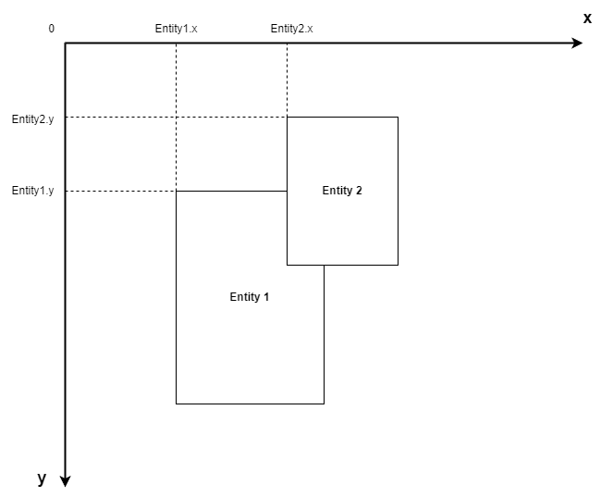
Collision Detection (cont)
Algorithm for Checking Collision between Two Entities
Algorithm 1: Checking Collision Between Two Entities
1 | procedure checkCollision(entity1, entity2) if entity1.x + entity1.width ≥ entity2.x && entity1.x ≤ entity2.x + entity2.width && entity1.y + entity1. height ≥ entity2.y && entity1.y ≤ entity2.y + entity2.height then return true return false
2
3
4
5
6
7

Slide 14
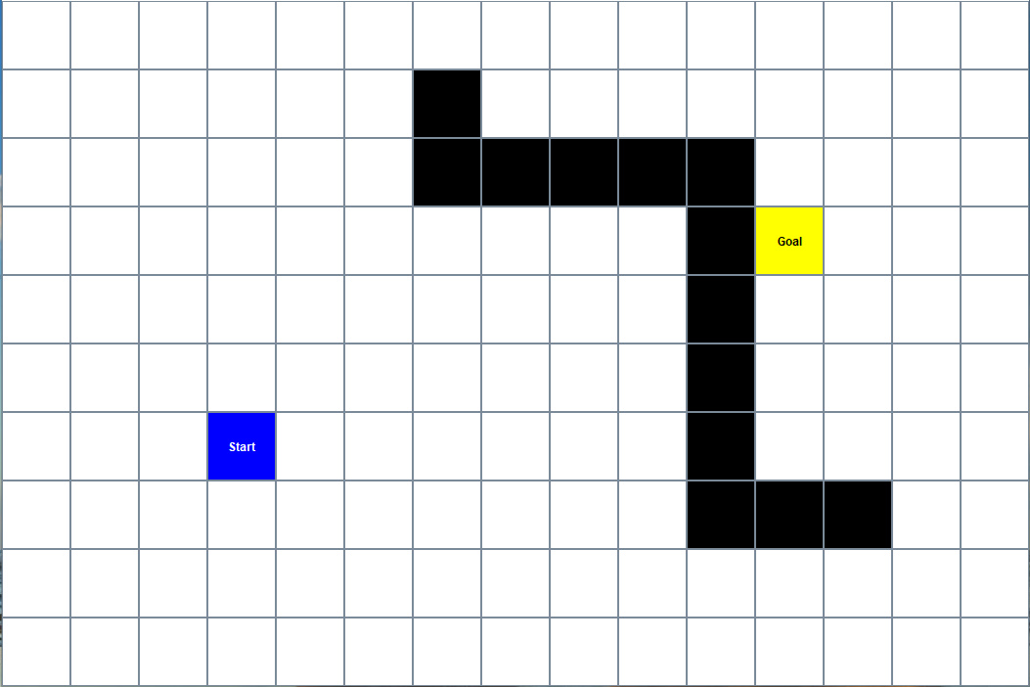
Finding The Shortest Path
How to find the shortest path between two points on the grid?
➔ A* Algorithm

Slide 15
A* Algorithm
The purpose of the A* algorithm is to find the shortest path between two points on the grid. Because of that, the algorithm is widely used in video game development.
To evaluate the best path, the algorithm uses the three numbers:
G – cost
H – cost
F – cost

Slide 16
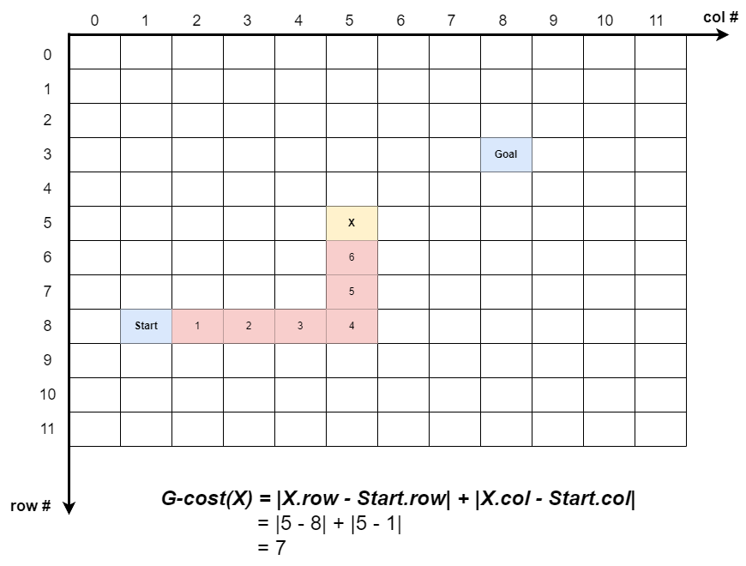
A* Algorithm (cont)
G–cost: The G–cost of Node X on the grid is the distance from the Start Node to Node X.

Slide 17
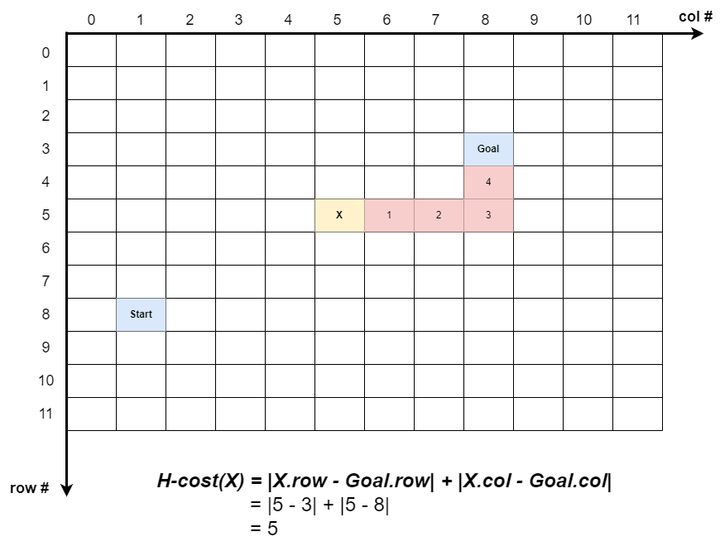
A* Algorithm (cont)
H–cost: The H–cost of Node X on the grid is the distance from the Node X to Goal Node.

Slide 18
A* Algorithm (cont)
F–cost: The H–cost of Node X on the grid is the sum of the G-cost of Node X and the H-cost of Node X
F-cost(X) = G-cost(X) + H-cost(X)

Slide 19
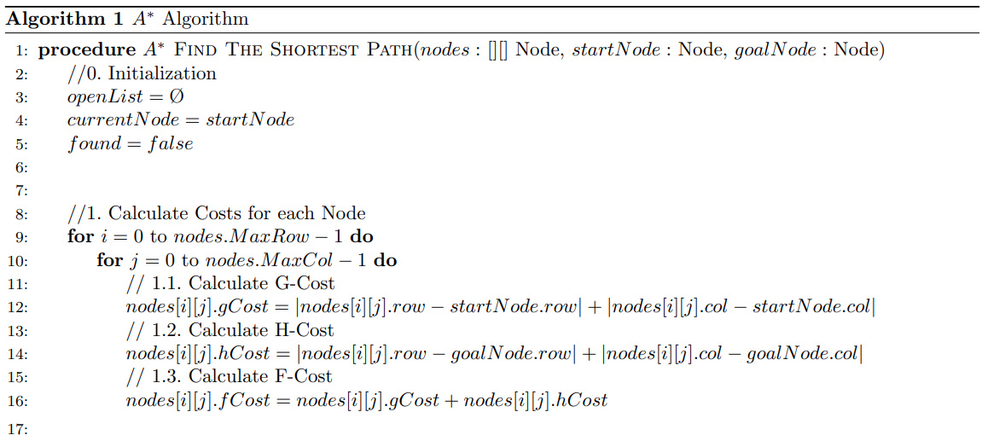
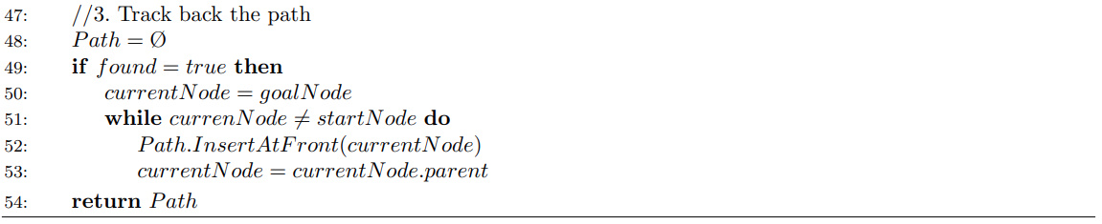
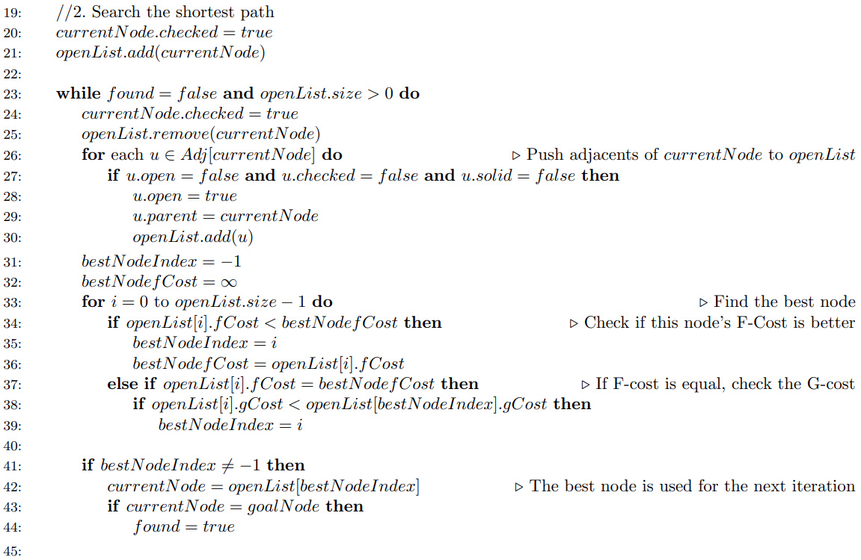
Structure Node { Node parent int row, col int gCost int hCost int fCost bool solid bool open bool checked }

Slide 20
Demo

Slide 22

THANK YOU!

