Slide 1
Topic:
Developing a Library Management Software of HUST
Group 1: Ta Duc Duy – 1624634
Tran Hai Minh – 1642853
Le Duc Tuyen – 1624790
Truong Thanh Hung – 1624817
Vu Duy Hao – 1628402
Lecturer: Dr. Du Dinh Vien

Slide 2
Table of Contributions
No. | Name | Role | Contributed Tasks
1 | Ta Duc Duy | Leader | Collect input requirements, write report
2 | Tran Hai Minh | Coder | Implement use cases: UC-09, UC-10, UC-11, UC-12, UC-23, UC-24, UC-25, UC-26, UC-27, UC-28
3 | Le Duc Tuyen | Tester | Design test cases
4 | Truong Thanh Hung | Coder | Implement use cases: UC-13, UC-14, UC-15, UC-16, UC-17, UC-18, UC-19, UC-20, UC-21, UC-22, UC-23
5 | Vu Duy Hao | Coder | Implement use cases: UC-01, UC-02, UC-03, UC-04, UC-05, UC-06, UC-07, UC-08

Slide 3
Contents
System Overview Description
Design & Implementation
Testing
Demo Final Product

Slide 4
System Overview Description

Slide 5
System Overview Description
Scope
The system is designed to center on two types of users:
Hust Student: the students are learning at Ha Noi University of Science and Technology (HUST).
Librarian: the librarians are working at Ta Quang Buu Library.

Slide 6
System Overview Description
Core Features
Library Management System
Manage process of borrowing and returning books
Manage readers
Manage book

Slide 7
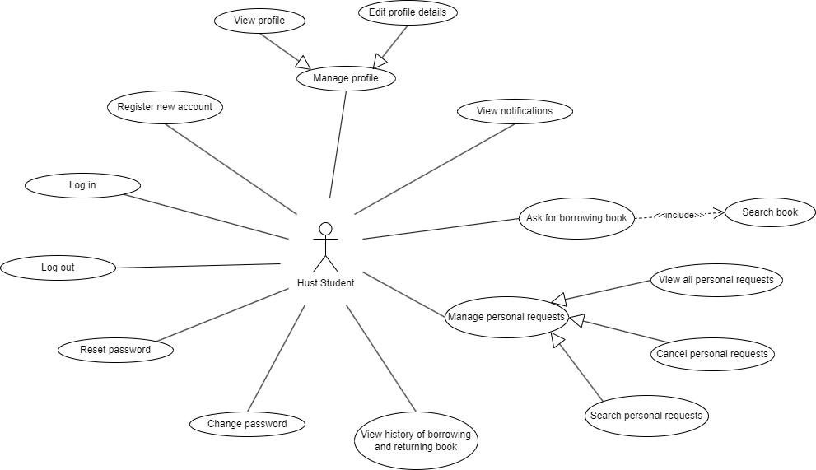
System Overview Description
Functional Requirements

Slide 8
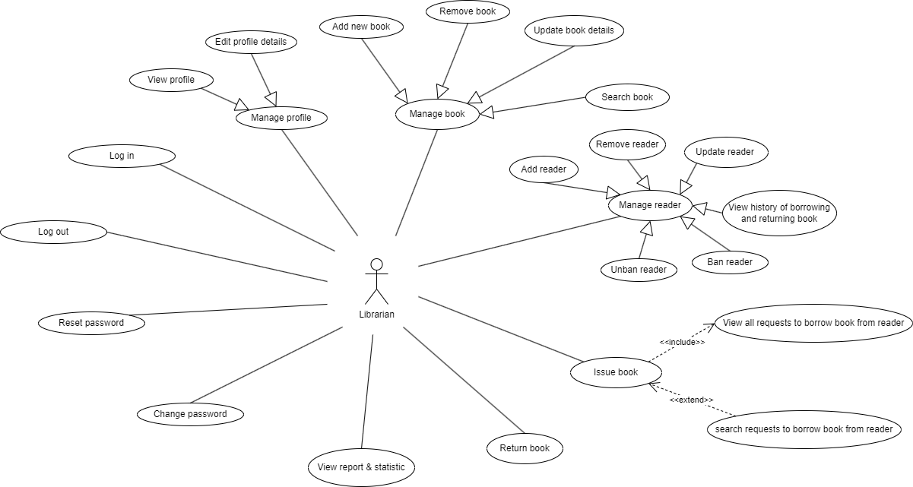
System Overview Description
Functional Requirements (cont)

Slide 9
System Overview Description
Non-Functional Requirements
Friendly user interface
Security
Easy to maintain

Slide 10
System Overview Description
Use Case Summary
ID | Name | Actor(s)
UC-01 | Register new account | Hust Student
UC-02 | Log in | Hust Student, Librarian
UC-03 | Reset password | Hust Student, Librarian
UC-04 | Change password | Hust Student, Librarian
UC-05 | Log out | Hust Student, Librarian
UC-06 | View profile | Hust Student, Librarian
UC-07 | Edit profile details | Hust Student, Librarian
UC-08 | View notifications | Hust Student
UC-09 | Ask for borrowing book | Hust Student
UC-10 | View all personal requests | Hust Student
UC-11 | Search personal requests | Hust Student

Slide 11
System Overview Description
Use Case Summary (cont)
ID | Name | Actor(s)
UC-12 | Cancel personal requests | Librarian
UC-13 | Add new book | Librarian
UC-14 | Remove book | Librarian
UC-15 | Update book details | Librarian
UC-16 | Search book | Hust Student, Librarian
UC-17 | Add reader | Librarian
UC-18 | Remove reader | Librarian
UC-19 | Update reader | Librarian
UC-20 | Search reader | Librarian
UC-21 | Ban reader | Librarian
UC-22 | Unban reader | Librarian

Slide 12
System Overview Description
Use Case Summary (cont)
ID | Name | Actor(s)
UC-23 | View history of borrowing and returning book | Hust Student, Librarian
UC-24 | Issue book | Librarian
UC-25 | View requests to borrow book | Librarian
UC-26 | Search requests to borrow book | Librarian
UC-27 | Return book | Librarian
UC-28 | View report and statistic | Librarian

Slide 13
Design & Implementation

Slide 14
2.1. System Architectures
Overall System Architectures
The system is designed follow by some Models and Patterns:
Model – Control – View (MVC): A model that is design to separate an application into three interconnected components that are Model, View, Control.
Repository Pattern: A structural that help separate business logic and data logic.
Singleton Pattern: a design that has only one instance throughout the application and provides a global points of access to that instance.

Slide 15
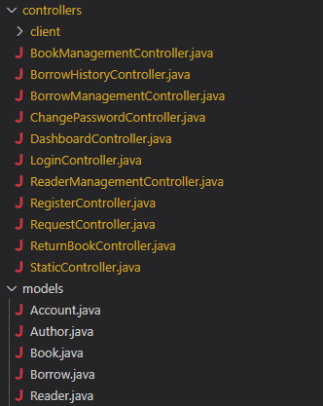
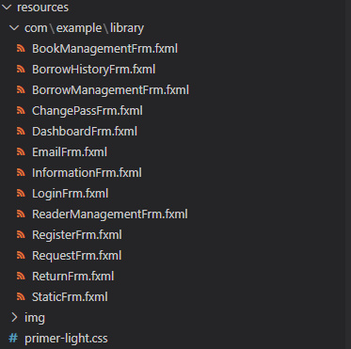
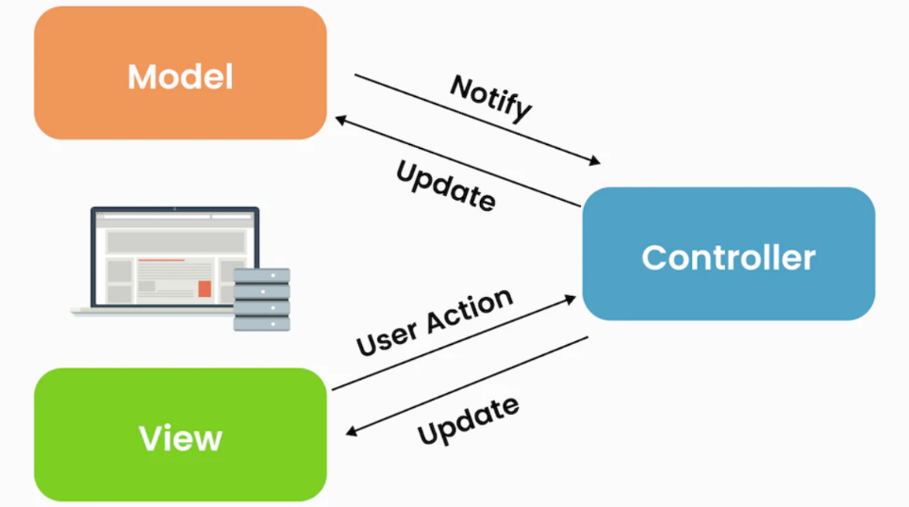
2.1. System Architectures
Model – Control – View (MVC) model
Model: Handling the object and data.
View: Handling the UI we interact.
Control: Processing and controlling the
interaction between the View and Model.

Slide 16
2.1. System Architectures
Model – Control – View (MVC) model
We chose this model to build the Project cause:
Separate model help us to dealt with one at a time.
Easy to maintain, testing and improvement in the future.

Slide 17
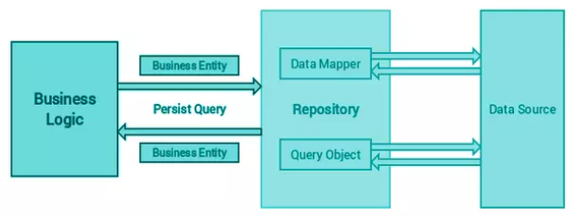
2.1. System Architectures
Repository Pattern
The Repository Pattern is the between layer of Business logic and Data logic.
This help to separate Business logic and Data logic, for a cleaner code.

Slide 18
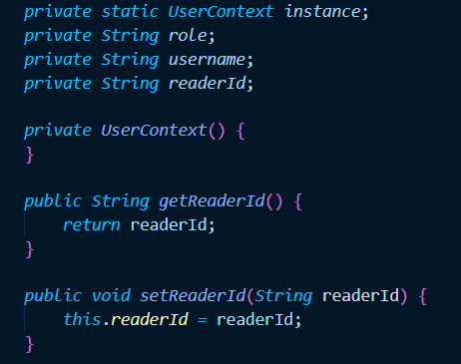
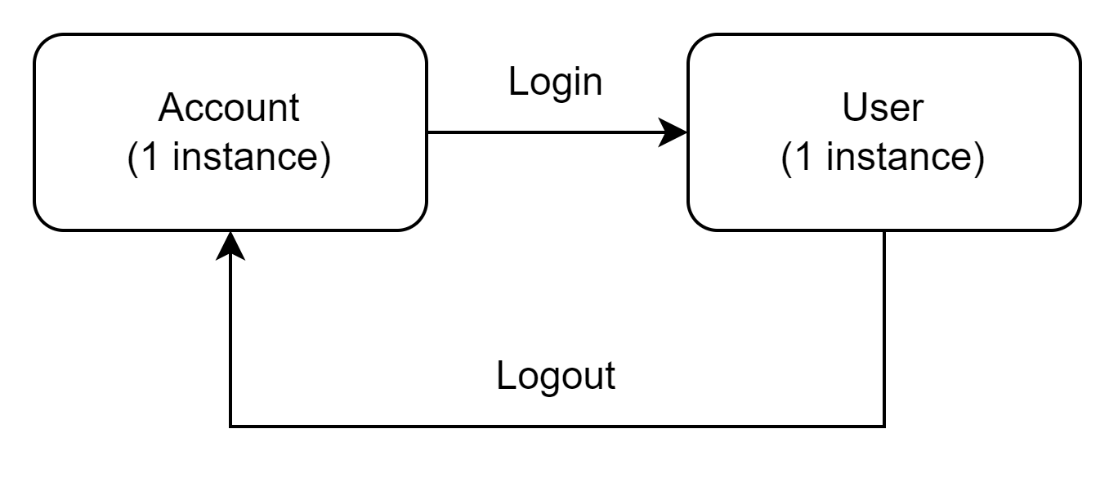
2.1. System Architectures
Singleton Pattern
The Singleton Pattern is a design that ensure a class has only one instance throughout the application and provides a global point of access to that instance.
Three key Components:
Private Static Instance.
Private Constructors.
Public Static method.

Slide 19
2.1. System Architectures
Singleton Pattern
The advantages of Singleton Pattern:
Reduce Memory Usage.
Consistency.
Global access points.

Slide 20
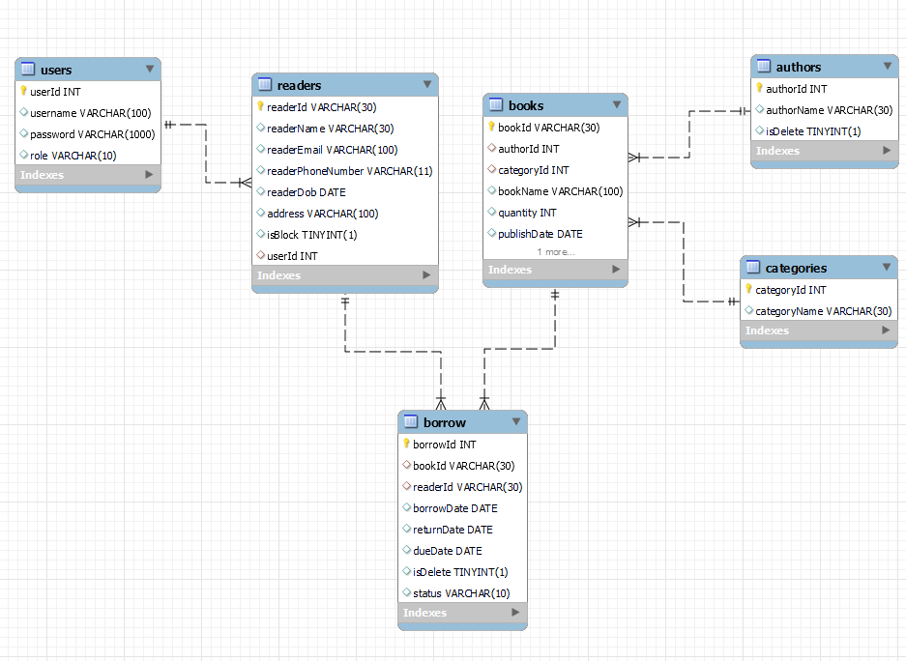
2.1. System Architectures
Database Design

Slide 21
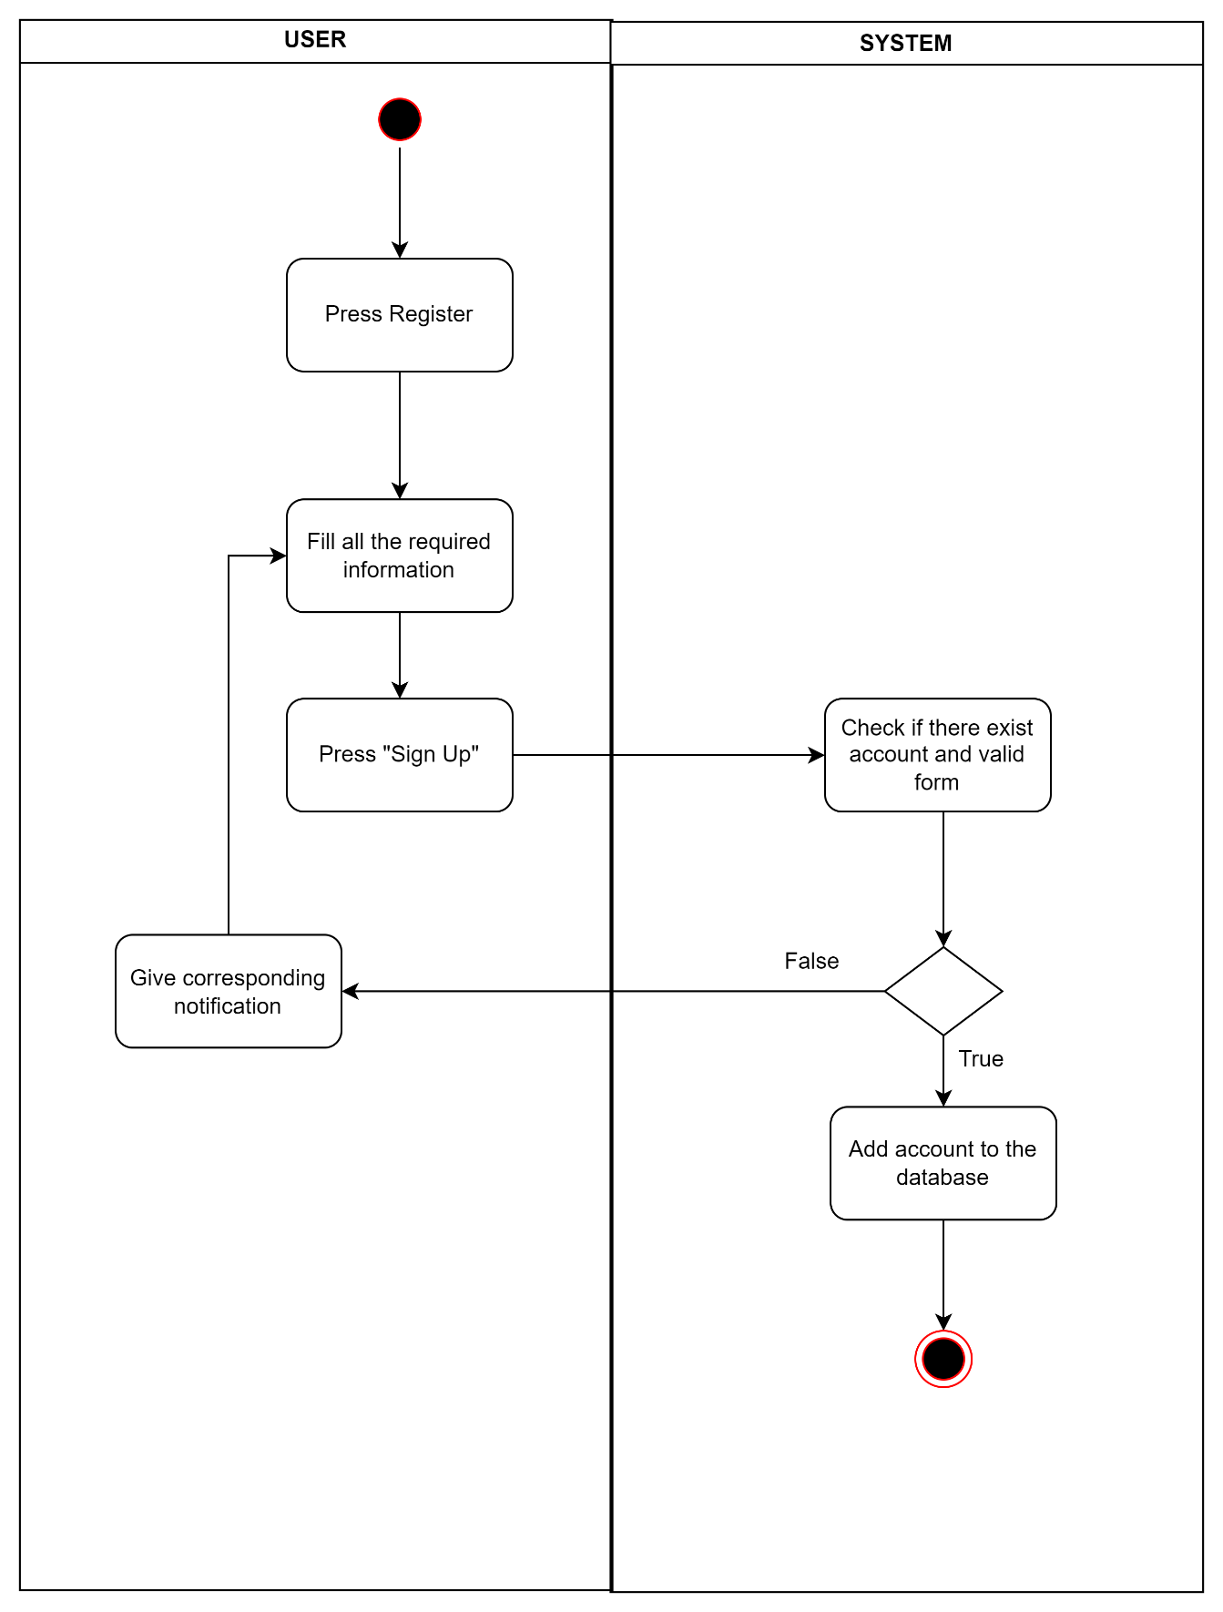
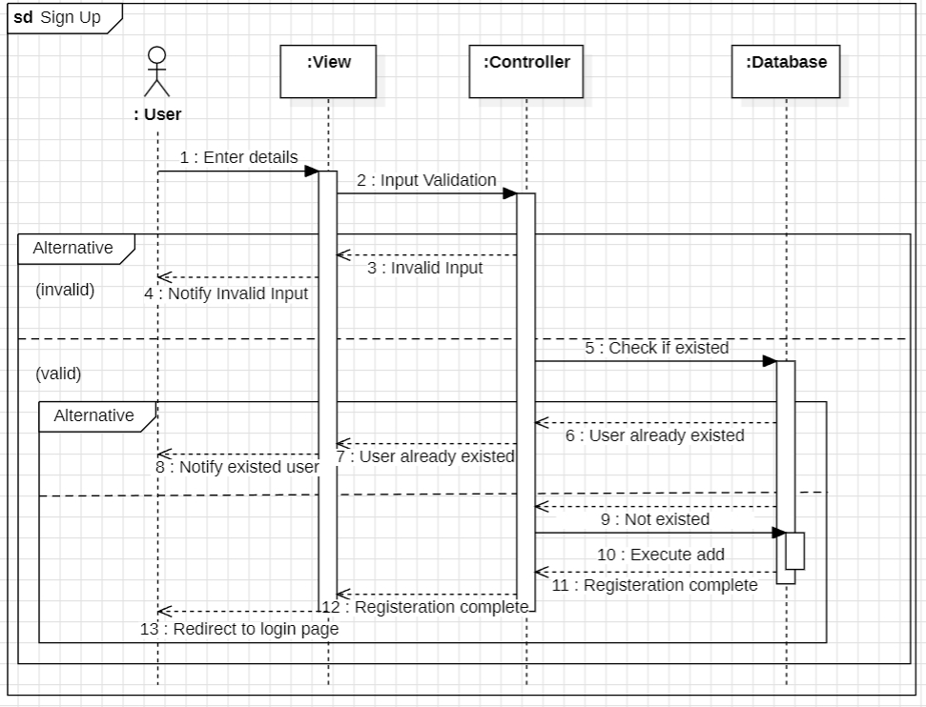
2.2. Activity & Sequence Diagrams
Register new account

Slide 22
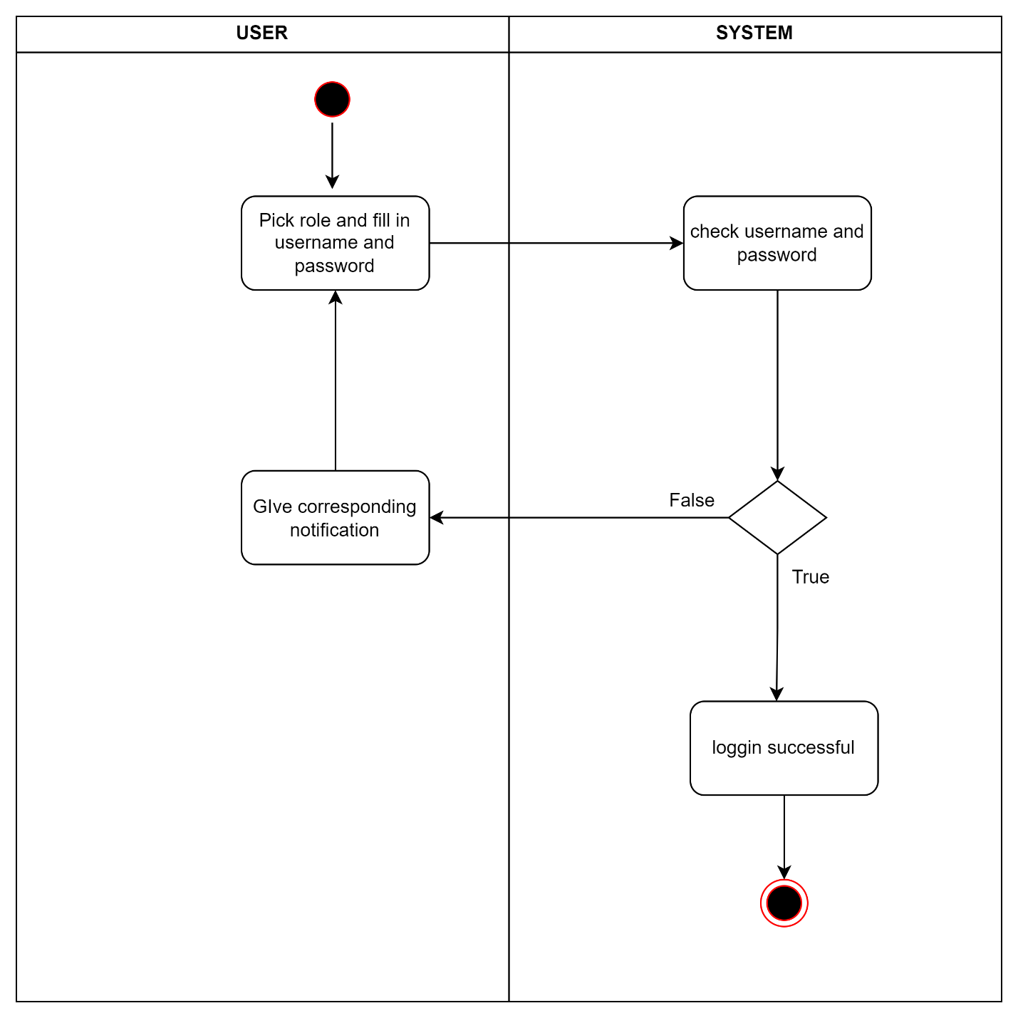
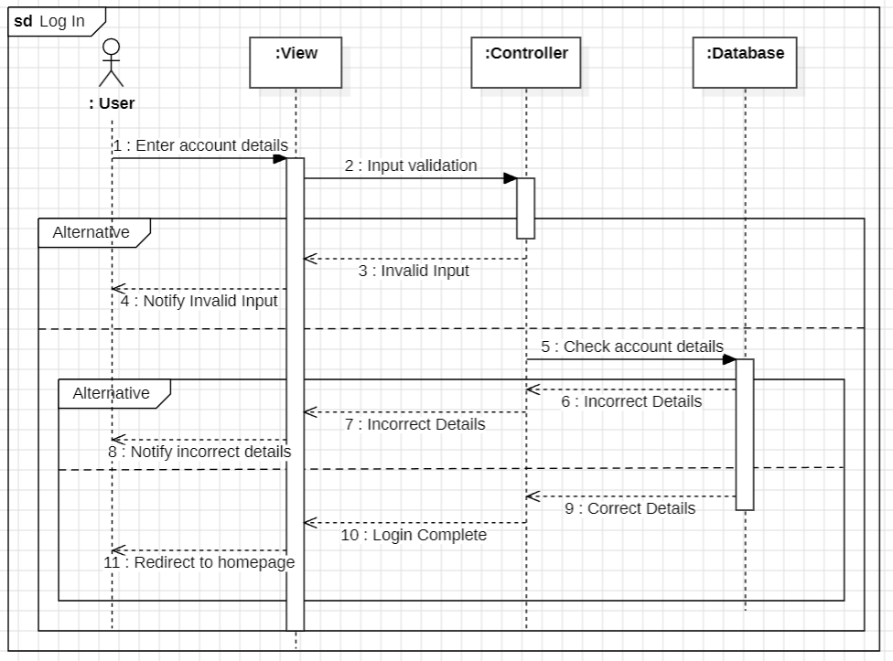
2.2. Activity & Sequence Diagrams
Log in

Slide 23
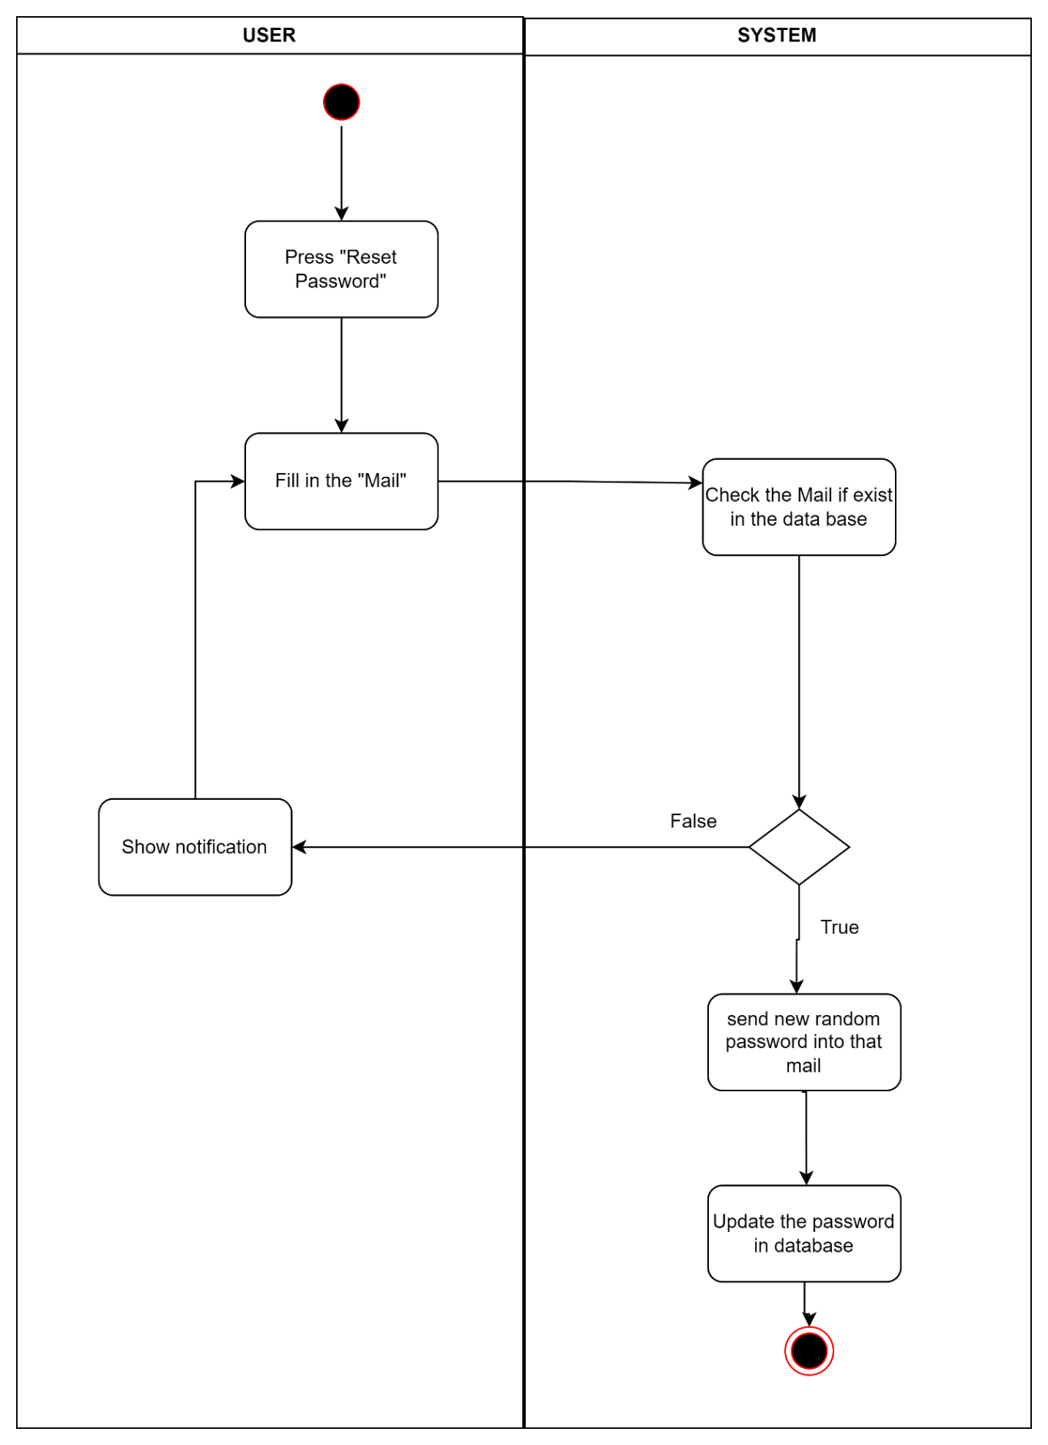
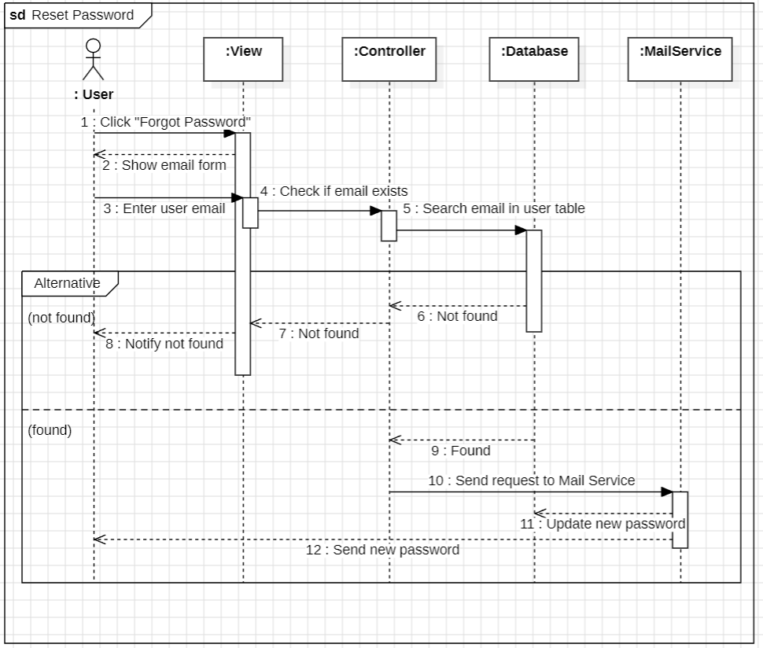
2.2. Activity & Sequence Diagrams
Reset password

Slide 24
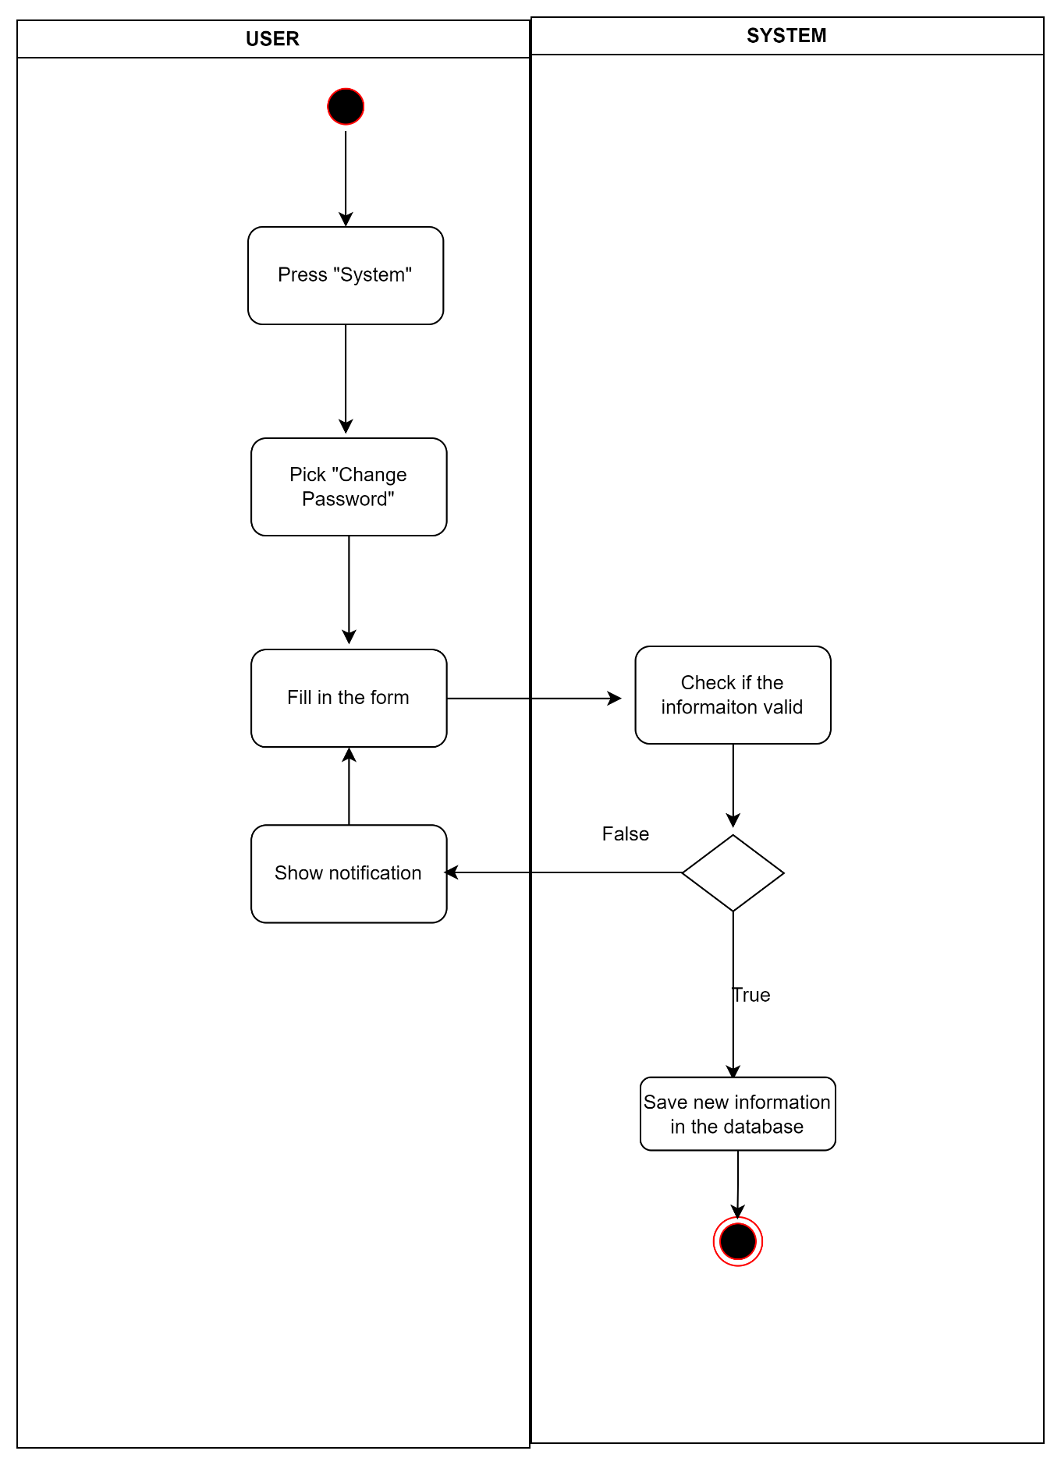
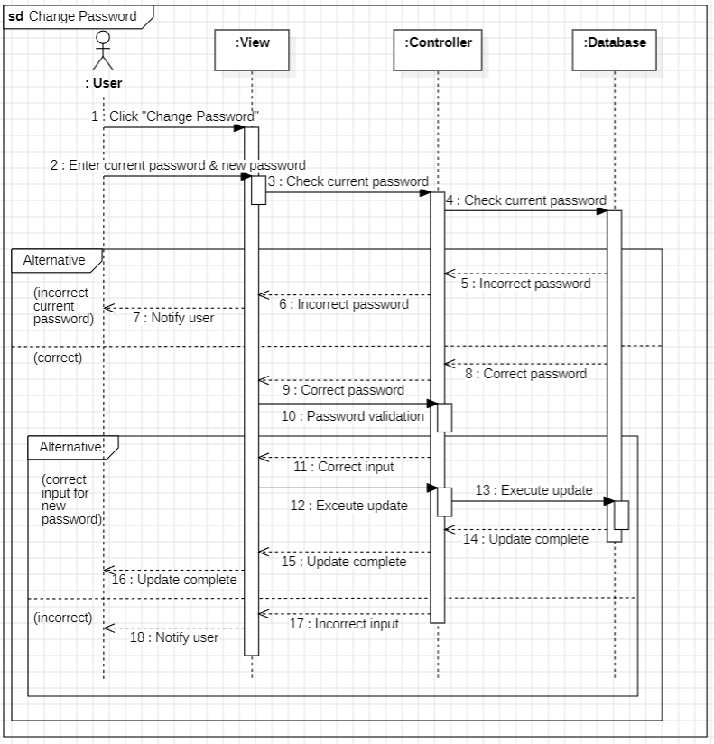
2.2. Activity & Sequence Diagrams
Change password

Slide 25
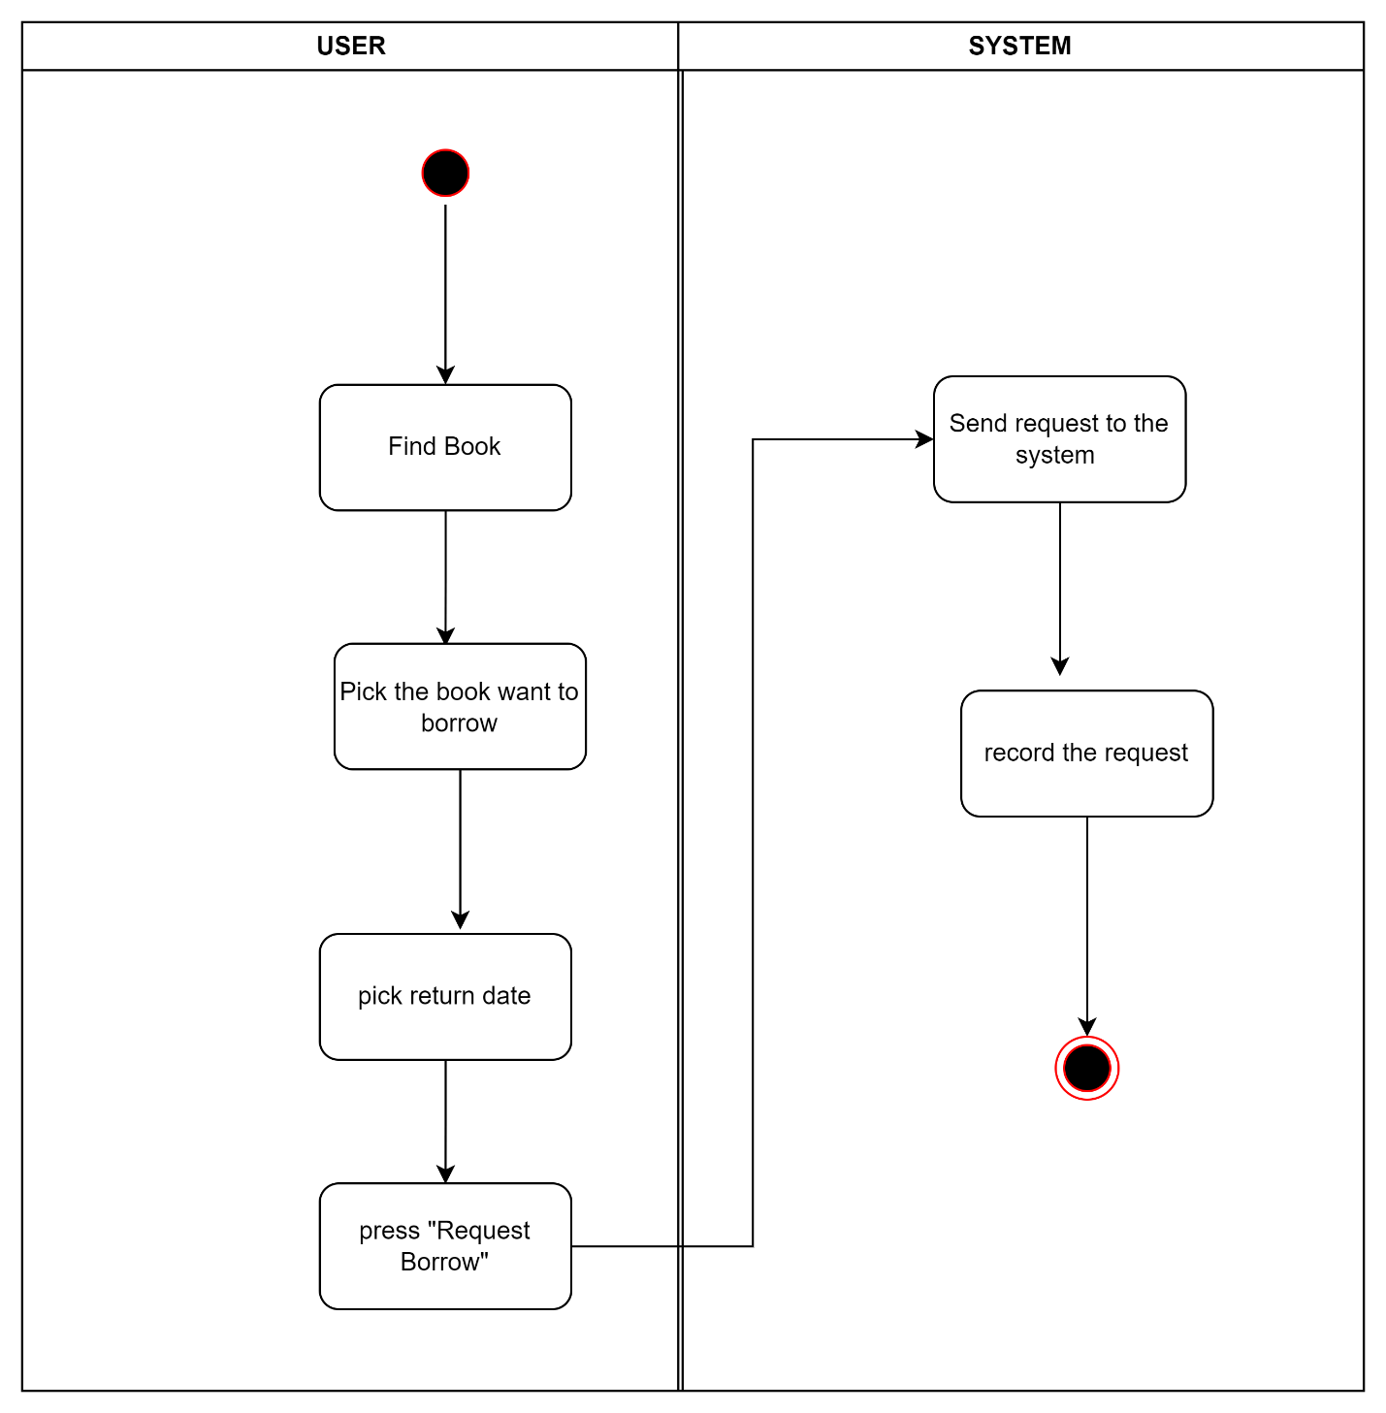
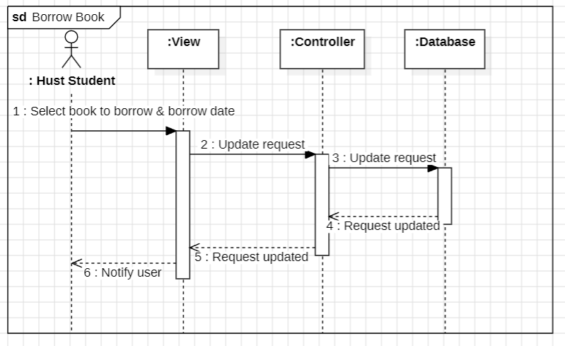
2.2. Activity & Sequence Diagrams
Ask for borrowing book

Slide 26
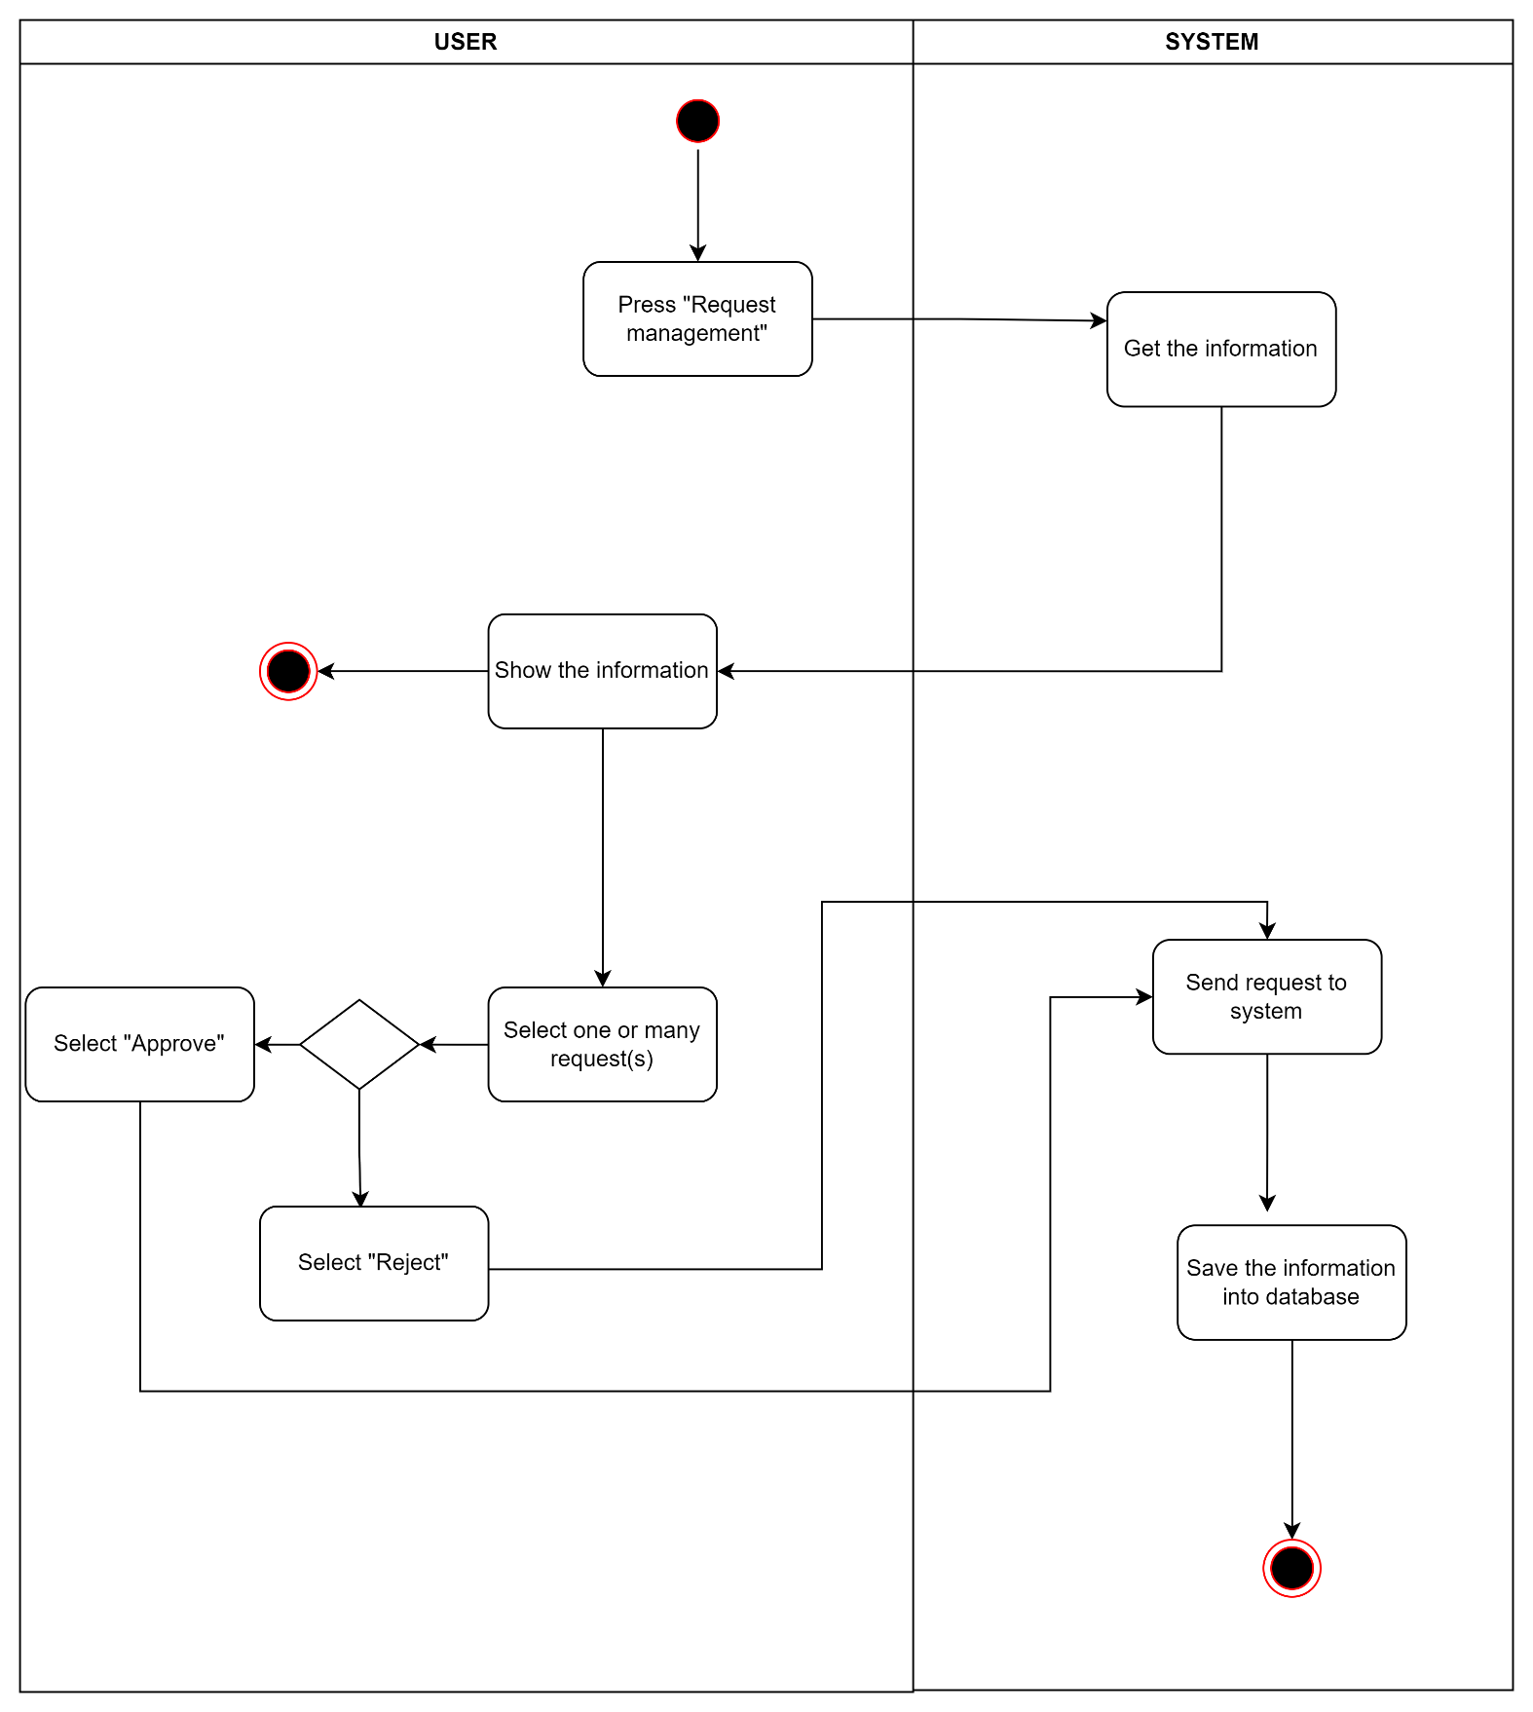
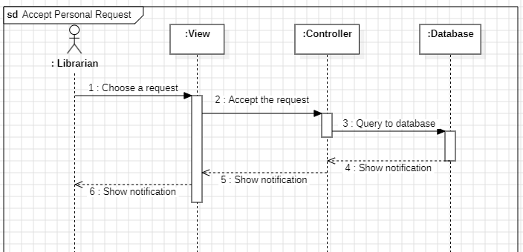
2.2. Activity & Sequence Diagrams
Issue book

Slide 27
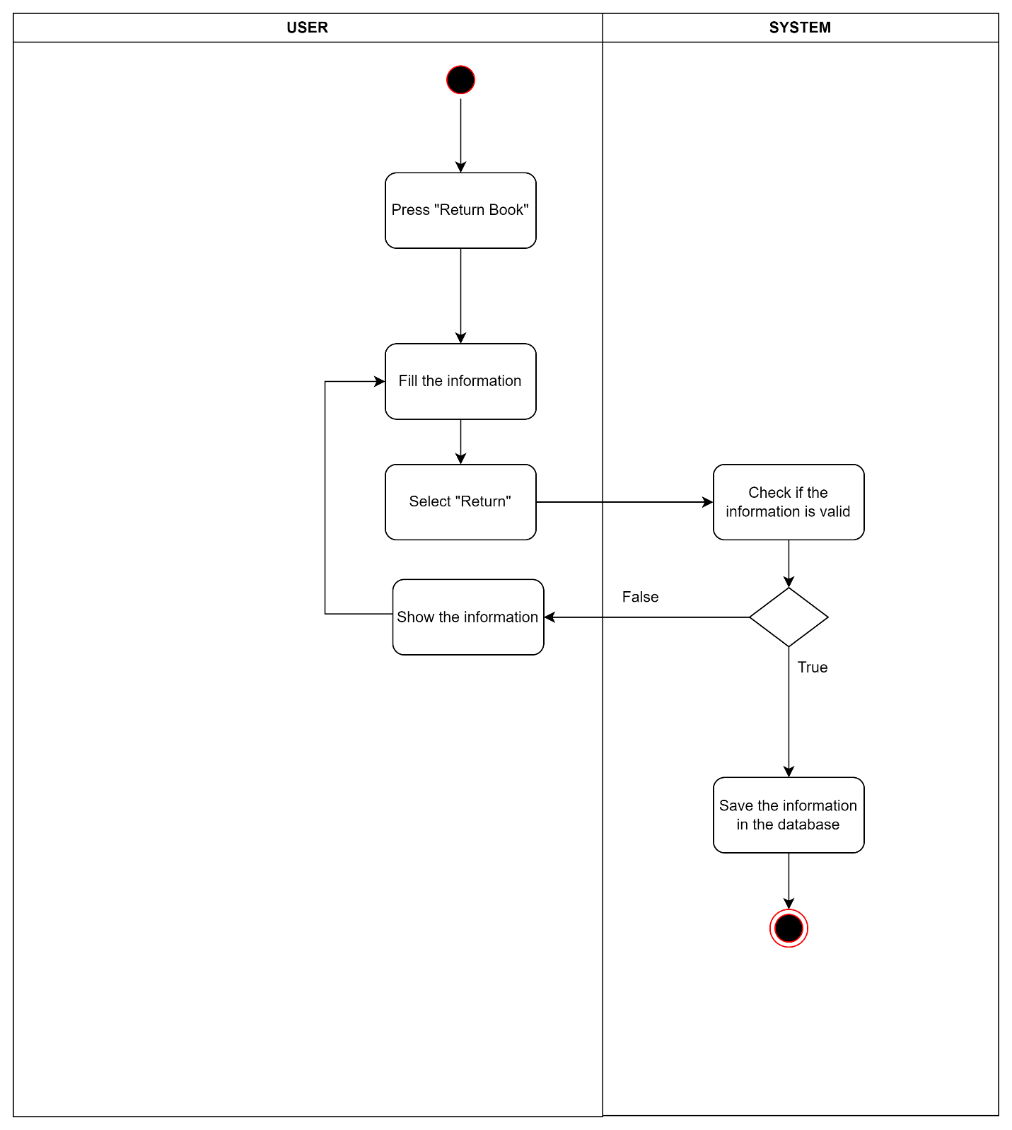
2.2. Activity & Sequence Diagrams
Return book

Slide 28
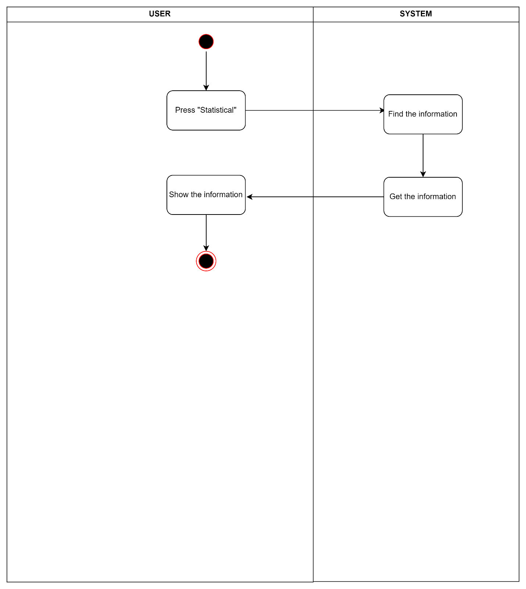
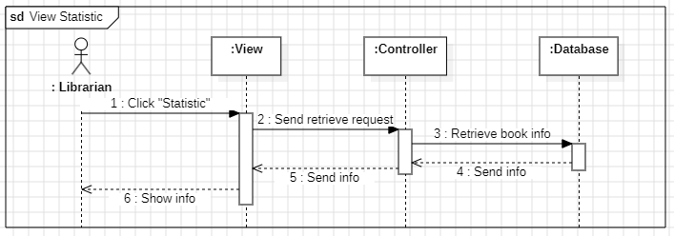
2.2. Activity & Sequence Diagrams
View statistic

Slide 29
Testing

Slide 30
3. Testing
Test Items
No | Name | Actor(s)
1 | Log in | Student and librarian
2 | Change password | Student and librarian
3 | Reset password | Student and librarian
4 | Log out | Student and librarian
5 | View and update own profile | Student and librarian
6 | View and search book | Student and librarian
7 | Borrow a book | Student
8 | Create a new account (sign up) | Student
9 | View , search and cancel personal request | Student
10 | View notification | Student

Slide 31
3. Testing
Test Items (cont)
No | Name | Actor(s)
11 | Add, remove and update book | Librarian
12 | Add, update or delete reader profile | Librarian
13 | Ban and unban reader | Librarian
14 | Issue and reject | Librarian
15 | Return book | Librarian
16 | View statistics | Librarian

Slide 32
Demo Final Product

Slide 34
THANK YOU!

