Slide 1

RPG GAME
Group 3
Tạ Đức Duy - 1624634
Trương Thanh Hùng - 1624817
Nguyễn Công Duy - 1669826

Slide 2
Contents
Overview
Game Features
Task Assignment

Slide 3
Overview

Slide 4

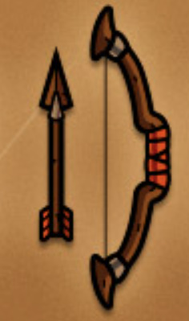
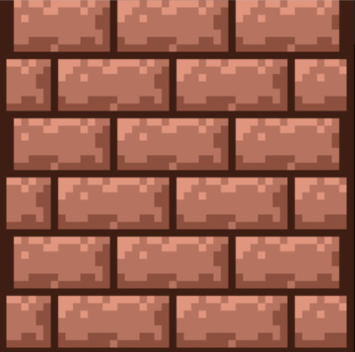



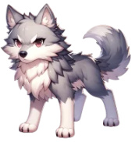
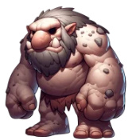
2. Hero
3. Items
1. Special Areas
4. Monsters

Slide 5
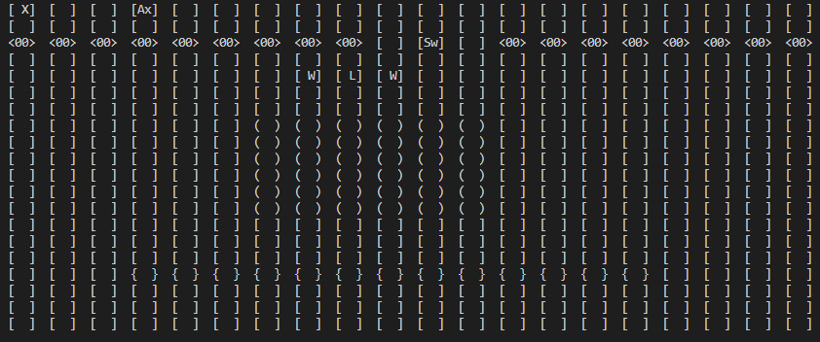
Game Features
1. Showing Map and Objects (Hero + Monsters + Items)

Slide 6
Game Features (Cont)
2. Moving
Hero:
- Player selects one of five choices (move up, move down, move left, move right, no move) to control the hero.
- Hero cannot move out of the border and cannot move into solid areas or obstacles.
Monsters:
- Random move.
- Pursuing move – moving towards the player

Slide 7
Game Features (Cont)
3. Inventory
Show Inventory
- Every item in inventory, with its properties, is shown.
Collect Item
- The picked item is automatically stored in inventory (if there is an available slot).
Remove Item
- Player selects an item to remove from inventory.
Equip/Unequip Item
- Player selects one item to equip or unequip it for hero.

Slide 8
Game Features (Cont)
Game Combat (Turn-Based Combat)
Player’s turn:
- All monsters within the player’s range will be listed. The player makes a decision by selecting
one of the following choices:
+ Move
+ Attack (player selects one monster to attack)
+ Take Potion (if available in inventory)
Monster’s turn:
+ Move (if player is not within the monster’s range)
+ Attack (if player is within the monster’s range)
An amount of attack dame in each turn is determined by using dice rolls.

Slide 9
Task Assignment
TASK | IMPLEMENTER
1. Display Objects | Tạ Đức Duy
2. Moving | Tạ Đức Duy + Trương Thanh Hùng
3. Inventory | Nguyễn Công Duy
4. Game Combat | Trương Thanh Hùng + Nguyễn Công Duy
5. ………............... | ……………………………….

Slide 10


