Slide 1

Turn-Based RPG
Group 3
Tạ Đức Duy - 1624634
Trương Thanh Hùng - 1624817
Nguyễn Công Duy - 1669826

Slide 2
Contents
Game Features
Class Design
Member Contribution
2

Slide 3
Game Features

Slide 4
Map Features
There are special areas on the map.
Land:
Allow hero and monsters to move into.
Wall:
Does not allow hero and monsters to move into.
Water:
Hero recovers a portion of lost health when moving into this area.
Fire:
Hero loses health when moving into this area.
Door:
Every stage has a door. It is opened only if all monsters on the stage are cleared. Hero moves into the opened door to reach the next stage.

Slide 5
Monster Features
A monster is able to
move randomly
pursue hero
attack hero by using special skills
drop an item when being killed

Slide 6
Monster Features (cont)
Regular Monster:
Random move
Loot rate = 60%
Target Monster:
Pursuing move
Loot rate = 50%
Boss:
Phase 1: pursuing move + not drop item when being killed
Phase 2: random move + drop item when being killed with loot rate = 100%
Special Skills: Boss pushes the hero to the edge of the map after every 5 collisions with the hero.

Slide 7
Item & Inventory Features
Items are classified by the role
Weapon: only serves for changing ATK, Range
Armor: only serves for changing DEF, HP
Potion: only serves for recovering HP
Inventory stores picked items for later use.

Slide 8
Game with Many Stages
Here we develop the game for 3 stages. If a player wants to reach a higher stage, he/she must pass the previous stages. Whenever the player fails at any stage, he/she will start at the initial stage.
Stage 1
Stage 2
Stage 3

Slide 9
Class Design

Slide 10
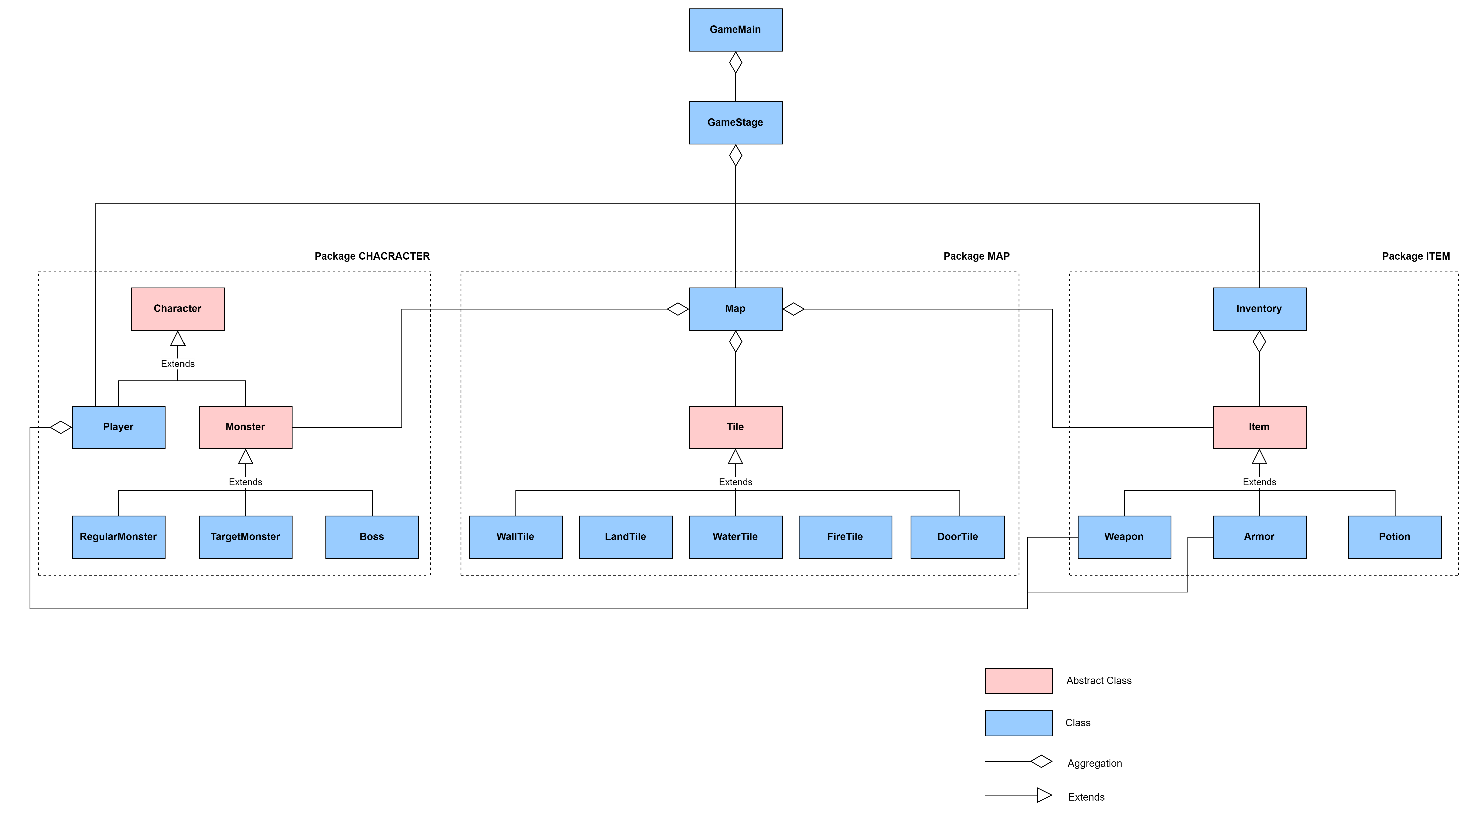
Overview

Slide 11
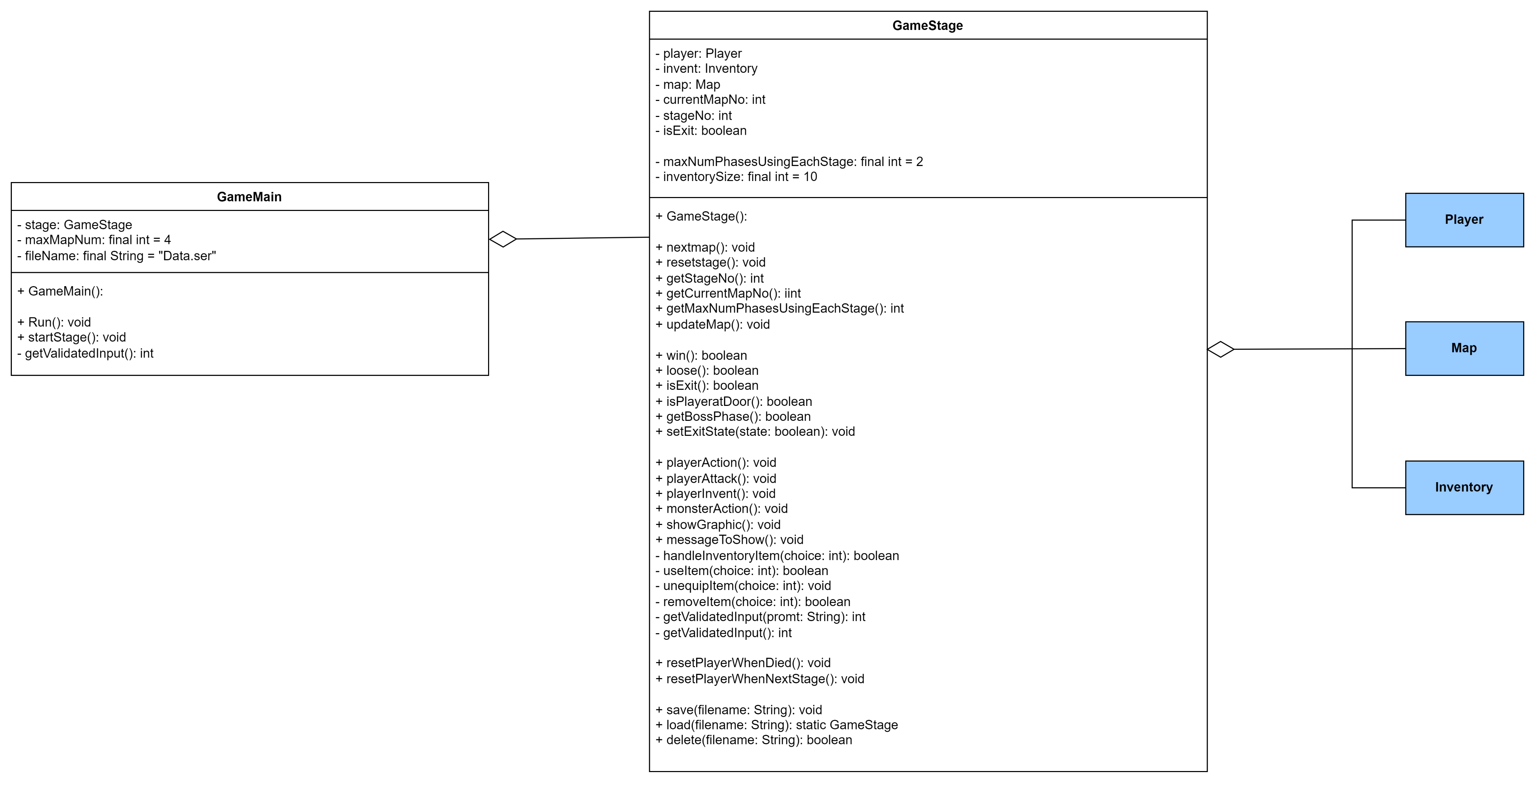

Slide 12
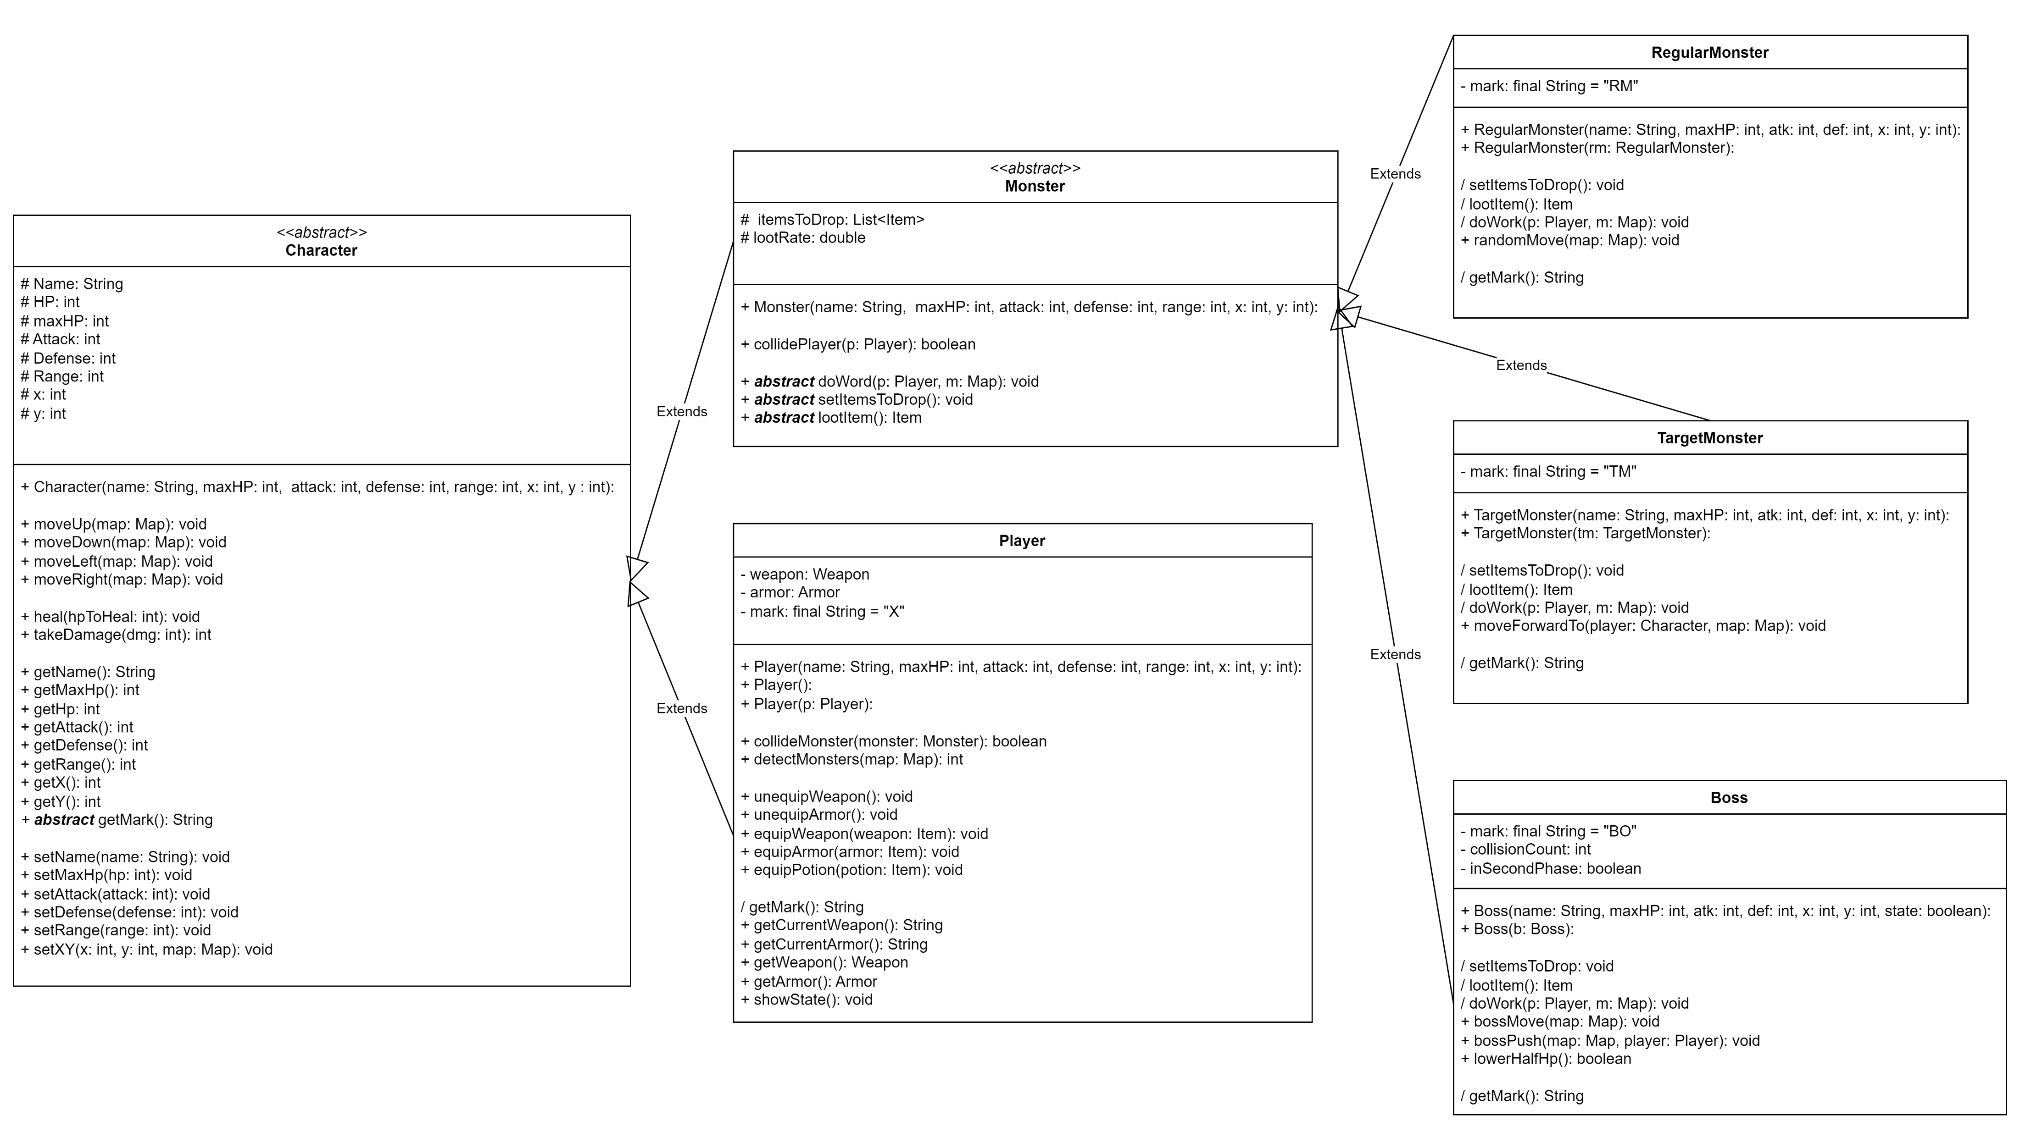
Package CHARACTER

Slide 13
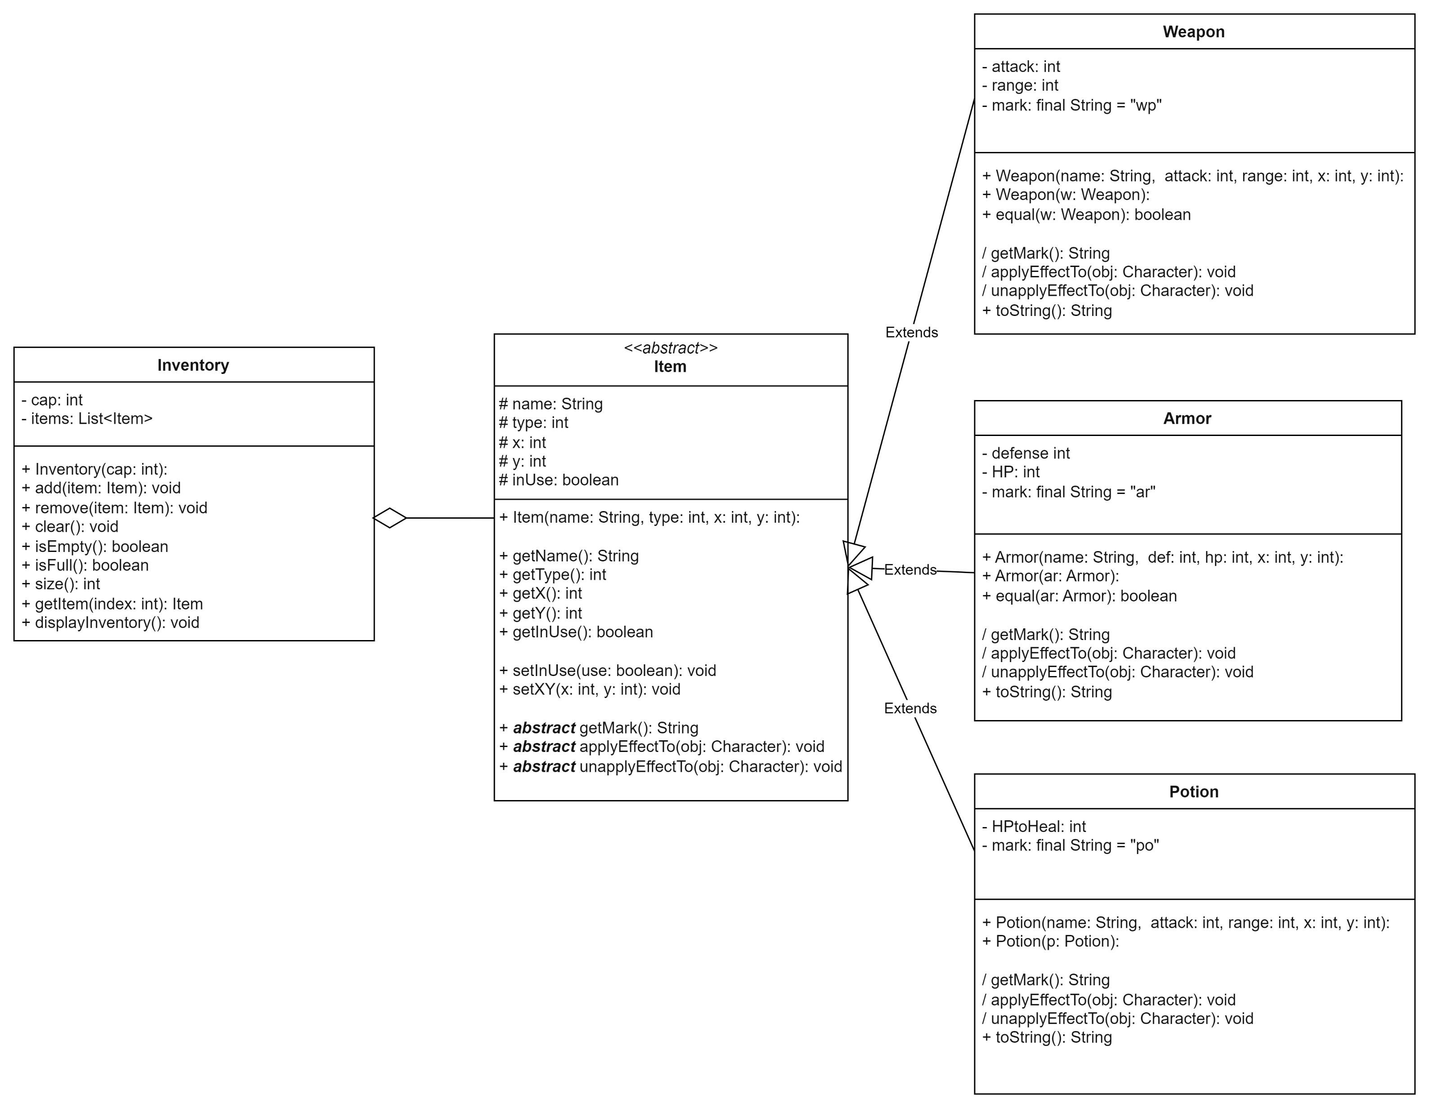
Package ITEM

Slide 14
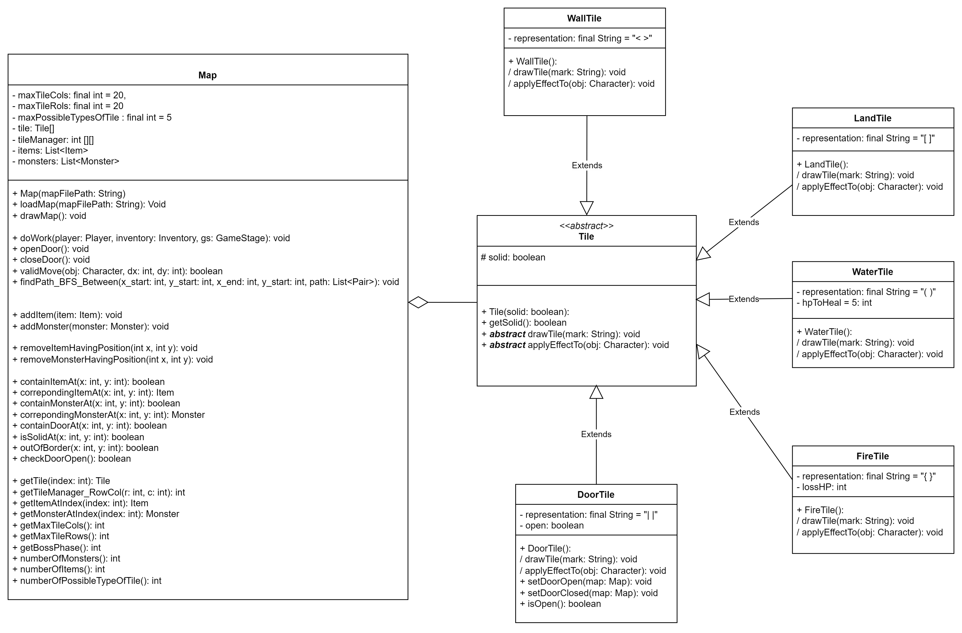
Package MAP

Slide 15
Member Contribution

Slide 16
Tạ Đức Duy
Presenter
Design Map with searching features in Map
Check collisions between Hero and Monsters
Validate the moving steps of Hero and Monsters

Slide 17
Nguyễn Công Duy
Design test case
Design inventory feature with menu driven for inventory
Design stats of objects (e.g. Name, Hp, Atk, Def, Range)

Slide 18
Trương Thanh Hùng
Handle game loop
Validate the user’s input
Design special skills for monsters
Write the game’s description

Slide 19
Table of Contribution
Implementer | Classes
 | GameStage | GameMain
Tạ Đức Duy
Nguyễn Công Duy
Trương Thanh Hùng | ✓ | ✓

Slide 20
Table of Contribution (cont)
Implementer | Classes (Package CHARACTER)
 | Character | Player | Monster | RegularMonster | TargetMonster | Boss
T.Đ.Duy | ✓ | ✓ | ✓ | ✓ | ✓
N.C.Duy
T.T.Hùng |  |  |  |  |  | ✓
Implementer | Classes (Package ITEM)
 | Item | Weapon | Armor | Potion | Inventory
T.Đ.Duy
N.C.Duy | ✓ | ✓ | ✓ | ✓ | ✓
T.T.Hùng

Slide 21
Table of Contribution (cont)
Implementer | Classes (Package MAP)
 | Tile | WallTile | LandTile | WaterTile | FireTile | DoorTile | Map
T.Đ.Duy | ✓ | ✓ | ✓ | ✓ | ✓ | ✓ | ✓
N.C.Duy
T.T.Hùng

Slide 22

THANK YOU!

