Slide 1
Optimizing Cryptocurrency Trading Decisions Using Deep Reinforcement Learning
Agenda
Your name: Vishal Taduri
student ID:14962338
Course code: 7151CEM
Supervisor’s name: James Brusey

Slide 2
Agenda
Broad Subject Area
Narrow Topic Area
Research Motivation
Relevant Existing Studies
Research Questions
Model Development
Data Collection
State, environment and observation
Environment Design
How Reward is Calculated
Training Process
Challenges Faced during Training process
Evaluation Summary
Limitations & Improvements
Conclusion
Discussion
Q&A

Slide 3
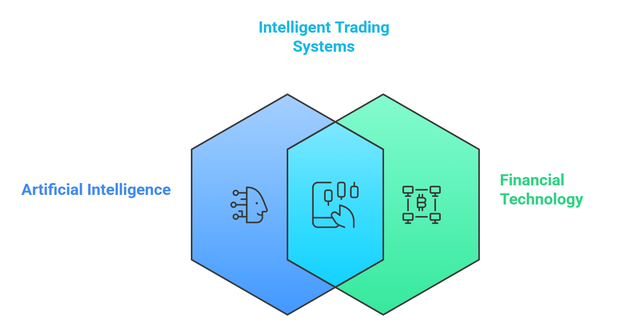
Broad Subject Area
Discipline: Artificial Intelligence and Financial Technology
Subfields: Deep Learning, Reinforcement Learning, Cryptocurrency Trading
Goal: Enhancing trading decisions using Reinforcement Learning

Slide 4
Narrow Topic Area
Project Focus: This project replicates the work of Sattarov et al. (2020), who used deep reinforcement learning to identify the best times to buy, sell, or hold cryptocurrencies. By following their approach, this study aims to validate their results while also introducing improvements to make the trading setup more realistic and better suited to real-world market conditions.
Challenges: Cryptocurrency markets are volatile and fast-moving, impacted by a variety of variables such as news, mood, and trade volume. Traditional machine learning algorithms fail to adapt to these changing environments.
Research Motivation
These challenges fueled the demand for:
A better, more adaptable approach to decision-making in crypto trading.
A model capable of learning from experience, adapting to changing market patterns, and improving over time.
Using Deep Reinforcement Learning (DRL), which mimics how humans learn via trial and error, to construct a trading agent that makes better buy, sell, or hold choices.

Slide 5
Relevant Existing Studies
Sattarov et al., 2020 – Recommending Cryptocurrency Trading Points with DRL
This was the initial research paper that inspired and guided the start of this project.
Introduced a Deep Reinforcement Learning -based trading system for BTC, ETH, LTC.
Achieved 14% monthly profit using buy/sell/hold actions.
Used a custom reward strategy and basic DQN model.
Goluža et al., 2024 – DRL with Positional Context for Intraday Trading
Used DQN enhanced with positional encoding to better understand time-based trade signals.
My work uses LSTM, which also captures time dependency through recurrent connections.
Research Questions
How does the inclusion of realistic trading constraints (transaction fees, cooldown periods, max holdings) influence the learning efficiency and profitability of the DRL agent?

Slide 6
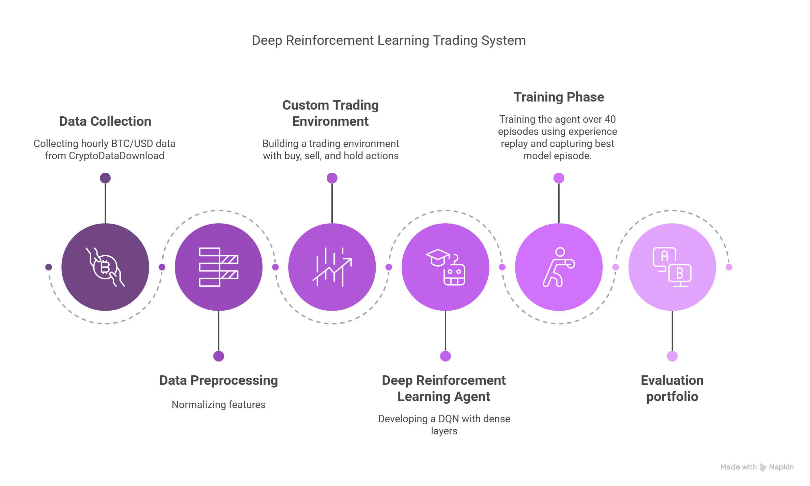
Model Development
Above image generated using Napkin.ai

Slide 7
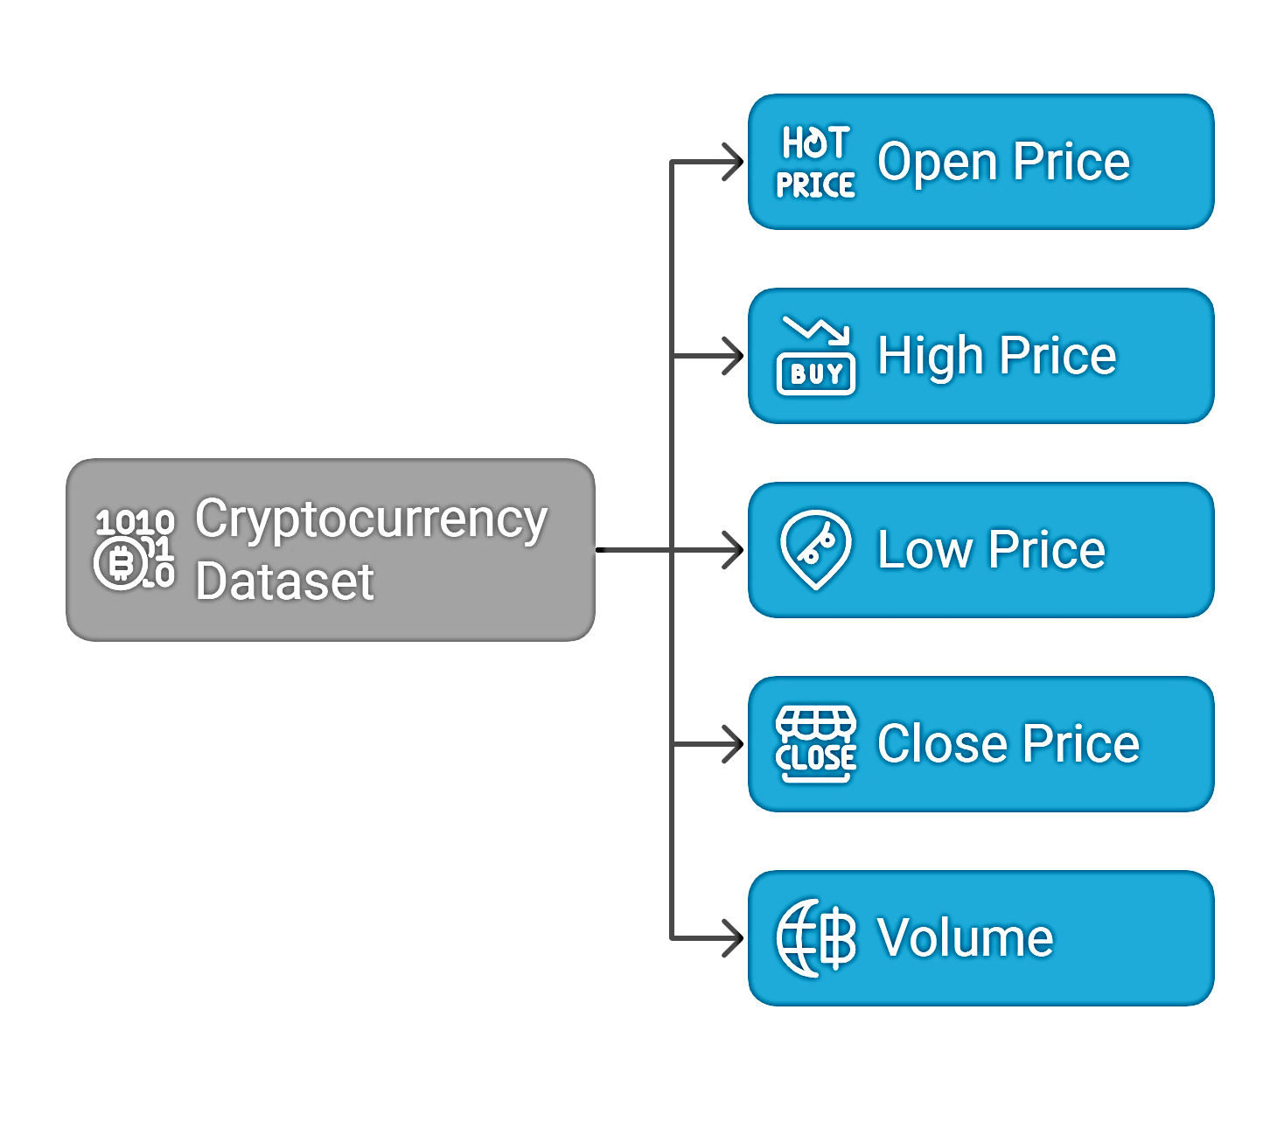
Data Collection:
The dataset used in the original study by Sattarov et al. (2020) was obtained from CryptoDataDownload and the dataset included hourly historical price data for Bitcoin (BTC), Ethereum (ETH), and Litecoin. However, the date range mentioned in the paper—from October 2, 2016 to March 1, 2019—is no longer available on the website.
In order to obtain the precise dataset, the author was contacted through email. Unfortunately, They have not responded. As a result, the current study makes use of the most recent available dataset from the same source, which spans the period from May 15, 2018 to October 11, 2020.
About Dataset:
Collected hourly OHLCV data for: Bitcoin (BTC), Ethereum (ETH), Litecoin (LTC)
Date range:15 May 2018 to 11 October 2020.
Preprocessing:
Applied Min-Max Normalization to scale features between 0 and 1

Slide 8
State, environment and Observation
State (Input to Agent):
A 10×5 matrix of the most recent 10-time steps
Each row = 1 hour of market data
Observation Features (per time step)
Open price
High price
Low price
Close price
Volume
Environment
Simulates a trading market using historical data
Tracks:
Balance
Holdings
Trade history
Last buy price
Cooldown period
Returns:
Next state
Reward
Done flag after each action

Slide 9
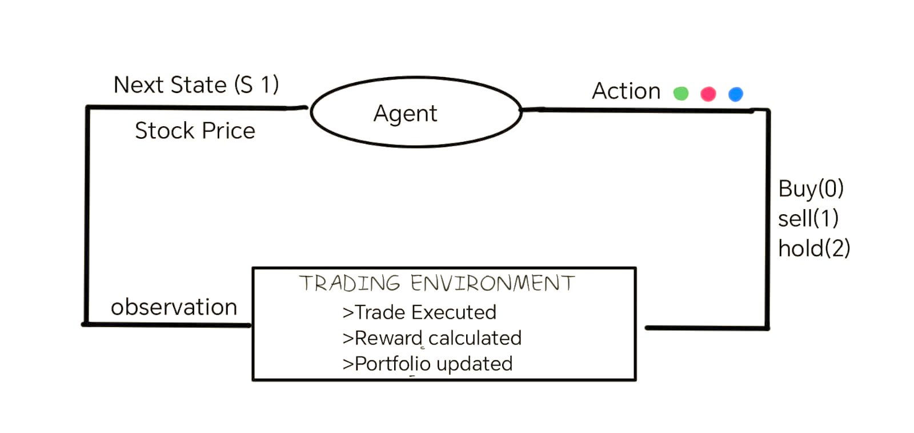
Deep Reinforcement Learning Agent
Deep Q-Network Agent (DQN): The DQN agent is the core of the cryptocurrency trading system. It acts as a decision-maker that learns to choose actions (Buy, Sell, Hold) based on historical market data to maximize cumulative rewards (i.e., profit) over time.
DQN combines Q-learning with a deep neural network to approximate the Q-function, which tells the agent the expected future reward for taking a particular action in a given state.

Slide 10

Input to the neural network
Shape of the Input: (10, 5)
This represents the state fed into the model at each step:
Example:
At step t1, 10-time steps × 5 features (Open, High, Low, Close, Volume BTC) is fed into Deep Q neural network as input. The input is then converted into a flattened vector and fed to dense layers of DQN.
Time | Open | High | Low | Close | Volume BTC
T-9 | 92195 | 92320 | 91633 | 91714 | 17.37
T-8 | 91925 | 92575 | 91633 | 92206 | 233.89
T-7 | 92700 | 93071 | 91833 | 91971 | 521.32
T-6 | 94170 | 94170 | 92700 | 92700 | 291.69
T-5 | 94197 | 94512 | 93811 | 94171 | 44.34
T-4 | 94140 | 94758 | 93993 | 94227 | 38.79
T-3 | 94351 | 94750 | 93910 | 94144 | 42.39
T-2 | 94836 | 95018 | 94343 | 94353 | 25.76
T-1 | 94588 | 95370 | 94514 | 94806 | 27.87
T | 94487 | 95162 | 94363 | 94608 | 32.13
[
92195, 92320, 91633, 91714, 17.37,
91925, 92575, 91633, 92206, 233.89,
92700, 93071, 91833, 91971, 521.32,
94170, 94170, 92700, 92700, 291.69,
94197, 94512, 93811, 94171, 44.34,
94140, 94758, 93993, 94227, 38.79,
94351, 94750, 93910, 94144, 42.39,
94836, 95018, 94343, 94353, 25.76,
94588, 95370, 94514, 94806, 27.87,
94487, 95162, 94363, 94608, 32.13
]
Output: Q-values [2.41, -0.82, 1.09]
# Agent picks action = Buy
DQN Agent
Dense(64, ReLU)
Dense(32, ReLU)
Dense(16, ReLU)
Dense(3, Linear)
input to DQN
Flattened Vector Before Dense Layers)

Slide 11
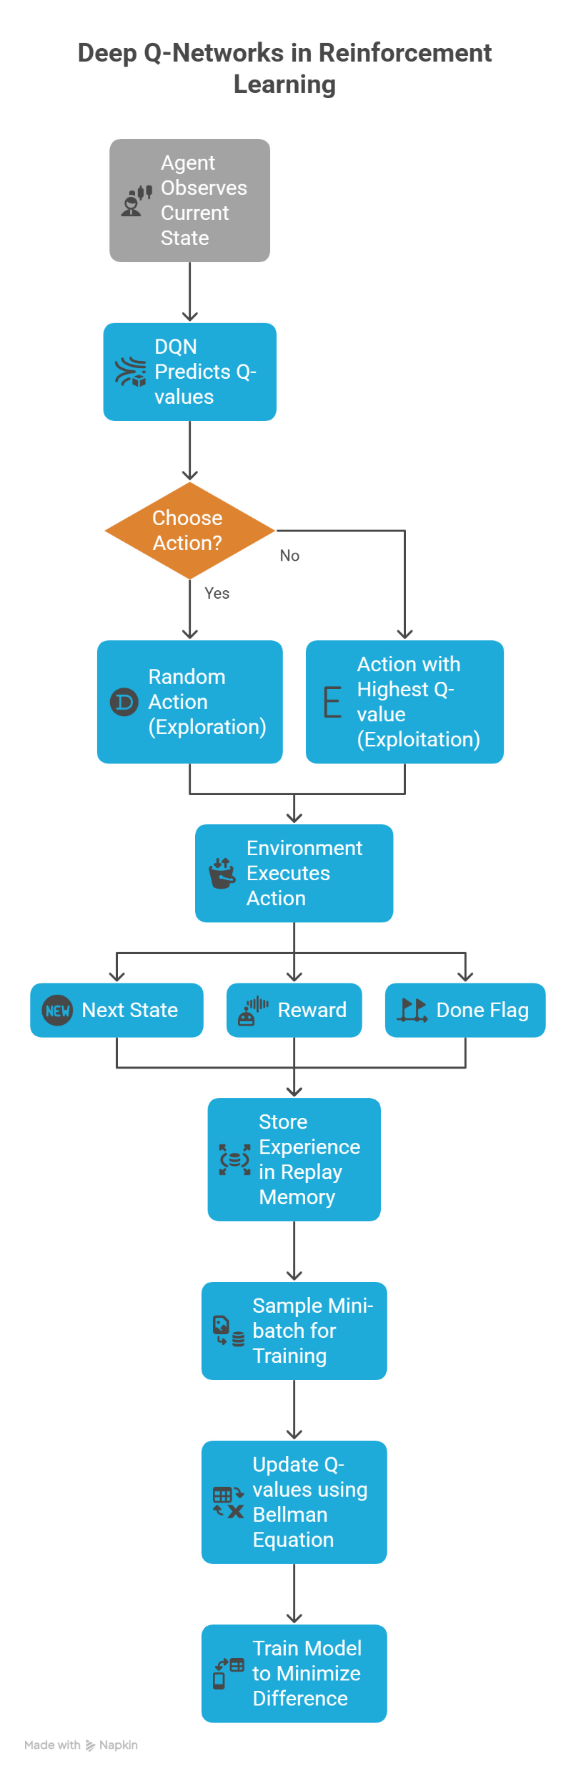
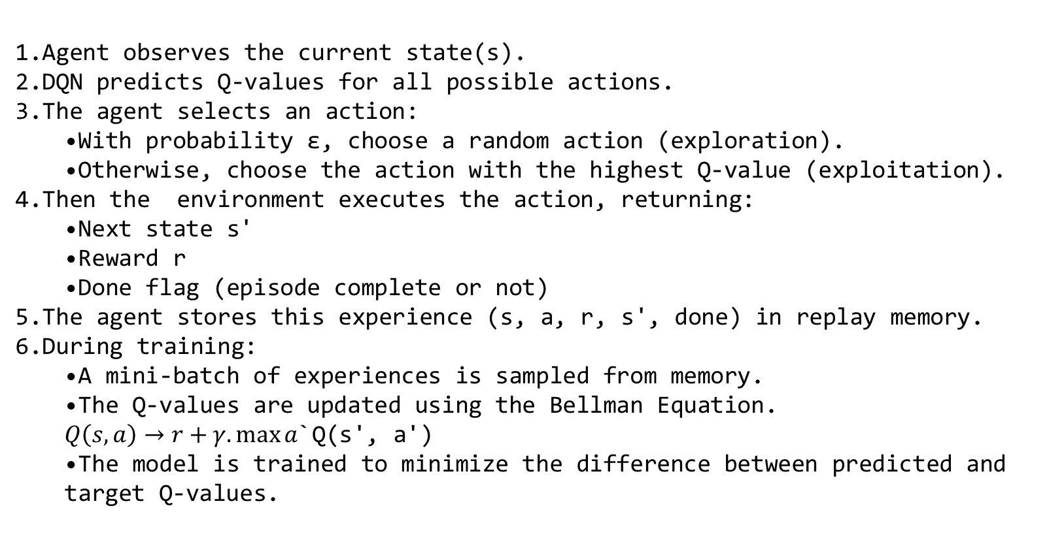
DQN Works – Step by Step
Agent observes the current state(s).
DQN predicts Q-values for all possible actions.
The agent selects an action:
  With probability ε, choose a random action (exploration).
  Otherwise, choose the action with the highest Q-value (exploitation).
Then the environment executes the action, returning:
  Next state s'
  Reward r
  Done flag (episode complete or not)
The agent stores this experience (s, a, r, s', done) in replay memory.
During training:
  A mini-batch of experiences is sampled from memory.
  The Q-values are updated using the Bellman Equation.
  $Q\left(s,a\right)→r+γ.\max{a}$`Q(s', a')
  The model is trained to minimize the difference between predicted and target Q-values.

Slide 12
Environment Design:
The model’s environment simulates a cryptocurrency trading environment (like a virtual exchange). It interacts with the DQN agent, which tries to maximize its profits by choosing actions buy, sell or hold.
The environment's job is to:
Simulate trades using historical data
Track portfolio (balance + holdings)
Calculate rewards based on performance
Return the next state to the agent
How Values Are Updated Per Action
Buy (action == 0)
Checks:
Is there enough balance?
Is the cooldown period over?
Is the max holdings limit reached?
If allowed:
Buy 1 unit of LTC/BTC/ETH
Subtract (price + fee) from balance
Update last_buy_price and last_trade_step
Increment buy count, reset hold_count

Slide 13
Sell (action == 1)
If holdings > 0:
Sell 1 unit
Add (price - fee) to balance
Reset buy_count and hold_count
If last_buy_price exists: Calculate profit/loss
Use it to compute reward
Hold (action == 2)
Increment hold_count
Small bonus/penalty based on price movement or inactivity
How Reward is Calculated
When Selling:
profit percentage = ((sell price - fee) –last buy price) / last buy price
reward = profit percentage * 100
if profit > 0:
reward += profit percentage * 10 #bonus or penalty depending on whether the agent made a profit or loss
else:
reward -= abs(profit_perentage) * 10

Slide 14
When Holding:
Penalty for holding too long:
reward -= 0.5 or reward -= 2
Bonus if price goes up while holding
When Overbuying:
If buy_count > 20:
reward -= 5

Slide 15
Training Process
Agent learns by interacting with the environment for 40 episodes
Uses experience replay to store transitions and train on mini-batches
Epsilon-greedy strategy to balance exploration and exploitation
Model saved when it achieves best profit
In this study, the training period is confined to 40 episodes, whereas the original research paper by Sattarov et al. (2020) trained the agent for 500 episodes.
Why Only 40 Episodes Were Used ?
Computational Constraints:
Each episode processes thousands of time steps (~21,000), with replay memory updates and neural network fitting.
This leads to long training time per episode, especially on a local CPU/GPU setup.
Despite limited episodes, the model is showing consistent profit signals, indicating that learning is happening, but:
The model is still in the exploration phase.
It requires more experience (more episodes) to converge and exploit patterns effectively.

Slide 16
Challenges Faced during Training process
While replicating the model described in Sattarov et al. (2020), there were several practical limitations and missing implementation details. To address this, several enhancements were introduced and customized.
These were not arbitrary — they were necessary due to observed inconsistencies, unrealistic trading behavior, or instability in the agent’s learning
Cooldown Period Between Trades: Without a cooldown, the agent could trade on every time step, which is unrealistic in real-world trading and caused excessive overtrading.
Reward system with Penalties:The original reward logic gave inconsistent results. The agent often learned to buy/sell repeatedly for no gain.
Input Feature Scaling: Unnormalized price features led to erratic learning. Values with different scales (price vs. volume) distorted learning.
Max Holdings Cap:The agent occasionally hoarded massive quantities, leading to unrealistic balances and instability.

Slide 17
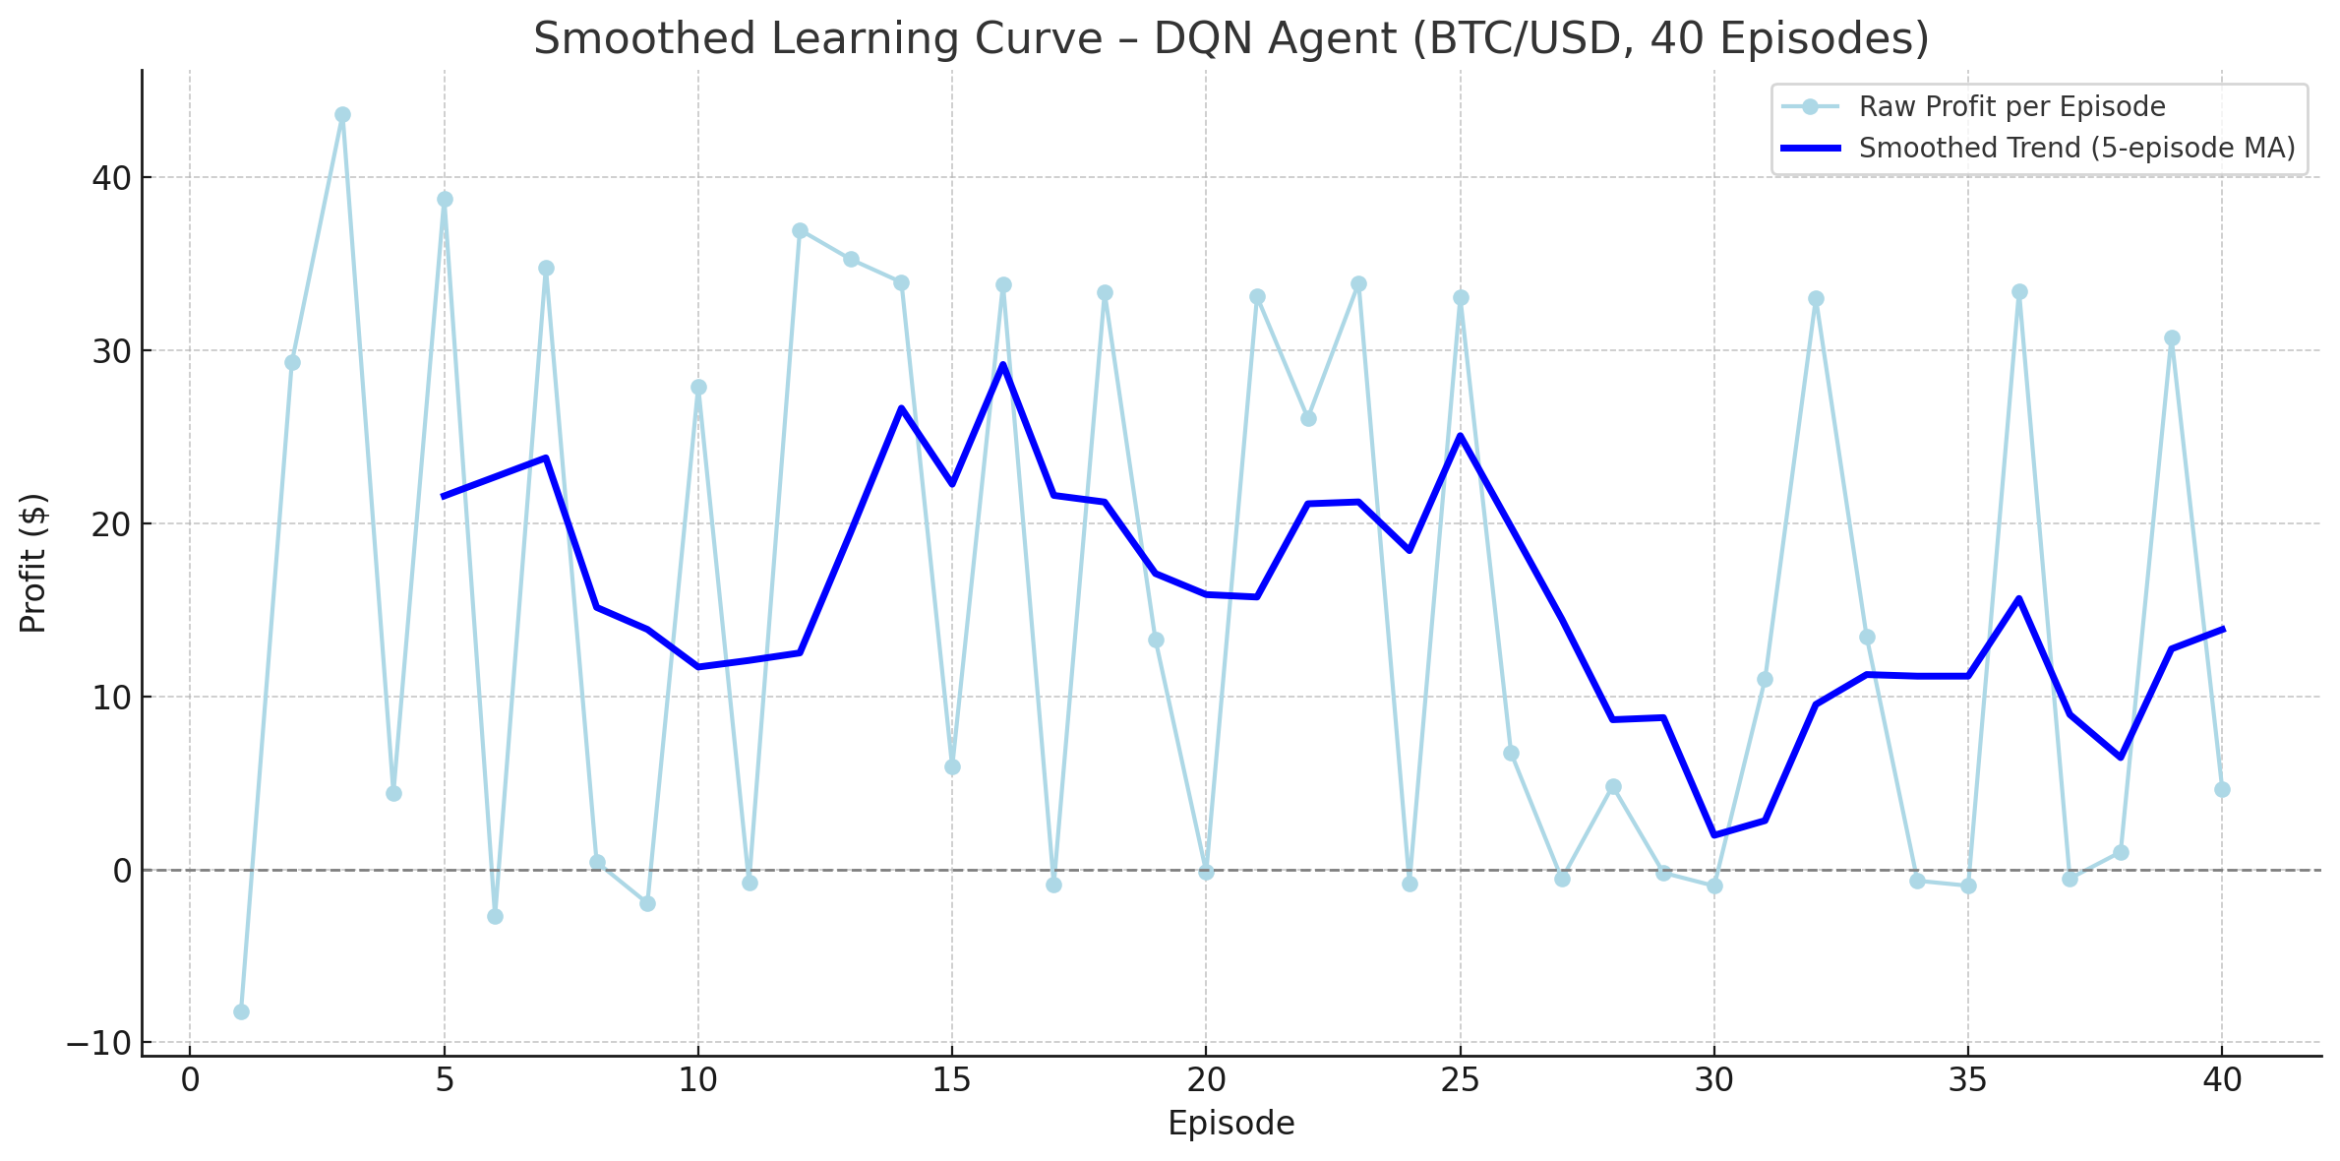
Evaluation Summary – DQN Agent (BTC)
Training Episodes: 40
Initial Balance: $10,000
Environment: Custom TradingEnv
Actions: Buy (0), Sell (1), Hold (2)
Model: Flatten → Dense(64 → 32 → 8 → 3)
Features Used: Open, High, Low, Close, Volume BTC
(shape = 10×5)
Epsilon-Greedy Strategy: Decayed from 1.0 to ~0.08
Metric Value
Best Final Balance $9999.42 (Episode 12)
Worst Final Balance $9957.76 (Episode 13)
Average Final Balance ≈ $9975.77
Best Profit $59.16 (Episode 12)
Worst Profit $0.56 (Episode 1)
Average Profit ≈ $40.04

Slide 18
Evaluation Summary – DQN Agent(ETH)
Metric Value
Best Final Balance $10001.66 (Episode 18)
Worst Final Balance $9983.70 (Episode 2)
Average Final Balance ≈ $9999.56
Average Profit ≈ $-0.44
The agent has successfully learned a low-risk policy, preserving capital across 40 episodes.
It has stopped making large losses, which is a clear success. However, it has not yet learned to maximize profits.
The Dense model converges safely, but requires:
Reward tuning
Longer training (100–300 episodes)

Slide 19
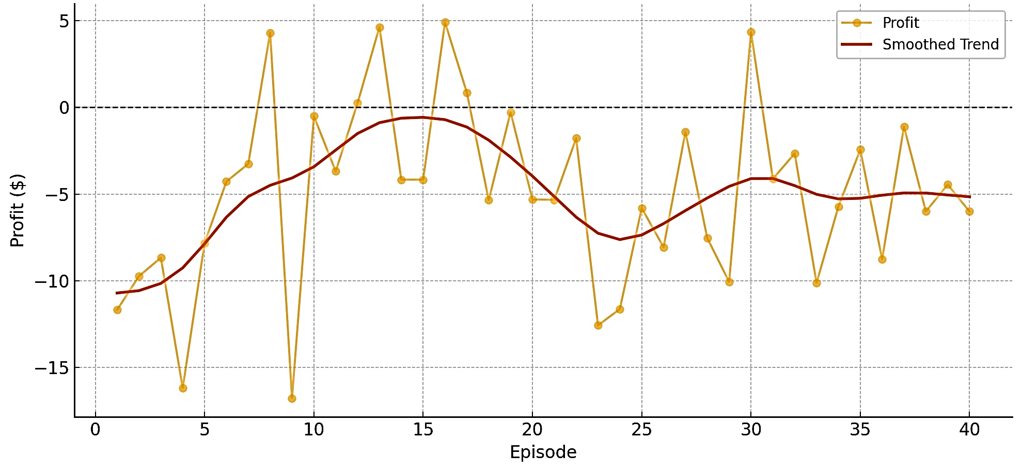
Evaluation Summary – DQN Agent(LTC)
Summary of Performance Metrics:
Average Profit per Episode: $-4.96
Best Profit (Max): $+4.90
Worst Profit (Min): $-16.76
Profitable Episodes: 6 out of 40
Loss-Making Episodes: 34 out of 40
Smoothed trend line of LTC profits
Observation:
LTC model underperformed. It shows signs of overtrading and reward misalignment, especially in early episodes.
Need to increase the number of episodes to 100-500 for better convergence.

Slide 20
Limitations & Improvements
Short Training Duration (40 Episodes)
Limitation: Training for only 40 episodes with exploration decay starting from ε = 1.0 means the agent hasn’t fully transitioned to exploitation.
Impact: Model is still learning; results are unstable and vary across runs.
Improvement: Extend training to 300–500 episodes to allow the agent to gather enough experience and optimize its policy.
No Time-Series Memory (Uses Dense, Not LSTM)
Limitation: Dense layers treat all input windows as independent and do not retain sequential dependencies.
Impact is that the model cannot learn temporal patterns or trends (e.g., momentum, moving average crossover), which are crucial in trading.
Improvement: It is recommended to Incorporate LSTM layers to capture temporal behavior in price sequences.

Slide 21
Conclusion
This study used a dense architecture to simulate BTC, ETH, and LTC trading. A custom environment was created with realistic trading constraints, such as transaction fees, cooldown periods, and maximum holdings limits, which were not addressed in the original paper (Sattarov et al., 2020).
The results across 40 episodes show that the agent progressively learned to make fewer poor decisions, indicating improved learning efficiency.
Despite low average profits, the agent consistently avoided large losses, demonstrating risk-adverse behavior learned under constrained trading conditions. These constraints encouraged more realistic decision-making, making the agent more aligned with real-world trading environments.
What Worked Well:
The agent successfully learned to preserve capital by limiting poor trades.
Realistic limitations were added into the environment design, which improved the simulation's realism and brought it closer to actual trading situations.
Challenges and Limitations:
The Dense architecture, while simpler and faster, lacks memory of sequential patterns, making it harder to capture market trends or temporal dependencies.
With only 40 episodes, the agent has limited exposure to diverse market states, and learning is incomplete.

Slide 22
Q&A

