Slide 1
Contention-Aware Lock Scheduling for Transactional Database
Tae-Gwang Jo
jo940114@naver.com

Slide 2
Introduction
Exclusive lock = write lock ?
Shared lock = read lock ?
What is lock scheduling?
Lock scheduling is different from Job scheduling

Slide 3
Introduction
An online problem
Dependencies
Non-uniform access patterns
Multiple locking modes

Slide 4
Introduction
LDSF(Largest Dependency Set First)
in the absence of shared lock
bLDSF(batched Largest Dependency Set First)

Slide 5
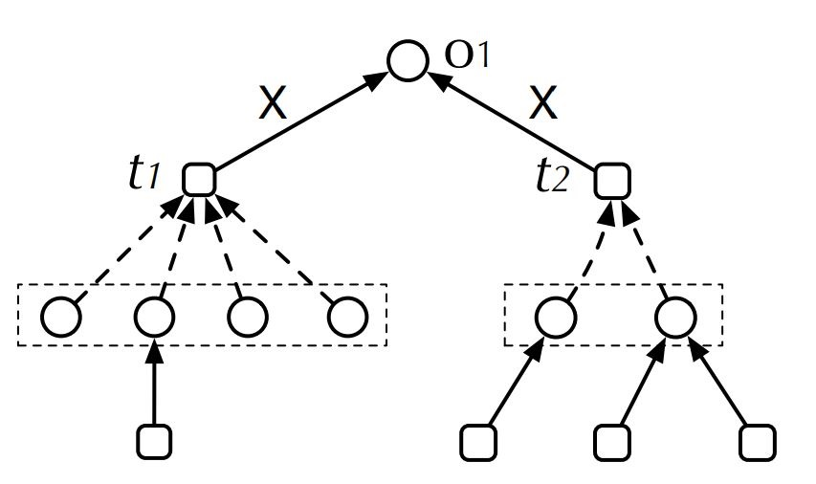
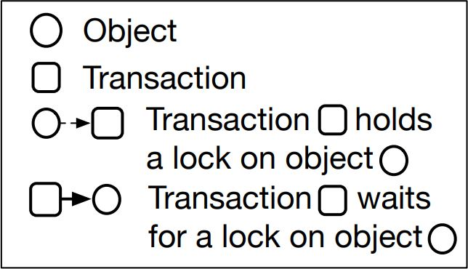
Most Locks First

Slide 6
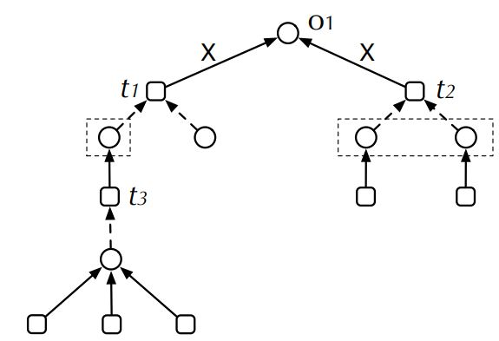
Most Blocking Locks First

Slide 7
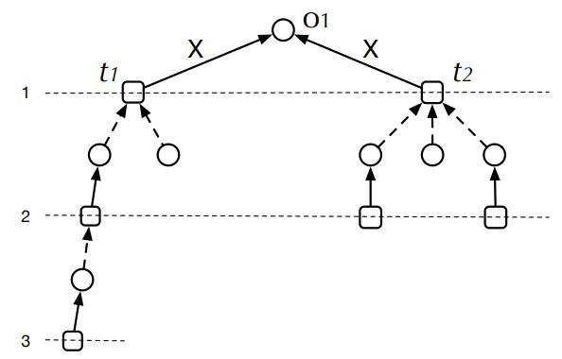
Deepest Dependency First

Slide 8
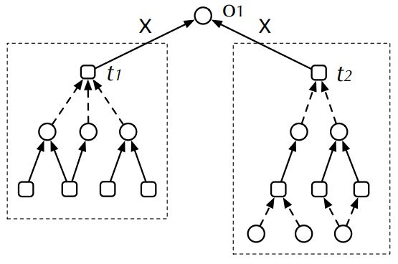
Largest Dependency Set First

Slide 9
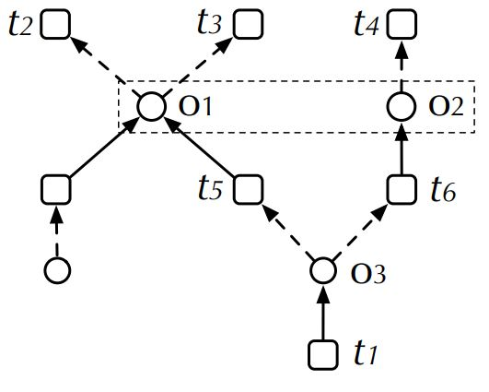
LDSF in shared lock

Slide 10




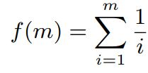
Batched Largest Dependency Set First
in shared lock

Slide 11
Batched Largest Dependency Set First
C1. f(1) = 1
C2. f(m) < f(m+1)
C3. f(m) ≤ m

Slide 12
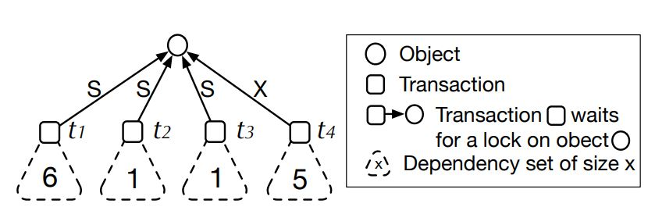
bLDSF
Assume f(2) = 1.5, f(3) = 2

Slide 13


bLDSF
Exclusive lock =
Shared lock =

Slide 14
bLDSF
Delay factor f(x) is not important
When batch size is small, the difference is also small

Slide 15
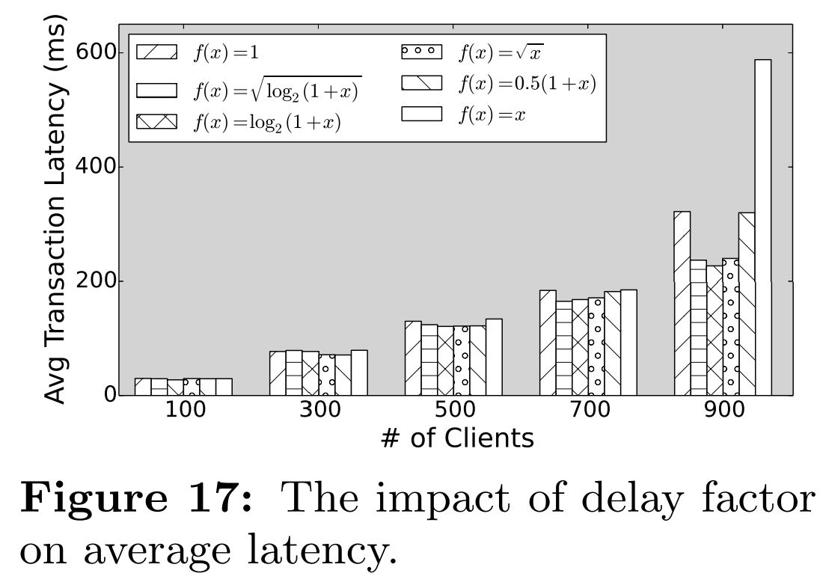
bLDSF

Slide 16
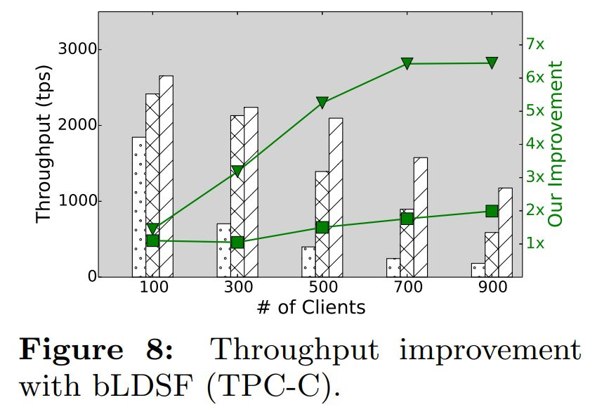
bLDSF

Slide 17
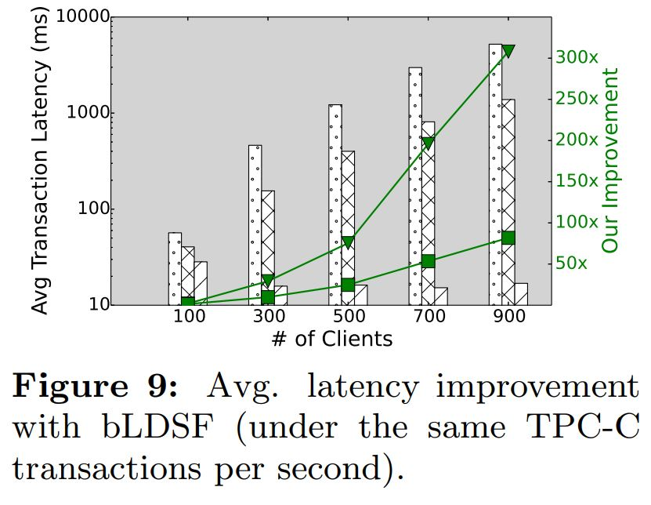
bLDSF

