Slide 1


Team, WEAVER (Kwon Bosung & Kwon Taehoon)

Slide 2
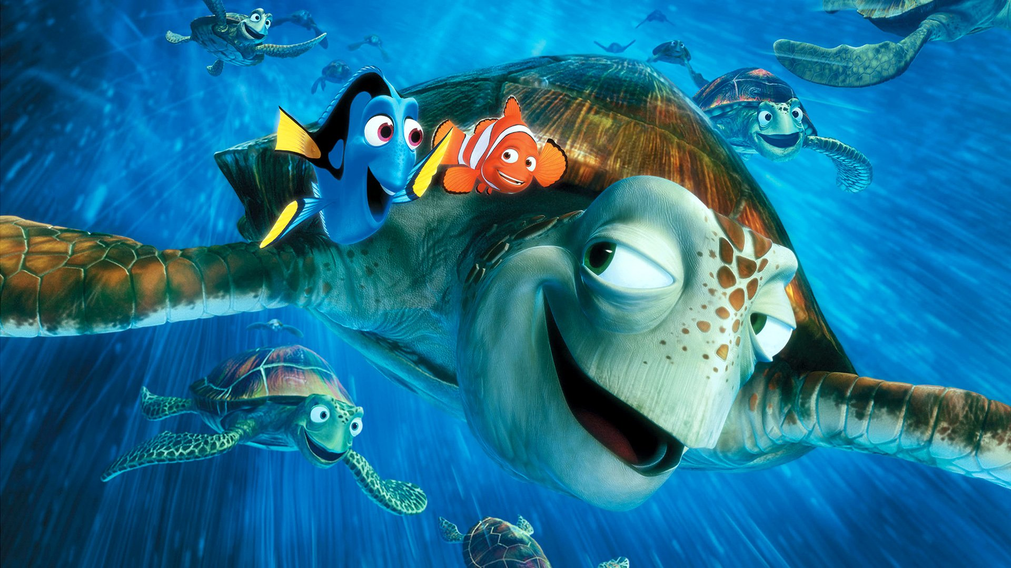


Slide 3
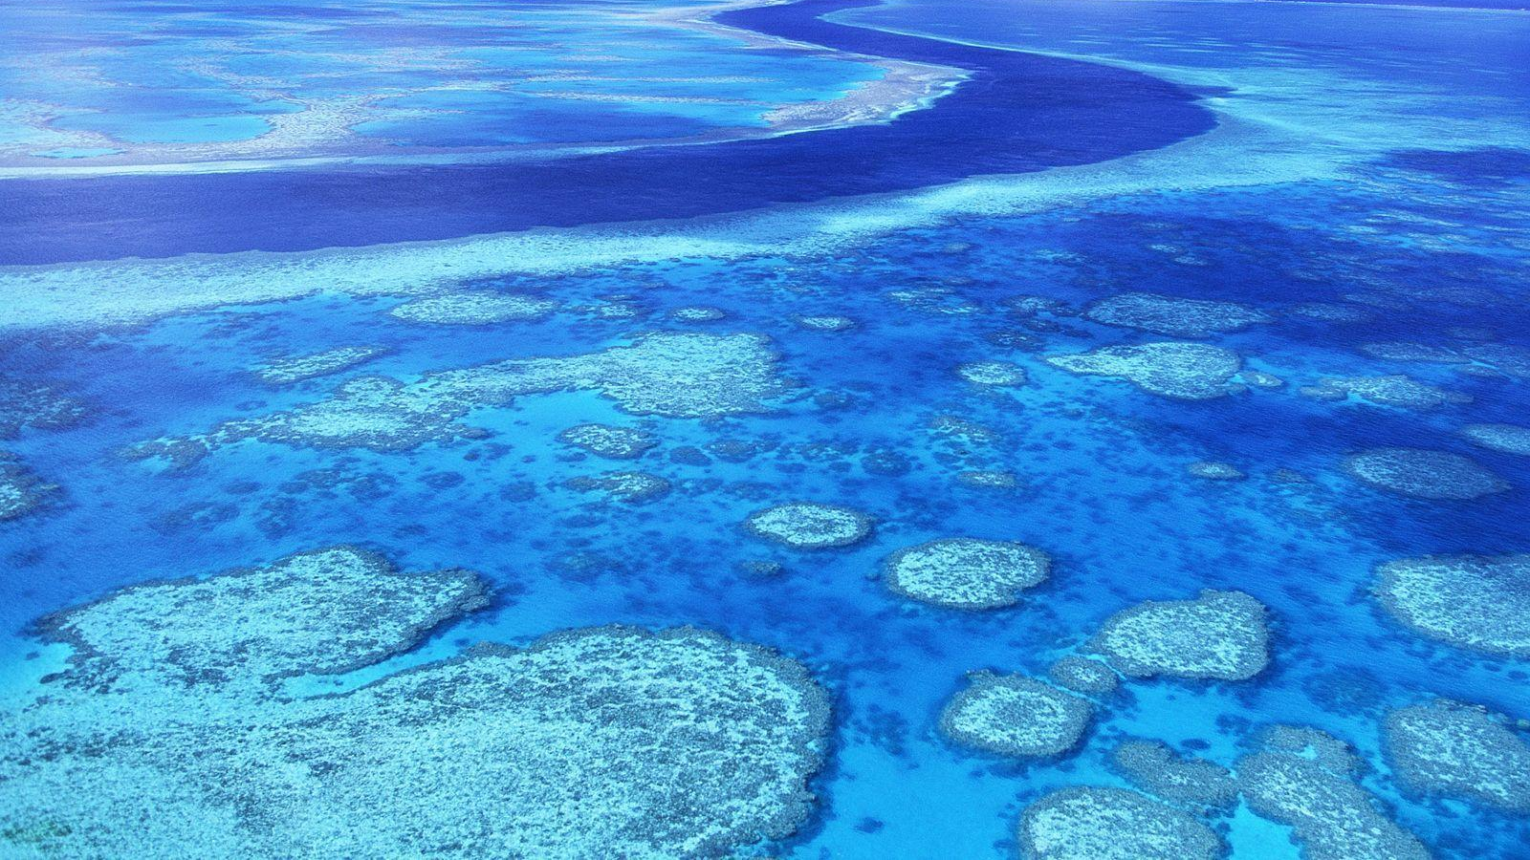
Great Barrier Reef
in Australia
2,253km
400 species of coral

Slide 4
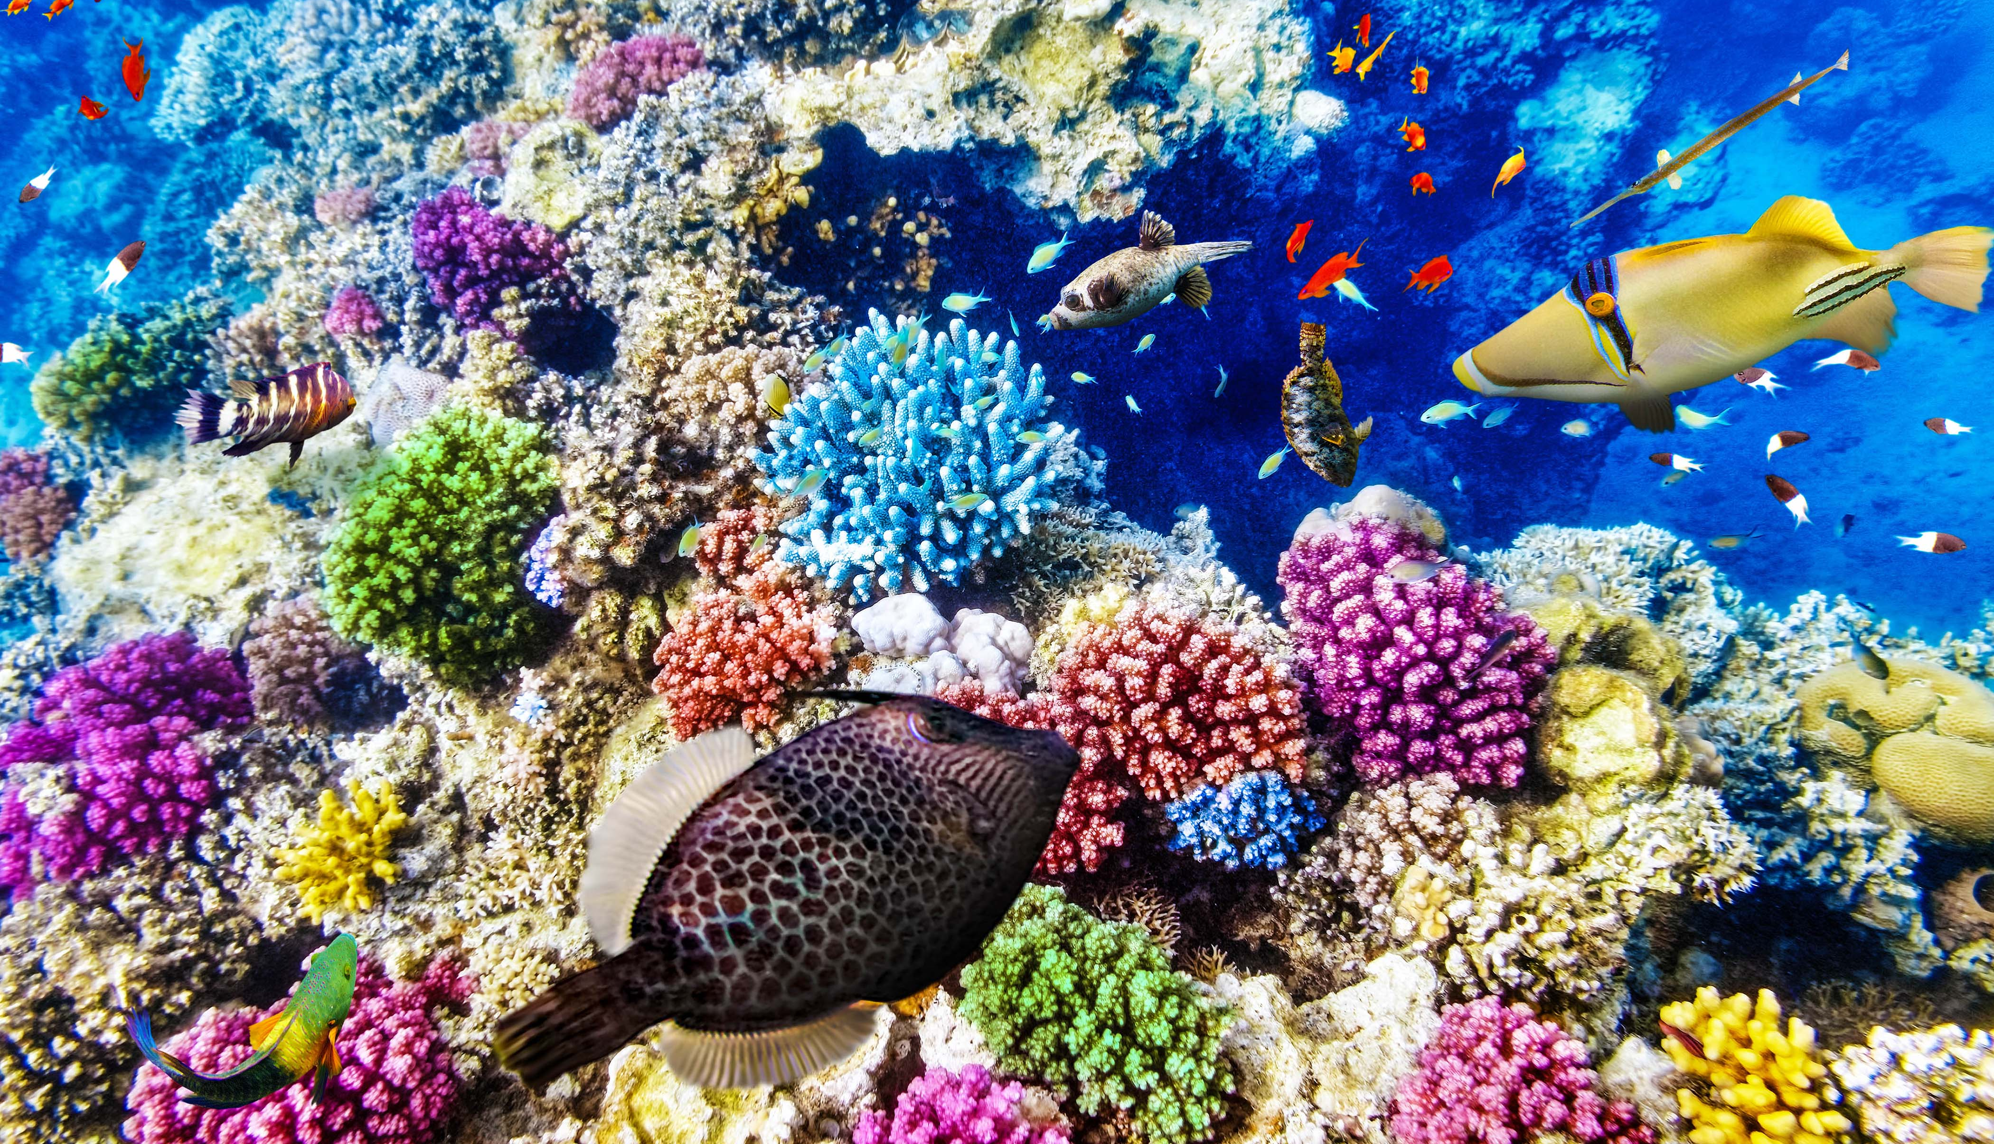

Slide 5
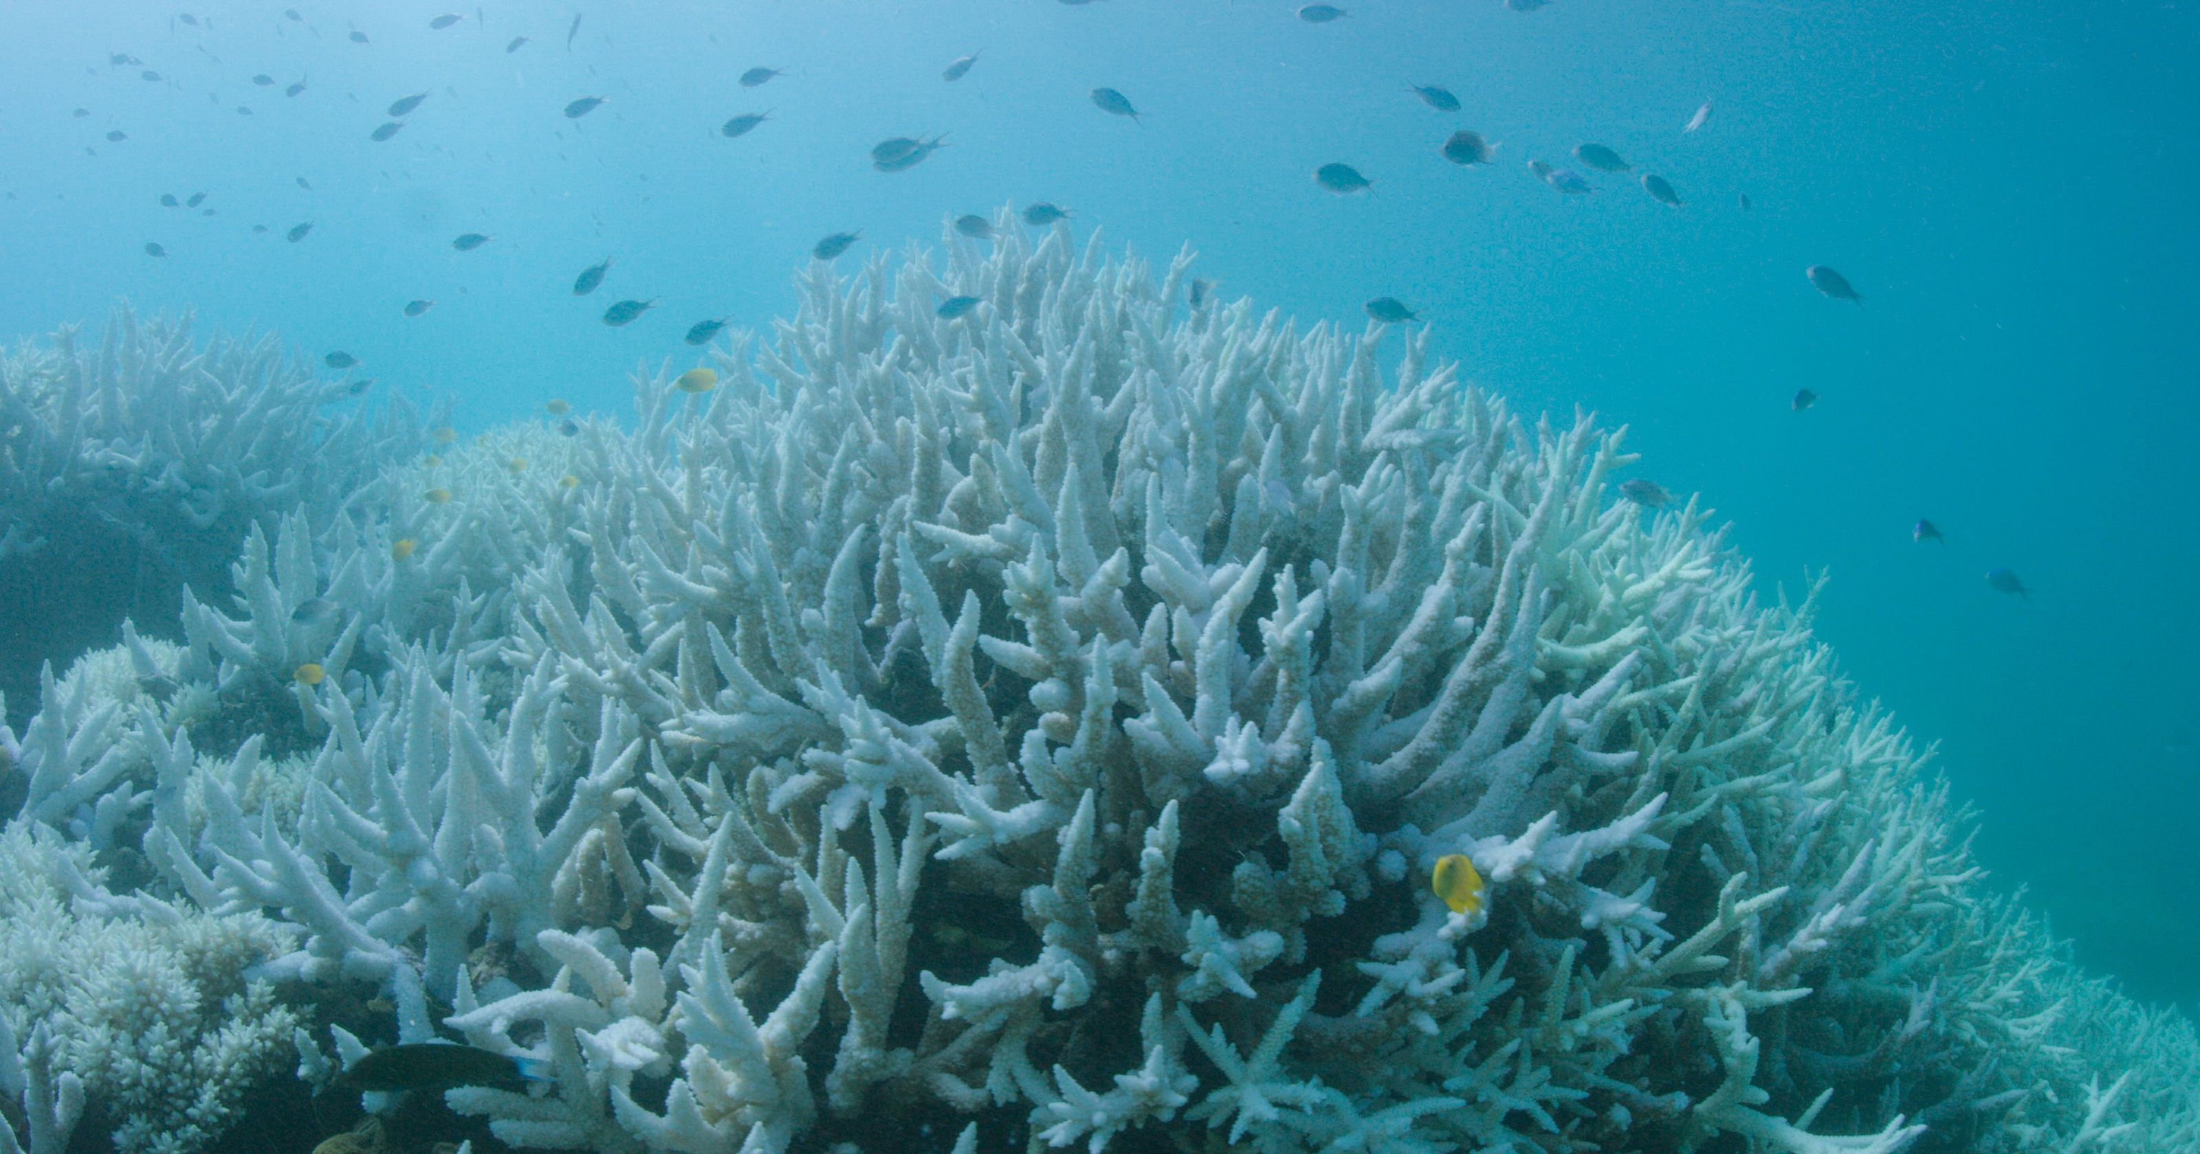

Slide 6


Slide 7


Slide 8


Slide 9


Slide 10


Slide 11
Suppressing coral reef bleaching
Restore the ocean ecosystem

Slide 12
1. Suppressing Coral Reef Bleaching
2. Cleaning floating garbage on the ocean
Notes:
Start

Slide 13
Suppressing Coral Reef Bleaching?
Notes:
Stop

Slide 14
Capsule Drop

Slide 15
Capsule?

Slide 16


Poly Vinyl Alcohol film
Dry Ice (Carbon dioxide)

Slide 17


_{coral reef bleaching}
_{dry ice}
_{sea water}
CaCO₃
+
CO₂
+
H₂O
=
Ca(HCO₃) ₂

Slide 18
2 Options
Notes:
Start & Stop

Slide 19
Suppressing Coral Reef Bleaching
Cleaning floating garbage on the ocean
Restore the ocean ecosystem

Slide 20
WEAVER was Made

Slide 21
to restore the ocean ecosystem
by suppressing coral reef bleaching

Slide 22
Thank you

