Slide 1
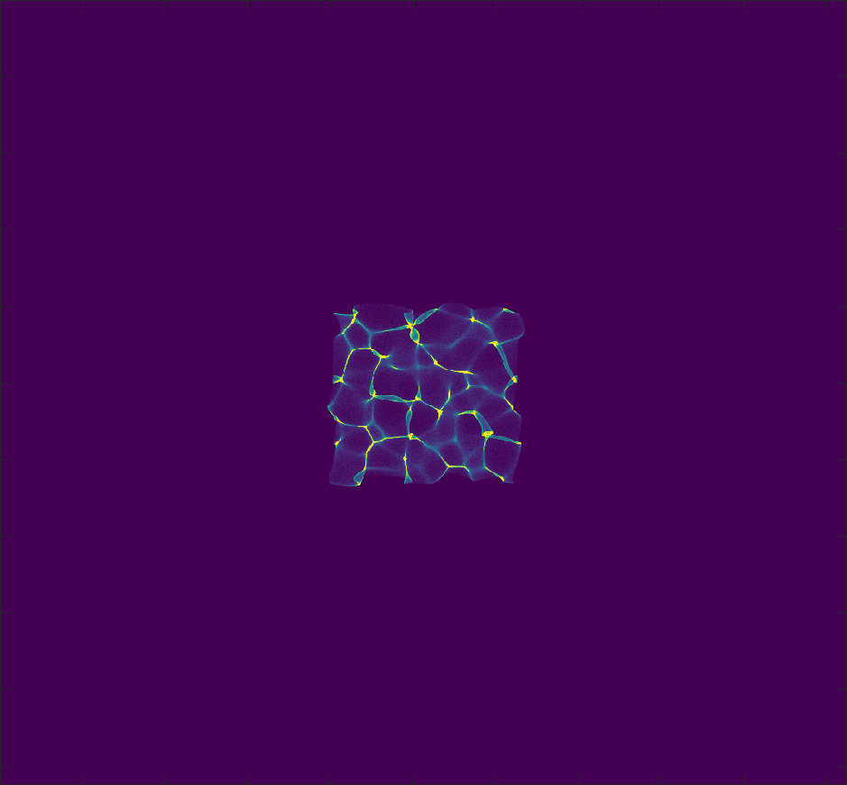
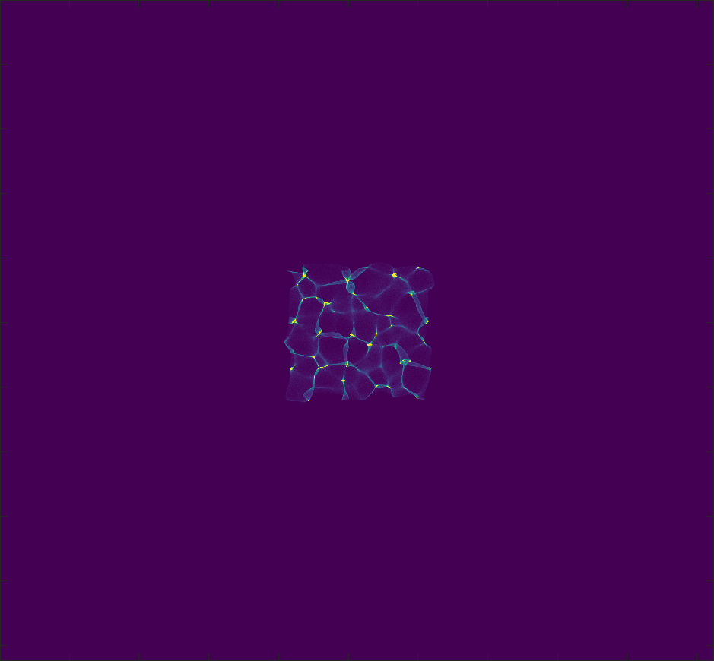
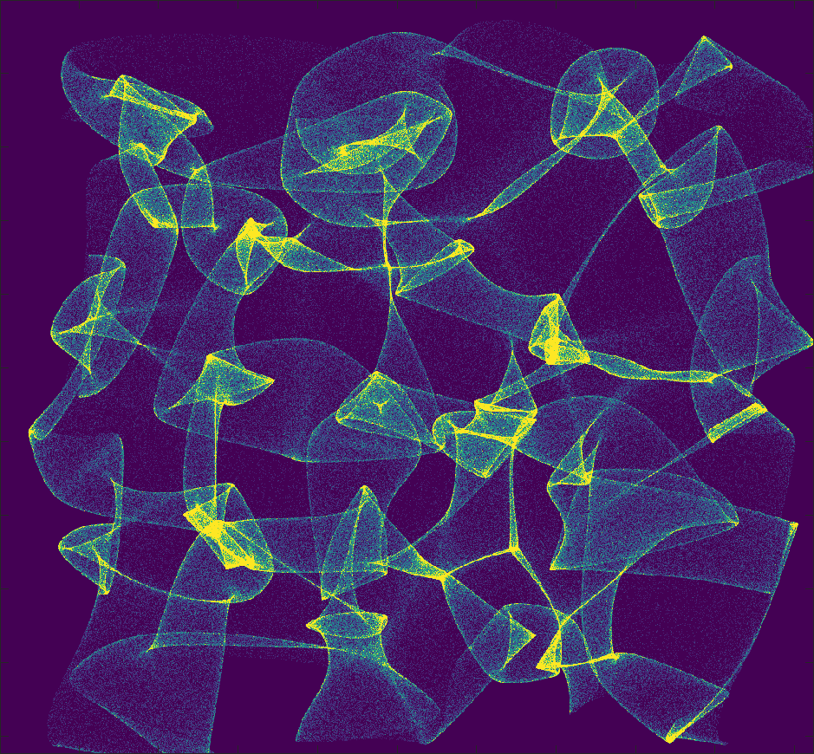
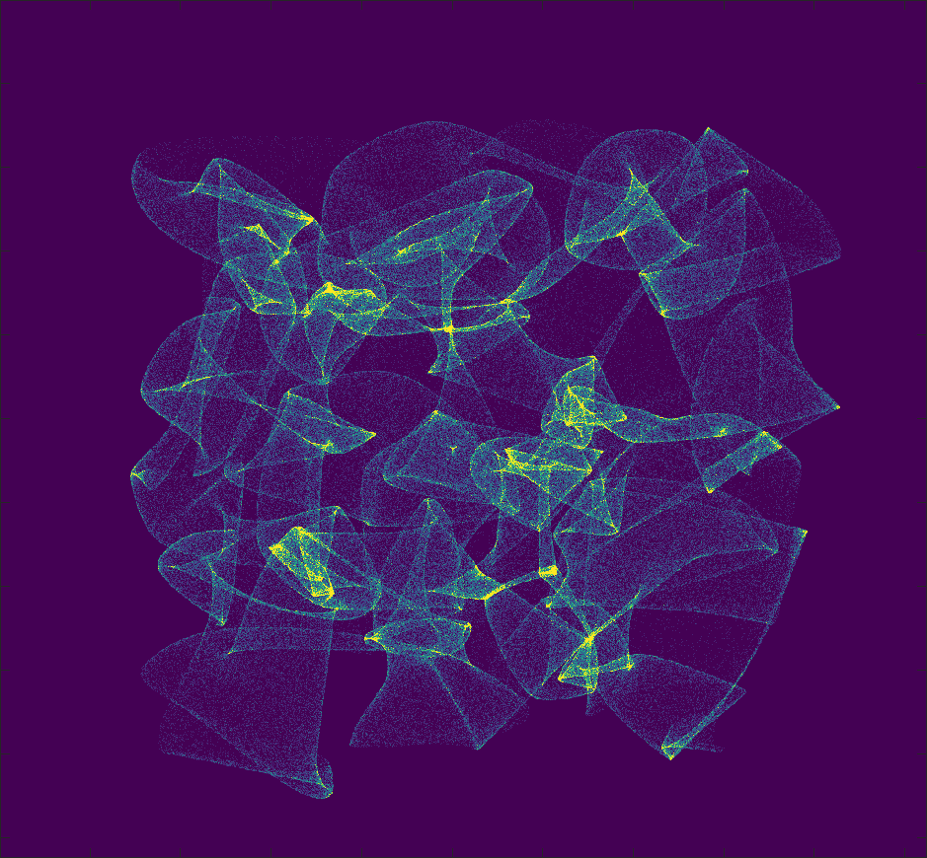
Object-diffuser 1.67cm
Object-diffuser 2.5cm
Sensor-diffuser 0.5cm
Sensor-diffuser 5cm

Slide 2
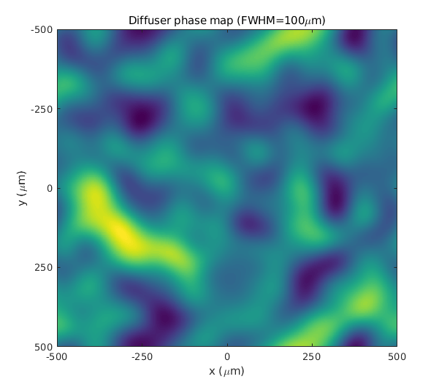
Gaussian Kernel FWHM=100um
Average slope magnitude=0.63°
Average focal length~3.5mm

Slide 3
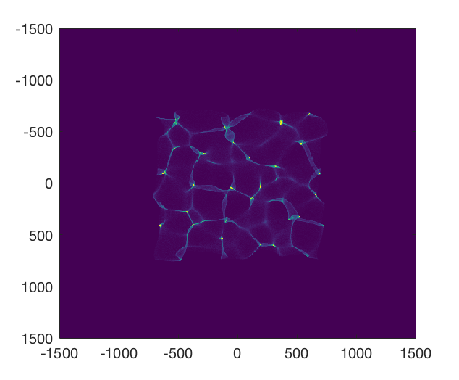
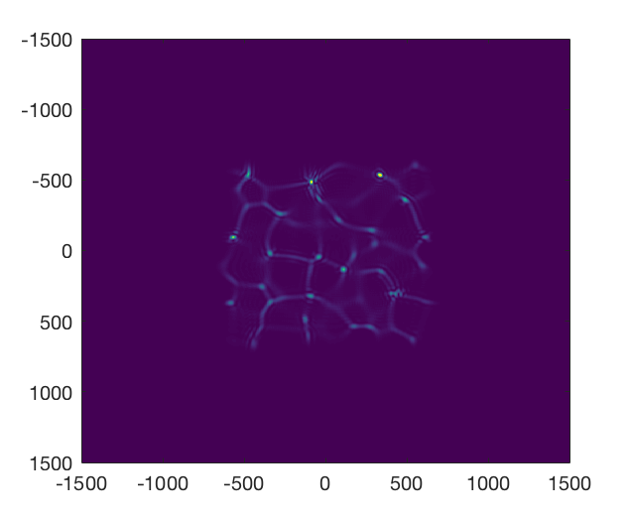
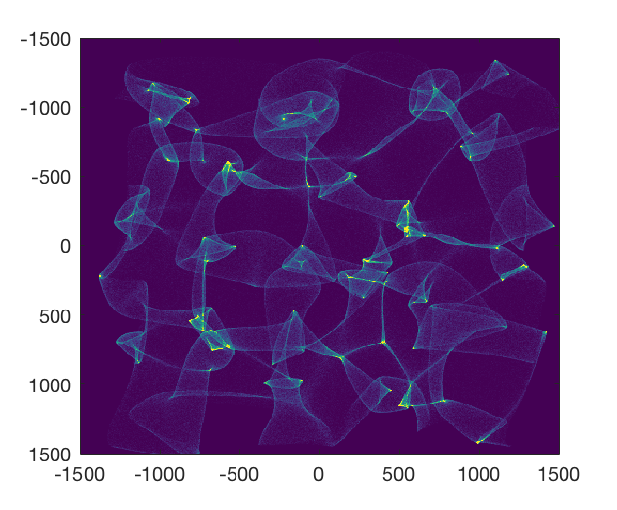
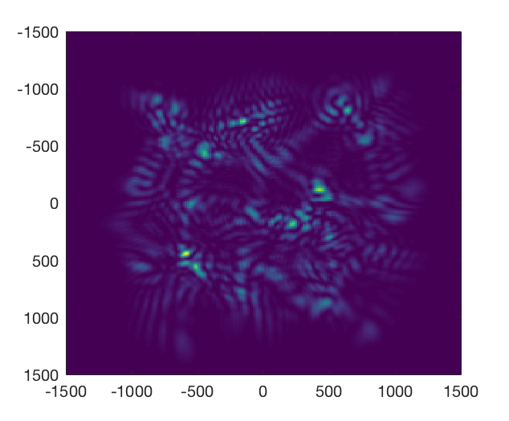
Ray Model
Wave Model
Sensor-diffuser 0.5cm
Sensor-diffuser 2cm

Slide 4
