Slide 1
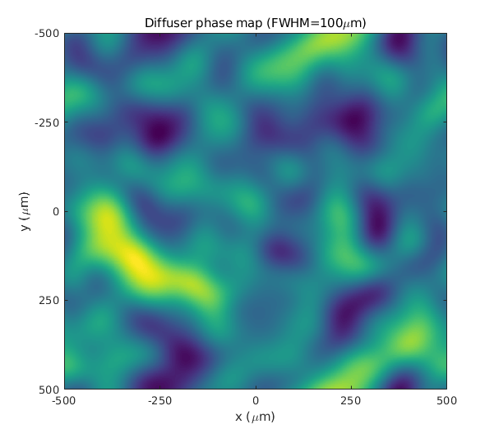
Gaussian Kernel FWHM=100um
Average slope magnitude=0.63°
Average focal length~3.5mm

Slide 2
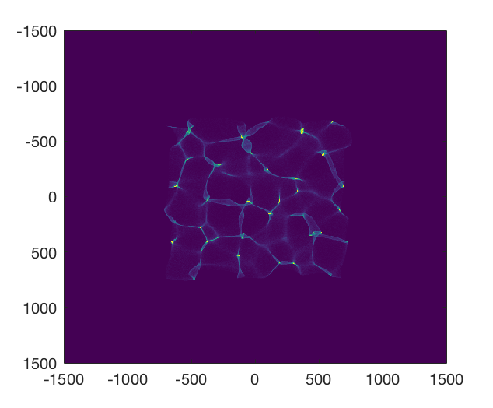
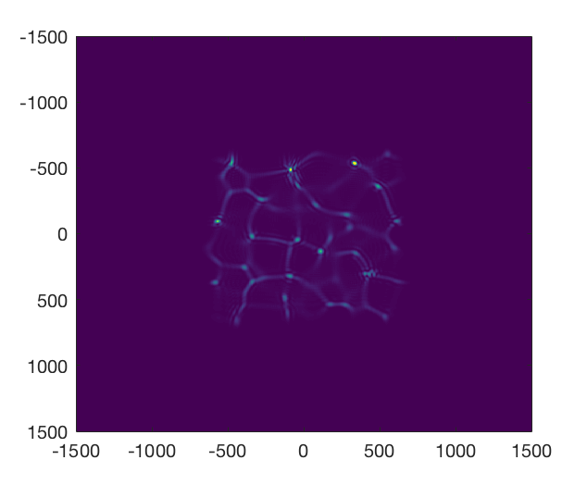
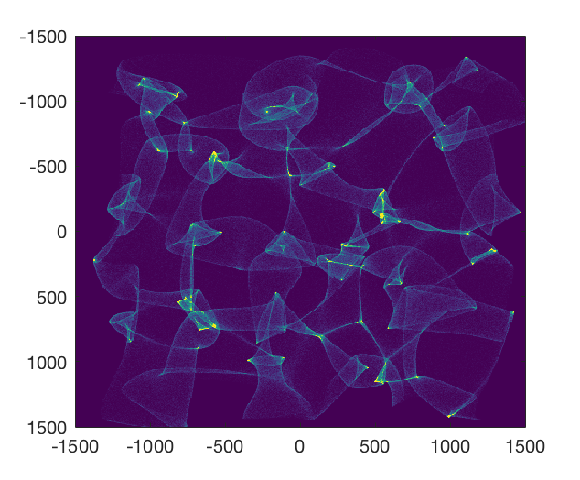
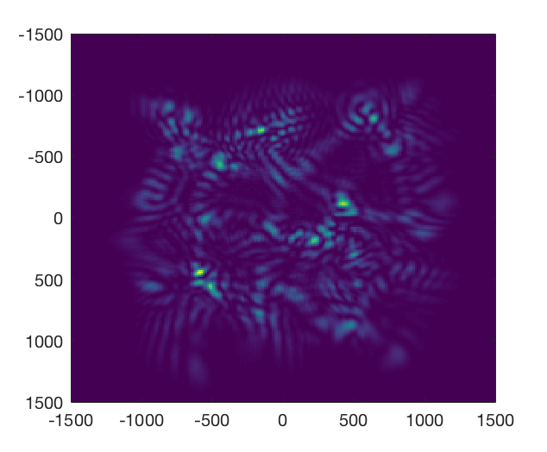
Ray Model
Wave Model
Sensor-diffuser 0.5cm
Sensor-diffuser 2cm

Slide 3
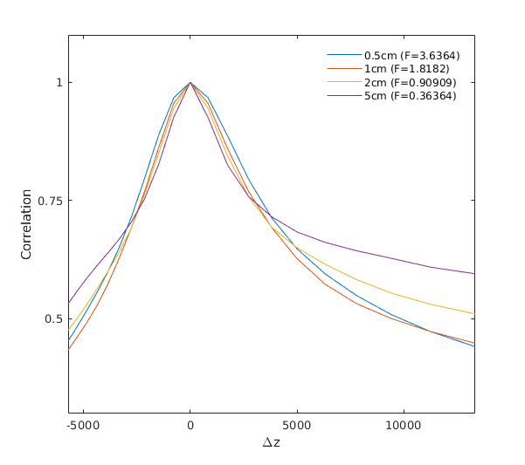

Slide 4
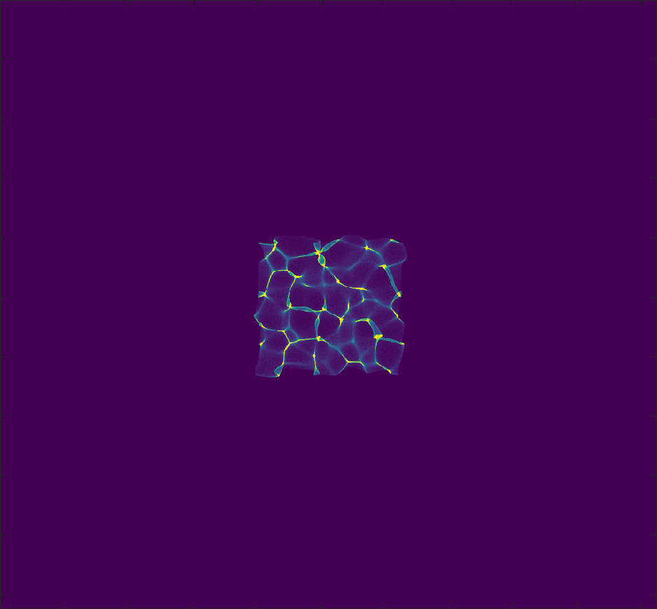
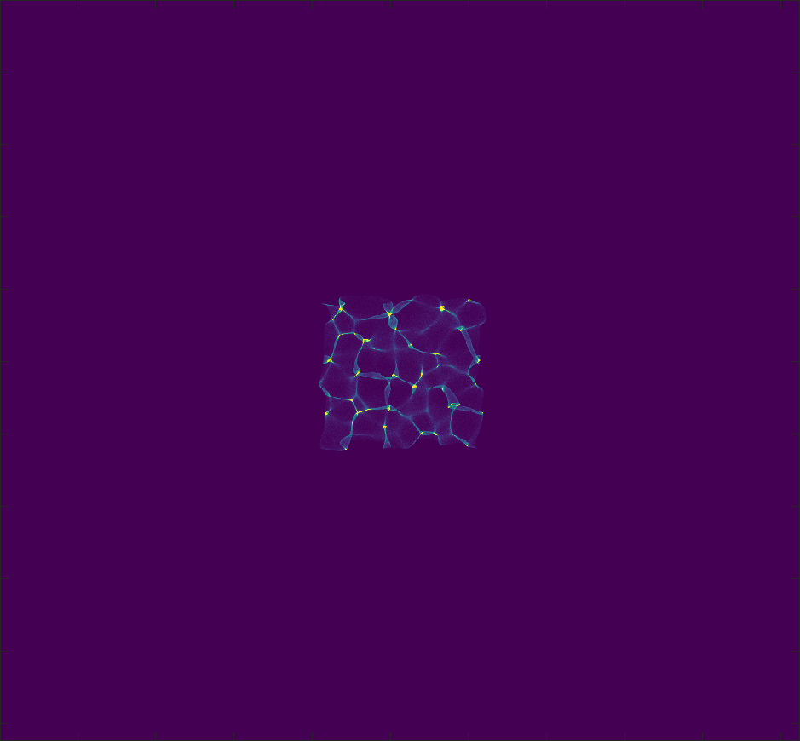
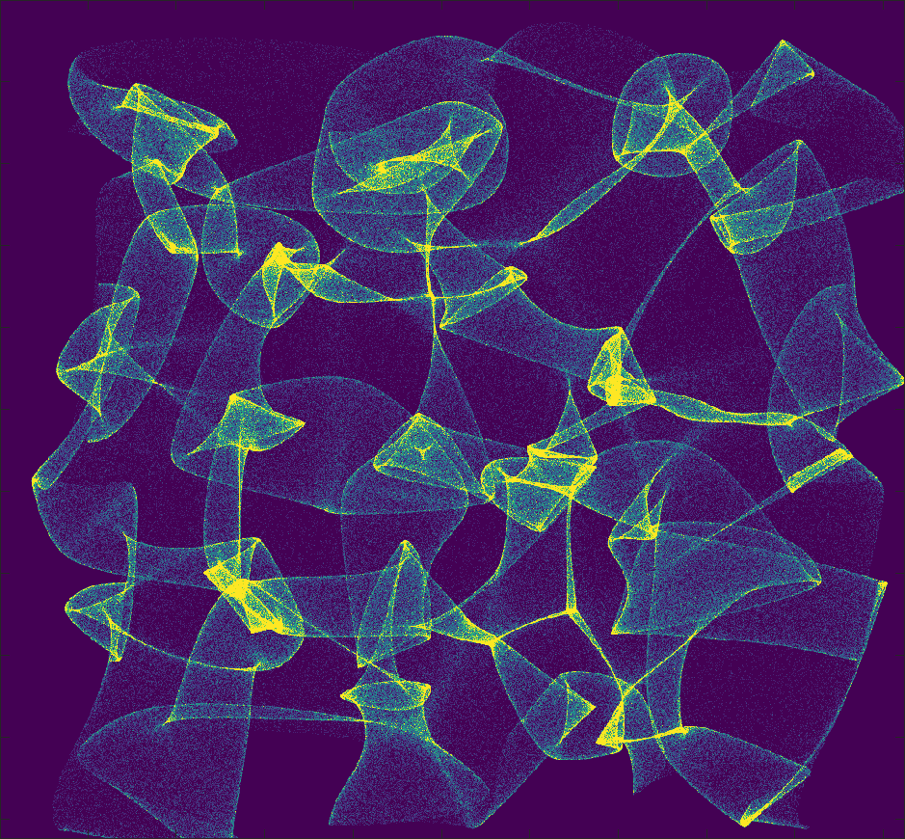
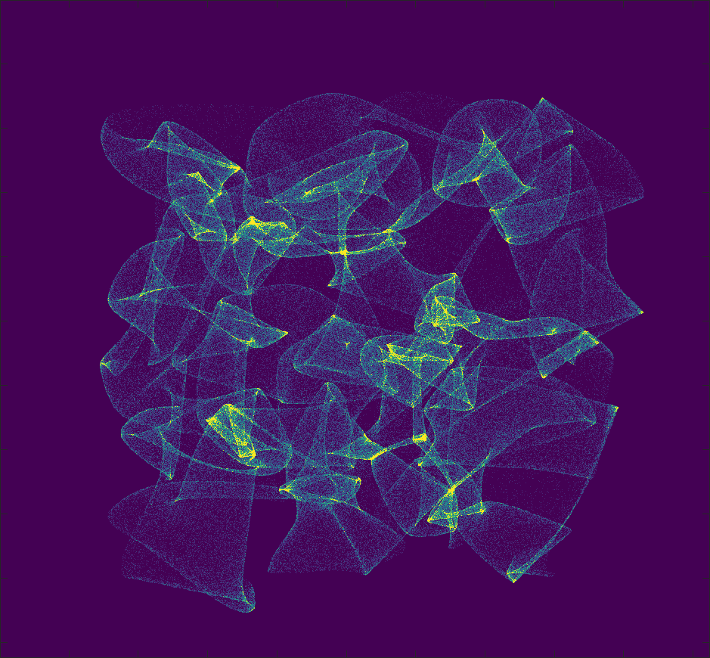
Object-diffuser 1.67cm
Object-diffuser 2.5cm
Sensor-diffuser 0.5cm
Sensor-diffuser 5cm

Slide 5
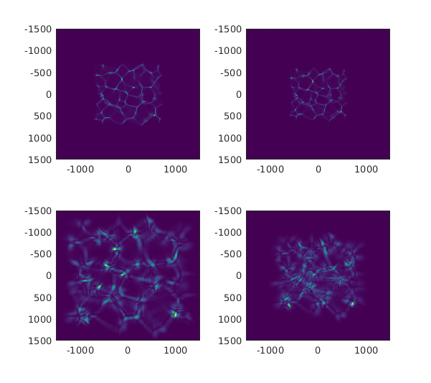
Object-diffuser 1.4cm
Object-diffuser 3.3cm
Sensor-diffuser 0.5cm
Sensor-diffuser 5cm

