Slide 1
Measurement of Emission Color of Single Molecules
Taehwan Kim
3/23/17

Slide 2
Single-Molecule Color Sensing Methods

Slide 3
Single-Molecule Color Sensing Methods
GOAL: Sensing spectral mean of a single emitter along with its position
Available Options
Optical filter bank & λ stack construction
PSF engineering based on chromatic dispersion (gratings¹ , prism² , programmable phase mask with 4f setup³ , etc.)
What is desired?
[1] Ma, Y. et al., High-Throughput Single-Molecule Spectroscopy in Free Solution. Anal. Chem. (2000).
[2] Zhang, Z. et al., Ultrahigh-throughput single-molecule spectroscopy and spectrally resolved super-resolution microscopy. Nat. Meth. (2015).
[3] Shechtman, Y. et al., Multicolour localization microscopy by point-spread-function engineering. Nat. Photon. (2016).
Notes:
S_i(f) = \frac{{i_0}^2}{2}\left[ \frac{{\tau}_c/(2\pi)}{1+\left(\pi f {\tau}_c \right)^2} \left\{ 1- e^{-\frac{2\tau}{{\tau}_c}} \left[ \cos(2\pi f\tau) + \frac{1}{\pi f \tau_c} \sin(2\pi f \tau) \right] \right\} \right]
\tau_c = \frac{2}{\textrm{linewidth}},\quad i_0: \textrm{nominal photocurrent amplitude},\quad \tau: \textrm{path delay}

Slide 4
Color Sensing Methods: Criteria
Minimum overhead in the optical setup
Less aberration & insertion loss, easy to apply, avoid complicated calibration
Minimum impact on lateral/axial localization accuracy
Localization accuracy degrades by √2 per imaging path split
Avoid PSF footprint enlargement
In SMLM context, minimize the probability of overlap of PSFs (impacts temporal resolution, especially in 2D samples like focal adhesion)
Flexibility (no need for a priori wavelength info)
Good λ estimation accuracy for given photon budget
Avoid possibility of bias from non-idealities
Notes:
S_i(f) = \frac{{i_0}^2}{2}\left[ \frac{{\tau}_c/(2\pi)}{1+\left(\pi f {\tau}_c \right)^2} \left\{ 1- e^{-\frac{2\tau}{{\tau}_c}} \left[ \cos(2\pi f\tau) + \frac{1}{\pi f \tau_c} \sin(2\pi f \tau) \right] \right\} \right]
\tau_c = \frac{2}{\textrm{linewidth}},\quad i_0: \textrm{nominal photocurrent amplitude},\quad \tau: \textrm{path delay}

Slide 5
SM color Sensing From PSF Fitting
Diffraction-limited image of a single molecule already contains color information
In principle, it should be possible to estimate emitter color from the scale of the fitted PSF
Spectrally resolved SMLM: just installation of a ImageJ plugin!
Literally zero impact on the optical setup/xyz accuracy
No PSF modification (more than what’s required for 3D)
No a priori information
Notes:
S_i(f) = \frac{{i_0}^2}{2}\left[ \frac{{\tau}_c/(2\pi)}{1+\left(\pi f {\tau}_c \right)^2} \left\{ 1- e^{-\frac{2\tau}{{\tau}_c}} \left[ \cos(2\pi f\tau) + \frac{1}{\pi f \tau_c} \sin(2\pi f \tau) \right] \right\} \right]
\tau_c = \frac{2}{\textrm{linewidth}},\quad i_0: \textrm{nominal photocurrent amplitude},\quad \tau: \textrm{path delay}

Slide 6
Single-Molecule Color Sensing Methods
Questions to be answered
Good enough λ estimation accuracy in realistic scenario?
Possibility of bias from non-idealities (not limited to)
Axial position dependency
Chromatic/spherical aberration
Spectral profile of the fluorophore (bandwidth, skewness)
Uniform/non-uniform background
Deconvolution artifacts
Pixelation
Motion blur
Or, in combination?
Notes:
S_i(f) = \frac{{i_0}^2}{2}\left[ \frac{{\tau}_c/(2\pi)}{1+\left(\pi f {\tau}_c \right)^2} \left\{ 1- e^{-\frac{2\tau}{{\tau}_c}} \left[ \cos(2\pi f\tau) + \frac{1}{\pi f \tau_c} \sin(2\pi f \tau) \right] \right\} \right]
\tau_c = \frac{2}{\textrm{linewidth}},\quad i_0: \textrm{nominal photocurrent amplitude},\quad \tau: \textrm{path delay}

Slide 7
Theoretical Performance Analysis: Accuracy

Slide 8
Performance of Measurement Method
Task
Estimation of x, y, (z), avg(λ) of a single emitter from values of sensor array (EMCCD, sCMOS) within certain ROI
A “measurement method” includes:
Optical setting (affecting SNR, bias)
PSF design (encoding scheme: prism/grating, astigmatism, double helix, etc.)
Reconstruction algorithm (LS/MLE, ROI selection, b/g correction, etc.)
Performance metrics
Highest accuracy (smallest σ) for given number of photons & noise profile
Unbiased
PSF footprint
Notes:
S_i(f) = \frac{{i_0}^2}{2}\left[ \frac{{\tau}_c/(2\pi)}{1+\left(\pi f {\tau}_c \right)^2} \left\{ 1- e^{-\frac{2\tau}{{\tau}_c}} \left[ \cos(2\pi f\tau) + \frac{1}{\pi f \tau_c} \sin(2\pi f \tau) \right] \right\} \right]
\tau_c = \frac{2}{\textrm{linewidth}},\quad i_0: \textrm{nominal photocurrent amplitude},\quad \tau: \textrm{path delay}

Slide 9
Design of Measurement Method
Major design decisions in our context
PSF design/PSF model to use (optical setting is determined by this)
Deconvolution algorithm
Today: theoretical bound of λ accuracy/impact of PSF choice
Fix other factors
Magnification, noise, pixel size, ROI, NA, illumination, emitter spectra BW
Consider only major physical implication of PSF design choice (e.g. consider the loss of photons when beam-split is necessary, but not the insertion loss from additional optical elements)
Ignore aberration (for now)

Slide 10
Theoretical Performance Evaluation
For given setting, accuracy can be estimated using Fisher information/Cramér–Rao lower bound (CRLB)
Fisher information matrix (FI): sensitivity of an observable quantity (e.g. PSF) to changes in its underlying parameters (e.g. emitter position)
Cramér-Rao lower bound: theoretical best-case precision with any unbiased estimator given a PSF model and a noise model
CRLB = diagonal elements of the inverse of FI matrix
Depending on the algorithm, actually achievable; not just fictitious number
Empirically, MLE yields close result to CRLB in most cases (although Insight3 uses LS)
Common metric to compare the performance of different PSFs¹ or optimize PSF for best precision²
[1] Badieirostami, M. et al., Three-dimensional localization precision of the double-helix point spread function versus astigmatism and biplane. Appl. Phys. Lett (2010).
[2] Shechtman, Y. et al., Optimal Point Spread Function Design for 3D Imaging. Phys. Rev. Lett. (2014).
Notes:
\begin{gather*}
I_{ij}(\boldsymbol{\theta})=-E\left(\frac{\partial^2 \ln (f(s;\boldsymbol{\theta}))}{\partial\theta_i\partial\theta_j}\right)\\\boldsymbol{\theta}:\textsf{parameters being estimated},\: f(s;\boldsymbol{\theta}):\textsf{probability of $s$ being the measurement given $\boldsymbol{\theta}$}
\end{gather*}

Slide 11
Theoretical Performance Evaluation
Fisher Information Matrix
Cramér–Rao lower bound
Notes:
\begin{gather*}
I_{ij}(\boldsymbol{\theta})=-E\left(\frac{\partial^2 \ln \left( f(s;\boldsymbol{\theta}) \right)}{\partial\theta_i \partial\theta_j}\right)\\
\boldsymbol{\theta}\textsf{: the vector of parameters being estimated $(x_0, y_0, z_0, \lambda, N_{photon}, \beta)$, }\\
\beta \textsf{: the number of background photons per pixel}\\
f(s;\boldsymbol{\theta})\textsf{: probability of $s$ being the measurement (i.e. PSF image) given $\boldsymbol{\theta}$}
\end{gather*}
\left[(\mathbf{I}(\boldsymbol{\theta}))^{-1}\right]_{ii}=\textrm{CRLB}_i

Slide 12
Theoretical Performance Evaluation
Explicit form in the presence of pixelation & shot noise only¹
[1] Ober, R. J et al., Localization Accuracy in Single-Molecule Microscopy. Biophysical Journal (2004).
Notes:
\begin{gather*}
I_{ij}(\boldsymbol{\theta})=\sum_{k=1}^{N_{pixel}}{\frac{1}{\mu_k(\boldsymbol{\theta})+\beta}\left(\frac{\partial \mu_k(\boldsymbol{\theta})}{\partial \theta_i}\right)\left(\frac{\partial \mu_k(\boldsymbol{\theta})}{\partial \theta_j}\right)}\\
\mu_k(\boldsymbol{\theta})\textsf{: the value of the model PSF in pixel k}\\
N_{pixel}\textsf{: the number of pixels in the ROI}
\end{gather*}
\begin{gather*}
\mu_k(\boldsymbol{\theta})=\int_{\mathscr{D}_k}{dxdy \left( Nq(\vec{r}-\vec{r}_0) \right)}\\
q(\vec{r}\,;z_0,\lambda)\textsf{: normalized PSF model,} \: a\textsf{: pixel size}\\
\mathscr{D}_k\textsf{: $k$th pixel area,}\: \vec{r}=(x,y)\textsf{: image plane location,}\:\vec{r}_0=(x_0,y_0)\textsf{: lateral emitter location}
\end{gather*}
\begin{gather*}
\frac{\partial\mu_k}{\partial N}=\int_{\mathscr{D}_k}{dxdy q(\vec{r}-\vec{r}_0)}\\
\frac{\partial\mu_k}{\partial\theta}=2N\int_{\mathscr{D}_k}{dxdy\,\frac{\partial q(\vec{r}-\vec{r}_0)}{\partial \theta}},\:\textsf{For $\theta=x_0, y_0, z_0, \lambda$}
\end{gather*}

Slide 13
Theoretical Performance Evaluation
Sensitivity for location & wavelength is PSF model dependent
3D PSF model for simple circular aperture: Born & Wolf model
Notes:
\begin{gather*}
q_{z_0}(\vec{r}-\vec{r}_0\,)=\left\|A \int_{0}^{1}{J_0\left(\frac{2\pi}{\lambda}\textrm{NA} \|\vec{r}-\vec{r}_0\| \rho\right)e^{-j\frac{\pi}{\lambda}\rho^2 z_0\left(\frac{\textrm{NA}^2}{n_i}\right) }\rho d\rho} \right\|^2\\
A\textsf{: normalization constant,}\: n_i\textsf{: refractive index of the immersion oil}\\
J_0\textsf{: zeroth order Bessel function of the first kind}
\end{gather*}
\begin{gather*}
q_{z_0}(\vec{r}-\vec{r}_0\,)=\frac{1}{A_{z_0}}\left(u_{z_0}^2(\vec{r}-\vec{r}_0\,) + v_{z_0}^2(\vec{r}-\vec{r}_0\,)\right)\\
u_{z_0}(\vec{r}-\vec{r}_0\,)=\mathlarger{\int}_{0}^{1}{J_0\left(\frac{2\pi}{\lambda}\textrm{NA} \|\vec{r}-\vec{r}_0\| \rho\right)\cos\left({\frac{\pi}{\lambda}\rho^2 z_0 \left(\frac{\textrm{NA}^2}{n_i}\right)}\right)\rho d\rho} \\
v_{z_0}(\vec{r}-\vec{r}_0\,)=\mathlarger{\int}_{0}^{1}{J_0\left(\frac{2\pi}{\lambda}\textrm{NA} \|\vec{r}-\vec{r}_0\| \rho\right)\sin\left({\frac{\pi}{\lambda}\rho^2 z_0 \left(\frac{\textrm{NA}^2}{n_i}\right)}\right)\rho d\rho} \\
A_{z_0} = \int_{\mathbb{R}^2} {\left(u^2(\vec{r}\,) + v^2(\vec{r}\,)\right)}d\vec{r}
\end{gather*}

Slide 14
Theoretical Performance Evaluation
Notes:
\begin{gather*}
\frac{\partial q(\vec{r}-\vec{r}_0\,)}{\partial x_0} = \frac{2}{A_{z_0}} \left( u(\vec{r}-\vec{r}_0\,) \frac{\partial u(\vec{r}-\vec{r}_0\,)}{\partial x_0} + v(\vec{r}-\vec{r}_0\,)\frac{\partial v(\vec{r}-\vec{r}_0\,)}{\partial x_0} \right)\\
\frac{\partial q(\vec{r}-\vec{r}_0\,)}{\partial y_0} = \frac{2}{A_{z_0}} \left( u(\vec{r}-\vec{r}_0\,) \frac{\partial u(\vec{r}-\vec{r}_0\,)}{\partial y_0} + v(\vec{r}-\vec{r}_0\,)\frac{\partial v(\vec{r}-\vec{r}_0\,)}{\partial y_0} \right)\\
\frac{\partial q(\vec{r}-\vec{r}_0\,)}{\partial \lambda} = \frac{2}{A_{z_0}} \left( u(\vec{r}-\vec{r}_0\,) \frac{\partial u(\vec{r}-\vec{r}_0\,)}{\partial \lambda} + v(\vec{r}-\vec{r}_0\,)\frac{\partial v(\vec{r}-\vec{r}_0\,)}{\partial \lambda} \right) - \frac{1}{A_{z_0}}\frac{\partial A_{z_0}}{\partial \lambda}q(\vec{r}-\vec{r}_0\,)
\end{gather*}
\begin{gather*}
\frac{\partial u(\vec{r}\,)}{\partial x_0}=\frac{2\pi}{\lambda}\textrm{NA}\frac{x}{\|\vec{r}\,\|} \int_{0}^{1}{J_1\left(\frac{2\pi}{\lambda}\textrm{NA} \|\vec{r}\,\|\rho \right)\cos\left({\frac{\pi}{\lambda}\rho^2 z_0 \left(\frac{\textrm{NA}^2}{n_i}\right)}\right)\rho^2 d\rho} \\
\frac{\partial v(\vec{r}\,)}{\partial x_0}=\frac{2\pi}{\lambda}\textrm{NA}\frac{x}{\|\vec{r}\,\|} \int_{0}^{1}{J_1\left(\frac{2\pi}{\lambda}\textrm{NA} \|\vec{r}\,\|\rho \right)\sin\left({\frac{\pi}{\lambda}\rho^2 z_0 \left(\frac{\textrm{NA}^2}{n_i}\right)}\right)\rho^2 d\rho} \\
\frac{\partial u(\vec{r}\,)}{\partial y_0}=\frac{2\pi}{\lambda}\textrm{NA}\frac{y}{\|\vec{r}\,\|} \int_{0}^{1}{J_1\left(\frac{2\pi}{\lambda}\textrm{NA} \|\vec{r}\,\|\rho \right)\cos\left({\frac{\pi}{\lambda}\rho^2 z_0 \left(\frac{\textrm{NA}^2}{n_i}\right)}\right)\rho^2 d\rho} \\
\frac{\partial v(\vec{r}\,)}{\partial y_0}=\frac{2\pi}{\lambda}\textrm{NA}\frac{y}{\|\vec{r}\,\|} \int_{0}^{1}{J_1\left(\frac{2\pi}{\lambda}\textrm{NA} \|\vec{r}\,\|\rho \right)\sin\left({\frac{\pi}{\lambda}\rho^2 z_0 \left(\frac{\textrm{NA}^2}{n_i}\right)}\right)\rho^2 d\rho} \\
\end{gather*}

Slide 15
Theoretical Performance Evaluation
Notes:
\begin{gather*}
\frac{\partial q(\vec{r}-\vec{r}_0\,)}{\partial x_0} = \frac{2}{A} \left( u(\vec{r}-\vec{r}_0\,) \frac{\partial u(\vec{r}-\vec{r}_0\,)}{\partial x_0} + v(\vec{r}-\vec{r}_0\,)\frac{\partial v(\vec{r}-\vec{r}_0\,)}{\partial x_0} \right)\\
\frac{\partial q(\vec{r}-\vec{r}_0\,)}{\partial y_0} = \frac{2}{A} \left( u(\vec{r}-\vec{r}_0\,) \frac{\partial u(\vec{r}-\vec{r}_0\,)}{\partial y_0} + v(\vec{r}-\vec{r}_0\,)\frac{\partial v(\vec{r}-\vec{r}_0\,)}{\partial y_0} \right)\\
\frac{\partial q(\vec{r}-\vec{r}_0\,)}{\partial \lambda} = \frac{2}{A} \left( u(\vec{r}-\vec{r}_0\,) \frac{\partial u(\vec{r}-\vec{r}_0\,)}{\partial \lambda} + v(\vec{r}-\vec{r}_0\,)\frac{\partial v(\vec{r}-\vec{r}_0\,)}{\partial \lambda} \right) - \frac{1}{A}\frac{\partial A}{\partial \lambda}q(\vec{r}-\vec{r}_0\,)
\end{gather*}
\begin{gather*}
\frac{\partial u(\vec{r}\,)}{\partial x_0}=\frac{2\pi \textrm{NA}}{\lambda}\frac{x}{\|\vec{r}\,\|} \int_{0}^{1}{J_1\left(\frac{2\pi \textrm{NA}}{\lambda} \rho \|\vec{r}\,\|\right)\cos\left({\frac{\pi \textrm{NA}^2 z_0}{\lambda n_m}\rho^2}\right)\rho^2 d\rho} \\
\frac{\partial v(\vec{r}\,)}{\partial x_0}=\frac{2\pi \textrm{NA}}{\lambda}\frac{x}{\|\vec{r}\,\|} \int_{0}^{1}{J_1\left(\frac{2\pi \textrm{NA}}{\lambda} \rho \|\vec{r}\,\|\right)\sin\left({\frac{\pi \textrm{NA}^2 z_0}{\lambda n_m}\rho^2}\right)\rho^2 d\rho} \\
\frac{\partial u(\vec{r}\,)}{\partial y_0}=\frac{2\pi \textrm{NA}}{\lambda}\frac{y}{\|\vec{r}\,\|} \int_{0}^{1}{J_1\left(\frac{2\pi \textrm{NA}}{\lambda} \rho \|\vec{r}\,\|\right)\cos\left({\frac{\pi \textrm{NA}^2 z_0}{\lambda n_m}\rho^2}\right)\rho^2 d\rho} \\
\frac{\partial v(\vec{r}\,)}{\partial y_0}=\frac{2\pi \textrm{NA}}{\lambda}\frac{y}{\|\vec{r}\,\|} \int_{0}^{1}{J_1\left(\frac{2\pi \textrm{NA}}{\lambda} \rho \|\vec{r}\,\|\right)\sin\left({\frac{\pi \textrm{NA}^2 z_0}{\lambda n_m}\rho^2}\right)\rho^2 d\rho} \\
\end{gather*}
\begin{gather*}
\frac{\partial u(\vec{r}\,)}{\partial \lambda}=\frac{2\pi \textrm{NA}}{\lambda^2}\|\vec{r}\,\| \int_{0}^{1}{J_1\left(\frac{2\pi \textrm{NA}}{\lambda} \rho \|\vec{r}\,\|\right)\cos\left({\frac{\pi \textrm{NA}^2 z_0}{\lambda n_m}\rho^2}\right)\rho^2 d\rho} \\
+\frac{\pi \textrm{NA}^2 z_0}{\lambda^2 n_m} \int_{0}^{1}{J_0\left(\frac{2\pi \textrm{NA}}{\lambda} \rho \|\vec{r}\,\|\right)\sin\left({\frac{\pi \textrm{NA}^2 z_0}{\lambda n_m}\rho^2}\right)\rho^3 d\rho}\\
\frac{\partial v(\vec{r}\,)}{\partial \lambda}=\frac{2\pi \textrm{NA}}{\lambda^2}\|\vec{r}\,\| \int_{0}^{1}{J_1\left(\frac{2\pi \textrm{NA}}{\lambda} \rho \|\vec{r}\,\|\right)\sin\left({\frac{\pi \textrm{NA}^2 z_0}{\lambda n_m}\rho^2}\right)\rho^2 d\rho} \\
-\frac{\pi \textrm{NA}^2 z_0}{\lambda^2 n_m} \int_{0}^{1}{J_0\left(\frac{2\pi \textrm{NA}}{\lambda} \rho \|\vec{r}\,\|\right)\cos\left({\frac{\pi \textrm{NA}^2 z_0}{\lambda n_m}\rho^2}\right)\rho^3 d\rho}
\end{gather*}
\begin{gather*}
\frac{\partial A}{\partial \lambda}= \int_{\mathbb{R}^2} { \left(2u(\vec{r}\,)\frac{\partial u(\vec{r}\,)}{\partial \lambda} + 2v(\vec{r}\,)\frac{\partial v(\vec{r}\,)}{\partial \lambda}\right) d\vec{r}} \\
\end{gather*}
\begin{align*}
\frac{\partial w(\vec{r}-\vec{r}_0)}{\partial x_0}&=\int_{0}^{1}{A \frac{\partial}{\partial x_0}\left[J_0\left(\frac{2\pi \textrm{NA}}{\lambda} \rho \|\vec{r}-\vec{r}_0\|\right)\right]e^{j\frac{\pi \textrm{NA}^2 z_0}{\lambda n_m}\rho^2}\rho d\rho} \\
&=-\frac{2\pi \textrm{NA}}{\lambda}\frac{x-x_0}{\|\vec{r}-\vec{r}_0\|}\int_{0}^{1}{A J_0'\left(\frac{2\pi \textrm{NA}}{\lambda} \rho \|\vec{r}-\vec{r}_0\|\right)e^{j\frac{\pi \textrm{NA}^2 z_0}{\lambda n_m}\rho^2}\rho^2 d\rho}\\
\frac{\partial w(\vec{r}-\vec{r}_0)}{\partial y_0}&=-\frac{2\pi \textrm{NA}}{\lambda}\frac{y-y_0}{\|\vec{r}-\vec{r}_0\|}\int_{0}^{1}{A J_0'\left(\frac{2\pi \textrm{NA}}{\lambda} \rho \|\vec{r}-\vec{r}_0\|\right)e^{j\frac{\pi \textrm{NA}^2 z_0}{\lambda n_m}\rho^2}\rho^2 d\rho}\\
\frac{\partial w(\vec{r}-\vec{r}_0)}{\partial \lambda}&=\int_{0}^{1}{A \left( \frac{\partial}{\partial \lambda}\left[J_0\left(\frac{2\pi \textrm{NA}}{\lambda} \rho \|\vec{r}-\vec{r}_0\|\right)\right]e^{j\frac{\pi \textrm{NA}^2 z_0}{\lambda n_m}\rho^2} +
J_0\left(\frac{2\pi \textrm{NA}}{\lambda} \rho \|\vec{r}-\vec{r}_0\|\right)\frac{\partial}{\partial \lambda}\left[e^{j\frac{\pi \textrm{NA}^2 z_0}{\lambda n_m}\rho^2}\right]\right)\rho d\rho} \\
&=-\frac{2\pi \textrm{NA}}{\lambda^2}\|\vec{r}-\vec{r}_0\|\int_{0}^{1}
{A J_0'\left(\frac{2\pi \textrm{NA}}{\lambda} \rho \|\vec{r}-\vec{r}_0\|\right)e^{j\frac{\pi \textrm{NA}^2 z_0}{\lambda n_m}\rho^2} \rho^2 d\rho}\\
&-\frac{\pi \textrm{NA}^2 z_0}{\lambda^2 n_m} \int_{0}^{1}{ A J_0 \left(\frac{2\pi \textrm{NA}}{\lambda} \rho \|\vec{r}-\vec{r}_0\|\right)
e^{j\frac{\pi \textrm{NA}^2 z_0}{\lambda n_m}\rho^2}
\rho^3 d\rho}
\end{align*}

Slide 17
Theoretical Performance Evaluation
Vectorial model¹ (considers dipole orientation/polarization)
[1] Mortensen, K. I. et al., Optimized localization analysis for single-molecule tracking and super-resolution microscopy. Nat. Meth. (2010).
Notes:
\begin{gather*}
w(\vec{r}\,)=\frac{1}{w_n}\int_{|\vec{\rho}\,|\leq 1}{d^2\rho A(\vec{\rho}\,)\exp{\left(\frac{2\pi i W(\vec{\rho}\,)}{\lambda}\right)}}q(\vec{\rho}\,)\exp{\left(-i \vec{k}(\vec{\rho}\,)\cdot \vec{r}\right)}\\
\vec{k}(\vec{\rho}\,)=\frac{2\pi}{\lambda}\left(\textrm{NA}\rho_x,\textrm{NA}\rho_y,\sqrt{n^2-\textrm{NA}^2\vec{\rho}\,^2}\right)\\
\vec{\rho}\,\textsf{: pupil plane coordinate,}\:W(\vec{\rho}\,)\textsf{: pupil plane modulation mask,}\:\vec{k}(\vec{\rho}\,)\textsf{: wavevector}
\end{gather*}
\begin{align*}
\frac{\partial\mu_k}{\partial\theta}&=\frac{2N}{3}\int_{\mathscr{D}_k}{dxdy\,\textrm{Re}\left\{w(\vec{r}-\vec{r}_0)\frac{\partial w(\vec{r}-\vec{r}_0)}{\partial \theta}\right\}}\\
\frac{\partial w(\vec{r}-\vec{r}_0)}{\partial \vec{r}_0}&=\frac{\partial w(\vec{r}-\vec{r}_0)}{\partial x_0}=\frac{\partial w(\vec{r}-\vec{r}_0)}{\partial y_0}=\frac{\partial w(\vec{r}-\vec{r}_0)}{\partial z_0}\\
&=\frac{i}{w_n}\int_{|\vec{\rho}\,|\leq 1}{d^2\rho A(\vec{\rho}\,)\exp{\left(\frac{2\pi i W(\vec{\rho}\,)}{\lambda}\right)}}q(\vec{\rho}\,)\vec{k}(\vec{\rho}\,)\exp{\left(-i \vec{k}(\vec{\rho}\,)\cdot (\vec{r}-\vec{r}_0)\right)}\\
\frac{\partial w(\vec{r}-\vec{r}_0)}{\partial \lambda}&=-\frac{2\pi i}{w_n \lambda ^2}\int_{|\vec{\rho}\,|\leq 1}{d^2\rho A(\vec{\rho}\,)\exp{\left(\frac{2\pi i W(\vec{\rho}\,)}{\lambda}\right)}}q(\vec{\rho}\,)W(\vec{\rho}\,)\exp{\left(-i \vec{k}(\vec{\rho}\,)\cdot (\vec{r}-\vec{r}_0)\right)}\\
&+\frac{1}{\lambda}(\vec{r}-\vec{r}_0)\cdot\frac{\partial w(\vec{r}-\vec{r}_0)}{\partial x_0}
\end{align*}

Slide 18
Theoretical Performance Evaluation
PSF options
Plain-vanilla circular aperture (Airy pattern)
Astigmatism
Double-helix
Multifocus
Assumptions
NA=1.25, effective pixel size=100nm, ROI=15x15 pixels
Only shot noise, uniform background of 10 photons/pixel
Procedure
Compute CRLB for different z location & number of photons
Notes:
S_i(f) = \frac{{i_0}^2}{2}\left[ \frac{{\tau}_c/(2\pi)}{1+\left(\pi f {\tau}_c \right)^2} \left\{ 1- e^{-\frac{2\tau}{{\tau}_c}} \left[ \cos(2\pi f\tau) + \frac{1}{\pi f \tau_c} \sin(2\pi f \tau) \right] \right\} \right]
\tau_c = \frac{2}{\textrm{linewidth}},\quad i_0: \textrm{nominal photocurrent amplitude},\quad \tau: \textrm{path delay}

Slide 19
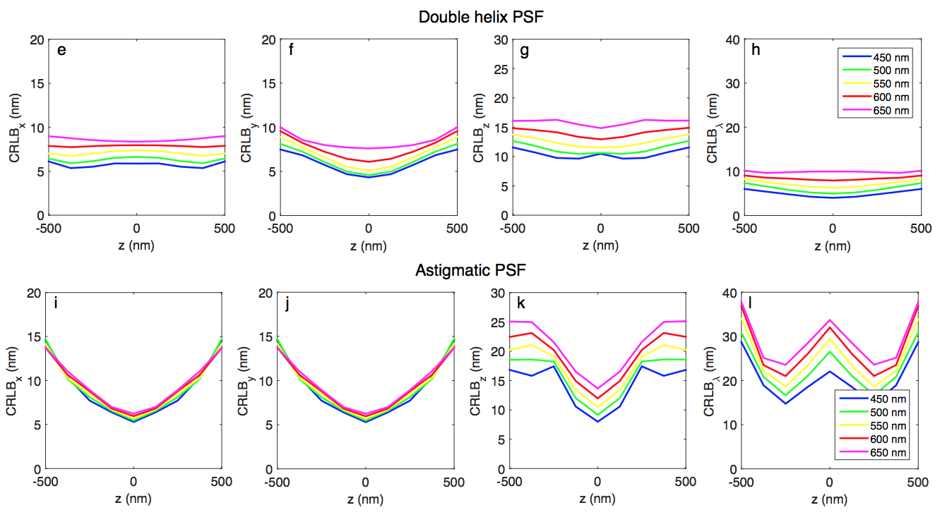
Theoretical Performance Evaluation
Notes:
S_i(f) = \frac{{i_0}^2}{2}\left[ \frac{{\tau}_c/(2\pi)}{1+\left(\pi f {\tau}_c \right)^2} \left\{ 1- e^{-\frac{2\tau}{{\tau}_c}} \left[ \cos(2\pi f\tau) + \frac{1}{\pi f \tau_c} \sin(2\pi f \tau) \right] \right\} \right]
\tau_c = \frac{2}{\textrm{linewidth}},\quad i_0: \textrm{nominal photocurrent amplitude},\quad \tau: \textrm{path delay}

Slide 20
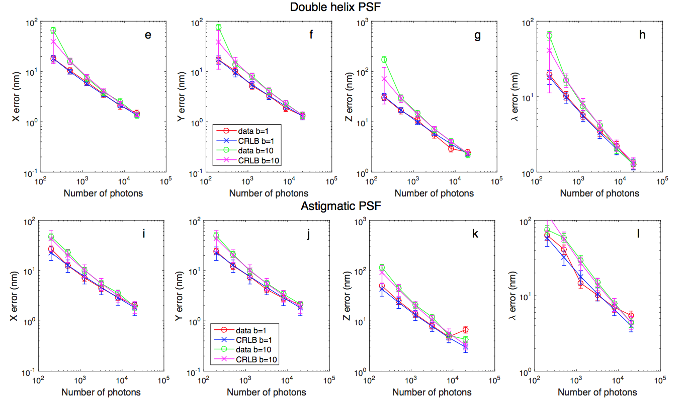
Theoretical Performance Evaluation
Notes:
S_i(f) = \frac{{i_0}^2}{2}\left[ \frac{{\tau}_c/(2\pi)}{1+\left(\pi f {\tau}_c \right)^2} \left\{ 1- e^{-\frac{2\tau}{{\tau}_c}} \left[ \cos(2\pi f\tau) + \frac{1}{\pi f \tau_c} \sin(2\pi f \tau) \right] \right\} \right]
\tau_c = \frac{2}{\textrm{linewidth}},\quad i_0: \textrm{nominal photocurrent amplitude},\quad \tau: \textrm{path delay}

Slide 21
Theoretical Performance Evaluation
To be added
CRLB including EMCCD readout noise
Fluorophore spectrum dependence
Actual PSF¹ estimation of existing microscope
Compared to the fitting simulation dataset (with MLE & LS)
…
[1] Theer, P. et al., PSFj: know your fluorescence microscope. Nat. Meth. (2014).
Notes:
S_i(f) = \frac{{i_0}^2}{2}\left[ \frac{{\tau}_c/(2\pi)}{1+\left(\pi f {\tau}_c \right)^2} \left\{ 1- e^{-\frac{2\tau}{{\tau}_c}} \left[ \cos(2\pi f\tau) + \frac{1}{\pi f \tau_c} \sin(2\pi f \tau) \right] \right\} \right]
\tau_c = \frac{2}{\textrm{linewidth}},\quad i_0: \textrm{nominal photocurrent amplitude},\quad \tau: \textrm{path delay}

Slide 22
Theoretical Performance Analysis: Possible Source of Bias

Slide 23
Possible Bias Sources
Axial position dependency
Chromatic/spherical aberration
Spectral profile of the fluorophore (bandwidth, skewness)
Uniform/non-uniform background
Deconvolution artifacts
Pixelation
Motion blur
Notes:
S_i(f) = \frac{{i_0}^2}{2}\left[ \frac{{\tau}_c/(2\pi)}{1+\left(\pi f {\tau}_c \right)^2} \left\{ 1- e^{-\frac{2\tau}{{\tau}_c}} \left[ \cos(2\pi f\tau) + \frac{1}{\pi f \tau_c} \sin(2\pi f \tau) \right] \right\} \right]
\tau_c = \frac{2}{\textrm{linewidth}},\quad i_0: \textrm{nominal photocurrent amplitude},\quad \tau: \textrm{path delay}

Slide 24
Experiment Design

Slide 25
Expected Impact of Experiment Settings
NA
Index matching
Magnification
Fluorophore density
Fluorophore spectrum
Illumination
Software setting
Notes:
S_i(f) = \frac{{i_0}^2}{2}\left[ \frac{{\tau}_c/(2\pi)}{1+\left(\pi f {\tau}_c \right)^2} \left\{ 1- e^{-\frac{2\tau}{{\tau}_c}} \left[ \cos(2\pi f\tau) + \frac{1}{\pi f \tau_c} \sin(2\pi f \tau) \right] \right\} \right]
\tau_c = \frac{2}{\textrm{linewidth}},\quad i_0: \textrm{nominal photocurrent amplitude},\quad \tau: \textrm{path delay}

