Slide 1
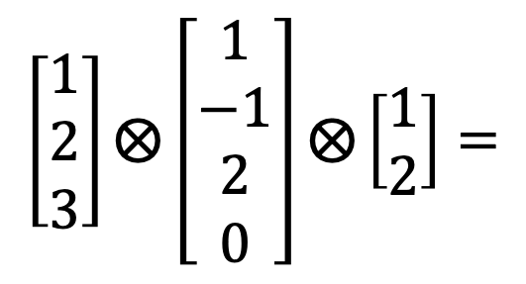
Index 3
Index 2
$$\left[\begin{aligned}1 \\ 2 \\ 3\end{aligned}\right]⨂\left[\begin{aligned}1 \\ −1 \\ 2 \\ 0\end{aligned}\right]⨂\left[\begin{aligned}1 \\ 2\end{aligned}\right]=$$
1
-1
2
0
2
-2
4
0
Index 1
3
-3
6
0

