Slide 1
Data Reporting with PowerBI in Business Setting
Tae Kim
10/29/2024

Slide 2
Speaker Background
2013
Math/Econ BS @ Cornell
2013–2014
Went back to Korea, worked at Hanwha Life Insurance Company
2014–2015
Research with Labor Dynamics Institute @ Cornell on large data parallelization & taught SAT
Statistics PhD @ University of Chicago with Dan Nicolae & Mengjie Chen
2019
Internship at Zurich North America as a Data Scientist, worked on crop yield prediction with deep learning
2020
Joined Microsoft Advertising as Data/Applied Scientist, Redmond WA
2022
Moved to Auburn
2015-2020

Slide 3
Work @ Microsoft
2020 – 2022: Analytics and Experimentation
Analytics owner of a new product (small and medium advertisers)
Partly built A/B testing system
Worked with product and engineering to improve the products
Calculated so many metrics, made so many dashboards
Regularly reported to VP-level
2022-current: Research / Machine Learning Science
Train language models to
Write ad copies for advertisers
Measure quality of ad copies (Relevance between website & search query & ad copy)
Personalization and targeting (ongoing)
User profiling
Data denoising: train models to select relevant data only

Slide 4
Agenda
Introduction
Context
Pros/Cons of PowerBI
Publishing report E2E (end to end)
Setting up workspace and getting data
Make charts
Publish report and refresh
Learnings from Analytics

Slide 5
Data Reporting

Slide 6
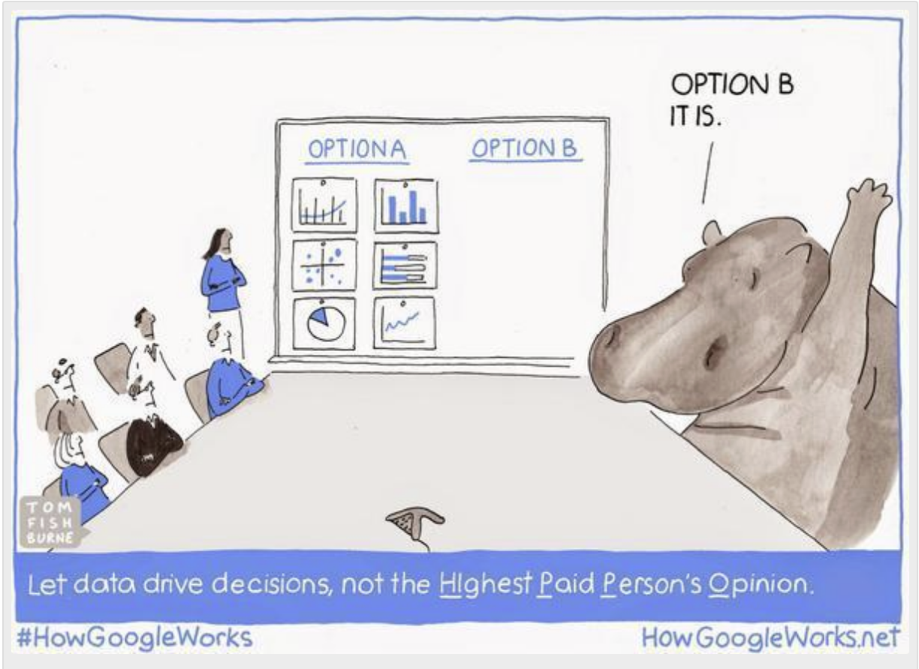
Culture of Data Driven Decision Making
HIPPO
Highest Paid Person’s Opinions
vs
Data-driven
Measurements
OKRs
Experimentation

Slide 7
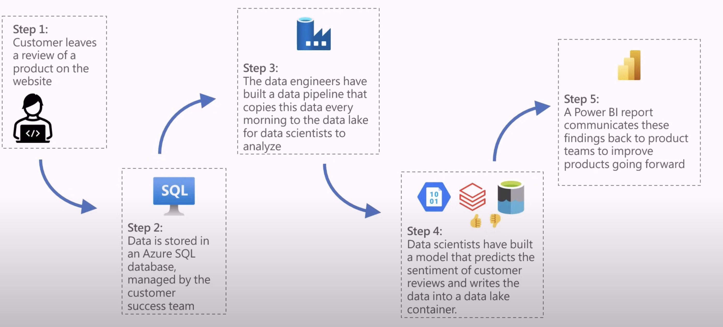
Workflow Example
Source: Fabric Tutorial Video

Slide 8
PowerBI can:
Make reports / dashboards
Interactive data visualizations
Integrate data
Connect to multiple data tables and aggregate across them
Custom visualizations
Various charts and graphs that can be customized
Allow safe collaboration
Share safely with tight access control
Refresh automatically
Read from latest data regularly

Slide 9
PowerBI is not perfect because..
Not free
Need to purchase PowerBI Desktop or Microsoft 365 Subscription
Uses client-side memory
As opposed to server-side memory
Weird syntax
Slow when data is large
It needs to load the raw data while showing you aggregated stats
Favors Microsoft ecosystem
It works well with Azure, not sure about others
Knowledge in CS doesn’t generalize well

Slide 10
Fabric
PowerBI went through a big transformation recently, and has been rebranded as part of “Fabric” – data analytics platform
Fabric includes data factory, data engineering, data storing, etc.
Fabric is intended to solve problems for companies, which needs to scale up its data operations.
It’s not designed for small individual projects
If the next exercise is confusing, keep that in mind
Good background video

Slide 11
Publishing Report E2E Exercise

Slide 12
Resources
Data:
github.com/taehyun0313/AUPowerBIWorkshop
Download two excel files
PowerBI:
app.powerbi.com, log-in using your AU credentials
Set up workspace
Make visualizations & set-up alerts
Publish & set-up refresh

Slide 13
Personal Learnings in Analytics

Slide 14
Org chart matters (in product context)
There could be a team of analysts
Each analyst is sent to different products
Your job is to be good at analytics.
Generally safe to call out bad things.
Analytics team knows that failure is not a bad thing.
There could be one analyst in each product team
Your job is to make product succeed
Based on data, provide product directions
Sometimes you’ll be pressured to highlight good numbers and hide the bad

Slide 15
Worst Case:
Devs
I built this super cool new feature for our users!
Analysts
Collect data and measure things
It’s hurting revenue. People hate this feature.
We can’t ship this.
Devs now have no impact. You also have no impact (in some culture).
No bonus or promotion for you
CULTURE around data driven decision making is very important
Failure is valuable. Not everyone sees it that way.

Slide 16
Impact Measurement Problem
Clarify first how your performance will be evaluated
If your job description says “find insights” from the data
Insights are rare, and they don’t come daily
Most data tells expected stories
Twyman’s Law
Any figure that looks interesting or different is usually wrong
How to measure analysts’ impact and performance?
Are you bringing in revenue? No, you “work with” people who bring in revenue (product team, devs)
Are you making decisions? No, you’re “helping” others make decisions.
Some analyst roles can have measurable impact. (e.g. DAU of your dashboard)

Slide 17
Q&A

Slide 18
Appendix

Slide 19
Two Cases of Data Reporting
 | Case 1: One-time thing | Case 2: Continuous monitoring
 | Helps make decisions
Purpose | To communicate results | To track key metrics
Examples | Annual performance review | Monitor daily active users (DAU) of a product
Data | Static. Focus on a snapshot of data. | Dynamic. Regularly updated to reflect near-real-time metrics.
Focus | Highlight key messages and engage audience | Clarity, alert mechanism
Consumer | Stakeholders | Product owners (mostly)

Slide 20
Treat a dashboard like a product
Design
Rule: if you build something, it should be hard to break.
Which data is useful to business & decision makers?
Metrics make sense? Room for misinterpretation?
Ease of maintenance /robustness (e.g. what if there’s delay in upstream data? What if it’s empty?)
Make it
Easy, routine, sometimes fun, sometimes boring
Maintaining & debugging
Annoying, time consuming, disruptive
People will ask you for more things. But since you put lots of thoughts into design, they will probably be wrong. Don’t introduce changes unless it’s critical.

