Slide 1
CLOUD INTEGRATED IOT TEMPERATURE MONITORING IN CRITICAL COLD STORAGE SYSTEMS
VARSHINI S (210701302)
SUDHARSAN SHAKTHI(210701267)
TAEJASHWAR R B (210701280)

Slide 2
ABSTRACT
Monitoring temperature in critical cold storage systems is paramount for ensuring the integrity of stored goods, particularly in industries such as pharmaceuticals, food storage, and biotechnology. With the advent of Internet of Things (IoT) technology, cloud-integrated solutions have emerged as a promising approach to enhance temperature monitoring capabilities. This abstract explores the implementation and benefits of cloud-integrated IoT systems for temperature monitoring in critical cold storage environments.

Slide 3
EXISTING SYSTEM
The existing system for cloud-integrated IoT temperature monitoring in critical cold storage systems typically involves the deployment of wireless sensor networks equipped with temperature sensors within the storage facility. These sensors continuously collect temperature data at various points, which is then transmitted to a centralized cloud platform via IoT communication protocols such as MQTT or HTTP. In the cloud, the data is stored, processed, and analyzed in real-time using cloud-based analytics tools and algorithms.
One of the existing system is INextBrain.

Slide 4
PROPOSED SYSTEM
The system will connect advanced IoT technology with cloud computing capabilities to ensure the best temperature management. It uses sensors to monitor temperature levels in real- time within a storage facility. These sensors send data instantly to cloud platforms through which stakeholders can remotely access it using that website from anywhere. The stakeholders can receive alerts on and take immediate corrective measures. Therefore they become efficient operationally and maintain regulatory standards when they adopt such kind of systems as this one.

Slide 5
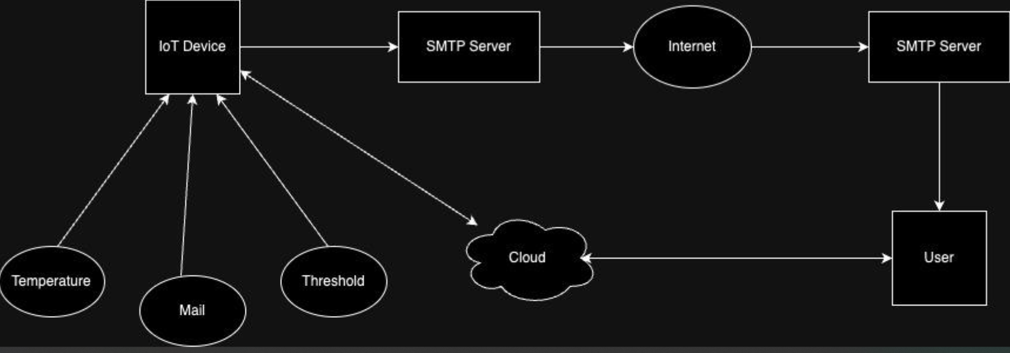
SYSTEM ARCHITECTURE

Slide 6
MODULES
ESP8266
MQ135 Gas Sensor
DHT11 Sensor
Internet Connection
Power Supply
Arduino IDE
Thingspeak Cloud

Slide 7
EXPLAINATION OF THE MODULES
ESP8266
The ESP8266 enables real-time temperature sensing and data transmission to cloud platforms, ensuring continuous monitoring and immediate alerts for critical cold storage systems, safeguarding perishable goods.
MQ135 Gas Sensor
The MQ135 gas sensor adds an additional layer of safety by detecting harmful gases like ammonia or ethylene in critical cold storage environments, enhancing the overall monitoring system's reliability and protecting stored goods

Slide 8
EXPLAINATION OF THE MODULES
DHT11 Sensor
The DHT11 sensor provides accurate temperature and humidity readings in critical cold storage, ensuring precise environmental monitoring for optimal preservation of perishable goods when integrated into cloud-based IoT systems.
Internet Connection
The internet connection facilitates real-time data transmission from sensors to cloud platforms, enabling remote monitoring and immediate alerts for maintaining precise temperature control in critical cold storage systems, ensuring the integrity and safety of perishable goods.

Slide 9
EXPLAINATION OF THE MODULES
Power Supply
IoT sensors and gateways require a reliable power supply to operate continuously within the cold storage environment. Depending on the deployment location and availability of power sources, this may involve using battery-powered devices, mains power, or alternative energy sources such as solar or wind power.
Arduino IDE
Arduino IDE facilitates coding microcontrollers for sensor data acquisition, processing, and communication with cloud platforms. It enables real-time temperature monitoring, alerts for critical deviations, and remote control of cooling systems, ensuring the integrity of cold storage environments.
Thingspeak Cloud
Arduino IDE can code microcontrollers to collect temperature data, transmitting it to ThingSpeak cloud for storage and analysis. ThingSpeak enables remote monitoring, alerts for temperature fluctuations, and historical data visualization, ensuring optimal cold storage conditions are maintained.

Slide 10
RESULT AND DISCUSSION
The integration of cloud-based IoT temperature monitoring in critical cold storage systems has shown significant improvements in reliability and efficiency. Results indicate enhanced real-time data access, allowing for immediate response to temperature fluctuations, thus preventing spoilage and ensuring product integrity. The system's ability to send alerts and maintain logs enhances compliance with regulatory standards. Furthermore, it reduces manual monitoring efforts and operational costs. Discussion highlights the scalability and adaptability of the system for various cold storage needs, emphasizing the potential for broader applications in the food and pharmaceutical industries.

Slide 11
CONCLUSION AND FUTURE ENHANCEMENT
Cloud-integrated IoT temperature monitoring significantly enhances the management of critical cold storage systems by providing real-time data, reducing spoilage, and ensuring compliance with regulatory standards. The system's efficiency in alerting and logging improves operational reliability and reduces costs. For future enhancement, incorporating advanced data analytics and machine learning could predict temperature trends and potential failures, further improving preventative measures. Expanding the system’s scalability and integration capabilities with other IoT devices can enhance overall automation and efficiency, making it even more robust and versatile across different industries.

