Slide 1
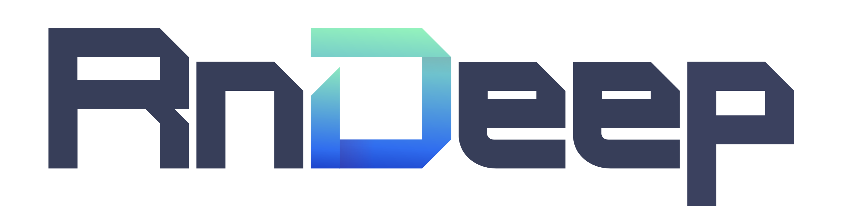
Graph Theory / Basic GNN
Basic of Graph Theory and Graph Neural Networks
담당자
정태진 / tjjeong@rndeep.co.kr
미래전략실

Slide 2
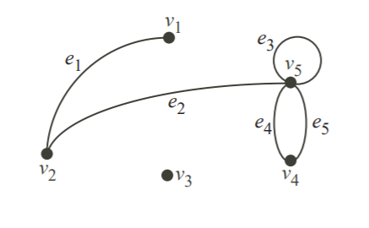
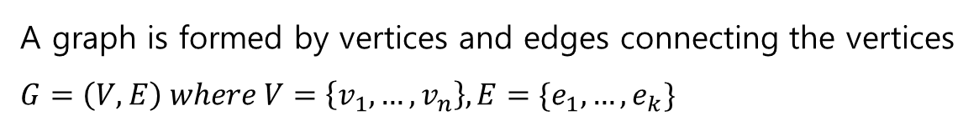
Intro to Graph Theory
What is Graph?
A graph is formed by vertices and edges connecting the vertices
$$G=\left(V,E\right) where V=\left\{v_{1},…,v_{n}\right\}, E=\{e_{1},…,e_{k}\}$$

Slide 3
Intro to Graph Theory
What is Graph?
Basic terms of Graph Theory
- Vertices
- Edges
- Loop
- Parallel
- Degree

Slide 4
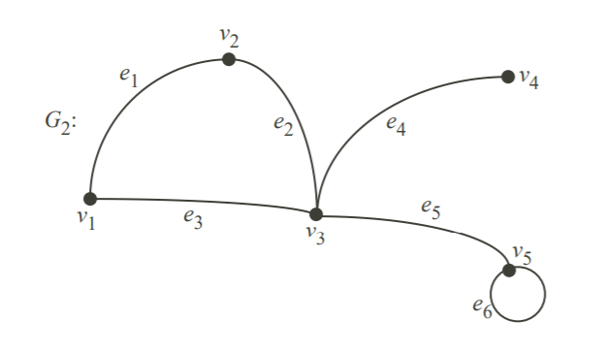
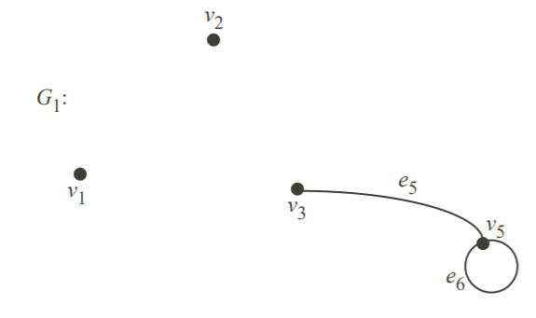
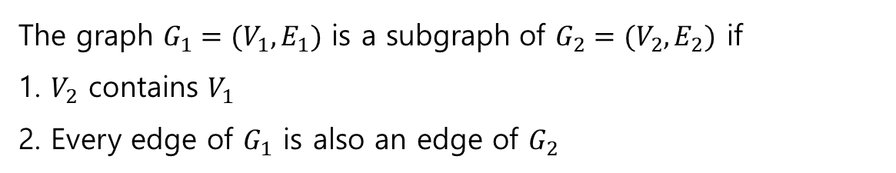
Intro to Graph Theory
What is Graph?
The graph $G_{1}=(V_{1},E_{1})$ is a subgraph of $G_{2}=(V_{2},E_{2})$ if
1. $V_{2}$ contains $V_{1}$
2. Every edge of $G_{1}$ is also an edge of $G_{2}$
Subgroup of the main graph
Main graph

Slide 5
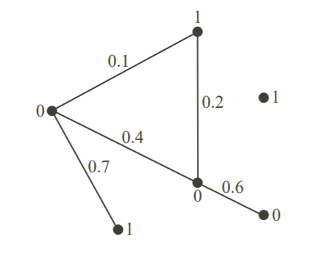
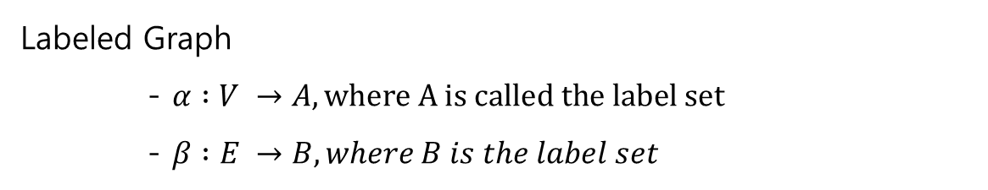

Intro to Graph Theory
Labeled Graph and Isomorphism
Labeled Graph
- $α :V →A, where A is called the label set$
- $β :E →B, where B is the label set$
$$A=\left\{0,1\right\} and B=R$$

Slide 6
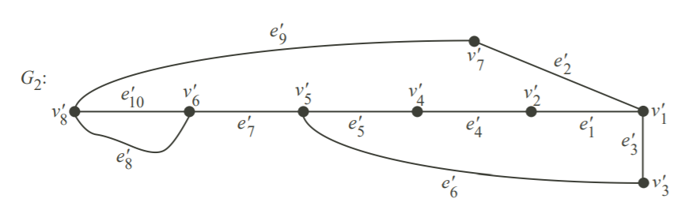
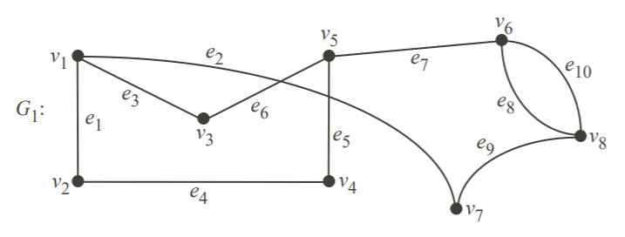
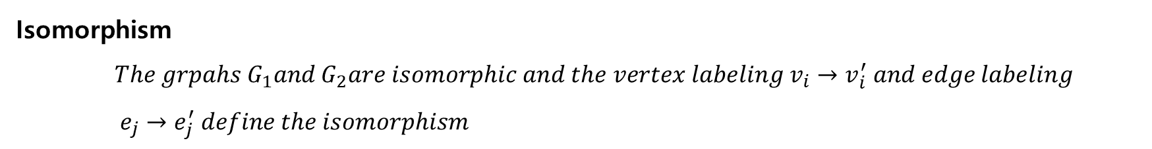

Intro to Graph Theory
Labeled Graph and Isomorphism
Isomorphism
$The grpahs G_{1}and G_{2}are isomorphic and the vertex labeling v_{i}→v_{i}^{′} and edge labeling$
$e_{j}→e_{j}^{′} define the isomorphism$
$$G_{1} is isomorphic to G_{2}, vice versa$$

Slide 7
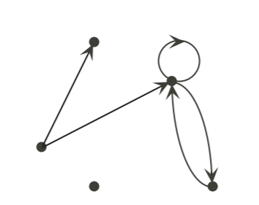
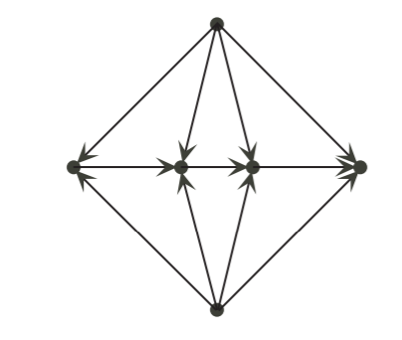
Intro to Graph Theory
Directed Graphs
A directed graph or digraph is formed by vertices connected by directed edges or arcs
Directed Graph
Acyclic Directed Graph

Slide 8
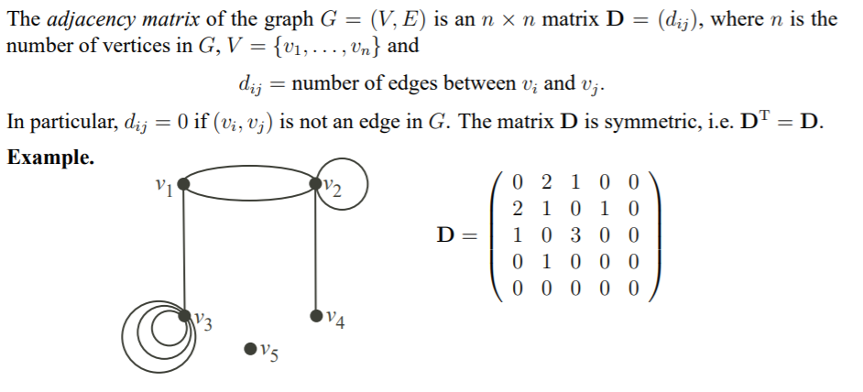
Intro to Graph Theory
Matrices and Vector Spaces of Graphs
Notes:
Node focused -> Marcov Chain, Markov Random walk

Slide 9
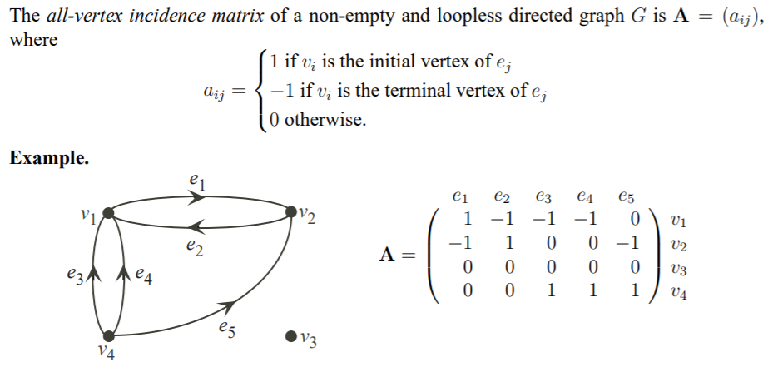
Intro to Graph Theory
Matrices and Vector Spaces of Graphs
Notes:
GNN with directed Graph

Slide 10
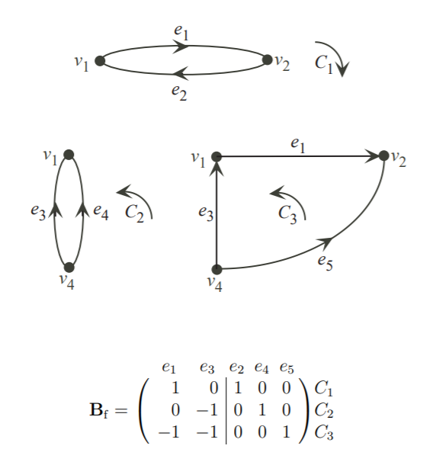
Intro to Graph Theory
Matrices and Vector Spaces of Graphs
Notes:
GNN with directed Graph

Slide 11
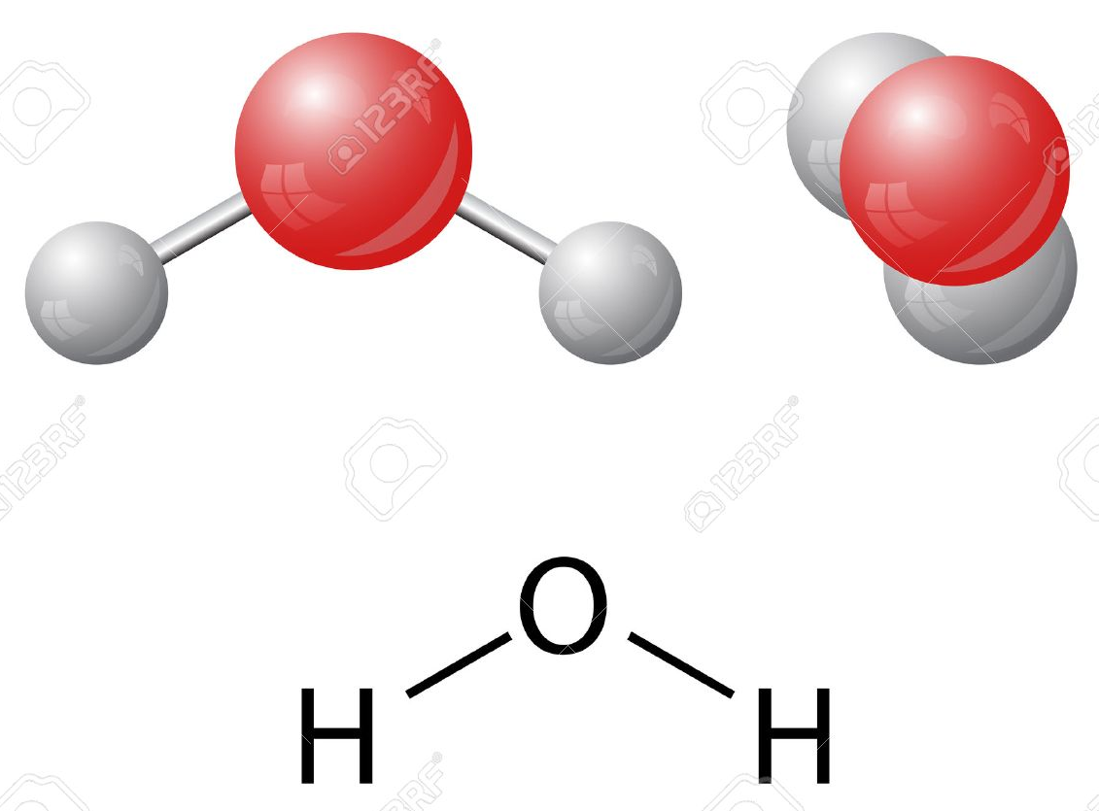
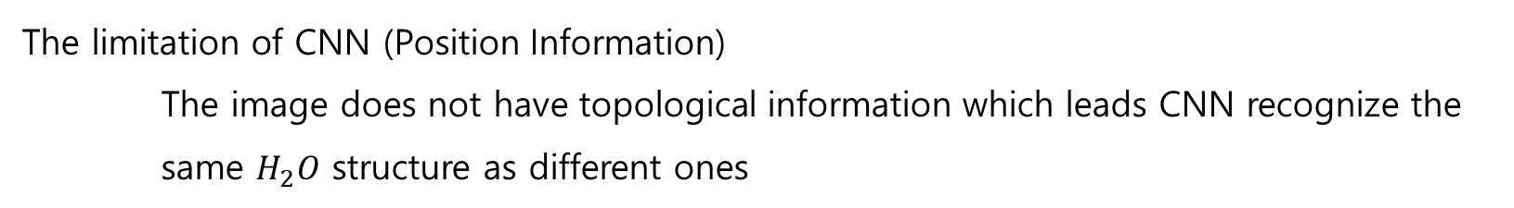

Introduction to Basic GNN
The limitation of CNN
The limitation of CNN (Position Information)
The image does not have topological information which leads CNN recognize the same $H_{2}O$ structure as different ones
The molecule structure of $H_{2}O$

Slide 12
Introduction to Basic GNN
Why do we need GNN?
Needs of Graph Convolutional Network, GNN
There exists a few data which cannot be converted into Euclidian space, i.e. vector space
(ex, Social Network, Chemical structure, Relational datasets)
There were several trials to train those data with CNN, but it did not perform well since CNNs rely on the position information, not on the relation between nodes
The needs of the new neural network system on graph domain due to the reasons above

Slide 13
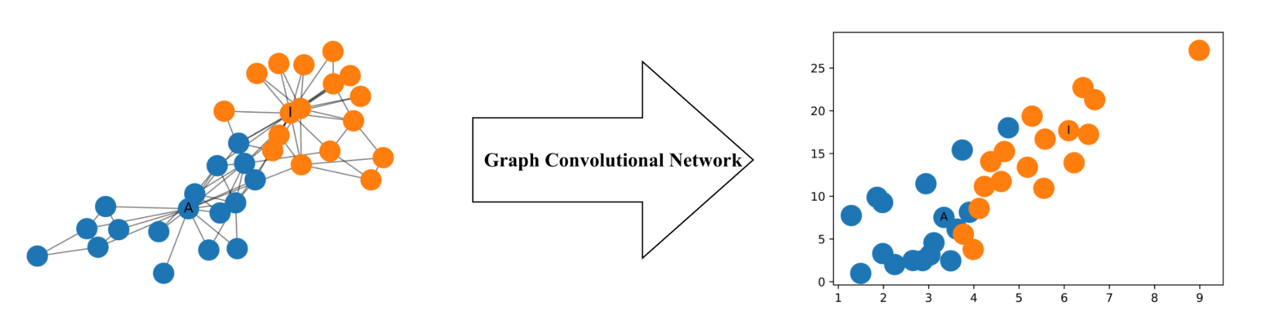
Introduction to Basic GNN
The advantages of GNN
What is the strength of GNN?
It is quite powerful to produce useful feature representation even with 2-layer neural network system
It could produce 2-dimensional representation even without any training

Slide 14
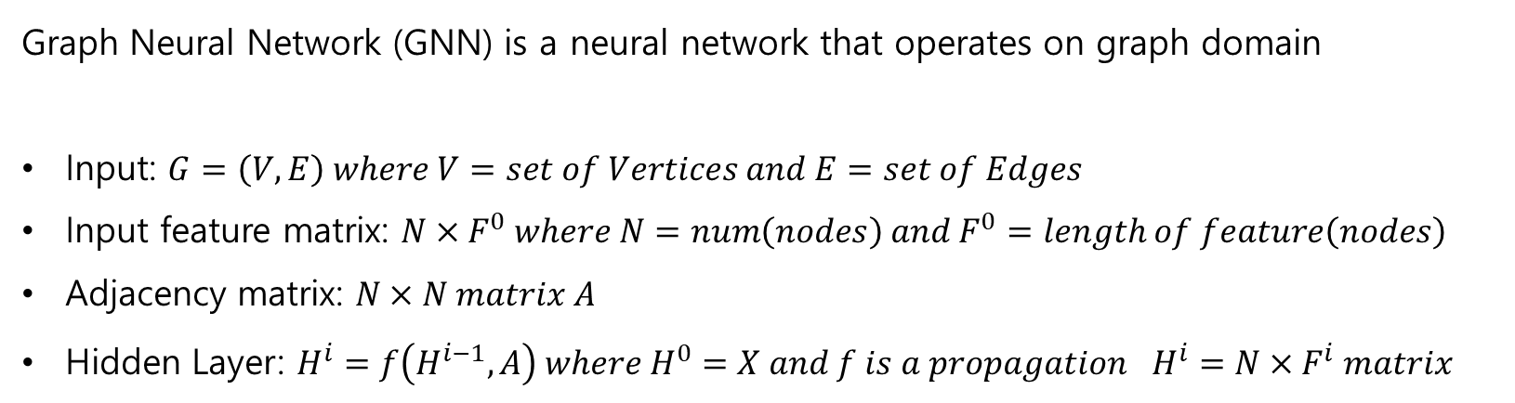
Introduction to Basic GNN
A brief concept of GNN
Graph Neural Network (GNN) is a neural network that operates on graph domain
Input: $G=\left(V,E\right) where V=set of Vertices and E=set of Edges$
Input feature matrix: $N×F^{0} where N=num\left(nodes\right) and F^{0}=length of feature\left(nodes\right)$
Adjacency matrix: $N×N matrix A$
Hidden Layer: $H^{i}=f\left(H^{i−1},A\right) where H^{0}=X and f is a propagation$ $H^{i}=N×F^{i} matrix$

Slide 15
Introduction to Basic GNN
Problems on the Horizon
There are two main problems on basic concept of GNN
The aggregated representation of a node does not include its own feature
Nodes with large degrees will have large values in their feature representation while nodes with small degrees will have small values

Slide 16
Introduction to Basic GNN
Problems on the Horizon
Solution for the problems
Adding Self-loops to preserve the feature of itself
Normalizing the Feature Representations

Slide 17
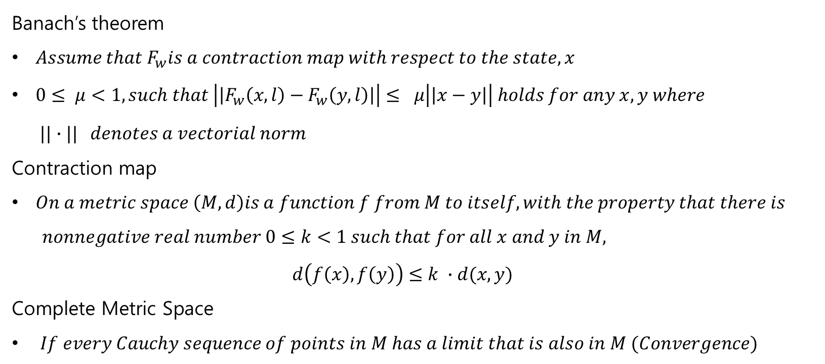
Introduction to Basic GNN
A brief concept of GNN
Banach’s theorem
$Assume that F_{w}is a contraction map with respect to the state, x$
$0≤ μ<1, such that \left|\left|F_{w}\left(x,l\right)−F_{w}\left(y,l\right)\right|\right|≤ μ\left|\left|x−y\right|\right| holds for any x,y where$ $||∙|| denotes a vectorial norm$
Contraction map
$On a metric space \left(M,d\right)is a function f from M to itself, with the property that there is$ $nonnegative real number 0≤k<1 such that for all x and y in M,$ $d\left(f\left(x\right), f\left(y\right)\right)≤k ∙d(x,y)$
Complete Metric Space
$If every Cauchy sequence of points in M has a limit that is also in M (Convergence)$

Slide 18
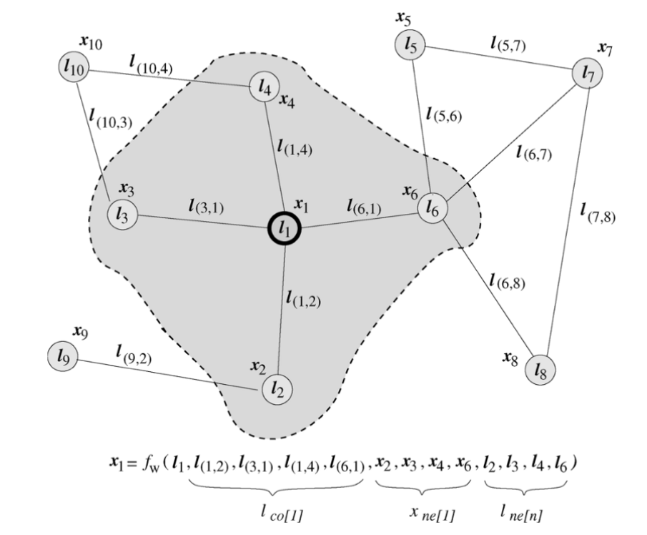



Introduction to Basic GNN
A brief concept of GNN
$$x_{n}=f_{w}(l_{n}, l_{co\left[n\right]}, x_{ne\left[n\right]}, l_{ne\left[n\right]})$$
$$o_{n}=g_{w}(x_{n}, l_{n})$$
$$x_{n+1}=F_{w}(x\left(t\right),l)$$

Slide 19
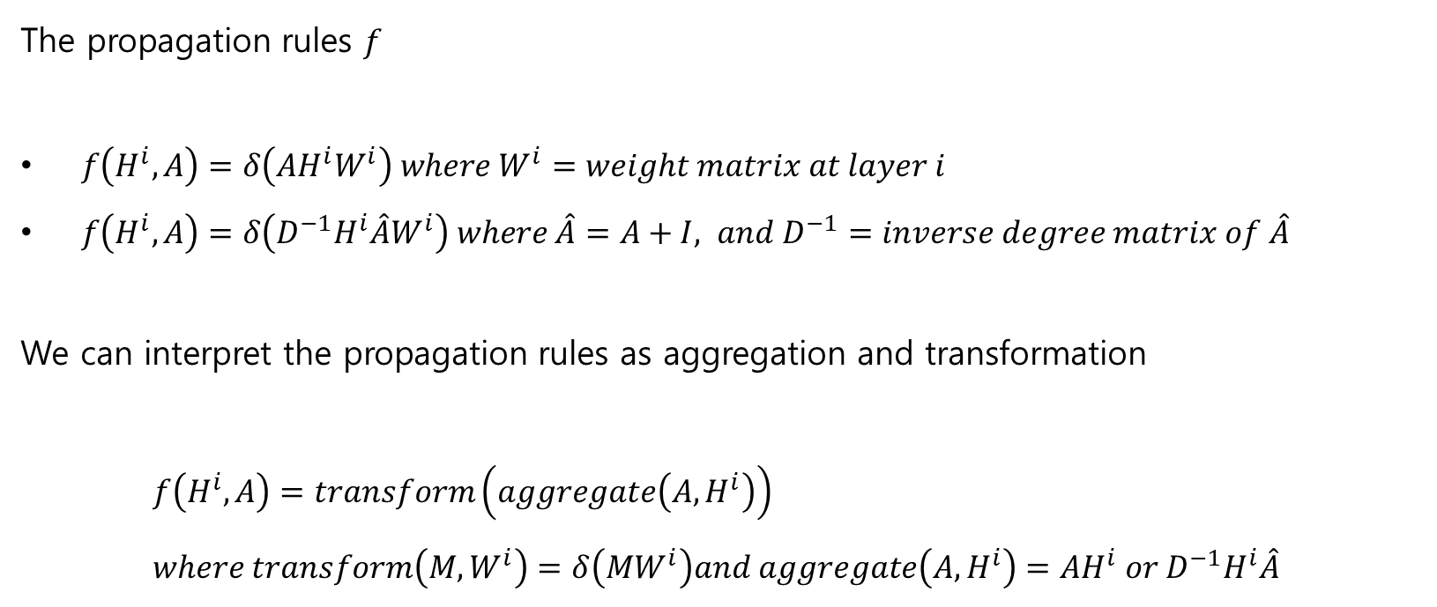
Introduction to Basic GNN
A brief concept of GNN
The propagation rules $f$
$f\left(H^{i},A\right)=δ\left(AH^{i}W^{i}\right) where W^{i}=weight matrix at layer i$
$f\left(H^{i},A\right)=δ\left(D^{−1}H^{i}\hat{A}W^{i}\right) where \hat{A}=A+I, and D^{−1}=inverse degree matrix of \hat{A}$
We can interpret the propagation rules as aggregation and transformation
$f\left(H^{i},A\right)=transform\left(aggregate\left(A,H^{i}\right)\right)$
$where transform\left(M,W^{i}\right)=δ\left(MW^{i}\right)and aggregate\left(A,H^{i}\right)=AH^{i} or D^{−1}H^{i}\hat{A}$

Slide 20
Conclusion GNN
Conclusion
The benefits of GNN
It can solve a problem caused by Isomorphism (Chemical bonds, social network relationship)
GNN module can train the relationship between nodes

Slide 21
Reference
Keijo Ruohonen – Graph Theory (http://math.tut.fi/~ruohonen/GT_English.pdf)
Tobias Skovgaard Jepsen – How to do Deep Learning on Graphs with Graph Convolutional Networks
(https://towardsdatascience.com/how-to-do-deep-learning-on-graphs-with-graph-convolutional-networks-7d2250723780)
Notes:
GNN with directed Graph

