Slide 1
maTLS: How to Make TLS middlebox-aware?
Hyunwoo Lee, Zach Smith, Junghwan Lim, Gyeongjae Choi,
Selin Chun, Taejoong Chung, Ted “Taekyoung” Kwon
Seoul National University, University of Luxembourg, Rochester Institute of Technology
Notes:
First of all, thanks to Professor Nikiforakis for introducing me.
Hello, as mentioned, my name is Hyunwoo Lee, a Ph D. student at Seoul National University
This work is jointly worked with Seoul National University, University of Luxembourgh, and Rochester Institute of Technology.

Slide 2
Middleboxes
Client
Server
Notes:
I’d like to start by looking at middleboxes in the TLS protocol.
What are middleboxes?

Slide 3
Middleboxes
Client
Middlebox
Server
Web Application Firewalls
Security Gateways
Parental Controls
…
Notes:
Middleboxes such as Web Application Firewalls, Security Gateways, or Parental Controls are located in-between the client and the server to perform their own functionality.

Slide 4

Middleboxes and Transport Layer Security
Client
Middlebox
Server
Middlebox
Web Application Firewalls
Security Gateways
Parental Controls
Cannot work!
…
Notes:
However, middleboxes cannot work with TLS because all the messages between two endpoints are encrypted

Slide 5
Motivation for SplitTLS
To perform their functions
Middleboxes split the TLS session
Private key sharing
Custom root certificate
Client
Middlebox
Server
Middlebox
Notes:
In order to enable their functionality, the common approach is the TLS interception scheme called SplitTLS by using private key sharing or custom root certificates

Slide 6
Session and Segment
To perform their functions
Middleboxes split the TLS session
Private key sharing
Custom root certificate
Client
Middlebox
Server
Segment
Segment
Session
Notes:
Before explaining about those schemes briefly, note that I will refer to the final channel between the client and the server a “session” that is composed of several segments

Slide 7

SplitTLS (1) Private Key Sharing
Client
Middlebox
Server
Certificate
CN: alice.com
Issuer: ca.com
Notes:
The private key sharing is generally used by server-side middleboxes such as web application firewalls

Slide 8
SplitTLS (1) Private Key Sharing
Client
Middlebox
Server
Certificate
CN: alice.com
Issuer: ca.com
Certificate
CN: alice.com
Issuer: ca.com
Server transfers
their private key and certificate
Notes:
Initially, the server transfers the private key with the corresponding certificate to the middlebox

Slide 9
SplitTLS (1) Private Key Sharing
Client initiates
a TLS handshake
Client
Middlebox
Server
Certificate
CN: alice.com
Issuer: ca.com
Certificate
CN: alice.com
Issuer: ca.com
Notes:
When a client initiates the TLS handshake,

Slide 10
SplitTLS (1) Private Key Sharing
Middlebox initiates
another TLS handshake
Client
Middlebox
Server
Certificate
CN: alice.com
Issuer: ca.com
Certificate
CN: alice.com
Issuer: ca.com
Notes:
the middlebox also initiates another TLS handshake with the server

Slide 11
SplitTLS (1) Private Key Sharing
Middlebox impersonates Server with the tranferred key pair
Client
Middlebox
Server
Certificate
CN: alice.com
Issuer: ca.com
Certificate
CN: alice.com
Issuer: ca.com
Notes:
The middlebox sends the certificate taken from the server to pretend to be the server

Slide 12




SplitTLS (1) Private Key Sharing
Client believes they have established a TLS session with Server, not Middlebox!
Client
Middlebox
Server
Certificate
CN: alice.com
Issuer: ca.com
Certificate
CN: alice.com
Issuer: ca.com
Notes:
Finally, the session is established
while the client believes they establish a TLS session directly with the server

Slide 13

SplitTLS (2) Custom Root Certificate
Client
Middlebox
Server
Custom
Root Certificate
CN: mitm.com
Issuer: mitm.com
Certificate
CN: alice.com
Issuer: ca.com
Notes:
The other way the middlebox splits the TLS session is using custom root certificates

Slide 14
SplitTLS (2) Custom Root Certificate
Client
Middlebox
Server
Custom
Root Certificate
CN: mitm.com
Issuer: mitm.com
Custom
Root Certificate
CN: mitm.com
Issuer: mitm.com
Certificate
CN: alice.com
Issuer: ca.com
Middlebox installs
a root certificate in the client
Notes:
The middlebox previously installs the root certificate into the client’s trusted certificate store

Slide 15
SplitTLS (2) Custom Root Certificate
Client initiates
a TLS handshake
Client
Middlebox
Server
Custom
Root Certificate
CN: mitm.com
Issuer: mitm.com
Custom
Root Certificate
CN: mitm.com
Issuer: mitm.com
Certificate
CN: alice.com
Issuer: ca.com
Notes:
Then, when the client initiates the TLS handshake,

Slide 16
SplitTLS (2) Custom Root Certificate
Middlebox initiates
another TLS handshake
Client
Middlebox
Server
Custom
Root Certificate
CN: mitm.com
Issuer: mitm.com
Custom
Root Certificate
CN: mitm.com
Issuer: mitm.com
Certificate
CN: alice.com
Issuer: ca.com
Notes:
the middlebox also initiates another TLS handshake with the server,

Slide 17

SplitTLS (2) Custom Root Certificate
Middlebox impersonates Server with the forged key pair
Client
Middlebox
Server
Custom
Root Certificate
CN: mitm.com
Issuer: mitm.com
Custom
Root Certificate
CN: mitm.com
Issuer: mitm.com
Certificate
CN: alice.com
Issuer: ca.com
Sign!
Forged
Certificate
CN: alice.com
Issuer: mitm.com
Generate a forged certificate
with the name, alice.com
Notes:
at the same time, it generates a forged certificate with the name of the server, that is alice.com, signed with the custom root certificate

Slide 18
SplitTLS (2) Custom Root Certificate
Client
Middlebox
Server
Custom
Root Certificate
CN: mitm.com
Issuer: mitm.com
Custom
Root Certificate
CN: mitm.com
Issuer: mitm.com
Certificate
CN: alice.com
Issuer: ca.com
Forged
Certificate
CN: alice.com
Issuer: mitm.com
Notes:
and uses the forged certificate to impersonate the server during the TLS handshake between the client and the middlebox

Slide 19
SplitTLS (2) Custom Root Certificate
Client believes they have established a TLS session with Server, not Middlebox!
Client
Middlebox
Server
Custom
Root Certificate
CN: mitm.com
Issuer: mitm.com
Custom
Root Certificate
CN: mitm.com
Issuer: mitm.com
Certificate
CN: alice.com
Issuer: ca.com
Forged
Certificate
CN: alice.com
Issuer: mitm.com
Notes:
the session is finally established between the client and the server, but note that the client does not know the existence of the middlebox

Slide 20
Problems in SplitTLS
No information for Client
Client
Middlebox
Server
Notes:
Unfortunately, lots of security drawbacks regarding SplitTLS are reported because the client has no information about security of segments after the immediate middlebox

Slide 21

Problems in SplitTLS - Authentication
Client
Middlebox
Server
alice.com
alice.com
Authentication
Client does not authenticate Server
Notes:
Let’s see the problems in more detail in terms of authentication, confidentiality, and integrity that are the primary goals of TLS.
Regarding authentication, the client does not directly authenticate the server. Many papers report that some middleboxes failed to validate the certificates.

Slide 22
Problems in SplitTLS - Authentication
Client
Middlebox
Server
Not Expired
Forged Certificate
CN: alice.com
Issuer: mitm.com
Expired
Certificate
CN: alice.com
Issuer: ca.com
Authentication
Client does not authenticate Server
Notes:
For example, there was a case that the middlebox receive the expired certificate from the server, but the middlebox generates the forged but not expired certificate

Slide 23

Problems in SplitTLS - Authentication
Client
Middlebox
Server
Not Expired
Forged Certificate
CN: alice.com
Issuer: mitm.com
Expired
Certificate
CN: alice.com
Issuer: ca.com
Authentication
Client does not authenticate Server
Notes:
And finally the client believes the session is secure

Slide 24
Problems in SplitTLS - Confidentiality
Client
Middlebox
Server
Authentication
Client does not authenticate Server
Confidentiality
Client does not know whether or not the segment is encrypted with a strong ciphersuite
Notes:
Regarding confidentiality,

Slide 25
Problems in SplitTLS - Confidentiality
Client
Middlebox
Server
RC4 or SHA-1?
Authentication
Client does not authenticate Server
Confidentiality
Client does not know whether or not the segment is encrypted with a strong ciphersuite
Notes:
even if weak algorithms such as RC4 or SHA-1 are used in the segment after the middlebox,

Slide 26

Problems in SplitTLS - Confidentiality
Client
Middlebox
Server
RC4 or SHA-1?
Authentication
Client does not authenticate Server
Confidentiality
Client does not know whether or not the segment is encrypted with a strong ciphersuite
Notes:
the client will still believes the session is secure if the immediate segment uses the strong ciphersuite

Slide 27

Problems in SplitTLS - Integrity
Client
Middlebox
Server
Authentication
Client does not authenticate Server
Confidentiality
Client does not know whether or not the segment is encrypted with a strong ciphersuite
Integrity
Client cannot confirm that Server sent the message, or which middleboxes have modified it
Notes:
Regarding Integrity, the client cannot confirm that the server sent the message, or which middleboxes have modified it.
When the server sends the original message

Slide 28

Problems in SplitTLS - Integrity
Client
Middlebox
Server
Middlebox inserts the unwanted script!
Authentication
Client does not authenticate Server
Confidentiality
Client does not know whether or not the segment is encrypted with a strong ciphersuite
Integrity
Client cannot confirm that Server sent the message, or which middleboxes have modified it
Notes:
the middlebox may modified it to the orange document with an unwanted script.

Slide 29
Problems in SplitTLS - Integrity
Client
Middlebox
Server
Client believes Server sent
Authentication
Client does not authenticate Server
Confidentiality
Client does not know whether or not the segment is encrypted with a strong ciphersuite
Integrity
Client cannot confirm that Server sent the message, or which middleboxes have modified it
Notes:
But the client still believes the received message is from the server without any modification

Slide 30

Middlebox-aware TLS Overview
Middlebox-aware TLS (maTLS) aims to
securely establish a session with middleboxes involved
while addressing the problems in SplitTLS
 | Problems in SplitTLS | Mechanisms in maTLS
Authentication | Client does not authenticate Server | Explicit Authentication
Confidentiality | Client does not know whether or not the segment is encrypted with a strong ciphersuite | Security Parameter Verification
Integrity | Client cannot confirm that Server sent the message, or which middleboxes have modified it | Valid Modification Checks
Notes:
So, we propose Middlebox-aware TLS, a TLS extension that aims to securely establish a session with the middleboxes involved, while addressing the problems in SplitTLS with introducing three audit mechanisms by the client
For authentication, we introduce Explicit Authentication in which the client authenticates the server as well as the middleboxes involved
For confidentiality, we design security parameter verification in which the client confirms all the security parameters, such as the selected TLS version and ciphersuite, of the segments by the reports from the entities
For integrity, we devise valid modification checks in which the client confirms who sent the message and who have modified it by HMACs from the entities.
These mechanisms assume the client is aware of the middleboxes involved.

Slide 31
Auditable Middleboxes
Certificate Authority
Middlebox Transparency Log Server
Middlebox
Certificate
CN: mb.com
Issuer: ca.com
Middlebox
(mb.com)
Auditable Middleboxes
Middleboxes that have their own middlebox certificates logged in a middlebox transparency log server
Middlebox
Certificate
CN: mb.com
Issuer: ca.com
Notes:
Therefore, we make middleboxes visible. We define the notion of auditablie middleboxes as middleboxes that have their own middlebox certificates logged in the middlebox transparency log server

Slide 32
Auditable Middleboxes
Certificate Authority
Middlebox Transparency Log Server
Middlebox
Certificate
CN: mb.com
Issuer: ca.com
Information about Middlebox
Type of Service
URL
Permission
Middlebox
(mb.com)
Notes:
The CA issues a middlebox certificate including informations about the middlebox. They are the type of service, the URL to a middlebox vendor, and the permission of the middlebox, which are provided by a middlebox vendor

Slide 33
Auditable Middleboxes
Certificate Authority
Middlebox Transparency Log Server
Middlebox
Certificate
CN: mb.com
Issuer: ca.com
Middlebox
Certificate
CN: mb.com
Issuer: ca.com
Middlebox
(mb.com)
Notes:
And finally the CA gives the certificate to the middlebox, while logging it into the middlebox transparency log server.

Slide 34

Advantages of Auditable Middleboxes
No impersonation
Awareness
Auditability
Revocability
Notes:
Then, what are the benefits of auditable middleboxes?

Slide 35

Advantages of Auditable Middleboxes
No impersonation
Middleboxes now have their own key pairs and do not need to impersonate others (in TLS)
Awareness
Auditability
Revocability
Notes:
First, no impersonation. Middleboxes now have their own key pairs so they does not need to impersonate others

Slide 36

Advantages of Auditable Middleboxes
No impersonation
Middleboxes now have their own key pairs and do not need to impersonate others (in TLS)
Awareness
Anyone can know the name and properties of a middlebox from its middlebox certificate
Auditability
Revocability
Notes:
Second, awareness. The certificate is public and cannot be altered after issueance, so anyone can know the name and properties of the middlebox

Slide 37
Advantages of Auditable Middleboxes
No impersonation
Middleboxes now have their own key pairs and do not need to impersonate others (in TLS)
Awareness
Anyone can know the name and properties of a middlebox from its middlebox certificate
Auditability
Any interested parties can check for fraudulent certificates using the middlebox transparency system
Revocability
Notes:
Third, auditability. Middlebox certificates are logged into a public log server, so any interested parties can check fraudulent certificates to prevent any unintended middleboxes

Slide 38
Advantages of Auditable Middleboxes
No impersonation
Middleboxes now have their own key pairs and do not need to impersonate others (in TLS)
Awareness
Anyone can know the name and properties of a middlebox from its middlebox certificate
Auditability
Any interested parties can check for fraudulent certificates using the middlebox transparency system
Revocability
Any incorrect middleboxes can be blocked following the certificate revocation mechanisms (e.g., CRL or OCSP)
Notes:
Lastly, revocability. Because the middleboxes are now abstracted by the middlebox certificates, we can utilize the certificate revocation mechanisms to block any incorrect middleboxes.

Slide 39
Security Goals of maTLS
Client
Middlebox
Server
Middlebox
Certificate
CN: mb.com
Issuer: ca1.com
Certificate
CN: alice.com
Issuer: ca2.com
Server Authentication
Data Source Authentication
Middlebox Authentication
Modification Accountability
Segment Secrecy
Path Integrity
Individual Secrecy
Notes:
Now let’s return to maTLS.
To address the problems in SplitTLS,
we set seven security goals that are finally achieved by three audit mechanisms

Slide 40
Security Goals of maTLS - Authentication
Client
Middlebox
Server
Middlebox
Certificate
CN: mb.com
Issuer: ca1.com
Certificate
CN: alice.com
Issuer: ca2.com
Server Authentication
Notes:
The server and

Slide 41
Security Goals of maTLS - Authentication
Client
Middlebox
Server
Middlebox
Certificate
CN: mb.com
Issuer: ca1.com
Certificate
CN: alice.com
Issuer: ca2.com
Server Authentication
Middlebox Authentication
Notes:
The middleboxes are authenticated with their own certificates by the client

Slide 42
Security Goals of maTLS - Authentication
Client
Middlebox
Server
Middlebox
Certificate
CN: mb.com
Issuer: ca1.com
Certificate
CN: alice.com
Issuer: ca2.com
Server Authentication
Explicit Authentication
Middlebox Authentication
Notes:
They are achieved by explicit authentication

Slide 43
Explicit Authentication
Client
Middlebox
Server
Middlebox
Certificate
CN: mb.com
Issuer: ca1.com
Certificate
CN: alice.com
Issuer: ca2.com
Certificate Blocks
Each entity sends its certificate (with its signed certificate timestamp)
No impersonation
Notes:
In explicit authentication, the client can be aware of all the entities with their certificates without impersonation

Slide 44
Security Goals of maTLS - Confidentiality
Client
Middlebox
Server
Middlebox
Certificate
CN: mb.com
Issuer: ca1.com
Certificate
CN: alice.com
Issuer: ca2.com
High TLS version
with strong ciphersuite
High TLS version
with strong ciphersuite
Segment Secrecy
Notes:
Now let’s consider about confidentiality. The third goal is Segment Secrecy meaning that each segment should be encrypted with a sufficiently high version of TLS and a strong ciphersuite.

Slide 45
Security Goals of maTLS - Confidentiality
Client
Middlebox
Server
Middlebox
Certificate
CN: mb.com
Issuer: ca1.com
Certificate
CN: alice.com
Issuer: ca2.com
Segment Secrecy
Individual Secrecy
Notes:
Furthermore, each segment should have its own segment key to avoid reusing the key stream with different messages by modification. We call this feature Individual Secrecy.

Slide 46
Security Goals of maTLS - Confidentiality
Client
Middlebox
Server
Middlebox
Certificate
CN: mb.com
Issuer: ca1.com
Certificate
CN: alice.com
Issuer: ca2.com
Segment Secrecy
Security Parameter Verification
Individual Secrecy
Notes:
These two goals are achieved by security parameter verification

Slide 47
Security Parameter Verification
Client
Middlebox
Server
Version, Ciphersuite,
…
Version,
Ciphersuite,
…
Version,
Ciphersuite,
…
Version,
Ciphersuite,
…
Security Parameter Blocks
Each entity describes information about its related segment(s)
Notes:
For security parameter verification, each entity described information about its related segment(s),

Slide 48
Security Parameter Verification
Client
Middlebox
Server
Version: TLS 1.3
Ciphersuite:
AEAD-AES256-SHA256
Transcript of Handshake
Hash of Master Secret
Version,
Ciphersuite,
…
Version,
Ciphersuite,
…
Version,
Ciphersuite,
…
Version,
Ciphersuite,
…
Security Parameter Blocks
Each entity describes information about its related segment(s)
TLS version
Ciphersuite
Segment Secrecy
Transcript of Handshake
Hash of Master Secret
Individual Secrecy
Notes:
including selected TLS versions as well as ciphersuites, a transcript of handshake, and hash valuees of master secrets.

Slide 49
Security Parameter Verification
Client
Middlebox
Server
Version,
Ciphersuite,
…
Version,
Ciphersuite,
…
Version,
Ciphersuite,
…
Version,
Ciphersuite,
…
Security Parameter Blocks
Each entity describes information about its related segment(s)
TLS version
Ciphersuite
Segment Secrecy
Report
Transcript of Handshake
Hash of Master Secret
Individual Secrecy
No low TLS versions and weak ciphersuites
Notes:
By these information, the client can confirm no low TLS versions and weak ciphersuites are used in the session

Slide 50
Security Parameter Verification
Client
Middlebox
Server
Version,
Ciphersuite,
…
Version,
Ciphersuite,
…
Version,
Ciphersuite,
…
Version,
Ciphersuite,
…
Security Parameter Blocks
Each entity describes information about its related segment(s)
TLS version
Ciphersuite
Segment Secrecy
Report
Transcript of Handshake
Hash of Master Secret
Individual Secrecy
No low TLS versions and weak ciphersuites
Confirmation of different segment keys
Notes:
With the transcript, the client can confirm two entities in the segment establishes the segment key.
And with different hash values of the master secrets, the client can confirm the different keys are established in the different segments.

Slide 51
Security Goals of maTLS - Integrity
Client
Middlebox
Server
Middlebox
Certificate
CN: mb.com
Issuer: ca1.com
Certificate
CN: alice.com
Issuer: ca2.com
The message is from Server
Data Source Authentication
Notes:
Now let’s move on to Integrity.
The fourth goal is Data Source Authentication is a feature that a client should be able to confirm that a received message has originated from a valid end point, such as a server or a web cache.

Slide 52
Security Goals of maTLS - Integrity
Client
Middlebox
Server
Middlebox
Certificate
CN: mb.com
Issuer: ca1.com
Certificate
CN: alice.com
Issuer: ca2.com
The message has been modified by Middlebox
Data Source Authentication
Modification Accountability
Notes:
The fifth goal is Modification Accountability that a client should be able to understand which middleboxes have made each modification to the message

Slide 53
Security Goals of maTLS - Integrity
Client
Middlebox
Server
Middlebox
Certificate
CN: mb.com
Issuer: ca1.com
Certificate
CN: alice.com
Issuer: ca2.com
The message has passed through the established order
Data Source Authentication
Modification Accountability
Path Integrity
Notes:
Finally, the messages should pass through the middleboxes in the established order to avoid any side effects. This goal is called Path Integrity.

Slide 54
Security Goals of maTLS - Integrity
Client
Middlebox
Server
Middlebox
Certificate
CN: mb.com
Issuer: ca1.com
Certificate
CN: alice.com
Issuer: ca2.com
Data Source Authentication
Valid Modification Checks
Modification Accountability
Path Integrity
Notes:
They are achieved by valid modification checks

Slide 55


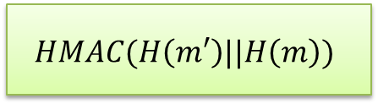

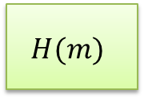


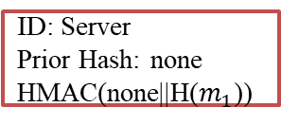
Valid Modification Checks
$$m_{0}$$
$$m_{0}$$
$$m_{1}$$
$$m_{1}$$
Client
Middlebox
Server
ID: Server
Prior Hash: none
HMAC(none||H($m_{1}$))
Message flow
Modification Log Blocks
Each entity describes information about its modification by using HMAC (The HMAC key is called an accountability key)
ID
$$H(m)$$
$$HMAC(H\left(m′\right)||H\left(m\right))$$
$$m →m′$$
* Optimization on a Modification Log is described in the paper
Notes:
All the entities generates a modification log block including its own HMAC of the input and output messages.

Slide 56
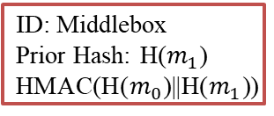
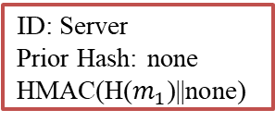
Valid Modification Checks
$$m_{0}$$
$$m_{0}$$
$$m_{1}$$
$$m_{1}$$
Client
Middlebox
Server
ID: Middlebox
Prior Hash: H($m_{1}$)
HMAC(H($m_{0}$)||H($m_{1}$))
ID: Server
Prior Hash: none
HMAC(H($m_{1}$)||none)
Message flow
Modification Log Blocks
Each entity describes information about its modification by using HMAC (The HMAC key is called an accountability key)
ID
$$H(m)$$
$$HMAC(H\left(m′\right)||H\left(m\right))$$
$$m →m′$$
* Optimization on a Modification Log is described in the paper
Notes:
We call HMAC keys accountability keys and a series of HMACs appended by the middleboxes a Modification Log.

Slide 57
Valid Modification Checks
$$m_{0}$$
$$m_{0}$$
$$m_{1}$$
$$m_{1}$$
Client
Middlebox
Server
ID: Middlebox
Prior Hash: H($m_{1}$)
HMAC(H($m_{0}$)||H($m_{1}$))
ID: Server
Prior Hash: none
HMAC(H($m_{1}$)||none)
Message flow
Modification Log Blocks
Each entity describes information about its modification by using HMAC (The HMAC key is called an accountability key)
ID
$$H(m)$$
$$HMAC(H\left(m′\right)||H\left(m\right))$$
Report
$$m →m′$$
Confirmation of who sends and who modifies the message
* Optimization on a Modification Log is described in the paper
Notes:
Now, the client can confirm who sent the message and which middleboxes modified the message to detect unauthorized data source and unauthorized writers.

Slide 58
Valid Modification Checks
$$m_{0}$$
$$m_{0}$$
$$m_{1}$$
$$m_{1}$$
Client
Middlebox
Server
ID: Middlebox
Prior Hash: H($m_{1}$)
HMAC(H($m_{0}$)||H($m_{1}$))
ID: Server
Prior Hash: none
HMAC(H($m_{1}$)||none)
Message flow
Modification Log Blocks
Each entity describes information about its modification by using HMAC (The HMAC key is called an accountability key)
ID
$$H(m)$$
$$HMAC(H\left(m′\right)||H\left(m\right))$$
Report
$$m →m′$$
Confirmation of who sends and who modifies the message
Confirmation of the order of middleboxes
* Optimization on a Modification Log is described in the paper
Notes:
And since HMACs are appended following the order of the middleboxes, the client can confirm whether the message has passed through the established order.

Slide 59
Summary of Audit Mechanisms
Explicit Authentication
Server Authentication
Middlebox Authentication
Server Certificate and Middlebox Certificates
(with their signed certificate timestamps)
Notes:
Now I summarize three audit mechanisms, again.
Explicit authentication aims to achieve server authentication and middlebox authentication by using a series of server certificate and middlebox certificates

Slide 60
Summary of Audit Mechanisms
Explicit Authentication
Server Authentication
Middlebox Authentication
Server Certificate and Middlebox Certificates
(with their signed certificate timestamps)
Security Parameter Verification
Segment Secrecy
Individual Secrecy
Security Information Blocks
Notes:
Security Parameter Verification achieves segment secrecy and individual secrecy by using security information blocks including a selected security parameters

Slide 61
Summary of Audit Mechanisms
Explicit Authentication
Server Authentication
Middlebox Authentication
Server Certificate and Middlebox Certificates
(with their signed certificate timestamps)
Security Parameter Verification
Segment Secrecy
Individual Secrecy
Security Information Blocks
Valid Modification Checks
Data Source Authentication
Modification Accountability
Path Integrity
Modification Log Blocks
Notes:
Valid modification checks aim to achieve data source authentication, modification accountability, and path integrity with modification log blocks

Slide 62
maTLS Handshake
Client
Middlebox
Server
Middlebox
Certificate
CN: mb.com
Issuer: ca1.com
Certificate
CN: alice.com
Issuer: ca2.com
Notes:
To sum up, we build the maTLS handshake.

Slide 63
maTLS Handshake
Client
alice.com
Middlebox
alice.com
Server
MATLS
MATLS
Middlebox
Certificate
CN: mb.com
Issuer: ca1.com
Certificate
CN: alice.com
Issuer: ca2.com
ClientHello and ServerHello,
Notes:
In the client hello and server hello messages,

Slide 64
maTLS Handshake
Client
Middlebox
Server
MATLS
MATLS
Middlebox
Certificate
CN: mb.com
Issuer: ca1.com
Certificate
CN: alice.com
Issuer: ca2.com
ClientHello and ServerHello,
Each segment negotiates its TLS version and ciphersuite
Each entity establishes HMAC keys (accountability keys)
Notes:
First, the usage of the maTLS protocol is negotiated to be used across the entities.
And TLS versions and ciphersuites are determined on segment basis
Finally, each entity establishes accountability keys

Slide 65
maTLS Handshake
Client
Middlebox
Server
Certificate
CN: alice.com
Issuer: ca2.com
Middlebox
Certificate
CN: mb.com
Issuer: ca1.com
ClientHello and ServerHello,
Each segment negotiates its TLS version and ciphersuite
Each entity establishes HMAC keys (accountability keys)
Certificate,
Explicit Authentication
Notes:
With Certificate messages, the client performs explicit authentication

Slide 66
maTLS Handshake
Client
Middlebox
Server
Middlebox
Certificate
CN: mb.com
Issuer: ca1.com
Certificate
CN: alice.com
Issuer: ca2.com
ClientHello and ServerHello,
Each segment negotiates its TLS version and ciphersuite
Each entity establishes HMAC keys (accountability keys)
Certificate,
Explicit Authentication
ServerKeyExchange and ClientKeyExchange,
Each segment establishes its master secret
Notes:
and each segment establishes its master secret with the help of ServerKeyExchange and ClientKeyExchange messages

Slide 67
maTLS Handshake
Client
Middlebox
Server
Version,
Ciphersuite,
…
Version,
Ciphersuite,
…
Version,
Ciphersuite,
…
Version,
Ciphersuite,
…
Finished
Each segment confirms the transcript of their handshake
Notes:
Each segment confirms a transcript of its handshake in Finished messages

Slide 68
maTLS Handshake
Client
Middlebox
Server
Version,
Ciphersuite,
…
Version,
Ciphersuite,
…
Version,
Ciphersuite,
…
Version,
Ciphersuite,
…
Finished
Each segment confirms the transcript of their handshake
ExtendedFinished
Security Parameter Verification
Notes:
We add one more message called ExtendedFinished delivering the information about segments. The client finally executes security parameter verification to confirm the security of the session.

Slide 69
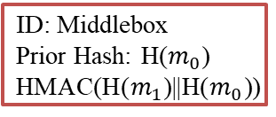
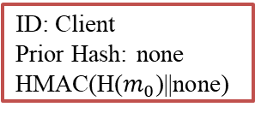
maTLS Record
$$m_{0}$$
$$m_{0}$$
$$m_{1}$$
$$m_{1}$$
Client
Middlebox
Server
ID: Client
Prior Hash: none
HMAC(H($m_{0}$)||none)
ID: Middlebox
Prior Hash: H($m_{0}$)
HMAC(H($m_{1}$)||H($m_{0}$))
Message flow
Message flow
Data Exchange
Valid Modification Checks
* Optimization on a Modification Log is described in the paper
Notes:
After the session is established between the client and the server, the messages are exchanged with modification logs between the client and the server

Slide 70




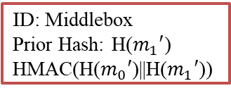
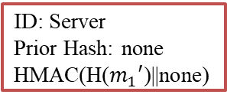
maTLS Record
$$m_{0}′$$
$$m_{0}′$$
$$m_{1}′$$
$$m_{1}′$$
Client
Middlebox
Server
ID: Middlebox
Prior Hash: H($m_{1}′$)
HMAC(H($m_{0}′$)||H($m_{1}′$))
ID: Server
Prior Hash: none
HMAC(H($m_{1}′$)||none)
Message flow
Message flow
Data Exchange
Valid Modification Checks
* Optimization on a Modification Log is described in the paper
Notes:
And endpoints performs valid modification checks to understand who sent the message and which middleboxes modified the message

Slide 71
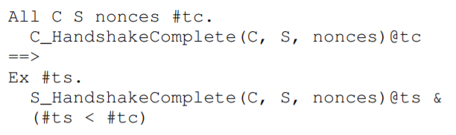
Security Verification
Security verification of maTLS through Tamarin
Dolev-Yao adversary
Can capture all the messages delivered on the air
Can insert/drop/alter/reorder messages
Can corrupt long-term keys
Seven lemmas (security goals in first-order logic)
Example of
Server Authentication
The result shows that the maTLS protocol is secure
* The implementation can be found at https://github.com/middlebox-aware-tls/matls-tamarin.git
Notes:
To verify the maTLS protocol, we implement the protocol and the security goals by using Tamarin, a state-of-the-art symbolic verification tool. The result shows that the maTLS protocol is secure in terms of our security goals.

Slide 72
Evaluation Setting
All the applications are implemented in C with OpenSSL (for maTLS)
Client
Client-side
Middlebox
Located in
Seoul National University
Client: Intel Broadwell CPU at 3.30GHz with 1GB Memory
Client-side Middlebox: Intel Core i7 at 2.30GHz with 1GB Memory
Located in
AWS Seoul (Intra-Country)
AWS Tokyo (Intra-Region)
AWS Virginia (Inter-Region)
Server-side
Middlebox
Server
Server and Server-side Middlebox: Intel Xeon CPU E5-3676 at 2.40GHz with 1GB Memory
* The implementation can be found at https://github.com/middlebox-aware-tls/matls-implementation.git
Notes:
We also implemented the maTLS protocol, by extending OpenSSL to show the performance overhead incurred by the protocol.
We situated the client and the client-side middlebox in SNU campus.
The server and the server-side middlebox is located in three different location according the scenario.
We call an intra-country scenario when the server and the server-side middlebox is set on AWS Seoul,
an intra-region scenario when the server and the server-side middlebox is set on AWS Tokyo,
and an inter-region scenario when the server and the server-side middlebox is set on AWS Virginia,

Slide 73
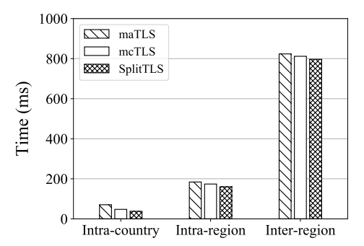
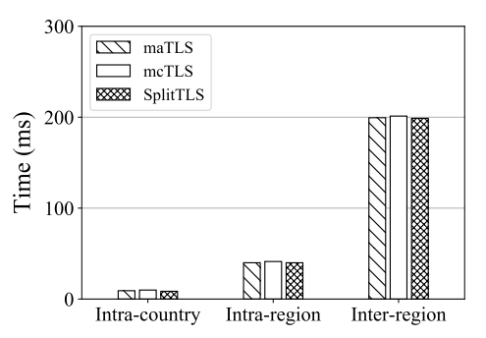
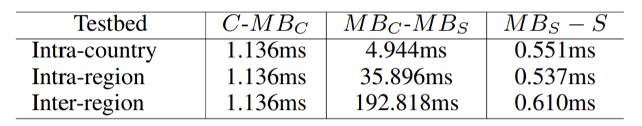
Evaluation – HTTP Load Time
HTTP Load Time
Data Transfer Time
HTTP Load Time: The TLS handshake and the HTTP message exchange (GET and RESPONSE)
Data Transfer Time: Only the HTTP message exchange (GET and RESPONSE)
Notes:
Now let's see the performance overhead incurred by the maTLS protocol.
The left chart shows HTTP load time including a TLS handshake time and the HTTP message exchange.
And the right chart demonstrates the data transfer time including only the HTTP message exchange.
We compare the maTLS protocol with the SplitTLS protocol and the mcTLS protocol.

Slide 74
Evaluation – HTTP Load Time
HTTP Load Time
Data Transfer Time
The maTLS protocol introduces a slight delay (10.22ms – 32.52ms) compared to SplitTLS and mcTLS
HTTP Load Time: The TLS handshake and the HTTP message exchange (GET and RESPONSE)
Data Transfer Time: Only the HTTP message exchange (GET and RESPONSE)
Notes:
The maTLS protocol introduces a slight delay compared to SplitTLS and mcTLS.

Slide 75
Evaluation – HTTP Load Time
HTTP Load Time
Data Transfer Time
Three schemes show similar delay time for data transfer.
HTTP Load Time: The TLS handshake and the HTTP message exchange (GET and RESPONSE)
Data Transfer Time: Only the HTTP message exchange (GET and RESPONSE)
Notes:
Interestingly, three schemes show similar delay time for data transfer.

Slide 76
Evaluation – HTTP Load Time
HTTP Load Time
Data Transfer Time
We conclude that the maTLS overhead is mainly due to the setup of an maTLS session
HTTP Load Time: The TLS handshake and the HTTP message exchange (GET and RESPONSE)
Data Transfer Time: Only the HTTP message exchange (GET and RESPONSE)
Notes:
Based on two observations, we conclude that the maTLS overhead is mainly due to the setup of an maTLS session

Slide 77
Evaluation – HTTP Load Time
HTTP Load Time
Data Transfer Time
Once the session is established,
maTLS provides similar performance to the others
while preserving all security merits that we have discussed
HTTP Load Time: The TLS handshake and the HTTP message exchange (GET and RESPONSE)
Data Transfer Time: Only the HTTP message exchange (GET and RESPONSE)
Notes:
This means that once the session is established, maTLS provides similar performance to the others while preserving all security merits that we have discussed

Slide 78
Conclusion
SplitTLS is risky
Client is not aware of the middleboxes involved
Client is forced to fully trust behavior of middleboxes
Auditable Middlebox
Middlebox Certificate
Middlebox Transparency System
Middlebox-aware TLS (maTLS)
Explicit Authentication
Security Parameter Verification
Valid Modification Checks
Notes:
Today I have shown you, the SplitTLS is risky, so we propose a notion of auditable middleboxes and the maTLS protocol based on three audit mechanisms.
I hope this protocol helps the endpoint to securely introduce middleboxes while guaranteeing the end-to-end security between the server and the client.

Slide 79
fin.
email: hwlee2014@mmlab.snu.ac.kr
project webpage: https://middlebox-aware-tls.github.io
source codes: https://github.com/middlebox-aware-tls
Notes:
This is end of my presentation and thank you very much for your attention. If there are any questions, I shall do my best to answer them. I would welcome any comments or suggestion.

Slide 80
Backup Slides

Slide 81
Why Middleboxes?
Acceptable Use Policy
Marware and Threat Protection
IoT Endpoint Protection
Unpatched Endpoint Protection
Crypto Security Audit
…
* I get the use cases from a draft of the RFC document titled “TLS 1.3 Impact on Network-Based Security”

Slide 82
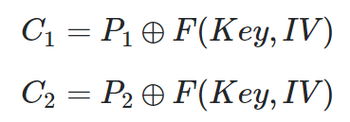



Why Individual Secrecy?
It is known that initialization vector should not be reused
Without Individual Secrecy, confidentiality is undermined
This happened when the same keystream is used across the session and the middlebox modified the message
Middlebox
$$C_{1}$$
$$C_{2}$$
The same keystream with the different message
It is desirable to use different segment keys across the session

Slide 83
Why Path Integrity?
Message Flow
Client
Anonymizer
Firewall
Server
The data is anonymized and then the firewall read it
Client
Firewall
Anonymizer
Server
The firewall read the data and then it is anonymized

Slide 84
Session Establishment Approach (1)
Top-down approach
Server determines a TLS version, a ciphersuite, and extensions
Client
Middlebox
Server
Client
Middlebox
Server

Slide 85
Session Establishment Approach (2)
Bottom-up approach
A TLS version, a ciphersuite, and extensions are selected on a segment basis
Client
Middlebox
Server
Client
Middlebox
Server

Slide 86
Difference from mcTLS
mcTLS does not achieves Individual Secrecy
The same keystream is used across the session, which might undermine the confidentiality of the session
maTLS establishes different segment keys in different segments
mcTLS requires all the entities support the protocol
Since the server determines the extensions among the “intersection” of the supported extensions by all the entities
maTLS allows a partial maTLS session

Slide 87
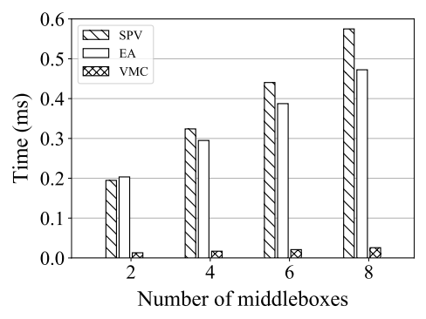
Evaluation – Scalability of Three Audit Mechanisms
SPV: Security Parameter Verification / EA: Explicit Authentication / VMC: Valid Modification Checks
Notes:
The next chart is regarding the scalability of the three audit mechanisms with regard to the number of middleboxes.

Slide 88
Evaluation – Scalability of Three Audit Mechanisms
0.063ms per middlebox
0.045ms per middlebox
0.026ms for 8 middleboxes
SPV: Security Parameter Verification / EA: Explicit Authentication / VMC: Valid Modification Checks
Notes:
Note that the increments are marginal. For example, only 0.063ms and 0.045ms are increased per one middlebox added for security parameter verification and explicit authentication, respectively.
Interestingly, only 0.026ms is needed for valid modification checks even with 8 middleboxes. This is natural because HMAC operations require small computation

Slide 89
Evaluation – Scalability of Three Audit Mechanisms
We conclude that the audit mechanisms can achieve
their goals without incurring a substantial delay
SPV: Security Parameter Verification / EA: Explicit Authentication / VMC: Valid Modification Checks
Notes:
Therefore, we conclude that the audit mechanisms can achieve their goals without incurring a substantial delay

Slide 90
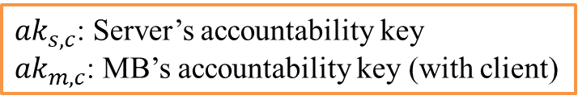











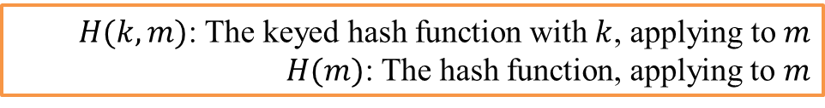


Modification Log
${ak}_{s,c}$: Server’s accountability key
${ak}_{m,c}$: MB’s accountability key (with client)
$H(k, m)$: The keyed hash function with $k$, applying to $m$
$H(m)$: The hash function, applying to $m$
A series of global message authentication codes
End point: Server, Client, or a valid end-point middlebox such as a cache proxy
$$m$$
$${ID}_{s}$$
$$H({ak}_{s,c}, H(m))$$
$${ID}_{mb}$$
$$H(m)$$
$$H({ak}_{m,c}, H\left(m\right)||H(m^{′}))$$
Local MAC
Writer: HTTP Header Enrichment, Optimizer (adding JavaScript) ($m→m′$)
$$m$$
$${ID}_{s}$$
$$H({ak}_{s,c}, H(m))$$
$${ID}_{mb}$$
$$H(m)$$
$$H({ak}_{m,c}, H\left(m\right)||H(m^{′}))$$
Local MAC
${ID}_{mb}$ modifies $m$ into $m’$
Modification Record
$(modification_record_length) =$
$(1 + 3 ∗ (the number of middlebox writers)) ∗ (SecurityParameters.mac_length)$

Slide 91


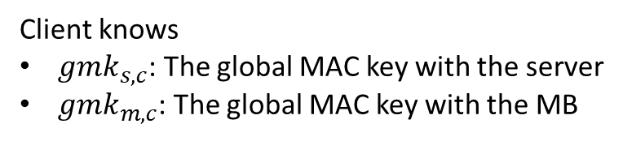






Modification Record Verification
Client
$$m′$$
MB
$$m$$
Server
$$m$$
$${ID}_{s}$$
$$H({gmk}_{s,c}, H(m))$$
$${ID}_{mb}$$
$$H(m)$$
$$H({gmk}_{m,c}, H\left(m\right)||H(m^{′}))$$
Client knows
${gmk}_{s,c}$: The global MAC key with the server
${gmk}_{m, c}$: The global MAC key with the MB

Slide 92

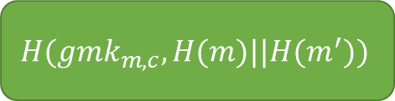
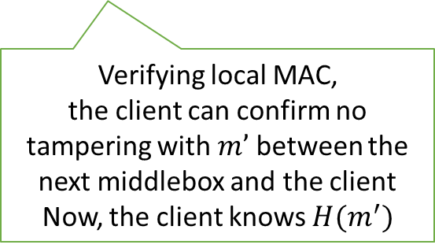


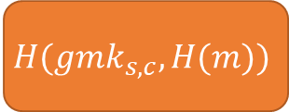
Modification Record Verification
$m$’
$$H({gmk}_{s,c}, H(m))$$
$${ID}_{mb}$$
$$H(m)$$
$$H({gmk}_{m,c}, H(m)||H(m^{′}))$$
Verifying local MAC,
the client can confirm no tampering with $m’$ between the next middlebox and the client
Now, the client knows $H(m^{′})$
Client knows
${gmk}_{s,c}$: The global MAC key with the server
${gmk}_{m, c}$: The global MAC key with the MB

Slide 93
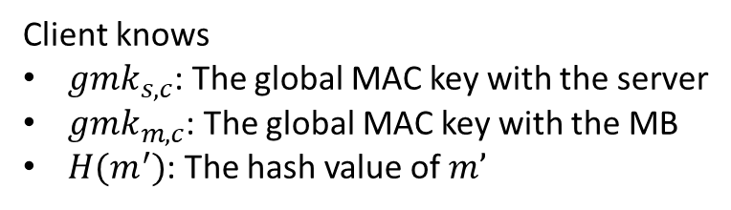
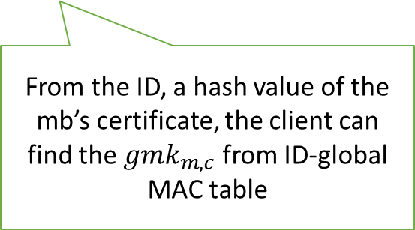
Modification Record Verification
$m$’
$$H({gmk}_{s,c}, H(m))$$
$${ID}_{mb}$$
$$H(m)$$
$$H({gmk}_{m,c}, H(m)||H(m^{′}))$$
From the ID, a hash value of the mb’s certificate, the client can find the ${gmk}_{m, c}$ from ID-global MAC table
Client knows
${gmk}_{s,c}$: The global MAC key with the server
${gmk}_{m, c}$: The global MAC key with the MB
$H(m^{′})$: The hash value of $m’$

Slide 94
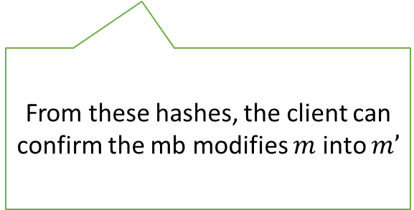
Modification Record Verification
$m$’
$$H({gmk}_{s,c}, H(m))$$
$${ID}_{mb}$$
$$H(m)$$
$$H({gmk}_{m,c}, H(m)||H(m^{′}))$$
From these hashes, the client can confirm the mb modifies $m$ into $m’$
Client knows
${gmk}_{s,c}$: The global MAC key with the server
${gmk}_{m, c}$: The global MAC key with the MB
$H(m^{′})$: The hash value of $m’$

Slide 95
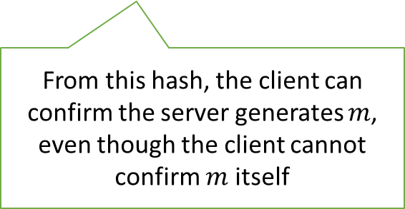
Modification Record Verification
$m$’
$$H({gmk}_{s,c}, H(m))$$
$${ID}_{mb}$$
$$H(m)$$
$$H({gmk}_{m,c}, H(m)||H(m^{′}))$$
From this hash, the client can confirm the server generates $m$,
even though the client cannot confirm $m$ itself
Client knows
${gmk}_{s,c}$: The global MAC key with the server
${gmk}_{m, c}$: The global MAC key with the MB
$H(m^{′})$: The hash value of $m’$

Slide 96
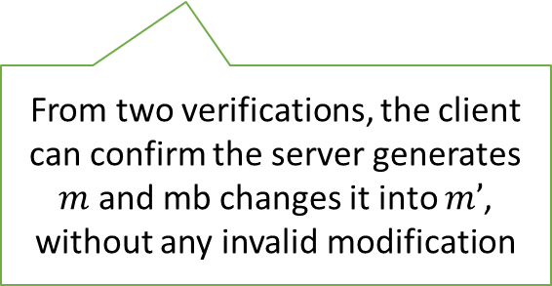
Modification Record Verification
$m$’
$$H({gmk}_{s,c}, H(m))$$
$${ID}_{mb}$$
$$H(m)$$
$$H({gmk}_{m,c}, H(m)||H(m^{′}))$$
From two verifications, the client can confirm the server generates $m$ and mb changes it into $m’$, without any invalid modification
Client knows
${gmk}_{s,c}$: The global MAC key with the server
${gmk}_{m, c}$: The global MAC key with the MB
$H(m^{′})$: The hash value of $m’$

