Slide 1
CSCI-351 Data communication and Networks
Lecture 8: Network Layer
(Putting the Net in Internet)
The slide is built with the help of Prof. Alan Mislove, Christo Wilson, and David Choffnes's class

Slide 2
Recap

Slide 3
Network Layer
Function:
Route packets end-to-end on a network, through multiple hops
Key challenge:
How to represent addresses
How to route packets
Scalability
Convergence
Application
Presentation
Session
Transport
Network
Data Link
Physical

Slide 4



Routers, Revisited
How to connect multiple LANs?
LANs may be incompatible
Ethernet, Wifi, etc…
Connected networks form an internetwork
The Internet is the best known example
Routers

Slide 5
Structure of the Internet
Network 3
Network 1
Network 4
Network 2
Ad-hoc interconnection of networks
No organized topology
Vastly different technologies, link capacities
Packets travel end-to-end by hopping through networks
Routers “peer” (connect) different networks
Different packets may take different routes

Slide 6
Internetworking Issues
Naming / Addressing
How do you designate hosts?
Routing
Must be scalable (i.e. a switched Internet won’t work)
Service Model
What gets sent?
How fast will it go?
What happens if there are failures?
Must deal with heterogeneity
Remember, every network is different
Internet Service Model
Best-effort (i.e. things may break)
Store-and-forward datagram network

Slide 7
Outline
Addressing
Class-based
CIDR
IPv4 Protocol Details
Packed Header
Fragmentation
IPv6

Slide 8
Possible Addressing Schemes
Flat
e.g. each host is identified by a 48-bit MAC address
Router needs an entry for every host in the world
Too big
Too hard to maintain (hosts come and go all the time)
Too slow (more later)
Hierarchy
Addresses broken down into segments
Each segment has a different level of specificity
Notes:
If time, show correlation between lookup speed and maximum line rate

Slide 9
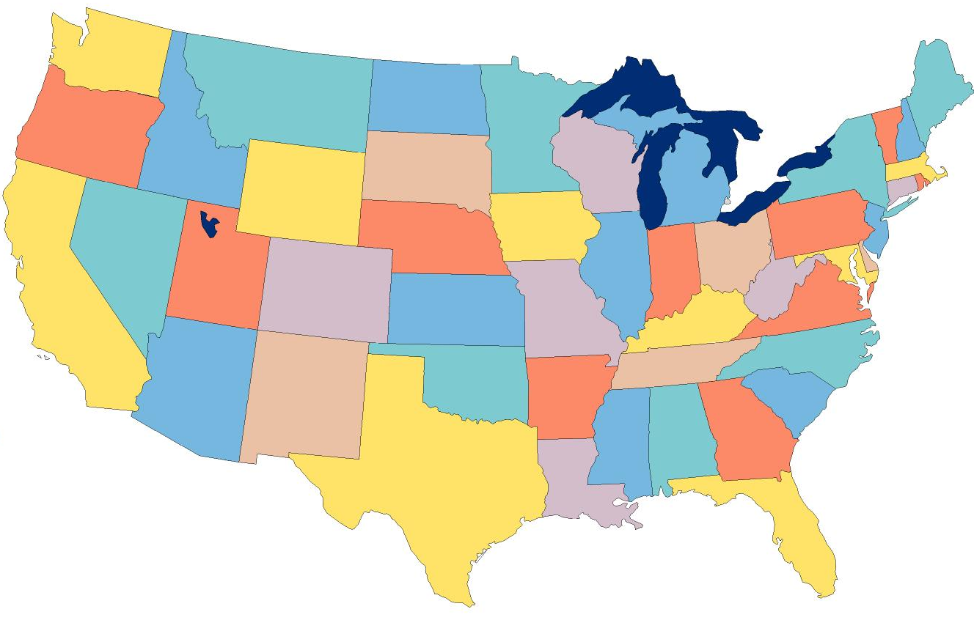

Example: Telephone Numbers
1-585-475-1234
3278
Very General
RIT GCCIS Room 4567
RIT GCCIS Room 1234
Updates are Local
Very Specific

Slide 10
Binary Hierarchy Example
1**
Datagram, Destination = 101
10*
100
101
11*
0**
110
00*
111
000
001
01*
010
011

Slide 11
IP Addressing
IPv4: 32-bit addresses
Usually written in dotted notation, e.g. 192.168.21.76
Each number is a byte
Stored in Big Endian order
0
8
16
24
31
Decimal
192
168
21
76
Hex
C0
A8
15
4C
Binary
11000000
10101000
00010101
01001100

Slide 12
IP Addressing and Forwarding
Routing Table Requirements
For every possible IP, give the next hop
But for 32-bit addresses, 2³² possibilities!
Too slow: 48GE ports and 4x10GE needs 176Gbps bandwidth DRAM: ~1-6 Gbps; TCAM is fast, but 400x cost of DRAM
Hierarchical address scheme
Separate the address into a network and a host
0
31
Pfx
Network
Host
Known by all routers
Known by edge (LAN) routers

Slide 13
Recap

Slide 14
IP address
IPv4: 32-bit addresses
Too big to fit into a routing table (2^32)
Let’s make a hierarchy!
Class-based IP address
Some address spaces are wasted
Still too many hosts in one network
Let’s make another hierarchy!
Subnet Mask
Classless Routing

Slide 15
Classes of IP Addresses
0
1
8
16
24
31
Class A
Example: MIT
18.*.*.*
0
Ntwk
Host
1-126
0
2
8
16
24
31
Class B
Example: RIT
172.31.*.*
10
Network
Host
128-191
0
3
8
16
24
31
Class C
Example:
216.63.78.*
110
Network
Host
192-223

Slide 16

How Do You Get IPs?
IP address ranges controlled by IANA
Internet Assigned Number Authority
Roots go back to 1972, ARPANET, UCLA
Today, part of ICANN
IANA grants IPs to regional authorities
ARIN (American Registry of Internet Numbers) may grant you a range of IPs
You may then advertise routes to your new IP range
There are now secondary markets, auctions, …
Notes:
Internet Corporation for Assigned Names and Numbers
Arin ripe apnic lacnic afrinic

Slide 17
Two Level Hierarchy
Pfx
Network
Host
…
Subtree size determined by network class
…

Slide 18
Class Sizes
Way too big
Class | Prefix Bits | Network Bits | Number of Classes | Hosts per Class
A | 1 | 7 | 2⁷ – 2 = 126 (0 and 127 are reserved) | 2²⁴ – 2 = 16,777,214 (All 0 and all 1 are reserved)
B | 2 | 14 | 2¹⁴ = 16,398 | 2¹⁶ – 2 = 65,534 (All 0 and all 1 are reserved)
C | 3 | 21 | 2²¹ = 2,097,512 | 2⁸ – 2 = 254 (All 0 and all 1 are reserved)
 |  |  | Total: 2,114,036
Too many network IDs
Too small to be useful
Notes:
inefficient, routing tables are too large

Slide 19
Subnets
Problem: need to break up large A and B classes
Solution: add another layer to the hierarchy
From the outside, appears to be a single network
Only 1 entry in routing tables
Internally, manage multiple subnetworks
Split the address range using a subnet mask
Pfx
Ntwk
Subnet
Host
Subnet Mask:

Slide 20
Subnet Example
Extract network:
IP Address:
10110101 11011101 01010100 01110010
Subnet Mask:
& 11111111 11111111 11000000 00000000
Result:
10110101 11011101 01000000 00000000
Extract host:
IP Address:
10110101 11011101 01010100 01110010
& ~(11111111 11111111 11000000 00000000)
Subnet Mask:
Result:
00000000 00000000 00010100 01110010

Slide 21
N-Level Subnet Hierarchy
Pfx
Network
Subnet
Host
…
Tree does not have a fixed depth
Increasingly specific subnet masks
…
Subtree size determined by length of subnet mask
…

Slide 22
Example Routing Table
Address Pattern | Subnet Mask | Destination Router
0.0.0.0 | 0.0.0.0 | Router 4
18.0.0.0 | 255.0.0.0 | Router 2
128.42.0.0 | 255.255.0.0 | Router 3
128.42.128.0 | 255.255.128.0 | Router 5
128.42.222.0 | 255.255.255.0 | Router 1
Question: 128.42.222.198 matches four rows
Which router do we forward to?
Longest prefix matching
Use the row with the longest number of 1’s in the mask
This is the most specific match
Notes:
128.42.222.198: 10000000.00101010.11011110.11000110
4/3/5/1
Subnet mask: 255.255.192.0

Slide 23
Subnetting Revisited
Question: does subnetting solve all the problems of class-based routing?
NO
Classes are still too coarse
Class A can be subnetted, but only 126 available
What if MIT does not use all IPs?
Class C is too small
Class B is nice, but there are only 16,398 available
Routing tables are still too big
2.1 million entries per router

Slide 24
Classless Inter Domain Routing
CIDR, pronounced ‘cider’
Key ideas:
Get rid of IP classes
Use bitmasks for all levels of routing
Aggregation to minimize FIB (forwarding information base)
Arbitrary split between network and host
Specified as a bitmask or prefix length
Example: Rochester Institute of Technology
172.31.0.0 with netmask 255.255.0.0
172.31.0.0 / 16

Slide 25
Aggregation with CIDR
Original use: aggregating class C ranges
One organization given contiguous class C ranges
Example: Microsoft, 207.46.192.* – 207.46.255.*
Represents 2⁶ = 64 class C ranges
Specified as CIDR address 207.46.192.0/18
0
8
16
24
31
Decimal
207
46
192
0
Hex
CF
2E
C0
00
Binary
11001111
00101110
11xxxxxx
xxxxxxxx
18 Bits Frozen By Netmask
14 Arbitrary Bits

Slide 26
Example CIDR Routing
Insert an routing entry to cover all addresses under 207.46.0.0/16
Address | Netmask | Third Byte | Byte Range
207.46.0.0 | 19 | 000xxxxx | 0 – 31
207.46.32.0 | 19 | 001xxxxx | 32 – 63
207.46.64.0 | 19 | 010xxxxx | 64 – 95
207.46.128.0 | 18 | 10xxxxxx | 128 – 191
207.46.192.0 | 18 | 11xxxxxx | 192 – 255
Hole in the Routing Table: No coverage for 96 – 127
207.46.96.0/19
Notes:
11001111.00101110.000XXXXX.0

Slide 27
Example CIDR Routing
Insert an routing entry to cover all addresses under 207.46.0.0/16
Address | Bit-represented Address
207.46.0.0/19 | 11001111.00101110.00000000.00000000/19
207.46.32.0/19 | 11001111.00101110.00100000.00000000/19
207.46.64.0/19 | 11001111.00101110.01000000.00000000/19
207.46.128.0/18 | 11001111.00101110.10000000.00000000/18
207.46.192.0/18 | 11001111.00101110.11000000.00000000/18

Slide 28
Example CIDR Routing
Insert an routing entry to cover all addresses under 207.46.0.0/16
Address | Bit-represented Address
207.46.0.0/19 | 11001111.00101110.00000000.00000000/19
207.46.32.0/19 | 11001111.00101110.00100000.00000000/19
207.46.64.0/19 | 11001111.00101110.01000000.00000000/19
207.46.96.0/19 | 11001111.00101110.01100000.00000000/19
207.46.128.0/18 | 11001111.00101110.10000000.00000000/18
207.46.192.0/18 | 11001111.00101110.11000000.00000000/18

Slide 29
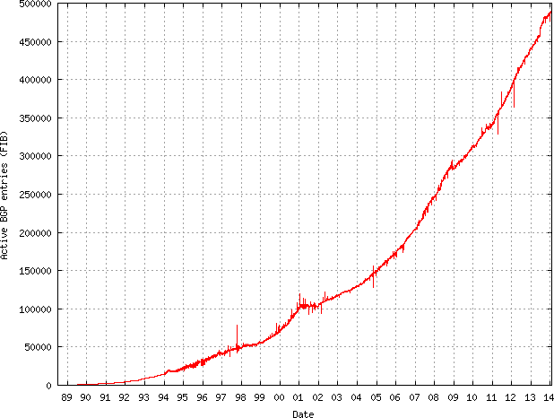
Size of CIDR Routing Tables
From www.cidr-report.org
CIDR has kept IP routing table sizes in check
Currently ~450,000 entries for a complete IP routing table
Only required by backbone routers

Slide 30
Takeaways
Hierarchical addressing is critical for scalability
Not all routers need all information
Limited number of routers need to know about changes
Non-uniform hierarchy useful for heterogeneous networks
Class-based addressing is too course
CIDR improves scalability and granularity
Implementation challenges
Longest prefix matching is more difficult than schemes with no ambiguity

Slide 31
Outline
Addressing
Class-based
CIDR
IPv4 Protocol Details
Packed Header
Fragmentation
IPv6

Slide 32
IP Datagrams
IP Datagrams are like a letter
Totally self-contained
Include all necessary addressing information
No advanced setup of connections or circuits
0
4
8
12
16
19
24
31
Version
HLen
DSCP/ECN
Datagram Length
Identifier
Flags
Offset
TTL
Protocol
Checksum
Source IP Address
Destination IP Address
Options (if any, usually not)
Data

Slide 33
IP Header Fields: Word 1
Version: 4 for IPv4
Header Length: Number of 32-bit words (usually 5)
Type of Service: Priority information (unused)
Datagram Length: Length of header + data in bytes
0
4
8
12
16
19
24
31
Version
HLen
DSCP/ECN
Datagram Length
Identifier
Flags
Offset
TTL
Protocol
Checksum
Limits packets to 65,535 bytes
Source IP Address
Destination IP Address
Options (if any, usually not)
Data
Notes:
Differentiated Services Code Point (DSCP)
Explicit Congestion Notification (ECN)
PROTOCOL: UDP/TCP

Slide 34
IP Header Fields: Word 3
Time to Live: decremented by each router
Used to kill looping packets
Protocol: ID of encapsulated protocol
6 = TCP, 17 = UDP
Checksum
0
4
8
12
16
19
24
31
Version
HLen
DSCP/ECN
Datagram Length
Identifier
Flags
Offset
TTL
Protocol
Checksum
Source IP Address
Used to implement trace route
Destination IP Address
Options (if any, usually not)
Data

Slide 35
IP Header Fields: Word 4 and 5
Source and destination address
In theory, must be globally unique
In practice, this is often violated
0
4
8
12
16
19
24
31
Version
HLen
DSCP/ECN
Datagram Length
Identifier
Flags
Offset
TTL
Protocol
Checksum
Source IP Address
Destination IP Address
Options (if any, usually not)
Data

Slide 36
Problem: Fragmentation
MTU = 4000
MTU = 2000
MTU = 1500
Datagram
Dgram1
Dgram2
1
2
3
4
Problem: each network has its own MTU
DARPA principles: networks allowed to be heterogeneous
Minimum MTU may not be known for a given path
IP Solution: fragmentation
Split datagrams into pieces when MTU is reduced
Reassemble original datagram at the receiver

Slide 37
IP Header Fields: Word 2
Identifier: a unique number for the original datagram
Flags: M flag (3 bits)
Offset: byte position of the first byte in the fragment
Divided by 8
0
4
8
12
16
19
24
31
Version
HLen
TOS
Datagram Length
Identifier
Flags
Offset
TTL
Protocol
Checksum
Source IP Address
Destination IP Address
Options (if any, usually not)
Data
Notes:
A three-bit field follows and is used to control or identify fragments. They are (in order, from most significant to least significant):
bit 0: Reserved; must be zero.[note 1]
bit 1: Don't Fragment (DF)
bit 2: More Fragments (MF)

Slide 38
Fragmentation Example
MTU = 4000
MTU = 2000
MTU = 1500
Length = 2000, M = 1
Offset = 0
IP
Data
Length = 3820, M = 0
20
1980
IP Hdr
Data
3800
1980
+ 1820
= 3800
20
Length = 1840, M = 0
Offset = 1980
IP
Data
20
1820

Slide 39
Fragmentation Example
MTU = 2000
MTU = 1500
Length = 2000, M = 1
Offset = 0
Length = 1500, M = 1
Offset = 0
IP
Data
IP
Data
Length = 1500, M = 1
Offset = 1980
20
1980
20
1480
IP
Data
Length = 520, M = 1
Offset = 1480
1480
+ 500
= 1980
20
1480
Length = 1840, M = 0
Offset = 1980
IP
Data
Length = 360, M = 0
Offset = 3460
IP
Data
20
500
IP
Data
20
1820
20
340

Slide 40
IP Fragment Reassembly
Length = 1500, M = 1, Offset = 0
Performed at destination
M = 0 fragment gives us total data size
360 – 20 + 3460 = 3800
Challenges:
Out-of-order fragments
Duplicate fragments
Missing fragments
Basically, memory management nightmare
IP
Data
20
1480
Length = 520, M = 1, Offset = 1480
IP
Data
20
500
Length = 1500, M = 1, Offset = 1980
IP
Data
20
1480
Length = 360, M = 0, Offset = 3460
IP
Data
20
340

Slide 41
Fragmentation Concepts
Highlights many key Internet characteristics
Decentralized and heterogeneous
Each network may choose its own MTU
Connectionless datagram protocol
Each fragment contains full routing information
Fragments can travel independently, on different paths
Best effort network
Routers/receiver may silently drop fragments
No requirement to alert the sender
Most work is done at the endpoints
i.e. reassembly

Slide 42
Fragmentation in Reality
Fragmentation is expensive
Memory and CPU overhead for datagram reconstruction
Want to avoid fragmentation if possible
MTU discovery protocol
Send a packet with “don’t fragment” bit set
Keep decreasing message length until one arrives
May get “can’t fragment” error from a router, which will explicitly state the supported MTU
Router handling of fragments
Fast, specialized hardware handles the common case
Dedicated, general purpose CPU just for handling fragments
Examples
Censorship?

Slide 43
Outline
Addressing
Class-based
CIDR
IPv4 Protocol Details
Packed Header
Fragmentation
IPv6

Slide 44
The IPv4 Address Space Crisis
Problem: the IPv4 address space is too small
2³² = 4,294,967,296 possible addresses
Less than one IP per person
Parts of the world have already run out of addresses
IANA assigned the last /8 block of addresses in 2011
Region | Regional Internet Registry (RIR) | Exhaustion Date
Asia/Pacific | APNIC | April 19, 2011
Europe/Middle East | RIPE | September 14, 2012
North America | ARIN | September 24, 2015
South America | LACNIC | June 10, 2014
Africa | AFRINIC | 2019 (Projected)

Slide 45
IPv6
IPv6, first introduced in 1998(!)
128-bit addresses
4.8 * 10²⁸ addresses per person
Address format
8 groups of 16-bit values, separated by ‘:’
Leading zeroes in each group may be omitted
Groups of zeroes can be omitted using ‘::’
2001:0db8:0000:0000:0000:ff00:0042:8329
2001:0db8:0:0:0:ff00:42:8329
2001:0db8::ff00:42:8329

Slide 46
IPv6 Trivia
Who knows the IP for localhost?
127.0.0.1
What is localhost in IPv6?
::1

Slide 47
IPv6 Header
Double the size of IPv4 (320 bits vs. 160 bits)
0
4
8
12
16
19
24
31
Version
DSCP/ECN
Flow Label
Datagram Length
Next Header
Hop Limit
Version = 6
Same as IPv4
Groups packets into flows, used for QoS
Same as IPv4
Same as Protocol in IPv4
Same as TTL in IPv4
Source IP Address
Destination IP Address
Notes:
Differentiated Services Code Point (DSCP)
Next Header specifies the transport layer protocol used by a packet’s payload. TCP (6), UDP (17)

Slide 48
Differences from IPv4 Header
Several header fields are missing in IPv6
Header length – rolled into Next Header field
Checksum – was useless, so why keep it
Identifier, Flags, Offset
IPv6 routers do not support fragmentation
Hosts are expected to use path MTU discovery
Reflects changing Internet priorities
Today’s networks are more homogeneous
Instead, routing cost and complexity dominate
No security vulnerabilities due to IP fragments

Slide 49
Performance Improvements
No checksums to verify
No need for routers to handle fragmentation
Simplified routing table design
Address space is huge
No need for CIDR (but need for aggregation)
Standard subnet size is 2⁶⁴ addresses
Simplified auto-configuration
Neighbor Discovery Protocol
Used by hosts to determine network ID
Host ID can be random!

Slide 50
Additional IPv6 Features
Source Routing
Host specifies the route to wants packet to take
Mobile IP
Hosts can take their IP with them to other networks
Use source routing to direct packets
Privacy Extensions
Randomly generate host identifiers
Make it difficult to associate one IP to a host
Jumbograms
Support for 4Gb datagrams

Slide 51
Deployment Challenges
HTTP, FTP, SMTP, RTP, IMAP, …
TCP, UDP, ICMP
IPv4
Ethernet, 802.11x, DOCSIS, …
Fiber, Coax, Twisted Pair, Radio, …
Switching to IPv6 is a whole-Internet upgrade
All routers, all hosts
ICMPv6, DHCPv6, DNSv6
2013: 0.94% of Google traffic was IPv6

Slide 52
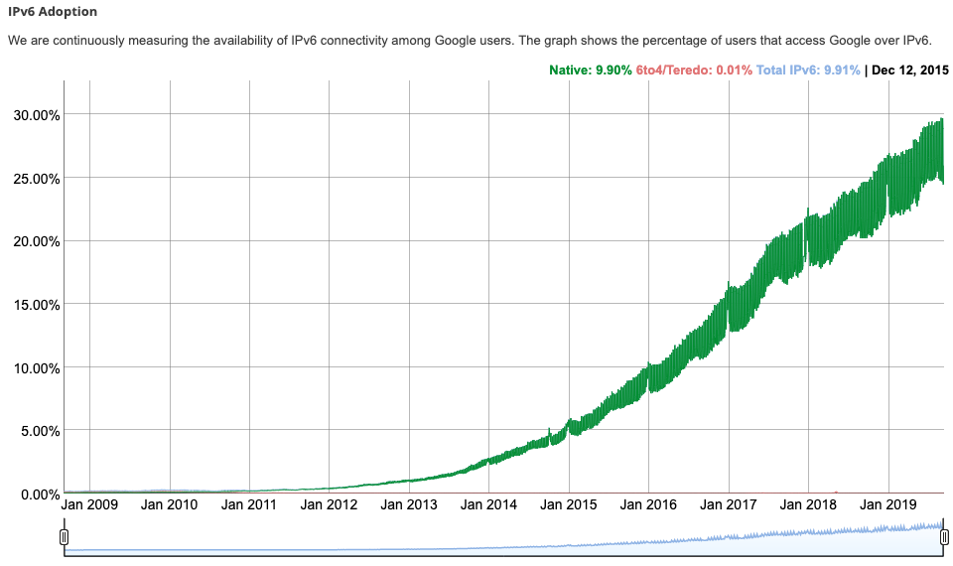
https://www.google.com/intl/en/ipv6/statistics.html

Slide 53
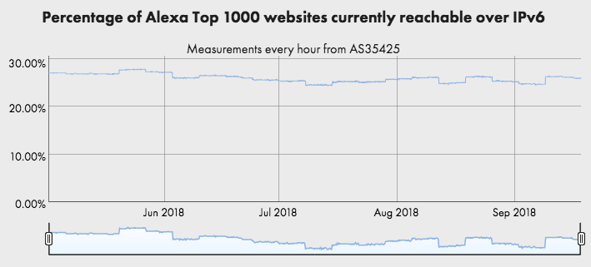
Server-side reachability

Slide 54
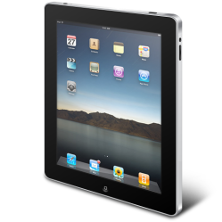
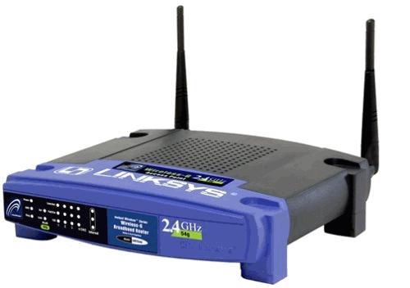
Transitioning to IPv6
How do we ease the transition from IPv4 to IPv6?
Today, most network edges are IPv6 ready
Windows/OSX/iOS/Android all support IPv6
Your wireless access point probably supports IPv6
The Internet core is hard to upgrade
… but a IPv4 core cannot route IPv6 traffic
IPv6 Ready
IPv4 Only :(
IPv6 Ready
IPv6 Packets
Home
Network
Core
Internet
Business
Network

Slide 55
Transition Technologies
How do you route IPv6 packets over an IPv4 Internet?
Transition Technologies
Use tunnels to encapsulate and route IPv6 packets over the IPv4 Internet
Several different implementations
6to4
IPv6 Rapid Deployment (6rd)
Teredo
… etc.

Slide 56
6to4 Basics
Problem: you’ve been assigned an IPv4 address, but you want an IPv6 address
Your ISP can’t or won’t give you an IPv6 address
You can’t just arbitrarily choose an IPv6 address
Solution: construct a 6to4 address
6to4 addresses always start with 2002::
Embed the 32-bit IPv4 inside the 128-bit IPv6 address
IPv4:
207.
46.
192.
0
IPv6:
20 02:
CF 2E:
C0 00:
0000

Slide 57
Routing from 6to4 to 6to4
How does a host using 6to4 send a packet to another host using 6to4?
Dest: 16.79.8.0
Dest: 2002:104F:0800::
IPv4
Internet
IPv4 – 207.46.192.0
IPv6 – 2002:CF2E:C000::
IPv4 – 16.79.8.0
IPv6 – 2002:104F:0800::

Slide 58
Routing from 6to4 to Native IPv6
Special, anycasted IPv4 address for
6to4 Relay Routers
Dest: 192. 88.99.1
Dest: 1893:92:13:99::
IPv4
Internet
IPv4 – 192.88.99.1
IPv6 – 2002:: /16
IPv4 – 207.46.192.0
IPv6 – 2002:CF2E:C000::
IPv6
Internet
Many ISPs provide 6to4 relay routers
IPv6 – 1893:92:13:99::

Slide 59
Routing from Native IPv6 to 6to4
IPv4
Internet
IPv4 – 192.88.99.1
IPv6 – 2002:: /16
Dest: 207.46.192.0
IPv4 – 207.46.192.0
IPv6 – 2002:CF2E:C000::
IPv6
Internet
Use normal IPv6 routing to reach a 6to4 relay router
Dest: 2002:CF2E:C000::
IPv6 – 1893:92:13:99::

Slide 60
Problems with 6to4
Uniformity
Not all ISPs have deployed 6to4 relays
Quality of service
Third-party 6to4 relays are available
…but, they may be overloaded or unreliable
Reachability
6to4 doesn’t work if you are behind a NAT
Possible solutions
IPv6 Rapid Deployment (6rd)
Each ISP sets up relays for its customers
Does not leverage the 2002:: address space
Teredo
Tunnels IPv6 packets through UDP/IPv4 tunnels
Can tunnel through NATs, but requires special relays

Slide 61
Consequences of IPv6
Beware unintended consequences of IPv6
Example: IP blacklists
Currently, blacklists track IPs of spammers/bots
Few IPv4 addresses mean list sizes are reasonable
Hard for spammers/bots to acquire new IPs
Blacklists will not work with IPv6
Address space is enormous
Acquiring new IP addresses is trivial

