Slide 1
CSCI-351 Data communication and Networks
Lecture 11: Middleboxes and NAT
(Duct tape for IPv4)
The slide is built with the help of Prof. Alan Mislove, Christo Wilson, and David Choffnes's class

Slide 2


Middleboxes
Devices in the network that interact with network traffic from the IP layer and up
Common functions
NAT
Firewall and other security
Proxy
Filtering
Caching
…
Internet
Notes:
Doesn’t have to be a physical thing

Slide 3
Outline
NAT
Other middleboxes

Slide 4
The IPv4 Shortage
Problem: consumer ISPs typically only give one IP address per-household
Additional IPs cost extra
More IPs may not be available
Today’s households have more networked devices than ever
Laptops and desktops
TV, bluray players, game consoles
Tablets, smartphones, eReaders
How to get all these devices online?

Slide 5
Private IP Networks
Idea: create a range of private IPs that are separate from the rest of the network
Use the private IPs for internal routing
Use a special router to bridge the LAN and the WAN
Properties of private IPs
Not globally unique
Usually taken from non-routable IP ranges (why?)
Typical private IP ranges
10.0.0.0 – 10.255.255.255
172.16.0.0 – 172.31.255.255
192.168.0.0 – 192.168.255.255

Slide 6
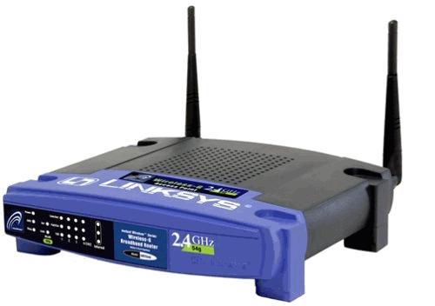
Private Networks
192.168.0.1
192.168.0.1
Private
Network
Private
Network
192.168.0.2
192.168.0.2
Internet
NAT
192.168.0.0
192.168.0.0
66.31.210.69

Slide 7
Network Address Translation (NAT)
NAT allows hosts on a private network to communicate with the Internet
Warning: connectivity is not seamless
Special router at the boundary of a private network
Replaces internal IPs with external IP
This is “Network Address Translation”
May also replace TCP/UDP port numbers
Maintains a table of active flows
Outgoing packets initialize a table entry
Incoming packets are rewritten based on the table

Slide 8
Basic NAT Operation
Private Network
Internet
Source: 192.168.0.1
Dest: 74.125.228.67
Source: 66.31.210.69
Dest: 74.125.228.67
Private Address | Public Address
192.168.0.1:2345 | 74.125.228.67:80
192.168.0.1
66.31.210.69
74.125.228.67
Source: 74.125.228.67
Dest: 192.168.0.1
Source: 74.125.228.67
Dest: 66.31.210.69

Slide 9
Advantages of NATs
Allow multiple hosts to share a single public IP
Allow migration between ISPs
Even if the public IP address changes, you don’t need to reconfigure the machines on the LAN
Load balancing
Forward traffic from a single public IP to multiple private hosts

Slide 10


Natural Firewall
Private Network
Internet
Private Address | Public Address
192.168.0.1
66.31.210.69
74.125.228.67
Source: 74.125.228.67
Dest: 66.31.210.69
Source: 74.125.228.67
Dest: 192.168.0.1

Slide 11
Concerns About NAT
Performance/scalability issues
Per flow state!
Modifying IP and Port numbers means NAT must recompute IP and TCP checksums
Breaks the layered network abstraction
Breaks end-to-end Internet connectivity
192.168.*.* addresses are private
Cannot be routed to on the Internet
Problem is worse when both hosts are behind NATs

Slide 12

Port Forwarding
Private Network
Internet
Private Address | Public Address
192.168.0.1:7000 | *.*.*.*:*
192.168.0.1
66.31.210.69
74.125.228.67
Source: 74.125.228.67:8679
Dest: 192.168.0.1:7000
Source: 74.125.228.67:8679
Dest: 66.31.210.69:7000
Notes:
66.31.210.69:3389

Slide 13
Outline
NAT
Other middleboxes

Slide 14
Firewall
A device that blocks traffic according to a set of rules
Why?
Services with vulnerabilities turned on by default
ISP policy forbidding certain traffic due to ToS
Typically specified using a 5-tuple
E.g., block outbound SMTP; block inbound SQL server reqs
GFC (Great Firewall of China)
Known to block based on IP, filter DNS requests, etc
Notes:
Protocol number

Slide 15
Web caching
ISP installs cache near network edge that caches copies of Web pages
Why?
Performance: Content is closer to clients, TCP will perform better with lower RTTs
Cost: “free” for the ISP to serve from inside the network
Limitations
Much of today’s content is not static (why does this matter?)
Content ownership
Potential privacy issues
Long tail of content popularity

Slide 16

Web caching
ISP installs cache near network edge that caches copies of Web pages
Why?
Performance: Content is closer to clients, TCP will perform better with lower RTTs
Cost: “free” for the ISP to serve from inside the network
Not cached
foo.htm
Internet
foo.htm

Slide 17
Proxying
Non-split connections
Like NAT, but IP address is no longer the one assigned to you
Split connections
Middlebox maintains two flows: C-M and M-S
Can be done transparently
How?
C
M
S
Syn
Syn
Ack
Ack
SynAck
SynAck

Slide 18
Proxying
Advantages
RTT is lower on each end
Can use different MTUs
Particularly useful in cell ntwks
Disadvantages
Extra delay can be bad for small flows
Buffering/state makes it potentially costly
C
M
S
Syn
Syn
Ack
Ack
SynAck
SynAck

Slide 19
Questions
Middleboxes that breaks end-to-end integrity
How can we tell if middle boxes do that?
ISP? Software on your computer? How can we tell that?

Slide 20
CSCI-351 Data communication and Networks
Lecture 11 ext: DHCP
The slide is built with the Prof. Kurose’s materials

Slide 21
DHCP: Dynamic Host Configuration Protocol
Let’s say that a ISP has X customers, How many IPs does it need to have?
X?
Goal: allow host to dynamically obtain its IP address from network server when it joins network
can renew its lease on address in use
allows reuse of addresses (only hold address while connected/“on”)
support for mobile users who want to join network (more shortly)

Slide 22
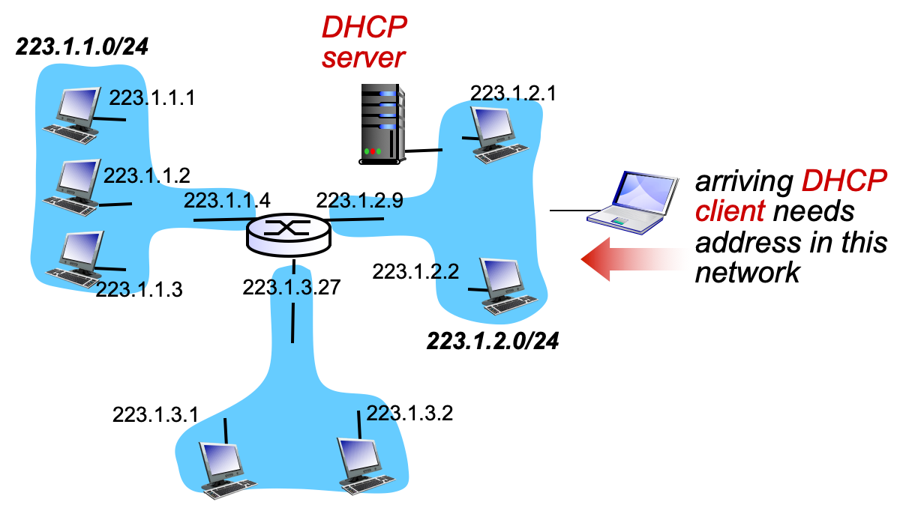
DHCP Client-Server

Slide 23


DHCP Client-Server
DHCP server: 223.1.2.5
DHCP discover
arriving
client
src : 0.0.0.0, 68
dest.: 255.255.255.255,67
yiaddr: 0.0.0.0
transaction ID: 654
Broadcast: is there a DHCP server out there?
DHCP offer
src: 223.1.2.5, 67
dest: 255.255.255.255, 68
yiaddrr: 223.1.2.4
transaction ID: 654
lifetime: 3600 secs
Broadcast: I’m a DHCP server! Here’s an IP address you can use
DHCP request
src: 0.0.0.0, 68
dest:: 255.255.255.255, 67
yiaddrr: 223.1.2.4
transaction ID: 655
lifetime: 3600 secs
Broadcast: OK. I’ll take that IP address!
DHCP ACK
src: 223.1.2.5, 67
dest: 255.255.255.255, 68
yiaddrr: 223.1.2.4
transaction ID: 655
lifetime: 3600 secs
Broadcast: OK. You’ve got that IP address!
Notes:
Your IP address

Slide 24
DHCP: More than IP address
DHCP can return more than just allocated IP address on subnet
address of first-hop router for client
name and IP address of DNS sever
network mask (indicating network versus host portion of address)

Slide 25
DHCP Header (Do not memorize)

Slide 26


DHCP: example
DHCP
DHCP
UDP
IP
Eth
Phy
connecting laptop needs its IP address, addr of first-hop router, addr of DNS server: use DHCP
DHCP
DHCP
DHCP
DHCP
DHCP request encapsulated in UDP, encapsulated in IP, encapsulated in 802.1 Ethernet
DHCP
DHCP
UDP
IP
Eth
Phy
168.1.1.1
DHCP
DHCP
DHCP
Ethernet frame broadcast (dest: FFFFFFFFFFFF) on LAN, received at router running DHCP server
DHCP
router with DHCP
server built into
router
Ethernet demuxed to IP demuxed, UDP demuxed to DHCP

Slide 27
DHCP: example
DHCP
UDP
IP
Eth
Phy
DCP server formulates DHCP ACK containing client’s IP address, IP address of first-hop router for client, name & IP address of DNS server
DHCP
DHCP
DHCP
DHCP
encapsulation of DHCP server, frame forwarded to client, demuxing up to DHCP at client
DHCP
DHCP
UDP
IP
Eth
Phy
DHCP
DHCP
DHCP
router with DHCP
server built into
router
client now knows its IP address, name and IP address of DSN server, IP address of its first-hop router
DHCP

