Slide 1
Comments about the quiz?
No limit of challenges;
But you need to bring a document
Still need to come to office hours with the following in writing:
Specify the problem(s) you want regraded
For each problem, explain why the grade is in error

Slide 2
CSCI-351 Data communication and Networks
Lecture 12: DNS and your Project2
The slide is built with the help of Prof. Alan Mislove, Christo Wilson, and David Choffnes's class

Slide 3
Why Skipping Transport Layer?
No; we will cover at the next class
Project 2 is announced: DNS
Application
Transport
Network
Data Link
Physical

Slide 4
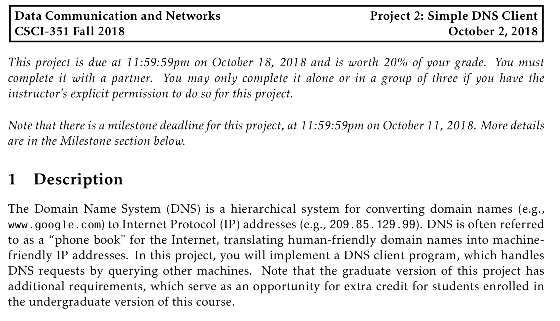
Project 2

Slide 5
Project 2

Slide 6
The IPv4 Shortage
Problem: consumer ISPs typically only give one IP address per-household
Additional IPs cost extra
More IPs may not be available
NAT and DHCP
NAT + DHCP
Notes:
Network Address Translator

Slide 7
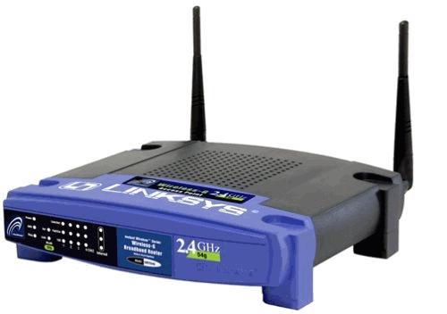

Basic NAT Operation
Private Network
Internet
Source: 192.168.0.1
Dest: 74.125.228.67
Source: 66.31.210.69
Dest: 74.125.228.67
Private Address | Public Address
192.168.0.1:2345 | 74.125.228.67:80
192.168.0.1
66.31.210.69
74.125.228.67
Source: 74.125.228.67
Dest: 192.168.0.1
Source: 74.125.228.67
Dest: 66.31.210.69

Slide 8
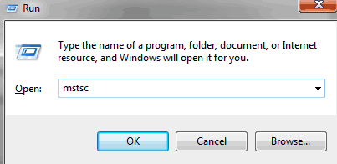
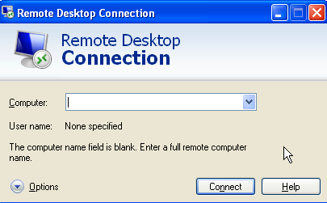
Port-forwarding

Slide 9
DHCP: Dynamic Host Configuration Protocol
Let’s say that a ISP has X customers, How many IPs does it need to have?
X?
Goal: allow host to dynamically obtain its IP address from network server when it joins network
can renew its lease on address in use
allows reuse of addresses (only hold address while connected/“on”)
support for mobile users who want to join network (more shortly)

Slide 10
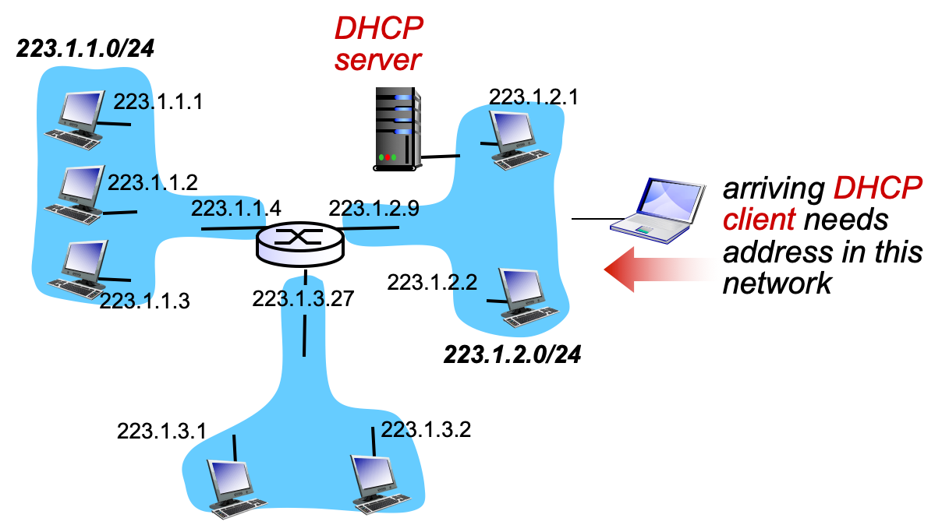
DHCP Client-Server

Slide 11


DHCP Client-Server
DHCP server: 223.1.2.5
DHCP discover
arriving
client
src : 0.0.0.0, 68
dest.: 255.255.255.255,67
yiaddr: 0.0.0.0
transaction ID: 654
Broadcast: is there a DHCP server out there?
DHCP offer
src: 223.1.2.5, 67
dest: 255.255.255.255, 68
yiaddrr: 223.1.2.4
transaction ID: 654
lifetime: 3600 secs
Broadcast: I’m a DHCP server! Here’s an IP address you can use
DHCP request
src: 0.0.0.0, 68
dest:: 255.255.255.255, 67
yiaddrr: 223.1.2.4
transaction ID: 655
lifetime: 3600 secs
Broadcast: OK. I’ll take that IP address!
DHCP ACK
src: 223.1.2.5, 67
dest: 255.255.255.255, 68
yiaddrr: 223.1.2.4
transaction ID: 655
lifetime: 3600 secs
Broadcast: OK. You’ve got that IP address!
Notes:
Your IP address

Slide 12
DHCP: More than IP address
DHCP can return more than just allocated IP address on subnet
address of first-hop router for client
name and IP address of DNS sever
network mask (indicating network versus host portion of address)

Slide 13
DHCP Header (Do not memorize)

Slide 14
CSCI-351 Data communication and Networks
Lecture 12: DNS
The slide is built with the help of Prof. Alan Mislove, Christo Wilson, and David Choffnes's class

Slide 15
Layer 8 (The Carbon-based nodes)
If you want to…
Call someone, you need to ask for their phone number
You can’t just dial “P R O F C H U N G”
Mail someone, you need to get their address first
What about the Internet?
If you need to reach Google, you need their IP
Does anyone know Google’s IP?
Problem:
People can’t remember IP addresses
Need human readable names that map to IPs

Slide 16
Internet Names and Addresses
Addresses, e.g. 129.10.117.100
Computer usable labels for machines
Conform to structure of the network
Names, e.g. www.rit.edu
Human usable labels for machines
Conform to organizational structure
How do you map from one to the other?
Domain Name System (DNS)

Slide 17
History
Before DNS, all mappings were in hosts.txt
/etc/hosts on Linux
C:\Windows\System32\drivers\etc\hosts on Windows
Centralized, manual system
Changes were submitted to SRI via email
Machines periodically FTP new copies of hosts.txt
Administrators could pick names at their discretion
Any name was allowed
tijay_server_at_rit_pwns_joo_lol_kthxbye
Notes:
SRI – Standford Research Institute

Slide 18
Towards DNS
Eventually, the hosts.txt system fell apart
Not scalable, SRI couldn’t handle the load
Hard to enforce uniqueness of names
e.g RIT
Rochester Institute of Technology?
Revolution in Training (US Navy)
Many machines had inaccurate copies of hosts.txt
Thus, DNS was born

Slide 19
Outline
DNS Basics
DNS Security

Slide 20
DNS at a High-Level
Domain Name System
Distributed database
No centralization
Simple client/server architecture
UDP port 53, some implementations also use TCP
Why? (You will learn at the TCP-lecture)
Hierarchical namespace
As opposed to original, flat namespace
e.g. .com → google.com → mail.google.com

Slide 21
Naming Hierarchy
Root
net
edu
com
gov
mil
org
uk
fr
etc.
Top Level Domains (TLDs) are at the top
Maximum tree depth: 128
Each Domain Name is a subtree
.edu → rit.edu → cs.rit.edu → www.ccs.rit.edu
Name collisions are avoided
rit.edu vs. rit.com
rit
mit
cs
csec
gccis
www
login
mail

Slide 22
Hierarchical Administration
Verisign
Root
ICANN
net
edu
com
gov
mil
org
uk
fr
etc.
Tree is divided into zones
Each zone has an administrator
Responsible for the part of the hierarchy
Example:
cs controls *.cs.rit.edu
RIT controls *.rit.edu
rit
mit
cs
www
login
mail

Slide 23
Server Hierarchy
Functions of each DNS server:
Authority over a portion of the hierarchy
No need to store all DNS names
Store all the records for hosts/domains in its zone
May be replicated for robustness
Know the addresses of the root servers
Resolve queries for unknown names
Root servers know about all TLDs
The buck stops at the root servers

Slide 24
Root Name Servers
Responsible for the Root Zone File
Lists the TLDs and who controls them
~272KB in size
com. 172800 IN NS a.gtld-servers.net.
com. 172800 IN NS b.gtld-servers.net.
com. 172800 IN NS c.gtld-servers.net.
Administered by ICANN
13 root servers, labeled A→M
6 are anycasted, i.e. they are globally replicated
Contacted when names cannot be resolved
In practice, most systems cache this information

Slide 25
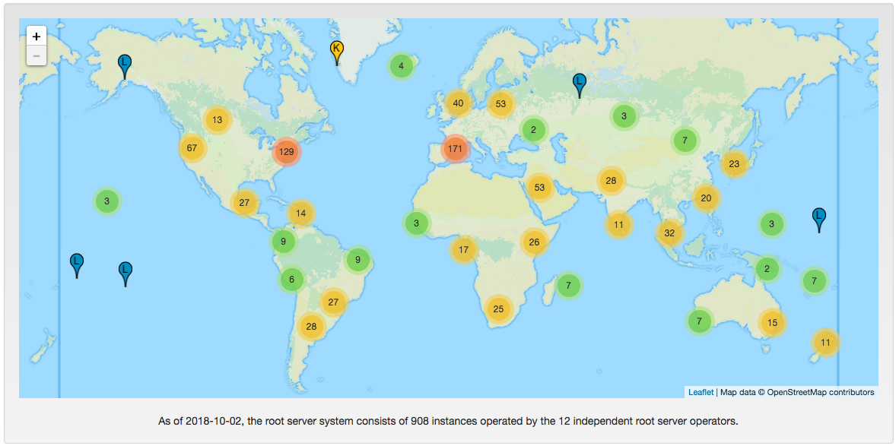
Map of the Roots (root-servers.org)

Slide 26


Local Name Servers (Resolvers)
Where is google.com?
RIT
Each ISP/company has a local, default name server
Often configured via DHCP
Hosts begin DNS queries by contacting the local name server
Frequently cache query results

Slide 27
Authoritative Name Servers
www.rit.edu = 129.21.1.40
Where is www.rit.edu?
www.rit.edu
RIT
Root
edu
rit
Authority for ‘edu’
Authority for ‘rit.edu’
Stores the name→IP mapping for a given host

Slide 28
Basic Domain Name Resolution
Every host knows a local DNS server
Sends all queries to the local DNS server
If the local DNS can answer the query, then you’re done
Local server has cached the record for that name
Otherwise, go down the hierarchy and search for the authoritative name server
Every local DNS server knows the root servers
Use cache to skip steps if possible
e.g. skip the root and go directly to .edu if the root file is cached

Slide 29
Recursive DNS Query
www.google.com
Where is www.google.com?
Puts the burden of resolution on the contacted name server
How does glados know who to forward responses too?
Random IDs embedded in DNS queries
What have we said about keeping state in the network?
glados.cs.rit.edu
ns1.google.com
com
Root

Slide 30
Iterated DNS query
www.google.com
Where is www.google.com?
Contact server replies with the name of the next authority in the hierarchy
“I don’t know this name, but this other server might”
This is how DNS works today
asgard.ccs.rit.edu
ns1.google.com
com
Root

Slide 31
DNS Propagation
How many of you have purchased a domain name?
Did you notice that it took ~72 hours for your name to become accessible?
This delay is called DNS Propagation
www.my-new-site.com
Root
com
asgard.ccs.rit.edu
ns.godaddy.com

Slide 32
Caching vs. Freshness
DNS Propagation delay is caused by caching
Where is
www.my-new-site.com?
That name does not exist.
Cached Root Zone File
Cached .com Zone File
Cached .net Zone File
Etc.
asgard.ccs.rit.edu
Zone files may be cached for 1-72 hours
Root
com
www.my-new-site.com
ns.godaddy.com

Slide 33
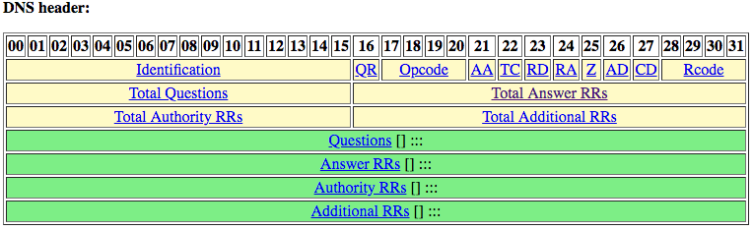
DNS Resource Records
DNS queries have two fields: name and type
Resource record is the response to a query
Four fields: (name, value, type, TTL)
There may be multiple records returned for one query
What are do the name and value mean?
Depends on the type of query and response

Slide 34
DNS Types
Type = NS
Name = partial domain
Value = name of DNS server for this domain
“Go send your query to this other server”
Type = A / AAAA
Name = domain name
Value = IP address
A is IPv4, AAAA is IPv6
Name: rit.edu
Type: NS
Query
Name: rit.edu
Value: ns1a.rit.edu.
Resp.
Name: www.rit.edu
Type: A
Query
Name: www.rit.edu
Value: 129.10.116.81
Resp.

Slide 35
DNS Types, Continued
Type = CNAME
Name = hostname
Value = canonical hostname
Useful for aliasing
CDNs use this (will be covered)
Type = MX
Name = domain in email address
Value = canonical name of mail server
Name: foo.mysite.com
Type: CNAME
Query
Name: foo.mysite.com
Value: bar.mysite.com
Resp.
Name: cs.rit.edu
Type: MX
Query
Name: cs.rit.edu
Value: pony-express.cs.rit.edu.
Resp.

Slide 36
Reverse Lookups
What about the IP→name mapping?
Separate server hierarchy stores reverse mappings
Rooted at in-addr.arpa and ip6.arpa
Additional DNS record type: PTR
Name = IP address
Value = domain name
Not guaranteed to exist for all IPs
Why do we need this?
Name: 129.10.116.51 Type: PTR
Query
Name: 129.21.30.104
Value: cs.rit.edu
Resp.

Slide 37
Quiz Recap

Slide 38
Announcements (1)
Project 1 scores….

Slide 39
Announcements (2)
Project 2: You may use other languages than C
MUST include a script that compiles or runs
runme.sh which creates executable 351dns
No third party libraries (of course, no dns-related libraries)
Today’s is the due of the team registration

Slide 40
Announcements (3)
No class at 10/09
Midterm reviews at 10/11
Study hard and bring your questions

Slide 41
Midterm
1 hour and 15 minutes
Closed book, closed notes, phones off
No need for calculator, no need to write working code
You may be asked to write pseudocode
You will be asked to write complete sentences

Slide 42
DNS Recap (Big picture)
Name hierarchy
Two kinds of DNS servers:
Authoritative Nameserver
Resolver

Slide 43
Naming Hierarchy
Root
net
edu
com
gov
mil
org
uk
fr
etc.
Top Level Domains (TLDs) are at the top
Maximum tree depth: 128
Each Domain Name is a subtree
.edu → rit.edu → cs.rit.edu → www.ccs.rit.edu
Name collisions are avoided
rit.edu vs. rit.com
rit
mit
cs
csec
gccis
www
login
mail

Slide 44
Authoritative Nameserver
What is the IP address of rit.edu?
ns1a.rit.edu
What is the mail server address of rit.edu?
Do you have other names than rit.edu?
What is your IPv6 address?

Slide 45
Process to look-up www.rit.edu
. (root)
I need .edu authoritative nameserver
a.edu-servers.net. and 192.5.6.30
IP address of rit.edu?
a.edu-servers.net
I need rit.edu nameserver
a.edu-servers.net. and 192.5.6.30
IP of www.rit.edu
ns1a.rit.edu
129.21.1.40

Slide 46
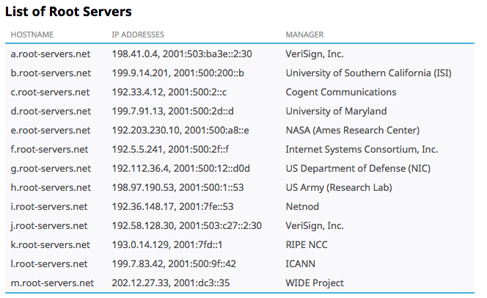
Demo 1
Dig: (Domain Information Grouper)
Very useful tool to send a DNS request and parse the DNS response

Slide 47
Resolver
www.google.com
Where is www.google.com?
Contact server replies with the name of the next authority in the hierarchy
“I don’t know this name, but this other server might”
This is how DNS works today
Cache!
asgard.ccs.rit.edu
ns1.google.com
com
Root

Slide 48
Demo 2
Dig: (Domain Information Grouper)
Dig @1.1.1.1 rit.edu
Dig @8.8.8.8 rit.edu

Slide 49
DNS Types
Type = NS
Name = partial domain
Value = name of DNS server for this domain
“Go send your query to this other server”
Type = A / AAAA
Name = domain name
Value = IP address
A is IPv4, AAAA is IPv6
Name: rit.edu
Type: NS
Query
Name: rit.edu
Value: ns1a.rit.edu.
Resp.
Name: www.rit.edu
Type: A
Query
Name: www.rit.edu
Value: 129.10.116.81
Resp.

Slide 51
How to buy a domain name (1)
. (Root)
IANA
Makes TLDs (Top level domains)
You have authority to sell .com SLD domains
.COM
(Verisign)
Registry
(TLD)
.com’s authoritative nameserver
You have authority to sell .com SLD domains
I need a domain
GoDaddy
Buy
Registrar
Owner
example.com

Slide 52

How to buy a domain name (2)
Using your own authoritative nameserver
.COM
(Verisign)
Registry
(TLD)
.com’s authoritative nameserver
example.com NS ns.example.com
ns.example.com A 1.2.3.4
I need a domain
GoDaddy
Buy
Registrar
Owner
example.com
www.example.com A 9.9.9.9
NS Record
My nameserver name is ns.example.com and
this is the IP addresss: 1.2.3.4.

Slide 53
How to buy a domain name (3)
Using the registrar’s default nameserver
.COM
(Verisign)
Registry
(TLD)
.com’s authoritative nameserver
example.com NS ns.godaddy.com
…
ns.godaddy.com A 4.5.6.7 (already here)
I need a domain
GoDaddy
Buy
Registrar
Owner
example.com
NS Record
My webserver
IP addresss is 9.9.9.9
Internally add
example.com A 9.9.9.9
example.com NS ns.godaddy.com

Slide 54
DNS as Indirection Service
DNS gives us very powerful capabilities
Not only easier for humans to reference machines!
Changing the IPs of machines becomes trivial
e.g. you want to move your web server to a new host
Just change the DNS record!

Slide 55
Aliasing and Load Balancing
One machine can have many aliases (virtual hosting)
www.reddit.com
taejoong.github.io
www.foursquare.com
cs.rit.edu/~tjc
www.huffingtonpost.com
*.blogspot.com
One domain can map to multiple machines
www.google.com

Slide 56
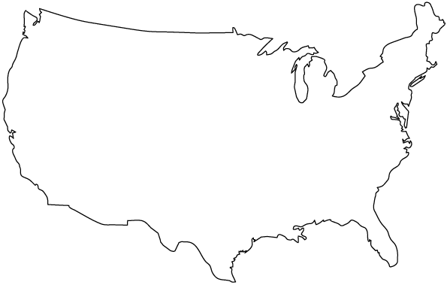


Content Delivery Networks
DNS responses may vary based on geography, ISP, etc
(details will be covered)

Slide 57
Outline
DNS Basics
DNS Security

Slide 58
The Importance of DNS
Without DNS…
How could you get to any websites?
You are your mailserver
When you sign up for websites, you use your email address
What if someone hijacks the DNS for your mail server?
DNS is the root of trust for the web
When a user types www.bankofamerica.com, they expect to be taken to their bank’s website
What if the DNS record is compromised?

Slide 59
Denial Of Service
Flood DNS servers with requests until they fail
October 2002: massive DDoS against the root name servers
What was the effect?
… users didn’t even notice
Root zone file is cached almost everywhere
More targeted attacks can be effective
Local DNS server → cannot access DNS
Authoritative server → cannot access domain

Slide 60

DNS Hijacking
Infect their OS or browser with a virus/trojan
e.g. Many trojans change entries in /etc/hosts
*.bankofamerica.com → evilbank.com
Man-in-the-middle
Response Spoofing
Eavesdrop on requests
Outrace the servers response

Slide 61



DNS Spoofing
Where is bankofamerica.com?
123.45.67.89
How do you know that a given name→IP mapping is correct?
Where is bankofamerica.com?
dns.bofa.com
66.66.66.93
123.45.67.89
dns.evil.com
66.66.66.93

Slide 62
DNS Cache Poisoning
Where is www.google.com?
Where is bankofamerica.com?
www.google.com = 74.125.131.26
dns.rit.edu
ns1.google.com
Until the TTL expires, all queries for BofA to dns.rit.edu will return poisoned result
Much worse than spoofing/man-in-the-middle
Whole ISPs can be impacted!
bankofamerica.com = 66.66.66.92

Slide 63
DNS Header
Query identifier:
used to be incremented by 1

Slide 64


Attacking DNS (only few examples)
Kaminsky Attack
(QID bruteforcing)
Random QID and
Random Port
?
?
Man-in-the-Middle

Slide 65
Solution: DNSSEC (Will be detailed)
Cryptographically sign critical resource records
Resolver can verify the cryptographic signature
Two new resource types
Type = DNSKEY
Name = Zone domain name
Value = Public key for the zone
Type = RRSIG
Name = (type, name) tuple, i.e. the query itself
Value = Cryptographic signature of the query results
Deployment
On the roots since July 2010
Verisign enabled it on .com and .net in January 2011
Comcast is the first major ISP to support it (January 2012)
Creates a hierarchy of trust within each zone
Prevents hijacking and spoofing

Slide 66

DNSSEC Hierarchy of Trust
Root Zone (ICANN)
.com (Verisign)
IP: 123.45.67.89
Key: < >
SIG: x9fnskflkalk
IP: 66.66.66.93
Key: < >
SIG: 9na8x7040a3
Where is bankofamerica.com?
dns.bofa.com
dns.evil.com

Slide 67
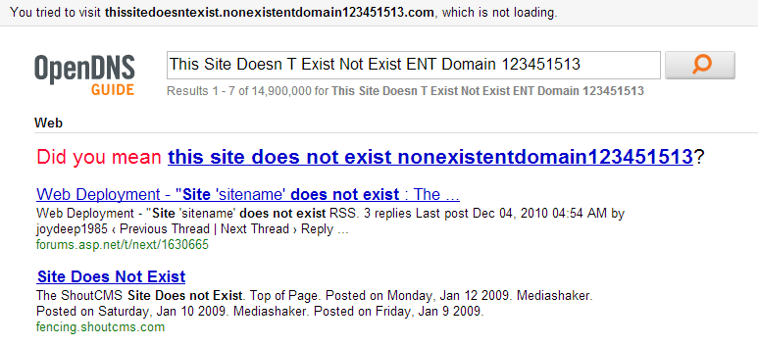
Site Finder
September 2003: Verisign created DNS wildcards for *.com and *.net
Essentially, catch-all records for unknown domains
Pointed to a search website run by Verisign
Search website was full of advertisements
Extremely controversial move
Is this DNS hijacking?
Definitely abuse of trust by Verisign
Site Finder was quickly shut down, lawsuits ensued

Slide 68
Much More to DNS
Caching: when, where, how much, etc.
Other uses for DNS (i.e. DNS hacks)
Content Delivery Networks (CDNs) – will be detailed later
Different types of DNS load balancing
Dynamic DNS (e.g. for mobile hosts)
DNS and botnets
Politics and growth of the DNS system
Governance
New TLDs (.xxx, .biz), eliminating TLDs altogether
Copyright, arbitration, squatting, typo-squatting

