Slide 1
CSCI-351 Data communication and Networks
Lecture 17: Peer-to-Peer System and BitTorrent
(I swear I only use it for Linux ISOs)
The slide is built with the help of Prof. Alan Mislove, Christo Wilson, and David Choffnes's class

Slide 2

Announcement
Class
Class by Prof. Kwon
No Class
Class

Slide 3
Announcement
Midterm scores will be announced today (scoring is almost done…)
Grading criteria
The average is around 60/100 (the maximum is 102)

Slide 4
Outline
Peer-to-Peer Overview
Example: Bittorrent

Slide 5
Traditional Internet Services Model
Client-server
Many clients, 1 (or more) server(s)
Web servers, DNS, file downloads, video streaming
Problems
Scalability: how many users can a server support?
What happens when user traffic overload servers?
Limited resources (bandwidth, CPU, storage)
Reliability: if # of servers is small, what happens when they break, fail, get disconnected, are mismanaged by humans?
Efficiency: if your users are spread across the entire globe, how do you make sure you answer their requests quickly?

Slide 6
The Alternative: Peer-to-Peer
A simple idea
Users bring their own resources to the table
A cooperative model: clients = peers = servers
The benefits
Scalability: # of “servers” grows with users
BYOR: bring your own resources (storage, CPU, B/W)
Reliability: load spread across many peers
Probability of them all failing is very low…
Efficiency: peers are distributed
Peers can try and get service from nearby peers

Slide 7
The Peer-to-Peer Challenge
What are the key components for leveraging P2P?
Communication: how do peers talk to each other
Service/data location: how do peers know who to talk to
New reliability challenges
Network reachability, i.e. dealing with NATs
Dealing with churn, i.e. short peer uptimes
What about security?
Malicious peers and cheating
The Sybil attack

Slide 8

Centralized Approach
The original: Napster
1999-2001
Shawn Fanning, Sean Parker
Specialized in MP3s (but not for long)
Centralized index server(s)
Supported all queries
What caused its downfall?
Not scalable
Centralization of liability

Slide 9






Napster Architecture
Napster
Central Server
B and C have the file
Log-in, upload list of files
Search for Gangnam Style
C
E
G
A
F
B
D
Notes:
Recording Industry Association of America

Slide 10

What is BitTorrent
Designed for fast, efficient content distribution
Ideal for large files, e.g. movies, DVDs, ISOs, etc.
Uses P2P file swarming
Not a full fledged P2P system
Does not support searching for files
File swarms must be located out-of-band
Trackers acts a centralized swarm coordinators
Fully P2P, trackerless torrents are now possible
Insanely popular
35-70% of all Internet traffic in early 2010

Slide 11







BitTorrent Overview
Tracker
Swarm
Seeder
Leechers

Slide 12
.torrent File
Contains all meta-data related to a torrent
File name(s), sizes
Torrent hash: hash of the whole file
URL of tracker(s)
BitTorrent breaks files into pieces
64 KB – 1 MB per piece
.torrent contains the size and SHA-1 hash of each piece
Basically, a .torrent tells you
Everything about a given file
Where to go to start downloading

Slide 13
Torrent Sites
Just standard web servers
Allow users to upload .torrent files
Search, ratings, comments, etc.
Some also host trackers
Many famous ones
Mostly because they host illegal content
Legitimate .torrents
Linux distribution
World of Warcraft patches

Slide 14
Torrent Trackers
Tracker
Really, just a highly specialized webserver
BitTorrent protocol is built on top of HTTP
Keeps a database of swarms
Swarms identified by torrent hash
State of each peer in each swarm
IP address, port, peer ID, TTL
Status: leeching or seeding
Optional: upload/download stats (to track fairness)
Returns a random list of peers to new leechers

Slide 15
Peer Selection
Tracker provides each client with a list of peers
Which peers are best?
Fastest bandwidth
Option 1: learn dynamically
Try downloading from many peers
Keep only the best peers
Strategy used by BitTorrent
Option 2: use external information
E.g. Some torrent clients prefer peers in the same ISP

Slide 16
Sharing Pieces
Initial Seeder
1
2
3
4
5
6
7
8
1
2
3
4
5
6
7
8
1
2
3
4
5
6
7
8
Leecher
Leecher
Seeder
Seeder

Slide 17
The Beauty of BitTorrent
More leechers = more replicas of pieces
More replicas = faster downloads
Multiple, redundant sources for each piece
Even while downloading, leechers take load off the seed(s)
Great for content distribution
Cost is shared among the swarm

Slide 18
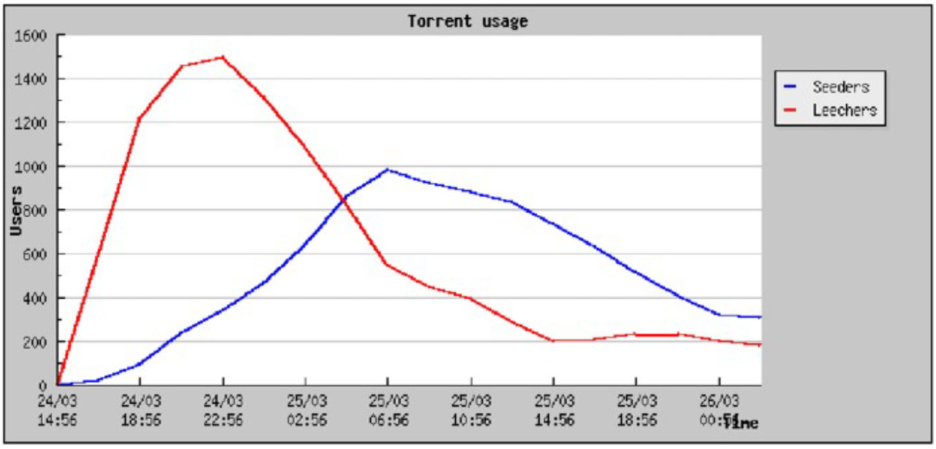
Typical Swarm Behavior

Slide 19
Sub-Pieces and Pipelining
Each piece is broken into sub-pieces
~16 KB in size
TCP Pipelining
For performance, you want long lived TCP connections (to get out of slow start)
Peers generally request 5 sub-pieces at a time
When one finished, immediately request another
Don’t start a new piece until previous is complete
Prioritizes complete pieces
Only complete pieces can be shared with other peers

Slide 20
Piece Selection
Piece download order is critical
Worst-case scenario: all leeches have identical pieces
Nobody can share anything :(
Worst-case scenario: the initial seed disappears
If a piece is missing from the swarm, the torrent is broken
What is the best strategy for selecting pieces?
Trick question
It depends on how many pieces you already have

Slide 21
Download Phases
0%
Bootstrap: random selection
Initially, you have no pieces to trade
Essentially, beg for free pieces at random
Steady-state: rarest piece first
Ensures that common pieces are saved for last
Endgame
Simultaneously request final pieces from multiple peers
Cancel connections to slow peers
Ensures that final pieces arrive quickly
% Downloaded
100%

Slide 22
Upload and Download Control
How does each peer decide who to trade with?
Incentive mechanism
Based on tit-for-tat, game theory
“If you give a piece to me, I’ll give a piece to you”
“If you screw me over, you get nothing”
Two mechanisms: choking and optimistic unchoke

Slide 23
A Bit of Game Theory
Iterated prisoner’s dilemma
Very simple game, two players, multiple rounds
Both players agree: +2 points each
One player defects: +5 for defector, +0 to other
Both players defect: +0 for each
Maps well to trading pieces in BitTorrent
Both peers trade, they both get useful data
If both peers do nothing, they both get nothing
If one peer defects, he gets a free piece, other peer gets nothing
What is the best strategy for this game?

Slide 24
Tit-for-Tat
Best general strategy for iterated prisoner’s dilemma
Meaning: “Equivalent Retaliation”
Rules
Initially: cooperate
If opponent cooperates, cooperate next round
If opponent defects, defect next round
Round |  |  | Points
1 | Cooperate | Cooperate | +2 / +2
2 | Cooperate | Defect | +0 / +5
3 | Defect | Cooperate | +5 / +0
4 | Cooperate | Cooperate | +2 / +2
5 | Cooperate | Defect | +0 / +5
6 | Defect | Defect | +0 / +0
7 | Defect | Cooperate | +5 / +0
 |  | Totals: | +14 / +14

Slide 25
Choking
Choke is a temporary refusal to upload
Tit-for-tat: choke free riders
Cap the number of simultaneous uploads
Too many connections congests your network
Periodically unchoke to test the network connection
Choked peer might have better bandwidth

Slide 26
Optimistic Unchoke
Each peer has one optimistic unchoke slot
Uploads to one random peer
Peer rotates every 30 seconds
Reasons for optimistic unchoke
Help to bootstrap peers without pieces
Discover new peers with fast connections

Slide 27


BitTorrent Protocol Fundamentals
1
2
3
4
Leecher
Leecher
BitTorrent divides time into rounds
Each round, decide who to upload to/download from
Rounds are typically 30 seconds
Each connection to a peer is controlled by four states
Interested / uninterested – do I want a piece from you?
Choked / unchoked – am I currently downloading from you?
Connections are bidirectional
You decide interest/choking on each peer
Each peer decides interest/chocking on you

Slide 28
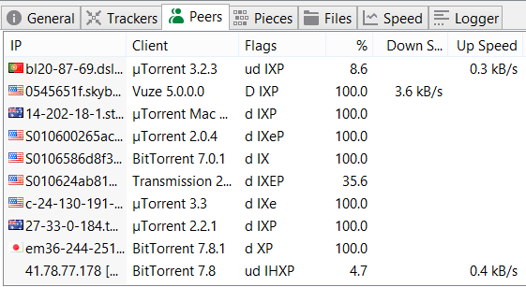
Connection States
Most peers are d or D. No need to connect with uninteresting peers.
Error states. Connection should be closed.
Download control
d – interested and choked
D – interested and unchoked
K – uninterested and unchoked
S – snubbed (no data received in 60 seconds)
F – piece(s) failed to hash
Upload control
u – interested and choked
U – interested and unchoked
O – optimistic unchoke
? – uninterested and unchoked
Connection information
I – incoming connection
E/e – Using protocol encryption
More on this later…
h – used UDP hole punching
P – connection uses µTP
How was this peer located?
H – DHT (distributed hash table)
L – local peer discovery (multicast)
X – peer exchange

Slide 29
Upload-Only Mode
Once a peer completes a torrent, it becomes a seed
No downloads, no tit-for-tat
Who to upload to first?
BitTorrent policy
Upload to the fastest known peer
Why?
Faster uploads = more available pieces
More available pieces helps the swarm

Slide 30
BitTorrent and TCP
BitTorrent used to account for 35-70% of all Internet traffic
Thus, BitTorrent’s behavior impacts everyone
BitTorrent’s use of TCP causes problems
Long lived, BitTorrent TCP flows are “elephants”
Ramp up past slow start, dominate router queues
Many applications are “mice,” get trampled by elephants
Short lived flows (e.g. HTTP traffic)
Delay sensitive apps (i.e. VoIP, SSH, online games)
Have you ever tried using SSH while using BitTorrent?

Slide 31
Conclusions
BitTorrent is an extremely efficient tool for content distribution
Strong incentive system based on game theory
Most popular file sharing client since 2001
More active users than YouTube and Facebook combined
However, BitTorrent is a large system with many different mechanisms
Ample room to modify the client, alter behavior

Slide 32
Recap
Three essential elements
.Torrent
Tracker
Peers
Seeds (or Seeders)
Leechers
Important algorithm
Rarest piece first and end-game mode
Tit for tat
Choking algorithm
Optimistic unchoke

