Slide 1
CSCI-351 Data communication and Networks
Lecture 13: HTTP
The slide is built with the help of Prof. Alan Mislove, Christo Wilson, and David Choffnes's class

Slide 2
Web and HTTP
Web pages consist of objects
Object can be HTML file, JPEG image, Java applet, etc.
Each object is addressable by a URL
DNS
Host
cs.rit.edu/index.html
Domain name (host name)
Path name (object)
GET /index.html

Slide 3
HTTP Basics
HTTP layered over bidirectional byte stream
Interaction
Client sends request to server, followed by response from server to client
Requests/responses are encoded in text
Stateless
Server maintains no information about past client requests

Slide 4
HTTP Request
GET /foo/bar.html HTTP/1.1
Request line
Method
GET – return URI
HEAD – return headers only of GET response
POST – send data to the server (forms, etc.)
…
URL (relative)
E.g., /index.html
HTTP version

Slide 5
HTTP Request
Request headers (each ended with CRLF)
Acceptable document types/encodings
Etag - Cache Identifier
If-None-Match
Referrer – what caused this page to be requested
User-Agent – client software
Cookie - previously stored information
Content-Length - Size of data (only on POST)
Blank-line (CRLF)
Body

Slide 6
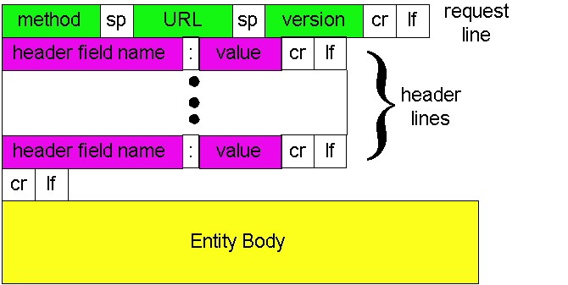
HTTP Request (visual)

Slide 7
HTTP Request Example
GET /blah.html?foo=bar HTTP/1.1
Accept: */*
Accept-Language: en-us
Accept-Encoding: gzip, deflate
User-Agent: Mozilla/4.0 (compatible; MSIE 5.5; Windows NT 5.0)
Host: www.intel-iris.net
Connection: Keep-Alive
Lecture 19: 2006-11-02

Slide 8

HTTP Response
Status-line
HTTP version
3 digit response code
1XX – informational
2XX – success
200 OK
3XX – redirection
301 Moved Permanently
303 Moved Temporarily
304 Not Modified (for etag)
4XX – client error
404 Not Found
5XX – server error
505 HTTP Version Not Supported
Reason phrase

Slide 9
HTTP Response (cont.)
Headers
Location – for redirection
Server – server software
WWW-Authenticate – request for authentication
Allow – list of methods supported (get, head, etc)
Content-Encoding – E.g x-gzip
Content-Length
Content-Type
Expires
Last-Modified
Blank-line
Body
Lecture 19: 2006-11-02

Slide 10
HTTP Response Example
HTTP/1.1 200 OK
Date: Tue, 27 Mar 2018 03:49:38 GMT
Server: Apache/1.3.14 (Unix)
Last-Modified: Mon, 29 Jan 2001 17:54:18 GMT
ETag: "7a11f-10ed-3a75ae4a"
Accept-Ranges: bytes
Content-Length: 4333
Keep-Alive: timeout=15, max=100
Connection: Keep-Alive
Content-Type: text/html
Cache-Control: private
...DATA...

Slide 11
Web pages
Multiple (typically small) objects per page
E.g., each image, JS, CSS, etc downloaded separately
Single page can have 100s of HTTP transactions!
File sizes
Heavy-tailed
Most transfers/objects very small
Problem: Browser can’t render complete page until all downloaded

Slide 12
HTTP 0.9/1.0
One request/response per TCP connection
Simple to implement
Disadvantages
Multiple connection setups → three-way handshake each time
Several extra round trips added to transfer
Multiple slow starts
Notes:
Now that you’ve seen TCP in the previous lectures, the overhead of one TCP connection per object is more clear.

Slide 13
Single Transfer, One Image
Server
Client opens TCP connection
0 RTT
SYN
SYN
Client sends HTTP request for HTML
1 RTT
ACK
DAT
Server reads from disk
ACK
DAT
Client parses HTML
Client opens TCP connection
2 RTT
FIN
ACK
FIN
ACK
SYN
Client sends HTTP request for image
SYN
3 RTT
ACK
DAT
Server reads from disk
ACK
Image begins to arrive
4 RTT
DAT

Slide 14
More Problems
Short transfers are hard on TCP
Stuck in slow start
Loss recovery is poor when windows are small
SYN/ACK overhead is highest
Lots of extra connections
Increases server state/processing
Server also forced to keep TIME_WAIT connection state
Why must server keep these?
Tends to be an order of magnitude greater than # of active connections, why?

Slide 15
Persistent Connections
Multiplex multiple transfers onto one TCP connection
Client keeps connection open
Can send another request after the first completes
Must announce intention via a header
Connection: keepalive
Server must say how long response is, so client knows when done
Content-Length: XXX

Slide 16
Persistent Connection Example
Server
0 RTT
DAT
Client sends HTTP request for HTML
ACK
Server reads from disk
DAT
1 RTT
ACK
Client parses HTML
Client sends HTTP request for image
DAT
Server reads from disk
ACK
DAT
2 RTT
Image begins to arrive

Slide 17
HTTP Caching
Clients often cache documents
Challenge: update of documents
If-Modified-Since requests to check
HTTP 0.9/1.0 used just date
HTTP 1.1 has an opaque “etag” (could be a file signature, etc.) as well
When/how often should the original be checked for changes?
Check every time?
Check each session? Day? Etc?
Use Expires header
If no Expires, often use Last-Modified as estimate
Notes:
Ask: What’s the problem with just using date for IMS queries?
- Web servers may generate content per-client Examples: CGI scripts, things like google customized home,
vary with cookies, client IP, referrer, accept-encoding, etc.

Slide 18
Example Cache Check Request
GET / HTTP/1.1
Accept: */*
Accept-Language: en-us
Accept-Encoding: gzip, deflate
If-Modified-Since: Mon, 29 Jan 2018 17:54:18 GMT
If-None-Match: "7a11f-10ed-3a75ae4a"
User-Agent: Mozilla/4.0 (compatible)
Host: www.intel-iris.net
Connection: Keep-Alive

Slide 19
Example Cache Check Response
HTTP/1.1 304 Not Modified
Date: Tue, 27 Mar 2018 03:50:51 GMT
Server: Apache/1.3.14 (Unix)
Connection: Keep-Alive
Keep-Alive: timeout=15, max=100
ETag: "7a11f-10ed-3a75ae4a”

Slide 20
Content in today’s Internet
Most flows are HTTP
Web is at least 52% of traffic
Median object size is 2.7K, average is 85K (as of 2007)
HTTP uses TCP, so it will
Be ACK clocked
For Web, likely never leave slow start
Is the Internet designed for this common case?
Why?

