Slide 1
CSCI-351 Data communication and Networks
Lecture 3: Internet Architecture
(Big picture of how Internet works)
The slide is built with the help of Prof. Alan Mislove, Christo Wilson, and David Choffnes's class

Slide 2
Recap

Slide 3
Okay, what are we going to study?
Application
Transport
Network
Data Link
Physical

Slide 4



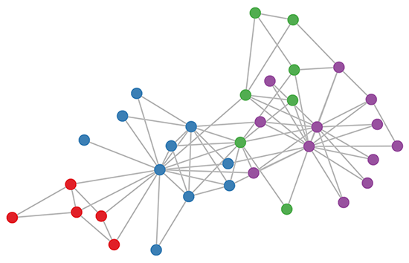

Okay, what are we going to study?
Application
John: Hi there
Transport
?
Network
Packet
Packet
Data Link
Datagram
Physical

Slide 5
CSCI-351 Data communication and Networks
Lecture 3: Internet Architecture
(Big picture of how Internet works)
The slide is built with the help of Prof. Alan Mislove, Christo Wilson, and David Choffnes's class

Slide 6
Organizing Network Functionality
Networks are built from many components
Networking technologies
Network styles
Applications
How do we make all this stuff work together?!
Ethernet, Wifi, Bluetooth, Fiber Optic, Cable Modem, DSL
Circuit switch, packet switch
Wired, Wireless, Optical, Satellite
Email, Web (HTTP), FTP, BitTorrent, VoIP
Notes:
- Network technologies: desktop? laptop? Credit card, NFC? (Near Field Communication)
- switch?

Slide 7




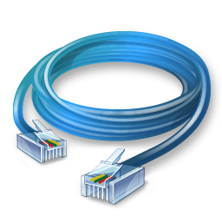



Problem Scenario
Web
Email
Bittorrent
VoIP
This is a nightmare scenario
Huge amounts of work to add new apps or media
Limits growth and adoption
Ethernet
802.11
Bluetooth
Cellular
Notes:
Let’s say you build an web application, then what do you need to do?
Layout, human interfaces,

Slide 8
More Problems
Bittorrent
Bittorrent
Application endpoints may not be on the same media
Ethernet
802.11
Notes:
Then what’s the solution?

Slide 9
Solution:
Web
Email
Bittorrent
Magical Network Abstraction Layer
Ethernet
802.11
Bluetooth
Notes:
What’s the complexity to add new application or new medium?
Order of N, N^2

Slide 10
Solution: Use Indirection
Web
Email
Bittorrent
VoIP
API
O(1) work to add new apps, media
Few limits on new technology
Magical Network Abstraction Layer
API
API
API
Ethernet
802.11
Bluetooth
Cellular
Notes:
What’s the complexity to add new application or new medium?
Order of N, N^2

Slide 11
Layered Network Stack
Applications
Modularity
Does not specify an implementation
Instead, tells us how to organize functionality
Layer N
Encapsulation
…
Interfaces define cross-layer interaction
Layers only rely on those below them
Layer 2
Flexibility
Reuse of code across the network
Module implementations may change
Layer 1
Unfortunately, there are tradeoffs
Physical
Media
Interfaces hide information
As we will see, may hurt performance…
Notes:
That’s why we need layering.
So each layer does not specify an implementation; instead it just want you to pass “this this this” information.
Do you know how to call it?
Second, interfaces define cross-layer interaction.
Also, one layer doest not care about other layers but neighbor layers.
Abstraction. Does it remind you something in programming language? Java? C++? Abstract class,

Slide 12



Key Questions
How do we divide functionality into layers?
Routing
Congestion control
Error checking
How do we distribute functionality across devices?
Example: who is responsible for sanity check?
Security
Fairness
And many more…
Switch
Switch
Router
Notes:
Every networking devices does not need to implement all of these functionalities.
Your machine does not need to have a routing of course.
Congestion control - interfere

Slide 13
Outline
Layering
The OSI Model
Communicating
The End-to-End Argument
Notes:
International Organization for Standardization (ISO)
Standardization organization

Slide 14
The ISO OSI Model
OSI: Open Systems Interconnect Model
Host 1
Router
Host 2
Application
Application
Application
Presentation
Presentation
Presentation
Session
Session
Session
Transport
Transport
Transport
Network
Network
Network
Data Link
Data Link
Data Link
Physical
Physical
Physical
Notes:
Host1 and host2 communicates
Of course, we need a router to pass the packets
3. Then, Do routers also need to implement all the layer’s functionality?
What is the core example of the network layer?

Slide 15
The ISO OSI Model
OSI: Open Systems Interconnect Model
Host 1
Router
Host 2
Application
Application
Presentation
Layers communicate peer-to-peer
Presentation
All devices implement the first three layers
Layers communicate peer-to-peer
Session
Session
Transport
Transport
Network
Network
Network
Data Link
Data Link
Data Link
Physical
Physical
Physical

Slide 16
Layer Features
Service
What does this layer do?
Interface
How do you access this layer?
Protocol
How is this layer implemented?
Application
Presentation
Session
Transport
Network
Data Link
Physical

Slide 17
Physical Layer
Service
Move information between two systems connected by a physical link
Interface
Specifies how to send one bit
Protocol
Encoding scheme for one bit
Voltage levels
Timing of signals
Examples: coaxial cable, fiber optics, radio frequency transmitters
Application
Presentation
Session
Transport
Network
Data Link
Physical

Slide 18
Data Link Layer
Service
Data framing: boundaries between packets
Media access control (MAC)
Per-hop reliability and flow-control
Interface
Send one packet between two hosts connected to the same media
Protocol
Physical addressing (e.g. MAC address)
Examples: Ethernet, Wifi
Application
Presentation
Session
Transport
Network
Data Link
Physical
Notes:
Each device has an unique ID of Mac address, and this ID must be unique in the local network.
So if you’re connected same RIT wifi network, and some of you happen to have the same Mac address? Then you will not be able to use the Internet, because the data supposed to be sent to you, may be sent to someone else.
Does anyone know good example of how this Mac address is used in practice?
If you goto the airport, some airport give you an free internet access just for an hour, after that
Open WIFI? TERMS OF SERVICES?

Slide 19
Network Layer
Service
Deliver packets across the network
Handle fragmentation/reassembly
Packet scheduling
Buffer management
Interface
Send one packet to a specific destination
Protocol
Define globally unique addresses
Maintain routing tables
Example: Internet Protocol (IP), IPv6
Application
Presentation
Session
Transport
Network
Data Link
Physical

Slide 20
Transport Layer
Service
Multiplexing/demultiplexing
Congestion control
Reliable, in-order delivery
Interface
Send message to a destination
Protocol
Port numbers
Reliability/error correction
Flow-control information
Examples: UDP, TCP
Application
Presentation
Session
Transport
Network
Data Link
Physical
Notes:
Mux and Demux
“Digital Circuit” or “Microprocessor” class

Slide 21
Session Layer
Service
Access management
Synchronization
Interface
It depends…
Protocol
Token management
Insert checkpoints
Examples: none
Application
Presentation
Session
Transport
Network
Data Link
Physical

Slide 22
Presentation Layer
Service
Convert data between different representations
E.g. big endian to little endian
E.g. Ascii to Unicode
Interface
It depends…
Protocol
Define data formats
Apply transformation rules
Examples: none
Application
Presentation
Session
Transport
Network
Data Link
Physical
Notes:
Digital circuit/ digital electronics?
Little endian = intel
0x12345678: 4 byte integer
bigEndian: 12/34/56/78
Little:
Memory address unit (A word)
ASCII: 128, Unicode: 2^21 two to the twenty one

Slide 23
Application Layer
Service
Interface
Protocol
Examples:
Application
Presentation
Whatever you want :)
Session
Transport
Whatever you want :D
Network
Whatever you want ;)
Data Link
turn on your smartphone and look at the list of apps
Physical

Slide 24
Encapsulation
How does data move through the layers?
Data
Application
Presentation
Session
Transport
Network
Data Link
Physical
Data
Notes:
WHY????

Slide 25
Real Life Analogy
Notes:
Do you have any idea of real life analogy?
What is the similar concept of this one in real life?
Layering, encapsulation

Slide 26



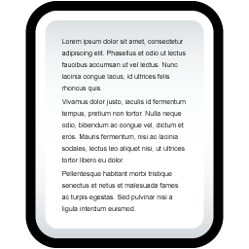




Real Life Analogy
Doesn’t know how the Postal network works
Label contains routing info
Un-packing
Doesn’t know contents of letter
Postal Service

Slide 27
Network Stack in Practice
Host 1
Router
Host 2
Application
Application
Presentation
Presentation
Video Client
Video Server
Session
Session
FTP Client
FTP Server
UDP
UDP
Transport
Transport
TCP
TCP
Network
Network
Network
IP
IP
IP
Data Link
Data Link
Data Link
Ethernet
Ethernet
802.11n
Ethernet
802.11n
802.11n
Physical
Physical
Physical

Slide 28
Encapsulation, Revisited
HTTP Header
Web Page
Web Server
TCP Header
HTTP Header
Web Page
TCP
TCP Segment
IP Header
TCP Header
HTTP Header
Web Page
IP
IP Datagram
Ethernet Header
IP Header
TCP Header
HTTP Header
Web Page
Ethernet Trailer
Ethernet
Ethernet Frame
Notes:
WHY???

Slide 29
The Hourglass
HTTP, FTP, RTP, IMAP, Jabber, …
One Internet layer means all networks interoperate
All applications function on all networks
Room for development above and below IP
But, changing IP is insanely hard
TCP, UDP, ICMP
Think about the difficulty of deploying IPv6…
IPv4
Ethernet, 802.11x, DOCSIS, …
Fiber, Coax, Twisted Pair, Radio, …

Slide 30
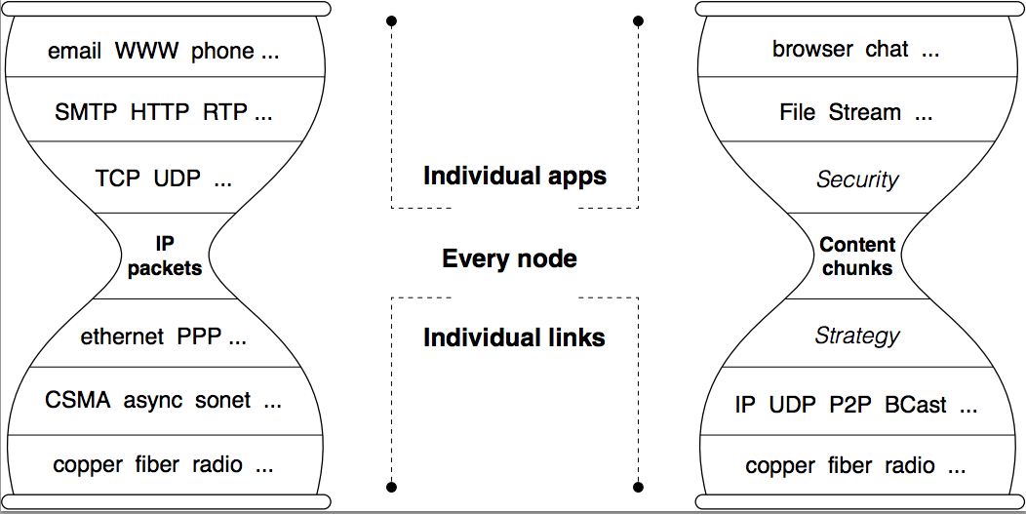
An Example of the New Architectures
Named Data Networking (NDN)
Notes:
Let me ask you something,
What do you usually do on the Internet? Content
When do you watch a video on Netflix, the server must have the IP address, and your phone and machine must have the IP address, right?
When you watch the video, do you care about the IP? Do you know where it comes from? Most importantly do you care?
2006 named data networking
the idea was very simple; hey you know what; I’ve just learned that we actually do not care about the IP; but we only care about the content!

Slide 31
Orthogonal Planes
Control plane: How Internet paths are established
Application
Presentation
Well cover this later…
Session
Transport
IP
BGP
RIP
OSPF
Control Plane
Data Link
Physical

Slide 32
Orthogonal Planes
Data plane: How data is forwarded over Internet paths
Host 1
Switch(es)
Host 2
Application
Application
Transport
Transport
Network
Network
Network
Data Link
Data Link
Data Link

Slide 33
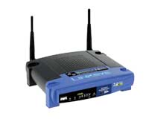


Reality Check
The layered abstraction is very nice
Does it hold in reality?
No. (Any examples?)
Firewalls
Analyze application layer headers
Transparent Proxies
Simulate application endpoints within the network
NATs
Break end-to-end network reachability
Notes:
Sometimes you input the wrong domain name on your browser, and the content is like “hey this is the result of your domain searching”

Slide 34
Outline
Layering
The OSI Model
Communicating
The End-to-End Argument

Slide 35
From Layers to Eating Cake
IP gives us best-effort datagram forwarding
So simple anyone can do it
Large part of why the Internet has succeeded
…but it sure isn’t giving us much
Layers give us a way to compose functionality
Example: HTTP over TCP for Web browsers with reliable connections
…but they do not tell us where (in the network) to implement the functionality

Slide 36
Where to Place Functionality
How do we distribute functionality across devices?
Example: who is responsible for security?
?
?
?
?
?
Switch
Switch
Router
“The End-to-End Arguments in System Design”
Saltzer, Reed, and Clark
The Sacred Text of the Internet
Endlessly debated by researchers and engineers

Slide 37
Basic Observation
Some applications have end-to-end requirements
Security, reliability, etc.
Implementing this stuff inside the network is hard
Every step along the way must be fail-proof
Different applications have different needs
End hosts…
Can’t depend on the network
Can satisfy these requirements without network level support

Slide 38


Example: Reliable File Transfer
Integrity Check
Integrity Check
Integrity Check
App has to do a check anyway!
Solution 1: Make the network reliable
Solution 2: App level, end-to-end check, retry on failure

Slide 39
Example: Reliable File Transfer
Please Retry
In-network implementation…
Doesn’t reduce host complexity
Does increase network complexity
Increased overhead for apps that don’t need functionality
But, in-network performance may be better
Full functionality can be built at App level
Solution 1: Make the network reliable
Solution 2: App level, end-to-end check, retry on failure

Slide 40
Conservative Interpretation
“Don’t implement a function at the lower levels of the system unless it can be completely implemented at this level” (Peterson and Davie)
Basically, unless you can completely remove the burden from end hosts, don’t bother

Slide 41
Radical Interpretation
Don’t implement anything in the network that can be implemented correctly by the hosts
Make network layer absolutely minimal
Ignore performance issues

Slide 42
Moderate Interpretation
Think twice before implementing functionality in the network
If hosts can implement functionality correctly, implement it a lower layer only as a performance enhancement
But do so only if it does not impose burden on applications that do not require that functionality…
…and if it doesn’t cost too much $ to implement

Slide 43
Reality Check, Again
Layering and E2E principals regularly violated
Firewalls
Transparent Proxies
NATs
Conflicting interests
Architectural purity
Commercial necessity

Slide 44




Real world example (DNS Hijacking)
non-exist-url.com
Browser
DNS Server
NXDOMAIN
Advertisement or
other contents
404 Not Found!

Slide 45
Real world example (DNS Hijacking)
Country | ISP | DNS Servers | Exit Nodes
Argentina | Telefonica de Argentina | 14 | 276
Australia | Dodo Australia | 21 | 1,404
Brazil | Oi Fixo | 21 | 2,558
 | CTBC | 4 | 290
Germany | Deutsche Telekom | 8 | 1,385
India | Airtel Broadband | 9 | 735
 | BSNL | 2 | 71
 | Ntl. Int. Backbone | 8 | 245
Malyasia | TMNet | 8 | 1,676
Spain | Ono | 2 | 71
U.K. | BT Internet | 6 | 479
 | Talk Talk | 46 | 3,738
U.S. | AT&T | 37 | 561
 | Cable One | 4 | 108
 | Cox Communications | 63 | 1,789
 | Mediacom Cable | 6 | 219
 | Suddenlink | 9 | 98
 | Verizon | 98 | 2,102
 | WideOpen West | 1 | 39
Tunneling for Transparency: A Large-Scale Analysis of End-to-End Violations in the Internet
Taejoong Chung, David Choffnes, and Alan Mislove
In Proceedings of ACM Internet Measurement Conference (IMC`16), Santa Monica, California, USA, November 2016

Slide 46
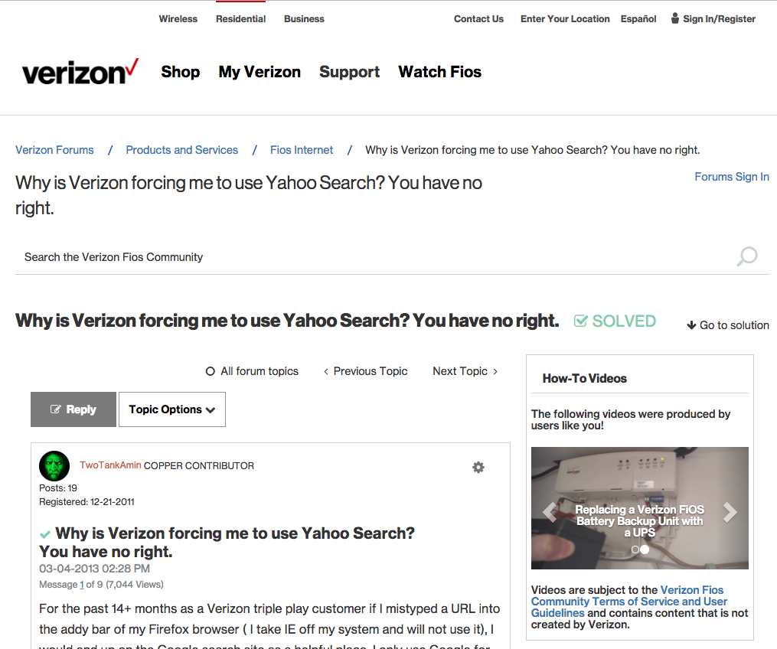

Slide 47
Takeaways
Layering for network functions
Helps manage diversity in computer networks
Not optimal for everything, but simple and flexible
Narrow waist ensures interoperability, enables innovation
E2E argument (attempts) to keep IP layer simple
Think carefully when adding functionality into the network

Slide 48
Questions?

Slide 49
Next Class..
C-Socket Programming

