Slide 1
CSCI-351 Data communication and Networks
Lecture 6: Data Link
The slide is built with the help of Prof. Alan Mislove, Christo Wilson, and David Choffnes's class

Slide 2
Good News!
Project 1 has been released.

Slide 3
Start Early!

Slide 4
Project Description
Chat server / client

Slide 5
Recap

Slide 6
C Socket API Overview
Clients
gethostbyname()
socket()
connect()
write() / send()
read() / recv()
close()
Servers
socket()
bind()
listen()
while (whatever) {
accept()
read() / recv()
write() / send()
close()
}
close()

Slide 7
htons(), htonl(), ntohs(), ntohl()
Little Endian vs. Big Endian
Not a big deal as long as data stays local
What about when hosts communicate over networks?
Network byte order
Standardized to Big Endian
Be careful: x86 is Little Endian
Functions for converting host order to network order
h to n s – host to network short (16 bits)
h to n l – host to network long (32 bits)
n to h * – the opposite
Notes:
convert values between host and network byte order: Big-endian is the most common format in data networking;
4bytes (128): 0x00 0x00 0x00 0x80
Little endian: 0x80 0x00 0x00 0x00 (Intel microprocessor) — most modern computers
Big endian: 0x00 0x00 0x00 0x80 (IBM Z architecutres…)
The network byte order is defined to always be big-endian,

Slide 8
More Resources
Beej’s famous socket tutorial
https://beej.us/guide/bgnet/

Slide 9
Wireshark

Slide 10



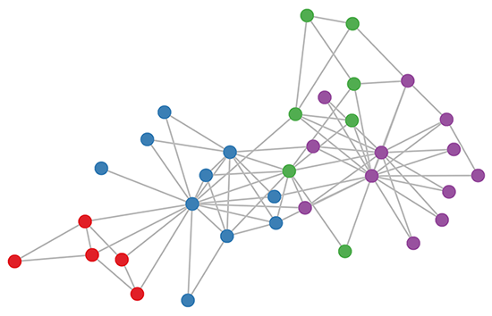

Okay, what are we going to study?
Application
John: Hi there
Transport
?
Network
Packet
Packet
Data Link
Datagram
Physical

Slide 11
Data Link Layer
Function:
Send blocks of data (frames) between physical devices
Regulate access to the physical media
Key challenge:
How to delineate frames?
How to detect errors?
How to perform media access control (MAC)?
How to recover from and avoid collisions?
Application
Transport
Network
Data Link
Physical

Slide 12
Outline
Framing
Error Checking and Reliability
Media Access Control
802.3 Ethernet
802.11 Wifi

Slide 13
Framing
Physical layer determines how bits are encoded
Next step, how to encode blocks of data
Packet switched networks
Each packet includes routing information (not IP routing)
Data boundaries must be known so headers can be read
Types of framing
Byte oriented protocols
Bit oriented protocols
Clock based protocols

Slide 14
Byte Oriented: Sentinel Approach
START
Data
DLE
DLE
DLE
END
END
Add START and END sentinels to the data
Problem: what if END appears in the data?
Add a special DLE (Data Link Escape) character before END
What if DLE appears in the data? Add DLE before it.
Similar to escape sequences in C
printf(“You must \”escape\” quotes in strings”);
printf(“You must \\escape\\ forward slashes as well”);
Used by Point-to-Point protocol, e.g. modem, DSL, cellular
Notes:
Sentinel: Special bytes (sentinel characters) delineate the boundaries of a frame

Slide 15
Byte Oriented: Byte Counting
132
132
Data
Sender: insert length of the data in bytes at the beginning of each frame
Receiver: extract the length and read that many bytes

Slide 16
Bit Oriented: Bit Stuffing
01111110
Data
01111110
Add sentinels to the start and end of data
Both sentinels are the same
Example: 01111110 in High-level Data Link Protocol (HDLC)
Sender: insert a 0 after each 11111 in data
Known as “bit stuffing”
Receiver: after seeing 11111 in the data…
111110
→ remove the 0 (it was stuffed)
111111
→ look at one more bit
1111110
→ end of frame
1111111
→ error! Discard the frame

Slide 17
Clock-based Framing: SONET
Synchronous Optical Network
Transmission over very fast optical links
STS-n, e.g. STS-1: 51.84 Mbps, STS-768: 36.7 Gbps
STS-1 frames based on fixed sized frames
9*90 = 810 bytes
Physical layer details
Bits are encoded using NRZ
Payload is XORed with a special 127-bit pattern to avoid long sequences of 0 and 1
90 Columns
Special start pattern
9 Rows
Payload
Overhead

Slide 18
Outline
Framing
Error Checking and Reliability
Media Access Control
802.3 Ethernet
802.11 Wifi

Slide 19
Dealing with Noise
The physical world is inherently noisy
Interference from electrical cables
Cross-talk from radio transmissions, microwave ovens
Solar storms
How to detect bit-errors in transmissions?
How to recover from errors?

Slide 20
Naïve Error Detection
Idea: send two copies of each frame
if (memcmp(frame1, frame2) != 0) { OH NOES, AN ERROR! }
Why is this a bad idea?
Extremely high overhead
Poor protection against errors
Twice the data means twice the chance for bit errors

Slide 21
Parity Bits
Idea: add extra bits to keep the number of 1s even
Example: 7-bit ASCII characters + 1 parity bit
0101001
1
1101001
0
1011110
1
0001110
1
0110100
1
10
1
Detects 1-bit errors and some 2-bit errors
Not reliable against bursty errors

Slide 22
Two Dimensional Parity
0101001
1101001
1011110
0001110
0110100
1011111
1
0
1
1
1
0
Parity bit for each row
Parity bit for each column
1111011
0
Parity bit for the parity byte
Can detect all 1-, 2-, and 3-bit errors, some 4-bit errors
24% overhead

Slide 23
Two Dimensional Parity Examples
0101001
1101001
1011110
0001110
0110100
1011111
1
0
1
1
1
0
1
0
Odd number of 1s
1
1
Odd number of 1s
1111011
0
Odd Number of 1s
Odd number of 1s
Notes:
two dimensional parity sometimes does not solve the problem.

Slide 24
Checksums
Idea:
Add up the bytes in the data
Include the sum in the frame
Use ones-complement arithmetic
Lower overhead than parity: 16 bits per frame
But, not resilient to errors
Why?
Used in UDP, TCP, and IP
START
Data
Checksum
END
1
0
0101001
+
1101001= 10010010
Notes:
which breaks the data into "words" with a fixed number n of bits, and then computes the exclusive or (XOR) of all those words
(2) No False positive, but false negative.

Slide 25
Cyclic Redundancy Check (CRC)
Uses field theory to compute a semi-unique value for a given message
Much better performance than previous approaches
Fixed size overhead per frame (usually 32-bits)
Quick to implement in hardware
Only 1 in 2³² chance of missing an error with 32-bit CRC
Details are in the book/on Wikipedia

Slide 26
Questions – Error Checking?

Slide 27
What About Reliability?
How does a sender know that a frame was received?
What if it has errors?
What if it never arrives at all?
Sender
Receiver
Frame
Time
ACK
Acknowledgement

Slide 28
Stop and Wait
Simplest form of reliability
Example: Bluetooth
Problems?
Utilization
Can only have one frame in flight at any time
10Gbps link and 10ms delay
Need 100 Mbit to fill the pipe
Assume packets are 1500B
1500B*8bit/(2*10ms) = 600Kbps
Utilization is 0.006%
Sender
Receiver
Frame
ACK
Frame
Timeout
Frame
Notes:
1500*8 / (0.01*2)

Slide 29
Sliding Window
Allow multiple outstanding, un-ACKed frames
Number of un-ACKed frames is called the window
Sender
Receiver
Frames
Window
ACKs
Made famous by TCP
We’ll look at this in more detail later

Slide 30
Should We Error Check in the Data Link?
Recall the End-to-End Argument
Cons:
Error free transmission cannot be guaranteed
Not all applications want this functionality
Error checking adds CPU and packet size overhead
Error recovery requires buffering
Pros:
Potentially better performance than app-level error checking
Data link error checking in practice
Most useful over lossy links
Wifi, cellular, satellite
Retransmission vs. Error correction
Notes:
When is an error check is useful?
Each Ethernet frame carries a CRC-32 checksum. Frames received with incorrect checksums are discarded by the receiver hardware.

Slide 31
Outline
Framing
Error Checking and Reliability
Media Access Control
802.3 Ethernet
802.11 Wifi

Slide 32
What is Media Access?
Ethernet and Wifi are both multi-access technologies
Broadcast medium, shared by many hosts
Simultaneous transmissions cause collisions
This destroys the data
Media Access Control (MAC) protocols are required
Rules on how to share the medium
Strategies for detecting, avoiding, and recovering from collisions

Slide 33
Strategies for Media Access
Channel partitioning
Divide the resource into small pieces
Allocate each piece to one host
Example: Time Division Multi-Access (TDMA) cellular
Example: Frequency Division Multi-Access (FDMA) cellular
Taking turns
Tightly coordinate shared access to avoid collisions
Token Ring
Contention
Allow collisions, but use strategies to recover
Examples: Ethernet, Wifi

Slide 34
Contention MAC Goals
Share the medium
Two hosts sending at the same time collide, thus causing interference
If no host sends, channel is idle
Thus, we want one user sending at any given time
High utilization
TDMA is low utilization
Just like a circuit switched network
Simple, distributed algorithm
Multiple hosts that cannot directly coordinate
No fancy (complicated) token-passing schemes
Notes:
The data transmission process goes as follows:
Empty information frames are continuously circulated on the ring.
When a computer has a message to send, it seizes the token. The computer will then be able to send the frame.
The frame is then examined by each successive workstation. The workstation that identifies itself to be the destination for the message copies it from the frame and changes the token back to 0.
When the frame gets back to the originator, it sees that the token has been changed to 0 and that the message has been copied and received. It removes the message from the frame.
The frame continues to circulate as an "empty" frame, ready to be taken by a workstation when it has a message to send.

Slide 35
Contention Protocol Evolution
ALOHA
Developed in the 70’s for packet radio networks
Slotted ALOHA
Start transmissions only at fixed time slots
Significantly fewer collisions than ALOHA
Carrier Sense Multiple Access (CSMA)
Start transmission only if the channel is idle
CSMA / Collision Detection (CSMA/CD)
Stop ongoing transmission if collision is detected

Slide 36
ALOHA
Topology: radio broadcast with multiple stations
Protocol:
Stations transmit data immediately
Receivers ACK all packets
No ACK = collision, wait a random time then retransmit
Simple, but radical concept
Previous attempts all divided the channel
TDMA, FDMA, etc.
Optimized for the common case: few senders
A
B
C

Slide 37
Tradeoffs vs. TDMA
In TDMA, each host must wait for its turn
Delay is proportional to number of hosts
In Aloha, each host sends immediately
Much lower delay
But, much lower utilization
Each host can send anytime, if collision happens the it sends again… (independent and discrete…)
Poisson distribution
k: transmission attempt
lambda: average transmission-attempts
Maximum throughput is ~18% of channel capacity
Notes:
Random variable: expresses the probability of a given number of events occurring i a known constant rate and independently of the time since the last even

Slide 38
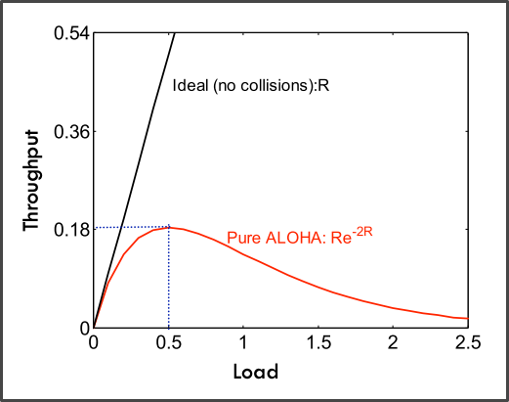
Tradeoffs vs. TDMA
In TDMA, each host must wait for its turn
Delay is proportional to number of hosts
In Aloha, each host sends immediately
Much lower delay
But, much lower utilization
Each host can send anytime, if collision happens the it sends again… (independent and discrete…)
Poisson distribution
k: transmission attempt
lambda: average transmission-attempts
Maximum throughput is ~18% of channel capacity
Notes:
Random variable: expresses the probability of a given number of events occurring i a known constant rate and independently of the time since the last even

Slide 39
Slotted ALOHA
Protocol
Same as ALOHA, except time is divided into slots
Hosts may only transmit at the beginning of a slot
Thus, frames either collide completely, or not at all
37% throughput vs. 18% for ALOHA
But, hosts must have synchronized clocks

Slide 40
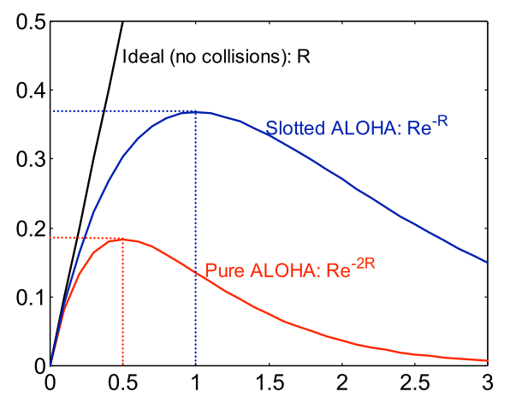
Slotted ALOHA
Protocol
Same as ALOHA, except time is divided into slots
Hosts may only transmit at the beginning of a slot
Thus, frames either collide completely, or not at all
37% throughput vs. 18% for ALOHA
But, hosts must have synchronized clocks
Throughput
Load

Slide 41
802.3 Ethernet
Bytes
7
1
6
6
2
0-1500
0-46
4
Preamble
SF
Source
Dest.
Length
Data
Pad
Checksum
Preamble is 7 bytes of 10101010. Why?
Start Frame (SF) is 10101011
Source and destination are MAC addresses
E.g. 00:45:A5:F3:25:0C
Broadcast: FF:FF:FF:FF:FF:FF
Minimum packet length is 64 bytes, hence the pad
Notes:
The preamble consists of a 56-bit (seven-byte) pattern of alternating 1 and 0 bits, allowing devices on the network to easily synchronize their receiver clocks,
Source dest length data pad checksum

Slide 42
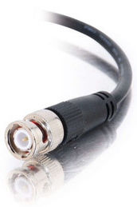

Broadcast Ethernet
Originally, Ethernet was a broadcast technology
Terminator
10Base2
Repeater
Tee Connector
Hubs and repeaters are layer-1 devices, i.e. physical only
10BaseT and 100BaseT
T stands for Twisted Pair
Hub

Slide 43
CSMA/CD
Carrier sense multiple access with collision detection
Key insight: wired protocol allows us to sense the medium
Algorithm
Sense for carrier
If carrier is present, wait for it to end
Sending would cause a collision and waste time
Send a frame and sense for collision
If no collision, then frame has been delivered
If collision, abort immediately
Why keep sending if the frame is already corrupted?
Perform exponential backoff then retransmit

Slide 44
CSMA/CD Collisions
Spatial Layout of Hosts
Collisions can occur
Collisions are quickly detected and aborted
Note the role of distance, propagation delay, and frame length
A
B
C
D
t₀
t₁
Time
Detect Collision and Abort

Slide 45
Exponential Backoff
When a sender detects a collision, send “jam signal”
Make sure all hosts are aware of collision
Jam signal is 32 bits long (plus header overhead)
Exponential backoff operates in multiples of 512 bits
Select k ∈ [0, 2^{n} – 1], where n = number of collisions
Wait k * 51.2µs before retransmission
n is capped at 10, frame dropped after 16 collisions
Backoff time is divided into contention slots
Remember this number
Notes:
512 bits = 51.2 sec (at 10 Mbit/sec)

Slide 46
Minimum Packet Sizes
Why is the minimum packet size 64 bytes?
To give hosts enough time to detect collisions
What is the relationship between packet size and cable length?
10 Mbps Ethernet
Packet and cable lengths change for faster Ethernet standards
A
B
Time t: Host A starts transmitting
Time t + d: Host B starts transmitting
Time t + 2*d: collision detected
Propagation Delay (d)
min_frame_size*light_speed/(2*bandwidth) = max_cable_length
(64B*8)*(2.5*10⁸mps)/(2*10⁷bps) = 6400 meters
Notes:
assuming copper wire i.e speed =2/3* speed of light
Propagation delay:

Slide 47
Cable Length Examples
min_frame_size*light_speed/(2*bandwidth) = max_cable_length
(64B*8)*(2.5*10⁸mps)/(2*10Mbps) = 6400 meters
What is the max cable length if min packet size were changed to 1024 bytes?
102.4 kilometers
What is max cable length if bandwidth were changed to 1 Gbps ?
64 meters
What if you changed min packet size to 1024 bytes and bandwidth to 1 Gbps?
1024 meters

Slide 48
Exponential Backoff, Revisited
Remember the 512 bit backoff timer?
Minimum Ethernet packet size is also 512 bits
64 bytes * 8 = 512 bits
Coincidence? Of course not.
If the backoff time was <512 bits, a sender who waits and another who sends immediately can still collide

Slide 49
Maximum Packet Size
Maximum Transmission Unit (MTU): 1500 bytes
Pros:
Bit errors in long packets incur significant recovery penalty
Cons:
More bytes wasted on header information
Higher per packet processing overhead
Datacenters shifting towards Jumbo Frames
9000 bytes per packet

Slide 50
Long Live Ethernet
Today’s Ethernet is switched
More on this later
1Gbit and 10Gbit Ethernet now common
25GB/100Gbit are being deployed
Uses same old packet header
Full duplex (send and receive at the same time)
Can also carry power

Slide 51
Outline
Framing
Error Checking and Reliability
Media Access Control
802.3 Ethernet
802.11 Wifi

Slide 52
Exponential Backoff, Revisited
Remember the 512 bit backoff timer?
Minimum Ethernet packet size is also 512 bits
64 bytes * 8 = 512 bits
Coincidence? Of course not.
If the backoff time was <512 bits, a sender who waits and another who sends immediately can still collide

Slide 53
802.3 vs. Wireless
Ethernet has one shared collision domain
All hosts on a LAN can observe all transmissions
Wireless radios have small range compared to overall system
Collisions are local
Collision are at the receiver, not the sender
Carrier sense (CS in CSMA) plays a different role
802.11 uses CSMA/CA not CSMA/CD
Collision avoidance, rather than collision detection
Notes:
Why Collision Avoidance, Collision Detection

Slide 54
Hidden Terminal Problem
Radios on the same network cannot always hear each other
Collision!
A
B
C
A cannot hear C
C cannot hear A
Hidden terminals mean that sender-side collision detection is useless

Slide 55
Exposed Terminal Problem
Carrier sense detects a busy channel
Carrier sensing is problematic in wireless
No collision
No collision
A
B
C
D
Carrier sense can erroneously reduce utilization

Slide 56
Reachability in Wireless
High level problem:
Reachability in wireless is not transitive
Just because A can reach B, and B can reach C, doesn’t mean A can reach C
A
B
C
D

Slide 57
RTS and CTS
RTS (Request to Send)
Can I send something to you?
CTS (Clear to Send)
Yes, you can send it
Data transmission actually happens after receiving a CTS
1. RTS
2. CTS
3. Data
A
B

Slide 58
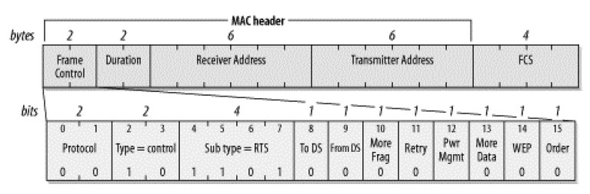
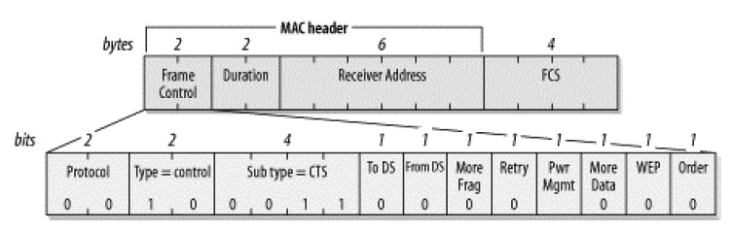
RTS and CTS
Notes:
FCS (Frame check sequence)
Why CTS does not have a transmitter address?

Slide 59
Solving Hidden Terminal Problem

Slide 60
Solving Exposed Terminal Problem

Slide 61
MACA
Multiple Access with Collision Avoidance
Developed in 1990
Sense the channel
The receiver is busy
Channel is idle
Host in
Sender’s
Range
Host in
Receiver’s
Range
Sender
Receiver
Soft-reserve the channel
RTS
RTS
CTS
CTS
RTS but no CTS = clear to send
Data
Data
Successful transmission
ACK
ACK
Notes:
So what they do is “collision avoidance”

Slide 62
Collisions in MACA
What if sender does not receive CTS or ACK?
Assume collision
Enter exponential backoff mode

Slide 63
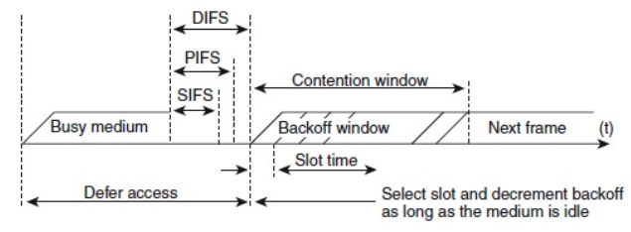
802.11 Media Access
Media Access prioritize the packets using a “timing”
Inter Frame Spacing (IFS)
DIFS – low priority, normal data packets
PIFS – medium priority, used with Point Coordination Function (PCF)
SIFS – high priority, control packets (CTS, ACK, etc.)
Contention interval: random wait time
PCF and DCF

Slide 64
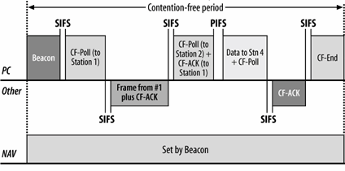
PCF (Point Coordination Function)
An access point (Coordinator) polls each terminal to see if it has something to send

Slide 65
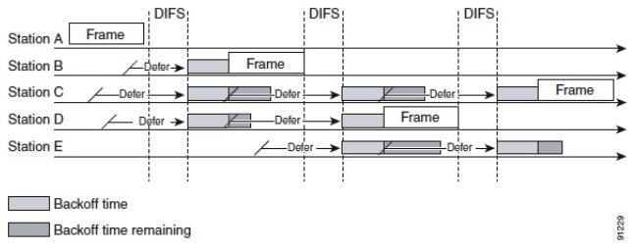
DCF (Distributed Coordination Function)
Each terminal needs to contend each other to send packets

Slide 66
RTS/CTS using DCF
Notes:
The rules for transmission of an RTS frame are the same as those for the data frame under DCF access, i.e. the transmitter sends an RTS frame after the channel has been idle for a time interval exceeding DIFS
However, wireless 802.11 implementations do not typically implement RTS/CTS for all transmissions; they may turn it off completely,

Slide 67
PCF + DCF
But in reality, PCF is rarely used..

Slide 68
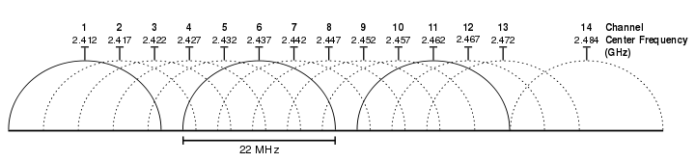
802.11b
802.11b
Introduced in 1999
Uses the unlicensed 2.4 Ghz band
Same band as cordless phones, microwave ovens
Complementary code keying (CCK) modulation scheme
5.5 and 11 Mbps data rates
Practical throughput with TCP is only 5.9 Mbps
11 channels (in the US*). Only 1, 6, and 11 are orthogonal
Notes:
14 Channel is only allowed in Japan.

Slide 69
802.11a/g
802.11a
Uses the 5 Ghz band
6, 9, 12, 18, 24, 36, 48, 54 Mbps
Switches from CCK to Orthogonal Frequency Division Multiplexing (OFDM)
Each frequency is orthogonal
802.11g
Introduced in 2003
Uses OFDM to improve performance (54 Mbps)
Backwards compatible with 802.11b

Slide 70
802.11n/ax
802.11n
Introduced in 2009
Multiple Input Multiple Output (MIMO)
Multiple send and receive antennas per devices (up to four)
Data stream is multiplexed across all antennas
Maximum 600 Mbps transfer rate (in a 4x4 configuration)
300 Mbps is more common (2x2 configuration)
802.11ac
December 2013
8x8 MIMO in the 5 GHz band, 500 Mbps – 1 GBps rates
802.11ax
December 2018
1.75 Gbps

Slide 71
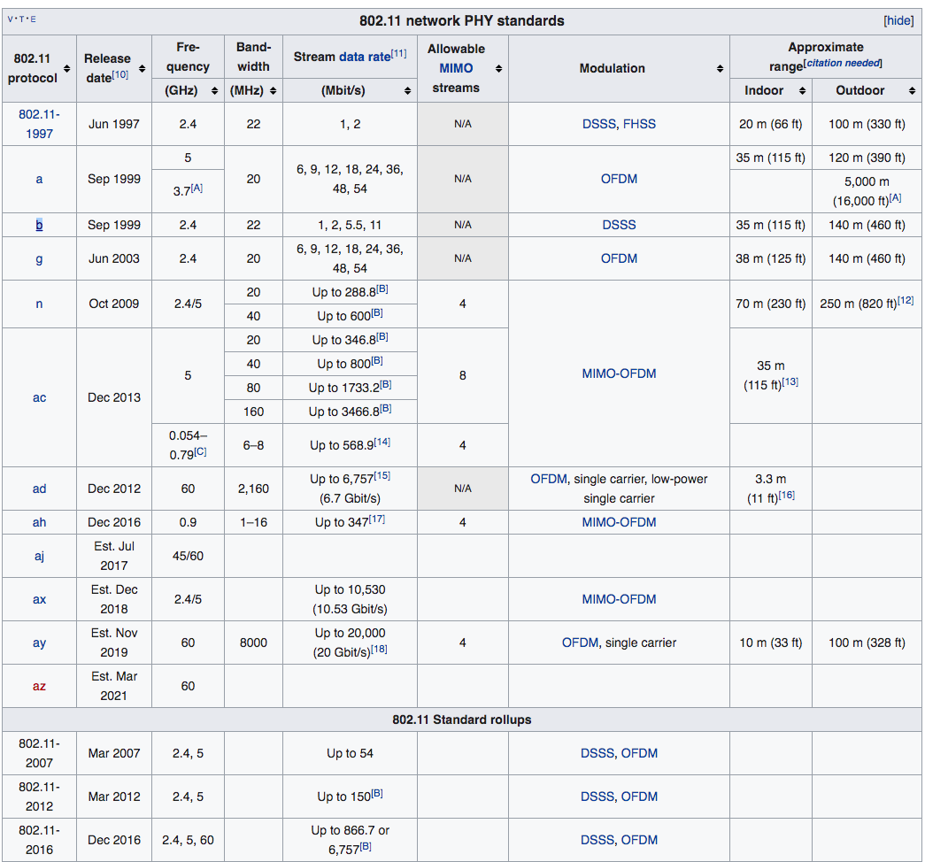

Slide 72
801.11 is Complicated
We’ve only scratched the surface of 802.11
Association – how do clients connect to access points?
Scanning
What about roaming?
Variable sending rates to combat noisy channels
Infrastructure vs. ad-hoc vs. point-to-point
Mesh networks and mesh routing
Power saving optimizations
How do you sleep and also guarantee no lost messages?
Security and encryption (WEP, WAP, 802.11x)
This is why there are courses on wireless networking

