Slide 1
CSCI-351 Data communication and Networks
Lecture 15: Security Basics
Something that you do not want to memorize
The slide is built with the help of Prof. Alan Mislove, Christo Wilson, and David Choffnes's class

Slide 2
Outline
Principles
Basics
Vulnerabilities
Notes:
Ask for definitions of security

Slide 3
3 principles of information security
CIA Triangles:
Confidentiality
Integrity
Availability

Slide 4
Confidentiality
"Hey, we're attacking at dawn!"
Data must only be released to authorized principals
Cryptography has historically focused on providing confidentiality
But, there are other mechanisms
Can have a temporal aspect

Slide 5
Integrity
"Retreat at dawn."
Data must not be modified (in an undetectable manner)
What constitutes a modification?
Corruption
Dropped, replayed, or reordered messages
Cryptography has also historically provided this
e.g, (cryptographic) hash functions, HMAC

Slide 6
Availability
“Xfk3^#M3mf a __ q3rf” – jamming results in garbled message
Data and resources must be accessible when required
Related to integrity, but more concerned with denial of service (DoS) attacks
Resource exhaustion (e.g., CPU, memory, network bandwidth)
Usually easy to perform, can be difficult to defend

Slide 7
Authenticity
Enemy commander: "Attack at dawn."
Establishment of identity
Or, verification of "genuineness"
Again, cryptography has long considered this
e.g., HMAC, signatures

Slide 8
Non-repudiation
"I never said to attack at dawn!"
Data must be bound to identity
Prevents denial of message transmission or receipt
Cryptographic techniques
e.g., HMAC, certificates

Slide 9
Access Control
Policy specifying how entities can interact with resources
i.e., Who can access what?
Requires authentication and authorization

Slide 10
Authentication
Verification of identity claim made by a subject on behalf of a principal
Involves examination of factors, or credentials
Something you have – e.g., a badge
Something you know – e.g., a password
Something you are – e.g., your fingerprint
Desirable properties include being unforgeable, unguessable, and revocable

Slide 11
Outline
Principals
Basics
Vulnerabilities
Notes:
Ask for definitions of security

Slide 12
Security Principles
We've seen some basic properties, policies, mechanisms, models, and approaches to security
But, designing secure systems (and breaking them) remains an art
Security principles help bridge the gap between art and science
Let's look at a few

Slide 13
Separation of Privilege
Privilege, or authority, should only be distributed to subjects that require it
Some components of a system should be less privileged than others
Not every subject needs the ability to do everything
Not every subject is deserving of full trust
Contrast with "ambient authority"

Slide 14
Least Privilege
Subjects should possess only that authority that is required to operate successfully
Closely related to separation of privilege
Not only should privilege be separated, but subjects should have the least amount necessary to perform a task

Slide 15
Security vs. Usability
Security often comes with a trade-off between the level of protection provided and ease-of-use
Systems that try to provide very strong security guarantees tend to be unusable in practice
Completely insecure systems are usually easy to use

Slide 16
Outline
Principals
Basics
Vulnerabilities
Notes:
Ask for definitions of security

Slide 17
Cryptographic Algorithms
Security foundation: cryptographic algorithms
Secret key cryptography, e.g. Data Encryption Standard (DES)
Public key cryptography, e.g. RSA algorithm
Message digest, e.g. MD5

Slide 18
Symmetric Key
Both the sender and the receiver use the same secret keys
Plaintext
Plaintext
Internet
Encrypt with
secret key
Decrypt with
secret key
Ciphertext

Slide 19
Public-Key Cryptography: RSA
Sender uses a public key
Advertised to everyone
Receiver uses a private key
See RSA if you’re interested in
Plaintext
Plaintext
Internet
Encrypt with
public key
Decrypt with
private key
Ciphertext

Slide 20
Hash
Time complexity
Obtaining a hash value is O(1)
Conjecturing keys from the hash is….
In case of sha256, it takes 10**57 minutes (theoretically)

Slide 21
Message Digest (MD) MD5/SHA1
Can provide data integrity
Used to verify the authenticity of a message
Idea: compute a hash value on the message and send it along with the message
Receiver can apply the same hash function on the message and see whether the result coincides with the received hash
Very hard to forge a message that produces the same hash value
i.e. Message -> hash is easy
Hash -> Message is hard
Compare to other error detection methods (CRC, parity, etc)

Slide 22
MD 5 (cont’d)
Basic property: digest operation very hard to invert
Send the digest via a different channel
Plaintext
corrupted msg
Plaintext
NO
=
digest’
Internet
Digest
(MD5)
Digest
(MD5)
digest

Slide 23
Outline
Principals
Basics
An example of Vulnerabilities
Notes:
Ask for definitions of security

Slide 24
Heartbleed
Serious vulnerability discovered in OpenSSL in April 2014
Involves a bug in the TLS heartbeat extension
Allows adversaries to read memory of vulnerable services
i.e., buffer over-read vulnerability
Discloses addresses, sensitive data, potentially TLS secret keys
Major impact
OpenSSL is the de facto standard implementation of TLS, so used everywhere
Many exposed services, often on difficult-to-patch devices
Trivial to exploit
Notes:
We'll see why memory disclosure (even without disclosing TLS keys) is such a problem when we talk about memory corruption vulnerabilities

Slide 25

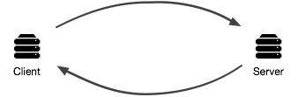

Heartbleed

Slide 26

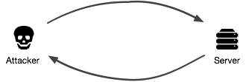

Heartbleed
Notes:
Fundamental problem is that server trusts and does not verify the length value
Stupid mistake

Slide 27
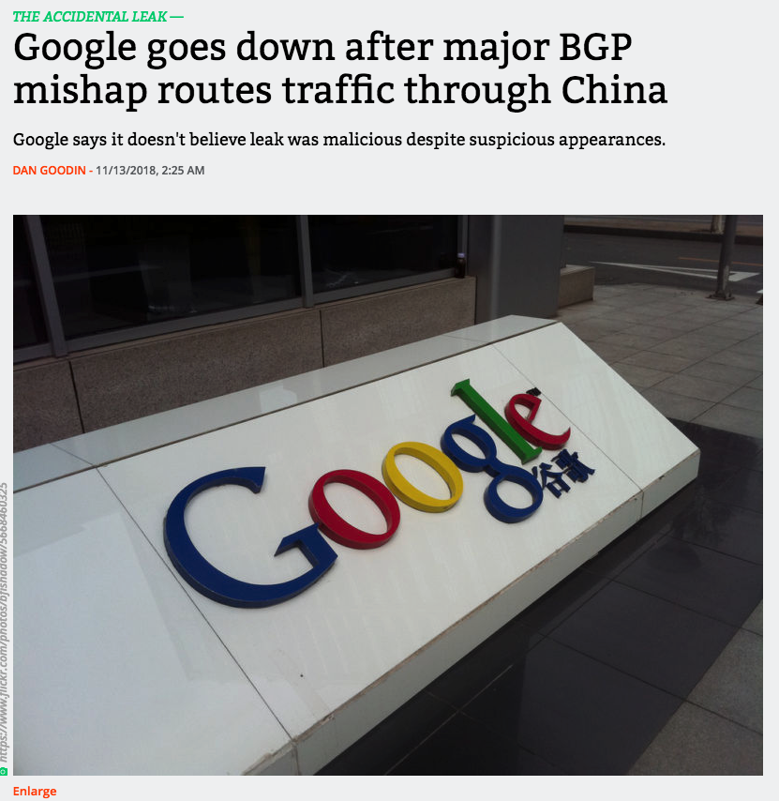

Slide 28


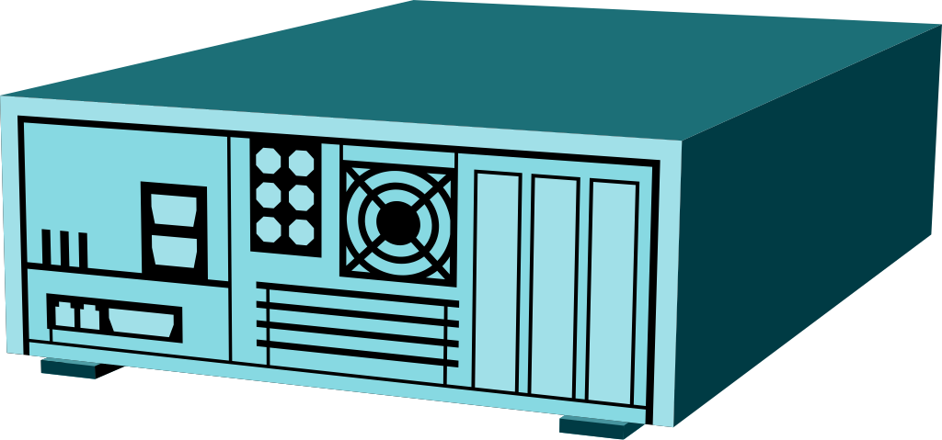
Firewall
Security device whose goal is to prevent computers from outside to gain control to inside machines
Hardware or software
Attacker
Firewall
Internet

Slide 29
Firewall (cont’d)
Restrict traffic between Internet and devices (machines) behind it based on
Source address and port number
Payload
Stateful analysis of data
Examples of rules
Block any external packets not for port 80
Block any email with an attachment
Block any external packets with an internal IP address
Ingress filtering

Slide 30
Firewalls: Properties
Easier to deploy firewall than secure all internal hosts
Doesn’t prevent user exploitation
Tradeoff between availability of services (firewall passes more ports on more machines) and security
If firewall is too restrictive, users will find way around it, thus compromising security
E.g., have all services use port 80
Can’t prevent problem from spreading from within

