Slide 1
CSCI-351 Data communication and Networks
Lecture 17: HTTPS
Warning: This may be hard to understand. Do not lose yourself during the class and keep asking questions

Slide 2
SSL/TLS
Application-layer protocol for confidentiality, integrity, and authentication between clients and servers
Introduced by Netscape in 1995 as the Secure Sockets Layer (SSL)
Designed to encapsulate HTTP, hence HTTPS
Transport Layer Security (TLS) is the upgraded standard
Defined in an RFC in 1999
Supersedes SSL: SSL is known to be insecure and should not be used
Sits between transport and application layers
Thus, applications must be TLS-aware
Both client and server must have an asymmetric keypair
X.509 certificates contain signed public keys
PKI rooted in trusted (?) Certificate Authorities (CAs)

Slide 3

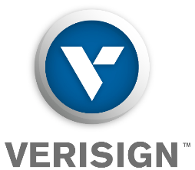





Goals of TLS
Confidentiality and integrity: use BofA’s public key to negotiate a session key; encrypt all traffic
Authentication: BofA’s cert can be validating by checking Verisign’s signature
Verisign
S_{Verisign}
https://www.bankofamerica.com
Trusted Key Store
Verisign
BofA
S_{BofA}
Contains BofA’s public key
Signed by Verisign

Slide 4
Let’s Talk about Certificates
Suppose you start a new website and you want TLS encryption
You need a certificate. How do you get one?
Option 1: generate a certificate yourself
Use openssl to generate a new asymmetric keypair
Use openssl to generate a certificate that includes your new public key
Problem?
Your new cert is self-signed, i.e. not signed by a trusted CA
Browsers cannot authenticate your cert to a trusted root CA
Users will be shown a scary security warning when they visit your site
Option 2:
Pay a well-known CA to sign your certificate
Any browser that trusts the CA will also trust your new cert

Slide 5
Certificate Authorities
Certificate Authorities (CAs) are the roots of trust in the TLS PKI
Symantec, Verisign, Thawte, Geotrust, Comodo, GlobalSign, Go Daddy, Digicert, Entrust, and hundreds of others
Issue signed certs on behalf of third-parties
How do you become a CA?
Create a self-signed root certificate
Get all the major browser vendors to include your cert with their software
Keep your private key secret at all costs
What is the key responsibility of being a CA?
Verify that someone buying a cert for example.com actually controls example.com
Any CA can issue a cert for any domain!
The only thing that stops me from buying a cert for google.com is a manual verification process

Slide 6


Acquiring a Certificate
Generate a new certificate using the data in the CSR, sign it with the CA’s private key
Generate a new keypair
Verify that the requestor owns the domain in the CSR
Generate a Certificate Signing Request (CSR).
Contains BofA’s details, the DNS name for the cert, and P_{BofA}
S_{BofA}
P_{BofA}
S_{Verisign}
Verisign
CSR
bofa.com
P_{BofA}
BofA

Slide 7
X.509 Certificate (Part 1)
Certificate:
Data:
Version: 3 (0x2)
Serial Number:
0c:00:93:10:d2:06:db:e3:37:55:35:80:11:8d:dc:87
Signature Algorithm: sha256WithRSAEncryption
Issuer: C=US, O=DigiCert Inc, OU=www.digicert.com, CN=DigiCert SHA2 Extended Validation Server CA
Validity
Not Before: Apr 8 00:00:00 2014 GMT
Not After : Apr 12 12:00:00 2016 GMT
Subject: businessCategory=Private Organization/1.3.6.1.4.1.311.60.2.1.3=US/1.3.6.1.4.1.311.60.2.1.2=Delaware/serialNumber=5157550/street=548 4th Street/postalCode=94107, C=US, ST=California, L=San Francisco, O=GitHub, Inc., CN=github.com
Subject Public Key Info:
Public Key Algorithm: rsaEncryption
Public-Key: (2048 bit)
Modulus:
00:b1:d4:dc:3c:af:fd:f3:4e:ed:c1:67:ad:e6:cb:
Issuer: who generated this cert? (usually a CA)
Certificates expire
Used for revocation
Github’s public key
Subject: who owns this cert?
This is Github’s certificate
Must be served from github.com

Slide 8
X.509 Certificate (Part 2)
Additional DNS names that may serve this cert
X509v3 extensions:
X509v3 Subject Alternative Name:
DNS:github.com, DNS:www.github.com
X509v3 CRL Distribution Points:
Full Name:
URI:http://crl3.digicert.com/sha2-ev-server-g1.crl
Full Name:
URI:http://crl4.digicert.com/sha2-ev-server-g1.crl
X509v3 Certificate Policies:
Policy: 2.16.840.1.114412.2.1
CPS: https://www.digicert.com/CPS
Authority Information Access:
OCSP - URI:http://ocsp.digicert.com
If this cert is revoked, it’s serial will be in the lists at these URLS
This cert’s revocation status may also be checked via OSCP

Slide 9
TLS Connection Establishment
S_{BofA}
BofA
ClientHello(Version, Prefs, Nonce_{c})
ServerHello(Version, Prefs, Nonce_{s})
Certificates({C_{BofA}, C_{Verisign}})
Certificate chain
ServerHelloDone
Encrypted using server’s public key
Both sides derive symmetric session key K from the PreMasterKey
ClientKeyExchange({PreMasterKey K}_{PBofA})
ChangeCipherSpec
{Finished}_{K}
Encrypted using symmetric session key
ChangeCipherSpec
{Finished}_{K}

Slide 10
Quick question
TLS is based on the Transport Layer
The layer below domain name service (DNS)
All message after TLS handshake encrypted
If one server (with IP address) serves one domain name, it will be trivial
What about the server serving multiple domains (virtual hosting?)
SNI, DNS, ESNI, DNS-over-TLS, and so on.

Slide 11
TLS Authentication
During the TLS handshake, the client receives a certificate chain
Chain contains the server’s cert, as well as the certs of the signing CA(s)
The client must validate the certificate chain to establish trust
i.e. is this chain authentic, correct, cryptographically sound, etc.
Client-side validation checks
Does the server’s DNS name match the common name in the cert?
E.g. example.com cannot serve a cert with common name google.com
Are any certs in the chain expired?
Is the CA’s signature cryptographically valid?
Is the chain’s root cert present in the client’s trusted key store?
Is any cert in the chain revoked? (more on this later)

Slide 12


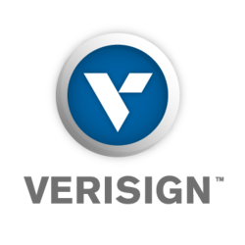


How HTTPS Works
How can users truly know with whom they are communicating?
Browser
Website
Certificate
Certificate
Root Certificate
Certificate
Certificate
Vetting
Certificate Authority
is indeed BoA
Certificate
The owner of
Certificate
Certificate
Notes:
In high level, HTTPS uses hierarchical public key infrastructure.
When a browser connects to an website to securely communicate each other, the website introduces a private and public key pair to encrypt the channel.
However, the browser has no guarantee that the provided public key actually belongs to the website. Thus, the website sends its public key to trusted third party, which is called Certificate Authority. After some vetting process, the CA issues a certificate, which basically says this website actually owns the public key and sign the certificate with its private key and hand it to the website.
And the website provides this certificate along with the public key to the browser during their handshake. The browser can check if the certificate is correctly signed by the trusted CA, which is ultimately signed by the root certificate that the browser trust.

Slide 13
HTTPS: Hierarchical PKI
Oh. now I trust your key
I only trust this certificate(s)
Certificate
Certificate
Root Certificates
Certificate
Certificate
How can I trust this key?
Notes:
So what you can see here is that HTTPS also use hierarchical public key infrastructure
You only have small sets of trusted certificate (public key) in your OS.
And if you receive a public key and certificate which binds a domain name and its public key
You can verify it by checking the certificate is signed by third parties which are ultimately signed by root certificates that I only trust.

Slide 14
X.509 Format
Version: 3 (0x2)
Serial Number:
0e:77:76:8a:5d:07:f0:e5:79:59:ca:2a:9d:50:82:b5
Signature Algorithm: sha1WithRSAEncryption
Issuer: C=US, O=DigiCert Inc, OU=www.digicert.com,
CN=DigiCert High Assurance EV CA-1
Validity
Not Before: May 27 00:00:00 2011 GMT
Not After : Jul 29 12:00:00 2013 GMT
Subject: C=US, ST=California, L=San Francisco,
O=GitHub, Inc., CN=github.com
Subject Public Key Info:
Public Key Algorithm: rsaEncryption
Public-Key: (2048 bit)
Modulus:
00:ed:d3:89:c3:5d:70:72:09:f3:33:4f:1a:72:74:
d9:b6:5a:95:50:bb:68:61:9f:f7:fb:1f:19:e1:da:

Slide 15
X.509 Format
Real world examples

Slide 16
CA Trustworthiness (1)
A CA is essentially a trusted third party
Certificate signatures are attestations of authenticity for the server and (optionally) the client
Remember: trust is bad and should be minimized!
If a CA mistakenly (or purposefully) signs a certificate for a domain and provides it to a malicious principal, TLS can be subverted
Not only must we trust root CAs, but also intermediate CAs that have been delegated signing authority

Slide 17
CA Trustworthiness (2)
Clearly, the CA secret key must be protected at all costs
Possession of the CA secret key grants adversaries the ability to sign any domain
Attractive target for adversaries
Signatures should only be issued after verifying the identity of the requester
Also known as domain validation
Should be easy, right?

Slide 18
CA Failures
Issued to: Microsoft Corporation
Issued by: VeriSign Commercial Software Publishers CA
Valid from 1/29/2001 to 1/30/2002
Serial number is 1B51 90F7 3724 399C 9254 CD42 4637 996A
Issued to: Microsoft Corporation
Issued by: VeriSign Commercial Software Publishers CA
Valid from 1/30/2001 to 1/31/2002
Serial number is 750E 40FF 97F0 47ED F556 C708 4EB1 ABFD
In 2001, VeriSign issued two executable signing certificates to someone claiming to be from Microsoft
Could be used to issue untrusted software updates

Slide 19
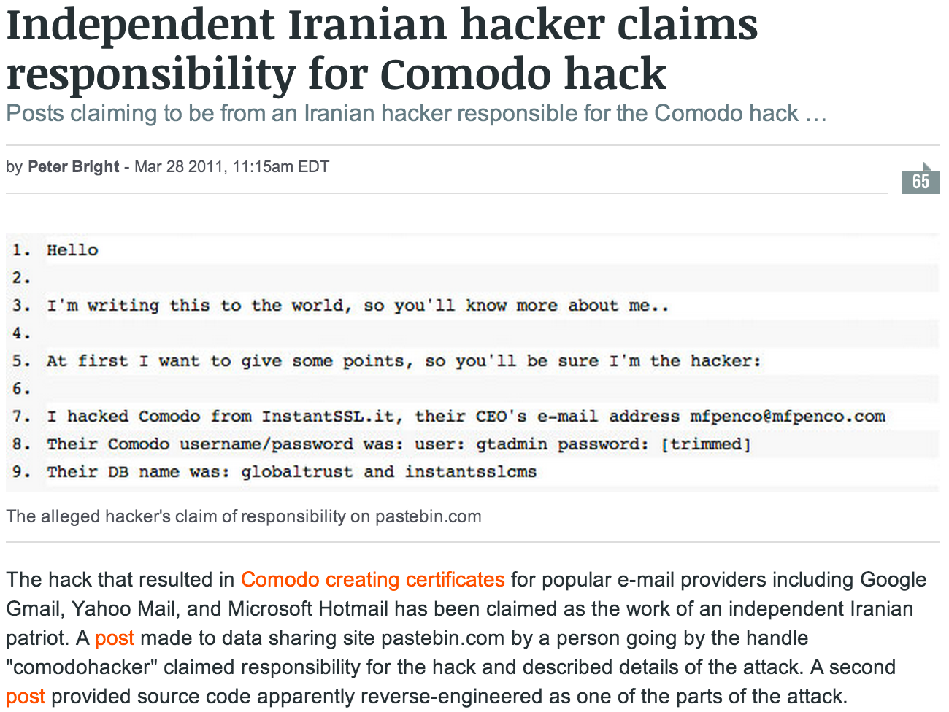
Comodo

Slide 20
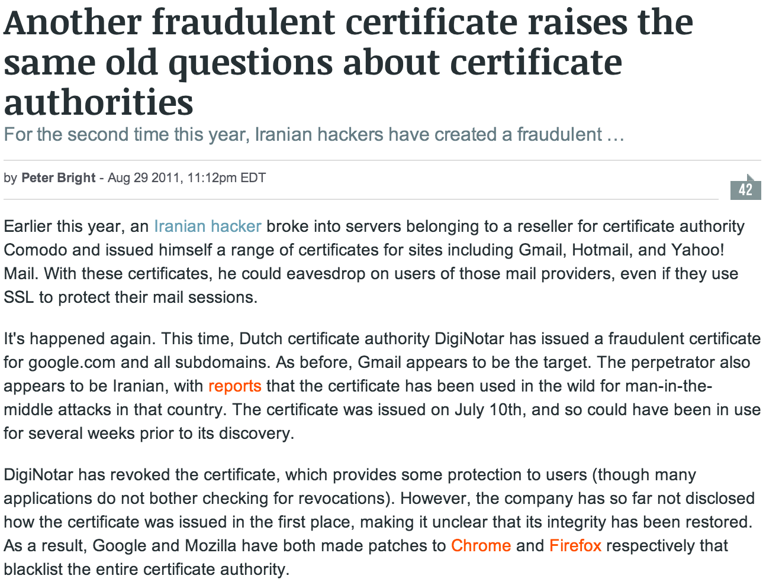
Diginotar

Slide 21
How to handle those situations?
A certificate has been mis-issued.
In the perspective of clients, the certificate seems legit
Still valid (not expired)
Question:
How can we protect clients from accepting mis-issued certificates?
Revocation

Slide 22
Certificate revocation
What happens when a certificate is no longer valid?
Browser
✗
Website
✗
Certificate
Certificate
Certificate
Attacker
Certificate
Periodically
pull / query
(CRL) (OCSP)
Certificate Authority
✗
Please revoke
✗
✗
✗
Certificate
Certificate
Certificate
Certificate
✗
✗
✗
Certificate
Certificate
Certificate
Certificate Revocation
Notes:
however, what happens when a certificate is no longer valid? Let’s say the private key has been stolen by an attacker, and now the attacker can impersonate the website.
If the website cannot notice that their key has been stolen, the attacker can impersonate the website until the certificate expires.
If the website can notice that the key has been stolen, they can ask the certificate authority to revoke their certificate.,
Actually, the CA maintains a lots of revoked certificate and have an infrastructure to disseminate the list of revoked certificates.
Now, when a browser receiving the compromised certificate, it’s Browser’s responsibility to check if the certificate has been revoked or not. There are two well known mechanism to check the revocation status of a certificate, CRL (certificate revocation list) and OCSP.

Slide 23
Revocation Check (1)
Certificate Revocation List
Browser
✗
Attacker
✗
Certificate
Certificate
Membership
Check
Certificate
Not efficient
(it can be up to 76 MB!)
Download
CRL
CRL
✗
Certificate Authority
✗
✗
✗
✗
✗
✗
Certificate
Certificate
Certificate
✗
✗
✗
✗
✗
✗
Certificate
Certificate
Certificate
✗
✗
✗
✗
Certificate Revocation
✗
List of revoked certificates
Notes:
CRL is a basically long list of the serial number of revoked certificates.
One of the characteristics is that the browser needs to download this list from the CA to check if the certificate is in the list or not.
This is very simple, but the major drawback is scalability; as you can tell the browser needs to download the “all” certificate revocation information even if it is only interested in a single certificate.
One study also found that CRLs can be up to 76MB.

Slide 24
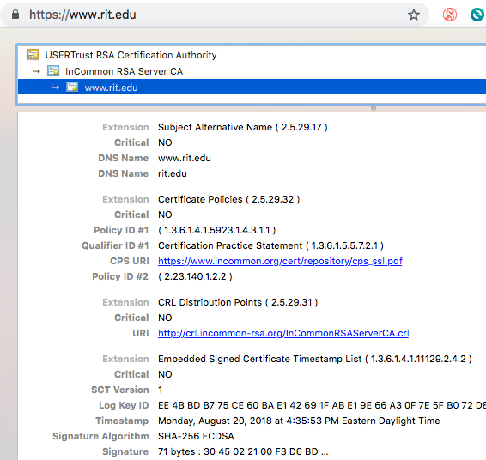
Revocation Check (1)
Certificate Revocation List
$ openssl crl -inform DER -text -noout -in InCommonRSAServerCA.crl

Slide 25

Revocation Check (2)
Online Certificate Status Protocol
Browser
✗
Attacker
✗
Certificate
Certificate
Certificate
Revoked
Good
Unknown
OCSP
Request
via HTTP
Certificate Authority
✗
✗
✗
Certificate
Certificate
Certificate
✗
✗
✗
Certificate
Certificate
Certificate
Certificate Revocation
OCSP Responders
Notes:
OCSP uses a different approach. OCSP is a web service protocol that allows a client to query the CA for the revocation status of a single certificate.
The CA now runs a server, called an OCSP responder. Clients can locate the OCSP responder for a certificate by using URL provided in a certificate and send an OCSP request to the responder with serial number, a hash of the issuer’s name public key.
The responder will returns a signed response which includes a revocation status: revoked, good, unknown.

Slide 26
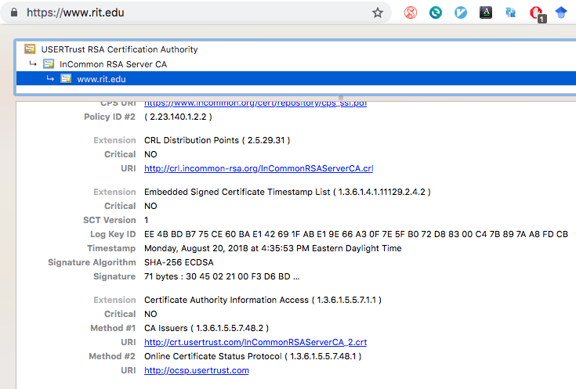
Revocation Check (2)
Online Certificate Status Protocol
$ openssl ocsp -issuer cert.pem -serial 5226810331521645508876562747113126991 -url http://ocsp.usertrust.com
-header host ocsp.usertrust.com
Notes:
Issuer’s certificate: https://censys.io/certificates/b1774f9b26b4e2d5f751713600ffeb163b34cb7a14c2c079704e95364fbcca49
-----BEGIN CERTIFICATE-----
MIIF+TCCA+GgAwIBAgIQJbVdRZm0XXTm3MkhAFSBcjANBgkqhkiG9w0BAQ0FADCB
iDELMAkGA1UEBhMCVVMxEzARBgNVBAgTCk5ldyBKZXJzZXkxFDASBgNVBAcTC0pl
cnNleSBDaXR5MR4wHAYDVQQKExVUaGUgVVNFUlRSVVNUIE5ldHdvcmsxLjAsBgNV
BAMTJVVTRVJUcnVzdCBSU0EgQ2VydGlmaWNhdGlvbiBBdXRob3JpdHkwHhcNMTQw
OTE5MDAwMDAwWhcNMjQwOTE4MjM1OTU5WjB2MQswCQYDVQQGEwJVUzELMAkGA1UE
CBMCTUkxEjAQBgNVBAcTCUFubiBBcmJvcjESMBAGA1UEChMJSW50ZXJuZXQyMREw
DwYDVQQLEwhJbkNvbW1vbjEfMB0GA1UEAxMWSW5Db21tb24gUlNBIFNlcnZlciBD
QTCCASIwDQYJKoZIhvcNAQEBBQADggEPADCCAQoCggEBAJwb8bsvf2MYFVFRVA+e
xU5NEFj6MJsXKZDmMwysE1N8VJG06thum4ltuzM+j9INpun5uukNDBqeso7JcC7v
HgV9lestjaKpTbOc5/MZNrun8XzmCB5hJ0R6lvSoNNviQsil2zfVtefkQnI/tBPP
iwckRR6MkYNGuQmm/BijBgLsNI0yZpUn6uGX6Ns1oytW61fo8BBZ321wDGZq0GTl
qKOYMa0dYtX6kuOaQ80tNfvZnjNbRX3EhigsZhLI2w8ZMA0/6fDqSl5AB8f2IHpT
eIFken5FahZv9JNYyWL7KSd9oX8hzudPR9aKVuDjZvjs3YncJowZaDuNi+L7RyML
fzcCAwEAAaOCAW4wggFqMB8GA1UdIwQYMBaAFFN5v1qqK0rPVIDh2JvAnfKyA2bL
MB0GA1UdDgQWBBQeBaN3j2yW4luHS6a0hqxxAAznODAOBgNVHQ8BAf8EBAMCAYYw
EgYDVR0TAQH/BAgwBgEB/wIBADAdBgNVHSUEFjAUBggrBgEFBQcDAQYIKwYBBQUH
AwIwGwYDVR0gBBQwEjAGBgRVHSAAMAgGBmeBDAECAjBQBgNVHR8ESTBHMEWgQ6BB
hj9odHRwOi8vY3JsLnVzZXJ0cnVzdC5jb20vVVNFUlRydXN0UlNBQ2VydGlmaWNh
dGlvbkF1dGhvcml0eS5jcmwwdgYIKwYBBQUHAQEEajBoMD8GCCsGAQUFBzAChjNo
dHRwOi8vY3J0LnVzZXJ0cnVzdC5jb20vVVNFUlRydXN0UlNBQWRkVHJ1c3RDQS5j
cnQwJQYIKwYBBQUHMAGGGWh0dHA6Ly9vY3NwLnVzZXJ0cnVzdC5jb20wDQYJKoZI
hvcNAQENBQADggIBAE3VdfpMw+uUkDK0VtAs3Op7bAOXhHqVbcZf+utvwT0n2Bj9
6vp8Jp1ZDwVCEFfRiF73xp7YhPGFkOwQdG4RtUe1XpC/yVoXw4lyoYgktvn1fZZw
Kk5aGoeQVrAlXsURWguxrplfhkU+ZNnPV+uFdc3s3aBhdQk61SrJnhswQKe1s60b
x2UYV+DBF5AcO+c1RGmhhnniQdTqnnaLwSl3H7hyRb1wyQjmZEm3NV/3gJkR2FGk
Bo4CBeMsIDePUa37W0iSM0t1HY4mPZqKRMRFZ34jC+misfmpgsZZhZvCxOgd8ifn
1NZ4ejRQgJZ6bV84cjXMet/DsQmQExWA6czjdVxL3DZ7IK7b7kqCHGcH29vp/Uhi
tIe1yZ/h/6Zc3ZgxN8uVIDwoO91XWmipxjHy32OuXXVmkBa8QQwm5fhJXxWrx2xz
Jgd153xof+0POHx/NZRD4F0C8UEXyC5gRg6mScl+XsIHwoqfBs4p7tWsd8vCbUio
xhVAcQPjVIPCuKnzj75TPsC3nsN0LxfvY5dSermWhiMEZL87JXRMb3+gjnm5jcyj
2Sd+b38qxZb6IKnm20+oeKzFLMebND0skFlX/hCX1zjAb4FQjVsw48BlPA++tgI4
7fZpHbnfbI/X8ZBKVyNbXJkVBxYmeM38IITtJRbBaKjAaXuF+UeFdGrq1dk4
-----END CERTIFICATE-----

Slide 27
Challenges of
Online Certificate Status Protocol
Browser
OCSP responders need to provide responses with (a) high availability and (b) low latency
CA can track users’ browsing behavior
✗
Attacker
✗
Certificate
Certificate
Certificate
OCSP
Request
Certificate Authority
✗
✗
✗
Certificate
Certificate
Certificate
✗
✗
✗
Certificate
Certificate
Certificate
OCSP Responders
Notes:
As you can tell, OCSP reduces the overhead of CRLs by allowing clients to query the CA for the revocation status for a single certificate, but it has some issues.
First, because the client depends on the OCSP responses, the responder needs to provide the responses with high availability and low latency. For example, the clients wait until the OCSP responses comes before completing the TLS handshake.
The second problem is about privacy issue; As a client will send a OCSP request to the CA whenever it visits an website that support OCSP. The CA basically can track the website that the client visits. Thus, it has a potential privacy risk.

Slide 28
OCSP Stapling
Not revoked!
Browser
Website
Certificate
Certificate
Certificate
No additional latency
CA can’t track the browsing behavior
OCSP response
Certificate Authority
✗
✗
✗
Certificate
Certificate
Certificate
✗
✗
✗
Certificate
Certificate
Certificate
OCSP Responders
Notes:
To overcome the limits, OCSP stapling was introduced.
The basic idea is very simple; the website fetches the revocation status information using OCSP in advance and cache it and provide the response along with the certificate during the handshake.
As the website prefetches the OCSP response in advance, OCSP Stapling does not introduce any additional latency and potential privacy risk.

Slide 29
Challenges still remain:
Soft failure
Most clients will accept a certificate
even if they are unable to obtain revocation information
Browser
Attacker
What should I do?
Certificate
Certificate
Certificate Authority
✗
✗
✗
Certificate
Certificate
Certificate
✗
✗
✗
Certificate
Certificate
Certificate
OCSP Responders
Notes:
Unfortunately, OCSP Stapling does not solve all issues with OCSP.
The major problem is that, most clients (browsers) will accept a certificate even if they are unable to obtain revocation information via OCSP.
If an attacker who has control over the client’s network could block any outgoing OCSP requests or strip any stapled OCSP responses, the client will just accept the certificate.
This behavior is called “soft-failure”

Slide 30
OCSP Must-Staple
No additional latency
No privacy issues
No soft failure
✗
Browser
Website
Certificate
1.3.6.1.5.5.7.1.24
OCSP response
Certificate
Certificate Authority
Certificate
Certificate Authority
✗
✗
✗
Certificate
Certificate
Certificate
1
1.3.6.1.5.5.7.1.24
1.3.6.1.5.5.7.1.24
✗
✗
✗
Certificate
Certificate
Certificate
Must-Staple Extension:
The server will provide a valid OCSP response
OCSP Responders
Notes:
To solve the soft-failure problem. A new X509 certificate extension, OCSP Must-staple was introduced.
as you can tell from its name, The idea is that it forces the OCSP Staple.
<click>
Now CA issues a certificate with Must-Staple extension;
If the extension is included in a certificate, it tells a client to require an OCSP response be provided (stapled) in the TLS handshake. Thus the website must fetch the OCSP response in advance from the OCSP responder.
<Click>
This extension acts as an explicit signal to the client that it must hard-fail if the server does not provide a fresh, valid OCSP response in the handshake.
Thus, OCSP Must-Staple can solve all the problems that we have mentioned; …
As you can tell, in order for OCSP Must-Staple to be deployed successfully, all those three entities must follow some rules.

Slide 31
To support OCSP Must Staple
(1) CA
Browser
Website
Include the OCSP Must-Staple extension into certificates
Certificate
Certificate
Certificate
Run reliable/error-free OCSP responders
1.3.6.1.5.5.7.1.24
Certificate Authority
Certificate
✗
✗
✗
Certificate
Certificate
Certificate
1.3.6.1.5.5.7.1.24
✗
✗
✗
Certificate
Certificate
Certificate
OCSP Responders

Slide 32
To support OCSP Must Staple
(2) Clients
Browser
Website
Certificate
Certificate
Certificate
1.3.6.1.5.5.7.1.24
Understand the OCSP Must-Staple extension in the certificate
Present the Certificate Status Request (CSR) to the web servers
Certificate Authority
✗
✗
✗
Certificate
Certificate
Certificate
Reject the certificate if they do not receive OCSP responses
✗
✗
✗
Certificate
Certificate
Certificate
OCSP Responders

Slide 33
To support OCSP Must Staple
(3) Web servers
Browser
Website
Certificate
Certificate
Certificate
1.3.6.1.5.5.7.1.24
1.3.6.1.5.5.7.1.24
(Web server software) must fetch/cache OCSP responses
(Web server administrators) must configure to use OCSP stapling
Certificate Authority
✗
✗
✗
Certificate
Certificate
Certificate
✗
✗
✗
Certificate
Certificate
Certificate
OCSP Responders

Slide 34
To support OCSP Must Staple
Browser
Website
Certificate
Certificate
Certificate
1.3.6.1.5.5.7.1.24
Certificate Authority
✗
✗
✗
Certificate
Certificate
Certificate
✗
✗
✗
Certificate
Certificate
Certificate
OCSP Responders

Slide 35
Is the Web Ready for
OCSP Must-Staple?
Certificate Authority
(OCSP Responder)
Website
Browser
Availability
Validity
Consistency with CRL
Notes:
Going back to the title again,
our paper examines each entity to see if they do what they need to do to support OCSP Must Staple.
Thus, we need separate three different methodologies and what I’m going to do for the rest of the talk is to examine each entity independently by showing our methodology and result.
The first one is CA’s OCSP responder; we see if the CAs run highly available OCSP responders and provide a valid OCSP responses and finally compare the consistency of the revocation status with CRL.

Slide 36
Measuring OCSP Responders
Certificates that
(1) Valid at least 30 days
(2) support OCSP
{
}
Certificates
…
ocsp.digicert.com
50 certs
…
{
}
ocsp.int-x3.letsencrypt.org
…
50 certs
536 OCSP responders
with 14,634 certificates
112 M certificates
77 M certificates
Notes:
To measure as many as OCSP responders, what we need is to have the list of the OCSP URLs and the certificates served from those responders.
To do that, we first obtain a pile of certificates from Censys, which contains 112 M certificate.
After that we filter out the invalid certificate, and the certificate that will expire during a month.
From the process, we obtain 536 OCSP responders and we picked at most 50 certificates using those OCSP responders, which gives us 14 thousands certificates.

Slide 37
Measuring OCSP Responders
ocsp.digicert.com
{
}
Certificate Status?
…
50 certs
ocsp.digicert.com
…
{
}
Measurement
Client
ocsp.int-x3.letsencrypt.org
…
50 certs
Send OCSP queries
ocsp.int-x3.letsencrypt.org
Notes:
After that, we implemented a measurement client, which basically sends OCSP requests to those OCSP responders to obtain each of certificate revocation status.

Slide 38
Measurement
Oregon (US West)
Virginia (US East)
São Paulo (Brazil)
Paris (France)
Sydney (Australia)
Seoul (Korea)
Scan them every hour
April 25, 2018 ~ September 4, 2018
~ 46 M OCSP requests & responses
Notes:
We deployed the measurement client across 6 different regions in AWS;
The reason is that it’s really hard to know the exact status of the some OCSP responders.
If we are not able to obtain the OCSP responses from a responder, it could be routing issues, or some client issues; thus we used multiple vantage points to send multiple OCSP queries to the same responder.
We send the requests every hour to monitor the availability and status of the OCSP responders for almost 4 months and we were able to analyze 46 M OCSP responses.

Slide 39
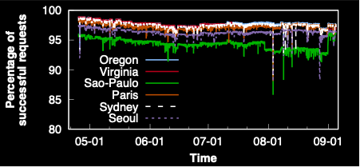
(1) Availability
Notes:
So, let’s first see the availability.
As the OCSP requests is obtained via HTTP, the definition of availability here is whether we are able to receive the HTTP response from the server with HTTP code 200.
Now, the x axis is the time, and the y axis is the percentage of the successful…
And of course the ideal graph will be y = 100.
Here is the result;
We have a number of observation here;

Slide 40
(1) Availability
Overview
d
We’re never able to receive successful responses from all OCSP responders
For 29 OCSP responders, there was at least one measurement client
that was never able to make a successful request.
(16: DNS problem, 4: TCP connection errors, 8: HTTP problems, 1: HTTPS Error)
Notes:
The first is that we were never able to receive successful requests from all OCSP responders in a given hour in any of our measurement client locations. On average, 1.7% of requests failed.
And also, during our measurement period, there was at least one measurement client that was never able to make a successful request to a OCSP responder even though we sent 50 OCSP requests.

Slide 41
(1) Availability:
Geographical Differences
d
(wellsfargo.com’s OCSP URL)
statush.digitalcertvalidation.com returned 404 to sao-paulo's client*
*After we contacted them on August 29th, the issue was fixed at 11pm August 31st.
Notes:
The second observation here is the geographical differences.
The failure rate varies substantially across different locations: the average failure rate ranges between 2.2% (Virginia) and 5.7% (Sa ̃o Paulo) of requests.
One of the interesting examples is digicertalidation.com;
During first three month of our measurement periods, the measurement client located at SaoPaulo cannot get any responses from this OCSP responder, which serves the wellsfargo’s certificate.
After we contacted them on August 29th, the issue was fixed at August 31st.

Slide 42
(1) Availability:
Transient Failure
d
Seoul, Sydney, and Oregon (Asia Pacific)
Notes:
Third observation is transient failure.
We observed that some OCSP responders are temporarily down for at least few hours or even multiple days.
For example, there was a sharp drop in April 25th, and interestingly it only happened in Seoul, Sydney, and Oregon which are Asia Pacific region;

Slide 43
(1) Availability:
Transient Failure (Case-Study)
OCSP Server Name | DNS Records
ocsp.comodoca.com
ocsp.comodoca4.com
Seoul, Sydney, and Oregon (Asia Pacific)
ocsp.gandi.net | CNAME: ocsp.comodoca.com
ocsp.globessl.com | CNAME: ocsp.comodoca.com
ocsp.incommon-ecc.org | CNAME: ocsp.comodoca.com
ocsp.incommon-igtf.org | NS: ns0.comododns.com.
ocsp.incommon-rsa.org | NS: ns0.comododns.com.
OCSP.intel.com | CNAME: ocsp.comodoca.com
ocsp.marketware.eu | CNAME: ocsp.comodoca.com
ocsp.netsolssl.com | CNAME: ocsp.comodoca.com
ocsp.register.com | CNAME: ocsp.comodoca.com
ocsp.securecore-ca.com | NS: ns0.comododns.com.
ocsp.sgssl.net. | NS: ns0.comododns.com.
ocsp.trustasiassl.com. | NS: ns0.comododns.com.
ocsp.trust-provider.com | CNAME: ocsp.comodoca.com
ocsp.usertrust.com | NS: ns0.comododns.com.
Notes:
This was due to OCSP servers maintained by comodoca.com and comodoca4.com. All OCSP requests to those servers are not served and Interestingly we also observed that some OCSP servers that are related with commodo are also down. For example, DNS CNAME record of Gandhi is ocsp.comodoca.com

Slide 44
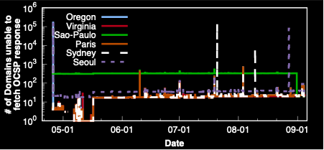
(1) Availability:
Impact on the Web
9 servers
from digicert
Comodo
down for 2 hours
43 servers from wosign
5 servers from startssl
16 servers
from ocsp-certum
Availability
OCSP responders are not fully reliable
Notes:
Then, I believe you’re also interested in the impact of this outage on the web.
If popular OCSP responders experience outage, it could be a serious problem as many certificates today rely on OCSP and the clients will not be able to check the revocation status.
To measure its impact, we estimate that how many popular websites (from Alexa 1M) were unable to fetch fresh OCSP responses due to the outage.
Here’s the result. We observed many spikes during our measurement period, which means that many popular websites were unable to fetch the fresh OCSP responses during that time.

Slide 45
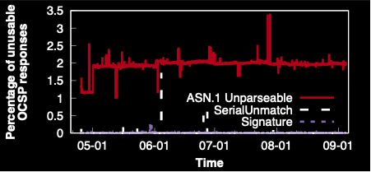
(2) Validity of the Response
3 servers from postsigum.cz
returning “0” response
Validity
OCSP responses are (mostly) valid
Notes:
Now, lets see how many of OCSP responses that we have successfully received, are actually valid.
The OCSP responses can be wrong due to multiple reasons, but the most representative ones are either the OCSP response format is not ASN1 format, or the serial number of the OCSP responses is different from that of OCSP request, or the signatur is invalid.
Here’s the result.
Generally, the most of the responses are valid but we often see the consistent error from some OCSP responders which only returns with “0”, which maps on the redline.
We also observe the transient errors such as ..

Slide 46
(3) Consistency
OCSP vs. CRL
Browser
Attacker
Certificate
Certificate
The revocation status
from CRL and OCSP must be same
=
✗
Certificate Authority
✗
✗
✗
✗
✗
Certificate
Certificate
Certificate
✗
✗
✗
✗
Certificate
Certificate
Certificate
✗
✗
CRL
OCSP Responders
Notes:
The last analysis of a CA is consistency.
As we know, the browser can use either CRL or OCSP to check the revocation status.
Thus, the revocation status from CRL and OCSP must be same;
If they were different, some clients could reject the compromised the certificate, but the others could still accept the certificate.

Slide 47
(3) Consistency
OCSP vs. CRL
unexpired
Certificates
from Alexa 1M
Certificates that support
both OCSP and CRL
2,041,345 Serials
w/ OCSP URL
728,261 Serials
w/ OCSP URL
1F3D4…9A8
1,568 CRLs
1F3D4…9A8
A234…FAA
A234…FAA
}
…
…
1F3D4…9A8
1F3D4…9A8
Some of them could be already expired!
Cross-check
Measurement
Client
112 M Certificates
from Censys
Notes:
To measure the consistency; we first need to obtain certificate revocation information from CRL.
We obtain certificates from Alexa 1M and we only use the certificates that support both OCSP and CRL and extract the CRLs.
From this process we were able to obtain 15 hundreds CRLs which contains 2M serial numbers that are revoked.
Before asking the revocation status of serial numbers to their OCSP responders, we have to exclude the expired certificates. Because if the certificate is expired, then a browser will reject the certificate no matter of its revocation status.
So, we filtered out the expired certificate by cross checking them with 112 M certificates from Censys, which gave us 700 Thousands certificates.
So these 700 thousands certificate are not expired and revoked, and what we did is to compare their revocation status by fetching OCSP responses using our measurement client.

Slide 48
(3) Consistency
OCSP vs. CRL
OCSP URL | CRL | # of certificates where the OCSP response is
 |  | Unknown | Good | Revoked
οχσπ.χαμερφιρμα.χομ | χρλ1.χαμερφιρμα.χομ/χαμερφιρμα_χσερϖεριι−2015.χρλ | 0 | 7 | 369
οχσπ.θυοϖαδισγλοβαλ.χομ | χρλ.θυοϖαδισγλοβαλ.χομ/θϖσσλγ3.χρλ | 0 | 1 | 514
οχσπ.σταρτσσλ.χομ | χρλ.σταρτσσλ.χομ/σχα−σερϖερ1.χρλ | 0 | 1 | 980
σσ.σψμχδ.χομ | σσ.σψμχβ.χομ/σσ.χρλ | 0 | 1 | 28,032
τωχασσλοχσπ.τωχα.χομ.τω/ | σσλσερϖερ.τωχα.χομ.τω/σσλσερϖερ/σεχυρεσσλ | 0 | 1 | 122
οχσπ2.γλοβαλσιγν.χομ/γσαλπηασηα2γ2 | χρλ2.αλπηασσλ.χομ/γσ/γσαλπηασηα2γ2.χρλ | 5,375 | 0 | 0
οχσπ.φιρμαπροφεσιοναλ.χομ | χρλ.φιρμαπροφεσιοναλ.χομ/ινφραεστρυχτυρα.χρλ | 11 | 0 | 0
… | … | 0 | 0 | …
Notes:
The ideal scenario is of course, all the responses from the OCSP responses are “Revoked”, as the certificate that we asked were from the CRL.
However, we observed some interesting stuff here; the revocation status from some of the certificate were different.
Here’s the result
Most of the revocation status were “revoked”, but some responders provided different revocation status. Thus, if a client only relies on the OCSP response and not using CRL, then it is possible that the client will accept those revoked certificates.
We actually contacted all the responsible CAs to report along with our dataset and measurement result and asked the reasons.

Slide 49
(3) Consistency
OCSP vs. CRL
OCSP URL | CRL | # of certificates where the OCSP response is
 |  | Unknown | Good | Revoked
ocsp.camerfirma.com | crl1.camerfirma.com/camerfirma_cserverii-2015.crl | 0 | 7 | 369
ocsp.quovadisglobal.com | crl.quovadisglobal.com/qvsslg3.crl | 0 | 1 | 514
ocsp.startssl.com | crl.startssl.com/sca-server1.crl | 0 | 1 | 980
ss.symcd.com | ss.symcb.com/ss.crl | 0 | 1 | 28,032
twcasslocsp.twca.com.tw/ | sslserver.twca.com.tw/sslserver/Securessl | 0 | 1 | 122
ocsp2.globalsign.com/gsalphasha2g2 | crl2.alphassl.com/gs/gsalphasha2g2.crl | 5,375 | 0 | 0
ocsp.firmaprofesional.com | crl.firmaprofesional.com/infraestructura.crl | 11 | 0 | 0
… | … | 0 | 0 | …
“OCSP and PKI Management are two different platforms and are synchronized by means of some DDBB triggers that are failing in some circumstances. Meanwhile CRL management is easer and simple, OCSP should give information about any certificate serial number issued by *** and the amount of information transmitted between them. That’s the source of this problem.”
Notes:
Basically they maintain two different databases.
Thus if the synchronization between the two databases might go wrong, the revocation status could be different.
After we contacted them, they told us that they would fix the issue.

Slide 50
Is the Web Ready for
OCSP Must-Staple?
Certificate authority
Web server
Browser
Fetch and cache OCSP responses
Handling errors
Notes:
Webservers ;
If they serve a certificate with the OCSP-must staple extension,
They should fetch the OCSP response in advance, and cache it to serve during its validity period.
And they need to handle errors, for example if they are unable to successfully fetch the fresh OCSP responses, they have to use the pervious cached one if it is not expired.

Slide 51

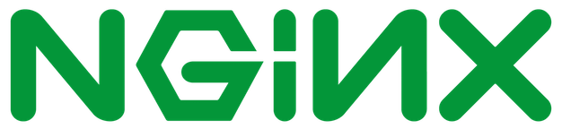
Web Server
Methodology
(1) Performance
?
Prefetch OCSP response
?
Cache OCSP response
(2) Caching
*
?
Respect nextUpdate in cache
(3) Availability
?
Retain OCSP response on error
*Expiration date of a OCSP response
Notes:
We deployed our certificate in two popular web servers;
After that we analyze them in three perspective.
performance: we see if web server software proactively fetches OCSP responses. If web servers do not prefetch and just fetch OCSP responses on-demand, then it could introduce unnecessary latency in completing the TLS handshake
Caching: they need to remove the cached responses once they have expired
Availability: the webserver should periodically ask the fresh ocsp responses before they expire. However, if the server is temporarily unavailable, they need to provide the cached response as long as it is not expired

Slide 52
Web Server Administrator
Result
Prefetch OCSP response
Cache OCSP response
Respect nextUpdate in cache
Retain OCSP response on error
* Apache version 2.4.18 and Nginx version 1.13.12
Notes:
First, we found that both of the web servers do not prefetch the response.
Actually Apache pauses the TLS handshake until the OCSP response comes in, and Nginx simply does not provide an OCSP stapled response to the first client.
Thus, the first client(s) using Apache will experience delays, and the clients using Nginx will refuse to accept the certificate.
Apache continues to serve OCSP responses from the cache even after they expire.
Finally when the web server encounters an error communicating with the OCSP responder Apache also deletes the old (but still valid) OCSP response and either provides no OCSP response or serves the error response itself.

Slide 53
Is the Web Ready for
OCSP Must-Staple?
Certificate Authority
Website
Browser
Understand the extension
Present Certificate Status Request extension
Reject the certificate if the response is not provided
Notes:
The last piece of ocsp must staple support is browsers
The browser, must understand the extension

Slide 54
Methodology
Browsers
1
(during the handshake)
Present CSR* extension?
Web server
Certificate
2
Reject the certificate?
.com
1.3.6.1.5.5.7.1.24
Do not send the OCSP response
3
Send additional OCSP request?
OCSP Responders
*CSR: Certificate Status Request
Notes:
We serve our ocsp-must staple enabled certificate in our web server and intentionally we do not provide ocsp stapled responses to the client.
From this experiment, we see first if the browsers present CSR extension, asking a staple response,
And “second”we see if they reject the certificates when we do not provide a stapled response
And “third” we see if the browsers send additional ocsp request to the ocsp responders.
This is not a desired behavior when they receive the ocsp-must staple enabled certificate, but we wanted to see if they bother to send OCSP requests as a backup plan

Slide 55
Methodology and Result
 | Desktop Browsers (OS X, Linux, Windows) |  |  |  |  |  | Mobile Browsers
 | Chrome 66 | Firefox 60 | Opera | Safari | IE | Edge | Safari | Chrome | Firefox/iOS | Firefox/Android
Request OCSP Response
Respect OCSP Must-Staple
Send own OCSP Request
-
-
Clients
Clients are largely not yet ready for OCSP Must-Staple
(the additional coding work necessary to support OCSP Must-Staple is likely not too significant)
*All tests were done on Ubuntu 16.04, Windows 10, OS X 10.12.6, iOS 11.3, and Android Oreo.
Notes:
We tested multiple popular browsers as well as the mobile browsers.
First, we noticed that all of them are asking the staple responses, which means they support ocsp stapling.
However we observe that only Firefox displays a certificate error to the user if the stapled ocsp responses doesn’t come.
Sadly, All other browsers (including Firefox on iOS) simply accept the certificate and do not even send their own OCSP request to the OCSP responder and none of them send additional ocsp requests to the responders.
These results indicate that clients are largely not yet ready for OCSP Must-Staple.
However, it does appear that all clients already support OCSP Stapling, meaning the additional coding work necessary to support OCSP Must-Staple is likely not too significant.

Slide 56
Conclusion
Considering OCSP Must-Staple can operate only if each of the principals in the PKI performs correctly.
OCSP servers: not fully reliable
Web server softwares: not fully support
Browsers: not fully support
But the bright side is
Only a few players need to take action to make it possible for web server administrators to begin enabling OCSP Must-staple
Much wider deployment of OCSP Must-Staple is an realistic and achievable goal
Notes:
On the bright side, only a few players need to take action to make it possible for web server administrators to begin relying on certificates with OCSP Must-Staple.
Thus, we believe a much wider deployment of OCSP Must-Staple is an realistic and achievable goal.

Slide 57
Some protocols
HSTS (HTTP-STRICT-TRANSPORT-SECURITY)
“Strict-Transport-Security” Header
HSTS-preloaded list
HPKP (HTTP Public Key Pinning)
SNI (Server Name Indication)
Certificate Transparency

Slide 58
Today’s another problem of HTTPS

Slide 59
How HTTPS Works
How can users truly know with whom they are communicating?
Browser
Website
Certificate
Certificate
Root Certificate
Certificate
Certificate
Vetting
Certificate Authority
is indeed BoA
Certificate
The owner of
Certificate
Certificate
Notes:
In high level, HTTPS uses hierarchical public key infrastructure.
When a browser connects to an website to securely communicate each other, the website introduces a private and public key pair to encrypt the channel.
However, the browser has no guarantee that the provided public key actually belongs to the website. Thus, the website sends its public key to trusted third party, which is called Certificate Authority. After some vetting process, the CA issues a certificate, which basically says this website actually owns the public key and sign the certificate with its private key and hand it to the website.
And the website provides this certificate along with the public key to the browser during their handshake. The browser can check if the certificate is correctly signed by the trusted CA, which is ultimately signed by the root certificate that the browser trust.

Slide 60
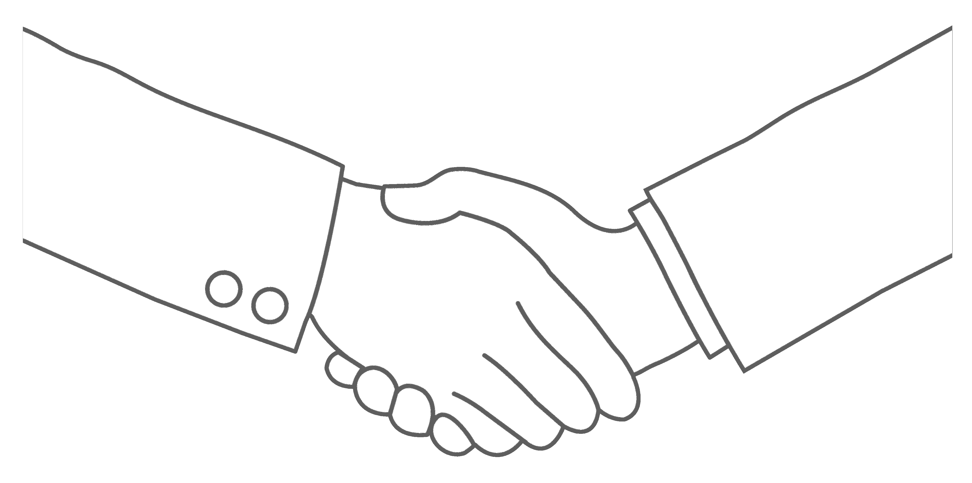
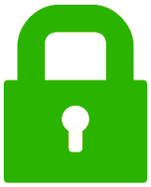
Fundamental Assumption in HTTPS
Browser
Website
Certificate
TLS Handshake
Authentication fundamentally assumes:
Only
knows
Notes:
So once a browser receives a certificate, it will participates in a TLS handshake—
if this handshake succeeds,
then your browser knows BoA must have the private key.
And of course the fundamental assumption is that
<click>
only the BoA knows this private key, which means that this server “owned” by bank of America (pause)

Slide 61
The PKI in Today’s Web
Rare!
Notes:
however, it turns out that this scenario as I’ve just described it is actually quite rare
as the internet has grown, because of the principle of economies of scale, it has become much more cost-effective (for both small and large websites) to rent their infrastructure from third-parties *CLICK*

Slide 62

The PKI in Today’s Web
Notes:
than to build and maintain it themselves..
<click>
and of course the whole point here is that they’re not just hosting one website, but many. website.
When i say third-parties here..

Slide 63
The PKI in Today’s Web
Third-party Hosting Providers
• Content delivery networks
• Web hosting services
• Cloud providers
Varying levels of involvement
But all trusted to deliver content
Notes:
this includes a few different types of services:
- content delivery networks like akamai
web hosting services like go daddy
or cloud providers like amazon’s EC2
They are involved in different elvels; but they all trusted to deliver a content using HTTPS.
so now if we take a step back and look at the big picture..

Slide 64
The PKI in Today’s Web
Certificate
Third-party hosting providers know their customers’ private keys
Notes:
what happens today in practice is that
When you send a DNS query for bankofamerica.com, for example, it resolves to one of the hosting provider’s servers,
and your browser makes a connection to the hosting provider,
and also! participates in the TLS handshake for authentication!
this implicitly means that the hosting provider must have private key.
And again, this applies not just to one single website, but to all of their customers..
so this is the state of things today: third-party hosting providers know their customers’ private keys!
…which breaks the fundamental assumption of authentication
Conceptually, this is what’s happening in the web today — but if you’re skeptical and want to verify this for yourself, here’s a quick example: just this morning i went to chick-fil-a.com, the website for a popular fast-food chain in the US, and took a screen shot of the certificate:

Slide 65

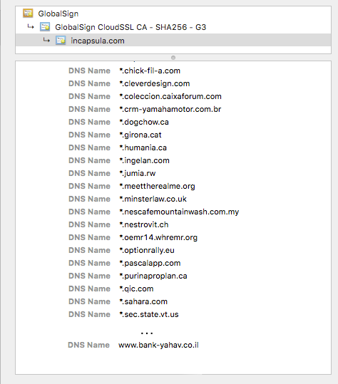
Example of Key Sharing
Large Saudi Arabian ISP
Secretary of State
of Vermont
Israeli bank
Notes:
just this morning i went to chick-fil-a.com, the website for a popular fast-food chain in the US, and took a screen shot of the certificate on my browser
In addition to chik-fil-a, there are other domains also included in this certificate, for instance
the secretary of state from vermont…
an israli bank
and.. a large Saudi Arabian ISP
These are all on the same certificate, so they all share the same private key.
So one of two things could be happening here: either ALL of them have the private key, which would mean they could all impersonate one another — this is not happening.
OR just one of them has the private key, which is the hosting provider, and they use the same private key to serve these websites content
This is just one example of several ways that keys are shared today..
Then, what’s the problem of key sharings?

Slide 66
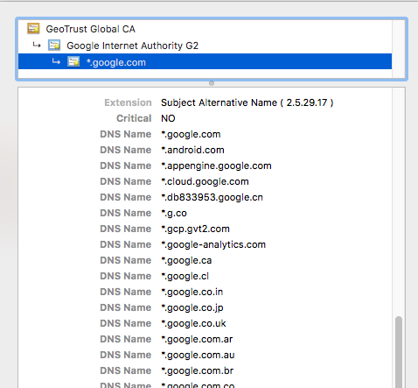
Example of (Non-) Key Sharing
All of them share the key,
but managed by the same entity (Google)

Slide 67
Problems of Key Sharing
Complicates the trust model, users don’t know who they’re really trusting
Potential to create centralization of trust
Potential to create single point of failure (in terms of management)
Notes:
First, it complicates the trust model of the PKI. The model doesn’t take hosting providers into account, and so there’s a huge lack of transparency: users don’t know who they’re really communicating with and thus who they’re trusting
Second, going back to this principle of economies of scale, because these third-parties are getting access to the keys for all their customers, this has the potential to centralize trust
And also to create a single point of failure, in that mistakes made by the hosting provider could harm the security of all of their customers at once.
So, we would like to know

Slide 68

Research Questions
How prevalent is the key sharing?
What’s the potential vulnerabilities?
How can we improve it?
Notes:
how well today’s DNSSEC PKI ecosystem is managed because it is challenging to monitor millions of domains and DNS resolvers to check if DNSSEC is correctly deployed

Slide 69
Scanning All IPv4 Certificates
 | Dataset
Period | 2013/10/30 ~ 2016/04/30
# of IPs | 101,306,358 (Full IPv4 scan)
Certificates | 38,514,130
# of Domains | 2,552,936
Notes:
To answer those questions; I applied data-driven approach to analyze all certificates from IPv4 spaces
From the 100M IP addresses, we fetched 38M certificates used from 2M domains

Slide 70
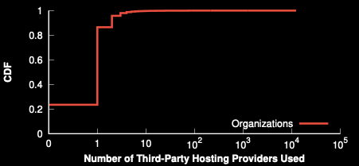
How Prevalent of Key Sharing?
76.5%
share
at least
1 key
23.5% Self-hosted
Notes:
let’s see how many of each domain organizations are shared by hosting providers.
We can see here that 23.5% of all organizations didn’t use any third-party hosting providers, but the vast majority, 76.5%, used at least 1 third-party.
So clearly a lot of organizations are sharing, but a logical question to ask her is: who is sharing? is it the sensitive websites like our banks or social media accounts or is it just the small websites?
(what’s the organization):
If we just use a domain name, then the analysis won’t be accurate; for example, the google.com, youtube are managed by Google, but if we just simply compare the domain name then the algorithm will determine that youtube is served from third party hosting provider.
We group the domain names if they are managed by same organization and we call it as domain organizations;
——-
This outlier is the google. Google operates a “global cache” that provides content over HTTPS from servers located in thousands of partner networks throughout the world

Slide 71
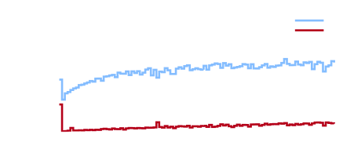
Who Shares the Keys?
43.2% (of Top 10k)
share at least one
Key sharing is common across the Internet
Economic incentives drives key sharing
Notes:
in order to answer that question: we looked at this distribution in terms of website popularity across the alexa top 1 million.
If we look at the most popular websites, the alexa top 10,000, we can see that 43.2% of them shared at least one of their private keys.
But we observe an interesting, non-linear relationship between popularity and the likelihood of key sharing; the most popular and least popular websites are both more likely to share their keys.
We expect this is driven by two distinct factors: popular websites have incentive to host their content on globally distributed CDNs for better availability and performance, while unpopular websites are likely to use hosting providers rather than manage their own servers.
These results indicate that economic incentives are a main driving force for key sharing on the web.

Slide 72
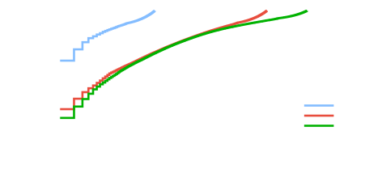
New Attack Targets
60% of Top 1K, same provider
>40% of all sites, 10 providers
Popular hosting services are prime targets for attack
Notes:
Then, how does key sharing impact on the security/vulnerability?
If you expand this idea: you might want to know how many hosting organizations you need to compromise to get X fractions of all private keys
let’s start by just considering the alexa top 1k websites for example.
First this plot shows that, by compromising just a single provider, an attacker could gain access to 60% of all the top 1k private keys.
now if we look at this across all domains, we can see that, for example, by compromising just 10 providers, an attacker could gain access to over 40% of the private keys of all domains.
Which means that…

Slide 73
Summary
Whom am I talking with?
Due to economic incentives, key sharing is prevalent in today’s web
76.5% of keys are shared
43.2% (of top 10K webpages) share the private keys
Compromising a single hosting provider could put 60% of top 1K webpages in danger

Slide 74
Preparing the Final
Okay to bring your cheat sheet
1 page letter-size both sides
Understanding concept is the most important thing.
Please feel free to post a question on the discussion board; I’ve created another discussion board category “Questions for Final”

Slide 75
Thanks again for taking my class
Best wishes for the final

