Slide 1



The 26th IEEE International Symposium on High-Performance Computer Architecture
A³: Accelerating Attention Mechanisms in Neural Networks with Approximation
Tae Jun Ham, Sung Jun Jung, Seonghak Kim, Young H. Oh, Yeonhong Park, Yoonho Song, Jung-Hun Park, Sanghee Lee, Kyoung Park, Jae W. Lee, Deog-Kyoon Jeong
SEOUL NATIONAL
UNIVERSITY

Slide 2
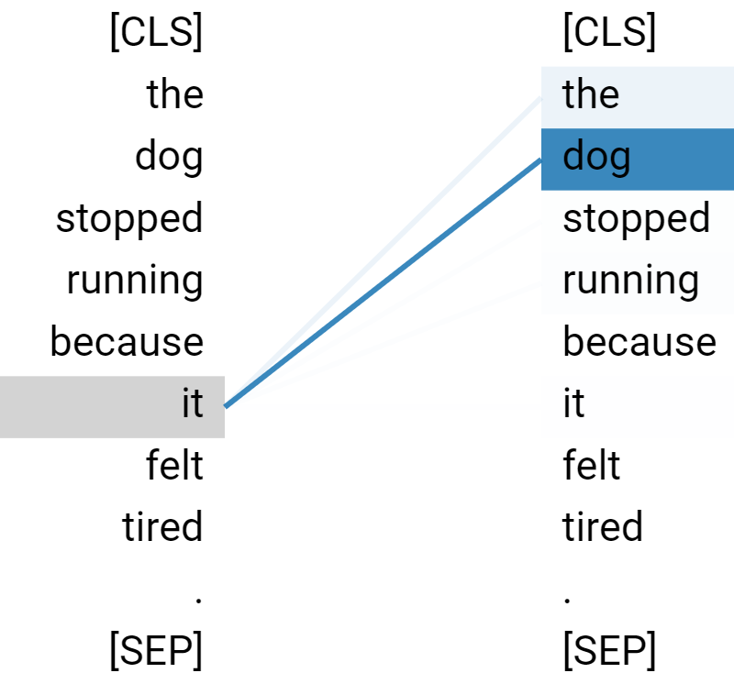
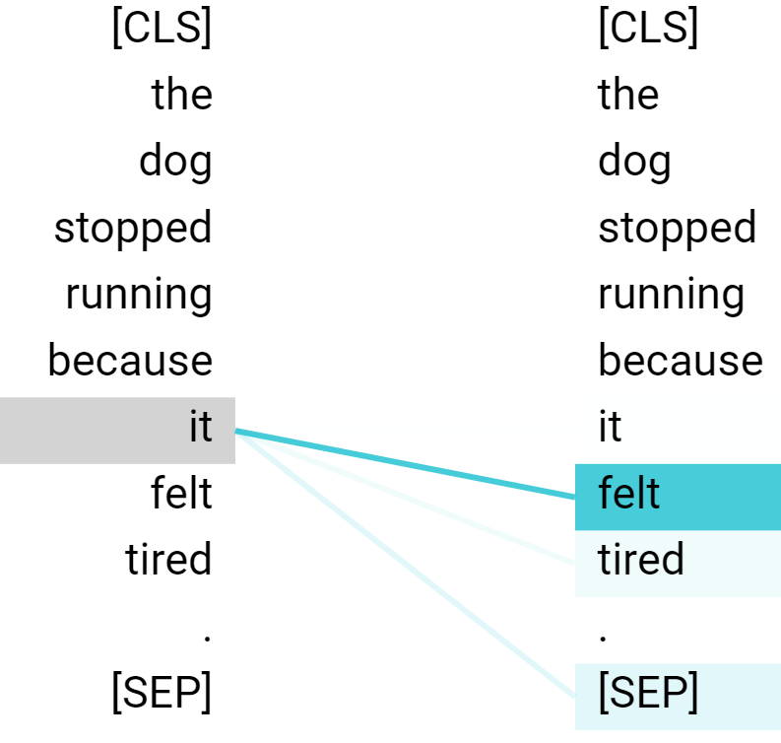
Neural Network Attention Mechanism
Novel neural network primitive for identifying and retrieving data relevant to the input
Information retrieval from knowledgebase (or memory) (e.g., Memory Network, Memory-augmented Neural Network)
Identify relations within the input data (e.g., Self-attention)
Application Domains: NLP, Vision, Recommendation, etc.
The dog stopped running because it felt tired.
[Head 8-10]
[Head 5-9]
Statements
John travelled to the hallway. Mary journeyed to the bathroom. Smith went to the bedroom. John moved to the garden.
Query
Where is John ?
Facebook Research - End-to-End Memory Network (Sukhbaatar et al., NeurIPS 15)
Google BERT (Devlin et al. Arxiv 18)

Slide 3
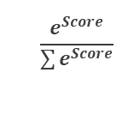
Attention Mechanism
Attention mechanism is a differentiable content-based similarity search
Attention mechanism finds data relevant to the query, then returns the weighted sum of such data
Dot Product Computation
Softmax Computation
Output Computation
-1.6 | -0.6 | -0.7
-1.2 | 0.7 | 0.3
2.0 | 0.5 | 1.1
2.21
-0.17
-2.81
$$\frac{e^{Score}}{\sum{e^{Score}}}$$
0.91
0.08
0.01
-1.6 | -0.6 | -0.5
-1.1 | 0.5 | 0.3
2.1 | -0.5 | 1.1
-0.6 | -0.8 | -1.1
-1.5 | -0.5 | -0.5
-1.5 | -0.5 | -0.4
-1.5 | -0.5 | -0.6
Query
(1 x d)
Key Matrix
(n x d)
Attention
Score (n x 1)
Normalized Score (n x 1)
Value Matrix
(n x d)
Output (1 x d)
Step 1: Compute dot product of each row in the key matrix and the query (i.e., Attention Score)
Step 2: Softmax normalization (i.e., normalized exponential function) on Attention Score
Step 3: Weighted sum of value matrix row vectors using Normalized Score as weights

Slide 4
Cost of Attention
Attention mechanism computation
2·n·d multiply-and-accumulate (MAC) operations (n·d for dot product and n·d for weighted sum)
n exponent computations (for softmax) per query
Accounts for a substantial portion of the total runtime (>35% and often >60%) in many NN models
Natural Language Processing
Computer Vision
Stand-Alone Self-Attention (NeurIPS 19)
Attention Augmented Convolutional Networks (ICCV 19)
End-to-End Memory Network (NeurIPS 15)
Key-value End-to-End Memory Network (EMNLP 16)
BERT: Pre-training of Deep Bidirectional Transformers for Language Understanding (ACL 19)
Recommendations
SASRec: Self-Attentive Sequential Recommendation (ICDM 18)
ATRank: An Attention-Based User Behavior Modeling Framework for Recommendation (AAAI 18)
Designing a specialized accelerator for the attention mechanism can substantially improve the performance and energy efficiency of the emerging neural network models

Slide 5
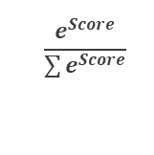
Opportunities for Approximation
Attention mechanism looks like a series of dense matrix operations, but it is also a content-based search
Softmax operation filters out data that are not relevant to the query based on attention scores
Opportunities: What if we can find out the set of candidates that are likely to be relevant to the query without much computation?
Can avoid large amount of computations (e.g., dot product, softmax)
Attention
Score
Softmax-Normalized Score
6.66
1.74
5.58
1.80
-0.85
-0.29
-0.19
-1.03
10.90
2.33
5.54
0.014
0.000
0.005
0.000
0.000
0.000
0.000
0.000
0.976
0.000
0.005
$$\frac{e^{Score}}{\sum{e^{Score}}}$$
Exploit approximation potential in attention mechanism with specialized hardware and algorithm for further speedup and energy efficiency

Slide 6
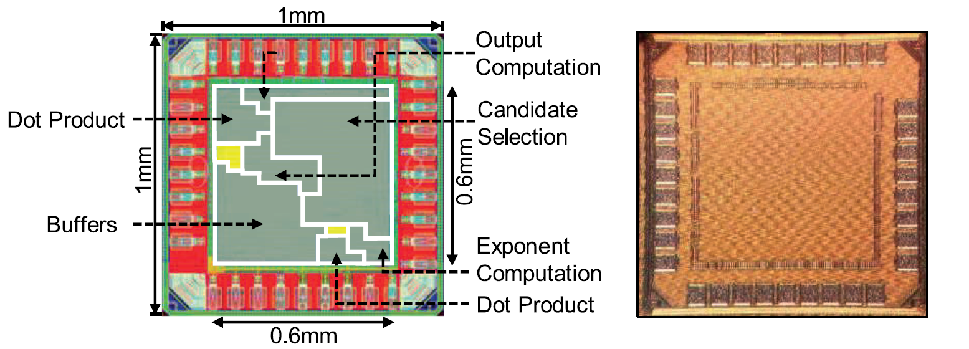
A³: Accelerating Attention Mechanisms with Approximation
A³ is the first specialized hardware accelerator that specifically targets attention mechanisms in NN, exploiting approximation potential in attention mechanism
Proposes a novel algorithm to exploits the approximation potential in attention mechanism
Architects the specialized hardware for vanilla and approximate attention mechanism
Achieves significant performance and energy efficiency gains over conventional hardware
Taped out a test chip at TSMC 40nm and fully validated its functionality
Quick demo video at the end of the talk!

Slide 7
Presentation Outline
What is Attention Mechanism?
A³: Accelerator for Attention with Approximation
Base-A³: Hardware Accelerator for Base Attention
Approximate Attention Mechanism
Approx-A³: Hardware Accelerator for Approximate Attention
Evaluation
Conclusions

Slide 8
A³-Base: Attention Mechanism Accelerator
Dot-Product
Exponent Computation
Output Computation
n × 1
n × 1
Row of the Key Matrix
from SRAM
×
Attention
Scores
ExpLookup Table
NormalizedAttention Score
×
+=
Output Vector
…
+
-
×
/
…
…
<
Maximum Value
ExpLookup Table
+=
Sum of Exponents
d × 1
d × 1
Query
Row of the Value Matrix
from Value Matrix SRAM
d × 1
d × 1
A³-Base modules: Dot-Product, Exponent Computation (for softmax), and Output Computation
Each module’s design directly maps to its computation
See the paper for efficient exponent approximation with lookup tables & quantization strategy
Module Throughput: single row / cycle
Each module takes n cycles to process a single query

Slide 9
Approximate Attention
Research Question: How to identify candidates that are relevant to the query with limited computation and avoid computation for likely to be non-relevant rows?

Slide 10
Approximate Attention
Research Question: How to identify candidates that are relevant to the query with limited computation and avoid computation for likely to be non-relevant rows?
Key Intuition: Can compute the estimated attention score with little computation if we can somehow identify a few largest and a few smallest component multiplication results
Element-wise
Multiplication
Sum over a row
-0.6 | 0.1 | 0.4
0.1 | 0.4 | -0.9
0.9 | -0.6 | 0.3
-0.48 | -0.05 | 0.24
0.08 | -0.20 | -0.54
0.72 | 0.30 | 0.18
-0.29
-0.66
1.20
0.8 | -0.5 | 0.6
Query
(1 x d)
Key Matrix
(n x d)
Component Multiplication Result
Attention
Score (n x 1)

Slide 11
Approximate Attention
Research Question: How to identify candidates that are relevant to the query with limited computation and avoid computation for likely to be non-relevant rows?
Key Intuition: Can compute the estimated attention score with little computation if we can somehow identify a few largest and a few smallest component multiplication results
Element-wise
Multiplication
Sum over a row
-0.29
-0.66
1.20
0
0
0
-0.6 | 0.1 | 0.4
0.1 | 0.4 | -0.9
0.9 | -0.6 | 0.3
-0.48 | -0.05 | 0.24
0.08 | -0.20 | -0.54
0.72 | 0.30 | 0.18
0
-0.54
0.72
0.8 | -0.5 | 0.6
0-0.54=
0+0.72=
Query
(1 x d)
Key Matrix
(n x d)
Component Multiplication Result
Attention
Score (n x 1)
Estimated Attention
Score (n x 1)
Step 1: Identify the largest and the smallest component multiplication result and accumulate estimated attention scores for the corresponding rows

Slide 12
Approximate Attention
Research Question: How to identify candidates that are relevant to the query with limited computation and avoid computation for likely to be non-relevant rows?
Key Intuition: Can compute the estimated attention score with little computation if we can somehow identify a few largest and a few smallest component multiplication results
Element-wise
Multiplication
Sum over a row
-0.6 | 0.1 | 0.4
0.1 | 0.4 | -0.9
0.9 | -0.6 | 0.3
-0.48 | -0.05 | 0.24
0.08 | -0.20 | -0.54
0.72 | 0.30 | 0.18
-0.29
-0.66
1.20
0 - 0.48 =
-0.48
-0.54
1.02
0.8 | -0.5 | 0.6
0.72 + 0.30 =
Query
(1 x d)
Key Matrix
(n x d)
Component Multiplication Result
Attention
Score (n x 1)
Estimated Attention
Score (n x 1)
Step 2: Identify the 2nd largest and the 2nd smallest component multiplication result and update estimated attention scores for the corresponding rows

Slide 13
Approximate Attention
Research Question: How to identify candidates that are relevant to the query with limited computation and avoid computation for likely to be non-relevant rows?
Key Intuition: Can compute the estimated attention score with little computation if we can somehow identify a few largest and a few smallest component multiplication results
Element-wise
Multiplication
Sum over a row
-0.6 | 0.1 | 0.4
0.1 | 0.4 | -0.9
0.9 | -0.6 | 0.3
-0.48 | -0.05 | 0.24
0.08 | -0.20 | -0.54
0.72 | 0.30 | 0.18
-0.29
-0.66
1.20
0.48+0.24=
-0.24
-0.74
1.02
0.8 | -0.5 | 0.6
-0.54–0.20=
Query
(1 x d)
Key Matrix
(n x d)
Component Multiplication Result
Attention
Score (n x 1)
Estimated Attention
Score (n x 1)
Step 3: Identify the 3rd largest and the 3rd smallest component multiplication result and update estimated attention scores for the corresponding rows

Slide 14
Approximate Attention
Research Question: How to identify candidates that are relevant to the query with limited computation and avoid computation for likely to be non-relevant rows?
Key Intuition: Can compute the estimated attention score with little computation if we can somehow identify a few largest and a few smallest component multiplication results
Element-wise
Multiplication
Sum over a row
-0.6 | 0.1 | 0.4
0.1 | 0.4 | -0.9
0.9 | -0.6 | 0.3
-0.48 | -0.05 | 0.24
0.08 | -0.20 | -0.54
0.72 | 0.30 | 0.18
-0.29
-0.66
1.20
-0.24
-0.74
1.02
0.8 | -0.5 | 0.6
Query
(1 x d)
Key Matrix
(n x d)
Component Multiplication Result
Attention
Score (n x 1)
Estimated Attention
Score (n x 1)
Repeat this process for M times. Ones with the positive scores are selected as candidates. On step M, this algorithm only performs 2 x M multiplications, which is much smaller than n x d.

Slide 15
Efficient Approximate Attention
How does one know which component multiplication results will be large?
Sort each column of the key matrix (along with its row #)
−0.6 | 0.1 | 0.4
0.1 | 0.4 | −0.9
0.9 | −0.6 | 0.3
−0.6[0] | −0.6[2] | −0.9[1]
0.1[1] | 0.1[0] | 0.3[2]
0.9[2] | 0.4[1] | 0.4[0]
0.8 | -0.5 | 0.6
Query
(1 x d)
Key Matrix
(n x d)
Sorted Key Matrix
(n x d)

Slide 16
Efficient Approximate Attention
How does one know which component multiplication results will be large?
Sort each column of the key matrix (along with its row #)
−0.6 | 0.1 | 0.4
0.1 | 0.4 | −0.9
0.9 | −0.6 | 0.3
−0.6[0] | −0.6[2] | −0.9[1]
0.1[1] | 0.1[0] | 0.3[2]
0.9[2] | 0.4[1] | 0.4[0]
0.8 | -0.5 | 0.6
Query
(1 x d)
Key Matrix
(n x d)
Sorted Key Matrix
(n x d)
Step 1: Initialize a pointer for each column in the sorted key matrix
- Point to the largest component if the corresponding query component is positive
- Point to the smallest component if the corresponding query component is negative

Slide 17
Efficient Approximate Attention
How does one know which component multiplication results will be large?
Sort each column of the key matrix (along with its row #)
1st Column
2nd Column
3rd Column
−0.6 | 0.1 | 0.4
0.1 | 0.4 | −0.9
0.9 | −0.6 | 0.3
−0.6[0] | −0.6[2] | −0.9[1]
0.1[1] | 0.1[0] | 0.3[2]
0.9[2] | 0.4[1] | 0.4[0]
0.72[2]
0.30[2]
0.24[0]
0
0.8 | -0.5 | 0.6
0
max
0.72
0+0.72=
0
Query
(1 x d)
Key Matrix
(n x d)
Sorted Key Matrix
(n x d)
0.72[2]
Estimated Attention
Score (n x 1)
1st Column
Step 2: Compute the component multiplication results for the pointed components and find the maximum among those results
Obtained value is the largest component multiplication result
This value is used to update the estimated attention score

Slide 18
Efficient Approximate Attention
How does one know which component multiplication results will be large?
Sort each column of the key matrix (along with its row #)
1st Column
2nd Column
3rd Column
0.08[1]
0.30[2]
0.24[0]
−0.6 | 0.1 | 0.4
0.1 | 0.4 | −0.9
0.9 | −0.6 | 0.3
−0.6[0] | −0.6[2] | −0.9[1]
0.1[1] | 0.1[0] | 0.3[2]
0.9[2] | 0.4[1] | 0.4[0]
0.72[2]
0
0.8 | -0.5 | 0.6
0
max
0.72
0.72+0.30=
1.02
Query
(1 x d)
Key Matrix
(n x d)
Sorted Key Matrix
(n x d)
0.30[2]
Estimated Attention
Score (n x 1)
2nd Column
Step 3: Move the pointer to the next element for the selected column and repeat Step 2
Obtained value is the second largest component multiplication result
This process is repeated for M times

Slide 19
Efficient Approximate Attention
How does one know which component multiplication results will be small?
Sort each column of the key matrix (along with its row #)
1st Column
2nd Column
3rd Column
−0.6 | 0.1 | 0.4
0.1 | 0.4 | −0.9
0.9 | −0.6 | 0.3
−0.6[0] | −0.6[2] | −0.9[1]
0.1[1] | 0.1[0] | 0.3[2]
0.9[2] | 0.4[1] | 0.4[0]
−0.48[0]
−0.20[1]
−0.54[1]
0
0.8 | -0.5 | 0.6
−0.54
0-0.54=
0
min
0
Query
(1 x d)
Key Matrix
(n x d)
Sorted Key Matrix
(n x d)
Estimated Attention
Score (n x 1)
−0.54
3rd Column
Similar process is performed to find small component multiplication results except that
Pointers are initialized in the opposite way
min function is used instead of max

Slide 20
Efficient Approximate Attention
Entry selected/updated by Max Pointer
Entry selected/updated by Min Pointer
Iter 1
Iter 2
Iter 3
Candidates
−0.6[0] | −0.6[2] | −0.9[1]
0.1[1] | 0.1[0] | 0.3[2]
0.9[2] | 0.4[1] | 0.4[0]
0
-0.54
0.72
-0.48
-0.54
1.02
-0.24
-0.74
1.02
x
x
o
0.8 | -0.5 | 0.6
Query
(1 x d)
Sorted Key Matrix
(n x d)
Estimated Attention Score
(n x 1)
The algorithm updates two estimated attention scores per iteration
Largest component multiplication result: green component from the query x green component from the sorted key matrix
Smallest component multiplication result: red component from the query x red component from the sorted key matrix
Candidates: Rows with positive estimated attention scores after M iterations

Slide 21
Efficient Approximate Attention
Performance overhead of sort?
Depending on the models, sorting may not be on the critical path
For memory network models, knowledges/information (i.e., key matrix) can be preprocessed before the query arrives. Sorting does not affect query time.
For workloads with self-attention mechanism (e.g., Transformer, BERT), the same key matrix is re-used for multiple queries (e.g., 512)
Sorting overhead can be amortized over multiple queries.

Slide 22
A³-Approx: Approximate Attention Accelerator
1st Column
2nd Column
3rd Column
Query Vector Register and Sorted Key Matrix SRAM
Max_ptr[ ] (and Min_ptr[ ]) tracks the currently pointed entry in each column of the sorted key matrix
Multiplier performs component multiplication
Component from Sorted Key Matrix · Query Component
Component Multiplication Buffer buffers component multiplication results for each column
Comparator Tree computes max (and min) entry among component multiplication results from each column
Outputs of Comparator Trees are used to update the Estimated Attention Score SRAM
The selected column’s pointer is moved
Repeat above processes and ones with the positive estimated attention scores are selected as candidate rows
−0.6[0] −0.6[2] −0.9[1]
−0.1[1] −0.1[0] − 0.3[2]
−0.9[2] −0.4[1] −0.4[0]
0.72[2]
0.30[2]
0.24[0]
0.8 -0.5 0.6
Query
(1 x d)
Sorted Key Matrix
(n x d)
Query Vector Register
Max_ptr[]
Min_ptr[]
d × 1
d × 1
×
Sorted Key Matrix SRAM
×
n × d
Component
Multiplication Buffer
Component
Multiplication Buffer

Slide 23
A³-Approx: Approximate Attention Accelerator
1st Column
2nd Column
3rd Column
Query Vector Register and Sorted Key Matrix SRAM
Max_ptr[ ] (and Min_ptr[ ]) tracks the currently pointed entry in each column of the sorted key matrix
Multiplier performs component multiplication
Component from Sorted Key Matrix · Query Component
Component Multiplication Buffer buffers component multiplication results for each column
Comparator Tree computes max (and min) entry among component multiplication results from each column
Outputs of Comparator Trees are used to update the Estimated Attention Score in SRAM
The selected column’s pointer is moved
Repeat the process and ones with the positive estimated attention scores are selected as candidate rows
−0.6[0] −0.6[2] −0.9[1]
−0.1[1] −0.1[0] − 0.3[2]
−0.9[2] −0.4[1] −0.4[0]
0.72[2]
0.30[2]
0.24[0]
0.8 -0.5 0.6
max
Query
(1 x d)
Sorted Key Matrix
(n x d)
0.72[2]
1st Column
Selected Column ID
Query Vector Register
Selected Column ID
Max_ptr[]
Min_ptr[]
d × 1
d × 1
×
Sorted Key Matrix SRAM
×
n × d
Component
Multiplication Buffer
Component
Multiplication Buffer
Max
Estimated Attention Score
Min
Comparator
tree
Candidate Vector
Comparator
tree

Slide 24
A³-Approx: Approximate Attention Accelerator
1st Column
2nd Column
3rd Column
Query Vector Register and Sorted Key Matrix SRAM
Max_ptr[ ] (and Min_ptr[ ]) tracks the currently pointed entry in each column of the sorted key matrix
Multiplier performs component multiplication
Component from Sorted Key Matrix · Query Component
Component Multiplication Buffer buffers component multiplication results for each column
4 entries per column for full-pipelining
Comparator Tree computes max (and min) entry among component multiplication results from each column
Outputs of Comparator Trees are used to update the Estimated Attention Score in SRAM
The selected column’s pointer is moved
Repeat the process and ones with the positive estimated attention scores are selected as candidate rows
−0.6[0] −0.6[2] −0.9[1]
−0.1[1] −0.1[0] − 0.3[2]
−0.9[2] −0.4[1] −0.4[0]
0.72[2]
0.30[2]
0.24[0]
0.8 -0.5 0.6
max
Query
(1 x d)
Sorted Key Matrix
(n x d)
0.72[2]
1st Column
Selected Column ID
Query Vector Register
Selected Column ID
Max_ptr[]
Min_ptr[]
d × 1
d × 1
×
Sorted Key Matrix SRAM
×
n × d
Component
Multiplication Buffer
Component
Multiplication Buffer
Component
Multiplication Buffer
Component
Multiplication Buffer
Max
Estimated Attention Score
Min
Comparator
tree
Candidate Vector
Comparator
tree

Slide 25
Presentation Outline
What is Attention Mechanism?
A³: Accelerator for Attention with Approximation
Base-A³: Hardware Accelerator for Base Attention
Approximate Attention Mechanism
Approx-A³: Hardware Accelerator for Approximate Attention
Evaluation
Conclusions

Slide 26
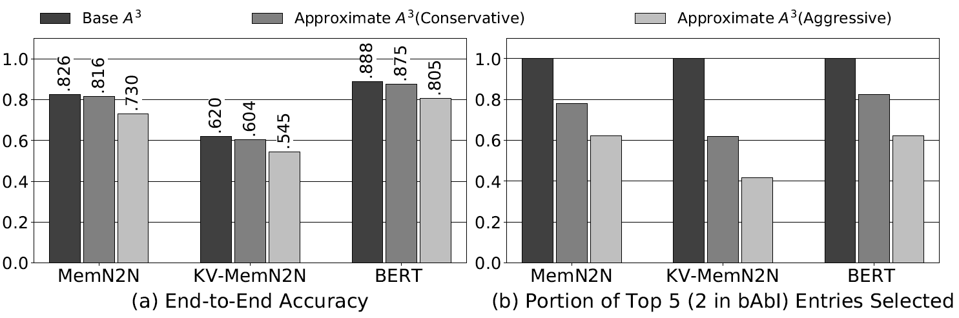
Impact of Approximation on Accuracy
Approximation scheme affects end-to-end model accuracy
Conservative approximation scheme (M = 1/2n, T = 5%*) loses about 1-1.6% accuracy metric
Aggressive approximation scheme (M= 1/8n, T = 10%*) loses about 8-9% accuracy metric
The amount of top entries selected (right graph) shows that aggressive approximation scheme may miss some items with high attention scores
Another approximation scheme omitted in this talk. Please see the paper.
Base A³
Approx. A³ (conservative)
Approx. A³ (aggressive)

Slide 27
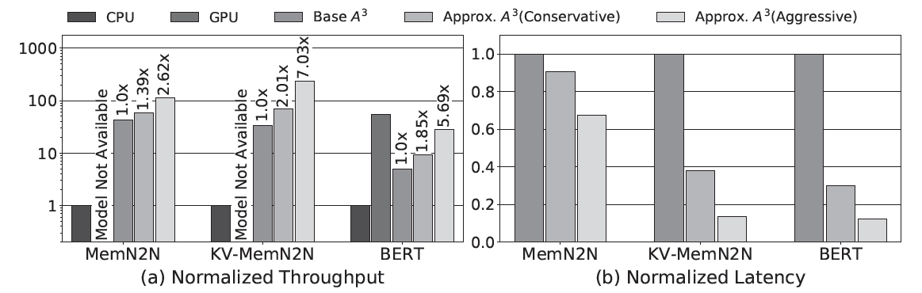
Performance Evaluation
We compare 1Ghz A³ accelerator performance to the 6-core Intel Xeon Gold (3.4 Ghz) CPU and NVIDIA Titan V GPU
Single Base A³ accelerator: 5-40× speedup over the 6-core CPU
Speedup varies depending on the implementation quality / parallelism of the CPU version code
Single Base A³ accelerator: about 10% of the GPU throughput on BERT
Multiple A³ accelerators can be used in parallel to improve the throughput
Approximation enables even further throughput improvement (2.6-7.0×) as well as latency improvement (1.6-8.0×)
CPU
GPU
Base A³
Approx. A³ (conservative)
Approx. A³ (aggressive)

Slide 28
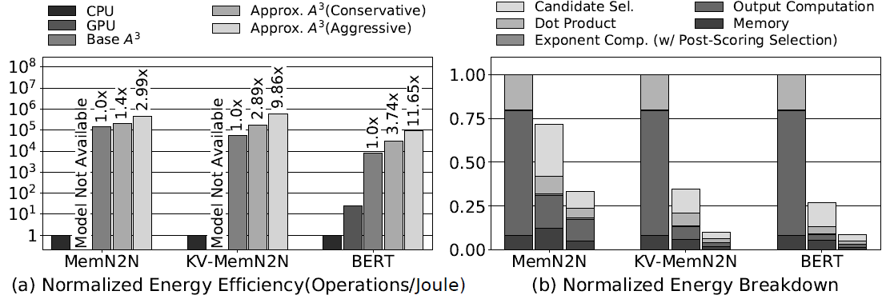
Area and Energy Efficiency
A³ accelerator is synthesized for the 1Ghz clock frequency using TSMC 40nm standard cell library
Area: 2.082mm² (77% on SRAM structures) / Peak power consumption: 110mW
Energy Efficiency: >10,000× more efficient than CPU; Approximation enables 3-11_{× extra energy efficiency}
Energy Breakdown: W/o approximation, most energy are spent on Output Computation; W/ approximation, most energy are spent on Candidate Selection

Slide 29
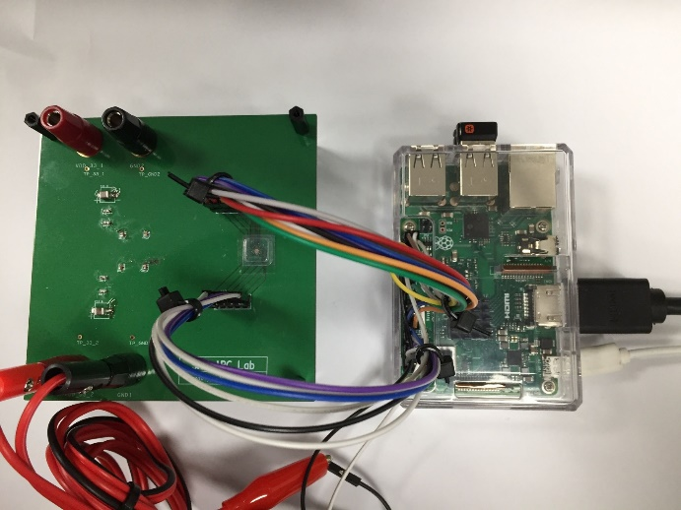
Prototype Chip
Prototype Chip
Post-layout Image
Die Photo
Prototype Chip w/ board and Raspberry Pi
We recently taped-out the scaled-down version of the A³ test chip and validated its functionality
Test chip can run attention mechanism of End-to-End Memory Network (bAbI workload)

Slide 30
A³: Accelerating Attention Mechanisms with Approximation
A³ is the first specialized hardware accelerator that specifically targets attention mechanisms in NN, exploiting approximation potential in attention mechanism
Proposes a novel approximation algorithm for attention mechanism
Architects the specialized hardware pipeline for vanilla & approximate attention mechanism
Achieves significant performance and energy efficiency gains over conventional hardware
Taped out a test chip at TSMC 40nm and fully validated its functionality

Slide 31
The 26th IEEE International Symposium on High-Performance Computer Architecture
A³: Accelerating Attention Mechanisms in Neural Networks with Approximation
Tae Jun Ham, Sung Jun Jung, Seonghak Kim, Young H. Oh, Yeonhong Park, Yoonho Song, Jung-Hun Park, Sanghee Lee, Kyoung Park, Jae W. Lee, Deog-Kyoon Jeong
SEOUL NATIONAL
UNIVERSITY

