Slide 1
Homomorphic Factorization of BRDFs for High-Performance Rendering
Taekyu Shin

Slide 2
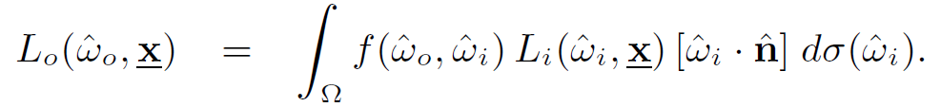
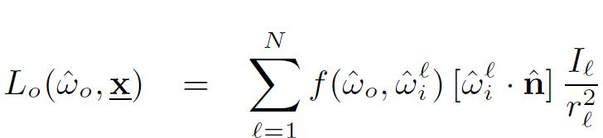
BRDF

Slide 3


Integral ➔ Summation
Changes
1. L term ➔ I
2. ➔ ➔

Slide 4
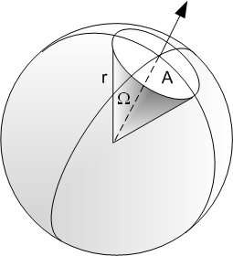
Solid Angle
is a solid angle unit.
= (S/r²)
S = Surface area on sphere(Intersection with cone)
Radius = r

Slide 5
Previously - Factorization
Can handle anisotropic reflectance models.
Represent BRDFs using lower-dimensional functions that are multiplied together.
Singular Value Decomposition

Slide 6
Singular Value Decomposition
M = UΣV^{T}
U = Unitary matrix = orthogonal matrix(Real)
Σ = Diagonal matrix
V^{T}
Any matrix can be expressed with multiplication of matrices.
Why SVD?
Compressed representation needed for hardware texturing
Multiple surfaces with different reflectance functions at interactive rates.
In the case of huge matrix multiplication, speed.
O(n) instead of O(n^2)

Slide 7

SVD – Used matlab
Image
M=u₁σ₁ v₁^{T} + u₂σ₂ v₂^{T} + u₃σ₃ v₃^{T}
(V_{i}-15 entries, u_{i}-25 entries) * 3 vectors
σ_{i} 3 values
Just 123 numbers instead of 375(=15*25)

Slide 8
Problem
Old
Difficult to find re-parametarization.
(Matrix is too big!)
Signed arithmetic (Slows down on HW)
New
Positive numbers(faster on Hardware)
Smoothness of the result
Relative error

Slide 9
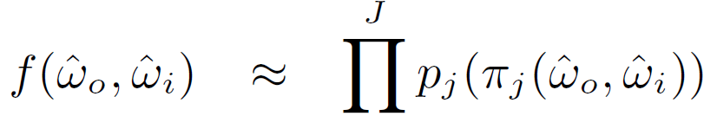
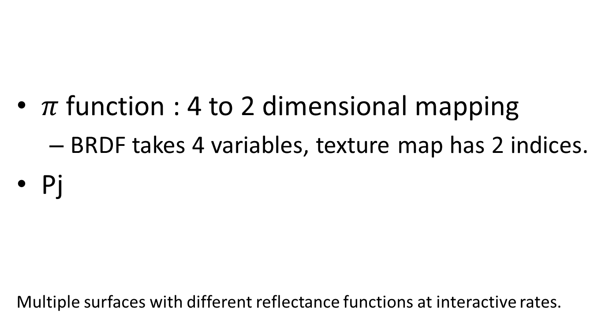
Decomposition Algorithm
$π$ function : 4 to 2 dimensional mapping
BRDF takes 4 variables, texture map has 2 indices.
Pj
Multiple surfaces with different reflectance functions at interactive rates.

Slide 10
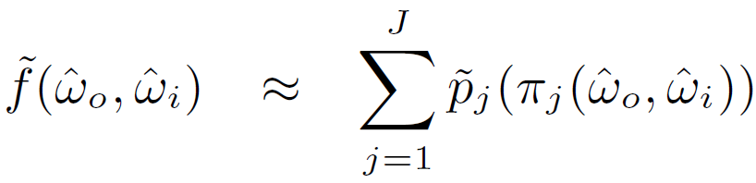
Decomposition Algorithm
Take LOG(x) of each.
Positive
Simplification
Becomes a linear data fitting problem
Find whatever fits these data

Slide 11
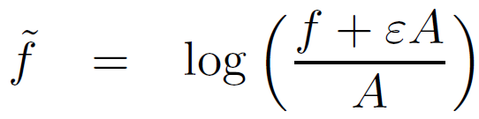
Problem again?
F cannot be zero
Log function
Let us avoid it
A = average of BRDF samples
= constant
Intuition
F little bigger than A ➔ mapping ➔ almost 0
Close to 0 ➔ Solutions also zero

Slide 12
What is good about this technique?
Solving the linear problem
By minimizing the root mean square error
Same as solving data-fitting problem.
Relative RMS error
Human eyes are sensitive to relative differences

Slide 13
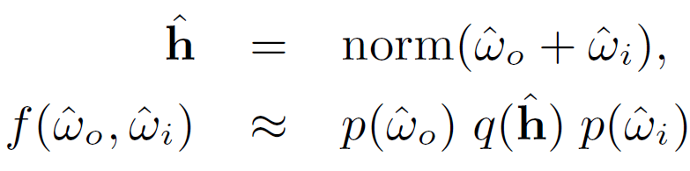
Parameterization
H makes separation easier.
Interactive Rendering with Arbitrary BRDFs using Separable Approximations
Good
Satisfy helmoltz reciprocity
Only require 2 texture maps

Slide 14
Parameterization
Take homomorphic log function
We need to get p, q
In this case, we know f
p, q may not be natural numbers.
Bilinear interpolation

Slide 15
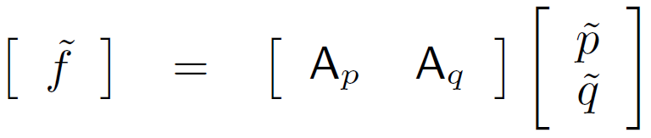

A = constraints = W, h

Slide 16
How to solve the equation ?
A can be large ➔ sparse matrix
Use Quasi-minimal residual algorithm
solve the system in a least squares sense
minimizes the sum of squared residuals

Slide 17




2D Real Example
$π$ = x, $π$ = y, $π=x−y$
Plausible approximation

Slide 18
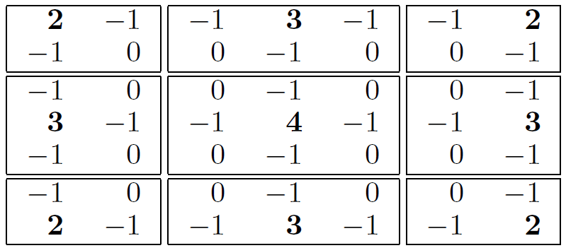
Smoothness Constraints
Let’s apply a smoothing operator as a manipulation
Laplacian operator

Slide 19
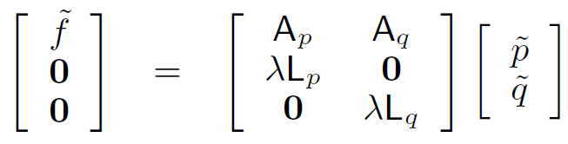
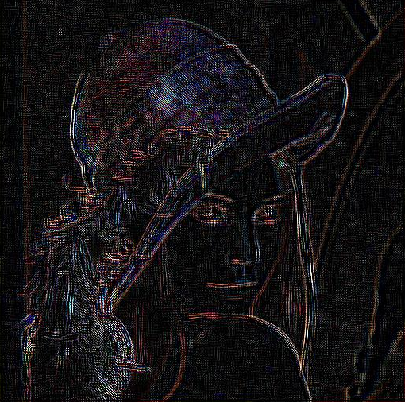
Lp = Laplacian
= constant
Smoothness
Reciprocal
P and constant
Bigger
Smother in edges

Slide 20
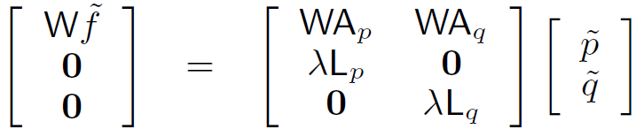
Weighting
Overall scaling up and down

Slide 21
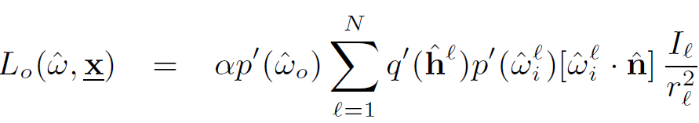
Hardware acceleration
Used openGL
Nothing different but normalized equation

Slide 22
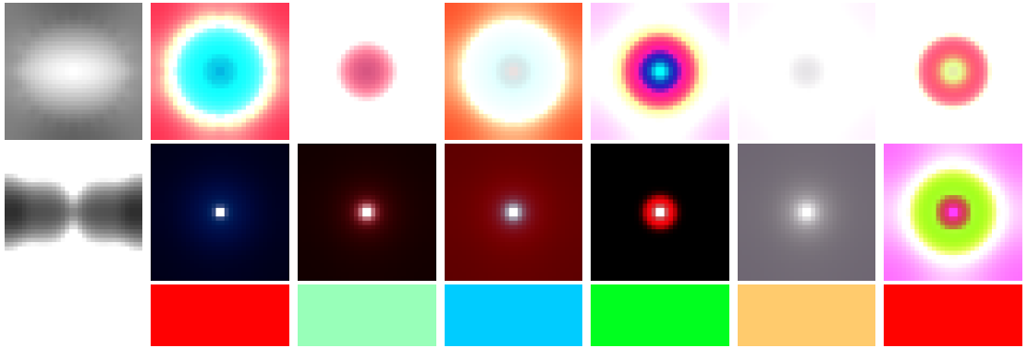
Example texture maps

Slide 23
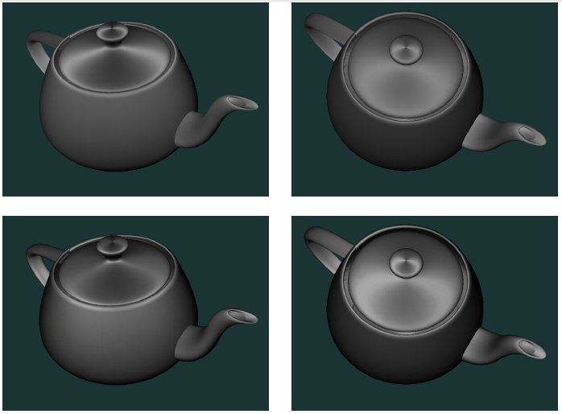
Comparison
Top – Poulin-Fournier anisotropic reflectance model
Bottom

Slide 24
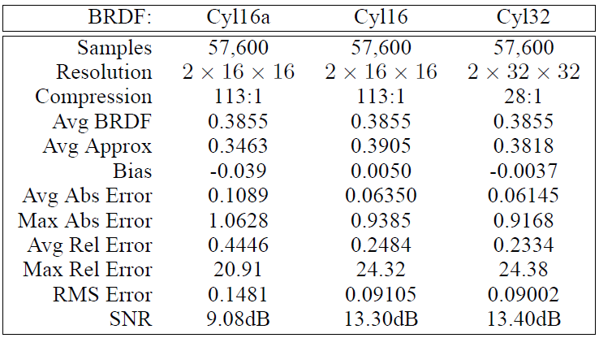
Error Analysis
Cy116a – naïve approximation
Cy116 and Cy132 – approximation via this technique

Slide 25
Q&A

