Slide 1
The Rendering Equation
James T. Kajiya
Taekyu Shin

Slide 2
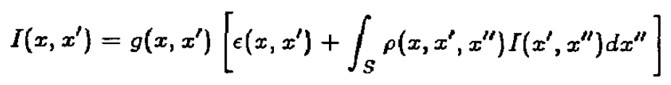
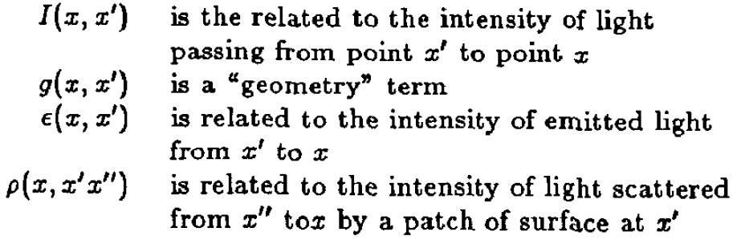
The Rendering Equation -What?

Slide 3
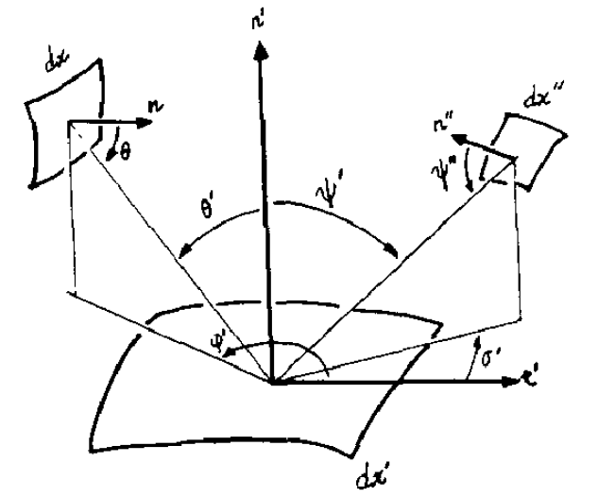
Assume that your eye is at x plane
How would you measure?
You are looking at x’

Slide 4
Sum up these two
light from x’ itself
Light reflected from x’ coming from x’’

Slide 5
That is this
Sum up these two
light from x’ itself
Light reflected from x’ coming from x’’

Slide 6

P(x,x’,x’’) is BRDF term
I(x’, x’’) – light intensity coming from x’’ plane.

Slide 7
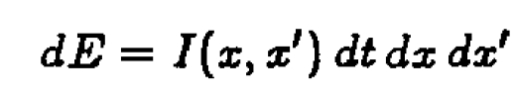
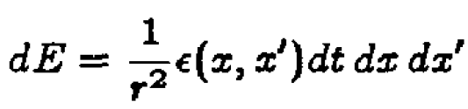
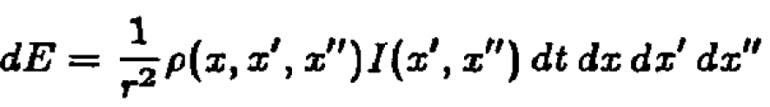
Energy Transport Function

Slide 8
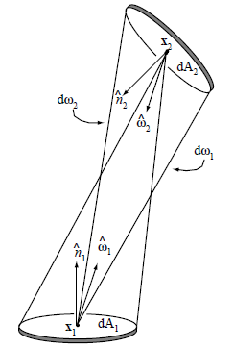

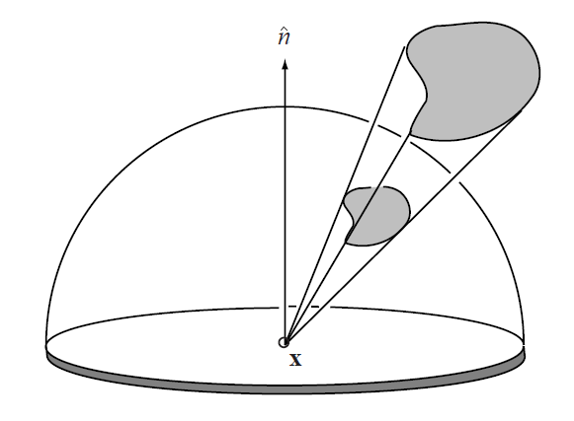

We can re-define I
in terms of angles
dw ➔ picture

Slide 9
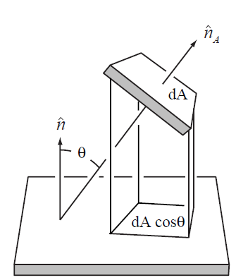

Emitting surface area – projected A

Slide 10
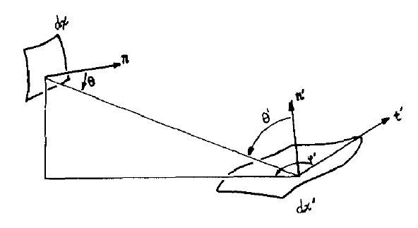
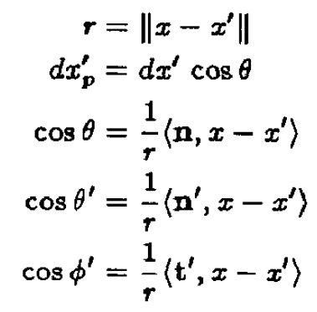

Slide 11
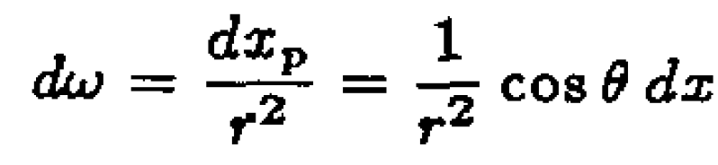

Slide 12



Induction

Slide 13

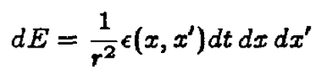
Equating two terms
We do that about just

Slide 15

How about reflectance terms?

Slide 16
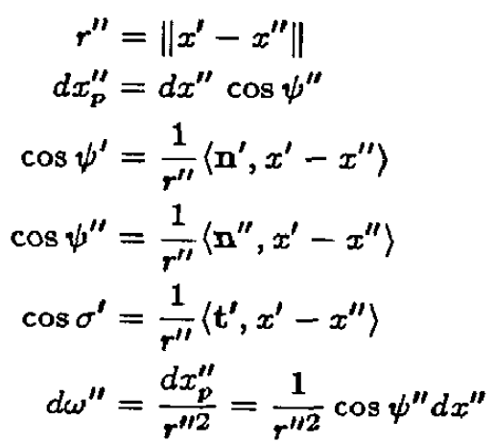

Slide 17

We already derived :
You see the pattern?

Slide 18



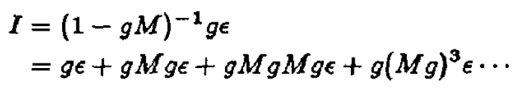
What is Newmann Seris?
Convergence=invertible == This case
We can solve this! ➔ Wait a minute. Is it?

Slide 19

Utah approximation

Slide 20
Ray tracing approximation
Turner Whitted proposed
The reflection and refraction of his lighting model
first model very similar to blinn phong
second model more complicated

Slide 21
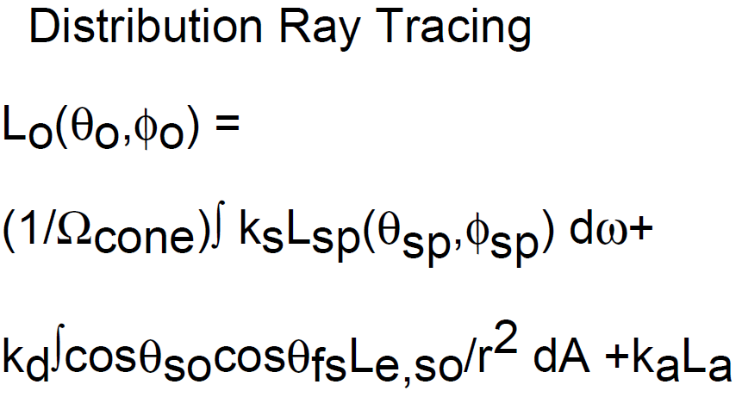
Distributed Ray Tracing Approximation

Slide 22

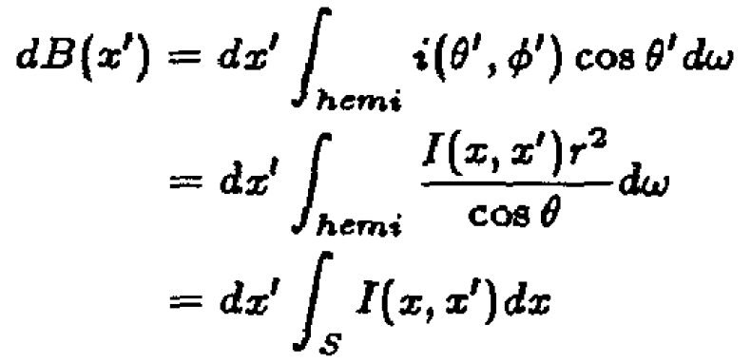
The Radiosity Approximation

Slide 23
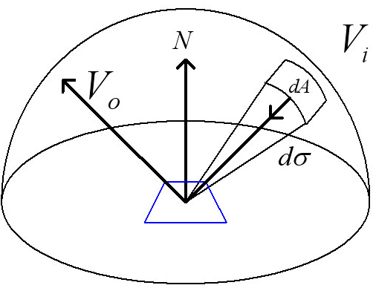
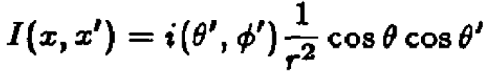

Slide 24

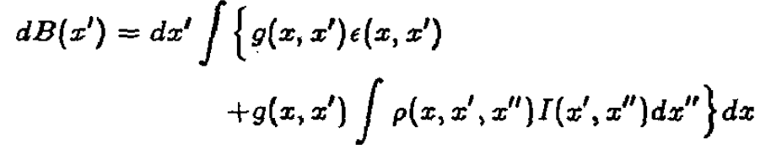

Slide 25
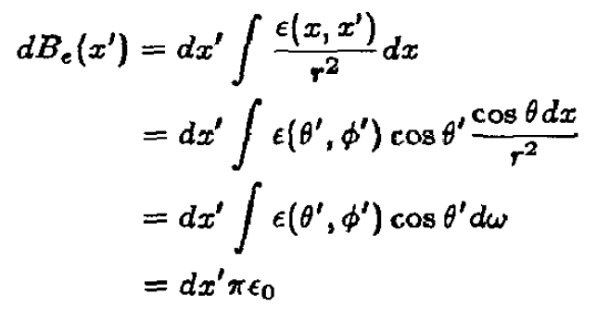

g(x,x’) = 1
No occlusion
is a constant representing hermispherical emittance

Slide 26
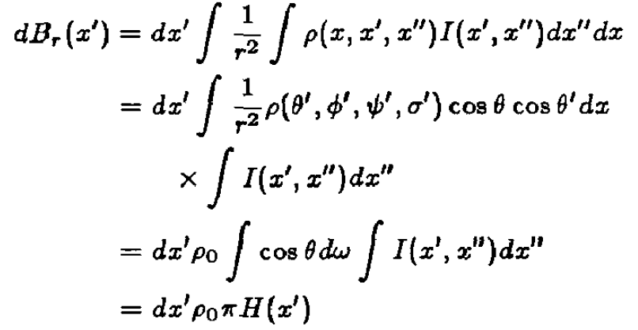

Slide 27



Sum up emittance and reflectance
The point of this equation.
We need to get H(x’), then we can get radiosity.

Slide 28

Markov chains for solving integral equations
(I-M)x = a
X=(I-M)^(-1) * a
Previously

Slide 29
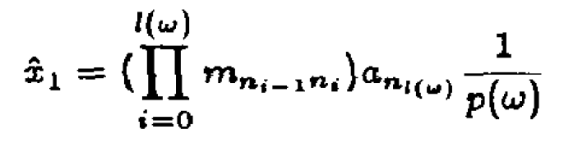
Finite Dimensional Distribution
Non-deterministic process

Slide 30
using Markov Chain
We can get I from Markov chains

Slide 31
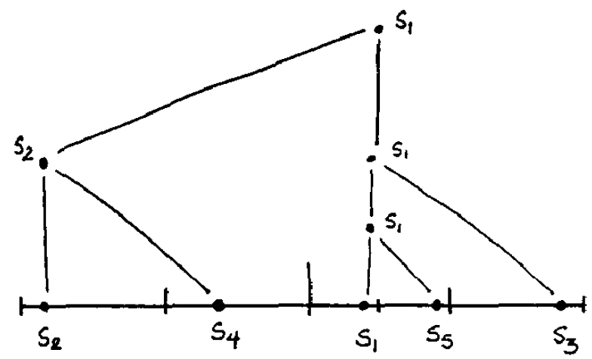
Hierachical sampling for one pixel
Stratified scheme(one jittered sample per sub-grid)
After taking s1 sample, now we know that we will take 5 samples
Sequential Uniform Sampling

Slide 32
Hierachical Integration (log instead of polynomials)
S1 → S2 → (S1 + S2) * 0.5 → S3 →
((S1 * 0.5 + S2 * 0.5) + S3)* 0.5 +
--- Why better than monte carlo integration?

Slide 33
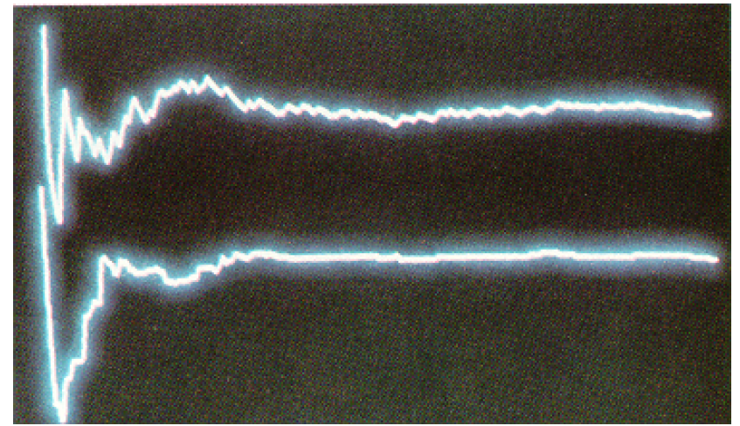
Hierachical Integration
Monte Carlo Integration VS Hierachical Integration
Hierachical Integration converges faster

Slide 34
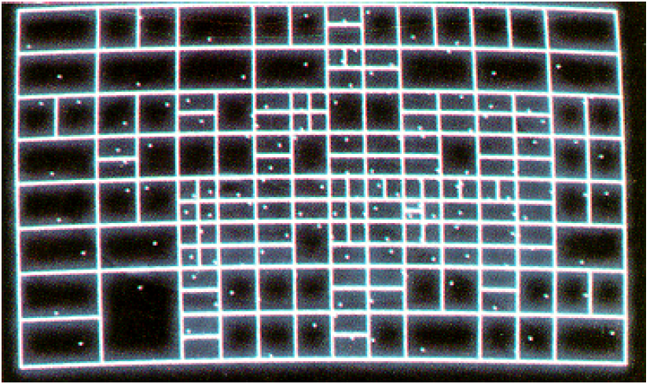
Hierachical Integration
Monte Carlo Integration VS Hierachical Integration
Hierachical Integration converges faster

Slide 35
Adaptive Hierachical Integration
Weighted average

Slide 36
Non-uniform sampling
Assume some probability density function p(x)
p(x1) = p(x2)= p(x3) = p(x4) = 0.25
x1 x2 x3 x4

Slide 37
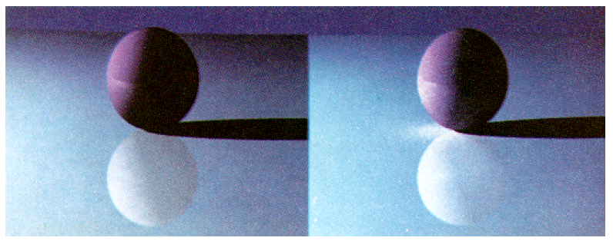
Raytracing VS Rendering Equation

Slide 38
