Slide 1
The Tyndall effects
Taekyu Shin

Slide 2
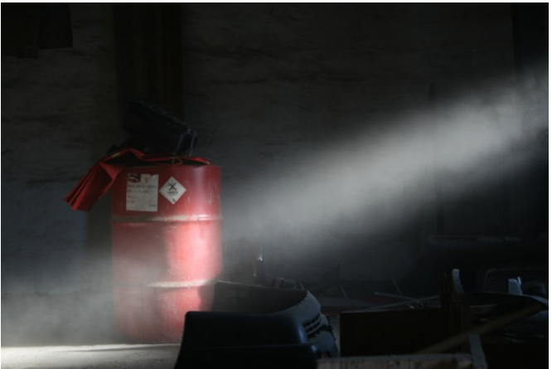

Slide 3
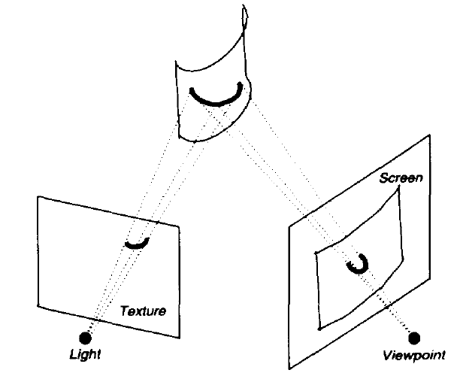
Fast Shadows and Lighting Effects Using Texture Mapping –siggraph 1994

Slide 4
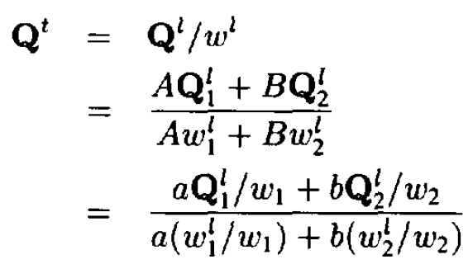

Slide 5
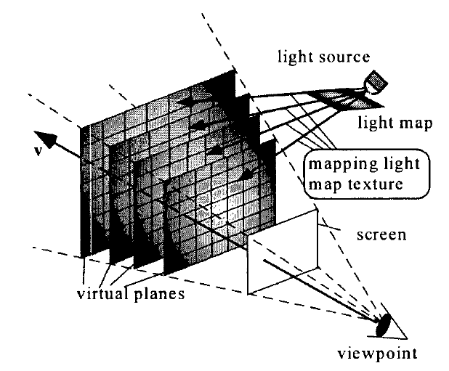
Interactive Rendering Method for Displaying Shafts of Light

Slide 6
Interactive Rendering of Atmospheric Scattering Effects Using Graphics Hardware

Slide 7
Airlight Model + Surface Radiance Model
the Fraunhofer Approximation
Probability Function
Save in texture map
Attenuating effects
Specularity – Surface Radiance Model

Slide 8
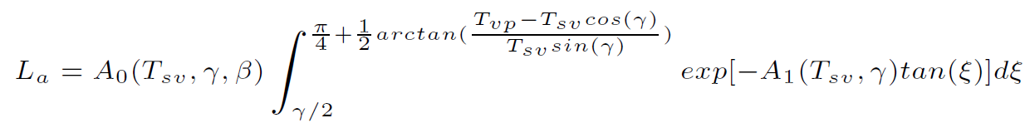
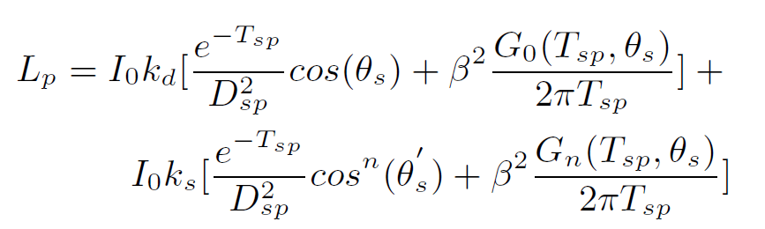
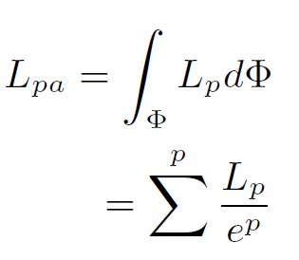

Slide 9
Q & A

