Slide 1
Dimensionality reduction
PCA, SVD, MDS, ICA, and friends
Jure Leskovec
Machine Learning recitation
April 27 2006

Slide 2
Why dimensionality reduction?
Some features may be irrelevant
We want to visualize high dimensional data
“Intrinsic” dimensionality may be smaller than the number of features

Slide 3
Supervised feature selection
Scoring features:
    Mutual information between attribute and class
    χ²: independence between attribute and class
    Classification accuracy
Domain specific criteria:
  E.g. Text:
    remove stop-words (and, a, the, …)
    Stemming (going → go, Tom’s → Tom, …)
    Document frequency

Slide 4
Choosing sets of features
Score each feature
Forward/Backward elimination
  Choose the feature with the highest/lowest score
  Re-score other features
  Repeat
If you have lots of features (like in text)
  Just select top K scored features

Slide 5
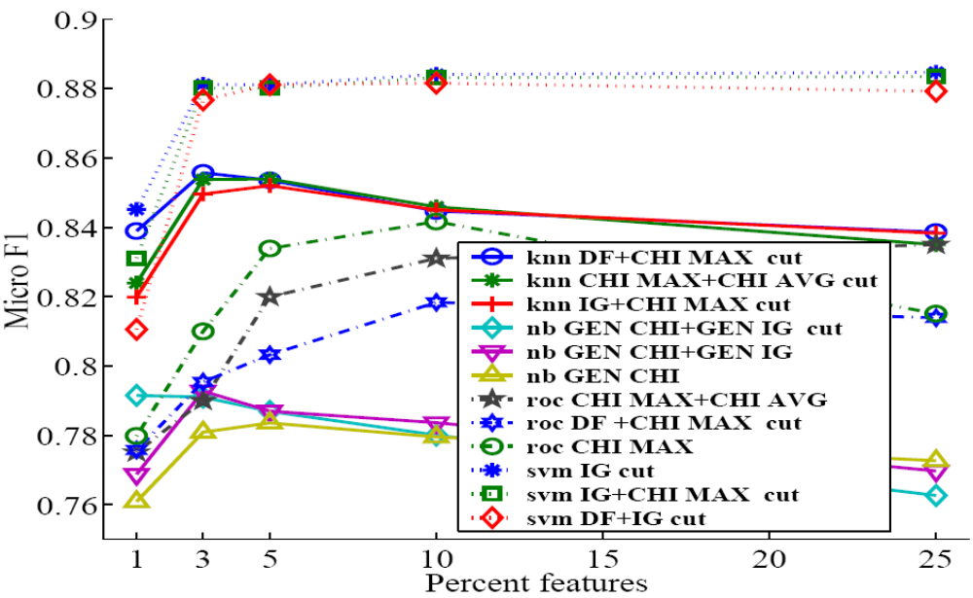
Feature selection on text
SVM
kNN
Rochio
NB

Slide 6
Unsupervised feature selection
Differs from feature selection in two ways:
  Instead of choosing subset of features,
  Create new features (dimensions) defined as functions over all features
  Don’t consider class labels, just the data points

Slide 7
Unsupervised feature selection
Idea:
  Given data points in d-dimensional space,
  Project into lower dimensional space while preserving as much information as possible
    E.g., find best planar approximation to 3D data
    E.g., find best planar approximation to 104D data
  In particular, choose projection that minimizes the squared error in reconstructing original data

Slide 8
PCA Algorithm
PCA algorithm:
  1. X ← Create N x d data matrix, with one row vector x_{n} per data point
  2. X subtract mean x from each row vector x_{n} in X
  3. Σ ← covariance matrix of X
  Find eigenvectors and eigenvalues of Σ
  PC’s ← the M eigenvectors with largest eigenvalues

Slide 9
PCA Algorithm in Matlab
% generate data
Data = mvnrnd([5, 5],[1 1.5; 1.5 3], 100);
figure(1); plot(Data(:,1), Data(:,2), '+');
%center the data
for i = 1:size(Data,1)
Data(i, :) = Data(i, :) - mean(Data);
end
DataCov = cov(Data); %covariance matrix
[PC, variances, explained] = pcacov(DataCov); %eigen
% plot principal components
figure(2); clf; hold on;
plot(Data(:,1), Data(:,2), '+b');
plot(PC(1,1)*[-5 5], PC(2,1)*[-5 5], '-r’)
plot(PC(1,2)*[-5 5], PC(2,2)*[-5 5], '-b’); hold off
% project down to 1 dimension
PcaPos = Data * PC(:, 1);

Slide 10
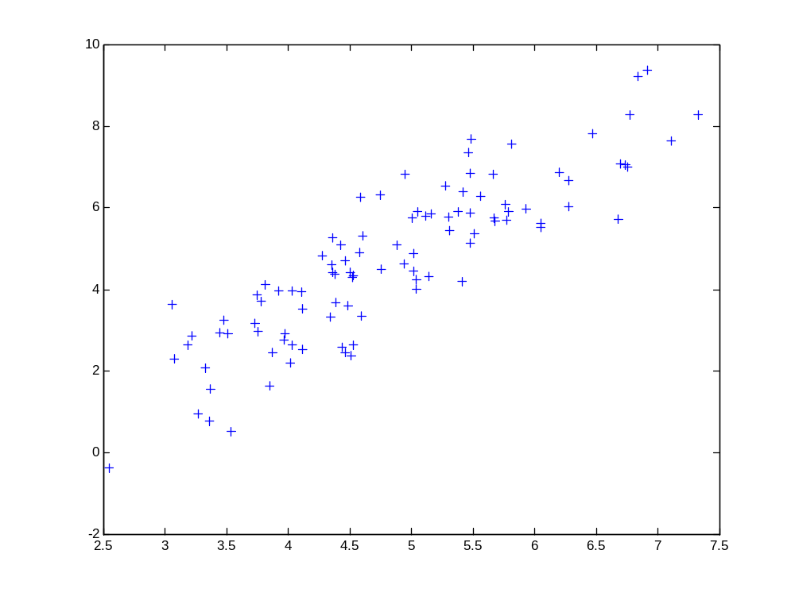
2d Data

Slide 11
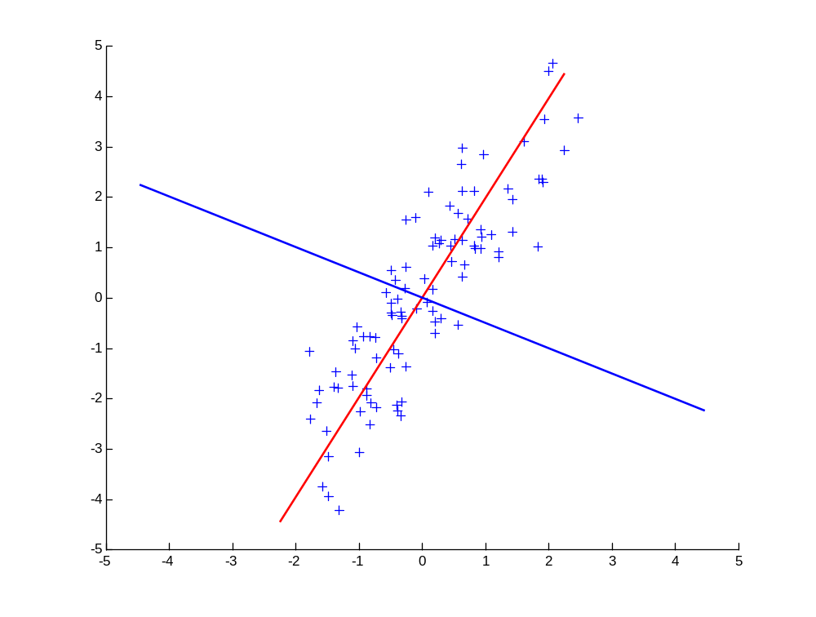
Principal Components
1st principal vector
Gives best axis to project
Minimum RMS error
Principal vectors are orthogonal
2nd principal vector

Slide 12
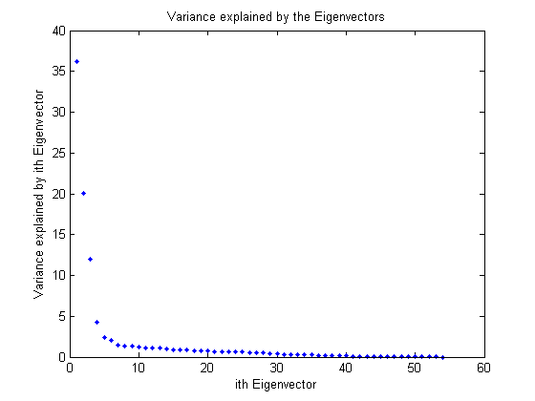
How many components?
Check the distribution of eigen-values
Take enough many eigen-vectors to cover 80-90% of the variance

Slide 13
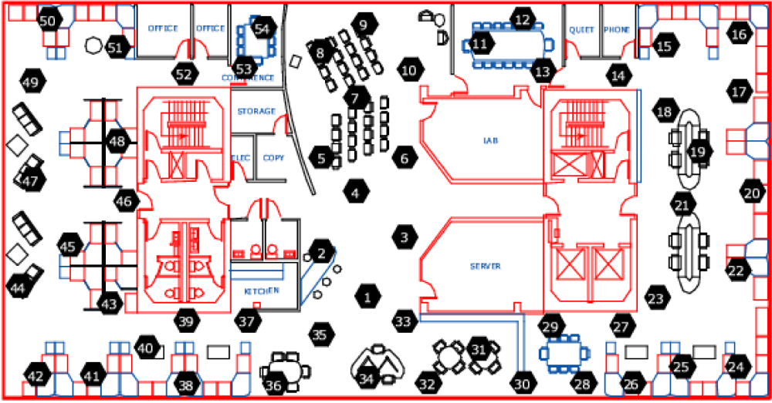
Sensor networks
Sensors in Intel Berkeley Lab

Slide 14
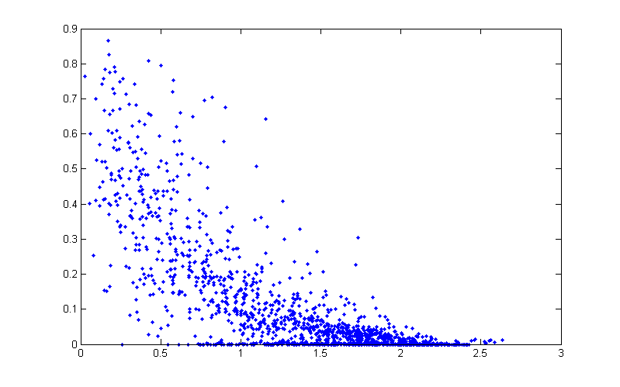
Pairwise link quality vs. distance
Link quality
Distance between a pair of sensors

Slide 15
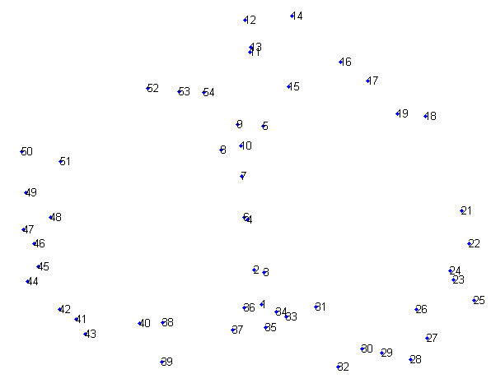
PCA in action
Given a 54x54 matrix of pairwise link qualities
Do PCA
Project down to 2 principal dimensions
PCA discovered the map of the lab

Slide 16
Problems and limitations
What if very large dimensional data?
  e.g., Images (d ≥ 10⁴)
Problem:
  Covariance matrix Σ is size (d²)
  d=10₄ → |Σ| = 10⁸
Singular Value Decomposition (SVD)!
  efficient algorithms available (Matlab)
  some implementations find just top N eigenvectors

Slide 17
SVD
Singular Value Decomposition

Slide 18
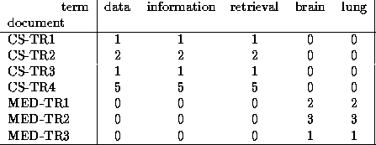
Singular Value Decomposition
Problem:
  #1: Find concepts in text
  #2: Reduce dimensionality

Slide 19
SVD - Definition
A_{[n x m]} = U_{[n x r]} Λ _{[ r x r]} (V_{[m x r]})^{T}
A: n x m matrix (e.g., n documents, m terms)
U: n x r matrix (n documents, r concepts)
Λ: r x r diagonal matrix (strength of each ‘concept’) (r: rank of the matrix)
V: m x r matrix (m terms, r concepts)

Slide 20
SVD - Properties
THEOREM [Press+92]: always possible to decompose matrix A into A = U Λ V^{T} , where
U, Λ, V: unique (*)
U, V: column orthonormal (ie., columns are unit vectors, orthogonal to each other)
  U^{T}U = I; V^{T}V = I (I: identity matrix)
Λ: singular value are positive, and sorted in decreasing order

Slide 21
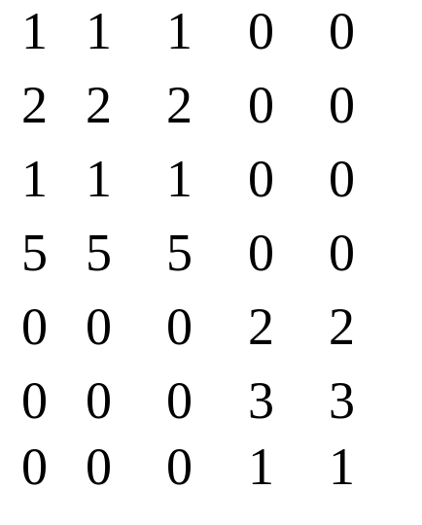
SVD - Properties
‘spectral decomposition’ of the matrix:
λ₁
=
u₁
u₂
x
x
λ₂
v₁
v₂

Slide 22
SVD - Interpretation
‘documents’, ‘terms’ and ‘concepts’:
U: document-to-concept similarity matrix
V: term-to-concept similarity matrix
Λ: its diagonal elements: ‘strength’ of each concept
Projection:
best axis to project on: (‘best’ = min sum of squares of projection errors)

Slide 23
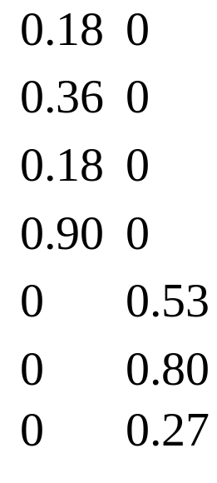
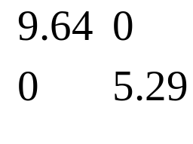
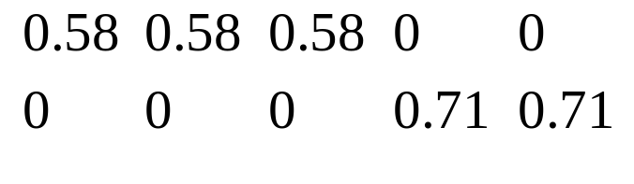
SVD - Example
A = U Λ V^{T} - example:
retrieval
inf.
lung
data
brain
CS
=
x
x
MD

Slide 24
SVD - Example
doc-to-concept
similarity matrix
A = U Λ V^{T} - example:
retrieval
CS-concept
inf.
lung
MD-concept
data
brain
CS
=
x
x
MD

Slide 25
SVD - Example
A = U Λ V^{T} - example:
retrieval
inf.
‘strength’ of CS-concept
lung
data
brain
CS
=
x
x
MD

Slide 26
SVD - Example
A = U Λ V^{T} - example:
term-to-concept
similarity matrix
retrieval
inf.
lung
data
brain
CS-concept
CS
=
x
x
MD

Slide 27
SVD – Dimensionality reduction
Q: how exactly is dim. reduction done?
A: set the smallest singular values to zero:
=
x
x

Slide 28
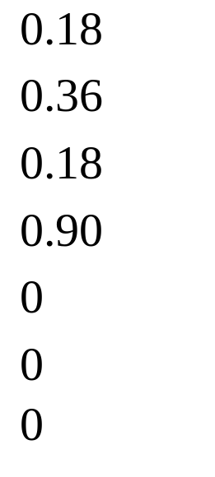
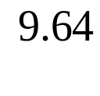
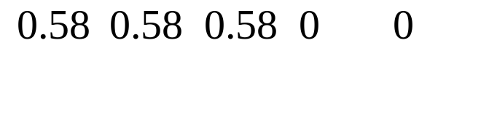
SVD - Dimensionality reduction
~
x
x

Slide 29
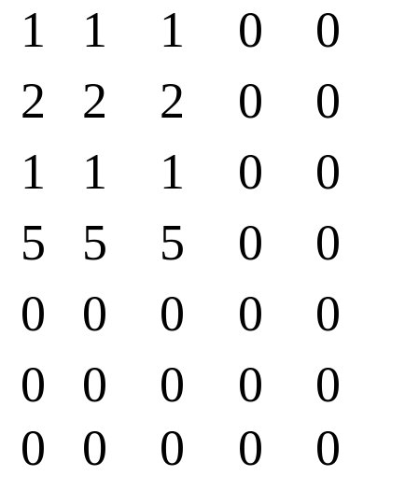
SVD - Dimensionality reduction
~

Slide 30
LSI (latent semantic indexing)
Q1: How to do queries with LSI?
A: map query vectors into ‘concept space’ – how?
retrieval
inf.
lung
data
brain
CS
=
x
x
MD

Slide 31
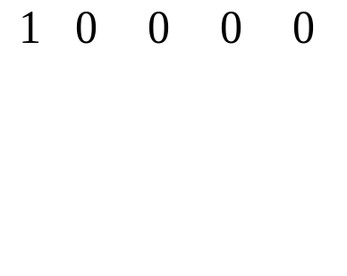
LSI (latent semantic indexing)
Q: How to do queries with LSI?
A: map query vectors into ‘concept space’ – how?
retrieval
inf.
lung
term2
q
data
brain
q=
v2
v1
A: inner product
(cosine similarity)
with each ‘concept’ vector v_{i}
term1

Slide 32
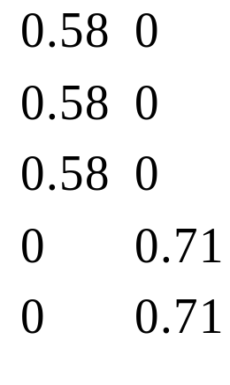

LSI (latent semantic indexing)
compactly, we have:
q_{concept} = q V
e.g.:
CS-concept
retrieval
inf.
lung
data
brain
=
q=
term-to-concept
similarities

Slide 33
Multi-lingual IR
(English query, on Spanish text?)
Q: multi-lingual IR (english query, on spanish text?)
Problem:
  given many documents, translated to both languages (eg., English and Spanish)
  answer queries across languages

Slide 34
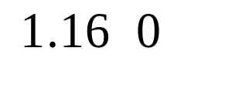

Little example
How would the document (‘information’, ‘retrieval’) handled by LSI? A: SAME:
d_{concept} = d V
Eg:
CS-concept
retrieval
inf.
lung
data
brain
=
d=
term-to-concept
similarities

Slide 35
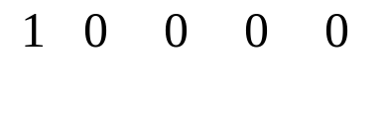
Little example
Observation: document (‘information’, ‘retrieval’) will be retrieved by query (‘data’), although it does not contain ‘data’!!
CS-concept
retrieval
inf.
lung
data
brain
d=
q=

Slide 36
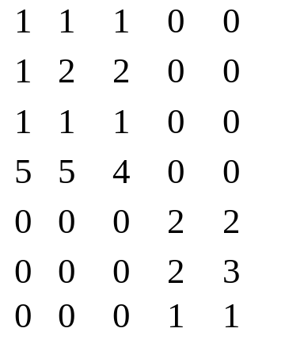
Multi-lingual IR
Solution: ~ LSI
Concatenate documents
Do SVD on them
Now when a new document comes project it into concept space
Measure similarity in concept spalce
informacion
retrieval
datos
inf.
lung
data
brain
CS
MD

Slide 37
Visualization of text
Given a set of documents how could we visualize them over time?
Idea:
  Perform PCA
  Project documents down to 2 dimensions
  See how the cluster centers change – observe the words in the cluster over time
Example:
  Our paper with Andreas and Carlos at ICML 2006

Slide 38
eigenvectors and eigenvalues on graphs
Spectral graph partitioning
Spectral clustering
Google’s PageRank

Slide 39
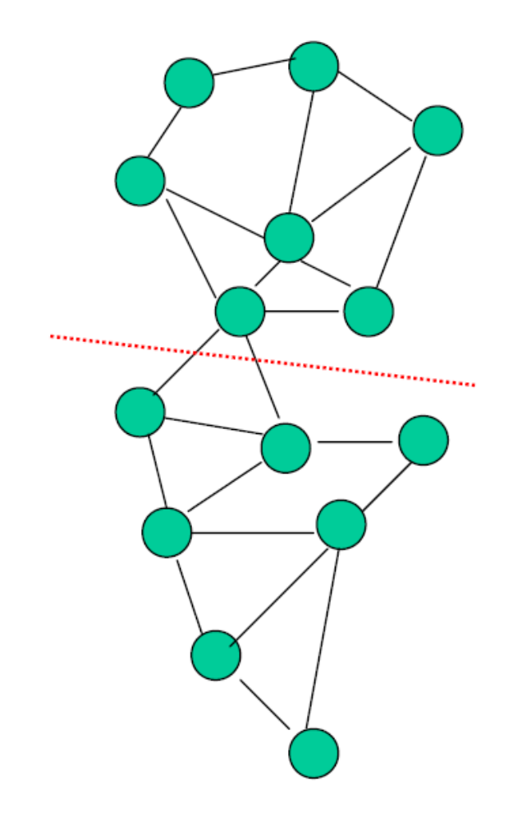
Spectral graph partitioning
How do you find communities in graphs?

Slide 40
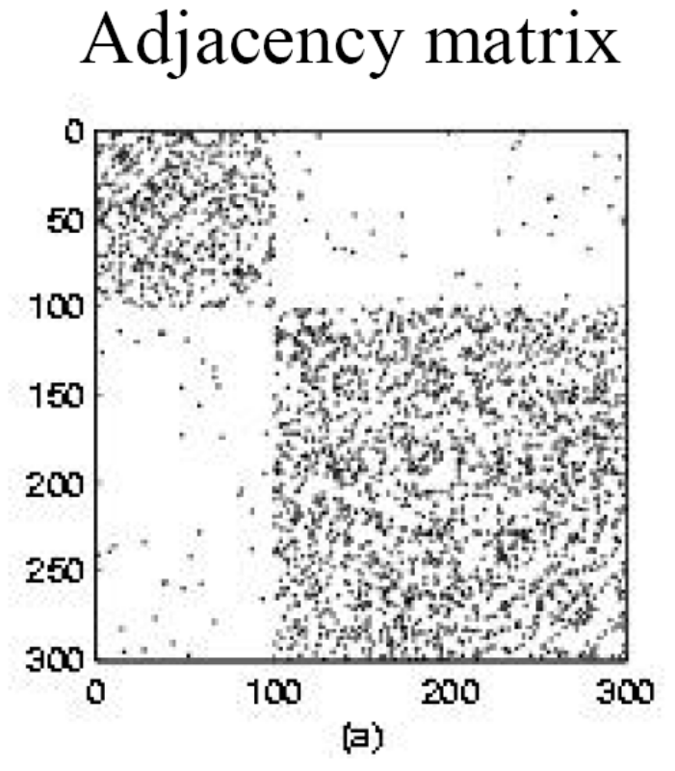
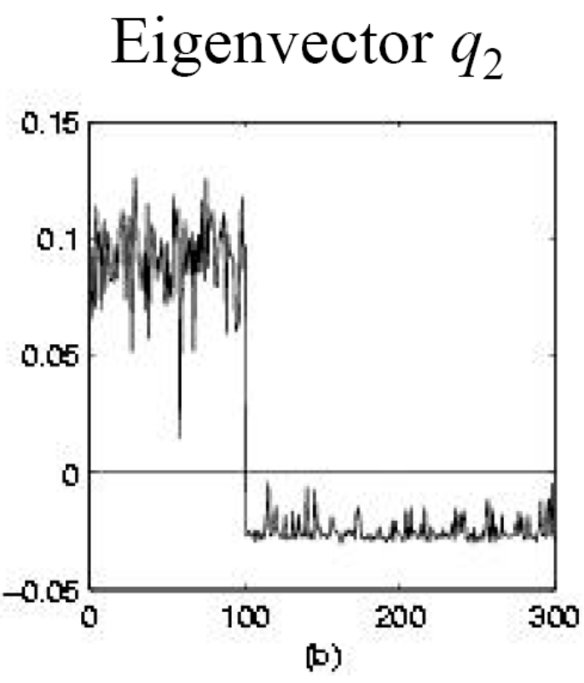
Spectral graph partitioning
Find 2nd eigenvector of graph Laplacian (think of it as adjacency) matrix
Cluster based on 2nd eigevector

Slide 41
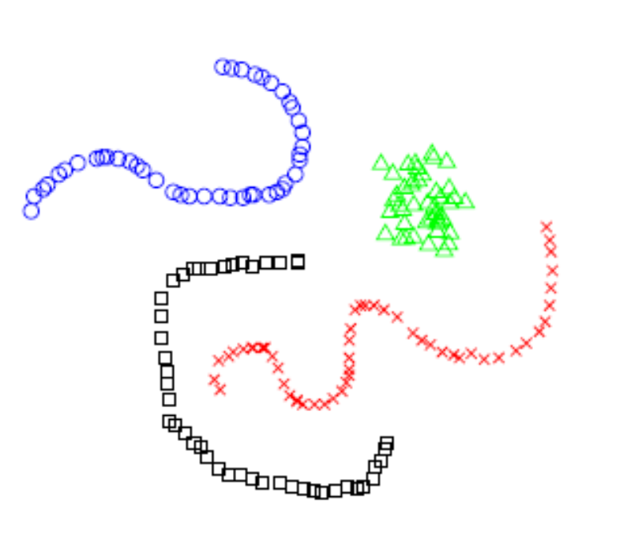
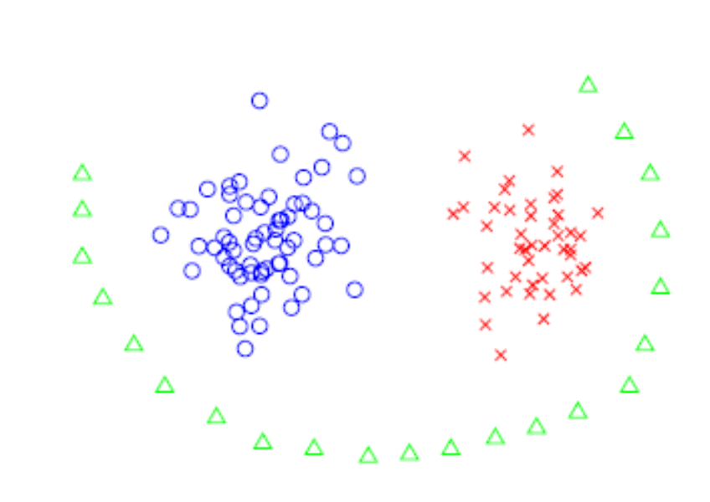
Spectral clustering
Given learning examples
Connect them into a graph (based on similarity)
Do spectral graph partitioning

Slide 42
Google/page-rank algorithm
Problem:
  given the graph of the web
  find the most ‘authoritative’ web pages for this query
closely related: imagine a particle randomly moving along the edges (*)
compute its steady-state probabilities
(*) with occasional random jumps

Slide 43
Google/page-rank algorithm
~identical problem: given a Markov Chain, compute the steady state probabilities p1 ... p5
2
1
3
4
5

Slide 44
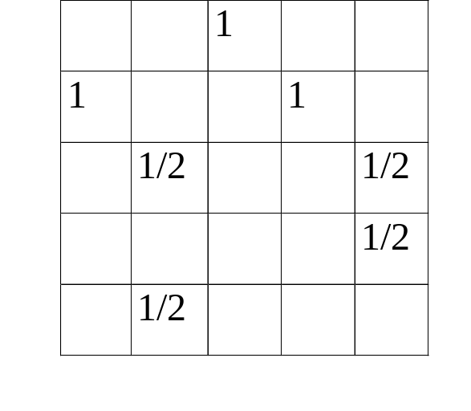
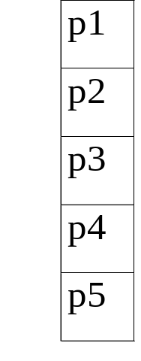
(Simplified) PageRank algorithm
Let A be the transition matrix (= adjacency matrix); let A^{T} become column-normalized - then
From
A^{T} p = p
To
2
1
3
=
4
5

Slide 45
(Simplified) PageRank algorithm
A^{T} p = 1 * p
thus, p is the eigenvector that corresponds to the highest eigenvalue (=1, since the matrix is column-normalized)
formal definition of eigenvector/value: soon

Slide 46
PageRank: How do I calculate it fast?
If A is a (n x n) square matrix
(λ , x) is an eigenvalue/eigenvector pair
of A if
A x = λ x
CLOSELY related to singular values

Slide 47
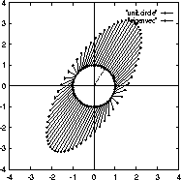

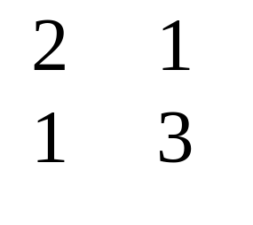

Power Iteration - Intuition
A as vector transformation
x’
A
x
A^{T} p = p
x’
=
x
1
2
3
1

Slide 48
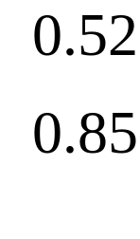
Power Iteration - Intuition
By definition, eigenvectors remain parallel to themselves (‘fixed points’, A x = λ x)
λ₁
v₁
A
v₁
3.62 *
=

Slide 49
Many PCA-like approaches
Multi-dimensional scaling (MDS):
  Given a matrix of distances between features
  We want a lower-dimensional representation that best preserves the distances
Independent component analysis (ICA):
  Find directions that are most statistically independent

Slide 50
Acknowledgements
Some of the material is borrowed from lectures of Christos Faloutsos and Tom Mitchell

