Slide 1
Figures

Slide 2
Tensorflow

Slide 3





Input X
Weight W
Bias b
Output Y
Rank 2 tensor
Rank 2 tensor
Rank 1 tensor
Rank 2 tensor
W
W
X
X
$$dot$$
WX
+
WX+b
$$σ$$
$σ$(WX+b)
$$softmax$$
$$\hat{y}$$
b
b

Slide 4
Word2vec (skip-gram)

Slide 5










A0
A1
A2
X
$${W1}^{T}$$
$$A1=np.dot(W1,X)$$
$$W2^{T}$$
$$A2=np.dot(W2,X)$$
$$\hat{Y}$$
.
=
.
=
softmax
$$(N_{x}, 1)$$
$$(N_{x}, N_{h})$$
$$(N_{h}, 1)$$
$$(N_{h}, N_{y})$$
$$(N_{y}, 1)$$
$$(N_{y}, 1)$$

Slide 6




A0
A1
A2
Context words
word
X
$${W1}^{T}$$
$$A1=np.dot(W1,X)$$
$$W2^{T}$$
$$A2=np.dot(W2,X)$$
$$\hat{Y}$$
feed
.
=
.
=
softmax
Cross-entropy
$$(N_{x}, 1)$$
$$(N_{x}, 1)$$
$$(N_{x}, N_{h})$$
$$(N_{h}, 1)$$
$$(N_{h}, N_{y})$$
$$(N_{y}, 1)$$
$$(N_{y}, 1)$$
$$(N_{x}, N_{c})$$

Slide 7
Recurrent Neural Network

Slide 8
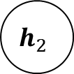
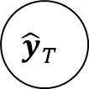
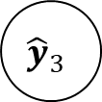
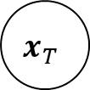
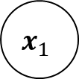

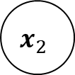
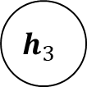
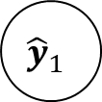

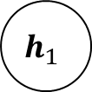
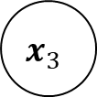

Simple RNN Architecture
n to n
Target application : language model
$${\hat{y}}_{1}$$
$${\hat{y}}_{2}$$
$${\hat{y}}_{3}$$
$${\hat{y}}_{T}$$
$$h_{0}$$
$$h_{1}$$
$$h_{2}$$
$$h_{3}$$
…
$$h_{T}$$
$$x_{1}$$
$$x_{2}$$
$$x_{3}$$
$$x_{T}$$

Slide 9


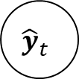



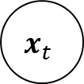

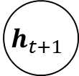

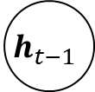



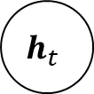


Simple RNN : forward dataflow
$${\hat{y}}_{t}$$
$$x_{t}$$
x
$$W_{xh}$$
$$h_{t−1}$$
$$h_{t}$$
$$h_{t+1}$$
+
$$tanh$$
$$h_{t}$$
x
+
$$g$$
$${\hat{y}}_{t}$$
$$h_{t−1}$$
x
$$W_{hy}$$
$$b_{y}$$
$$W_{hh}$$
$$x_{t}$$
$$b_{h}$$
$$h_{t}$$

Slide 10









Simple RNN : shape of dataflow
$$(n_{v},1)$$
$${\hat{y}}_{t}$$
$$x_{t}$$
$$(n_{h},n_{v})$$
x
$$W_{xh}$$
$$(n_{h},1)$$
$$(n_{v},1)$$
$$h_{t−1}$$
$$h_{t}$$
$$h_{t+1}$$
$$(n_{h},1)$$
+
$$tanh$$
$$h_{t}$$
x
+
$$g$$
$${\hat{y}}_{t}$$
$$h_{t−1}$$
x
$$(n_{v},n_{h})$$
$$(n_{v},1)$$
$$(n_{h},n_{h})$$
$$W_{hy}$$
$$b_{y}$$
$$W_{hh}$$
$$(n_{h},1)$$
$$x_{t}$$
$$b_{h}$$
$$h_{t}$$

Slide 11
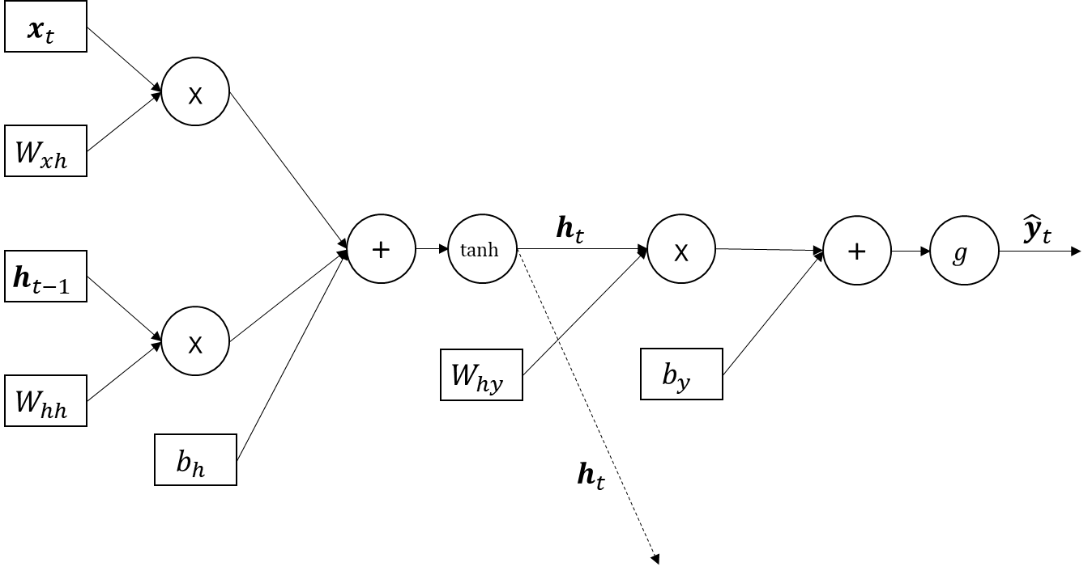








Simple RNN : forward propagation
$$z_{xh}^{<t>}=W_{xh}x_{t}$$
$$z_{hh}^{<t>}=W_{hh}h_{t−1}$$
$$z_{h}^{<t>}=z_{xh}^{<t>}+z_{hh}^{<t>}+b_{h}$$
$$a_{h}^{<t>}=h_{t}=tanh⁡(z_{h}^{<t>})$$
$$z_{y}^{<t>}=W_{hy}a_{h}^{<t>}+b_{y}$$
$$a_{y}^{<t>}={\hat{y}}_{t}=g(z_{y}^{<t>})$$
$$g(z)=softmax(z)$$
$${g(z}_{j})=\frac{\exp\left(z_{j}\right)}{\sum_{k=1}^{K}{\exp\left(z_{k}\right)}} for j=1…k$$

Slide 12








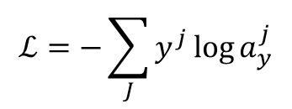






Simple RNN : backward propagation
$${\hat{y}}_{t}$$
$$x_{t}$$
$$\frac{∂ℒ}{∂x_{t}}$$
Cross-entropy
$$ℒ=−\sum_{J}{y^{j}\log{a_{y}^{j}}}$$
x
$$\frac{∂ℒ}{∂z_{h}}∗1$$
$$W_{xh}$$
$$\frac{∂ℒ}{∂W_{xh}}$$
$$\frac{∂ℒ}{∂z_{h}}$$
$$\frac{∂ℒ}{∂a_{h}}$$
$$\frac{∂ℒ}{∂z_{y}}∗1$$
$$\frac{∂ℒ}{∂z_{y}}$$
$$\frac{∂ℒ}{∂a_{y}}$$
$$h_{t−1}$$
$$h_{t}$$
$$h_{t+1}$$
$$\frac{∂ℒ}{∂z_{h}}∗1$$
+
$$tanh$$
x
+
$$g$$
$$ℒ$$
$$h_{t−1}$$
$$\frac{∂ℒ}{∂h_{t−1}}$$
x
$$W_{hy}$$
$$\frac{∂ℒ}{∂W_{hy}}$$
$$b_{y}$$
$$\frac{∂ℒ}{∂z_{y}}∗1$$
$$W_{hh}$$
$$\frac{∂ℒ}{∂W_{hh}}$$
$$\frac{∂ℒ}{∂z_{h}}∗1$$
$$x_{t}$$
$$b_{h}$$
$$\frac{∂ℒ}{∂a_{h+1}}$$

Slide 13







Cross Entropy Computation Graph
$$y^{1}$$
*
Cross-entropy
$$a_{y}^{1}$$
log
$$ℒ=−\sum_{J}{y^{j}\log{a_{y}^{j}}}$$
$$y^{2}$$
*
$$a_{y}^{2}$$
log
+
$$ℒ$$
…
$$y^{J}$$
*
$$a_{y}^{J}$$
log

Slide 14










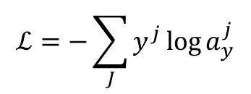






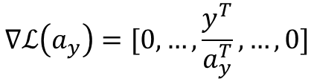






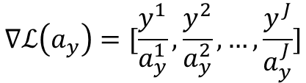







Cross Entropy Backpropagation
$$y^{1}$$
$$\frac{∂ℒ}{∂ℒ}∗log⁡(a_{y}^{1})$$
Cross-entropy
*
$$ℒ=−\sum_{J}{y^{j}\log{a_{y}^{j}}}$$
$$\frac{y^{1}}{a_{y}^{1}}$$
$$a_{y}^{1}$$
log
$$\frac{∂ℒ}{∂ℒ}$$
$$\frac{∂ℒ}{∂ℒ}∗y^{1}$$
$$x$$
$$δ∗1$$
$$\frac{∂ℒ}{∂ℒ}∗y^{1}∗\frac{1}{a_{y}^{1}}$$
$$δ$$
+
$$y^{2}$$
$$\frac{∂ℒ}{∂ℒ}$$
*
$$\frac{∂ℒ}{∂ℒ}$$
$$y$$
$$δ∗1$$
$$\frac{y^{2}}{a_{y}^{2}}$$
+
$$ℒ$$
$$a_{y}^{2}$$
log
$$x$$
$$δ∗y$$
…
$$δ$$
*
$$y^{J}$$
$$\frac{y^{J}}{a_{y}^{J}}$$
*
$$y$$
$$δ∗x$$
$$a_{y}^{J}$$
log
$$\frac{∂ℒ}{∂ℒ}$$
$δ$*$\frac{1}{x}$
$$∇ℒ\left(a_{y}\right)=[\frac{y^{1}}{a_{y}^{1}},\frac{y^{2}}{a_{y}^{2}}, …,\frac{y^{J}}{a_{y}^{J}}]$$
$$∇ℒ\left(a_{y}\right)=[0,…,\frac{y^{T}}{a_{y}^{T}}, …,0]$$
log
$$δ$$
$$x$$
$$if y is one hot vector$$

Slide 15









Softmax Computation Graph
$$g\left(z\right)=softmax=a_{y}$$
$$=\exp\left(z_{j}\right)\frac{\exp\left(z_{j}\right)}{\sum_{k=1}^{K}{\exp\left(z_{k}\right)}} for j=1…k$$
$$z^{1}$$
exp
*
$$a_{y}^{1}$$
$$z^{2}$$
exp
*
$$a_{y}^{2}$$
…
…
…
+
$$x^{−1}$$
…
…
…
$$z^{J}$$
exp
*
$$a_{y}^{J}$$

Slide 16



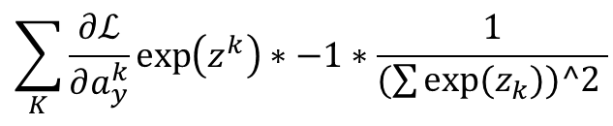
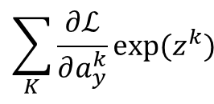













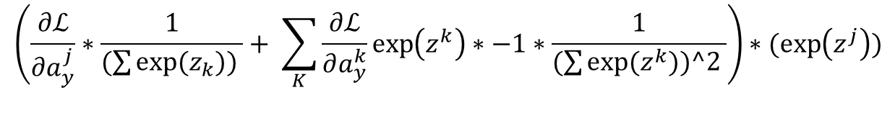






Softmax BackPropagation
$$g\left(z\right)=softmax=a_{y}$$
$$=\exp\left(z_{j}\right)\frac{\exp\left(z_{j}\right)}{\sum_{k=1}^{K}{\exp\left(z_{k}\right)}} for j=1…k$$
$$\frac{∂ℒ}{∂a_{y}^{j}}∗\frac{1}{(\sum{exp⁡(z_{k})) }}$$
$$\frac{∂ℒ}{∂a_{y}^{1}}$$
$$z^{1}$$
exp
*
$$a_{y}^{1}$$
$$\frac{∂ℒ}{∂a_{y}^{2}}$$
$$z^{2}$$
exp
*
$$a_{y}^{2}$$
$$\sum_{K}{\frac{∂ℒ}{∂a_{y}^{k}}exp⁡(z^{k})}$$
…
…
…
+
$$x^{−1}$$
…
…
…
$$\sum_{K}{\frac{∂ℒ}{∂a_{y}^{k}}\exp\left(z^{k}\right)∗−1∗\frac{1}{(\sum{exp⁡(z_{k}))^2 }}}$$
$$\frac{∂ℒ}{∂a_{y}^{J}}$$
$$\sum_{N}{d_{i}}$$
$$d_{1}$$
$$z^{J}$$
exp
*
$$a_{y}^{J}$$
$$d_{2}$$
$$d_{n}$$
$$\left(\frac{∂ℒ}{∂a_{y}^{j}}∗\frac{1}{(\sum{exp⁡(z_{k})) }}+ \sum_{K}{\frac{∂ℒ}{∂a_{y}^{k}}\exp\left(z^{k}\right)∗−1∗\frac{1}{(\sum{exp⁡(z^{k}))^2 }}}\right)∗(\exp\left(z^{j}\right))$$
$$exp⁡(x)$$
1*$\frac{−1}{x^{2}}$
$$exp$$
$$1$$
$$x^{−1}$$
$$1$$
$$x$$
$$x$$

Slide 17
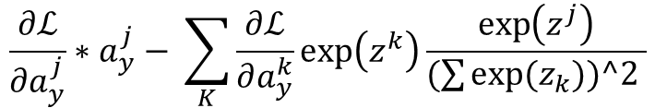
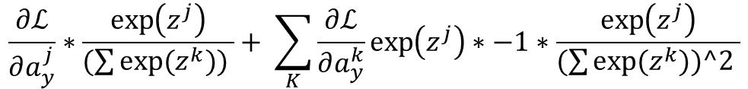
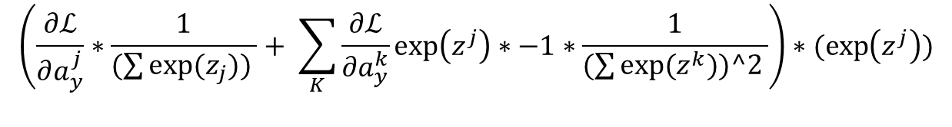


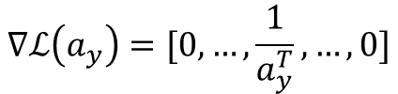
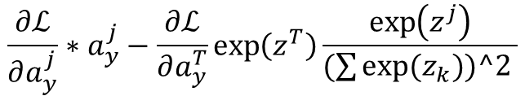
Softmax BackPropagation
$$g\left(z\right)=softmax=a_{y}$$
$$=\exp\left(z_{j}\right)\frac{\exp\left(z_{j}\right)}{\sum_{k=1}^{K}{\exp\left(z_{k}\right)}} for j=1…k$$
$$\left(\frac{∂ℒ}{∂a_{y}^{j}}∗\frac{1}{(\sum{exp⁡(z_{j})) }}+ \sum_{K}{\frac{∂ℒ}{∂a_{y}^{k}}\exp\left(z^{j}\right)∗−1∗\frac{1}{(\sum{exp⁡(z^{k}))^2 }}}\right)∗(\exp\left(z^{j}\right))$$
$$\frac{∂ℒ}{∂a_{y}^{j}}∗\frac{\exp\left(z^{j}\right)}{(\sum{exp⁡(z^{k})) }}+ \sum_{K}{\frac{∂ℒ}{∂a_{y}^{k}}\exp\left(z^{j}\right)∗−1∗\frac{\exp\left(z^{j}\right)}{(\sum{exp⁡(z^{k}))^2 }}}$$
$$\frac{∂ℒ}{∂a_{y}^{j}}∗a_{y}^{j}− \sum_{K}{\frac{∂ℒ}{∂a_{y}^{k}}\exp\left(z^{k}\right)\frac{\exp\left(z^{j}\right)}{(\sum{exp⁡(z_{k}))^2 }}}$$
$$∇ℒ\left(a_{y}\right)=[0,…,\frac{1}{a_{y}^{T}}, …,0]$$
$$if y is one hot vector$$
$$\frac{∂ℒ}{∂a_{y}^{j}}∗a_{y}^{j}−\frac{∂ℒ}{∂a_{y}^{T}}\exp\left(z^{T}\right)\frac{\exp\left(z^{j}\right)}{(\sum{exp⁡(z_{k}))^2 }}$$
$$a−y$$

Slide 18
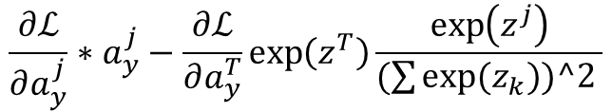
$$\frac{∂ℒ}{∂a_{y}^{j}}∗a_{y}^{j}−\frac{∂ℒ}{∂a_{y}^{T}}\exp\left(z^{T}\right)\frac{\exp\left(z^{j}\right)}{(\sum{exp⁡(z_{k}))^2 }}$$

Slide 19
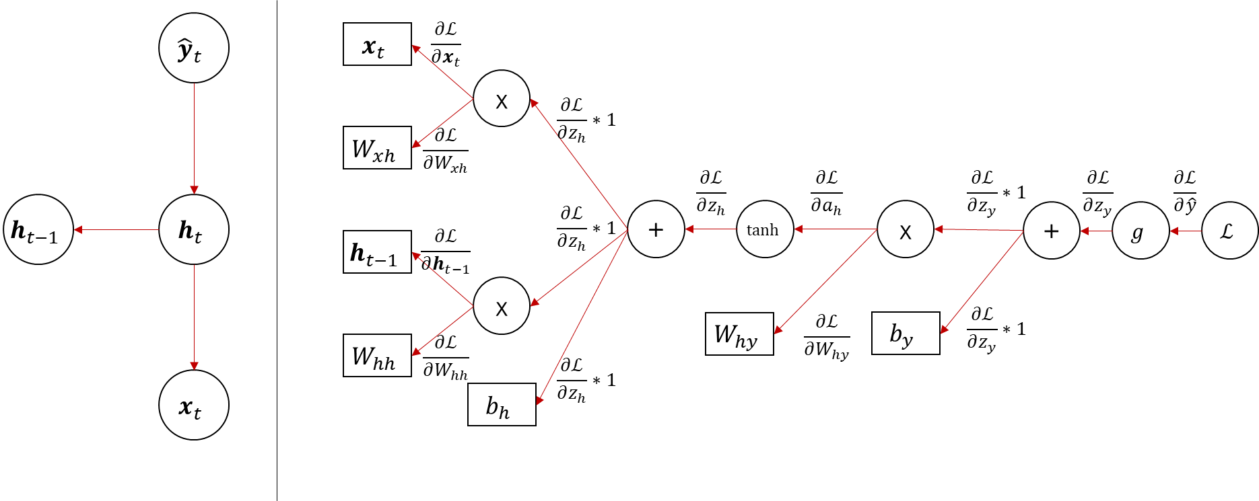
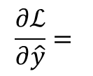
Simple RNN : backward propagation 2
$$\frac{∂ℒ}{∂\hat{y}}=$$

Slide 20
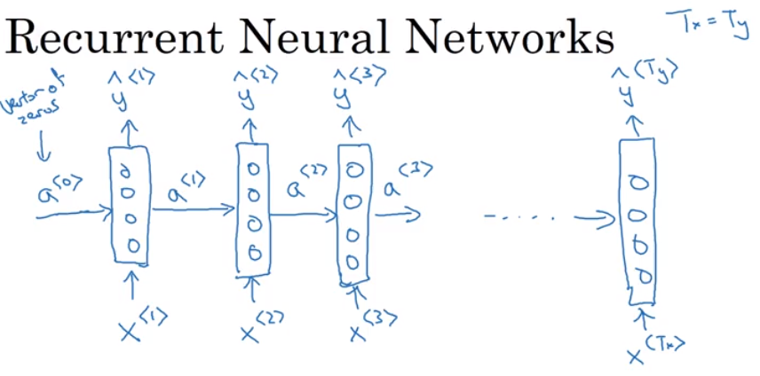
time step의 set of weight는 shared된다.
RNN의 약점은 sequence의 이전 데이터가 이후 데이터에 영향을 주지만, 이후 데이터가 이전 데이터에 영향을 주지는 못한다. y3를 예측할 때 x1,x2,x3는 영향을 주지만, x4,x5는 영향을 주지 못한다
이를 해결하고자 하는 시도가 BRNN(bi-directional RNN)
https://www.coursera.org/learn/nlp-sequence-models/lecture/ftkzt/recurrent-neural-network-model

Slide 21
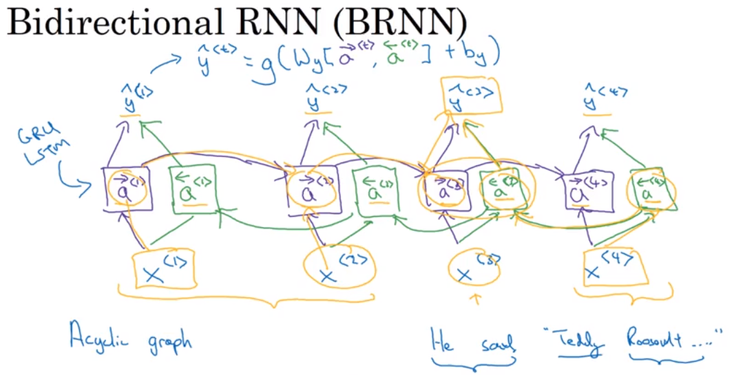
BRNN + LSTM 이 일반적인 조합
단점 : 전체 sequence가 필요

Slide 22
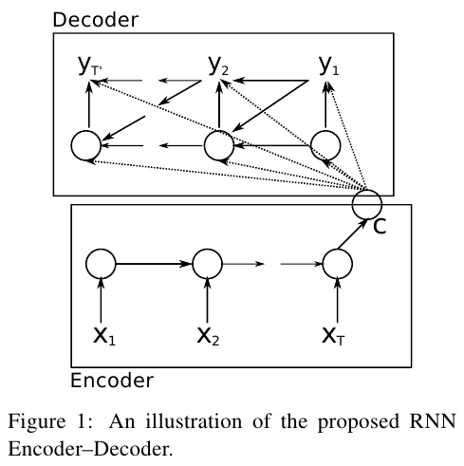
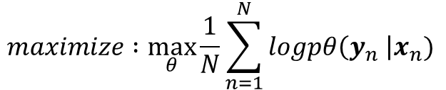





RNN Encoder-Decoder
$$maximize :\max_{θ}{\frac{1}{N}\sum_{n=1}^{N}{logpθ\left(y_{n} \right|x_{n})}}$$
$$h_{<t>}^{Dec}=f(h_{<t−1>}^{Dec},y_{t−1}, c)$$
$$c= h_{<t+1>}^{Enc}$$
$$h_{<t>}^{Enc}=f(h_{<t−1>}^{Enc}, x_{t})$$
$$f∈\{φ, LSTM, GRU, …\}$$
$\left|x\right|$와 $|y|는$ 서로 다를 수 있다.
Cho, K. et al., 2014. Learning phrase representations using RNN encoder-decoder for statistical machine translation. arXiv preprint arXiv:1406.1078.

Slide 23
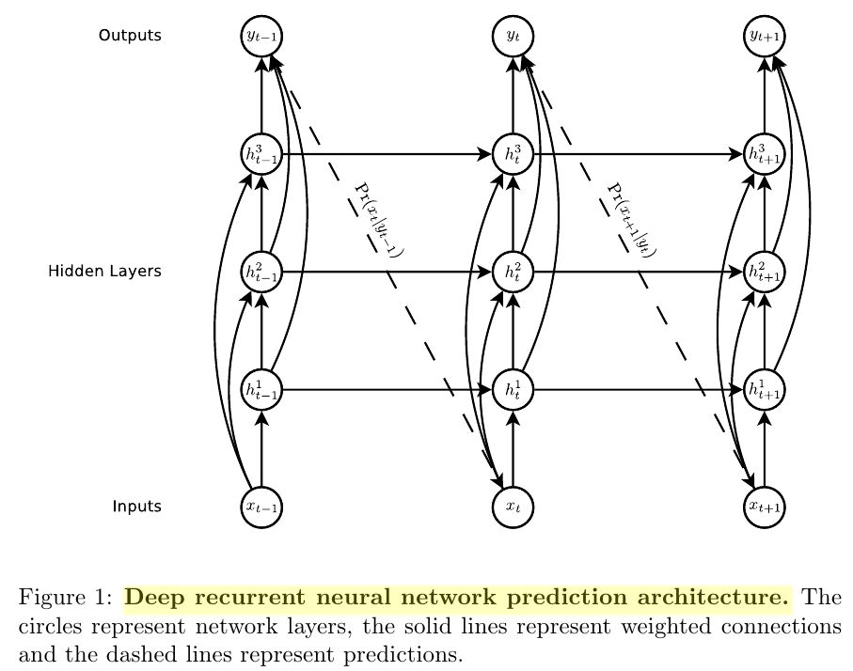
deep RNN with Stacked LSTM layers
LSTM layer
LSTM layer
Skip-connections
LSTM layer
Graves, A., 2013. Generating sequences with recurrent neural networks. arXiv preprint arXiv:1308.0850.

Slide 24












Long Short-Term Memory (LSTM)
Gate Variables
$$i_{t}^{j}=σ{\left(W_{i}x_{t}+U_{i}h_{t−1}+b_{i}\right)}^{j}$$
$$c_{t−1}$$
c
$$c_{t}$$
$$f_{t}^{j}=σ{\left(W_{f}x_{t}+U_{f}h_{t−1}+b_{f}\right)}^{j}$$
~
$$o_{t}^{j}=σ{\left(W_{f}x_{t}+U_{f}h_{t−1}+b_{f}\right)}^{j}$$
f
i
c
o
$$h_{t−1}$$
$$h_{t}$$
new Memory Cell
$${\tilde{c}}_{t}^{j}=tanh{\left(W_{c}x_{t}+U_{c}h_{t−1}+b_{c}\right)}^{j}$$
Update Memory Cell
$$c_{t}^{j}=f_{t}^{j}c_{t−1}^{j}+i_{t}^{j}{\tilde{c}}_{t}^{j}$$
Update Hidden State
$$h_{t}^{j}=o_{t}^{j}tanh⁡(c_{t}^{j})$$
http://colah.github.io/posts/2015-08-Understanding-LSTMs/
Chung, J. et al., 2014. Empirical evaluation of gated recurrent neural networks on sequence modeling. arXiv preprint arXiv:1412.3555.

Slide 25
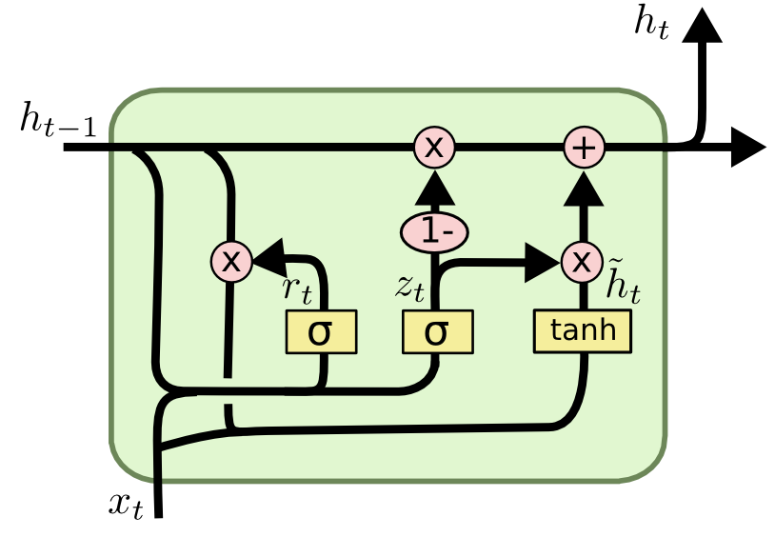





Gated Recurrent Unit (GRU)
Gate Variables
$$r_{t}^{j}=σ{\left(W_{r}x_{t}+U_{r}h_{t−1}+b_{r}\right)}^{j}$$
$$z_{t}^{j}=σ{\left(W_{z}x_{t}+U_{z}h_{t−1}+b_{z}\right)}^{j}$$
new Hidden State
$${\tilde{h}}_{t}^{j}=tanh{\left(W_{h}x_{t}+U_{h}(r_{t}⊙h_{t−1})+b_{h}\right)}^{j}$$
Update Hidden State
$h_{t}^{j}={(1−z}_{t}^{j})h_{t−1}^{j}$+$z_{t}^{j}h_{t}^{j}$
https://www.kaggle.com/thebrownviking20/intro-to-recurrent-neural-networks-lstm-gru
Chung, J. et al., 2014. Empirical evaluation of gated recurrent neural networks on sequence modeling. arXiv preprint arXiv:1412.3555.

