Slide 1
Figures

Slide 2
Tensorflow

Slide 3





Input X
Weight W
Bias b
Output Y
Rank 2 tensor
Rank 2 tensor
Rank 1 tensor
Rank 2 tensor
W
W
X
X
$$dot$$
WX
+
WX+b
$$σ$$
$σ$(WX+b)
$$softmax$$
$$\hat{y}$$
b
b

Slide 4
Word2vec (skip-gram)

Slide 5










A0
A1
A2
X
$${W1}^{T}$$
$$A1=np.dot(W1,X)$$
$$W2^{T}$$
$$A2=np.dot(W2,X)$$
$$\hat{Y}$$
.
=
.
=
softmax
$$(N_{x}, 1)$$
$$(N_{x}, N_{h})$$
$$(N_{h}, 1)$$
$$(N_{h}, N_{y})$$
$$(N_{y}, 1)$$
$$(N_{y}, 1)$$

Slide 6




A0
A1
A2
Context words
word
X
$${W1}^{T}$$
$$A1=np.dot(W1,X)$$
$$W2^{T}$$
$$A2=np.dot(W2,X)$$
$$\hat{Y}$$
feed
.
=
.
=
softmax
Cross-entropy
$$(N_{x}, 1)$$
$$(N_{x}, 1)$$
$$(N_{x}, N_{h})$$
$$(N_{h}, 1)$$
$$(N_{h}, N_{y})$$
$$(N_{y}, 1)$$
$$(N_{y}, 1)$$
$$(N_{x}, N_{c})$$

Slide 7
Recurrent Neural Network

Slide 8
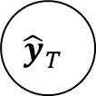
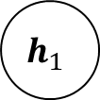
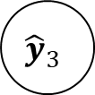
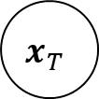
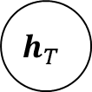
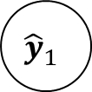

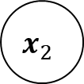
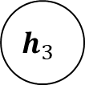
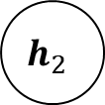
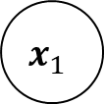

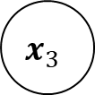
Simple RNN Architecture
n to n
Target application : language model
$${\hat{y}}_{1}$$
$${\hat{y}}_{2}$$
$${\hat{y}}_{3}$$
$${\hat{y}}_{T}$$
$$h_{0}$$
$$h_{1}$$
$$h_{2}$$
$$h_{3}$$
…
$$h_{T}$$
$$x_{1}$$
$$x_{2}$$
$$x_{3}$$
$$x_{T}$$

Slide 9


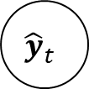



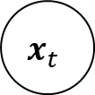

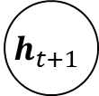

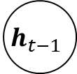



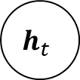


Simple RNN : forward dataflow
$${\hat{y}}_{t}$$
$$x_{t}$$
x
$$W_{xh}$$
$$h_{t−1}$$
$$h_{t}$$
$$h_{t+1}$$
+
$$tanh$$
$$h_{t}$$
x
+
$$g$$
$${\hat{y}}_{t}$$
$$h_{t−1}$$
x
$$W_{hy}$$
$$b_{y}$$
$$W_{hh}$$
$$x_{t}$$
$$b_{h}$$
$$h_{t}$$

Slide 10
Simple RNN : forward dataflow
$${\hat{y}}_{t}$$
$$x_{t}$$
x
$$W_{xh}$$
$$h_{t−1}$$
$$h_{t}$$
$$h_{t+1}$$
+
$$tanh$$
$$h_{t}$$
x
+
$$g$$
$${\hat{y}}_{t}$$
$$h_{t−1}$$
x
$$W_{hy}$$
$$b_{y}$$
$$W_{hh}$$
$$x_{t}$$
$$b_{h}$$
$$h_{t}$$

Slide 11
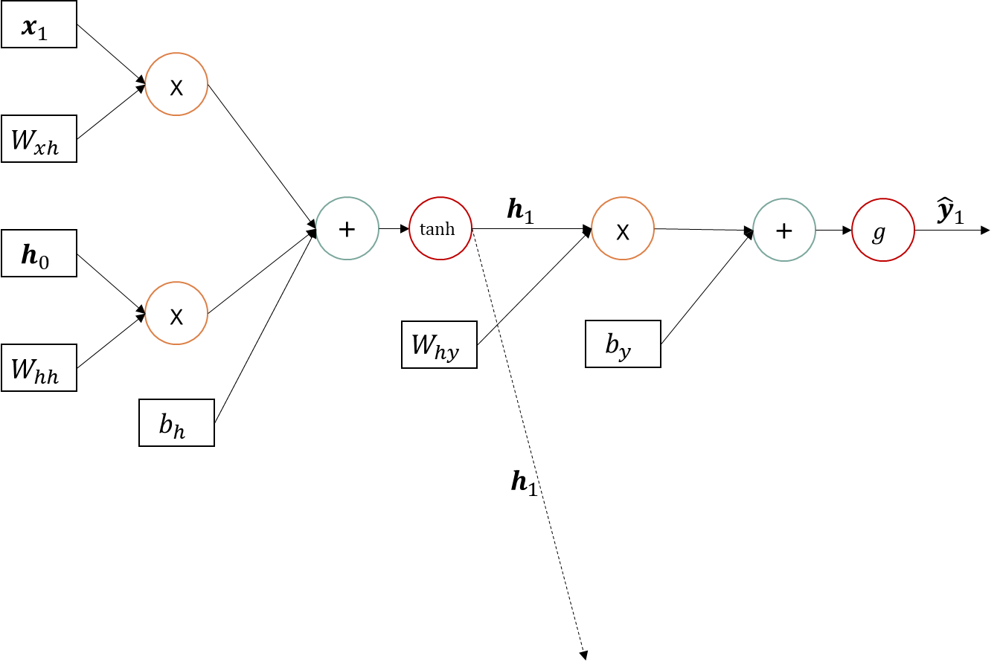
Simple RNN : forward dataflow unroll t=1

Slide 12


Simple RNN : forward dataflow unroll t=2

Slide 13
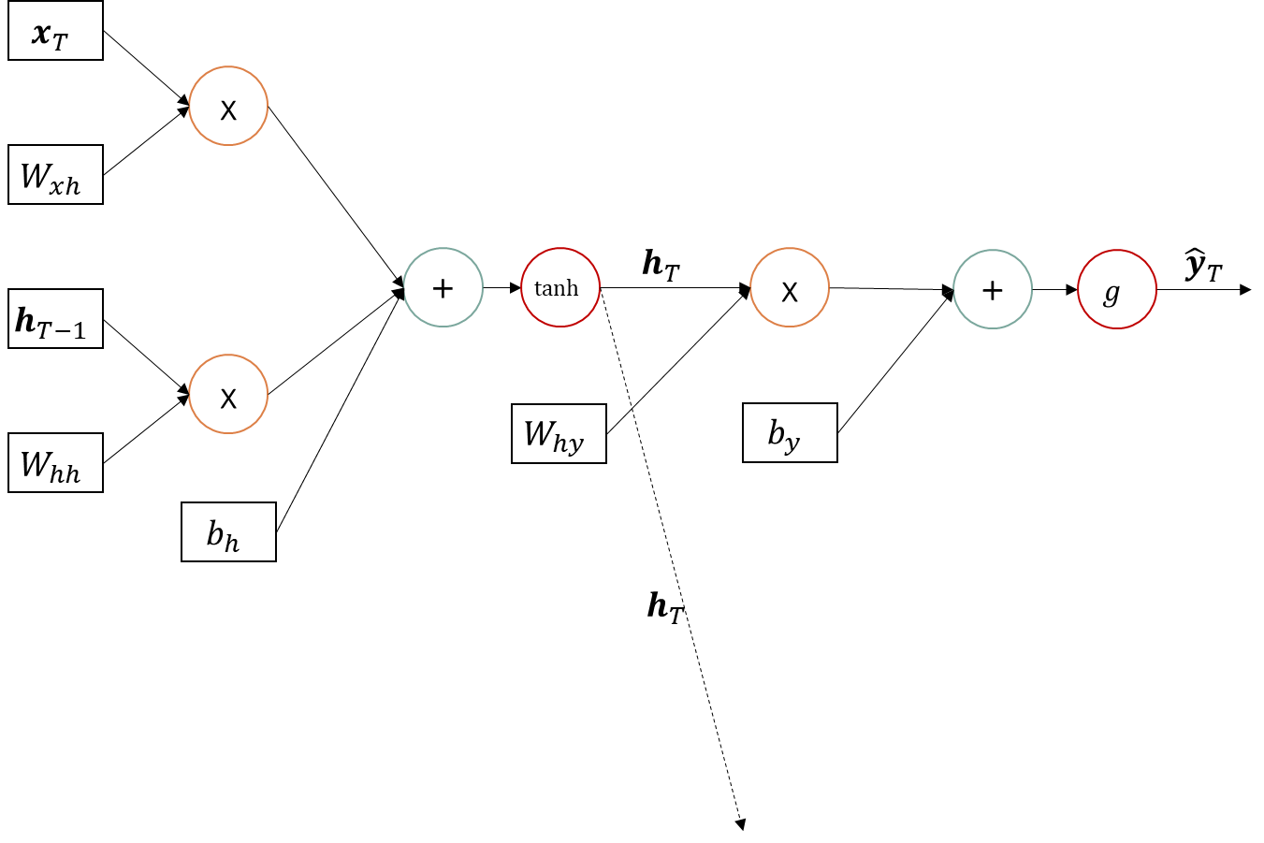
Simple RNN : forward dataflow unroll t=T
T-layer neural network
…

Slide 14












Simple RNN : shape of dataflow
$$(n_{v},1)$$
$${\hat{y}}_{t}$$
$$x_{t}$$
$$(n_{v},1)$$
$$(n_{h},n_{v})$$
x
$$W_{xh}$$
$$(n_{h},1)$$
$$(n_{v},1)$$
$$h_{t−1}$$
$$h_{t}$$
$$h_{t+1}$$
$$(n_{h},1)$$
+
$$tanh$$
$$h_{t}$$
x
+
$$g$$
$${\hat{y}}_{t}$$
$$h_{t−1}$$
$$(n_{h},1)$$
x
$$(n_{v},n_{h})$$
$$(n_{v},1)$$
$$(n_{h},n_{h})$$
$$W_{hy}$$
$$b_{y}$$
$$W_{hh}$$
$$(n_{h},1)$$
$$x_{t}$$
$$b_{h}$$
$$h_{t}$$
$$(n_{v},1)$$

Slide 15
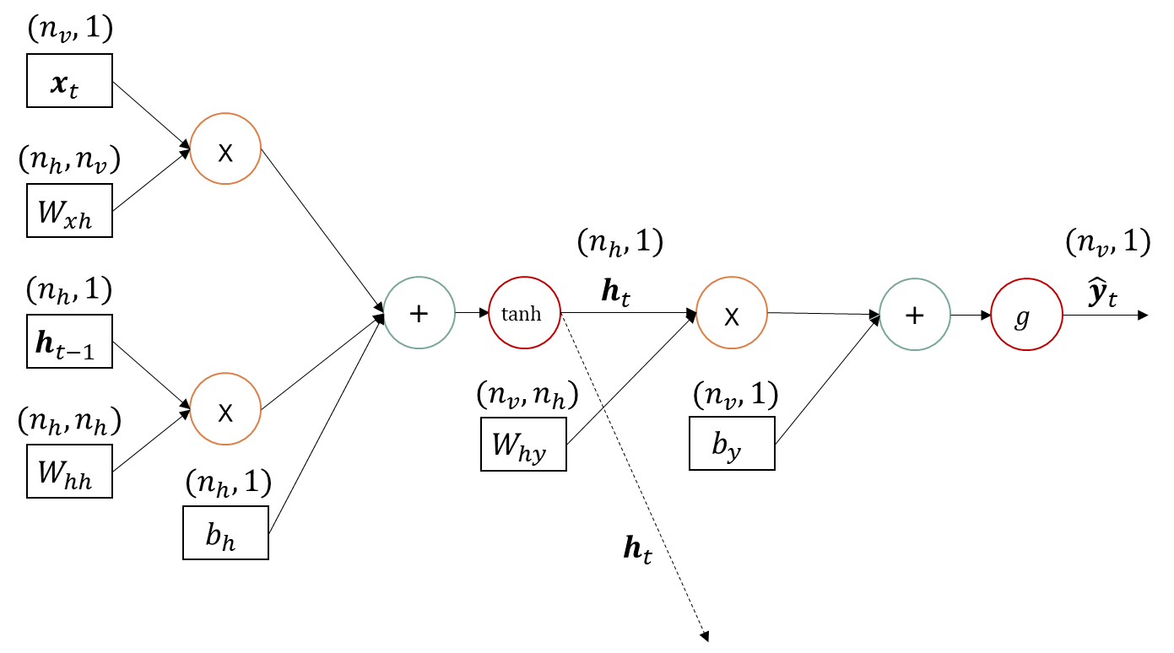








Simple RNN : forward propagation
$$z_{xh}^{<t>}=W_{xh}x_{t}$$
$$z_{hh}^{<t>}=W_{hh}h_{t−1}$$
$$z_{h}^{<t>}=z_{xh}^{<t>}+z_{hh}^{<t>}+b_{h}$$
$$a_{h}^{<t>}=h_{t}=tanh⁡(z_{h}^{<t>})$$
$$z_{y}^{<t>}=W_{hy}a_{h}^{<t>}+b_{y}$$
$$a_{y}^{<t>}={\hat{y}}_{t}=g(z_{y}^{<t>})$$
$$g(z)=softmax(z)$$
$${g(z}_{j})=\frac{\exp\left(z_{j}\right)}{\sum_{k=1}^{K}{\exp\left(z_{k}\right)}} for j=1…k$$

Slide 16









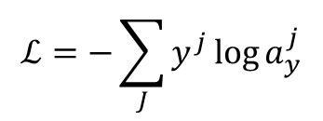






Simple RNN : backward propagation
$${\hat{y}}_{t}$$
$$x_{t}$$
$$\frac{∂ℒ}{∂x_{t}}$$
Cross-entropy
$$ℒ=−\sum_{J}{y^{j}\log{a_{y}^{j}}}$$
x
$$\frac{∂ℒ}{∂z_{h}}∗1$$
$$W_{xh}$$
$$\frac{∂ℒ}{∂W_{xh}}$$
$$\frac{∂ℒ}{∂z_{h}}$$
$$\frac{∂ℒ}{∂a_{h}}$$
$$\frac{∂ℒ}{∂z_{y}}∗1$$
$$\frac{∂ℒ}{∂z_{y}}$$
$$\frac{∂ℒ}{∂a_{y}}$$
$$h_{t−1}$$
$$h_{t}$$
$$h_{t+1}$$
$$\frac{∂ℒ}{∂z_{h}}∗1$$
+
$$tanh$$
x
+
$$g$$
$$ℒ$$
$$h_{t−1}$$
$$\frac{∂ℒ}{∂h_{t−1}}$$
x
$$W_{hy}$$
$$\frac{∂ℒ}{∂W_{hy}}$$
$$b_{y}$$
$$\frac{∂ℒ}{∂z_{y}}∗1$$
$$W_{hh}$$
$$\frac{∂ℒ}{∂W_{hh}}$$
$$\frac{∂ℒ}{∂z_{h}}∗1$$
$$x_{t}$$
$$b_{h}$$
$$\frac{∂ℒ}{∂a_{h+1}}$$

Slide 17

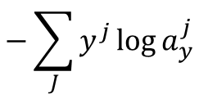


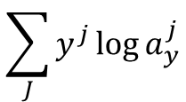







Cross Entropy : forward propagation
$$y^{1}$$
$$y^{1}$$
x
Cross-entropy
$$a_{y}^{1}$$
log
$$y^{1}log⁡(a_{y}^{1})$$
$$ℒ=−\sum_{J}{y^{j}\log{a_{y}^{j}}}$$
$$log⁡(a_{y}^{1})$$
$$\sum_{J}{y^{j}\log{a_{y}^{j}}}$$
$$y^{2}$$
x
$$a_{y}^{2}$$
log
+
*-
$$ℒ$$
$$−\sum_{J}{y^{j}\log{a_{y}^{j}}}$$
…
…
$$y^{J}$$
x
$$a_{y}^{J}$$
log

Slide 18










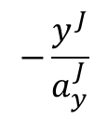
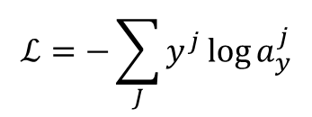

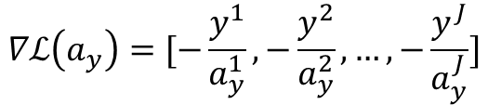




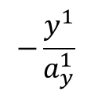



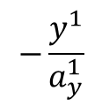









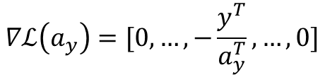


Cross Entropy : backward propagation
$$−\frac{∂ℒ}{∂ℒ}∗log⁡(a_{y}^{1})$$
Cross-entropy
$$y^{1}$$
$$ℒ=−\sum_{J}{y^{j}\log{a_{y}^{j}}}$$
$$−\frac{y^{1}}{a_{y}^{1}}$$
*
$$−δ$$
$$δ$$
$$a_{y}^{1}$$
log
$$−\frac{∂ℒ}{∂ℒ}$$
$$x$$
*-
$$−\frac{∂ℒ}{∂ℒ}∗y^{1}$$
$$−\frac{∂ℒ}{∂ℒ}∗y^{1}∗\frac{1}{a_{y}^{1}}$$
$$x$$
$$δ∗1$$
$$y^{2}$$
$$−\frac{∂ℒ}{∂ℒ}$$
$$−\frac{∂ℒ}{∂ℒ}$$
$$\frac{∂ℒ}{∂ℒ}$$
$$δ$$
*
+
$$−\frac{y^{1}}{a_{y}^{1}}$$
+
*-
$$ℒ$$
$$a_{y}^{2}$$
log
$$y$$
$$δ∗1$$
…
…
$$−\frac{∂ℒ}{∂ℒ}$$
$$x$$
$$δ∗y$$
$$y^{J}$$
$$δ$$
*
*
$$−\frac{y^{J}}{a_{y}^{J}}$$
$$a_{y}^{J}$$
log
$$y$$
$$δ∗x$$
$δ$*$\frac{1}{x}$
$$δ$$
$$∇ℒ\left(a_{y}\right)=[−\frac{y^{1}}{a_{y}^{1}},−\frac{y^{2}}{a_{y}^{2}}, …,−\frac{y^{J}}{a_{y}^{J}}]$$
$$∇ℒ\left(a_{y}\right)=[0,…,−\frac{y^{T}}{a_{y}^{T}}, …,0]$$
$$x$$
log
$$if y is one hot vector$$

Slide 19


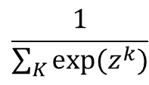


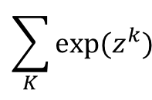






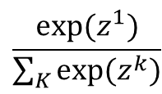
Softmax : forward propagation
$$g(z)=softmax(z)$$
$${g(z}_{j})=\frac{\exp\left(z_{j}\right)}{\sum_{k=1}^{K}{\exp\left(z_{k}\right)}} for j=1…k$$
$$\frac{exp⁡(z^{1})}{\sum_{K}{exp⁡(z^{k})}}$$
$$exp⁡(z^{1})$$
$$z^{1}$$
exp
x
$$a_{y}^{1}$$
$$z^{2}$$
exp
x
$$a_{y}^{2}$$
$$\sum_{K}{exp⁡(z^{k})}$$
$$\frac{1}{\sum_{K}{exp⁡(z^{k})}}$$
…
…
+
$$x^{−1}$$
…
…
$$z^{J}$$
exp
x
$$a_{y}^{J}$$

Slide 20



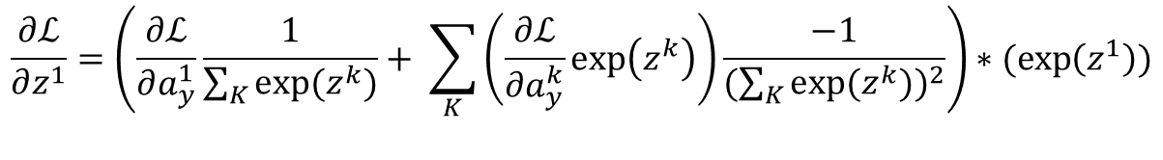
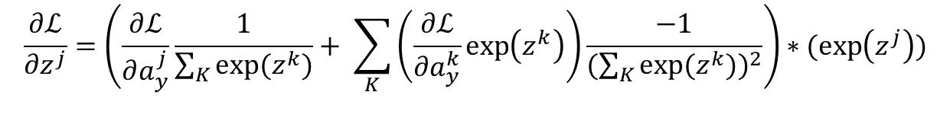






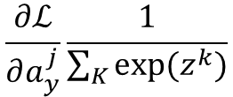




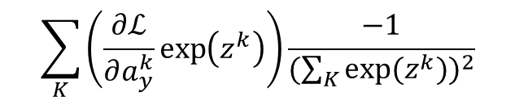








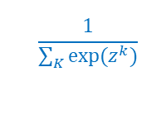
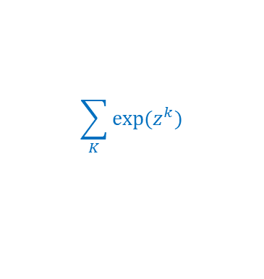



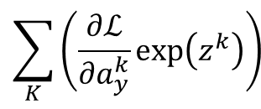





Softmax : back-propagation
$$g(z)=softmax(z)$$
$${g(z}_{j})=\frac{\exp\left(z_{j}\right)}{\sum_{k=1}^{K}{\exp\left(z_{k}\right)}} for j=1…k$$
$$\frac{∂ℒ}{∂a_{y}^{j}}\frac{1}{\sum_{K}{exp⁡(z^{k})}}$$
$$\frac{∂ℒ}{∂a_{y}^{1}}$$
$$exp⁡(z^{1})$$
$$x$$
$$δ∗y$$
$$z^{1}$$
exp
x
$$a_{y}^{1}$$
x
$$δ$$
$$\frac{∂ℒ}{∂a_{y}^{1}}exp⁡(z^{1})$$
$$\frac{1}{\sum_{K}{exp⁡(z^{k})}}$$
$$\frac{∂ℒ}{∂a_{y}^{2}}$$
$$y$$
$$δ∗x$$
$$z^{2}$$
exp
x
$$a_{y}^{2}$$
$$\sum_{N}{δ_{i}}$$
$$δ_{1}$$
$$\sum_{K}{exp⁡(z^{k})}$$
$$\sum_{K}{\left(\frac{∂ℒ}{∂a_{y}^{k}}\exp\left(z^{k}\right)\right)}$$
$$δ_{2}$$
…
…
+
$$x^{−1}$$
…
$$δ_{n}$$
$$\sum_{K}{\left(\frac{∂ℒ}{∂a_{y}^{k}}\exp\left(z^{k}\right)\right)\frac{−1}{{(\sum_{K}{exp⁡(z^{k})})}^{2}}}$$
$$\frac{∂ℒ}{∂a_{y}^{J}}$$
$$z^{J}$$
exp
x
$$a_{y}^{J}$$
$$δ∗\frac{−1}{x^{2}}$$
$$x^{−1}$$
$$δ$$
$$x$$
$$\frac{∂ℒ}{∂z^{1}}=\left(\frac{∂ℒ}{∂a_{y}^{1}}\frac{1}{\sum_{K}{exp⁡(z^{k})}}+ \sum_{K}{\left(\frac{∂ℒ}{∂a_{y}^{k}}\exp\left(z^{k}\right)\right)\frac{−1}{{(\sum_{K}{exp⁡(z^{k})})}^{2}}}\right)∗(\exp\left(z^{1}\right))$$
$$δ∗exp⁡(x)$$
$$δ$$
$$\frac{∂ℒ}{∂z^{j}}=\left(\frac{∂ℒ}{∂a_{y}^{j}}\frac{1}{\sum_{K}{exp⁡(z^{k})}}+ \sum_{K}{\left(\frac{∂ℒ}{∂a_{y}^{k}}\exp\left(z^{k}\right)\right)\frac{−1}{{(\sum_{K}{exp⁡(z^{k})})}^{2}}}\right)∗(\exp\left(z^{j}\right))$$
$$x$$
$$exp$$

Slide 21







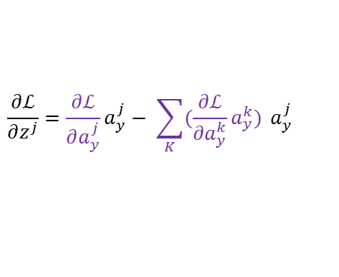



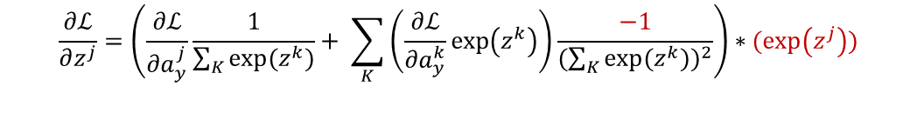





Softmax BackPropagation
$$\frac{∂ℒ}{∂z^{j}}=\left(\frac{∂ℒ}{∂a_{y}^{j}}\frac{1}{\sum_{K}{exp⁡(z^{k})}}+ \sum_{K}{\left(\frac{∂ℒ}{∂a_{y}^{k}}\exp\left(z^{k}\right)\right)\frac{−1}{{(\sum_{K}{exp⁡(z^{k})})}^{2}}}\right)∗(\exp\left(z^{j}\right))$$
$$g(z)=softmax(z)$$
$$\frac{∂ℒ}{∂z^{j}}=\frac{∂ℒ}{∂a_{y}^{j}}\frac{exp⁡(z^{j})}{\sum_{K}{exp⁡(z^{k})}}− \sum_{K}{\left(\frac{∂ℒ}{∂a_{y}^{k}}\exp\left(z^{k}\right)\right)\frac{exp⁡(z^{j})}{{(\sum_{K}{exp⁡(z^{k})})}^{2}}}$$
$${g(z}_{j})=\frac{\exp\left(z_{j}\right)}{\sum_{k=1}^{K}{\exp\left(z_{k}\right)}} for j=1…k$$
$$\frac{∂ℒ}{∂z^{j}}=\frac{∂ℒ}{∂a_{y}^{j}}\frac{exp⁡(z^{j})}{\sum_{K}{exp⁡(z^{k})}}− \sum_{K}{(\frac{∂ℒ}{∂a_{y}^{k}}\frac{exp⁡(z^{k})}{\sum_{K}{exp⁡(z^{k})}})\frac{exp⁡(z^{j})}{\sum_{K}{exp⁡(z^{k})}}}$$
$$a_{y}^{j}=g(z_{y}^{j})$$
$$\frac{∂ℒ}{∂z^{j}}=\frac{∂ℒ}{∂a_{y}^{j}}a_{y}^{j}− \sum_{K}{(\frac{∂ℒ}{∂a_{y}^{k}}a_{y}^{k}) }a_{y}^{j}$$
$$∇ℒ\left(a_{y}\right)=[−\frac{y^{1}}{a_{y}^{1}},−\frac{y^{2}}{a_{y}^{2}}, …,−\frac{y^{J}}{a_{y}^{J}}]$$
$$−\frac{1}{a_{y}^{j}}a_{y}^{j}+\frac{1}{a_{y}^{T}}a_{y}^{T}a_{y}^{j}, if j=T$$
$$∇ℒ\left(a_{y}\right)=[0,…,−\frac{y^{T}}{a_{y}^{T}}, …,0]$$
$$\frac{∂ℒ}{∂z^{j}}=$$
$$if y is one hot vector$$
$$0∗a_{y}^{j}+\frac{1}{a_{y}^{T}}a_{y}^{T}a_{y}^{j}, otherwise.$$
$$\frac{∂ℒ}{∂z^{j}}=$$
$$−y^{T}+a_{y}^{j}, if j=T$$
$$a_{y}^{j}, otherwise.$$
$$∇ℒ\left(z\right)=[a_{y}^{1},…,a_{y}^{T}−y^{T},…,a_{y}^{J}]$$
$$∇ℒ\left(z\right)=a_{y}−y$$

Slide 22
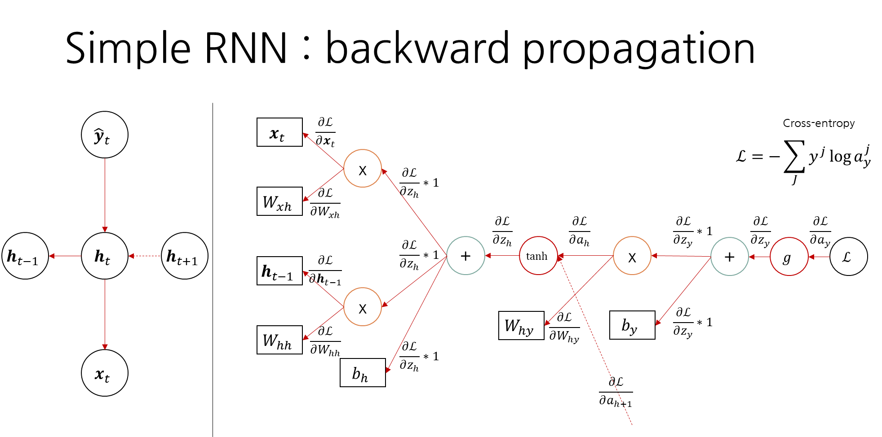

Slide 23














Simple RNN : backward propagation
$${\hat{y}}_{t}$$
$$x_{t}$$
$$dx_{t}$$
Cross-entropy
$$ℒ=−\sum_{J}{y^{j}\log{a_{y}^{j}}}$$
x
$$dz_{h}$$
$$W_{xh}$$
$$dW_{xh}$$
$$dz_{h}$$
$$da_{h}$$
$$dz_{y}$$
$$dz_{y}$$
$$da_{y}$$
$$h_{t−1}$$
$$h_{t}$$
$$h_{t+1}$$
$$dz_{h}$$
+
$$tanh$$
x
+
$$g$$
$$ℒ$$
$$h_{t−1}$$
$${dh}_{t−1}$$
x
$$W_{hy}$$
$$dW_{hy}$$
$$b_{y}$$
$$db_{y}=dz_{y}$$
$$W_{hh}$$
$${dW}_{hh}$$
$$db_{h}=dz_{h}$$
$$x_{t}$$
$$b_{h}$$
$$da_{h+1}$$

Slide 24
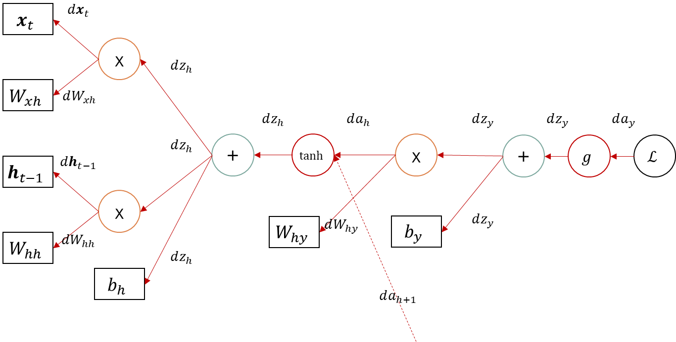








Simple RNN : backward propagation
$$dz_{y}=y−a_{y}$$
$$da_{h}=W_{hy}^{T}dz_{y}$$
$$dW_{hy}=dz_{y}a_{h}^{T}$$
$$dz_{h}=1−{\left(da_{h}\right)}^{2}$$
$$dx_{t}=W_{xh}^{T}dz_{h}$$
$$dW_{xh}=dz_{h}x_{t}^{T}$$
$$dh_{t−1}=W_{hh}^{T}dz_{h}$$
$$dW_{hh}=dz_{h}h_{t−1}^{T}$$

Slide 25













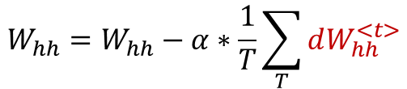




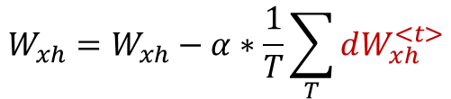
Simple RNN : forward dataflow unroll t=T
$$dW_{xh}^{<1>}$$
$$dW_{hh}^{<1>}$$
$$dW_{hy}^{<1>}$$
$$dW_{xh}^{<2>}$$
$$dW_{hh}^{<2>}$$
$$dW_{hy}^{<2>}$$
$$dW_{xh}^{<3>}$$
T-layer neural network
$$dW_{hh}^{<3>}$$
$$dW_{hy}^{<3>}$$
$$W_{hy}=W_{hy}−α∗\frac{1}{T}\sum_{T}{dW_{hy}^{<t>}}$$
$$dW_{xh}^{<4>}$$
$$dW_{hh}^{<4>}$$
$$dW_{hy}^{<4>}$$
$$W_{xh}=W_{xh}−α∗\frac{1}{T}\sum_{T}{dW_{xh}^{<t>}}$$
$$W_{hh}=W_{hh}−α∗\frac{1}{T}\sum_{T}{dW_{hh}^{<t>}}$$
…
$$dW_{xh}^{<T>}$$
$$α=learning rate$$
$$∗ parameters are updated after the backward is completed$$
$$dW_{hh}^{<T>}$$
$$dW_{hy}^{<T>}$$

Slide 26

Other RNN models
N to 1
$$\hat{y}$$
$$h_{0}$$
$$h_{1}$$
$$h_{2}$$
$$h_{3}$$
…
$$h_{T}$$
$$x_{1}$$
$$x_{2}$$
$$x_{3}$$
$$x_{T}$$

Slide 27
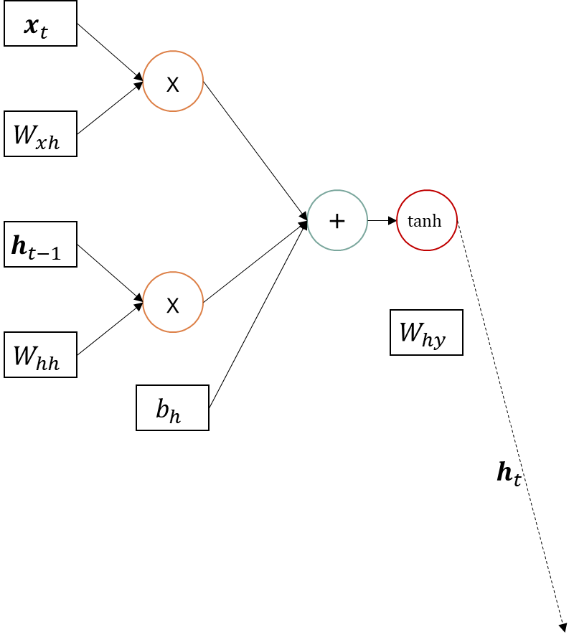
N to 1 RNN : forward dataflow unroll t=T
T-layer neural network
…

Slide 28
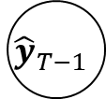
Other RNN models
Not confirmed yet
1 to N
$${\hat{y}}_{1}$$
$${\hat{y}}_{2}$$
$${\hat{y}}_{3}$$
$${\hat{y}}_{T}$$
$$h_{0}$$
$$h_{1}$$
$$h_{2}$$
$$h_{3}$$
…
$$h_{T}$$
$$x_{1}$$
$${\hat{y}}_{1}$$
$${\hat{y}}_{2}$$
$${\hat{y}}_{T−1}$$

Slide 29
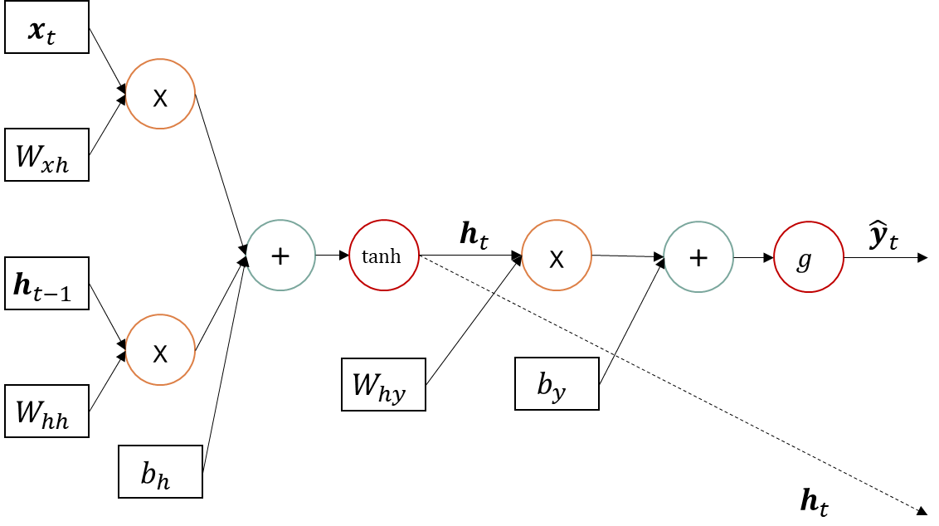

1 to N RNN : forward dataflow unroll t=T
Not confirmed yet
T-layer neural network
…

Slide 30

Other RNN models
Not confirmed yet
1 to N (alt.)
$${\hat{y}}_{1}$$
$${\hat{y}}_{1}$$
$${\hat{y}}_{2}$$
$${\hat{y}}_{3}$$
$${\hat{y}}_{T}$$
$$h_{0}$$
$$h_{1}$$
$$h_{2}$$
$$h_{3}$$
…
$$h_{T}$$
$$c$$
$$c=concept vector which represents sequences$$

Slide 31







RNN Encoder-Decoder
$$maximize :\max_{θ}{\frac{1}{N}\sum_{n=1}^{N}{logpθ\left(y_{n} \right|x_{n})}}$$
$$h_{<t>}^{Dec}=f(h_{<t−1>}^{Dec},y_{t−1}, c)$$
1 to N
$$c= h_{<t+1>}^{Enc}$$
N to 1
$$h_{<t>}^{Enc}=f(h_{<t−1>}^{Enc}, x_{t})$$
$$f∈\{φ, LSTM, GRU, …\}$$
$\left|x\right|$와 $|y|는$ 서로 다를 수 있다.
Cho, K. et al., 2014. Learning phrase representations using RNN encoder-decoder for statistical machine translation. arXiv preprint arXiv:1406.1078.

Slide 32

time step의 set of weight는 shared된다.
RNN의 약점은 sequence의 이전 데이터가 이후 데이터에 영향을 주지만, 이후 데이터가 이전 데이터에 영향을 주지는 못한다. y3를 예측할 때 x1,x2,x3는 영향을 주지만, x4,x5는 영향을 주지 못한다
이를 해결하고자 하는 시도가 BRNN(bi-directional RNN)
https://www.coursera.org/learn/nlp-sequence-models/lecture/ftkzt/recurrent-neural-network-model

Slide 33

BRNN + LSTM 이 일반적인 조합
단점 : 전체 sequence가 필요
https://www.coursera.org/learn/nlp-sequence-models/lecture/fyXnn/bidirectional-rnn

Slide 34

deep RNN with Stacked LSTM layers
LSTM layer
LSTM layer
Skip-connections
LSTM layer
Graves, A., 2013. Generating sequences with recurrent neural networks. arXiv preprint arXiv:1308.0850.

Slide 35












Long Short-Term Memory (LSTM)
Gate Variables
$$i_{t}^{j}=σ{\left(W_{i}x_{t}+U_{i}h_{t−1}+b_{i}\right)}^{j}$$
$$c_{t−1}$$
c
$$c_{t}$$
$$f_{t}^{j}=σ{\left(W_{f}x_{t}+U_{f}h_{t−1}+b_{f}\right)}^{j}$$
~
$$o_{t}^{j}=σ{\left(W_{f}x_{t}+U_{f}h_{t−1}+b_{f}\right)}^{j}$$
f
i
c
o
$$h_{t−1}$$
$$h_{t}$$
new Memory Cell
$${\tilde{c}}_{t}^{j}=tanh{\left(W_{c}x_{t}+U_{c}h_{t−1}+b_{c}\right)}^{j}$$
Update Memory Cell
$$c_{t}^{j}=f_{t}^{j}c_{t−1}^{j}+i_{t}^{j}{\tilde{c}}_{t}^{j}$$
Update Hidden State
$$h_{t}^{j}=o_{t}^{j}tanh⁡(c_{t}^{j})$$
http://colah.github.io/posts/2015-08-Understanding-LSTMs/
Chung, J. et al., 2014. Empirical evaluation of gated recurrent neural networks on sequence modeling. arXiv preprint arXiv:1412.3555.

Slide 36






Gated Recurrent Unit (GRU)
Gate Variables
$$r_{t}^{j}=σ{\left(W_{r}x_{t}+U_{r}h_{t−1}+b_{r}\right)}^{j}$$
$$z_{t}^{j}=σ{\left(W_{z}x_{t}+U_{z}h_{t−1}+b_{z}\right)}^{j}$$
new Hidden State
$${\tilde{h}}_{t}^{j}=tanh{\left(W_{h}x_{t}+U_{h}(r_{t}⊙h_{t−1})+b_{h}\right)}^{j}$$
Update Hidden State
$h_{t}^{j}={(1−z}_{t}^{j})h_{t−1}^{j}$+$z_{t}^{j}h_{t}^{j}$
https://www.kaggle.com/thebrownviking20/intro-to-recurrent-neural-networks-lstm-gru
Chung, J. et al., 2014. Empirical evaluation of gated recurrent neural networks on sequence modeling. arXiv preprint arXiv:1412.3555.

