Slide 1
11-4processing.pde
import processing.serial.*;
Serial port;
PImage img;
void setup() {
println(Serial.list());
port = new Serial(this, Serial.list()[2], 9600);
size(800,600);
img = loadImage("color.png");
image(img,0,0,width,height);
}
void draw() {
color sample = get(mouseX,mouseY);
int R = int(red(sample));
int G = int(green(sample));
int B = int(blue(sample));
port.write(R + " " + G + " " + B + "\n");
print(R);print(" ");print(G);print(" ");print(B);print(" ");
println();
delay(20);
}

Slide 2
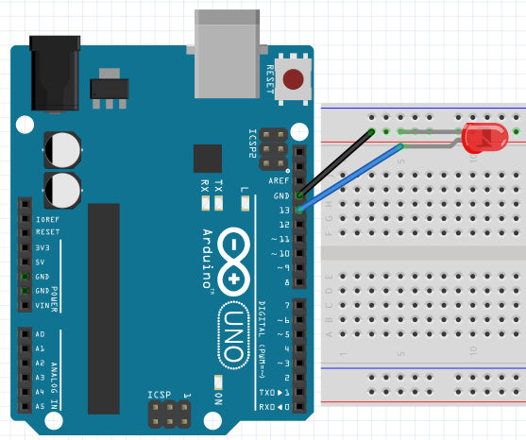
02-1-2.ino
void setup() {
pinMode(13, OUTPUT);
}
void loop() {
digitalWrite(13, HIGH);
delay(1000);
digitalWrite(13, LOW);
delay(1000);
}

Slide 3
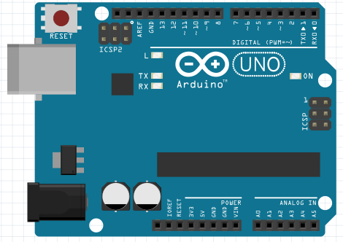
04-1.ino
void setup() {
Serial.begin(9600);
}
void loop() {
Serial.println("Hello World");
}

Slide 4
04-2.ino
void setup() {
Serial.begin(9600);
}
void loop() {
if(Serial.available() > 0) {
int incomingByte = Serial.read();
Serial.print("I received: ");
Serial.println(incomingByte, DEC);
}
}

Slide 5
04-3.ino
void setup() {
Serial.begin(9600);
}
void loop(){
const uint8_t temp[5] = {'1', '2', '3', '4', '5'};
Serial.write(1); // write()함수로 1 전송
delay(500);
Serial.write(49); // write()함수로 49 전송
delay(500);
Serial.print(1); // print()함수로 1 전송
delay(500);
Serial.write('a'); // write()함수로 'a' 전송
delay(500);
Serial.write(temp, 5); // write()함수로 temp배열을 5만큼 전송
delay(500);
Serial.write("12345"); // write()함수로 string값 전송
delay(500);
Serial.write('\n'); // 줄바꿈
delay(500);
}

Slide 6
04-4.ino
void setup(){
Serial.begin(9600);
}
void loop(){
if(Serial.available()){
long value1 = Serial.parseInt();
long value2 = Serial.parseInt();
Serial.print("value 1 : ");
Serial.println(value1);
Serial.print("value 2 : ");
Serial.println(value2);
Serial.print("value1 + value2 = ");
Serial.println(value1 + value2);
}
}

Slide 7
04-5.ino
void setup(){
Serial.begin(9600);
}
void loop(){
if(Serial.available()){
float value1 = Serial.parseFloat();
float value2 = Serial.parseFloat();
Serial.print("value 1 : ");
Serial.println(value1);
Serial.print("value 2 : ");
Serial.println(value2);
Serial.print("value1 + value2 = ");
Serial.println(value1 + value2);
}
}

Slide 8
04-6.ino
void setup(){
Serial.begin(9600);
}
void loop(){
char temp[100];
if(Serial.available()){
byte leng = Serial.readBytes(temp, 20);
Serial.print("Input data Lenght : ");
Serial.println(leng);
for(int i = 0; i <leng; i++){
Serial.print(temp[i]);
}
Serial.println();
}
}

Slide 9
04-7.ino
void setup(){
Serial.begin(9600);
}
void loop(){
char temp[100];
if(Serial.available()){
byte leng = Serial.readBytesUntil('k', temp, 20);
Serial.print("Input data Lenght : ");
Serial.println(leng);
for(int i = 0; i <leng; i++){
Serial.print(temp[i]);
}
Serial.println();
}
}

Slide 10
04-8.ino
void setup(){
Serial.begin(9600);
}
long temp = 0;
void loop(){
while(Serial.available()){
if(Serial.find("f")){
temp = Serial.parseInt();
} else {
temp = 0;
}
Serial.print("Temp Value = ");
Serial.println(temp);
}
}

Slide 11
04-9.ino
void setup(){
Serial.begin(9600);
}
void loop(){
while(Serial.available()){
Serial.println(Serial.findUntil("f", "T"));
}
}

Slide 12
04-11.ino
//Serial.peek() 함수 사용
void setup(){
Serial.begin(9600);
}
void loop(){
if(Serial.available()){
Serial.println(Serial.peek());
}
}
//Serial.read() 함수 사용
void setup(){
Serial.begin(9600);
}
void loop(){
if(Serial.available()){
Serial.println(Serial.read());
}
}

Slide 13
04-12.ino
void setup(){
Serial.begin(9600);
}
void loop(){
}
void serialEvent(){
char text = Serial.read();
Serial.print("data : ");
Serial.println(text);
}

Slide 14
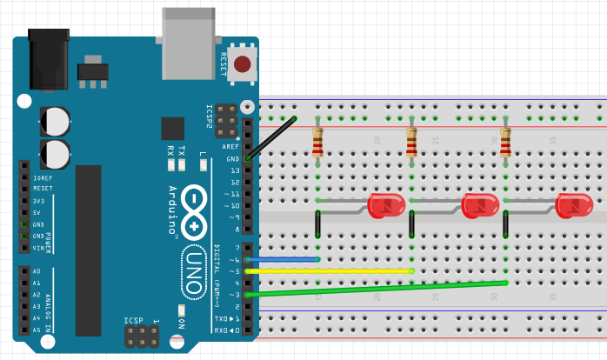
05-1.ino
int LED1 = 6;
int LED2 = 5;
int LED3 = 3;
void setup() {
pinMode(LED1, OUTPUT);
pinMode(LED2, OUTPUT);
pinMode(LED3, OUTPUT);
}
void loop() {
digitalWrite(LED1, HIGH);delay(1000);
digitalWrite(LED1, LOW); delay(1000);
digitalWrite(LED2, HIGH);delay(1000);
digitalWrite(LED2, LOW); delay(1000);
digitalWrite(LED3, HIGH);delay(1000);
digitalWrite(LED3, LOW); delay(1000);
}

Slide 15
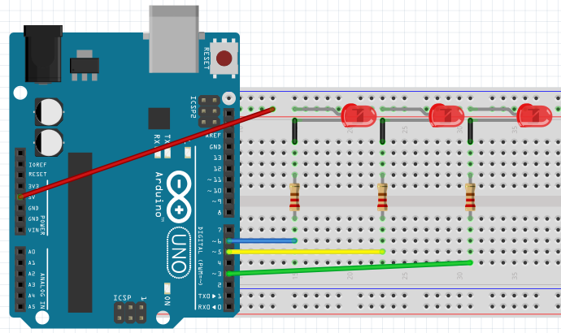
05-2.ino
int LED1 = 6;
int LED2 = 5;
int LED3 = 3;
void setup() {
pinMode(LED1, OUTPUT);
pinMode(LED2, OUTPUT);
pinMode(LED3, OUTPUT);
}
void loop() {
digitalWrite(LED1,LOW); //ON
digitalWrite(LED2,HIGH); //OFF
digitalWrite(LED3,HIGH);delay(1000); //OFF
digitalWrite(LED1,HIGH); //OFF
digitalWrite(LED2,LOW); //ON
digitalWrite(LED3,HIGH);delay(1000); //OFF
digitalWrite(LED1,HIGH); //OFF
digitalWrite(LED2,HIGH); //OFF
digitalWrite(LED3,LOW); delay(1000); //ON
}

Slide 16
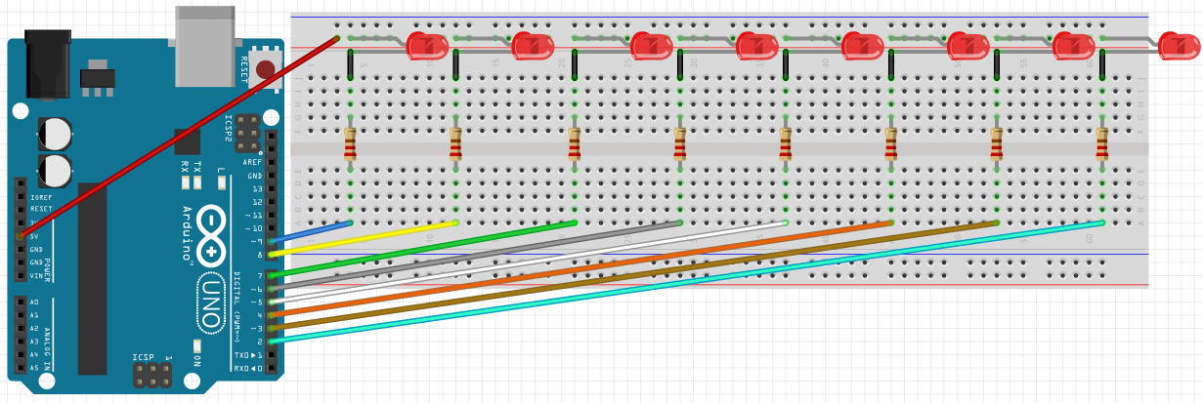
05-3.ino
int pin[] = {2,3,4,5,6,7,8,9};
int pinSize = sizeof(pin) / sizeof(pin[0]);
int wait = 30;
void setup() {
for(int led=0;led<pinSize;led++) {
pinMode(pin[led],OUTPUT);
}
}
void loop() {
//LED를 왼쪽에서 오른쪽으로 이동 동작
for(int led=0;led<pinSize-1;led++) {
digitalWrite(pin[led],HIGH); delay(wait);
digitalWrite(pin[led+1],HIGH); delay(wait);
digitalWrite(pin[led],LOW); delay(wait*2);
}
//LED를 오른쪽에서 왼쪽으로 이동 동작
for(int led=pinSize-1;led>0;led--) {
digitalWrite(pin[led],HIGH); delay(wait);
digitalWrite(pin[led-1],HIGH); delay(wait);
digitalWrite(pin[led],LOW); delay(wait*2);
}
}

Slide 17
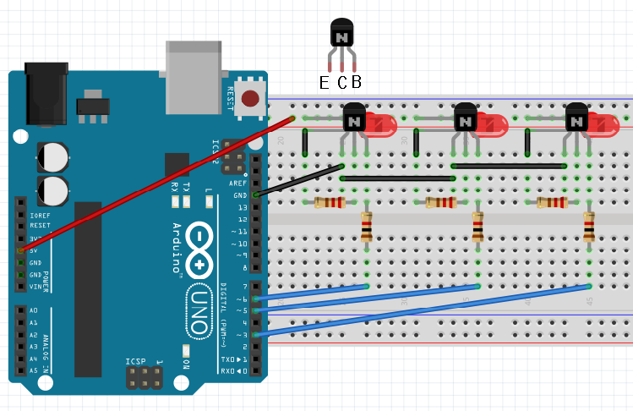
05-4.ino
int LED1 = 6;
int LED2 = 5;
int LED3 = 3;
void setup() {
pinMode(LED1, OUTPUT);
pinMode(LED2, OUTPUT);
pinMode(LED3, OUTPUT);
}
void loop() {
digitalWrite(LED1,HIGH); //ON
digitalWrite(LED2,LOW); //OFF
digitalWrite(LED3,LOW);delay(1000); //OFF
digitalWrite(LED1,LOW); //OFF
digitalWrite(LED2,HIGH); //ON
digitalWrite(LED3,LOW);delay(1000); //OFF
digitalWrite(LED1,LOW); //OFF
digitalWrite(LED2,LOW); //OFF
digitalWrite(LED3,HIGH);delay(1000);//ON
}

Slide 18
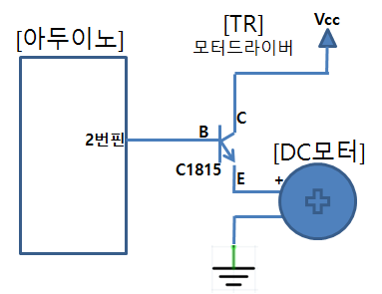
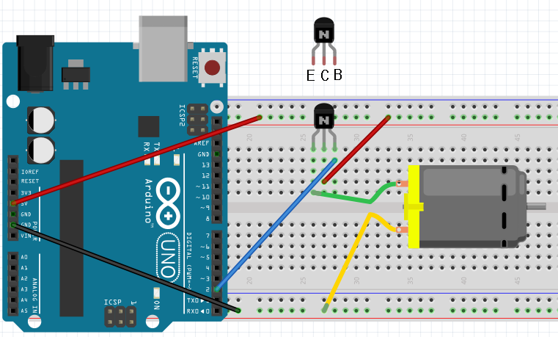
05-5.ino
int motor = 2;
void setup() {
pinMode(motor, OUTPUT);
}
void loop() {
digitalWrite(motor, HIGH); // 정회전
delay(1000); // 1초 유지
digitalWrite(motor, LOW); // 정지
delay(1000); // 1초 유지
}

Slide 19

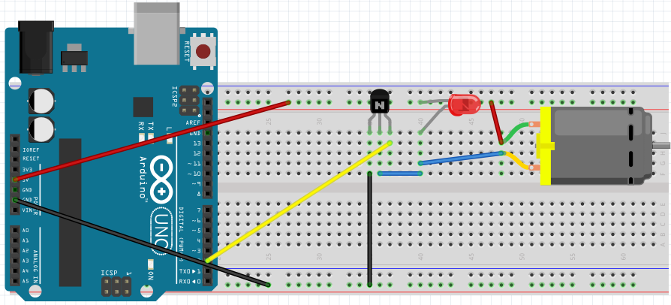
05-5.ino(다른회로)
[TR]
모터드라이버
int motor = 2;
void setup() {
pinMode(motor, OUTPUT);
}
void loop() {
digitalWrite(motor, HIGH); // 정회전
delay(1000); // 1초 유지
digitalWrite(motor, LOW); // 정지
delay(1000); // 1초 유지
}
Vcc
[아두이노]
[DC모터]
LED1
+
+
B
C
2번핀
C1815
E

Slide 20
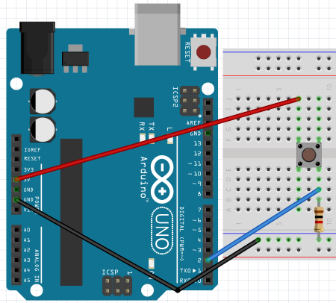
06-1.ino
int LED_output = 13;
int SW_input = 2;
void setup() {
pinMode(LED_output, OUTPUT);
pinMode(SW_input, INPUT);
}
void loop() {
int PUL_D_val = digitalRead(SW_input);
if(PUL_D_val == HIGH) { //SW-ON
digitalWrite(LED_output,HIGH);
}
else { //SW-OFF
digitalWrite(LED_output,LOW);
}
}

Slide 21
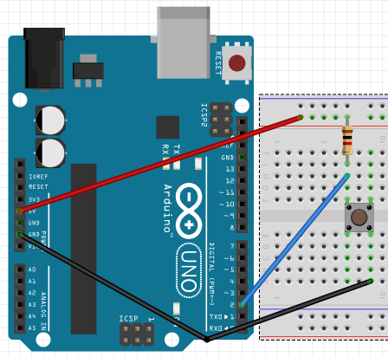
06-2.ino
int LED_output = 13;
int SW_input = 2;
void setup() {
pinMode(LED_output, OUTPUT);
pinMode(SW_input, INPUT);
}
void loop() {
int PUL_U_val = digitalRead(SW_input);
if(PUL_U_val == LOW) { //SW-ON
digitalWrite(LED_output,LOW);
}
else { //SW-OFF
digitalWrite(LED_output,HIGH);
}
}

Slide 22
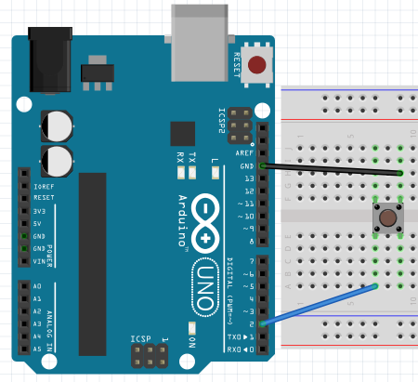
06-3.ino
int LED_output = 13;
int SW_input = 2;
void setup() {
pinMode(LED_output, OUTPUT);
pinMode(SW_input, INPUT_PULLUP);
}
void loop() {
int val = digitalRead(SW_input);
if(val == LOW) { //SW-ON
digitalWrite(LED_output,LOW);
}
else { //SW-OFF
digitalWrite(LED_output,HIGH);
}
}

Slide 23
06-4.ino
int switchPin = 2;
long startTime;
long duration;
void setup()
{
pinMode(switchPin, INPUT_PULLUP);
Serial.begin(9600);
}
void loop()
{
if(digitalRead(switchPin) == LOW)
{
startTime = millis();
while(digitalRead(switchPin) == LOW) ;
long duration = millis() - startTime;
Serial.println(duration);
}
}

Slide 24
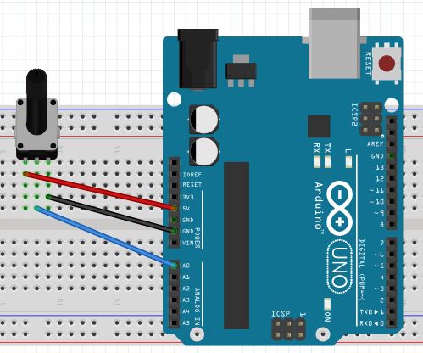
07-1.ino
int LED = 13;
int POT = A0;
int val_time = 0;
void setup() {
pinMode(LED, OUTPUT);
}
void loop() {
val_time = analogRead(POT);
digitalWrite(LED, HIGH);delay(val_time);
digitalWrite(LED, LOW);delay(val_time);
}

Slide 25
07-2.ino
int LED = 13;
int POT = A0;
void setup() {
pinMode(LED, OUTPUT);
Serial.begin(9600);
}
void loop() {
int val, percent;
val = analogRead(POT);
percent = map(val, 0, 1023, 0, 100);
digitalWrite(LED, HIGH); delay(percent);
digitalWrite(LED, LOW); delay(100-percent);
Serial.println(percent);
}

Slide 26
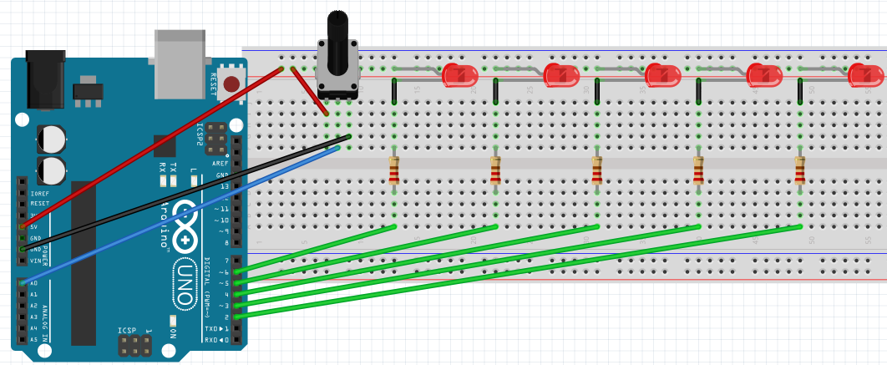
07-3.ino
int pin[] = {2,3,4,5,6,7,8,9};
int pinSize = sizeof(pin) / sizeof(pin[0]);
int POT = A0;
boolean LED_ON = LOW;
boolean LED_OFF = HIGH;
int sensor_val = 0;
int led_level = 0;
void setup() {
for(int led=0;led<pinSize;led++) {
pinMode(pin[led],OUTPUT);
}
}
void loop() {
sensor_val = analogRead(POT);
led_level = map(sensor_val, 0, 1023, 0, pinSize);
for(int led=0;led<pinSize;led++) {
if(led<led_level) {
digitalWrite(pin[led],LED_ON);
}
else {
digirite(pin[led],LED_OFF);
}
}
}

Slide 27
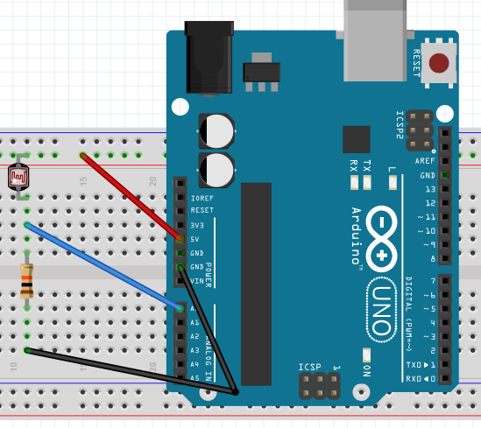
07-4.ino
int sensorMin = 0; //실험치
int sensorMax = 600; //실험치
int CDS = A0;
void setup() {
Serial.begin(9600);
}
void loop() {
int sensor_val = analogRead(CDS);
int range = map(sensor_val, sensorMin, sensorMax, 0, 3);
switch(range) {
case 0:
Serial.println("dark"); break;
case 1:
Serial.println("dim"); break;
case 2:
Serial.println("medium"); break;
case 3:
Serial.println("bright"); break;
}
delay(1); //입력 안정화를 위한 지연시간
}

Slide 28
08-1.ino
int LED1 = 6;
int LED2 = 5;
int LED3 = 3;
int brightness = 0;
int increment = 1;
void setup() {
}
void loop() {
if(brightness > 255)
increment = -1;
else if(brightness < 1)
increment = 1;
brightness = brightness + increment;
analogWrite(LED1, brightness);
analogWrite(LED2, brightness);
analogWrite(LED3, brightness);
delay(10);
}

Slide 29
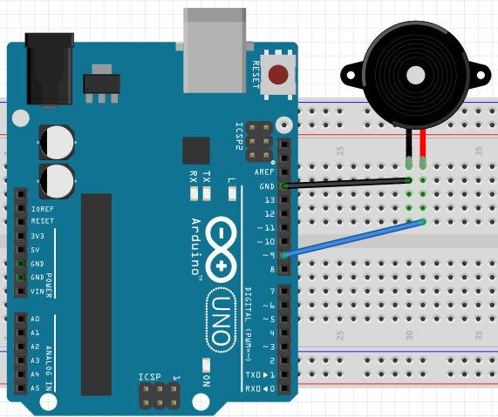
08-2-1.ino
// analogWrite() 함수 이용
int piezo = 9;
int del = 1000;
void setup() {
}
void loop()
{
analogWrite(piezo, 64); // PWM 25% 적용
delay(del); // 1초 대기
analogWrite(piezo, 128); // PWM 50% 적용
delay(del); // 1초 대기
analogWrite(piezo, 255); // PWM 100% 적용
delay(del); // 1초 대기
}

Slide 30
08-2-2.ino
// tone() 함수 이용
#define PI 3.141592
#define piezoPin 9
float sinVal;
int toneVal;
void setup()
{
pinMode(piezoPin, OUTPUT);
}
void loop()
{
for(int i=0;i<180;i++)
{
sinVal=sin(i*PI/180);
toneVal=(int)(1000*sinVal);
tone(piezoPin,toneVal);
delay(10);
}
}

Slide 31
08-2-3.ino
#include "pitches.h"
int melody[] = {
NOTE_G4, NOTE_G4, NOTE_A4, NOTE_A4, NOTE_G4, NOTE_G4, NOTE_E4,
NOTE_G4, NOTE_G4, NOTE_E4, NOTE_E4, NOTE_D4, 0,
};
int noteDurations[] = {
4, 4, 4, 4, 4, 4, 2,
4, 4, 4, 4, 2, 2,
};
void setup() {
for (int thisNote = 0; thisNote < sizeof(noteDurations)/sizeof(int); thisNote++) {
int noteDuration = 1000/noteDurations[thisNote];
tone(8, melody[thisNote],noteDuration);
int pauseBetweenNotes = noteDuration * 1.30;
delay(pauseBetweenNotes);
noTone(8);
}
}
void loop() {
}

Slide 32
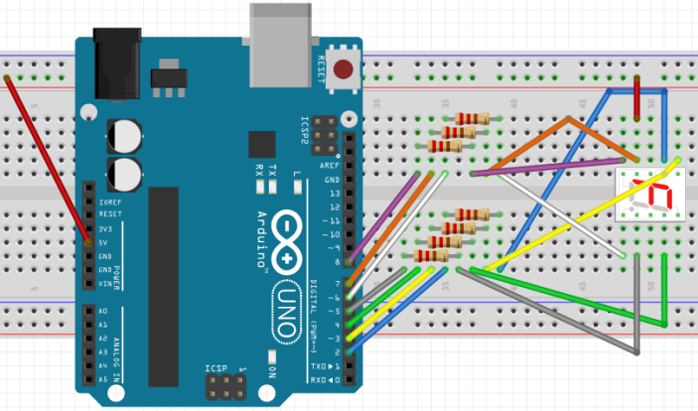

// direct FND
int pin[] = { 2, 3, 4, 5, 6, 7, 8 }; //A[0] B[1] C[2] D[3] E[4] F[5] G[6]
int pinSize = sizeof(pin) / sizeof(int);
int delaytimeTag = 200;
void setup() {
for(int i=0; i < pinSize; i++) {
pinMode(pin[i],OUTPUT);
digitalWrite(pin[i],HIGH);
}
}
void loop() {
digitalWrite(pin[0],LOW);digitalWrite(pin[1],LOW);digitalWrite(pin[2],LOW);
digitalWrite(pin[3],LOW);digitalWrite(pin[4],LOW);digitalWrite(pin[5],LOW);
digitalWrite(pin[6],HIGH);delay(delaytimeTag); // 0 ⇒ HIGH:G(6)
digitalWrite(pin[0],HIGH);digitalWrite(pin[1],LOW);digitalWrite(pin[2],LOW);
digitalWrite(pin[3],HIGH);digitalWrite(pin[4],HIGH);digitalWrite(pin[5],HIGH);
digitalWrite(pin[6],HIGH);delay(delaytimeTag); // 1 ⇒ HIGH:A(0),D(3),E(4),F(5),G(6)
digitalWrite(pin[0],LOW);digitalWrite(pin[1],LOW);digitalWrite(pin[2],HIGH);
digitalWrite(pin[3],LOW);digitalWrite(pin[4],LOW);digitalWrite(pin[5],HIGH);
digitalWrite(pin[6],LOW);delay(delaytimeTag); // 2 ⇒ HIGH:C(2),F(5)
digitalWrite(pin[0],LOW);digitalWrite(pin[1],LOW);digitalWrite(pin[2],LOW);
digitalWrite(pin[3],LOW);digitalWrite(pin[4],HIGH);digitalWrite(pin[5],HIGH);
digitalWrite(pin[6],LOW);delay(delaytimeTag); // 3 ⇒ HIGH:E(4),F(5)
digitalWrite(pin[0],HIGH);digitalWrite(pin[1],LOW);digitalWrite(pin[2],LOW);
digitalWrite(pin[3],HIGH);digitalWrite(pin[4],HIGH);digitalWrite(pin[5],LOW);
digitalWrite(pin[6],LOW);delay(delaytimeTag); // 4 ⇒ HIGH:A(0),D(3),E(4)
digitalWrite(pin[0],LOW);digitalWrite(pin[1],HIGH);digitalWrite(pin[2],LOW);
digitalWrite(pin[3],LOW);digitalWrite(pin[4],HIGH);digitalWrite(pin[5],LOW);
digitalWrite(pin[6],LOW);delay(delaytimeTag); // 5 ⇒ HIGH:B(1),E(4)
digitalWrite(pin[0],HIGH);digitalWrite(pin[1],HIGH);digitalWrite(pin[2],LOW);
digitalWrite(pin[3],LOW);digitalWrite(pin[4],LOW);digitalWrite(pin[5],LOW);
digitalWrite(pin[6],LOW);delay(delaytimeTag); // 6 ⇒ HIGH:A(0),B(1)
digitalWrite(pin[0],LOW);digitalWrite(pin[1],LOW);digitalWrite(pin[2],LOW);
digitalWrite(pin[3],HIGH);digitalWrite(pin[4],HIGH);digitalWrite(pin[5],LOW);
digitalWrite(pin[6],HIGH);delay(delaytimeTag); // 7 ⇒ HIGH:D(3),E(4),G(6)
digitalWrite(pin[0],LOW);digitalWrite(pin[1],LOW);digitalWrite(pin[2],LOW);
digitalWrite(pin[3],LOW);digitalWrite(pin[4],LOW);digitalWrite(pin[5],LOW);
digitalWrite(pin[6],LOW);delay(delaytimeTag); // 8 ⇒ HIGH: ․
digitalWrite(pin[0],LOW);digitalWrite(pin[1],LOW);digitalWrite(pin[2],LOW);
digitalWrite(pin[3],HIGH);digitalWrite(pin[4],HIGH);digitalWrite(pin[5],LOW);
digitalWrite(pin[6],LOW);delay(delaytimeTag); // 9 ⇒ HIGH:D(3),E(4)
}
09-1.ino

Slide 33
09-1.ino

Slide 34
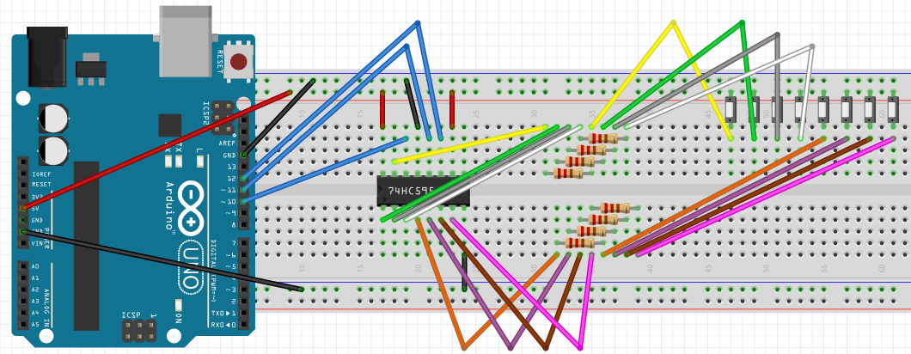
09-2.ino
//00000000 ~ 11111111 repeat
int dataPin = 10;
int latchPin = 11;
int clockPin = 12;
void setup() {
pinMode(latchPin, OUTPUT);
pinMode(clockPin, OUTPUT);
pinMode(dataPin, OUTPUT);
}
void loop() {
for (int num = 0; num < 256; num++) {
digitalWrite(latchPin, LOW);
shiftOut(dataPin, clockPin, MSBFIRST, num);
digitalWrite(latchPin, HIGH);
delay(1000);
}
}

Slide 35
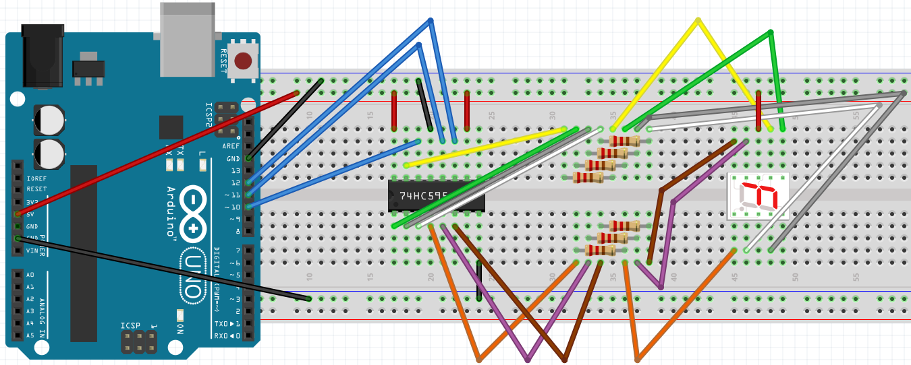
09-3-1.ino
// 74HC595를 이용한 FND : 0 ~ 9 반복
int dataPin = 10;
int latchPin = 11;
int clockPin = 12;
byte dec_digits[] = {0b0111111, 0b0000110, 0b1011011, 0b1001111, 0b1100110,
0b1101101, 0b1111100, 0b0000111, 0b1111111, 0b1100111};
void setup() {
pinMode(latchPin, OUTPUT);
pinMode(clockPin, OUTPUT);
pinMode(dataPin, OUTPUT);
}
void loop() {
for (int numberToDisplay = 0; numberToDisplay < 10; numberToDisplay++) {
digitalWrite(latchPin, LOW);
shiftOut(dataPin, clockPin, MSBFIRST, ~dec_digits[numberToDisplay]);
digitalWrite(latchPin, HIGH);
delay(300);
}
}

Slide 36
09-3-2.ino
// 74HC595와 시리얼 입력을 통한 FND 출력
// 0->63, 1->6, 2->91, 3->79, 4->102,
// 5->109, 6->124, 7->7, 8->127, 9->103
int dataPin = 10;
int latchPin = 11;
int clockPin = 12;
int val;
void setup() {
pinMode(latchPin, OUTPUT);
pinMode(clockPin, OUTPUT);
pinMode(dataPin, OUTPUT);
Serial.begin(9600);
}
void loop() {
while(Serial.available()) {
val = Serial.parseInt();
Serial.println(val, BIN);
digitalWrite(latchPin, LOW);
shiftOut(dataPin, clockPin, MSBFIRST, ~val);
digitalWrite(latchPin, HIGH);
delay(1000);
}
}

Slide 37
11-1.ino
boolean SW = HIGH;
void setup() {
pinMode(2, INPUT_PULLUP);
Serial.begin(9600);
}
void loop() {
SW = digitalRead(2);
if(SW == LOW) {
Serial.write(1);
}
else {
Serial.write(0);
}
delay(100);
}

Slide 38
11-1processing.pde
import processing.serial.*;
Serial myPort;
int val;
void setup()
{
size(200, 200);
println(Serial.list());
myPort = new Serial(this, Serial.list()[2], 9600);
}
void draw()
{
if ( myPort.available() > 0) {
val = myPort.read();
}
background(255);
if (val == 0) {
fill(0);
}
else {
fill(255,0,0);
}
rect(50, 50, 100, 100);
}

Slide 39
11-2.ino
void setup() {
Serial.begin(9600);
}
void loop() {
int val = analogRead(A0);
val = map(val, 0,1023, 0, 255);
Serial.write(val);
delay(100);
}

Slide 40
11-2processing가.pde
import processing.serial.*;
Serial myPort;
int val;
void setup()
{
size(200, 200);
println(Serial.list());
myPort = new Serial(this, Serial.list()[2], 9600);
}
void draw()
{
if ( myPort.available() > 0) {
val = myPort.read();
}
background(255);
fill(val);
rect(50, 50, 100, 100);
}

Slide 41
11-2processing나.pde
import processing.serial.*;
Serial myPort;
int data1;
PImage img;
int cellsize = 2;
int columns, rows;
void setup() {
size(840, 600, P3D);
img = loadImage("food.jpg");
columns = img.width / cellsize;
rows = img.height / cellsize;
println(Serial.list());
myPort = new Serial(this, Serial.list()[2], 9600);
}
void draw() {
background(0);
while (myPort.available () > 0)
{
data1 = myPort.read();
}
for ( int i = 0; i < columns; i++) {
for ( int j = 0; j < rows; j++) {
int x = i*cellsize + cellsize/2;
int y = j*cellsize + cellsize/2;
int loc = x + y*img.width;
color c = img.pixels[loc];
float z = (data1*50 / float(width)) * brightness(img.pixels[loc])
- 20.0;
pushMatrix();
translate(x + 20, y + 20, z);
fill(c, 204);
noStroke();
rectMode(CENTER);
rect(0, 0, cellsize, cellsize);
popMatrix();
}
}
}

Slide 42
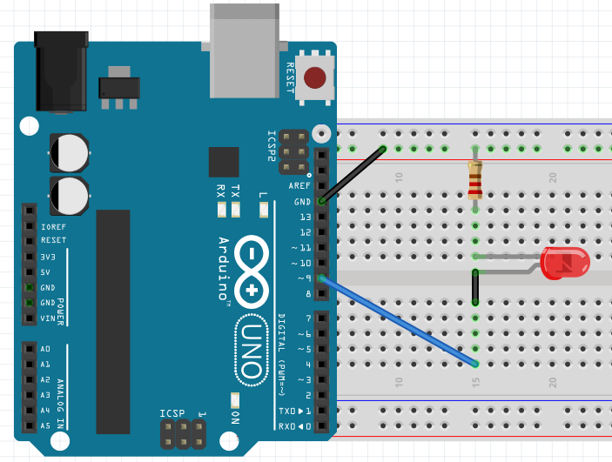
11-3-1.ino
char val = 'H';
int led = 9;
void setup() {
Serial.begin(9600);
pinMode(led, OUTPUT);
}
void loop() {
if(Serial.available()>0){
val = Serial.read();
if(val == 'H'){
digitalWrite(led, HIGH);
} else {
digitalWrite(led, LOW);
}
}
}

Slide 43
11-3-1processing가.pde
import processing.serial.*;
Serial port;
void setup(){
port = new Serial(this, Serial.list()[2]);
}
void draw(){
port.write('H');
delay(1000);
port.write('L');
delay(1000);
}

Slide 44
11-3-1processing나.pde
import processing.serial.*;
Serial port;
void setup() {
size(200, 200);
noStroke();
frameRate(10);
port = new Serial(this, Serial.list()[2], 9600);
}
void draw() {
background(255);
if (mouseOverRect() == true) {
fill(255,0,0);
port.write('H');
} else {
fill(0);
port.write('L');
}
rect(50, 50, 100, 100);
}
boolean mouseOverRect() {
return ((mouseX >= 50) && (mouseX <= 150) && (mouseY >= 50) && (mouseY <= 150));
}

Slide 45
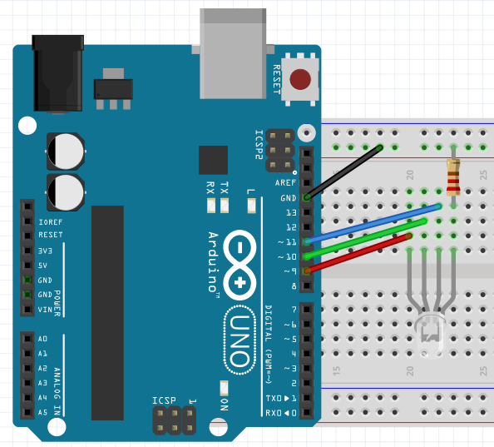
11-3-2.ino
int light = 0;
int pwmled = 9;
void setup() {
Serial.begin(9600);
}
void loop() {
if(Serial.available() > 0){
light = Serial.read();
analogWrite(pwmled, light);
}
}

Slide 46
11-3-2processing가.pde
import processing.serial.*;
Serial port;
void setup() {
size(250, 200);
println(Serial.list());
port = new Serial(this, Serial.list()[2], 9600);
}
void draw() {
background(0, 0, 255);
textSize(50);
text(mouseX, width/4, height*2/3);
port.write(mouseX);
println(mouseX);
}

Slide 47
11-3-2processing나.pde
import processing.serial.*;
import controlP5.*;
Serial port;
ControlP5 cp5;
int sliderValue = 100;
void setup() {
size(600,200);
println(Serial.list());
port = new Serial(this, Serial.list()[2], 9600);
cp5 = new ControlP5(this);
cp5.addSlider("sliderValue")
.setPosition(100,50)
.setRange(0,255)
.setSize(400,40)
;
}
void draw() {
background(0);
port.write(sliderValue);
fill(sliderValue);
rect(0,0,width,200);
}

Slide 48
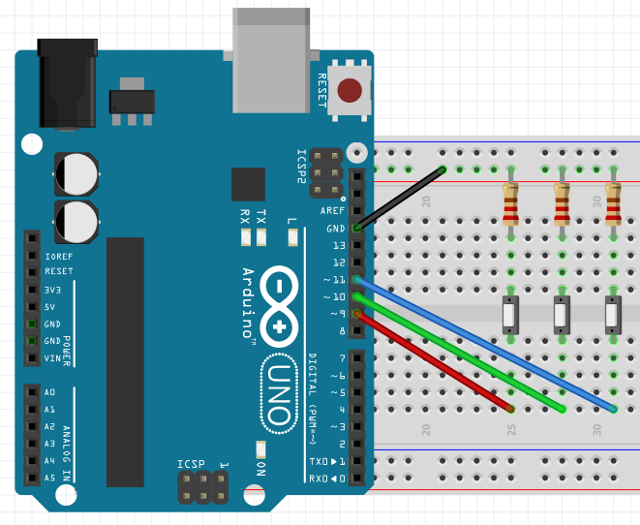
11-4.ino
int R = 11;
int G = 10;
int B = 9;
void setup() {
Serial.begin(9600);
}
void loop() {
while (Serial.available()) {
int red = Serial.parseInt();
int green = Serial.parseInt();
int blue = Serial.parseInt();
if (Serial.read() == '\n') {
analogWrite(R,red);
analogWrite(G,green);
analogWrite(B,blue);
}
}
}

Slide 49
11-4processing.pde
import processing.serial.*;
Serial port;
PImage img;
void setup() {
println(Serial.list());
port = new Serial(this, Serial.list()[2], 9600);
size(800,600);
img = loadImage("color.png");
image(img,0,0,width,height);
}
void draw() {
color sample = get(mouseX,mouseY);
int R = int(red(sample));
int G = int(green(sample));
int B = int(blue(sample));
port.write(R + " " + G + " " + B + "\n");
print(R);print(" ");print(G);print(" ");print(B);print(" ");
println();
delay(20);
}

Slide 50
[사용전자부품 리스트]
[관리품 리스트]
01. 아두이노 1개
02. 아두이노케이블 1개
03. 브레드보드(긴것) 1개
04. 점퍼케이블 26개
05. SW(Push버튼) 1개
06. 330저항 8개
07. 1k저항 3개
08. 10k저항 1개
09. 10k가변저항 1개
10. CDS광센서 1개
11. LED 8개
12. 트랜지스터(C1815) 3개
13. FND507 1개
14. 74HC595 1개
15. DC모터 1개
16. 피에조부저(스피커) 1개
01. 니퍼1개
02. 롱로우즈 1개

