Slide 1
-Creating a web application using Visual Studio 2017
-Setting up the project to work with Typescript
-Creating the default page and bootstrapping your script on it
Blog application
Client : Written in TypeScript,
HTML,and CSS.
Asks server for blog articles
Server :
-Written in C#
Using ASP.NET.
-Stores articles
-Handles requests

Slide 2
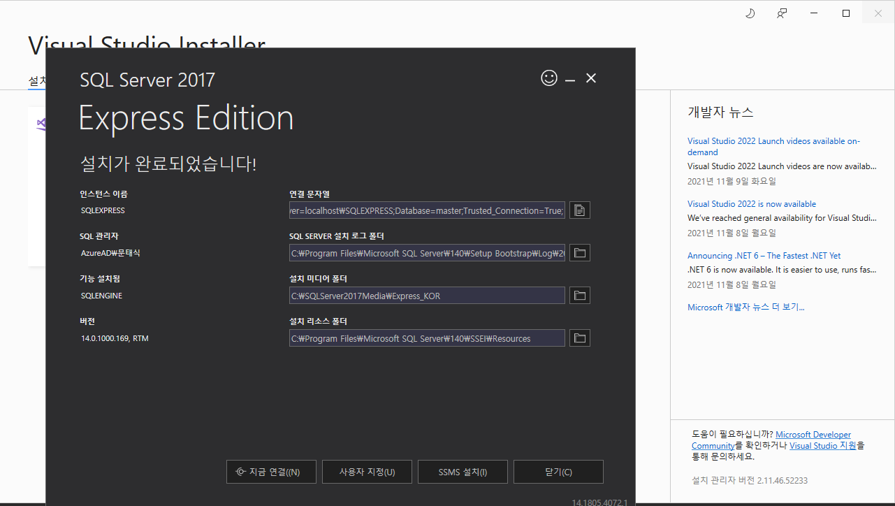

Slide 3
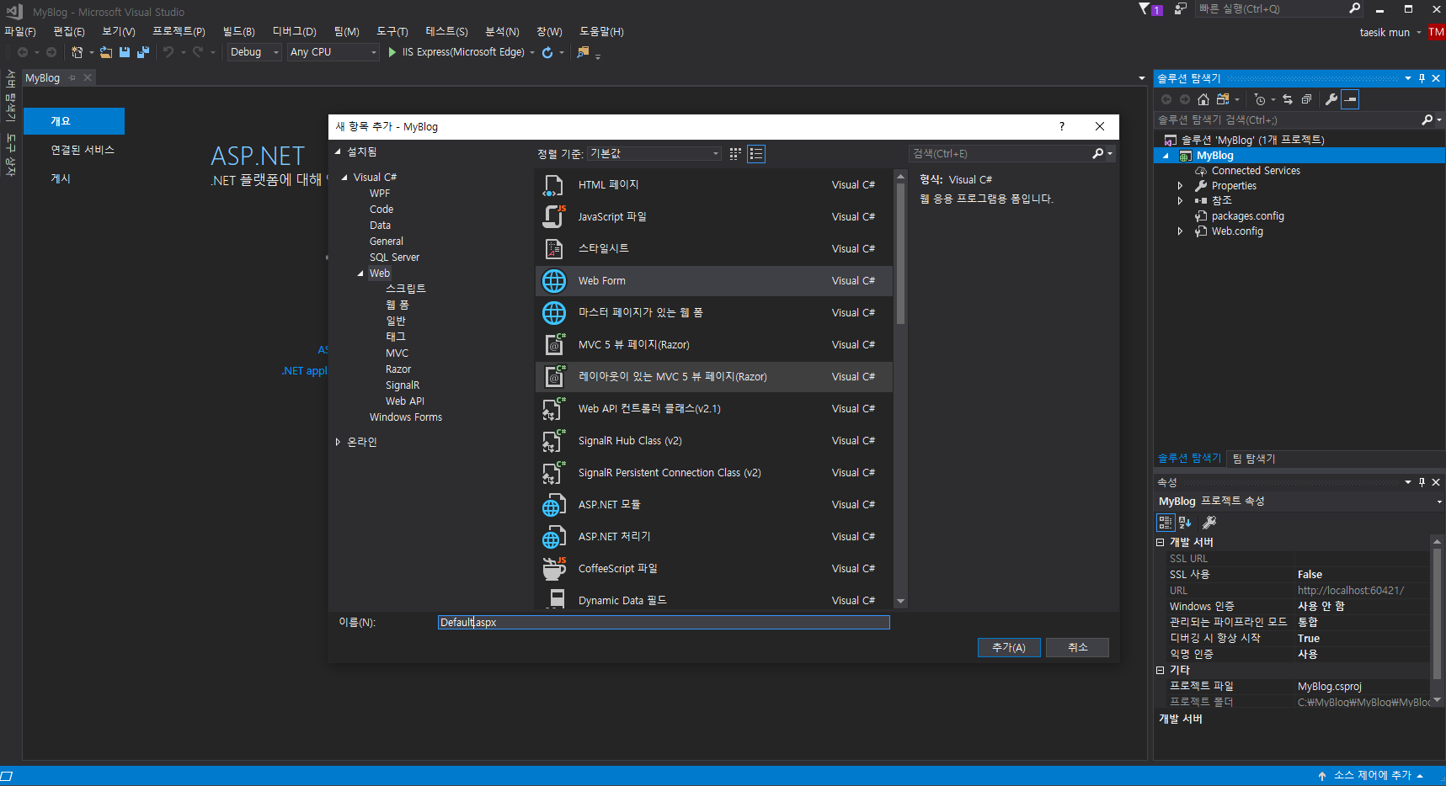

Slide 4
Default.aspx
<%@ Page Language="C#" AutoEventWireup="true" CodeBehind="Default.aspx.cs" Inherits="MyBlog.Default" %>
<!DOCTYPE html>
<html xmlns="http://www.w3.org/1999/xhtml">
<head runat="server">
<meta http-equiv="Content-Type" content="text/html; charset=utf-8"/>
<title>MyBlog</title>
<script type="text/javascript" src="main.js"></script>
<link type="text/css" rel="stylesheet" href="main.css"
</head>
<body>
<form id="form1" runat="server">
<h1 class="banner">Taesik_Blog</h1>
<div id="articles"></div>
</form>
</body>
</html>

Slide 5
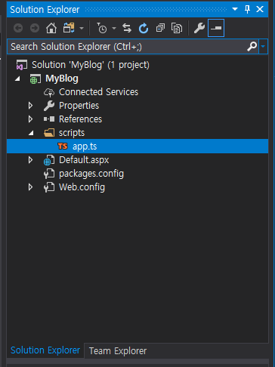
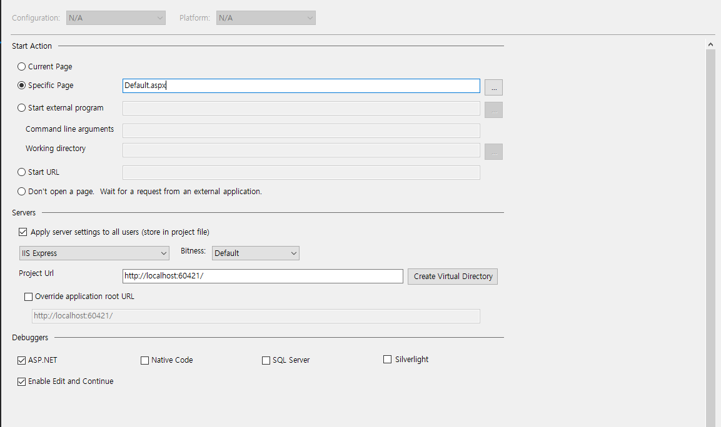

Slide 6
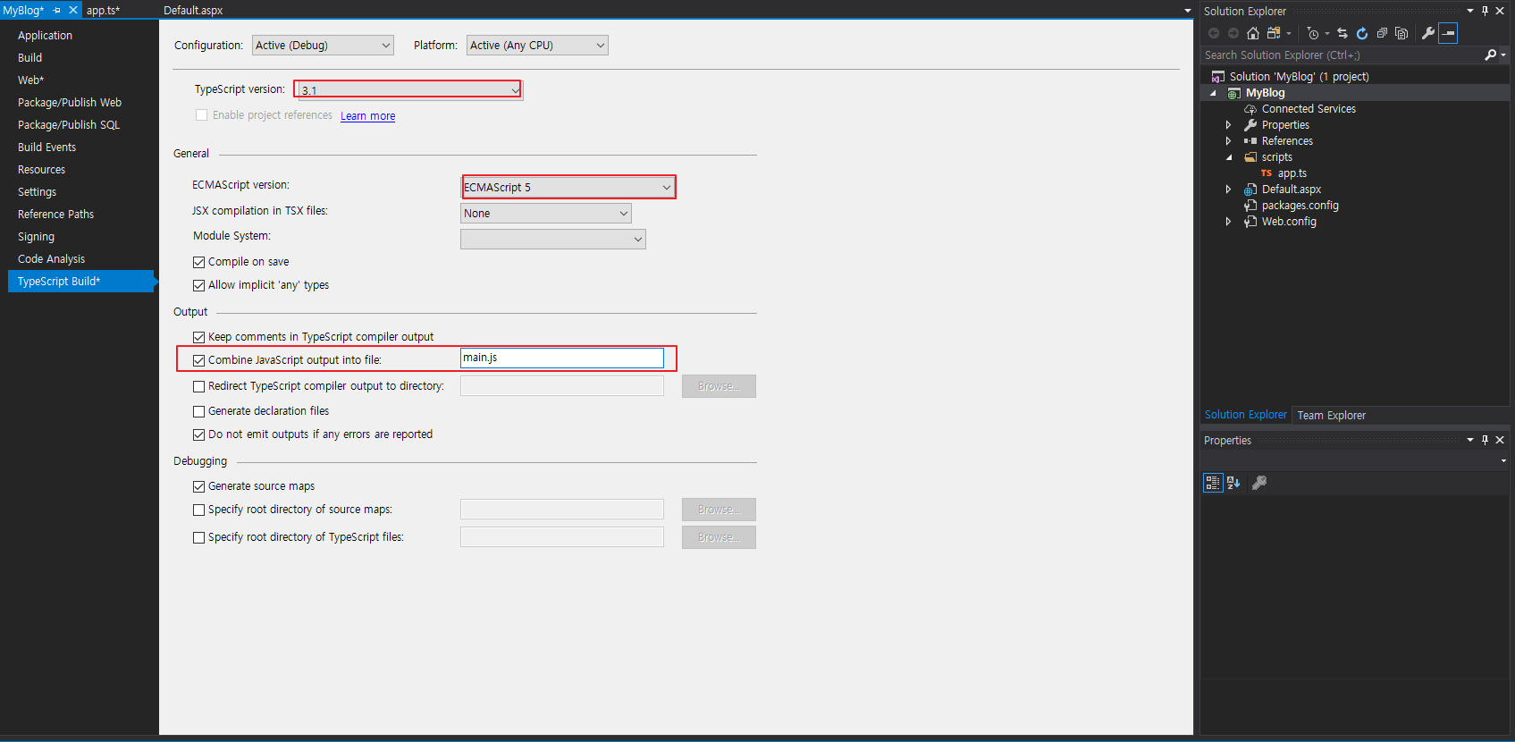

Slide 7
