Slide 1
Reviewing the high-level architecture of the chat application
Setting up the client and server code projects
Creating a quick, basic build system for my projects

Slide 2
Chat Application
Runs in browser
HTML,CSS
Typescript
WebSockets
Runs in Node.js
Listens via WebSockets
Client side
Server side

Slide 3
Client > package.json
{ "name": "sample", "version": "1.0.0", "description": "A sample game.", "main": "index.js", "scripts": { "build": "node build.js", "test": "echo \"Error: no test specified\" && exit 1" }, "author": "Taesik", "license": "ISC", "devDependencies": { "fs-extra": "^8.1.0", "typescript": "^3.3.3" }, "dependencies": { "@types/websocket": "0.0.40", "websocket": "^1.0.28" } }

Slide 4
Client > tsconfig.json
{ "compilerOptions": { /* Basic Options */ "target": "es5", /* Specify ECMAScript target version: 'ES3' (default), 'ES5', 'ES2015', 'ES2016', 'ES2017','ES2018' or 'ESNEXT'. */ "module": "amd", /* Specify module code generation: 'none', 'commonjs', 'amd', 'system', 'umd', 'es2015', or 'ESNext'. */ // "lib": [], /* Specify library files to be included in the compilation. */ // "allowJs": true, /* Allow javascript files to be compiled. */ // "checkJs": true, /* Report errors in .js files. */ // "jsx": "preserve", /* Specify JSX code generation: 'preserve', 'react-native', or 'react'. */ "declaration": false, /* Generates corresponding '.d.ts' file. */ "declarationMap": false, /* Generates a sourcemap for each corresponding '.d.ts' file. */ "sourceMap": false, /* Generates corresponding '.map' file. */ "outFile": "./dist/index.js", /* Concatenate and emit output to single file. */ "outDir": "./dist", /* Redirect output structure to the directory. */ // "rootDir": "./", /* Specify the root directory of input files. Use to control the output directory structure with --outDir. */ // "composite": true, /* Enable project compilation */ // "removeComments": true, /* Do not emit comments to output. */ // "noEmit": true, /* Do not emit outputs. */ // "importHelpers": true, /* Import emit helpers from 'tslib'. */ // "downlevelIteration": true, /* Provide full support for iterables in 'for-of', spread, and destructuring when targeting 'ES5' or 'ES3'. */ // "isolatedModules": true, /* Transpile each file as a separate module (similar to 'ts.transpileModule'). */ /* Strict Type-Checking Options */

Slide 5
"strict": true, /* Enable all strict type-checking options. */ "noImplicitAny": false, /* Raise error on expressions and declarations with an implied 'any' type. */ "strictNullChecks": false, /* Enable strict null checks. */ // "strictFunctionTypes": true, /* Enable strict checking of function types. */ "strictPropertyInitialization": false, /* Enable strict checking of property initialization in classes. */ // "noImplicitThis": true, /* Raise error on 'this' expressions with an implied 'any' type. */ // "alwaysStrict": true, /* Parse in strict mode and emit "use strict" for each source file. */ /* Additional Checks */ // "noUnusedLocals": true, /* Report errors on unused locals. */ // "noUnusedParameters": true, /* Report errors on unused parameters. */ // "noImplicitReturns": true, /* Report error when not all code paths in function return a value. */ // "noFallthroughCasesInSwitch": true, /* Report errors for fallthrough cases in switch statement. */ /* Module Resolution Options */ // "moduleResolution": "node", /* Specify module resolution strategy: 'node' (Node.js) or 'classic' (TypeScript pre-1.6). */ // "baseUrl": "./", /* Base directory to resolve non-absolute module names. */ // "paths": {}, /* A series of entries which re-map imports to lookup locations relative to the 'baseUrl'. */ // "rootDirs": [], /* List of root folders whose combined content represents the structure of the project at runtime. */ // "typeRoots": [], /* List of folders to include type definitions from. */ // "types": [], /* Type declaration files to be included in compilation. */ // "allowSyntheticDefaultImports": true, /* Allow default imports from modules with no default export. This does not affect code emit, just typechecking. */ "esModuleInterop": true /* Enables emit interoperability between CommonJS and ES Modules via creation of namespace objects for all imports. Implies 'allowSyntheticDefaultImports'. */ // "preserveSymlinks": true, /* Do not resolve the real path of symlinks. */ /* Source Map Options */

Slide 6
// "sourceRoot": "", /* Specify the location where debugger should locate TypeScript files instead of source locations. */ // "mapRoot": "", /* Specify the location where debugger should locate map files instead of generated locations. */ // "inlineSourceMap": true, /* Emit a single file with source maps instead of having a separate file. */ // "inlineSources": true, /* Emit the source alongside the sourcemaps within a single file; requires '--inlineSourceMap' or '--sourceMap' to be set. */ /* Experimental Options */ // "experimentalDecorators": true, /* Enables experimental support for ES7 decorators. */ // "emitDecoratorMetadata": true, /* Enables experimental support for emitting type metadata for decorators. */ }, "include": [ "./src/**/*.ts" ], "exclude": [ "node_modules", "./**/*.d.ts" ] }

Slide 7
Server
.vscode > launch.json
{ "version": "0.2.0", "configurations": [ { "type": "node", "request": "launch", "name": "Launch Program", "program": "${workspaceFolder}\\dist\\app.js", "outFiles": [ "${workspaceFolder}/dist/**/*.js" ] } ] }

Slide 8
Server
> package.json
{ "name": "sample-server", "version": "1.0.0", "description": "A sample server.", "main": "index.js", "scripts": { "build": "node build.js", "local": "node dist/app.js", "test": "echo \"Error: no test specified\" && exit 1" }, "author": "Travis Vroman", "license": "ISC", "devDependencies": { "fs-extra": "^8.0.1", "typescript": "^3.3.3" }, "dependencies": { "@types/websocket": "0.0.40", "websocket": "^1.0.28" } }

Slide 9
Server
> tsconfig.json
{ "compilerOptions": { /* Basic Options */ "target": "es5", /* Specify ECMAScript target version: 'ES3' (default), 'ES5', 'ES2015', 'ES2016', 'ES2017','ES2018' or 'ESNEXT'. */ "module": "commonjs", /* Specify module code generation: 'none', 'commonjs', 'amd', 'system', 'umd', 'es2015', or 'ESNext'. */ // "lib": [], /* Specify library files to be included in the compilation. */ // "allowJs": true, /* Allow javascript files to be compiled. */ // "checkJs": true, /* Report errors in .js files. */ // "jsx": "preserve", /* Specify JSX code generation: 'preserve', 'react-native', or 'react'. */ "declaration": true, /* Generates corresponding '.d.ts' file. */ "declarationMap": true, /* Generates a sourcemap for each corresponding '.d.ts' file. */ "sourceMap": true, /* Generates corresponding '.map' file. */ // "outFile": "./dist/index.js", /* Concatenate and emit output to single file. */ "outDir": "./dist", /* Redirect output structure to the directory. */ // "rootDir": "./", /* Specify the root directory of input files. Use to control the output directory structure with --outDir. */ // "composite": true, /* Enable project compilation */ // "removeComments": true, /* Do not emit comments to output. */ // "noEmit": true, /* Do not emit outputs. */ // "importHelpers": true, /* Import emit helpers from 'tslib'. */ // "downlevelIteration": true, /* Provide full support for iterables in 'for-of', spread, and destructuring when targeting 'ES5' or 'ES3'. */ // "isolatedModules": true, /* Transpile each file as a separate module (similar to 'ts.transpileModule'). */

Slide 10
/* Strict Type-Checking Options */ "strict": true, /* Enable all strict type-checking options. */ // "noImplicitAny": true, /* Raise error on expressions and declarations with an implied 'any' type. */ "strictNullChecks": false, /* Enable strict null checks. */ // "strictFunctionTypes": true, /* Enable strict checking of function types. */ "strictPropertyInitialization": false, /* Enable strict checking of property initialization in classes. */ // "noImplicitThis": true, /* Raise error on 'this' expressions with an implied 'any' type. */ // "alwaysStrict": true, /* Parse in strict mode and emit "use strict" for each source file. */ /* Additional Checks */ // "noUnusedLocals": true, /* Report errors on unused locals. */ // "noUnusedParameters": true, /* Report errors on unused parameters. */ // "noImplicitReturns": true, /* Report error when not all code paths in function return a value. */ // "noFallthroughCasesInSwitch": true, /* Report errors for fallthrough cases in switch statement. */ /* Module Resolution Options */ // "moduleResolution": "node", /* Specify module resolution strategy: 'node' (Node.js) or 'classic' (TypeScript pre-1.6). */ // "baseUrl": "./", /* Base directory to resolve non-absolute module names. */ // "paths": {}, /* A series of entries which re-map imports to lookup locations relative to the 'baseUrl'. */ // "rootDirs": [], /* List of root folders whose combined content represents the structure of the project at runtime. */ // "typeRoots": [], /* List of folders to include type definitions from. */ // "types": [], /* Type declaration files to be included in compilation. */ // "allowSyntheticDefaultImports": true, /* Allow default imports from modules with no default export. This does not affect code emit, just typechecking. */ "esModuleInterop": true /* Enables emit interoperability between CommonJS and ES Modules via creation of namespace objects for all imports. Implies 'allowSyntheticDefaultImports'. */ // "preserveSymlinks": true, /* Do not resolve the real path of symlinks. */

Slide 11
/* Source Map Options */ // "sourceRoot": "", /* Specify the location where debugger should locate TypeScript files instead of source locations. */ // "mapRoot": "", /* Specify the location where debugger should locate map files instead of generated locations. */ // "inlineSourceMap": true, /* Emit a single file with source maps instead of having a separate file. */ // "inlineSources": true, /* Emit the source alongside the sourcemaps within a single file; requires '--inlineSourceMap' or '--sourceMap' to be set. */ /* Experimental Options */ // "experimentalDecorators": true, /* Enables experimental support for ES7 decorators. */ // "emitDecoratorMetadata": true, /* Enables experimental support for emitting type metadata for decorators. */ }, "include": [ "./src/**/*.ts" ], "exclude": [ "node_modules", "./**/*.d.ts" ] }

Slide 12
Creating the client (Frontend) as a Web Page

Slide 13
Src > packets.ts
namespace Chat { export enum RequestType { LOGIN = "login", CHAT_SEND = "chat_send" } export enum ResponseType { LOGIN_RESULT = "login_result", CHAT_RESULT = "chat_result", } /**It deals with what kind of packet **/ export interface IResponsePacket { readonly responseType: string; } export class ChatResponse implements IResponsePacket { public readonly responseType:string; public constructor(public userData:UserData, public content:string) { this.responseType = ResponseType.CHAT_RESULT } } export class LoginResponse implements IResponsePacket { public readonly responseType:string; public constructor(public success:boolean ) { this.responseType = ResponseType.LOGIN_RESULT; } } }

Slide 14
Src > userData.ts
namespace Chat { export class UserData { public constructor(public userId: number, public name: string,public color:string) { } public static readonly SERVER:UserData = new UserData(-1, "SERVER","yellow"); } }

Slide 15
Src >
serverConnection.ts
namespace Chat { /** Handles a connection to the chat server**/ export class ServerConnection { private _connection:WebSocket; public constructor(public readonly host:string, public readonly port:number, private _connectionCallback:()=>void, private _packetResponseCallback:(packet:IResponsePacket)=>void, private _connectionCloseCallback: () => void) { } public connect():void { this._connection = new WebSocket(`ws://${this.host}:${this.port}`); this._connection.addEventListener("open",this._connectionCallback.bind(this)); this._connection.addEventListener("error",()=>alert("unable to connect to server")); this._connection.addEventListener("message",this.onMessage.bind(this)); this._connection.addEventListener("close",this._connectionCloseCallback.bind(this)); } public login(username:string):void { let request = { requestType: RequestType.LOGIN, username:username, } this._connection.send(JSON.stringify(request)); }

Slide 16
public disconnect():void { this._connection.close(1000,"User disconnect"); } public send(request:any):void { this._connection.send(JSON.stringify(request)); } private onMessage( message:MessageEvent):void { this._packetResponseCallback(JSON.parse(message.data) as IResponsePacket); } } }

Slide 17
Src >documentHelper.ts
namespace Chat { export class DocumentHelper { public static initialize():void { DocumentHelper.getInputElement("username").addEventListener("keyup",DocumentHelper.userKeyup); DocumentHelper.getInputElement("entry").addEventListener("keyup",DocumentHelper.entryKeyup); } public static toggleLogin(showLogin:boolean):void { DocumentHelper.toggleForm("JoinDiv",showLogin); DocumentHelper.toggleForm("inputWrapper",!showLogin); } public static getInputElement(id:string):HTMLInputElement { return (document.getElementById(id) as HTMLInputElement); } public static userKeyup(event: KeyboardEvent):void { let value = DocumentHelper.getInputElement("username").value; let valueEmpty = value ===""; DocumentHelper.getInputElement("loginbutton").disabled = valueEmpty; /**if enter is pressed**/ if(event.keyCode ===13) { if(valueEmpty) alert("A username is required."); else App.connect(); } }

Slide 18
public static entryKeyup(event:KeyboardEvent):void { let value = DocumentHelper.getInputElement("entry").value; let valueEmpty = value ===""; DocumentHelper.getInputElement("sendbutton").disabled = valueEmpty; if (event.keyCode ===13 && !valueEmpty) App.sendChat(); } public static appendMessage(userData:UserData, content:string):void { if(content.trim() !== "") { let wrapper = document.createElement("div"); wrapper.className = "messageWrapper"; let userSection = document.createElement("span"); userSection.style.color=userData.color; userSection.innerHTML = `[${userData.name}]:&nbsp;`; let contentSection = document.createElement("span"); contentSection.innerHTML=content; wrapper.appendChild(userSection); wrapper.appendChild(contentSection); let log =document.getElementById("chatlog"); log.appendChild(wrapper); //Make sure to always scroll to the bottom. log.scrollTo(0,log.clientHeight); } }

Slide 19
private static toggleForm(id:string, value: boolean):void { document.getElementById(id).style.display=value? "block":"none"; } } }

Slide 20
Src >index.ts
namespace Chat { export class App { private static _serverConnection:ServerConnection; public static start():void { //Prepare a server connection. App._serverConnection = new ServerConnection( "127.0.0.1", 5001, App.onConnected, App.processPacket, App.onDisconnected, ); DocumentHelper.initialize(); } public static connect():void { App._serverConnection.connect(); } public static disconnect():void { App._serverConnection.disconnect(); DocumentHelper.toggleLogin(true); //Clear the user box. DocumentHelper.getInputElement("username").value=""; }

Slide 21
/** Sends the content in the entry box as a chat message. **/ public static sendChat(): void { let input = DocumentHelper.getInputElement("entry"); let text = input.value; input.value = ""; /** Special cases for commands **/ if(text[0] == "/") { let command = text.substr(1).toLowerCase(); if(command === "logout" || command === "disconnect" || command ==="quit" ) { App.disconnect(); } return ; } let request = { requestType:RequestType.CHAT_SEND, message:text }; this._serverConnection.send(request); }

Slide 22
private static onConnected():void { let username = DocumentHelper.getInputElement("username").value; //Attempt login DocumentHelper.toggleLogin(username === undefined); App._serverConnection.login(username); } private static onDisconnected():void { DocumentHelper.toggleLogin(true); DocumentHelper.appendMessage(UserData.SERVER, "You have benn disconnected from the chat server"); } private static processPacket(packet:IResponsePacket):void { switch (packet.responseType) { case ResponseType.CHAT_RESULT: //Add message to the log. let response = packet as ChatResponse; DocumentHelper.appendMessage(response.userData,response.content); break; case ResponseType.LOGIN_RESULT: let result = packet as LoginResponse; if(result.success) DocumentHelper.appendMessage(UserData.SERVER,"Welcome to the chat server"); DocumentHelper.toggleLogin(!result.success); break; } } } }

Slide 23
/** Application entry point**/ window.onload = () => { Chat.App.start(); }

Slide 24
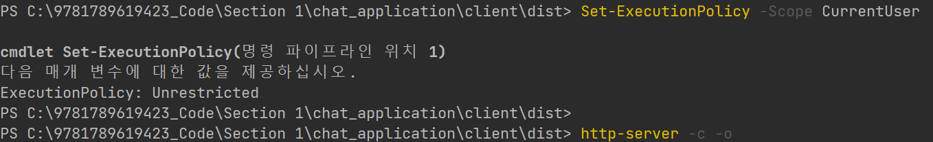

Slide 25
PS C:\9781789619423_Code\Section 1\chat_application\client\dist> http-server -c -o
Starting up http-server, serving ./
http-server version: 14.0.0
http-server settings:
CORS: disabled
Cache: true seconds
Connection Timeout: 120 seconds
Directory Listings: visible
AutoIndex: visible
Serve GZIP Files: false
Serve Brotli Files: false
Default File Extension: none
Available on:
http://192.168.56.1:8080
http://192.168.0.102:8080
http://127.0.0.1:8080
Hit CTRL-C to stop the server
Open: http://127.0.0.1:8080

Slide 26
Creating the Server (Backend)

Slide 27
Src>users.ts
export class UserData { private static GLOBAL_USER_ID: number = 0; public userID: number; public constructor(public name: string, public color?: string) { this.userID = UserData.GLOBAL_USER_ID++; this.color = color ? color : this.generateRandomColor(); } /** return HTML style hexcode **/ private generateRandomColor():string { return '#' + (Math.floor(Math.random()*(0xFFFFFF - 0x666666 +1) ) +0x666666).toString(16); } /** The static user data for server communications. **/ public static readonly SERVER:UserData = new UserData("SERVER","yellow"); }

Slide 28
export class UserManager { private static _users: { [name: string]: UserData} = {}; // hashTable Key:name value:UserData public static getUserDataForId(id: number):UserData { let users = Object.values(UserManager._users).map(x=>x).filter(x=>x.userID === id); return users[0] ? users[0] : undefined; } public static tryAuthenticateUser(request:any):number { let username = request.username.toLowerCase(); let record = UserManager._users[username]; if(record === undefined) { /** If not defined, create a new record**/ record = new UserData(username); UserManager._users[username] = record; } return record.userID; } }

Slide 29
Src>responsePackets.ts
export enum ResponseType { LOGIN_RESULT = "login_result", LOGOUT_RESULT = "logout_result", CHAT_RESULT = "chat_result" }
Src>requestPackets.ts
export enum RequestType { LOGIN = "login", CHAT_SEND = "chat_send", }

Slide 30
Src>clientConnection.ts
import WebSocket from "websocket"; import {ResponseType} from "./responsePackets"; import {UserManager} from "./users"; import {RequestType} from "./requestPackets"; import {Server} from "./app"; /**Represents a single client connection.**/ export class ClientConnection { private static _GLOBAL_CONNECTION_ID: number = 0; private _server: Server; private _connection: WebSocket.connection; private _connectionID: number; private _userId:number = -1;

Slide 31
public constructor(server:Server, request:WebSocket.request) { this._server = server; // Set the connection id and increment the global counter. this._connectionID = ClientConnection._GLOBAL_CONNECTION_ID++; //Create the connection this._connection = request.accept(null, request.origin); //Setup event handlers. this._connection.on("message",this.onMessage.bind(this)); this._connection.on("close", (code:number,description:string) =>{ console.log(`Connection closed (${this._connectionID}):`,closed); this._server.onClientDisconnected(this); }); this._connection.on("error",(error:Error)=>{ console.log("Error:",error); }); this._connection.on("error", (error:Error)=> { console.log("Error:",error); }); }

Slide 32
public get connectionID():number { return this._connectionID; } public get userId():number { return this._userId; } public send(response:any):void { this._connection.sendUTF(JSON.stringify(response)); } public disconnect():void { //Tell the server about the disconnection, then actually close this._server.onClientDisconnected(this); this._connection.close(); }

Slide 33
private onMessage(message: WebSocket.IMessage):void { console.debug(message); //This only accepts text. if(message.type ===“utf8") { let packet = JSON.parse(message.utf8Data); if(this._userId ===-1) { if(packet.responseType !== RequestType.LOGIN) this.respondFail(); else { if(this.tryAuth(packet)) this.respondSuccess(); else this.respondFail(); } }else { //User is authenticated and sending a chat. Broadcast is //Otherwise it is invalid - disconnect the user. if(packet.responseType === RequestType.CHAT_SEND) { let response = { responseType:ResponseType.CHAT_RESULT, content:packet.message, userData:UserManager.getUserDataForId(this.userId) }; Server.broadcast(response); }else this.respondFail(); } } }

Slide 34
private respondSuccess():void { this.send({responseType: ResponseType.LOGIN_RESULT,success:true}); //Notify other users this one has logged in. this._server.onClientAuthenticated(this); } private respondFail():void { this.send({responseType:ResponseType.LOGIN_RESULT,success:false}); this.disconnect(); } private tryAuth(packet:any):boolean { this._userId=UserManager.tryAuthenticateUser(packet); return this._userId !== -1; } }

Slide 35
Src>app.ts
import {ClientConnection} from "./clientConnection"; import WebSocket from "websocket"; import Http from "http"; import {UserData, UserManager} from "./users"; import {ResponseType} from "./responsePackets"; export class Server { //Hold all connections. private static _connections:{[connectionID:number]:ClientConnection}={}; public static broadcast(response:any):void { Object.values(Server._connections).map(x=>x).forEach(x=>x.send(response)); } public constructor(public readonly port:number) { //Create the http server. let httpServer = Http.createServer(this.listenerCallback.bind(this)); //Create the websocket server and pass the http server to it. let wsServer = new WebSocket.server({httpServer:httpServer}) } public static getConnectedUserIds():number[] { return Object.values(Server._connections).map(x=>x.userId).filter(x=>x !==-1); }

Slide 36
public onClientDisconnected(client:ClientConnection):void { //If client was authenticated, tell all the other clients about if(client.userId !== -1) { console.log("User disconnected: "+client.userId); let user = UserManager.getUserDataForId(client.userId); let message = (user? user.name : "Someone" ) + " has gone offline"; let response = { responseType: ResponseType.CHAT_RESULT, userData: UserData.SERVER, }; Server.broadcast(response); } console.log("Connection id disconnected: "+ client.connectionID); Server._connections[client.connectionID] = undefined; delete Server._connections[client.connectionID]; }

Slide 37
public onClientAuthenticated(client:ClientConnection):void { //If the client is authenticated, thell all the other clients about the con if(client.userId !==-1) { console.log("User signed on: "+ client.userId); let user = UserManager.getUserDataForId(client.userId); let message = (user?user.name:"Someone")+ " has come online."; let response = { responseType: ResponseType.CHAT_RESULT, userData:UserData.SERVER, content:message }; Server.broadcast(response); } } private listenerCallback(message:Http.IncomingMessage, response:Http.ServerResponse):void { //Handle HTTP requests. This will be useful for registration. } private requestCallback(): void { console.log((new Date() )+ " - Server started and listening on port: " + this.port); }

Slide 38
private onWebSocketRequest(request:WebSocket.request):void { console.log((new Date())+ " - New client connection:" +request.remoteAddress); let connection = new ClientConnection(this,request); Server._connections[connection.connectionID] = connection; } } //Server config process.title = "Chat Server"; var server = new Server(5001);

Slide 39
Bringing Client and Server together

Slide 40
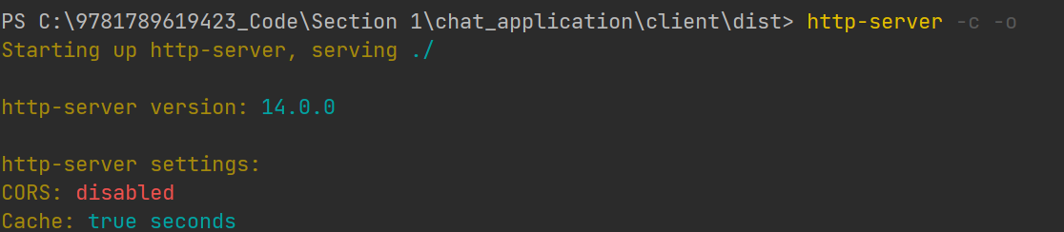

Slide 41
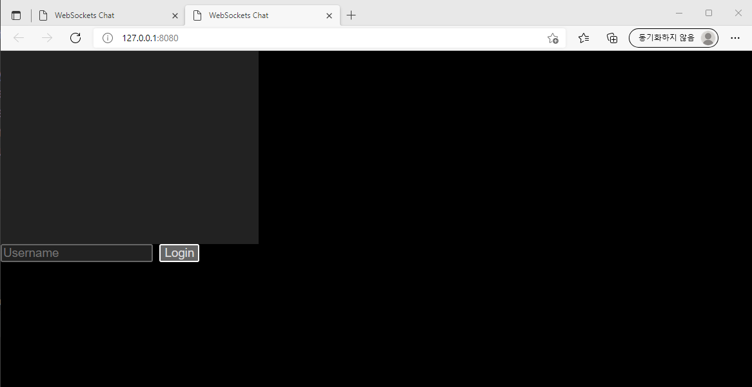

Slide 42
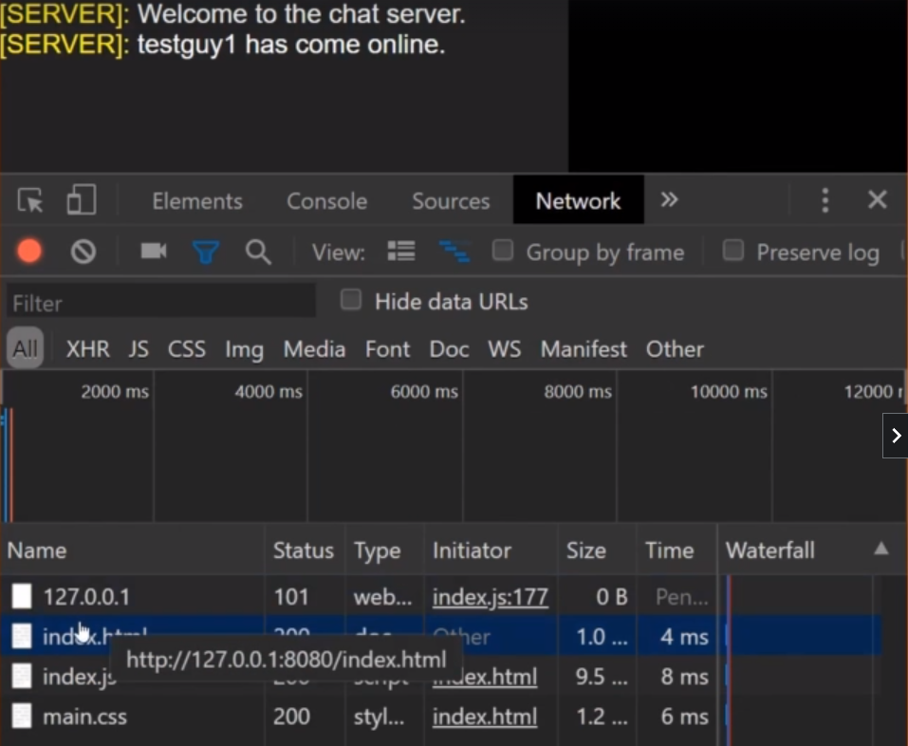

Slide 43
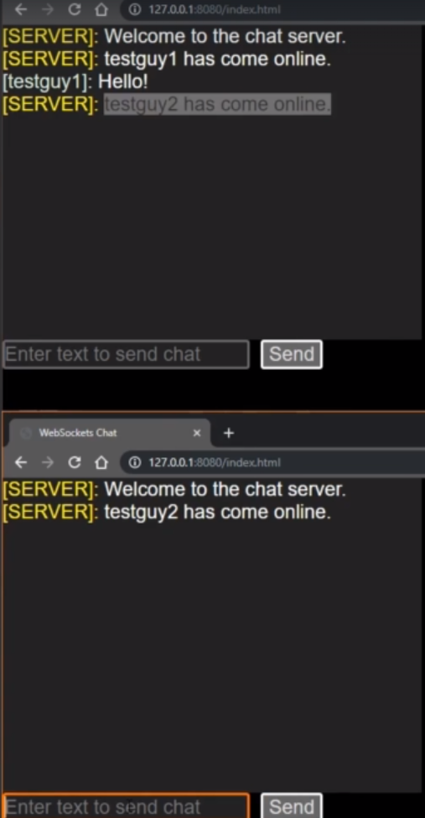

Slide 44
Enhancing the experience
with Chat attachments

Slide 45
Client>www>main.css
html, body { margin: 0; padding: 0; overflow: hidden; font-family: Arial, Helvetica, sans-serif; font-size: 14pt; background:black; color:white; } img { max-width: 95%; margin: 5px; } .messageWrapper { display: block; max-width: 100%; min-height: 20px; } #chatlog { width:550px; height:300px; overflow:hidden; overflow-y: auto; background: #222; color:white; }

Slide 46
input[type=text] { border:2px solid #666; background: #222; border-radius: 3px; outline: none; font-size: 14pt; color:white; width: 450px; }
input[type=text]:active, input[type=text]:focus { border-color:#ff6600; } input[type=button] { border:2px solid white; background: #FF6600; border-radius: 3px; outline: none; font-size: 14pt; color:white; width: 100px; } input[type=button]:disabled { background: #666666; color:#ddd; }

Slide 47
public static appendMessage(userData:UserData, content:string):void { if(content.trim() !== "") { let wrapper = document.createElement("div"); wrapper.className = "messageWrapper"; let userSection = document.createElement("span"); userSection.style.color=userData.color; userSection.innerHTML = `[${userData.name}]:&nbsp;`; let contentSection = document.createElement("span"); //[img]https://www.gstatic.com/webp/gallery/1.jpg[/img] //<img src="https://www.gstatic.com/webp/gallery/1.jpg"/> let replaceContent = content.replace(/\[img\]/g,"<img src=\"") .replace(/\[\/img\]/g,"\"/>"); contentSection.innerHTML=replaceContent; wrapper.appendChild(userSection); wrapper.appendChild(contentSection); let log =document.getElementById("chatlog"); log.appendChild(wrapper); //Make sure to always scroll to the bottom. log.scrollTo(0,log.clientHeight); }
change

