Slide 1
Problem Solving Methods Term Project Guideline
Fall 2021

Slide 2
General Guideline
You must write the first 4 problem solving steps in detail, plus the working source code (step 5).
The overall structure of the entire program in terms of functions is very important.
This is a team project.
After defining the overall structure of the program, the team should assign different functions to different members of the team.
Each team member should test and document his/her own functions.
The team should put the pieces together, and do the testing of the entire program together, and update the documentation together.

Slide 3
Submission Guideline
When submitting the project, each team member must sign off on percentage contribution and the work done.
The submission should include the problem solving step writeup, source code, result screen capture, and the individual contributions signoff – all in a single ZIP file.
The results have to be reproduceable by a Test PC.
Never manipulate the result, otherwise you will get ZERO point.

Slide 4
Term Project Specification: (1) Setup
** practice file I/O, struct array, basic data structures
Read a text file provided (conference registrations data).
Store the data in a struct array.
Store the data in a linked list.

Slide 5
Registration Data (30 records -- including some “Choi”, and some “Gachon University”)
tag# (registration number – unique integer)
date registered (yyyy-mm-dd)
fee-paid (“yes” or “no”)
name (char[25])
age (integer)
organization (company or university; char[35])
job (student, professor, staff, executive, engineer, marketer; char[15])

Slide 6
Term Project Specification: (2) Search, Reorganize
Search for “Choi” (if found, print all information about the persons)
in the array (Mark P1-1 in code, Print result P1-1.png)
In the linked list (Mark P1-2 in code, Print result P1-2.png)
Search for all from Gachon University (if found, print all information about the persons).
in the array (Mark P2-1 in code, Print result P2-1.png)
in the linked list (Mark P2-2 in code, Print result P2-2.png)
Sort the data in the array in tag# order (Mark P3-1 in code, Print result P3-1.png)
Create a linked list using the sorted data. (Mark P4-1 in code, Print result P4-1.png)
Sort the data in the array in age group order (using selection sort – self-study)
** “age group” means 10 (10-19), 20 (20-29), 30 (30-39), ….
Write the sorted data to a text file. (Mark P5-1 in code, submit a text file P5-1.txt)

Slide 7
Term Project Specification: (2) Update
All “Choi”s canceled registration. Remove the data from
the array (fill the memory) (Mark P6-1 in code, Print result P6-1.png)
the linked list (Mark P6-2 in code, Print result P6-2.png)
One “Paik” registered late.
tag#/2021-11-30/yes/Gildong Paik/35/Gachon University/Student.
Give Paik's tag# in consideration of the tag# of the registered persons. Add the data to
the array (in the sorted order; shift all affected data)
(Mark P7-1 in code, Print result P7-1.png)
the linked list (in the right sorted order)
(Mark P7-2 in code, Print result P7-2.png)

Slide 8
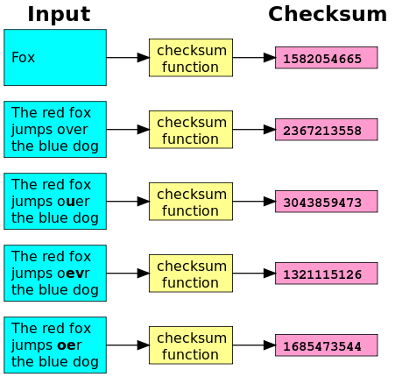
Exclusive OR Checksum
checksum = 0 ^ Bae ^ Chung ^ Hong ^ Kong ^….
(* ^ is bit-wise exclusive OR)
Bit-wise operation with fixed-length data array.
Checksum is computed for the original.
Checksum is computed for the copy.
Compare the checksums.
If the two checksums are the same, copying was OK.
original
Bae
Chung
Hong
Kong
Kim
Lee
checksum
copy
Bae
Chung
Hong
Kong
Kim
Lee
checksum
Checksum only comparison
for fast verification of successful copy
Checksum on wiki.

Slide 9
Term Project Specification: (2) Update
Copy the most recent data in the array for transmission to a remote computer.
Compute the checksum of the original data (using bitwise ExclusiveOR) and write it to the copy.
Most recent data: last 10 data in the array. Use only “name (char[25])” field for checksum calculation.
Write two files as one for the most recent data and the other is for checksum (P8-1.txt ang P8-2.txt)
Read the copied data and compute the checksum in the copied data.
Compare the checksum against the checksum in the original data.
Confirm that the two data are the same.
Mark P8-1, and P8-2 in the code and Print result P8-1 and P8-2.png

Slide 10
Submission Format
Submit with a [Team-A].Zip file
/code/
Copy the entire visual studio project here.
comment the authors of each function in codes
Team-A.pdf (Documentation)
Team introduction (list all members & roles)
Contribution percentage (Kim: 25%, Park: 30% …)
Achievement table (self-evaluation)
Problem solving steps 1-4
(including Design structure, Code description, solving strategy)
Codes & Result screenshots for each problem
/output/
P1-1.png ~ P8-1.png, P5-1.txt, P8-1.txt , P8-2.txt
Achievement Table
Problem | Members Involved | Achievement
P1-1 | name1, name2 | 100%
P1-2 | name2 | 50%
P2-1 | name3 | 0%
… | … | …
P8-1 | name1, name2, name3 | 20%

Slide 11
End of Slides

