Slide 1
NDN Security
2020.09.04 이종석

Slide 2

NDN Data Networking
https://named-data.net

Slide 3
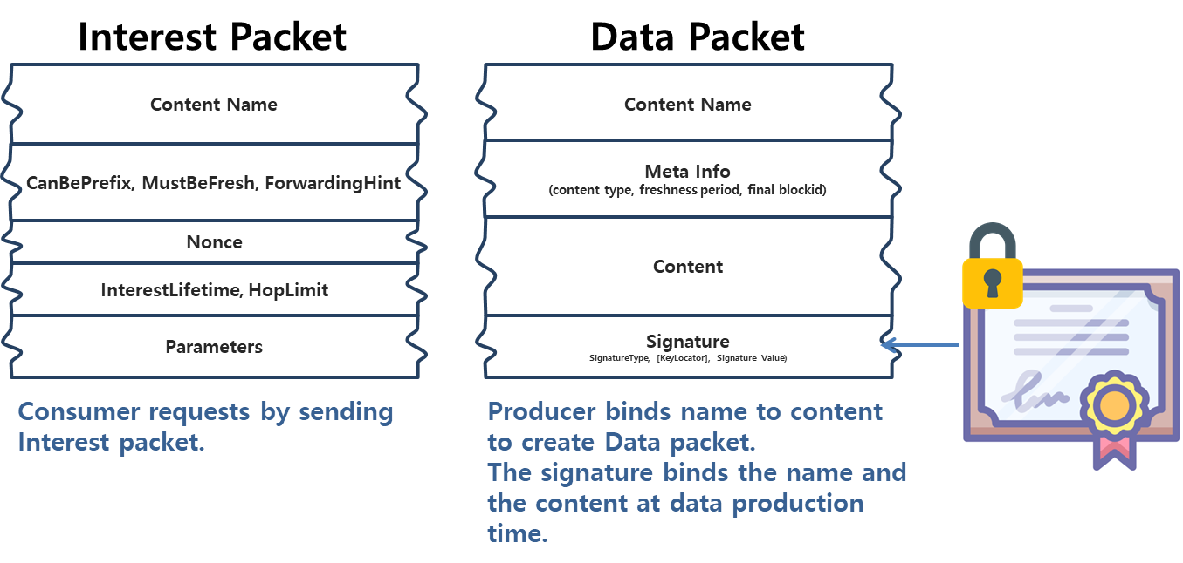
NDN Packet Format

Slide 4
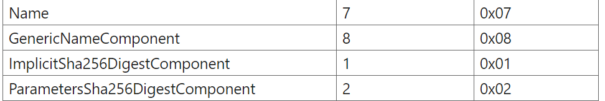
NDN Packet Format
https://named-data.net/doc/NDN-packet-spec/current/name.html#ndn-name-format
An NDN Name is a hierarchical name for NDN content, which contains a sequence of name components.
NDN Name Format :
We use a 2-level nested TLV to represent a name.
The NAME-TYPE in the outer TLV indicates this is a Name.
Inner TLVs should be NameComponent elements

Slide 5
NDN Security
The NDN security framework is built on public-key cryptography[공개-키 암호 방식].
Public-key cryptography invented in 1976 by Diffie, Hellman, and Merkle, enabling:
Digital signatures: private key signs, public key verifies.
Privacy: public key encyrpts, private key decrypts.
But: Are you using the “right” public key?
Public keys must be authentic, if not necessarily secret.

Slide 6
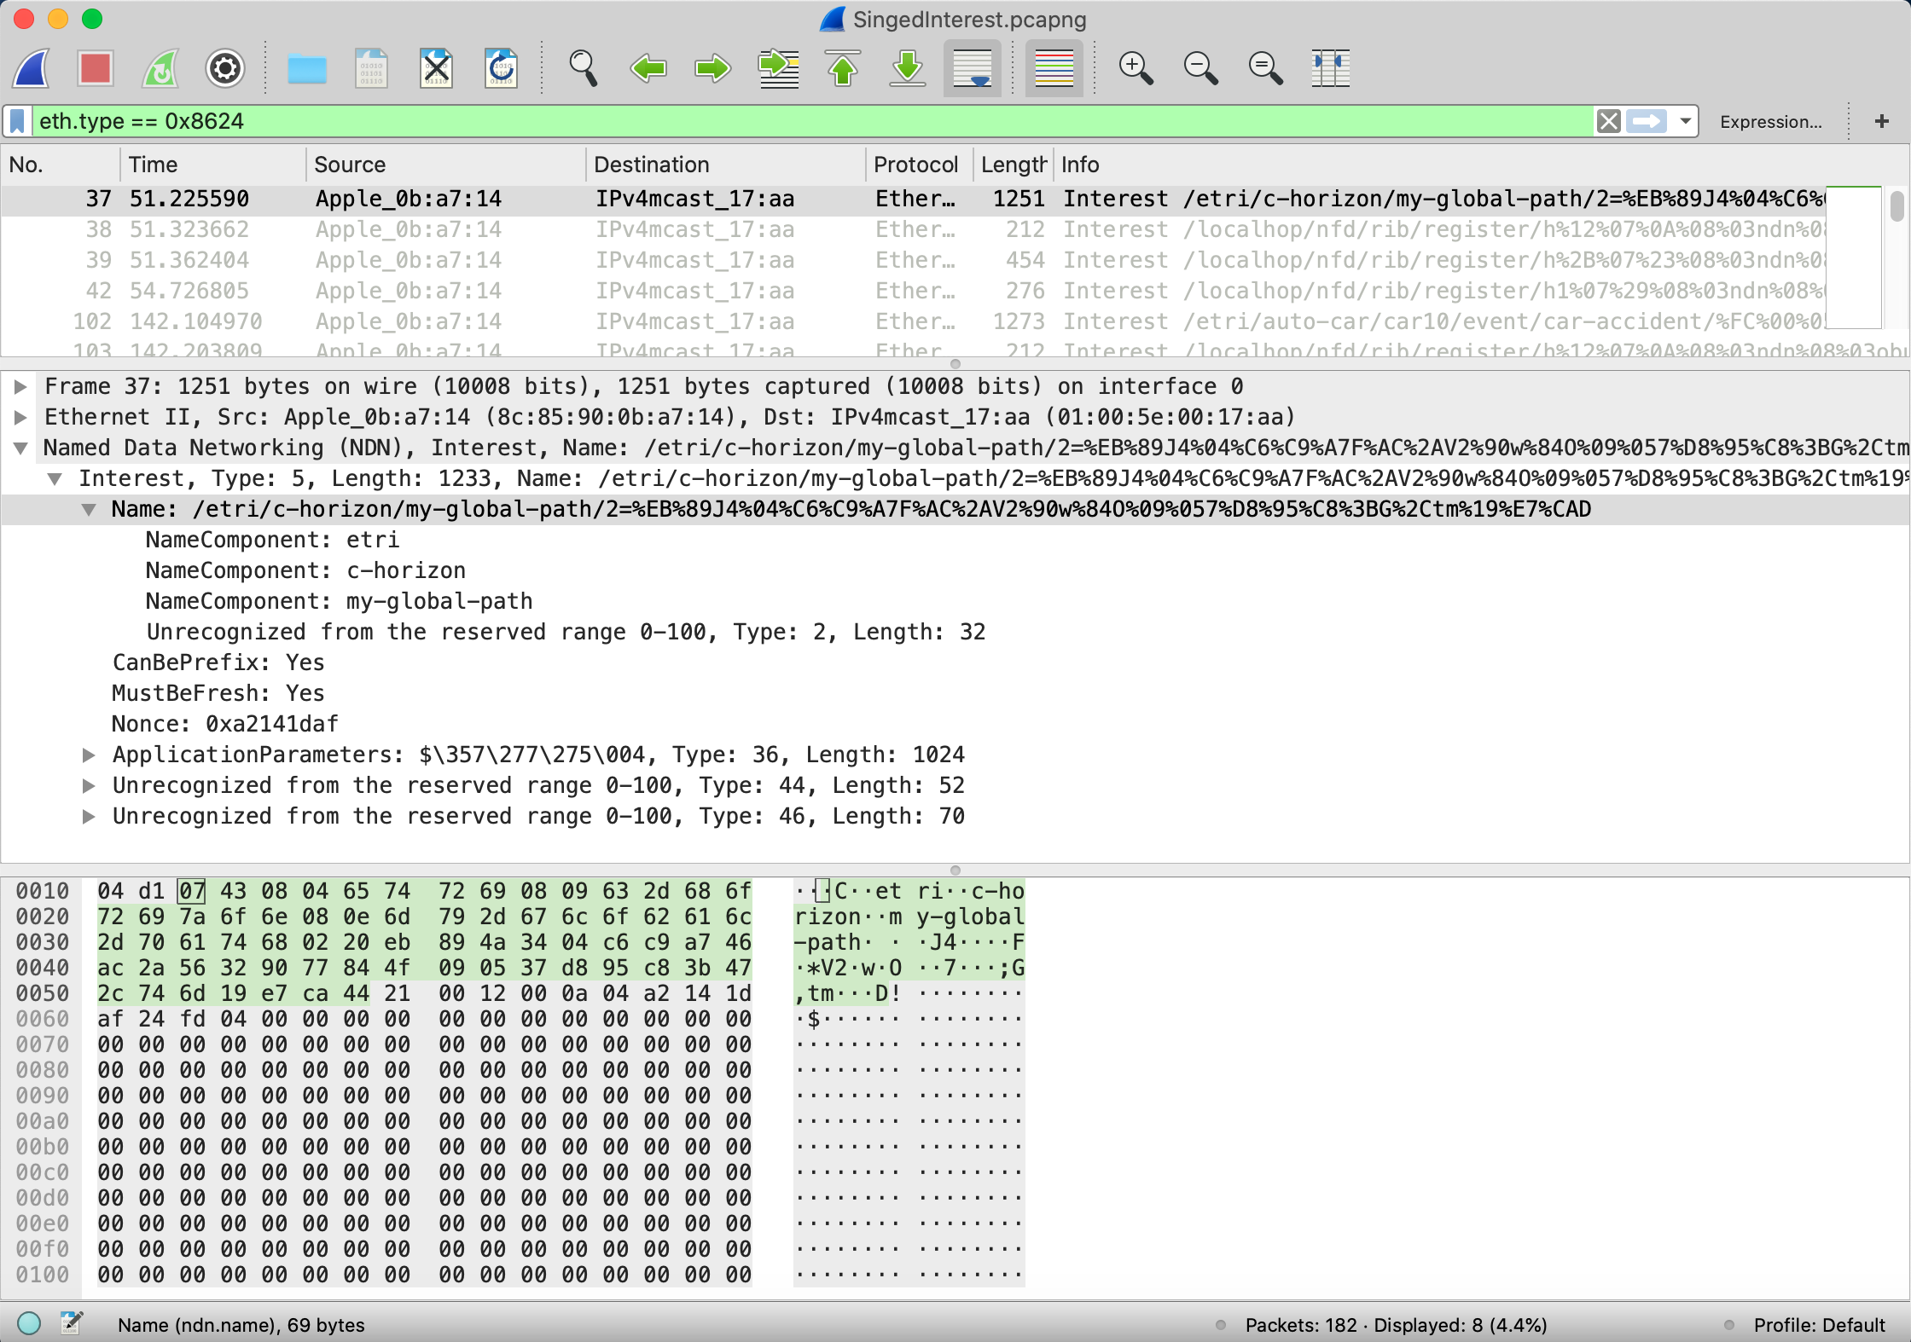
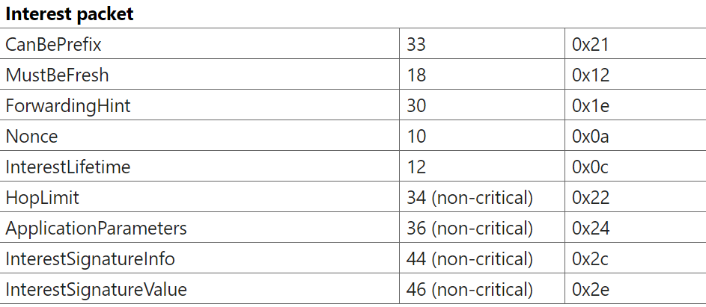
Signed Interest Example

Slide 7
Diagram of NDN Validation
ndn-cxx 라이브러리가 자동으로 진행
개발자가 추가해야 하는 코드
RSU
OBU
SI:/etri/c-horizon/my-global-path with /etri/obu/KEY
I:/etri/obu/KEY
C:/etri/obu/KEY with /etri/KEY
ndn-cxx::validator::validate with trustAnchor
Pib에서 KEY를 검색하여
Certificate을 RSU에게
전달될 수 있도록 개발자
코딩이 필요 함.
D:/etri/c-horizon/my-global-path with /etri/rsu/KEY
I:/etri/rsu/KEY
C:/etri/rsu/KEY with /etri/KEY
ndn-cxx::validator::validate with trustAnchor

Slide 8
Example of NDN Network
Root Server
RSU(Jim)
OBU(kr300)
ObuNdnAPP
RsuNdnAPP
NFD
dev::enx00b201708168
Face Id: 258
NFD
dev:enx00b20170808d
Face Id: 257
nfdc
nfdc
$sudo nfdc route add /etri 257
$sudo nfdc route add /etri 258

Slide 9
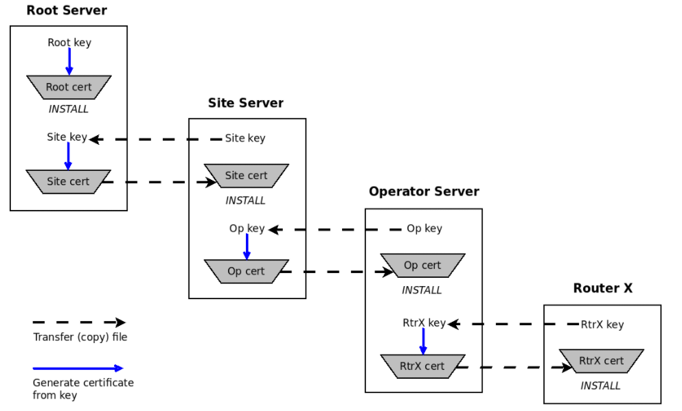
NDN Security(Key Chain)

Slide 10
NDN Security ToolKits
https://named-data.net/doc/ndn-cxx/current/manpages.html
주요 toolkits - demo
ndnsec is a command-line toolkit to perform various NDN security management operations. // ndnsec list -vvv
ndnsec-key-gen generates a key pair for the specified identity and sets the generated public key as the identity’s default key.
ndnsec-cert-gen takes a signing request as input and issues an identity certificate for the key in the signing request. // ndnsec-cert-get –s /etri hii.key > hii.cert
ndnsec-cert-install allows importing a certificate into the Public Information Base (PIB).
/home/$(HOME)/.ndn

Slide 11
NDN Security Configuration
1. $sudo ndnsec key-get /etri/ > etri.key
2. $sudo ndnsec cert-dump –I /etri/ > etri.cert
Root Server(DCN01)
[1]
Etri Key
9. copy etri.cert to RSU Server for TrustAnchor
[2]
Etri cert
[9]
RSU Server(Jim)
[4]
RSU Key
RSU Key
[3]
[6]
[5]
RSU cert
RSU cert
INSTALL
[7]
5. $sudo ndnsec cert-gen –s /etri rsu.key > rsu.cert
6. copy rsu.cert to RSU Server
3. $sudo ndnsec key-get /etri/rsu > rsu.key
4. copy rsu.key to Root Server
7. $sudo ndnsec cert-install –f rsu.cert
8. $sudo ndnsec list -vvv

Slide 12
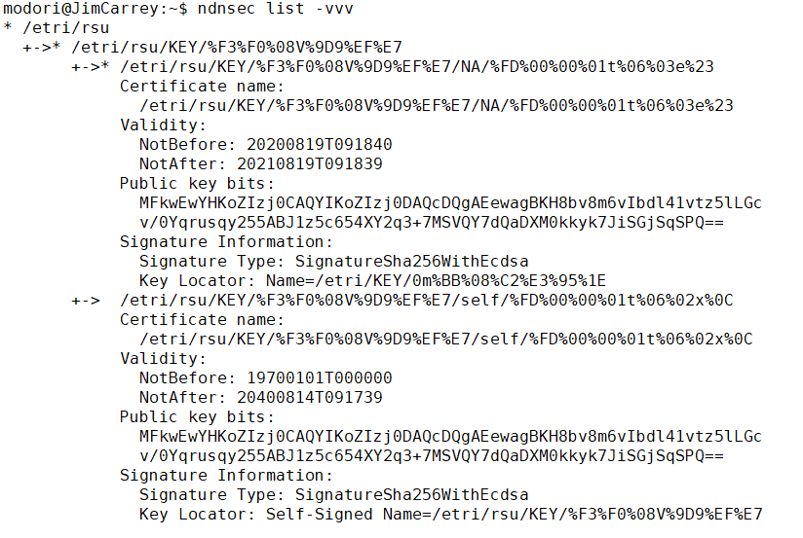
NDN Security Configuration

Slide 13
주요 NDN-CXX Classes
Interest Class : 필요한 데이터를 요청할 때 전송
InterestSigner Class : An authenticated Interest를 발행
Data Class : 요청된 데이터와 Signature 정보를 담아서 되돌려 줌.
Certificate Class : a common certificate format to standardize the public key authentication procedure.
KeyChain Class : ndnsec으로 생성된 Key/Certificate를 관리
Face Class : Interest/Data 패킷 전송 담당
ValidatorConfig : Sign된 Interest 나 Data를 검증할 때 사용
ndn-cxx/tests -> unit test 제공

Slide 14
Command Interest Coding
ndn::security::CommandInterestSigner signer(m_keyChain);
vector<uint8_t> appData(m_udp_data, m_udp_data+pkt_len);
Name name("/etri/auto-car");
tring str_car_id("/car");
str_car_id += std::to_string(m_confParam.getCarId());
name.append(str_car_id);
name.append("car-event");
Interest interest = signer.makeCommandInterestWithAppParams(
name, appData, signingByIdentity(m_keyChain.getPib().getDefaultIdentity()));
interest.setMustBeFresh(true);
interest.setCanBePrefix(true);
cout << "Express interest " << interest.toUri() << "\n" << endl;
m_face.expressInterest(interest, nullptr, nullptr, nullptr);

Slide 15
Certificate Request Coding
void onKeyInterest(const InterestFilter&, const Interest&interest)
{
std::cout << "Got interest for certificate. Interest: " << std::endl;
try{
Name identity = extractIdentityFromKeyName(interest.getName());
const auto cert =
m_keyChain.getPib().getIdentity(identity).getDefaultKey().getDefaultCertificate();
m_face.put(cert);
} catch(std::exception& e) {
std::cout << "Certificate is not found for: " << interest << std::endl;
}
}

Slide 16
Data Coding
void onInterestValidationSuccess(const Interest& interest)
{
cout << "\nInterest Validation success\n" << endl;
cout << "Got interest packet with name " << interest.getName().toUri() << "\n" << endl;
if(!interest.getName().compare(0, 3, g_c_horizon_name)){
vector<uint8_t> horizon(1024);
auto data = make_shared<Data>(interest.getName());
data->setFreshnessPeriod(1_s);
data->setContent(reinterpret_cast<const uint8_t*>(horizon.data()), horizon.size());
m_keyChain.sign(*data, signingByIdentity(m_identity));
// Return Data packet to the requester
std::cout << "<< D: " << *data << std::endl;
m_face.put(*data);
}else{
ndn::Block pa = interest.getApplicationParameters();
std::cout << "<< Received Parameters's Size: " << pa.value_size() << std::endl;
}
}

Slide 17
dcn-cxx-0.7.0/NFD-0.7.0
https://etrioss.kr/hii/dcn/dcn-cxx-0.7.0.git → ndn-cxx-0.7.0 버전
https://github.com/named-data/NFD/releases/tag/NFD-0.7.0
https://etrioss.kr/hii/autocar/v2x-ndn-obu -> NDN App Demo

Slide 18
Demo 실행 방법
Auto-Car Event Case
RSU: $sudo ./ndn –-mode=rsu
OBU: $sudo ./ndn --mode=obu –e
Object Notification Case
OBU: $sudo ./ndn --mode=obu
RSU: $sudo ./ndn --mode=rsu –n
C-Horizon Case
RSU: $sudo ./ndn --mode=rsu
OBU: $sudo ./ndn --mode=obu -c

Slide 19
Dissect-Wireshrk
https://github.com/named-data/ndn-tools/tree/master/tools/dissect-wireshark
Usage By default, the dissector script ndn.lua is installed into /usr/local/share/ndn-dissectwireshark. On some platforms, it may also be installed in /usr/share/ndn-dissectwireshark or /opt/local/share/ndn-dissect-wireshark. To enable the dissector for Wireshark session, use -X command line option, specifying the full path to the ndn.lua script: wireshark -X lua_script:/usr/local/share/ndn-dissect-wireshark/ndn.lua Similarly, NDN packets dissector can be enabled when using tshark: tshark shark -X lua_script:/usr/local/share/ndn-dissect-wireshark/ndn.lua To enable NDN packets dissector for all future Wireshark sessions, you can create/edit Wireshark's init.lua script, which located in /usr/share/wireshark, /usr/local/share/wireshark, /Applications/Wireshark.app/Contents/Resourc es/share/wireshark, or similar location depending on the platform and the way Wireshark is installed. The dofile command should be added to the end of init.lua file:
-- dofile("/full/path/to/ndn.lua")
dofile("/usr/local/share/ndn-dissect-wireshark/ndn.lua")
For more detailed information about how to use Lua refer to Lua wiki.
$ sudo apt-get install wireshark
$ sudo dpkg-reconfigure wireshark-common
$ sudo usermod -a -G wireshark $USER
$ newgrp wireshark
ndn-tools 미리 설치 해야 함.

Slide 20
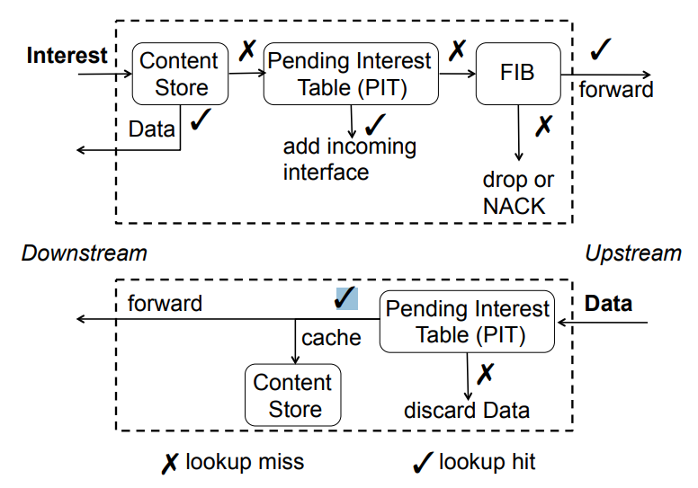
NDN Router(NFD) Model

Slide 21
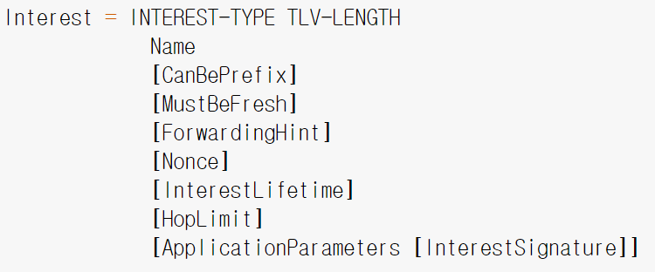
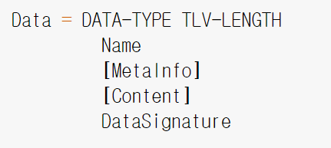
NDN Packet Format

Slide 22
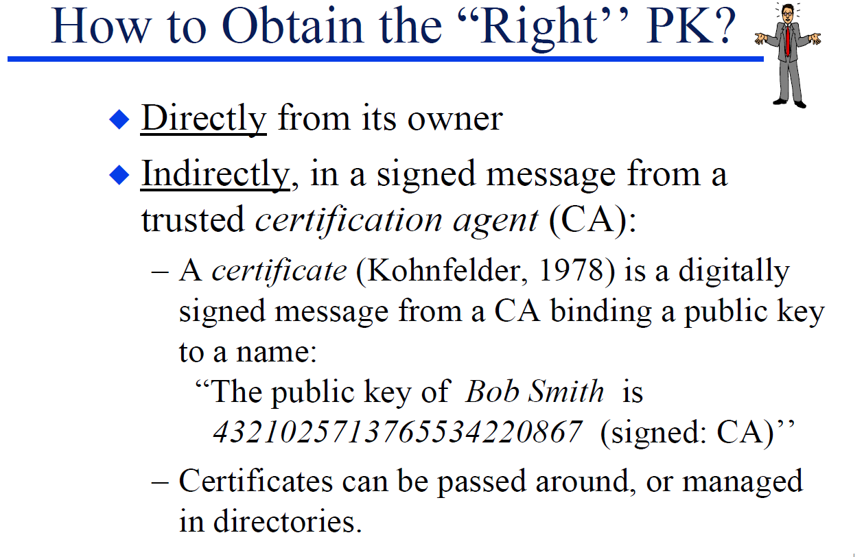
NDN Security

Slide 23
Signed Interest
Signed Interest is a mechanism to issue an authenticated Interest.
A signed Interest is an Interest where:
Name ends with ParametersHas256DigestComponent.
InterestSignature is present.

Slide 24
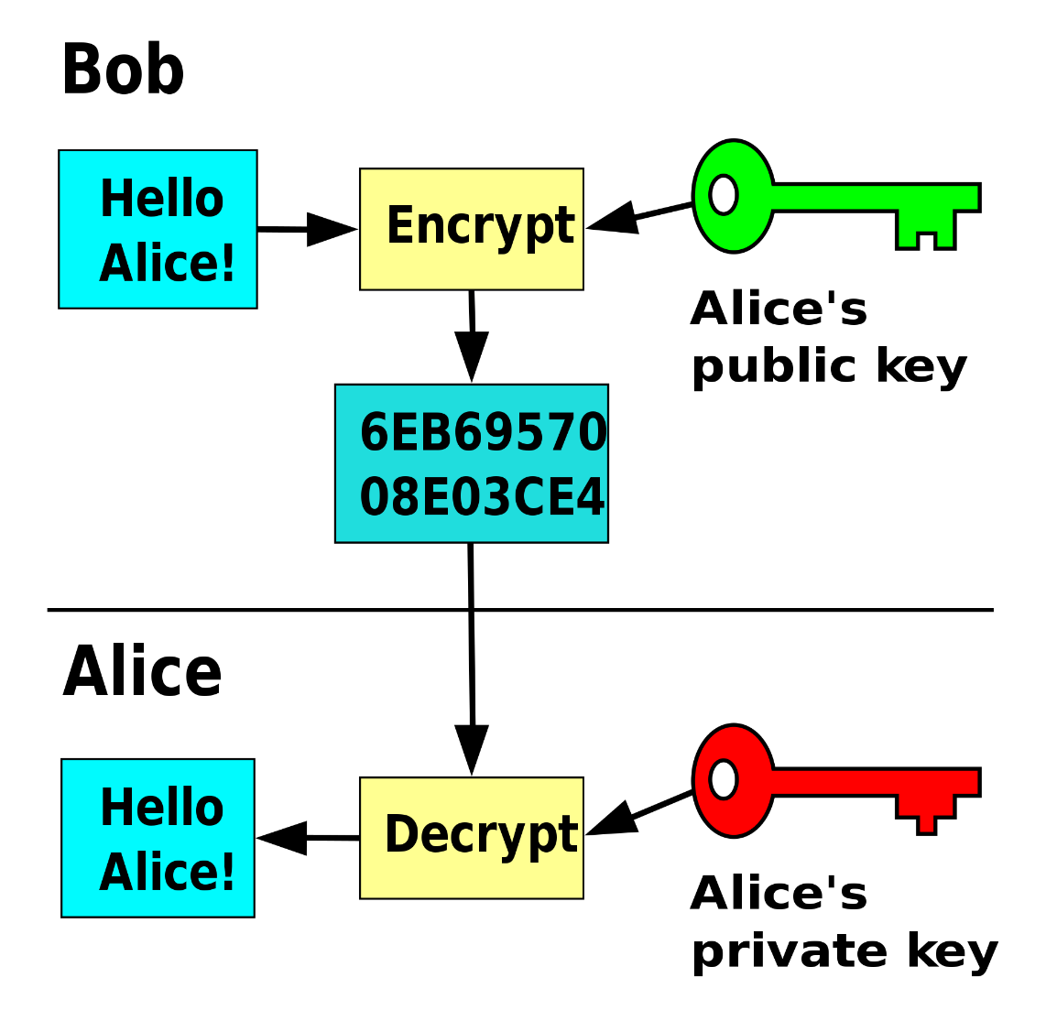
NDN Security
공개키 암호에서는 누구나 공개키를 이용해 메세지를 암호화 할 수 있지만 개인키의 소유자만이 암호화된 메세지를 복호화 할 수 있다.

Slide 25
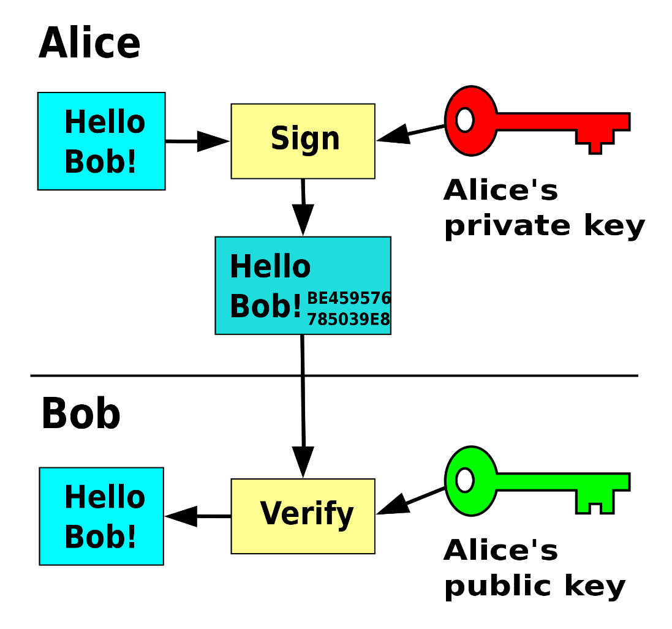
NDN Security
메세지와 개인키를 결합하여 디지털 서명을 하는 경우 그에 대응되는 공개키를 가진 누구나 서명이 유효한지 검증할 수 있다.

Slide 26






