Slide 1

How Robust Are AI Watermarks?
Evaluating Text Watermarking Under Paraphrase Attacks
CSGS Hackathon 2026 • P4: AI Security
Mustafa Ibrahim • Muhammad Rabiu • Aamr Ibrahim
Department of Computer Science, Old Dominion University
March 31, 2026

Slide 2
Why Use Watermark LLM-Generated Text?
Intellectual Property Protection
Organizations invest millions training LLMs watermarks prove model ownership and trace unauthorized use of outputs
Unauthorized Knowledge Distillation
Adversaries can train competing models on watermarked API outputs watermarks enable detection of this IP theft
Content Authenticity & Integrity
Watermarks verify whether text was AI-generated critical for academic integrity, media trust, and regulatory compliance

Slide 3
How KGW Watermarking Works
Kirchenbauer et al., ICML 2023
1
2
3
4
Hash Context
Split Vocabulary
Bias Generation
Detect via Z-test
Hash the preceding h tokens to get a position-specific seed
Use the seed to partition vocab into Green List and Red List
Add bias to green-list token logits during sampling
Count green tokens
Key Parameters: γ = green list fraction (0.25 or 0.5) | δ = logit bias strength (1.0 to 4.0) | h = context width (1 or 4)
Higher δ = stronger watermark but potential quality loss. Larger γ = more green tokens but weaker signal per token.

Slide 4

Threat Model
DEFENDER
ADVERSARY
LLM service provider
• Embeds watermark to assert model IP
• Controls secret key and γ, δ, h
• Detects unauthorized output usage
• Goal: prove ownership, maintain TPR
User stripping model IP
• Black-box: no key, no detector access
• Has access to a separate LLM
• Paraphrases to remove IP signal
• Goal: claim output as own / distill model

Slide 5
Our Approach: Systematic Robustness Evaluation
6
×
4
=
24
Watermark
Configurations
Attack
Types
Robustness
Evaluations
Attack Types:
Configurations:
Synonym Substitution
Config | γ | δ | h
weak | 0.50 | 1.0 | 1
moderate_low | 0.25 | 2.0 | 1
moderate_high | 0.50 | 2.0 | 1
strong | 0.25 | 4.0 | 1
moderate_ctx4 | 0.25 | 2.0 | 4
strong_ctx4 | 0.25 | 4.0 | 4
WordNet-based word replacement (30%)
LLM Paraphrase
Flan-T5 semantic rewriting
Back-Translation
EN → FR → EN round-trip
Sentence Rewrite
Aggressive restructuring via Flan-T5

Slide 6
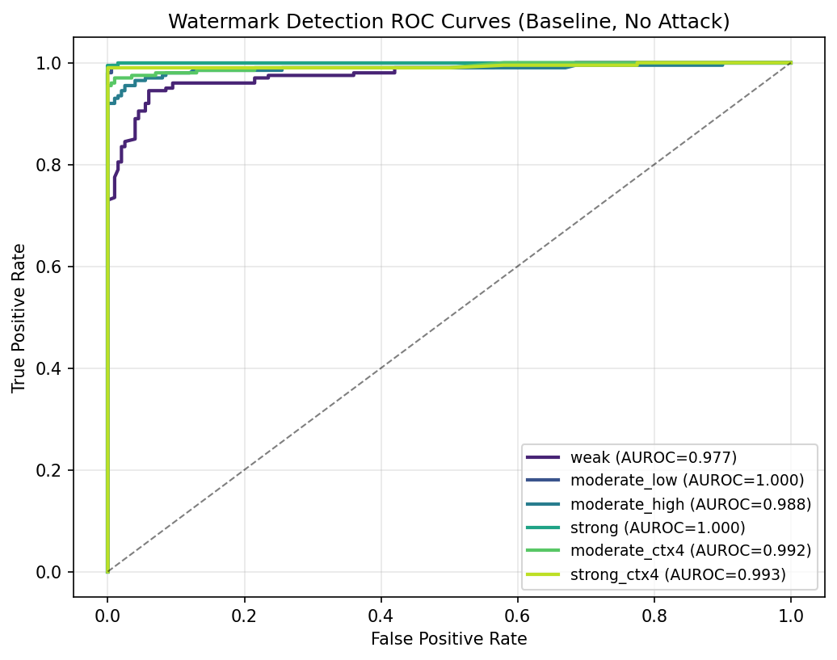
Result 1: Baseline Detectability
All configs achieve
high AUROC without attack
Strong config (δ=4.0) reaches near-perfect separation between watermarked and unwatermarked text.
Z-score distributions
show clear separation
Watermarked texts cluster at high z-scores; unwatermarked texts stay near zero.

Slide 7
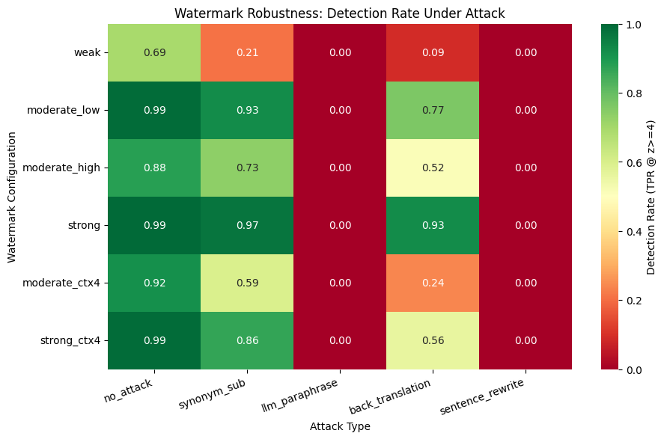
Result 2: Robustness Under Attack
Key Findings
1
Synonym substitution and back-translation partially degrade detection. Stronger δ resists better.
2
LLM paraphrase and sentence rewrite reduce output length below detection threshold, yielding 0% detection. This is a dual attack on both signal and text length.
3
This exposes a fundamental limitation: z-score detection requires sufficient token count, and attackers who condense text exploit this dependency.

Slide 8
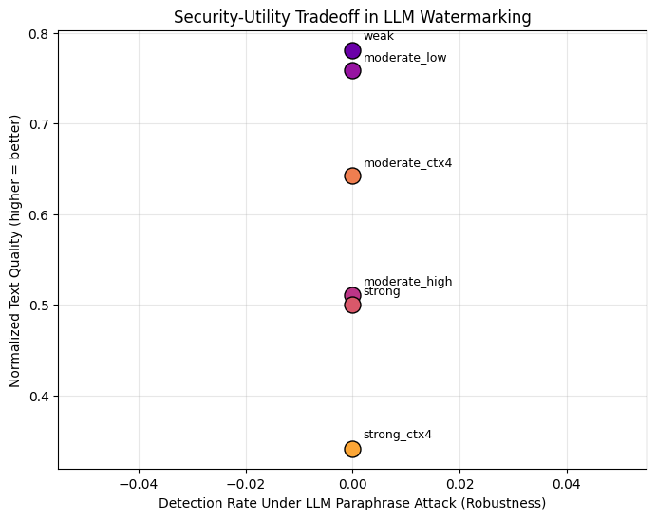
Result 3: Security-Utility Tradeoff
Stronger δ = More Robust
Higher logit bias creates stronger green-list alignment that survives more editing.
But: Higher Perplexity
Strong watermarks push the model away from its natural token distribution, increasing perplexity.

Slide 9
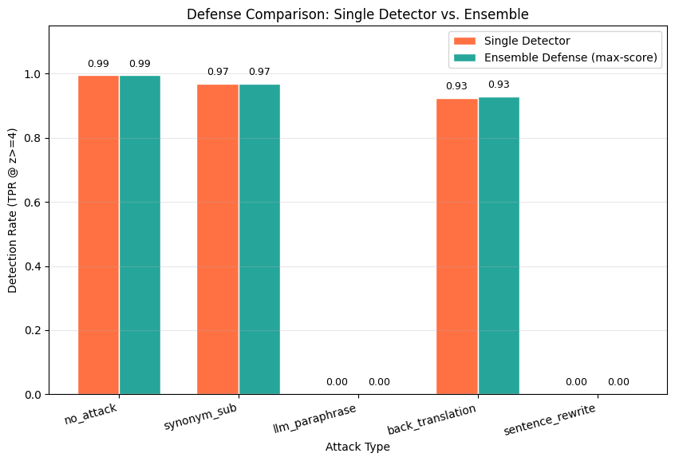
Defense: Ensemble Detection
Why It Works
Ensemble matches single-detector performance across all attacks.
Neither approach detects watermarks when attacks compress text length.
Provides a safety net against future attacks that target specific context widths.
The real gap is text-compressing attacks, not token-shuffling ones.

Slide 10
Key Takeaways
Watermarks work under benign conditions
All configurations achieve high AUROC for AI text detection when text is unmodified.
A fundamental tradeoff exists
Stronger watermarks resist attacks better but degrade text naturalness. No free lunch.
Ensemble detection helps but doesn't solve it
Combining context widths improves robustness, but a determined adversary with LLM access remains a challenge.

Slide 11

Thank You — Questions?
Mustafa Ibrahim • Muhammad Rabiu • Aamr Ibrahim
References
[1] Kirchenbauer et al. (2023). A Watermark for Large Language Models. ICML 2023.
[2] Kirchenbauer et al. (2024). On the Reliability of Watermarks for LLMs. ICLR 2024.
[3] Pan et al. (2024). MarkLLM: An Open-Source Toolkit for LLM Watermarking. EMNLP 2024.
[4] No Free Lunch in LLM Watermarking. NeurIPS 2024.
[5] Zhao et al. (2025). Can Watermarks Detect LLM IP Infringement For Free? ICLR 2025.

