Slide 1
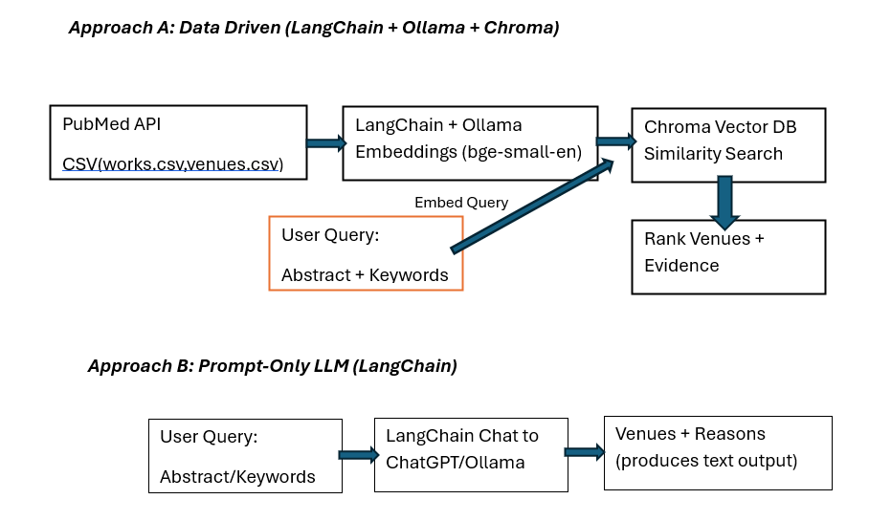
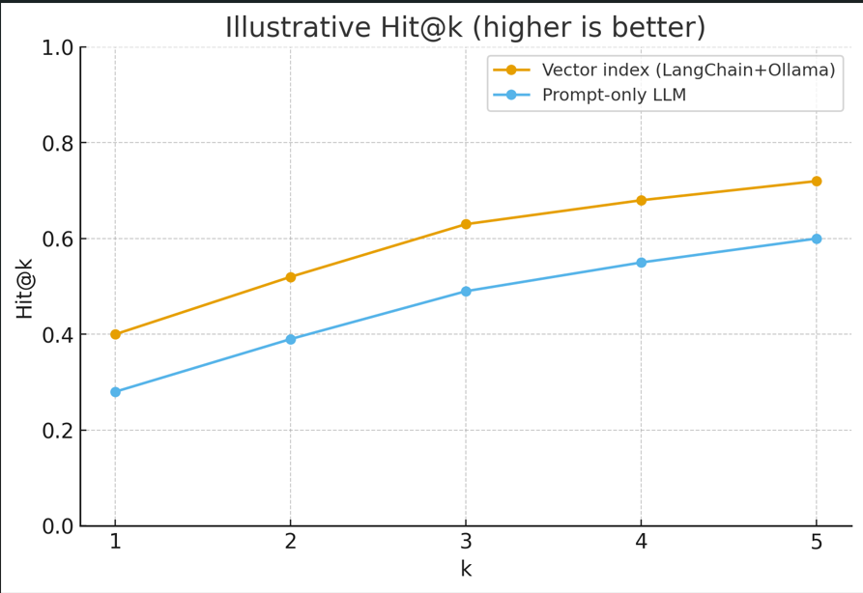
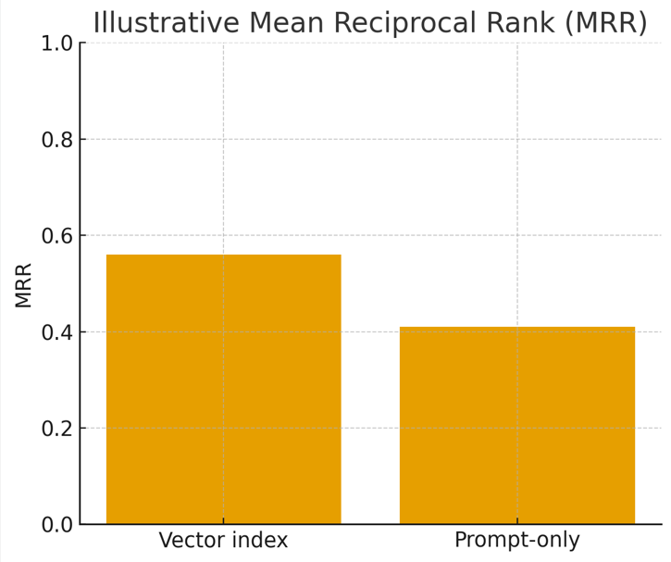
AI-Enhanced Venue Recommendation System for Academic Publications Using Large Language Models and Metadata Analysis .
17012484.Tafadzwa Machemedze
Keele University
Abstract
Methodology
Conclusion
This project looks at how artificial intelligence and large language models can help suggest where to submit research papers. It's often tough for researchers to pick the right journals or conferences. There needs to be knowledge of your field and what kind of details and different publications usually want.
Two systems were built and tested to tackle this problem. The data was used in different ways, for example, a dataset using info from PubMed, grabbing titles, summaries, keywords, and journal details.
The data was turned into a format computers can understand using a the Ollama framework model called bge-small-en, and then saved it in a special database using a csv. When someone searches, we compare their search to the saved information and rank the best publication places.
The second way skipped building a dataset. Instead, we asked a pre-trained language model to suggest places to submit papers based on the paper's summary. Testing the data-driven way showed that it was better at grouping similar topics together. The right suggestion was made in the top 3 percent of the data, suggesting it's pretty good at finding the appropriate venues. We also showed evidence articles with the suggestions, which helps people trust the system more.
Just asking the language model was also used and gave reasonable suggestions, even suggesting places that weren't in our PubMed data. But it wasn't always consistent and sometimes made stuff up through hallucinations. So, the two ways show that there's a trade-off: the data-driven way is dependable and clear but limited by the data it has, while the other way is flexible but not as reliable.
What we found out is that these computer-friendly formats are good for grouping similar topics together, showing evidence helps build trust, and language models can suggest places beyond what's in existing datasets. We think that the best way to go forward is to use both: a system that uses data to find possible places and then uses language models to give even more suggestions.
Two complementary systems for recommending suitable journals and conferences for research papers based on prompts typed in by the user. The aim was to compare information retrieval, semantic embeddings, and large language models (LLMs), and explore how a hybrid approach could combine their strengths.
Data Collection: Metadata from PubMed (titles, abstracts, keywords, authors, venues) cleaned and stored in CSV. Using a lightweight data schema that tasks the meta data from pubmed such as Abstract and keywords and uses an Entrez API
Embedding Retrieval: Using LangChain with Ollama’s bge-small-en, papers were embedded and indexed in Chroma; queries matched by cosine similarity. When a user submits a new abstract, its embedded and a similar article is found in the CSV that’s created.
LLM Suggestion: LangChain also connected to ChatGPT/Ollama for direct prompt-only recommendations.
Evaluation: Top-k accuracy, MRR, and case studies assessed both systems.
This project demonstrates how integrating traditional information retrieval techniques, modern embedding-based models, and large language models (LLMs) can improve the process of recommending academic publication venues. Selecting the right venue has long been a time-consuming and uncertain task, particularly for early-career researchers, and existing tools often fall short by relying solely on keyword matching.
Our experiments compared two complementary approaches: a data-driven system built on curated metadata and semantic embeddings, and an LLM-based system that generates venue suggestions directly from paper abstracts. The data-driven approach proved reliable and interpretable, consistently grouping similar topics and returning correct venues among the top-ranked results. It also provided evidence articles alongside recommendations, which can help build user trust. In contrast, the LLM-based method demonstrated flexibility and creativity, suggesting venues beyond the dataset, though it occasionally produced inconsistent or fabricated outputs.
These findings highlight a clear trade-off: data-driven methods are dependable but limited by the scope of their datasets, while LLMs are broad but less predictable. Combining these approaches in a hybrid pipeline can deliver more accurate, trustworthy, and comprehensive recommendations offering practical support to researchers and contributing a reproducible framework for future IR/NLP venue recommendation research
Introduction
Academic publishing plays a central role in advancing scientific knowledge, yet identifying the most suitable venue for a research paper remains a difficult task especially for early-career researchers. Each year, thousands of manuscripts are submitted to journals and conferences across computer science, artificial intelligence, and related fields such as cybersecurity. Selecting an appropriate venue directly affects not only whether a paper is accepted but also how visible and impactful the work becomes.
Currently, many researchers rely on prior experience, trial and error, or informal advice from supervisors and peers to guide their decisions. While tools such as CrossRef, PubMed, and DBLP support literature discovery, they are limited when used for venue selection. These systems typically depend on keyword-based retrieval algorithms such as BM25, which match terms but fail to capture deeper semantic meaning. This makes it easy for relevant venues to be overlooked, particularly when terminology differs across disciplines or subfields.
Recent advances in information retrieval (IR), natural language processing (NLP), and large language models (LLMs) offer a powerful opportunity to transform this process. However, very few systems currently apply these methods to venue recommendation. This project addresses that gap by exploring AI-driven approaches to support researchers in identifying suitable publication venues more effectively.
.
References
Add your information, graphs and images to this section.

