Slide 1
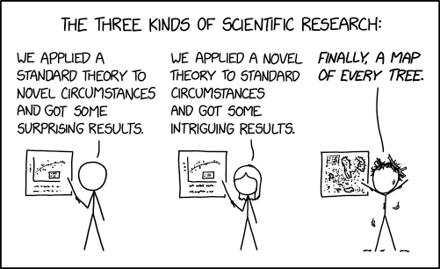
Introduction to Research
Summer Project Research Workshop
12 Nov 2025
Mingfeng Qiu
School of Maths & Stats
Slides:
Mingfeng Qiu, Philipp Wacker

Slide 2
life cycle of a research project
Idea
Literature
Project
Communication
Elements of a research project
Idea
Communication
Project
Literature

Slide 3
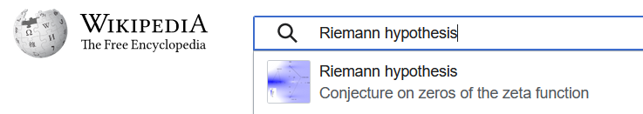
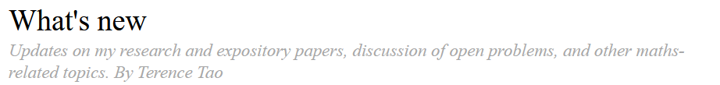
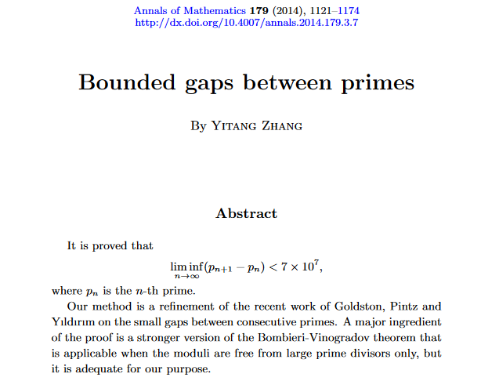
literature
Types of literature
Webpages, news reports
Lecture notes, Books
Preprints
Journal article
Conference papers
LLM outputs ?
Signs of credibility
Peer-reviewed
Editorial standard
DOI: Digital Object Identifier
Use all kinds of literature for clues and inspiration.
Trust more credible sources.
Cite officially published results.

Slide 4
generative AI
Can be good for brainstorming, can explain some basics concept quite well, is OK at basic math and quite good in coding
Can hallucinate
Be very careful with taking its statements at face value. Always verify, either by yourself (check calculations, run code,...) or with a more trustworthy source (papers, blog posts by trustworthy people, even Wikipedia ...)
Is very bad at advanced research-level math (lack of suitable training material for GenAI), since it just replicates existing material
Becoming a mathematician/statistician means building up your knowledge by "improving your cognitive fitness" over many years. Don't let ChatGPT take away your learning!
"Using GenAI is like bringing a forklift to the weight room" (Ted Chiang)
That being said, it can be an excellent tool to help you get "unstuck", give you running code, explain some concept in a way that might work better, rephrase text if English is not your first language...
Treat GenAI like a semi-trustworthy roommate with a PhD who is on psychedelics all the time

Slide 5
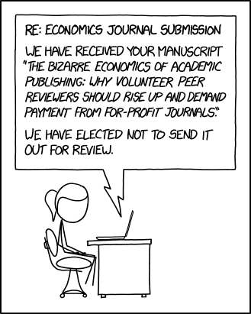
genesis of papers
Find out something new
Write up results as a manuscript
Upload to a preprint server (arxiv, biorxiv)
Do {
  Submit manuscript to suitable journal
  Journal editors (unpaid) pick 2-3 referees (unpaid) who read the paper.
  Referees check the paper, look for mistakes, etc
  Referees send report to editor with one of the following recommendations:
    Accept without modifications
    Accept after minor modifications
    Major changes needed, possible resubmit
    Reject without resubmit
  Editor usually follows the suggestion of the referees and sends out a accept/reject/modify letter
  } (until accepted by a journal) # This process can take a 6-12 months easily
Do revision if needed, reupload to preprint server, submit revised version to journal (with a possible revision after that)
Journal accepts article
After a few months, proof-editing (typos etc)
Paper is published (typically 1-3 years after first manuscript)
In very fast-changing fields turnaround time can be quicker

Slide 6
finding papers
Google Scholar (usually with pdf)
Most math and stats papers are on arXiv, which is (up to formatting) identical to the published version
biology: bioRxiv
health: medRxiv
Journal webpages (but sometimes these are paywalled, although UC has some blanket subscriptions so you should be able to access if you are logged in)

Slide 7
collecting papers
Active search
Google scholar good general search engine
Using citation relations
From researchers’ web pages
AI tools: Litmaps, Semantic Scholar… AI recommendations
Passive search
Journal newsletters sent to your email
RSS subscriptions following a collection of journals in one dedicated place
AI tool feeds can create email alerts
Twitter/X follow individual researchers or journals
bluesky/Mastodon a lot of researchers have migrated since Twitter/X has become a festering cesspool
ArXiv newsletter
Google scholar: useful tips
AND, OR, “ ”
Cited by
You can get PDFs!

Slide 8
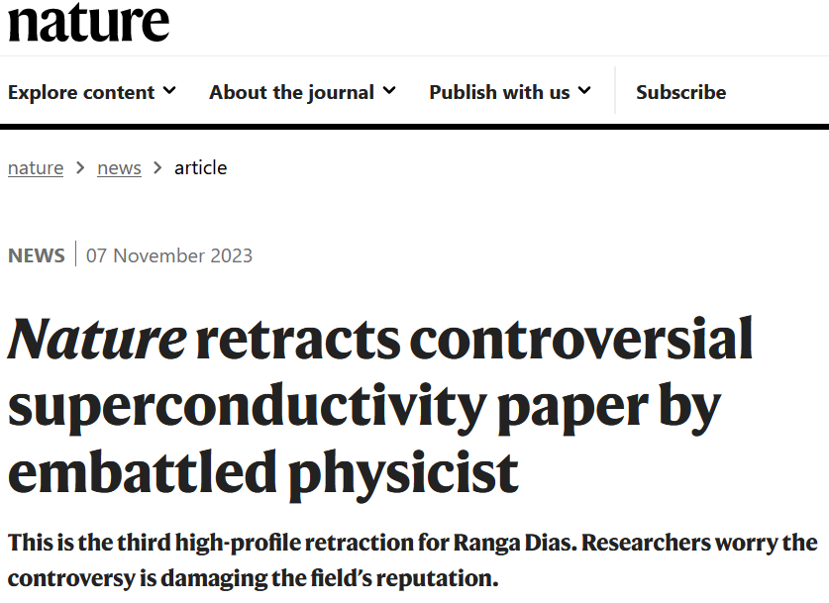
evaluating journals
Is this a good journal?
It should become obvious after some time.
Use metrics (discipline dependent)
  Indexing databases: SCI, EI, Scopus…
  Impact factor
  H index
  Scimago journal rankings, Q1-4
Any metric of a journal does not necessarily reflect the quality of any individual publication.
Read up on "predatory publishing"
In my experience, even published papers can (and often do) still have errors that you might need to find, and correct.

Slide 9
reading papers
Find a specific detail
Parts of a paper (read in any order)
Abstract
Introduction
Conclusion
Figures
Section headings
Equations
Read full details
First sentences of paragraphs
Skim through sections
Full paper
Read the abstract
Appendices/supplementaries
Be flexible.

Slide 10
reading papers
DO NOT PANIC
Reading papers is hard and it can take a very long time (weeks, months, or even years) until you think you have sufficiently understood a paper.
You don't have to understand every aspect of every paper every time.
Most papers are written badly (publish or perish means there often is no time for pedagogy).
get help from generative AI?

Slide 11
example
Noll et al., Nat. Phys., 2017

Slide 12
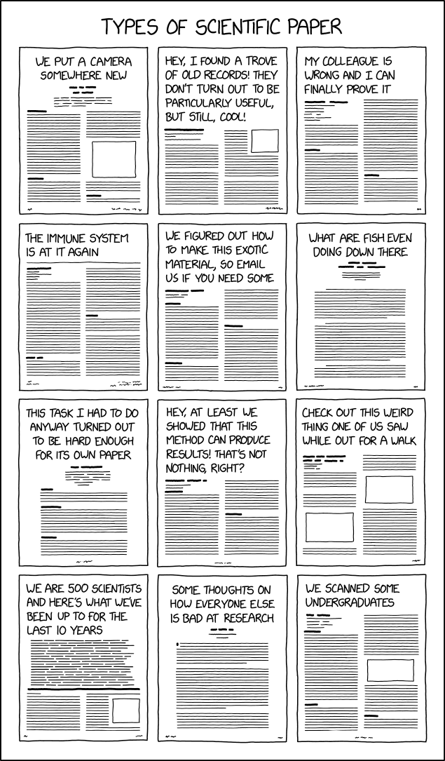
evaluating papers
Types of journal articles
Review
  Good for entering a field
  Overview of existing knowledge and latest developments
Original work (Research paper)
What makes a “good” original result?
Small incremental work?
Completely new direction?
Number of citations?
Depth of result
Generality of conclusions
A new way to think about something that is already known

Slide 13
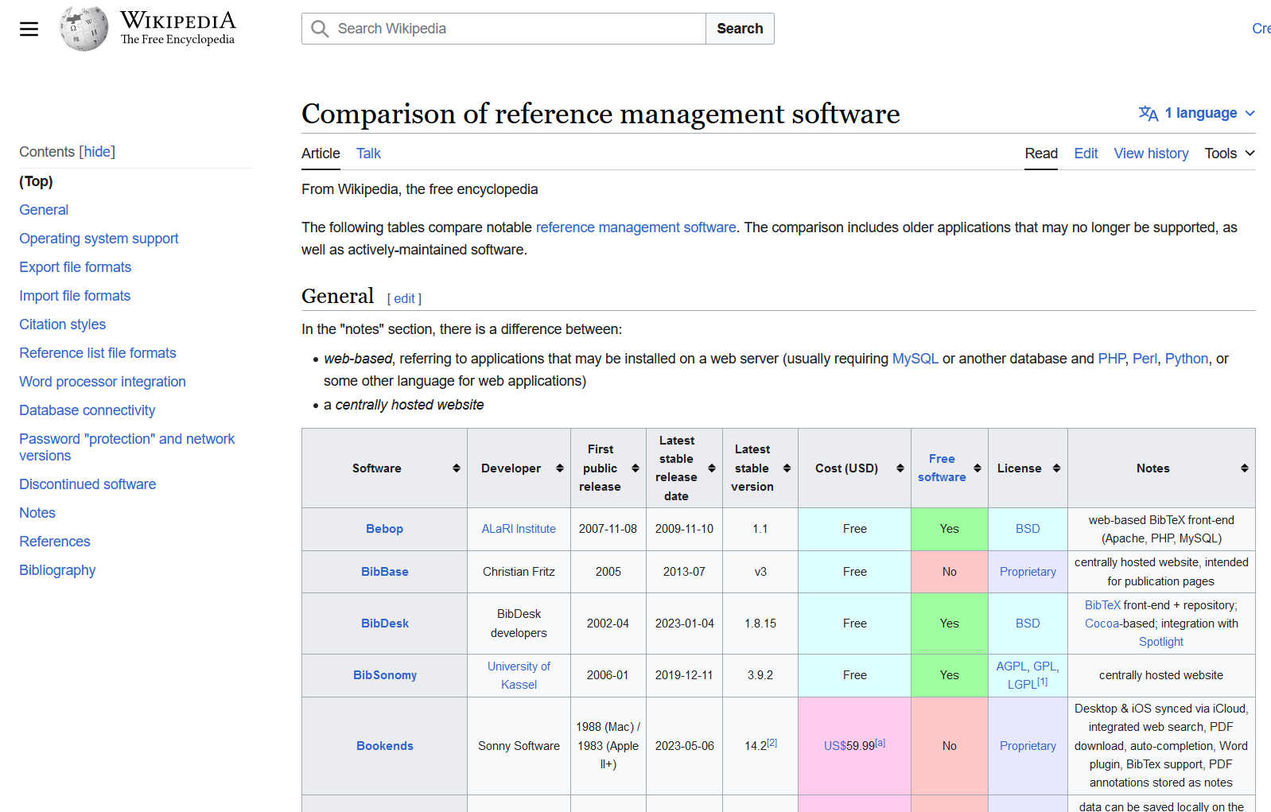
curating papers
Literature management systems
A folder with PDFs
A folder with subfolders
Automated tools
  Mendeley, EndNote…
  Zotero, Jabref
  Papers
Use an automated system to typeset citations in your report
LaTeX: bibtex or biblatex
Word: Mendeley…

Slide 14
doing research
You are expected to
Put in a reasonable amount of time
Have regular discussions with your supervisor
Uphold academic integrity
Present results at the end of the project
Idea
Communication
Project
Literature
You are encouraged to
Think independently and show initiative
Come to the school’s research seminars (see how other researchers present their work and learn how to (or not to) do this!)
Do things you are excited about

Slide 15
impostor Syndrome
"any day now, people will realise I don't really know what I am doing"
"I don't belong here"
"I am not as clever as all the other researchers/students/scientists"
Almost everyone has it
It hits under-represented groups over-proportionally hard
Almost no one is really as smart as they seem
Almost all major math achievements are the result of hard work, not of talent or even "genius"
If you enjoy math, and keep at it, you will be able to understand many things that you did not expect you could understand (maybe not fast enough for your taste).

Slide 16
summary
Learn a bit about how research and collaborative science works
Learn to be OK with knowing nothing and being completely stumped
Learn to communicate science, both verbally, in writing, and in a presentation
Collaborate with others
Use gen-AI effectively and responsibly
Have fun

