Slide 1
Service Oriented Architecture
TABUEU FOTSO Laurent Cabrel
PhD Candidate
Notes:
10

Slide 2
Content
Introduction
A SOA Course! Isn't SOA Dead?
What's Special About this Course?
Course Structure
<numéro>
Notes:
10

Slide 3
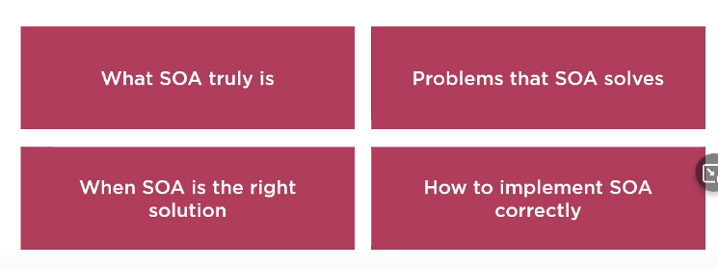
Introduction
In 2009, an article titled SOA is Dead (By Anne thomas) caused various discussion and many people agreed;
SOA problems
- False expectations from implementing SOA
- Misconceptions
We will teach you
In fact, it'is very much alive and will continue to be for a considerable time
<numéro>
Notes:
10

Slide 4
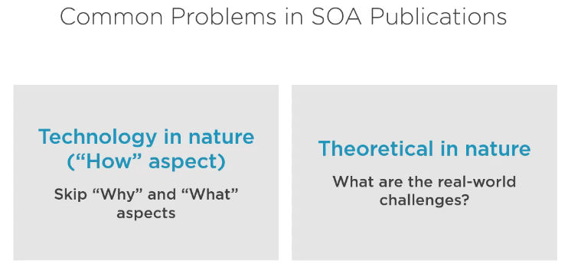

What's Special About this?
<numéro>
Notes:
10

Slide 5
Structure
Part I
as we start examining SOA at the high-level architecture, known as a reference architecture, here we will learn what SOA is made of, what are its building blocks, what type of services will we create, and the overall structure and dynamics of a SOA.
<numéro>
Notes:
10

Slide 6
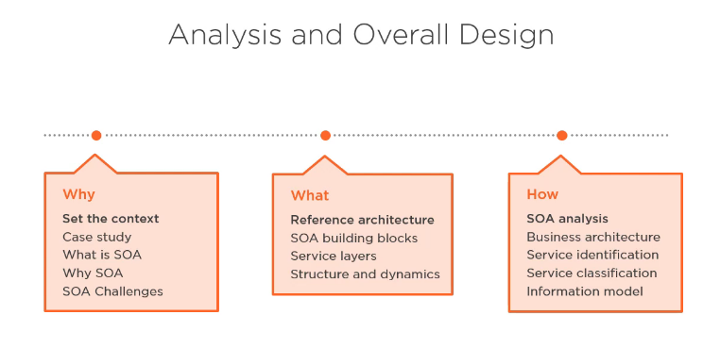
Structure
Part I
5
Notes:
10

Slide 7
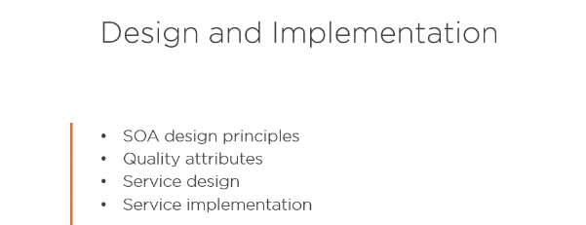
Structure
Part II
6
Notes:
10

Slide 8
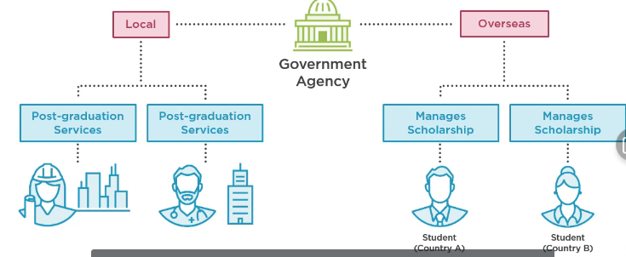
Case Study
The case study is an adaptation of a real world scenario of a government agency. This agency funds and manages the scholarship of post-graduate students who are study overseas to earn the master , PhD. After completion scholarship the agency also offers post-graduation services which help graduates find internships and jobs. The type of students , thiers allocated funds and other complex business concerns are not relevant to this discussion.
7
Notes:
10

Slide 9
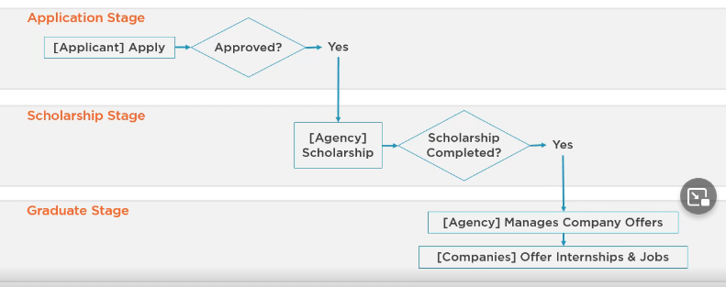
Case Study
The high-level scenario goes as follows:
Application stage: where the applicant submit thier requests and get either approuved or rejected ; scholarship stage: This is the core of thier buisness where approuved applicants get thier entire scholarship managed in terms of finance and administration; graduate stage: get services that help them get internship son jobs.
8
Notes:
10

Slide 10
Case Study
In the high-level an applicant to a scholarship, the govmment manage everything related to this scholarship, such as funding, changing the major, grade striking, financial requests, pausing and resuming the scholarship
9
Notes:
10

Slide 11
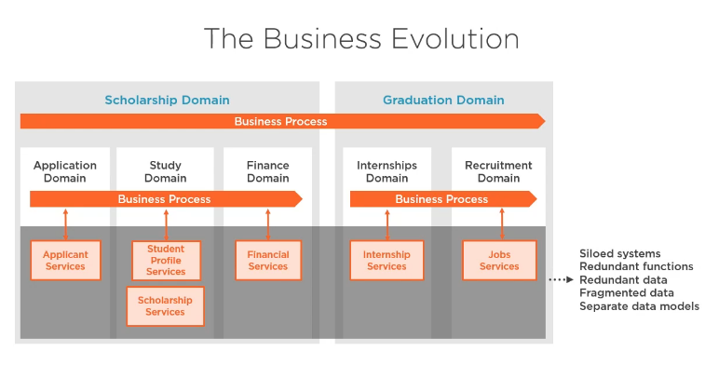
Case Study : Problems
10
Notes:
10

Slide 12
Case Study : Problems
let's examine the problems that the organisation is facing and throughout
the course we're going to see how SOA help solving these problems.
So when the government agency first started. the demands was to get
the public services into as soon as possible at all costs.
So the team started by creating a couple of systems that provide certain.
The scope started to get bigger and it was requested to present
schoolarship related services such as majour changind and stopping
a scholarship.
Then later, the financial services were requested as
the agency decided to streamline the process by which
they compensate students.
10
Notes:
10

Slide 13
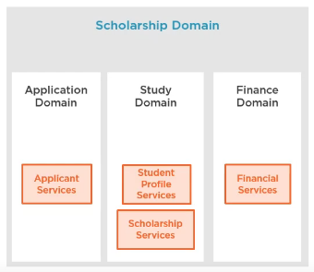
Case Study : Problems
At this stage the agency decided that as the range of busness is incresed,
then it must partition the buisness domaines into a set of subdomains to
ease managment and planning
So a scholarship business doamin was established and included study,
study and finance each become the owner of the set informations system
that serve this domain.
10
Notes:
10

Slide 14
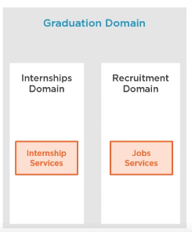
Case Study : Problems
But the business model of the agency kept
growing and now a major decision was taken
to provide most schoolarship services ,
first helping graduales land interships, then
expending the scope to help them land jobs .
10
Notes:
10

Slide 15
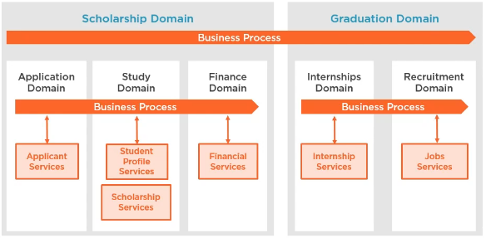
Case Study : Problems
During expansion came critical moment. Many services exposed to public ,
now required creation of cross-unit or cross-domain process
(collaborate to present public services).
Theses buisness processus use fonctions and data presented by
the informational system in order to perform thier services
-> this lies the problem.
10
Notes:
10

Slide 16
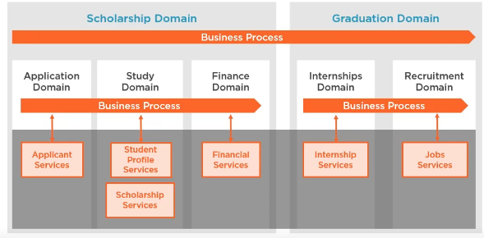
Case Study : Problems
System is initially built in silos without a single holistic view
of the entire architecture
This means that each system was created without taking consideration
the overall growth and architecture
10
Notes:
10

Slide 17
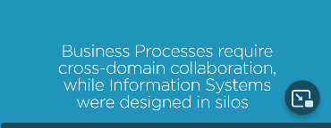
Case Study : Problems
a set of siled systems with redundant functionality,
redundant data between data stores, fragmented data between
different stores. So what the organization has is an interesting problem.
Business processes that were from the start designed to croos
unit boundaries and required different units to collaborate
to achieve requires outcomes. Yet the supporting systems the ones
that provide functiond and data to the processes are built in siloed
manner with no regard to cross-unit collaboration.
10
Notes:
10

Slide 18

Case Study : Problems
This makes the agency slow to react to requirements, new services and
slow to take advantage of new technical opportunities.
That could better enable the businesses.
It costs are high since it spends valuable
time and money. working arround the limitations
caused by the IT state.
Both developpment and operations costs
are high to keep the buisness running .
Customers are often required to enter the same information multiple times
and over the time, this information become inconsistent.
10
Notes:
10

Slide 19
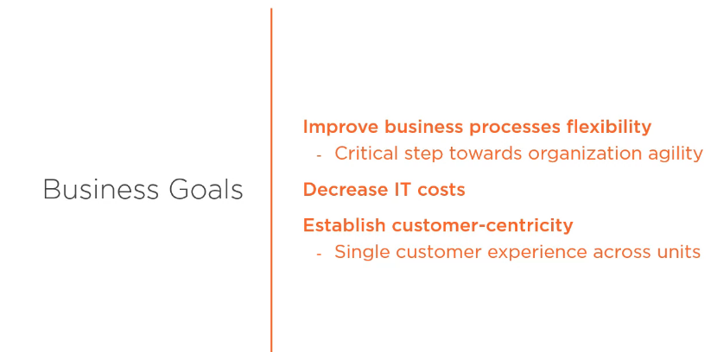
Case Study : Goals
10
Notes:
10

Slide 20
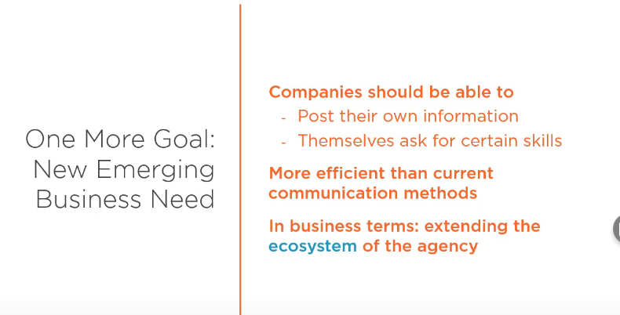
Case Study : Goals
10
Notes:
10

Slide 21
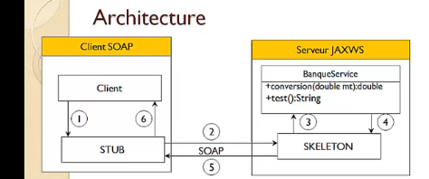
TP : Web service
1- The client asks the stub to call the conversion method
2- the stub connects to the skeleton and sends it a soap
request
3- The skeleton uses the method of the web service
4- the web service returns the result to the skeleton
5- The skeleton sends the result in a SOAP response
to the STUB
6- the stub provides the result to the client
10
Notes:
10

Slide 22
TP : Web service
package ws;
import java.io.Serializable;
/**
*
* @author FOTSO
*/
public class Account implements Serializable{
int id;
float solde;
public Account() {
super();
}
public Account(int id, float solde) {
this.id = id;
this.solde = solde;
}
wsgen -s . -wsdl -cp ../build/classes jaxws.ws.BankService
10
Notes:
10

Slide 23
TP : Web service
@WebService(serviceName = "BanqueWs")
public class BankService {
@WebMethod(operationName = "concersionEuroGh")
public double conversion(@WebParam(name = "amount") double mt) {
return 10 * mt;
}
@WebMethod
public String test() {
return "test";
}
@WebMethod
public Account getAcccount(@WebParam(name = "code") int id) { //if not public you can not see it
return new Account(id, (float) Math.random() * 152);
}
public List<Account> getAcounptes() {
List<Account> accounts = new ArrayList<>();
for (int i = 0; i < 6; i++) accounts.add(new Account(i, (float) Math.random() * 152));
return accounts;
}
}
10
Notes:
10

Slide 24
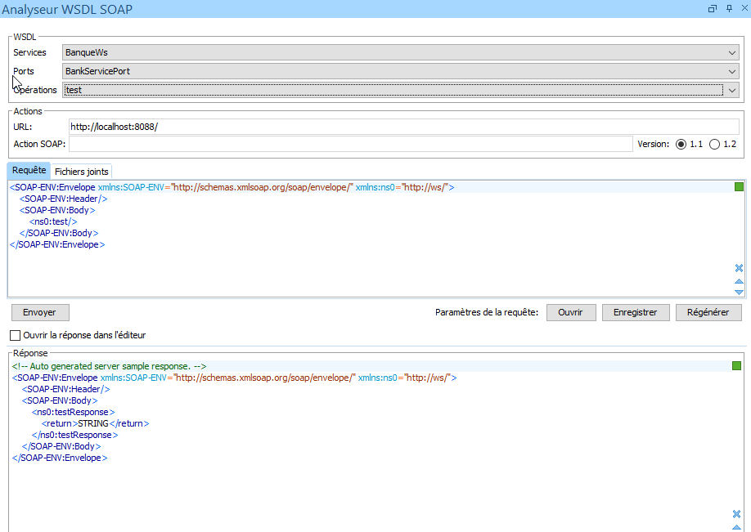
TP : Web service testing (uing oxygen, SoapUI,…)
10
Notes:
10

Slide 25
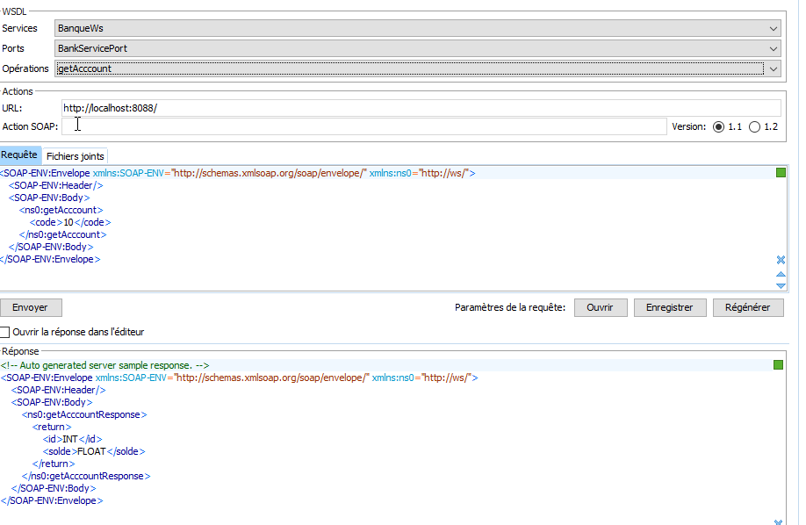
TP : Web service testing (getAccount)
Send request
10
Notes:
10

Slide 26
TP : Web service testing (getAccount)
<SOAP-ENV:Envelope xmlns:SOAP-ENV="http://schemas.xmlsoap.org/soap/envelope/" xmlns:ns0="http://ws/">
<SOAP-ENV:Header/>
<SOAP-ENV:Body>
<ns0:getAcounptes/>
</SOAP-ENV:Body>
</SOAP-ENV:Envelope>
<?xml version="1.0" ?>
<S:Envelope xmlns:S="http://schemas.xmlsoap.org/soap/envelope/">
<S:Body>
<ns2:getAcounptesResponse xmlns:ns2="http://ws/">
<return>
<id>0</id>
<solde>99.93814</solde>
</return>
<return>
<id>1</id>
<solde>74.77114</solde>
</return>
<return>
<id>2</id>
<solde>109.61301</solde>
</return>
<return>
<id>3</id>
<solde>15.757117</solde>
</return>
<return>
<id>4</id>
<solde>0.121832766</solde>
</return>
<return>
<id>5</id>
<solde>43.642258</solde>
</return>
</ns2:getAcounptesResponse>
</S:Body>
</S:Envelope>
Request: get all accounts
Respone: get accounts
10
Notes:
10

Slide 27
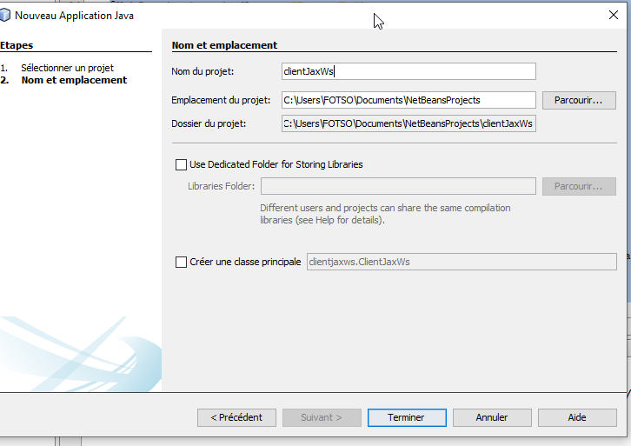
TP : Web service
Mainatenant suis une
autre entreprise connu
lien web Service dois
consomme
create java project:
How to create his stub?
10
Notes:
10

Slide 28
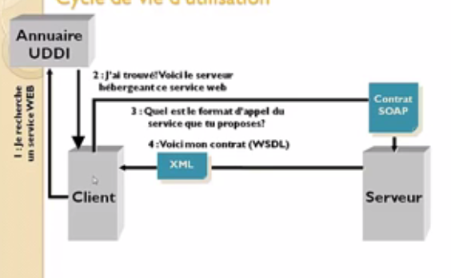
TP : Web service
Save wsdl file src java client project
10
Notes:
10

Slide 29
TP : Java customer
public class Customer {
public static void main(String[] args) {
BankService stub = new BanqueWs().getBankServicePort();
System.out.println("convert :" + stub.concersionEuroGh(10));
System.out.println(stub.getAcounptes());
for (Account acounpte : stub.getAcounptes()) {
System.out.println("id: "+acounpte.getId()+ " solde: "+acounpte.getSolde());
System.out.println("-----------------------------------");
}
}
}
10
Notes:
10

Slide 30
TP : PHP customer
Create and consume SOAP web service using PHP
Prerequisites
Apache HTTP Server 2.4, PHP 7 or more, NUSOAP Library, CURL
Configure PHP SOAP
Consume SOAP Service
I will show you here 3 different ways of calling or consuming SOAP web service. The first method is using SoapClient, the second method is using NUSOAP library and the third method is using CURL.
Using SoapClient
Using SoapClient you do not need to use any third party library because SoapClient is already available in PHP engine.
The following PHP code using SoapClient calls the converter method, get account ,….
10
Notes:
10

Slide 31
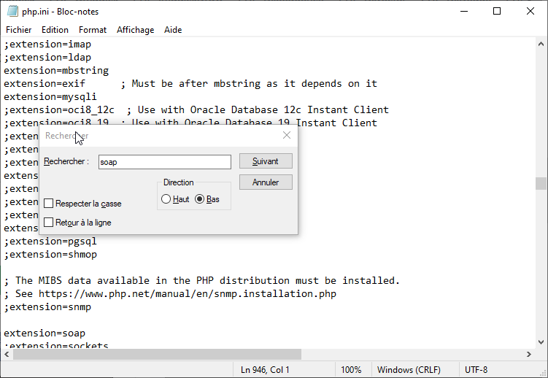
TP : PHP customer (enable soap extension)
10
Notes:
10

Slide 32
TP : PHP customer (code)
<!doctype html>
<html lang="en">
<head>
<meta charset="UTF-8">
<title>Document</title>
</head>
<body>
<form method="post">
<label for="amount">Amount in EUR</label>
<input type="number" name="amount" min="0" value="<?= isset($_POST['amount']) ? $_POST['amount'] : '' ?>"
placeholder="Enter the amount"/>
<input type="submit" value="Convert"> <b><?= $converted !== null ? ' = ' . $converted . ' XAF' : '' ?></b>
</form>
</body>
</html>
<?php
$PORT = 8585;
$amount = 0;
$converted = null;
if (isset($_POST['amount'])) {
$converted = null;
$amount = $_POST['amount'];
$client = new SoapClient("http://localhost:$PORT/BankWs?wsdl");
$param = new stdClass();
$param->amount = $amount;
$result = $client->__soapCall("conversionEURToXAF", [$param]);
$converted = $result->return;
} ?>
10
Notes:
10

Slide 33
TP : PHP customer
Create and consume SOAP web service using PHP
Prerequisites
Apache HTTP Server 2.4, PHP 7 or more, NUSOAP Library, CURL
Configure PHP SOAP
Consume SOAP Service
I will show you here 3 different ways of calling or consuming SOAP web service. The first method is using SoapClient, the second method is using NUSOAP library and the third method is using CURL.
Using SoapClient
Using SoapClient you do not need to use any third party library because SoapClient is already available in PHP engine.
The following PHP code using SoapClient calls the converter method, get account ,….
10
Notes:
10

Slide 34
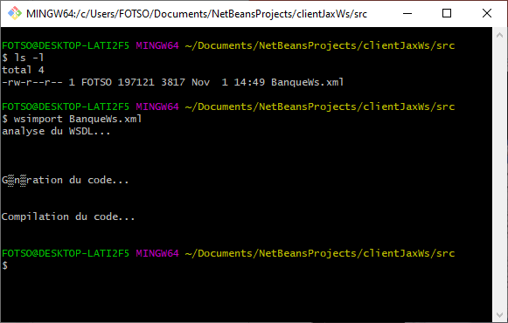
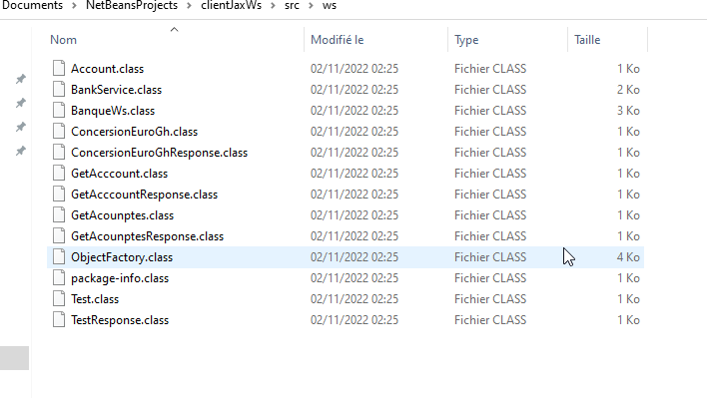
Generation stub client app
10
Notes:
10

Slide 35
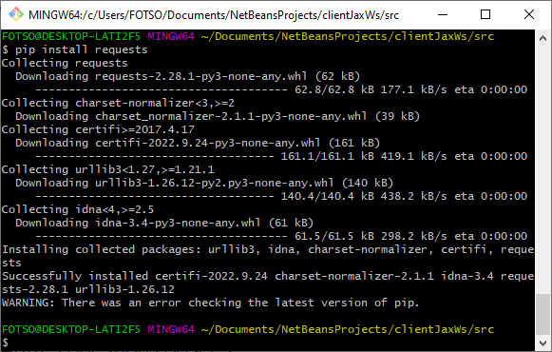
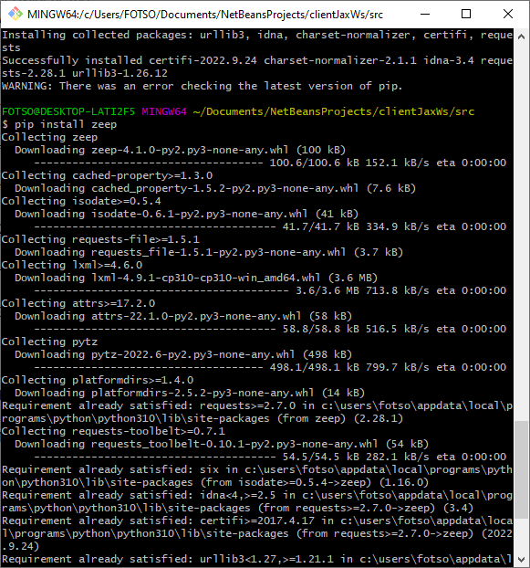
Generation stub client app
10
Notes:
10

Slide 36
Case of python client: use zeep module
pip3 install zeep
from zeep import Client
client = Client(wsdl='http://localhost:8088/BankWs?wsdl')
print('result of conversion: ', client.service.concersionEuroGh(20))
print('accounts : ', client.service.getAcounptes())
10
Notes:
10

Slide 37
Application Authentication with JAX-WS
In this section, we show you how to implement the above "application level authentication in JAX-WS". Client provides " username" and "password", attached in SOAP request header and send to server. Server parse the SOAP document and retrieve the provided username and 'password from request header.
10
Notes:
10

Slide 38
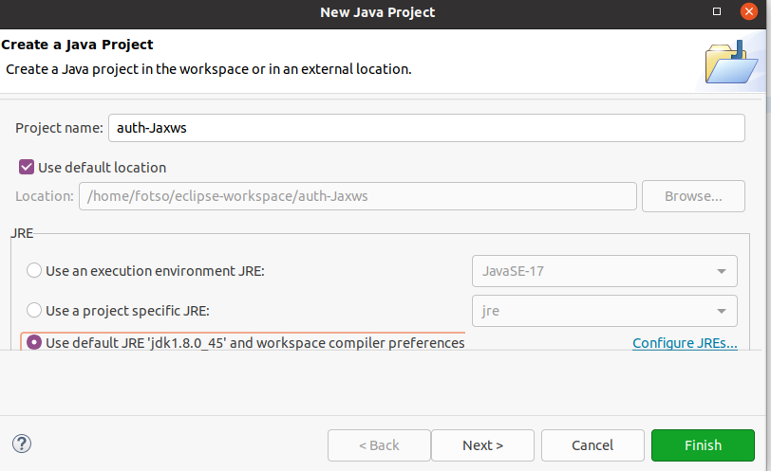
Application Authentication with JAX-WS
1. WebService Server :
Create a simple JAX-WS hello world example to handle the authentication in application level.
File : HelloWorld.java
10
Notes:
10

Slide 39
Application Authentication with JAX-WS
HelloWorld.java
.java
This interface will contain the declarations of all the methods for the Web Service.
Then we have to create a class that actually implements the above interface, which will be your Endpoint implementation.
10
Notes:
10

Slide 40
Application Authentication with JAX-WS
HelloWorld.java
HelloWorldImpl.java
package auth;
import javax.jws.WebService;
//Service Implementation Bean
@WebService(endpointInterface = "auth.HelloWorld")
public class HelloWorldImpl implements HelloWorld {
@Override
public String getHelloWorldAsString() {
// TODO Auto-generated method stub
return null;
}
}
package auth;
import javax.jws.WebMethod;
import javax.jws.WebService;
import javax.jws.soap.SOAPBinding;
import javax.jws.soap.SOAPBinding.Style;
@WebService
@SOAPBinding(style = Style.RPC)
public interface HelloWorld {
@WebMethod String getHelloWorldAsString();
}
10
Notes:
10

Slide 41
Application Authentication with JAX-WS
The server would have to read the HTTP request header information which the client put, and validate its identity.
Service Endpoint Implementation obtains a MessageContext object through a WebServiceContext for accessing the objects of the message.
The WebServiceContext interface enables a web service endpoint implementation class to access message contexts and security information of the requester.
The service runtime will inject the WebServiceContext on any field marked with @Resource annotation. We will call the WebServiceContext‘s getMessageContext() method to get MessageContext instance.
10
Notes:
10

Slide 42
Application Authentication with JAX-WS
HelloWorldImpl.java
package auth;
import java.util.List;
import java.util.Map;
import javax.annotation.Resource;
import javax.jws.WebService;
import javax.xml.ws.WebServiceContext;
import javax.xml.ws.handler.MessageContext;
//Service Implementation Bean
@WebService(endpointInterface = "auth.HelloWorld")
public class HelloWorldImpl implements HelloWorld {
@Resource
WebServiceContext wsctx;
@Override
public String getHelloWorldAsString() {
MessageContext mctx = wsctx.getMessageContext();
// get detail from request headers
Map http_headers = (Map) mctx.get(MessageContext.HTTP_REQUEST_HEADERS);
List userList = (List) http_headers.get("Username");
List passList = (List) http_headers.get("Password");
String username = "";
String password = "";
if (userList != null) {
// get username
username = userList.get(0).toString();
}
if (passList != null) {
// get password
password = passList.get(0).toString();
}
// Should validate username and password with database
if (username.equals("root") && password.equals("admin")) {
return "Hello World JAX-WS - Valid User!";
} else {
return "Unknown User!";
}
}
}
10
Notes:
10

Slide 43
Application Authentication with JAX-WS
2. EndPoint Publisher
Create an endpoint publisher to deploy above web service at this
URL : “http://localhost:8088/ws/hello”
File : HelloWorldPublisher.java
package auth;
import javax.xml.ws.Endpoint;
public class HelloWorldPublisher {
public static void main(String[] args) {
String url = "http://localhost:8088/ws/hello";
Endpoint.publish(url, new HelloWorldImpl());
System.out.println(url);
}
}
A QName, or qualified name, is the full name of an element, attribute. A QName concisely associates the URI of an XML namespace with the local name of an element, attribute, or identifier in that namespace.
10
Notes:
10

Slide 44
Application Authentication with JAX-WS
3. WebService Client
The client will consume the web service so the client has to make a new HTTP Request Header containing its username and password.
To access and manipulate the request contexts of the message the client has to get a BindingProvider from the service port using getRequestContext() method.
The BindingProvider interface enables the client to access and manipulate the associated context objects for request and response messages. The Request Context is retrieved as a Map object.
MessageContext.ENDPOINT_ADDRESS_PROPERTY is used to nominate the target service endpoint address. Now we need to add two properties username and password
to the Map object.
Then we put this Map object in MessageContext.HTTP_REQUEST_HEADERS.
10
Notes:
10

Slide 45
Application Authentication with JAX-WS
3. WebService Client
Create a web service client to send “username” and “password” for authentication.
File : HelloWorldClient.java
import javax.xml.ws.Service;
Creates a Service instance. The specified WSDL document location and service qualified name MUST uniquely identify a wsdl:service element.
public interface BindingProvider The BindingProvider interface provides access to the protocol binding and associated context objects for request and response message processing.
Since: JAX-WS 2.0
ENDPOINT_ADDRESS_PROPERTY Standard property: Target service endpoint address.
static String PASSWORD_PROPERTY Standard property: Password for authentication.
static String SESSION_MAINTAIN_PROPERTY Standard property: This boolean property is used by a service client to indicate whether or not it wants to participate in a session with a service endpoint.
static String SOAPACTION_URI_PROPERTY Standard property for SOAPAction.
static String SOAPACTION_USE_PROPERTY Standard property for SOAPAction.
static String USERNAME_PROPERTY Standard property: User name for authentication.
Output
Hello World JAX-WS - Valid User!
10
Notes:
10

Slide 46
Application Authentication with JAX-WS
3. WebService Client
Create a web service client to send “username” and “password” for authentication.
File : HelloWorldClient.java
public class HelloWorldClient {
private static final String WS_URL = "http://localhost:8088/ws/hello?wsdl";
public static void main(String[] args) throws Exception {
URL url = new URL(WS_URL);
QName qname = new QName("http://ws.tafoca.com/", "HelloWorldImplService");
Service service = Service.create(url, qname);
HelloWorld hello = service.getPort(HelloWorld.class);
/******************* UserName & Password ******************************/
Map<String, Object> req_ctx = ((BindingProvider) hello).getRequestContext();
req_ctx.put(BindingProvider.ENDPOINT_ADDRESS_PROPERTY, WS_URL);
Map<String, List<String>> headers = new HashMap<String, List<String>>();
headers.put("Username", Collections.singletonList("root"));
headers.put("Password", Collections.singletonList("admin"));
req_ctx.put(MessageContext.HTTP_REQUEST_HEADERS, headers);
/**********************************************************************/
System.out.println(hello.getHelloWorldAsString());
}
}
10
Notes:
10

Slide 47
Application Authentication with JAX-WS
4. Tracing SOAP Traffic
From top to bottom, showing how SOAP envelope flows between client and server.
1. Client send request, the username “root” and password “admin” are included in the SOAP envelope.
POST /ws/hello?wsdl HTTP/1.1
Password: admin
Username: root
SOAPAction: ""
Accept: text/xml, multipart/related, text/html, image/gif, image/jpeg, *; q=.2, */*; q=.2
Content-Type: text/xml; charset=utf-8
User-Agent: Java/1.6.0_13
Host: localhost:8088
Connection: keep-alive
Content-Length: 178
<?xml version="1.0" ?>
<S:Envelope xmlns:S="http://schemas.xmlsoap.org/soap/envelope/">
<S:Body>
<ns2:getHelloWorldAsString xmlns:ns2="http://app/"/>
</S:Body>
</S:Envelope>
10
Notes:
10

Slide 48
Application Authentication with JAX-WS
4. Tracing SOAP Traffic
From top to bottom, showing how SOAP envelope flows between client and server.
1. Client send request, the username “root” and password “admin” are included in the SOAP envelope.
HTTP/1.1 200 OK
Transfer-encoding: chunked
Content-type: text/xml; charset=utf-8
<?xml version="1.0" ?>
<S:Envelope xmlns:S="http://schemas.xmlsoap.org/soap/envelope/">
<S:Body>
<ns2:getHelloWorldAsStringResponse xmlns:ns2="http://ws.mkyong.com/">
<return>Hello World JAX-WS - Valid User!</return>
</ns2:getHelloWorldAsStringResponse>
</S:Body>
</S:Envelope>
https://github.com/tafoca/Tp-Tutorial-tafo-group/tree/main/auth-Jaxws
10
Notes:
10

Slide 49
JAX-WS SOAP Web Service
For CRUD Operations Using Eclipse, SQL

Slide 50
Case study add Database connection service (DAO)
How to generate a web service with top-down approach using JAX-WS by creating Java Classes using wsimport tool and then incorporate them in your java project.
• How to implement web service endpoint interface using an implementation class.
• How to call DAO layer methods from your SOAP Web service implementation class.
• How to connect to SQL database using JDBC and perform CRUD operation.
• How to test and consume a SOAP Web service.
10
Notes:
10

Slide 51
Case study add Database connection service (DAO)
We will implement a User Management Web Service with following key operations:
• Operation to add a new user to database table.
• Operation to update an existing user in database table.
• Operation to delete an existing user from database table.
• Operation to Fetch any user from database table.
• Operation to get all users from database table.
10
Notes:
10

Slide 52
Case study add Database connection service (DAO)
CREATE TABLE TBL_USERS (user_id INT NOT NULL,user_name VARCHAR(255) NOT NULL,user_category VARCHAR(255),user_active_status BOOLEAN,user_level Float,PRIMARY KEY ( user_id ));
Step 2: Add Required Libraries in Tomcat Server
Add jar library in lib directory
of tomcat
jar_files-tp4/javax.annotation-api-1.2-b03.jar
jar_files-tp4/javax.xml.soap-api-1.3.5.jar
jar_files-tp4/jaxb-api-2.2.9.jar
jar_files-tp4/jaxws-api-2.2.10.jar
jar_files-tp4/jsr181-api-1.0-MR1.jar
10
Notes:
10

Slide 53
Case study add Database connection service (DAO)
Step 3: Create Dynamic Web Project for JAX-WS SOAP Web Service
Name : JAXWSSoapWebService
Step 3: Create Dynamic Web Project for JAX-WS SOAP Web Service
Name : JAXWSSoapWebService
Step 4: Top-Down SOAP Web Service: Create XML Schema and WSDL File
For a Top-Down (Contract-First) Web service, we need to first define the contract and then create Java Classes based on that. For this purpose, we will create XSD file (XML Schema) for our User Management use case and then use elements from that XSD in the WSDL file for input and output messages for different operations.
You can create XSD by choosing File–> New–>XML Schema File and name it as UserSchema.xsd
Eclipse provide a good tool for creating XSD and defining elements and types. Using Eclipse, I created the schema with Users element containing User where User will have following primitive elements:
• UserID (Integer)
• UserName (String)
• UserCategory (String)
• UserLevel (Double)
• UserActiveStatus (Boolean)
10
Notes:
10

Slide 54
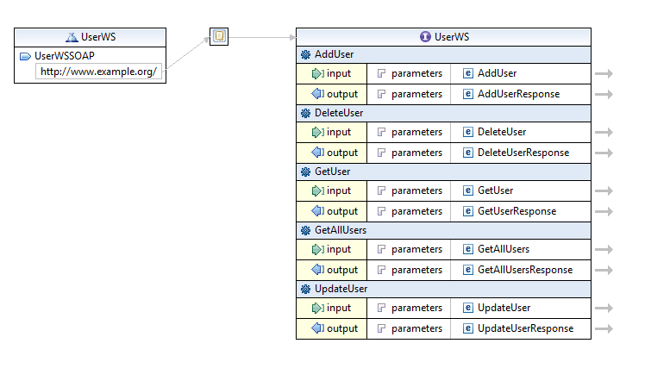
Case study add Database connection service (DAO)
10
Notes:
10

Slide 55
Case study add Database connection service (DAO)
Step 5: Implement DAO Layer with JDBC to for SOAP Web Service to Save Data in Database
For our tutorial, we will use JDBC with MySQL/Postgresl driver to connect with database to perform
all CRUD operations in our dtabase tableÂ TBL_USERSÂ which was created in Step 2.
Our DAO class (UserDAO.java) implements all CRUD operations for our web service to save, fetch, update and delete records from users table.
10
Notes:
10

Slide 56
Case study add Database connection service (DAO)
Step 6: Develop SOAP Web Service Operations by Implementing Service Interface
In this step we implement all service operations by creating an implementation
class UserWSImpl.java in which we implement methods of our SEI (Service Endpoint Interface)
The implementation class has following annotations:
• @WebService annotation to mark it as a web service implementation class.
• @WebMethod annotation for our methods which are implementing web service operatons.
• @WebResult annotation to customize our Response element (e.g. to give response element a meaningful name)
• @WebParam annotation to get web service parameters received from the client.
In our Service implementation class, we are calling our DAO class method so that all the logic for database handling is segregated from our service layer.
10
Notes:
10

Slide 57
Case study add Database connection service (DAO)
Step 6: Develop SOAP Web Service Operations by Implementing Service Interface
import java.util.List;
import javax.jws.WebMethod;
import javax.jws.WebParam;
import javax.jws.WebService;
import entity.Users;
@WebService
public interface UserWS {
@WebMethod public String addUser(@WebParam(name="User") Users addRequest);
@WebMethod public String deleteUser(@WebParam(name="UserID") int userID);
@WebMethod public String updateUser(Users updateUserRequest);
@WebMethod public Users getUser(@WebParam(name="UserName") String userName);
@WebMethod public List<Users> getAllUsers();
}
10
Notes:
10

Slide 58
Case study add Database connection service (DAO)
Step 6: Develop SOAP Web Service Operations by Implementing Service Interface
package service;
import java.util.List;
import javax.jws.WebService;
import dao.UserDAO;
import entity.Users;
@WebService
public class UserWSImpl implements UserWS {
UserDAO userdao;
@Override
public String addUser(Users addRequest) {
return null;
}
@Override
public String deleteUser(int userID) {
return null;
}
@Override
public String updateUser(Users updateUserRequest) {
// TODO Auto-generated method stub
return null;
}
@Override
public Users getUser(String userName) {
return null;
}
@Override
public List<Users> getAllUsers() {
return null;
}
}
10
Notes:
10

Slide 59
Case study add Database connection service (DAO)
Step 6: Develop SOAP Web Service Operations by Implementing Service Interface
@Override
@WebMethod
@WebResult(name="ResponseMessage")
public String addUser(@WebParam(name="User") Users addRequest) {
return new UserDAO().addUser(addRequest);
}
@Override
@WebMethod
@WebResult(name="ResponseMessage")
public String deleteUser(@WebParam(name="UserID") int userID) {
return new UserDAO().deleteUser(userID);
}
@Override
@WebMethod
@WebResult(name="ResponseMessage")
public String updateUser(Users updateUserRequest) {
return new UserDAO().updateUser(updateUserRequest);
}
@Override
@WebMethod
@WebResult(name="User")
public Users getUser(@WebParam(name="UserName") String userName) {
return new UserDAO().getUser(userName);
}
@Override
@WebMethod
@WebResult(name="Users")
public List<Users> getAllUsers() {
return new UserDAO().getAllUsers();
}
package service;
import javax.xml.ws.Endpoint;
public class MainUserPublish {
public static void main(String[] args) {
String url = "http://localhost:8086/ws/users";
Endpoint.publish(url, new UserWSImpl());
System.out.println(url);
}
}
10
Notes:
10

Slide 60
Case study add Database connection service (DAO)
Step 7: Deployment Web Service
package service;
import javax.xml.ws.Endpoint;
public class MainUserPublish {
public static void main(String[] args) {
String url = "http://localhost:8086/ws/users";
Endpoint.publish(url, new UserWSImpl());
System.out.println(url);
}
}
http://localhost:8086/ws/users?wsdl
https://github.com/tafoca/Tp-Tutorial-tafo-group/tree/main/UserModule
10
Notes:
10

Slide 61
Case study add Database connection service (DAO)
Step 7: Deployment Web Service : AddUser request
<SOAP-ENV:Envelope xmlns:SOAP-ENV="http://schemas.xmlsoap.org/soap/envelope/"
xmlns:ns0="http://service/">
<SOAP-ENV:Header/>
<SOAP-ENV:Body>
<ns0:addUser>
<User>
<userActiveStatus>BOOLEAN</userActiveStatus>
<userCategory>STRING</userCategory>
<userId>INT</userId>
<userLevel>DOUBLE</userLevel>
<userName>STRING</userName>
</User>
</ns0:addUser>
</SOAP-ENV:Body>
</SOAP-ENV:Envelope>
<!-- Auto generated server sample response. -->
<SOAP-ENV:Envelope xmlns:SOAP-ENV="http://schemas.xmlsoap.org/soap/envelope/"
xmlns:ns0="http://service/">
<SOAP-ENV:Header/>
<SOAP-ENV:Body>
<ns0:addUserResponse>
<ResponseMessage>STRING</ResponseMessage>
</ns0:addUserResponse>
</SOAP-ENV:Body>
</SOAP-ENV:Envelope>
10
Notes:
10

Slide 62
JEE Architecture
Enterprise Java Beans (EJB)
Outline :
• JEE architecture
• Principle of inversion of control
• EJBs
• Session EJBs
• Entity EJBs
• Web Services
• JMS, MDB
• Transaction Management
• Implementation and Applications
10
Notes:
10

Slide 63
JEE Architecture Requirements of an IT project
Src : http://fr.slideshare.net/mohamedyoussfi9
Functional requirements:
◦ An application is created to respond, first of all, to the business functional needs.
Technical Requirements:
◦ Performance:
Response time
High availability and fault tolerance
Avoid the scaling problem
Avoid the scaling problem
◦ Maintenance:
An application must evolve over time.
Must be closed to modification and open to extension
◦ Security
◦ Portability
◦ Distribution
◦ Ability to communicate with other remote applications.
◦ Ability to provide the service to different types of customers (DesktOP, Mobile, SMS, http...)
◦ Software cost
10
Notes:
10

Slide 64
JEE Architecture Technologies
It is very difficult to develop a software system that
meets these requirements without using the experience of others:
◦ JEE Application Server:
JBOSS, WebSphere,
GlassFish, Tomcat,
...
◦ Framework for Inversion of Control:
Spring (Light container)
EJB (Heavy Container)
◦ Frameworks:
Relational object mapping (ORM): JPA, Hibernate, Toplink, ...
Web applications: Struts, JSF, SpringMVC
◦ Middleware:
RMI, CORBA: Distributed applications
JAXWS for SOAP web services
JAXRS for RESTful web services
JMS: Asynchronous communication between applications
10
Notes:
10

Slide 65
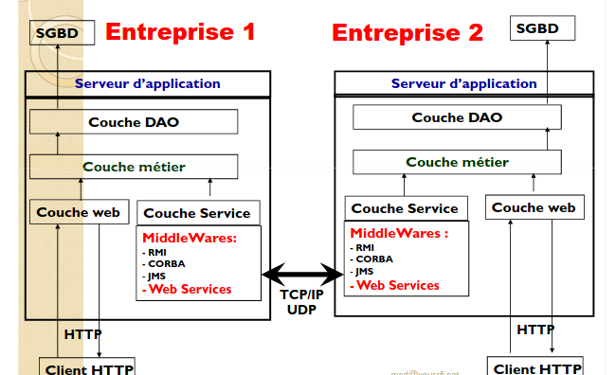
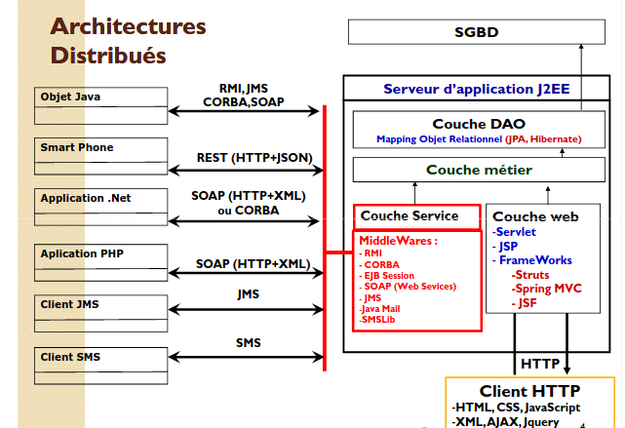
JEE Architecture Distributed architectures
Global vision architectures
10
Notes:
10

Slide 66
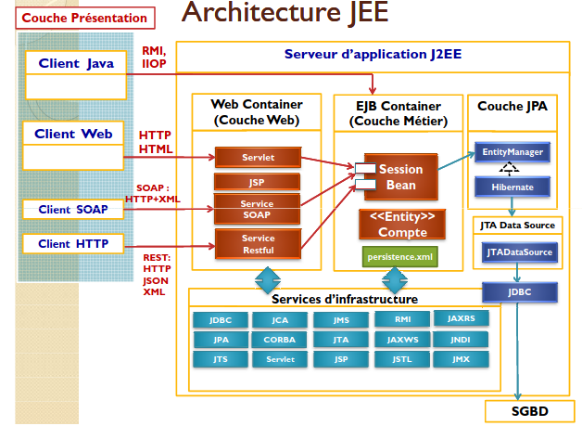
JEE Architecture architecture JEE
10
Notes:
10

Slide 67
JEE Architecture
Presentation Layer
It implements the presentation logic of the application
The presentation layer is linked to the type of client used:
◦ Heavy Client java Desktop:
Graphical interfaces java SWING, AWT, SWT.
This type of client can communicate directly with the business components
deployed in the EJB container using the RMI middleware (Remote Method
Invocation)
◦ Web Client
HTML, Java Script, CSS.HTML, Java Script, CSS.
A web client communicates with Servlet web components deployed in the
application server web container using the HTTP protocol.
◦ A .Net client, PHP, C++, ...
This kind of clients developed with other programming language other than java,
generally communicate with the Web Services components deployed in the
application server web container using SOAP protocol (HTTP+XML)
◦ Mobile Client
Android, iPhone, Tablet etc.
Generally this type of client communicates with the Web Services components by
using HTTP or SOA protocol
10
Notes:
10

Slide 68
JEE Architecture
Application or web layer
Also called web layer.
The application layer mediates between the application layer
presentation and the business layer.
It controls the sequence of tasks offered by the application
◦ It receives client http requests
◦ Tracks sessions
◦ Tracks sessions
◦ Check access permissions for each session
◦ Ensures the validation of the data sent by the customer
◦ Calls on the business components to ensure the processing required
◦ Generates a view that will be sent to the presentation layer.
It uses Servlet and JSP web components
It respects the MVC model (Controller View Model)
Frameworks like JSF, SpringMVC or Struts are typically used in this layer
10
Notes:
10

Slide 69
JEE Architecture
Business or service layer
The business layer is the main layer of any application
◦ It implements the business logic of a company
◦ It is responsible for recovering, from the different data sources, the data necessary to ensure the business processing triggered by the layer application.
◦ It ensures the management of the WorkFlow (Business processing process in several steps)
However, it is important to separate the data access part (DAO layer) of the processing part of the business logic (Layer(DAO layer) of the processing part of the business logic (Layer profession) for the following reasons:
10
Notes:
10

Slide 70
JEE Architecture
Business or service layer
◦ Do not get lost between the business code, which is sometimes complex, and the access code to data which is elementary but substantial.
◦ Add a level of abstraction on data access to be more flexible and therefore independent of t he nature of the data storage units.
◦ The business layer is often stable. Business processes are rarely changed.
While the DAO layer is not stable. It often happens that we are opposed to change DBMS or split and distributed databases.
◦ Facilitate the distribution of tasks between development teams.
◦ Delegate the DAO layer to specialized data access frameworks
(Hibernate, Toplink, etc.)
10
Notes:
10

Slide 71
JEE Architecture
JEE APPLICATION SERVER INFRASTRUCTURE SERVICES
10
Notes:
10

Slide 72
JEE Architecture
JEE APPLICATION SERVER INFRASTRUCTURE SERVICES
10
Notes:
10

Slide 73
JEE Eclipse + wilfly
Requirements
First, we start by installing the following software: Java, Eclipse and WildFly
Then we verify if everything is properly configured. If both, Eclipse and WildFly, work correctly, then we can continue with our configuration.
Installing the JBoss Tools Plugin
We're going to use the JBoss Tools Plugin for Eclipse. JBoss Tools provides, among others, integration between Eclipse and WildFly.
There are two ways to install the plugin:
We can install it through the website
We can install it through the Eclipse Marketplace
- Open Eclipse
- Click on Help and then on Eclipse Marketplace
- Search for JBoss Tools
- Click Install next to the JBoss Tools solution
10
Notes:
10

Slide 74
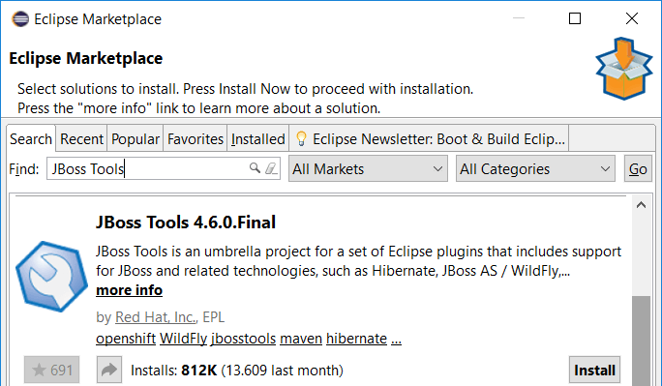
JEE Eclipse + wilfly
Configuring the Application Server in Eclipse. We start by adding the WildFly server to Eclipse
First, we add a new View in Eclipse. Please click on the Window/Show View/Other:
10
Notes:
10

Slide 75
JEE Eclipse + wilfly
Configuring the Application Server in Eclipse. We start by adding the WildFly server to Eclipse
First, we add a new View in Eclipse. Please click on the Window/Show View/Other:
10
Notes:
10

Slide 76
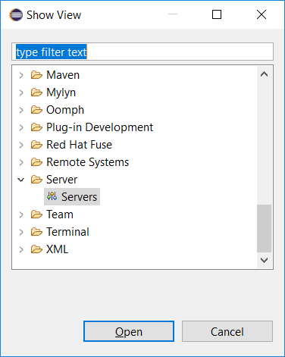
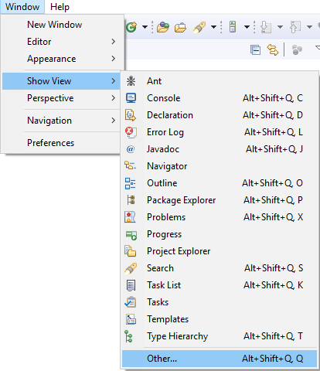

JEE Eclipse + wilfly
After that we can add a server by clicking on No servers are available. Click this link to create a new server… in the Servers tab:
10
Notes:
10

Slide 77
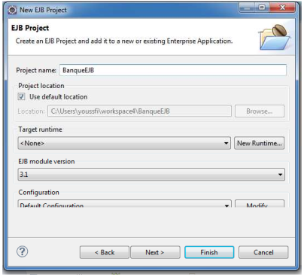
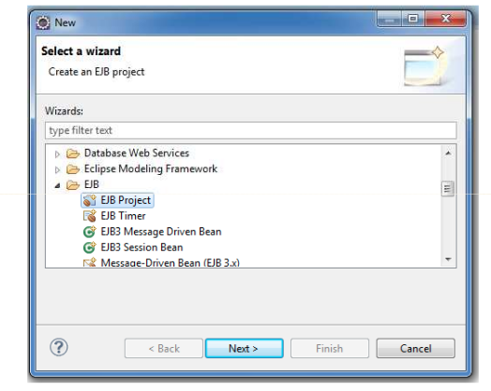
Creation of EJB project
New > EJB Project
After specifying the project name,
Click on the New Runtime button, to associate a server to this project
10
Notes:
10

Slide 78
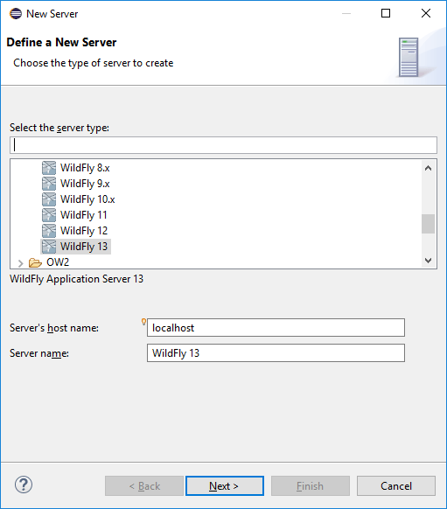
JEE Eclipse + wilfly
In the next step, we expand the JBoss Community category and select the WildFly version that matches with the WildFly installation. For the rest we simply follow the wizard:
Select the newest version when your installed version isn't available. But make sure to upgrade JBoss Tools when they have a new release with support for that specific version:
10
Notes:
10

Slide 79
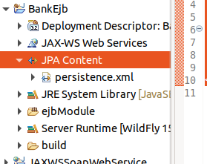
Structure of the EJB Project
Empty Project
Project to be set up
10
Notes:
10

Slide 80
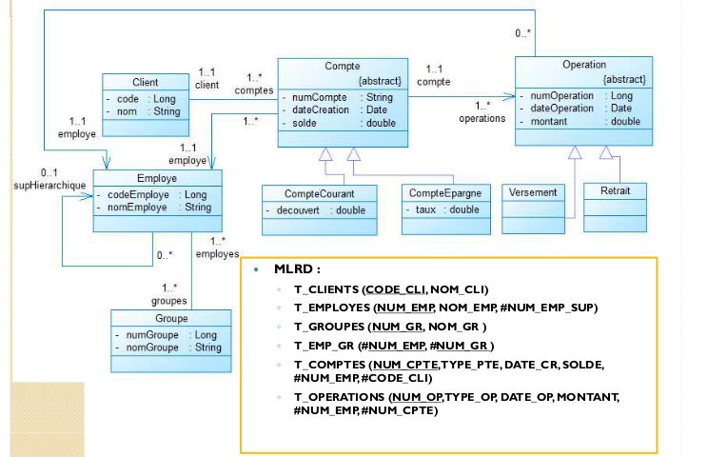
Class diagram and MLDR
10
Notes:
10

Slide 81
Manipulated data (Entities) : Account.java
- We start by creating the data structures handled by the application. These are the entities of the application.
- In our case, our application deals with accounts. For the moment we are not going to treat the persistence of the entities
- We consider that Account is a simple Java Bean and not an EJB Entity
public class Account implements Serializable {
private int code;
private double amount;
private Date createdAt;
private static final long serialVersionUID = 1L;
public Account() {
super();
}
// Getter and Setter
@Override
public String toString() {
return "Account [code=" + code + ", amount=" + amount + ", createdAt=" + createdAt + "]";
}
}
10
Notes:
10

Slide 82
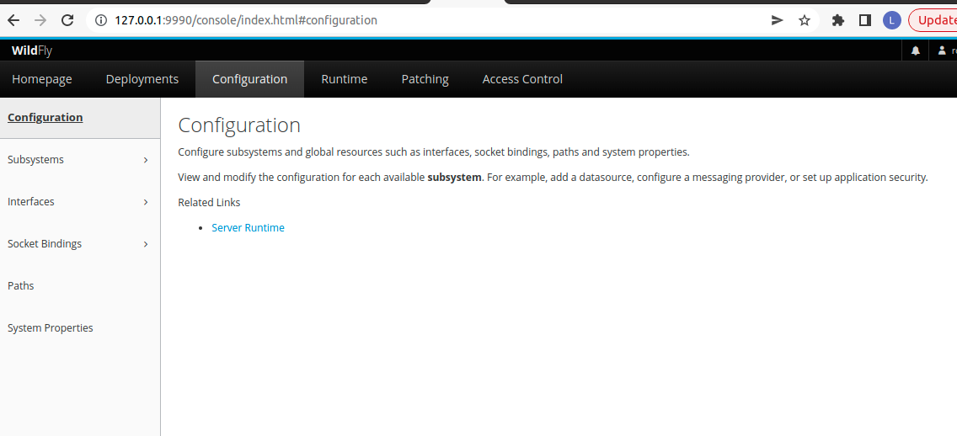

Slide 83
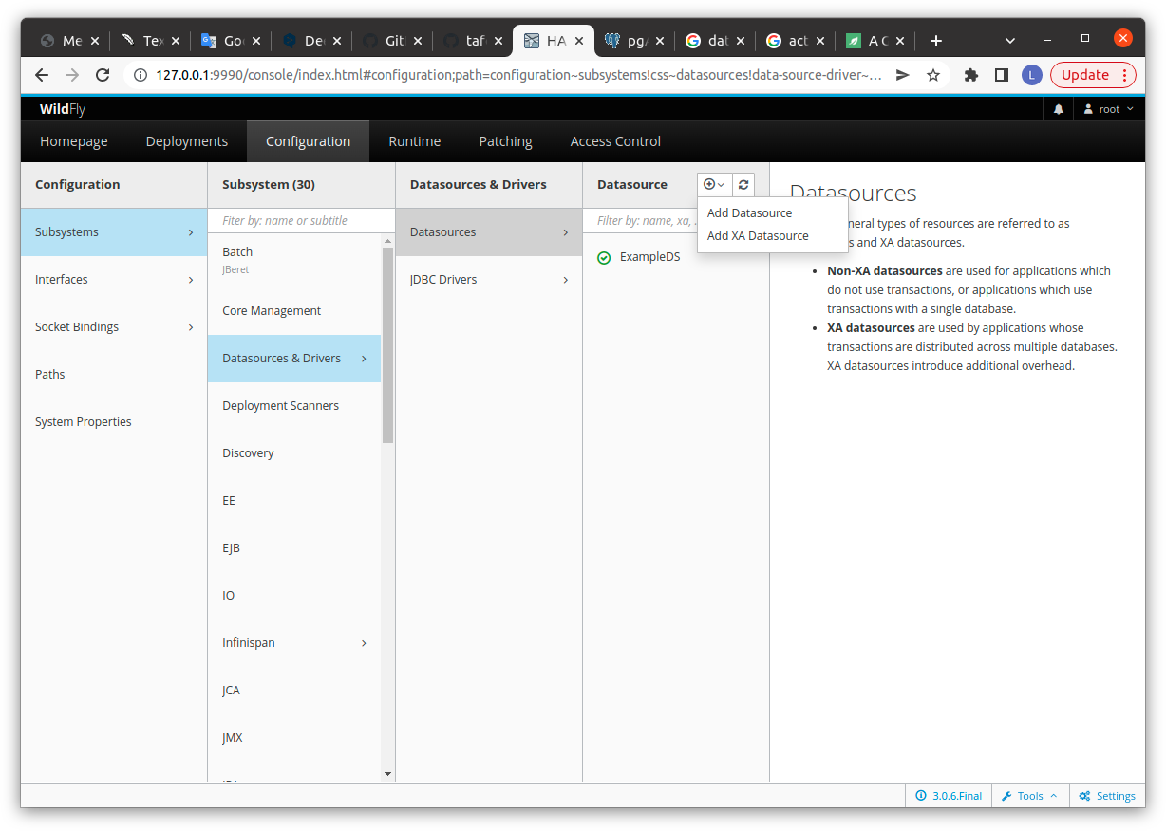

Slide 84
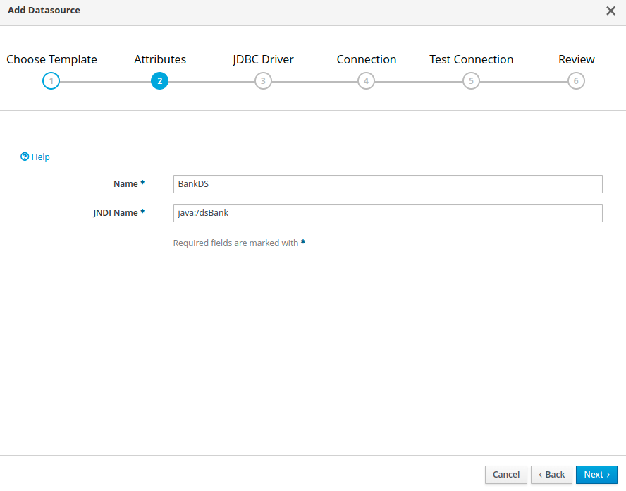

Slide 85
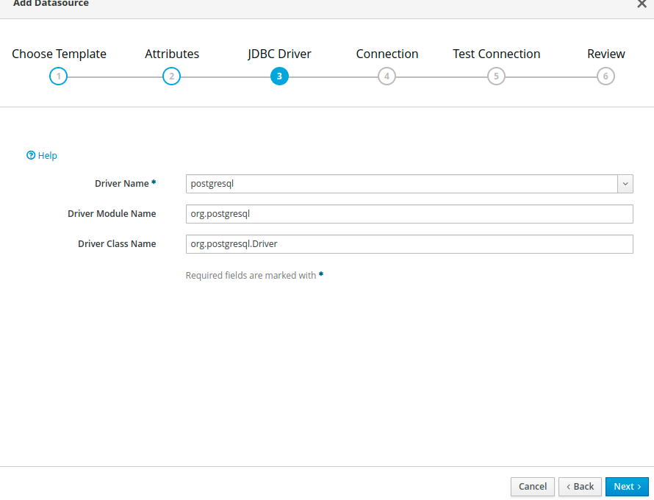

Slide 86
Standalone.xml
<datasource jndi-name="java:/PostgresDS" pool-name="PostgresDS">
<connection-url>jdbc:postgresql://localhost:5432/users</connection-url>
<driver-class>org.postgresql.Driver</driver-class>
<datasource-class>org.postgresql.ds.PGSimpleDataSource</datasource-class>
<driver>Postgresql</driver>
<security>
<user-name>postgres</user-name>
<password>bacmil</password>
</security>
<validation>
<valid-connection-checker class-name="org.jboss.jca.adapters.jdbc.extensions.postgres.PostgreSQLValidConnectionChecker"/>
<background-validation>true</background-validation>
<exception-sorter class-name="org.jboss.jca.adapters.jdbc.extensions.postgres.PostgreSQLExceptionSorter"/>
</validation>
</datasource>
<drivers>
<driver name="h2" module="com.h2database.h2">
<xa-datasource-class>org.h2.jdbcx.JdbcDataSource</xa-datasource-class>
</driver>
<driver name="Postgresql" module="org.postgresql"/>
</drivers>
</datasources>

Slide 87
DROP TABLE IF EXISTS contacts;
DROP TABLE IF EXISTS customers;
CREATE TABLE customers(
customer_id INT GENERATED ALWAYS AS IDENTITY,
customer_name VARCHAR(255) NOT NULL,
PRIMARY KEY(customer_id)
);
CREATE TABLE contacts(
contact_id INT GENERATED ALWAYS AS IDENTITY,
customer_id INT,
contact_name VARCHAR(255) NOT NULL,
phone VARCHAR(15),
email VARCHAR(100),
PRIMARY KEY(contact_id),
CONSTRAINT fk_customer
FOREIGN KEY(customer_id)
REFERENCES customers(customer_id)
ON DELETE CASCADE
);

Slide 88
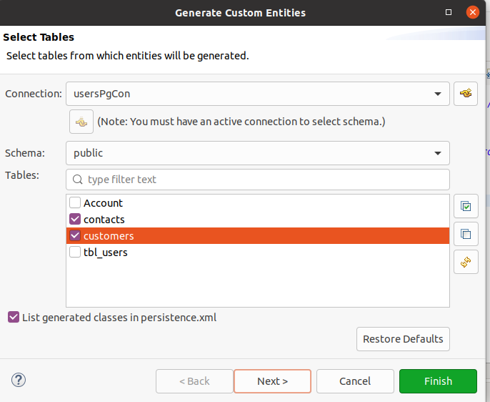
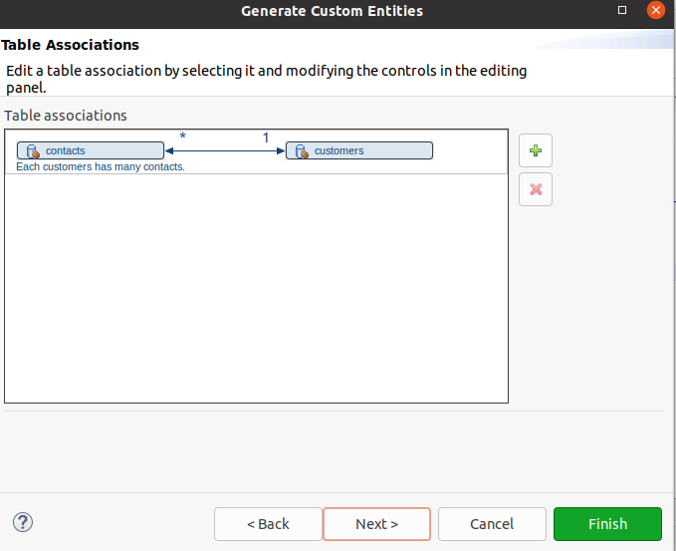
JPA

Slide 89
Persistance.xml
<?xml version="1.0" encoding="UTF-8"?>
<persistence version="2.0" xmlns="http://java.sun.com/xml/ns/persistence" xmlns:xsi="http://www.w3.org/2001/XMLSchema-instance" xsi:schemaLocation="http://java.sun.com/xml/ns/persistence http://java.sun.com/xml/ns/persistence/persistence_2_0.xsd">
<persistence-unit name="BanqueEJB" transaction-type="JTA">
<jta-data-source>java:/PostgresDS</jta-data-source>
<class>entity.Contact</class>
<class>entity.Customer</class>
<class>entity.Account</class>
<properties>
<property name="javax.persistence.schema-generation.database.action" value="drop-and-create" />
</properties>
</persistence-unit>
</persistence>

Slide 90
Entities : Contact and Customer generate
/ Customer
public Integer getCustomerId() {
return this.customerId;
}
public void setCustomerId(Integer customerId) {
this.customerId = customerId;
}
public String getCustomerName() {
return this.customerName;
}
public void setCustomerName(String customerName) {
this.customerName = customerName;
}
public List<Contact> getContacts() {
return this.contacts;
}
public void setContacts(List<Contact> contacts) {
this.contacts = contacts;
}
public Contact addContact(Contact contact) {
getContacts().add(contact);
contact.setCustomer(this);
return contact;
}
public Contact removeContact(Contact contact) {
getContacts().remove(contact);
contact.setCustomer(null);
return contact;
}
}
package entity;
import java.io.Serializable;
import javax.persistence.*;
import java.util.List;
/**
* The persistent class for the customers database table.
*
*/
@Entity
@Table(name="customers")
@NamedQuery(name="Customer.findAll", query="SELECT c FROM Customer c")
public class Customer implements Serializable {
private static final long serialVersionUID = 1L;
@Id
@GeneratedValue(strategy=GenerationType.IDENTITY)
@Column(name="customer_id")
private Integer customerId;
@Column(name="customer_name")
private String customerName;
//bi-directional many-to-one association to Contact
@OneToMany(mappedBy="customer")
private List<Contact> contacts;
public Customer() {
}
10
Notes:
<numéro>

Slide 91
Entities : Contact and Customer generate
/ Contact
package entity;
import java.io.Serializable;
import javax.persistence.*;
/**
* The persistent class for the contacts database table.
*
*/
@Entity
@Table(name="contacts")
@NamedQuery(name="Contact.findAll", query="SELECT c FROM Contact c")
public class Contact implements Serializable {
private static final long serialVersionUID = 1L;
@Id
@GeneratedValue(strategy=GenerationType.IDENTITY)
@Column(name="contact_id")
private Integer contactId;
@Column(name="contact_name")
private String contactName;
private String email;
private String phone;
//bi-directional many-to-one association to Customer
@ManyToOne
@JoinColumn(name="customer_id")
private Customer customer;
public Contact() {
}
public Integer getContactId() {
return this.contactId;
}
public void setContactId(Integer contactId) {
this.contactId = contactId;
}
public String getContactName() {
return this.contactName;
}
public void setContactName(String contactName) {
this.contactName = contactName;
}
public String getEmail() {
return this.email;
}
public void setEmail(String email) {
this.email = email;
}
public String getPhone() {
return this.phone;
}
public void setPhone(String phone) {
this.phone = phone;
}
public Customer getCustomer() {
return this.customer;
}
public void setCustomer(Customer customer) {
this.customer = customer;
}
}
10
Notes:
<numéro>

Slide 92
Interface Remote
public class Account implements Serializable {
private int code;
private double amount;
private Date createdAt;
private static final long serialVersionUID = 1L;
public Account() {
super();
}
// Getter and Setter
@Override
public String toString() {
return "Account [code=" + code + ", amount=" + amount + ", createdAt=" + createdAt + "]";
}
}
10
Notes:
<numéro>

Slide 93
Different types of EJBs
There are three types of EJBs:
◦ Entity Beans: Entity EJBs Represent the data handled by the application (Components persistent) Each EJB Entity is associated with a table at the database level
◦ Session Beans: Session EJBs
Distributed components that implement business logic processing.
These components are accessible remotely via the RMI and IIOP protocols.
There are two types of Session EJBs.
Stateless: stateless
An instance is created by the server for several client connections.
This type of bean does not keep any data in its state.
Statefull: stateful
Create an instance for each client connection.
This type of bean can retain data between exchanges with the client.
Singleton: Single Instance
Creation of a single instance regardless of the number of connections.
◦ Message Driven Beans: Message Beans
A listener that lets you trigger processing at the level of
the application following the reception of a JMS asynchronous message
10
Notes:
<numéro>

Slide 94
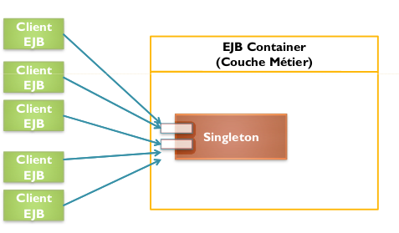
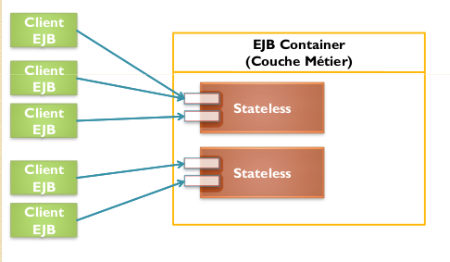
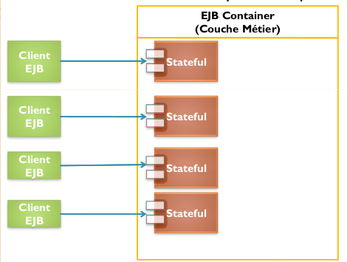
Different types of EJBs
10
Notes:
<numéro>

Slide 95
Infrastructure services of a J2EE application server
JDBC (Java Data Base Connectivity): Java drivers to allow access to
data base
JPA (Java Persistence API). Interface that allows you to manage the persistence of
EJB Entity. The application server provides a Framework implementing the
JPA specification to ensure relational object mapping (For JBOSS it is
Hibernate which is used)
JNDI (Java Naming Directory Interface): Service allowing to
connect the application components to name or directory services such as the RMI, CORBA, LDAP, DNS directories, etc. each application server has its own directory which allows it to publish
the references of the components deployed in the server by associating them with a
name. That way they will be accessible locally or remotely by other components.
JMS: Asynchronous Messaging Service. This service allows components such as MDBs to connect to a JMS inter-application messaging service queue to asynchronously send and receive JMS messages to and from other remote components. Each application server has its own JMS provider which allows you to deploy new JMS queues.
JMX: service that allows you to modify the configuration parameters of the application server on-the-fly
10
Notes:
<numéro>

Slide 96
Infrastructure services of a J2EE application server
JCA (Java Connector Architecture): to connect the components of a J2EE application to other systems business information such as ERPs.
JAXWS: Specification for web implementation SOAP services. Each application server has its own JaxWS implementation (CXF, AXIS,...)
JAXRS: Specification for the implementation of web services REST FULL. Each application server has its own JaxRS implementation (Jersey, RestEasy,...)
JSTL (Java Server Pages Stadium Tag Library): Libraries for JSP tag that facilitates the writing of web pages dynamic JSP.
JSF (Java Server faces): MVC framework for developing
J2EE web application in the same way as Struts and Spring MVC.
10
Notes:
<numéro>

Slide 97
Infrastructure services of a J2EE application server
An EJB Session is a component that has
◦ A remote interface: which allows you to declare the methods that are remotely accessible. That's to say accessible to components that are deployed in other machines.
◦ A Local interface: which allows you to declare the methods that are locally accessible. That is to say the methods accessible by the components deployed in
the same application server.
◦ The bean class that implements the two interfaces remote and local. the implementation of the methods of this class represent the business processes of
the application
10
Notes:
<numéro>

Slide 98
Case Study
We want to create an application that allows us to manage accounts.
Each account is defined by its code, its balance and its date of
creation
The application must allow the following operations to be carried out:
Add an account
consult all accounts
Consult an account
Deposit an amount into an account
Withdraw an amount from an account
The application must be accessible by:
◦ A remote java client
◦ A web application based on Servlet and JSP
◦ A SOAP client
We will assume, initially, that the accounts are stored in a non-persistent list.
Thereafter we will discuss the persistence of accounts in a
database using JPA.
10
Notes:
<numéro>

Slide 99
JNDI Info
:06:42,786 INFO [org.jboss.as.ejb3.deployment.processors.EjbJndiBindingsDeploymentUnitProcessor] (MSC service thread 1-11) JNDI bindings for session bean named BK1 in deployment unit deployment "BanqueEJB.jar" are as follows:
java:global/BanqueEJB/BK1!session.BankSingletonLocal
java:app/BanqueEJB/BK1!session.BankSingletonLocal
java:module/BK1!session.BankSingletonLocal
java:global/BanqueEJB/BK1!session.BankSingletonRemote
java:app/BanqueEJB/BK1!session.BankSingletonRemote
java:module/BK1!session.BankSingletonRemote
java:jboss/exported/BanqueEJB/BK1!session.BankSingletonRemote
10
Notes:
<numéro>

