Slide 1
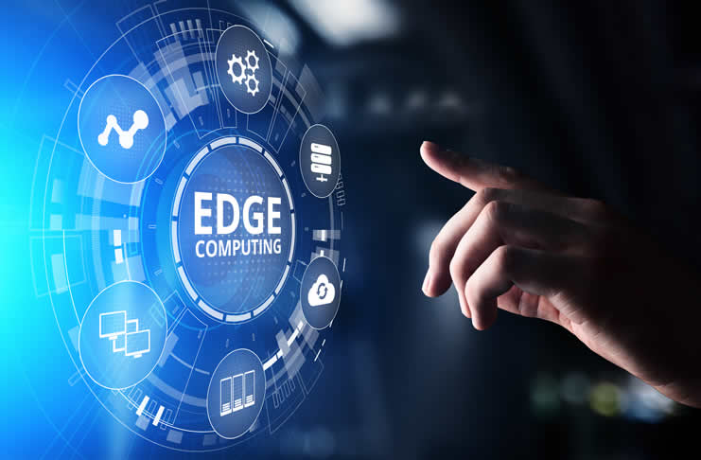
Edge Computing
Federico Tafur

Slide 2
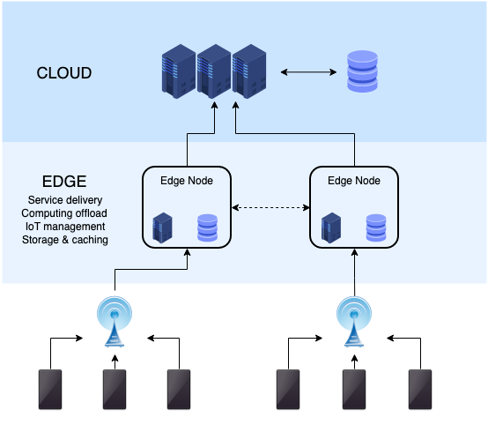
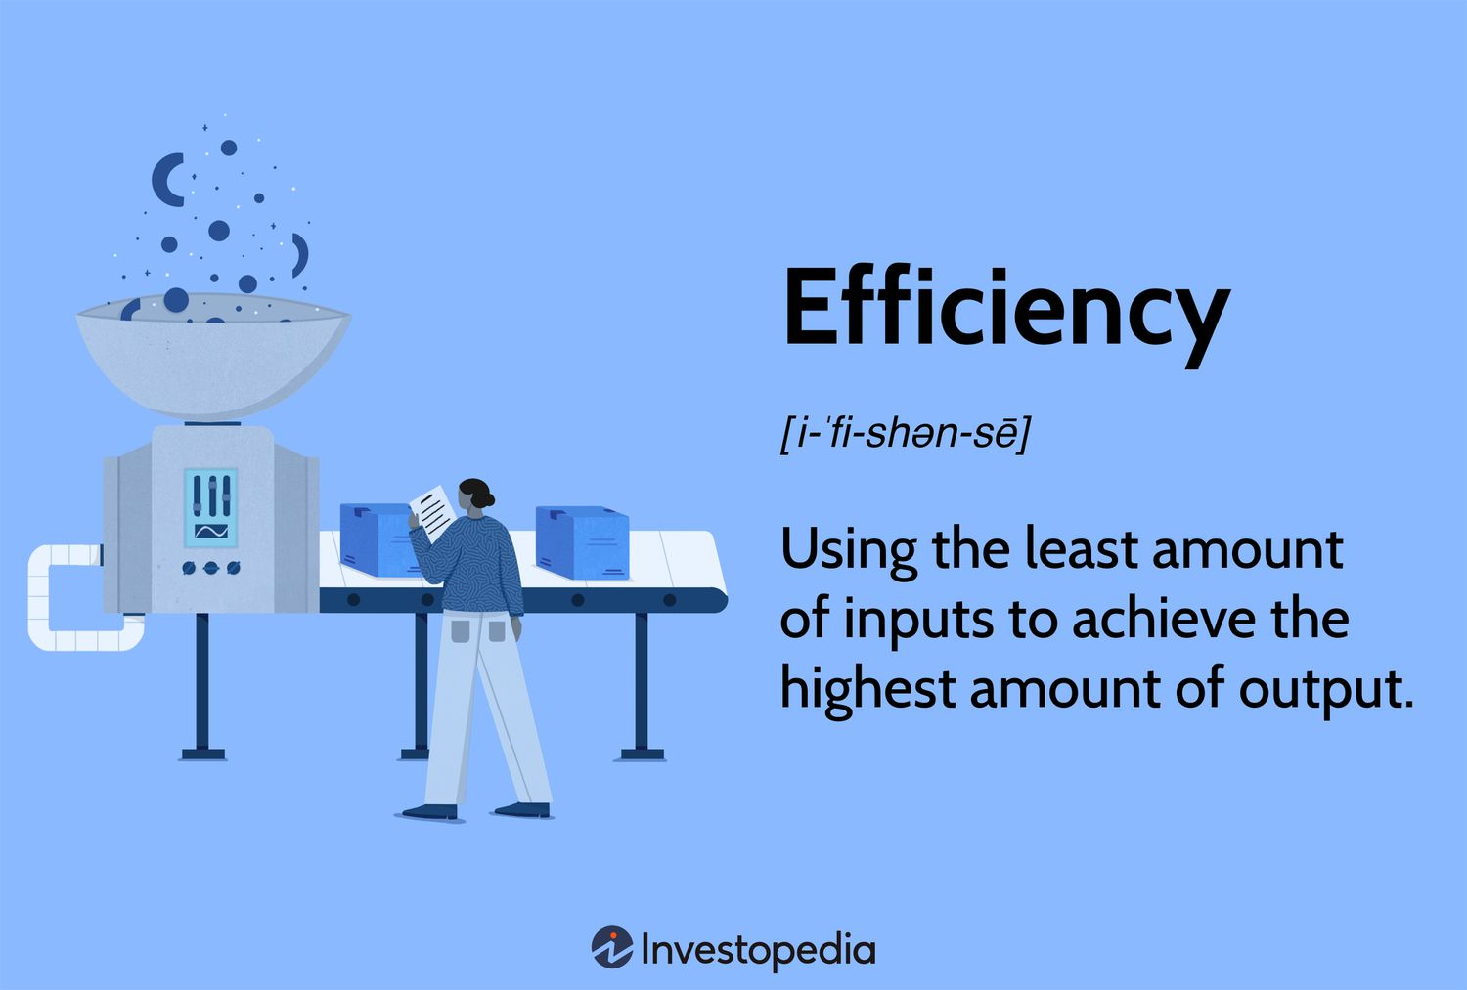
What is Edge Computing?

Slide 3
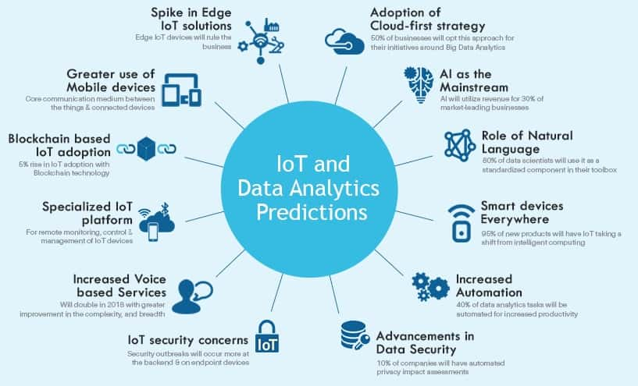
Brief History and previous versions…

Slide 4
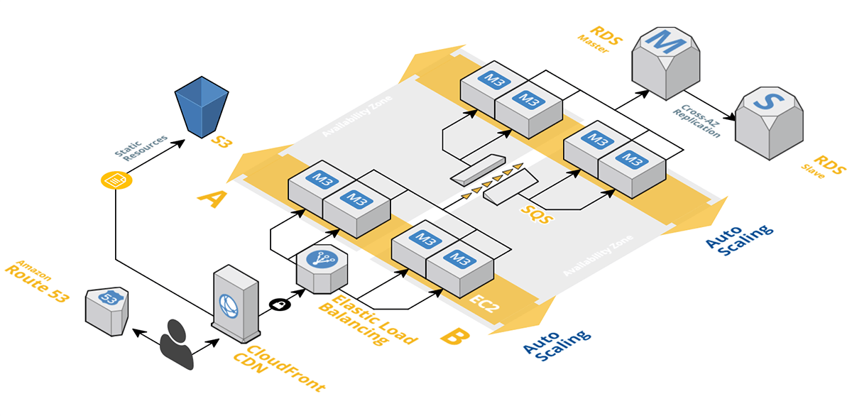
What does it do and how?
- Process Locally - Bandwidth Optimization
- Latency Reduction - Decentralized Architecture

Slide 5
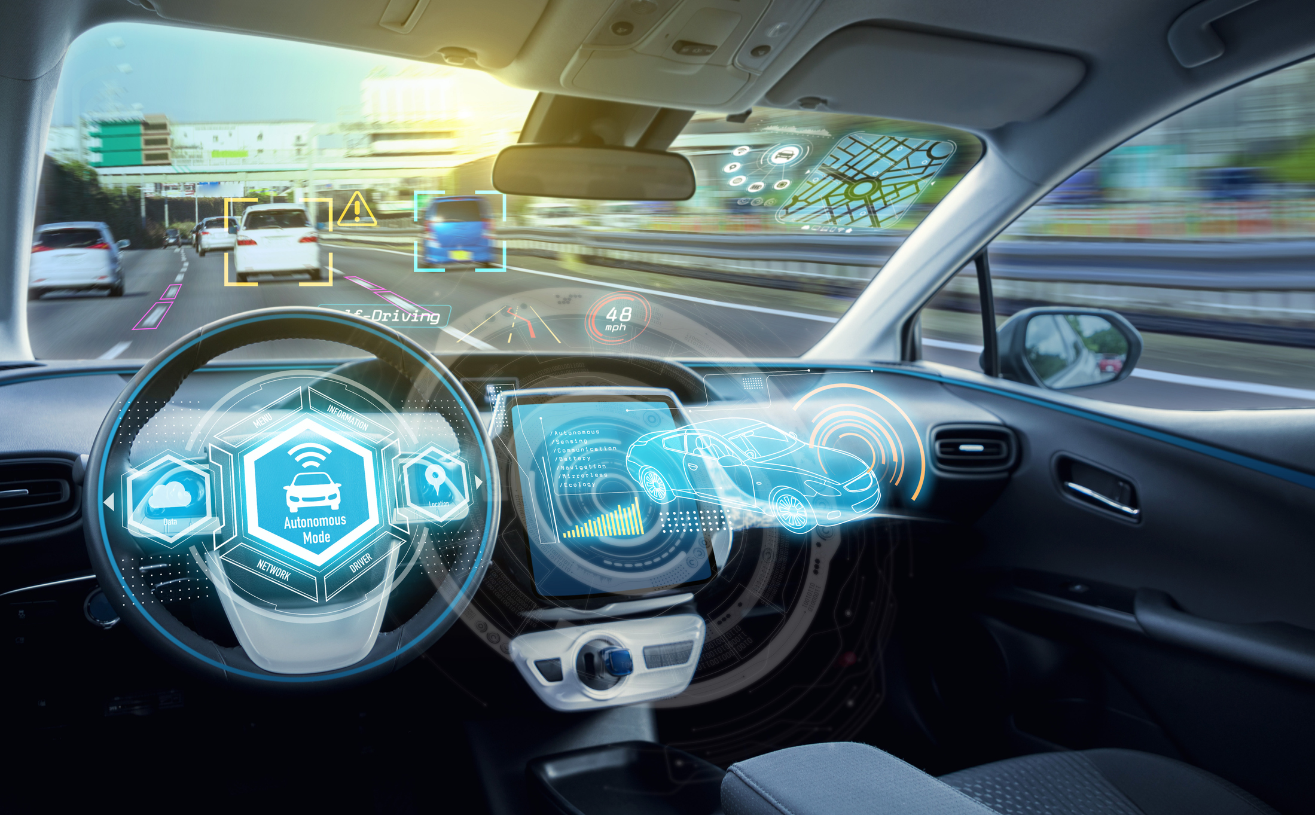
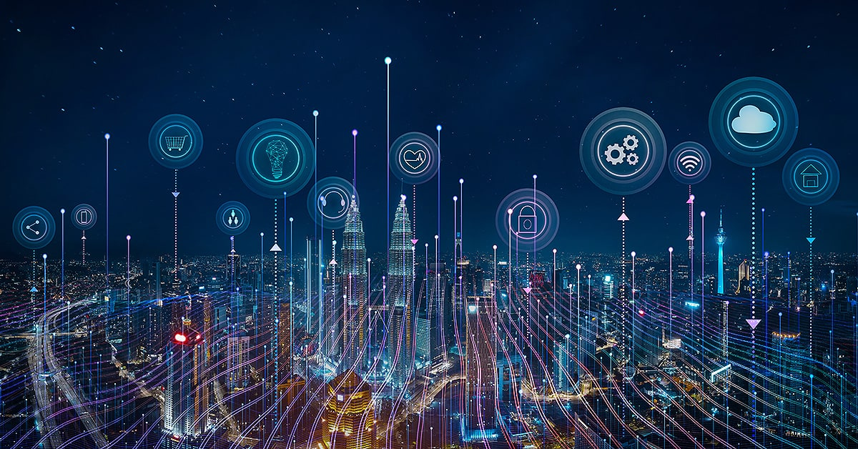
How is it useD and why is it important?
Autonomous Vehicles
Smart Cities

Slide 6
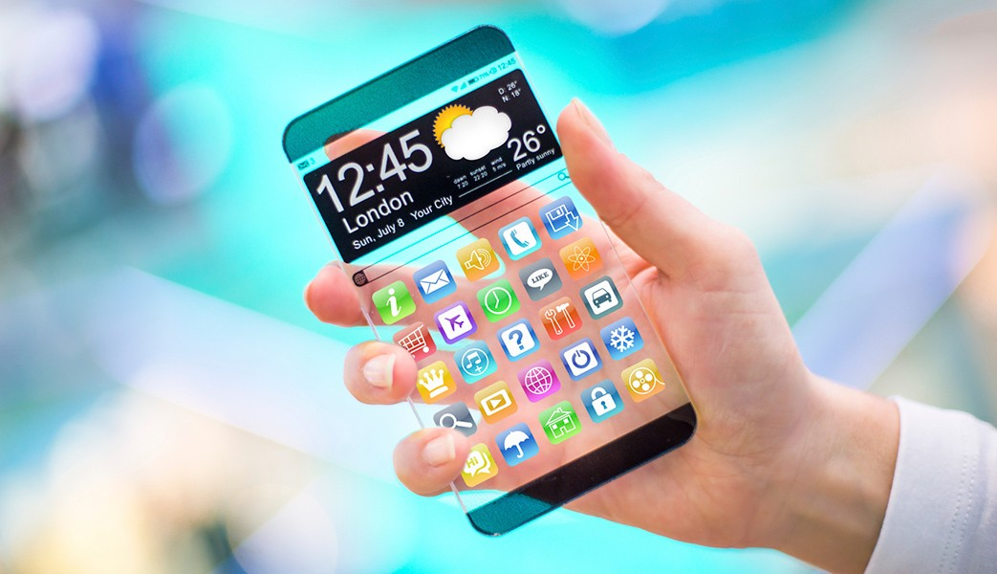
Impact

Slide 7

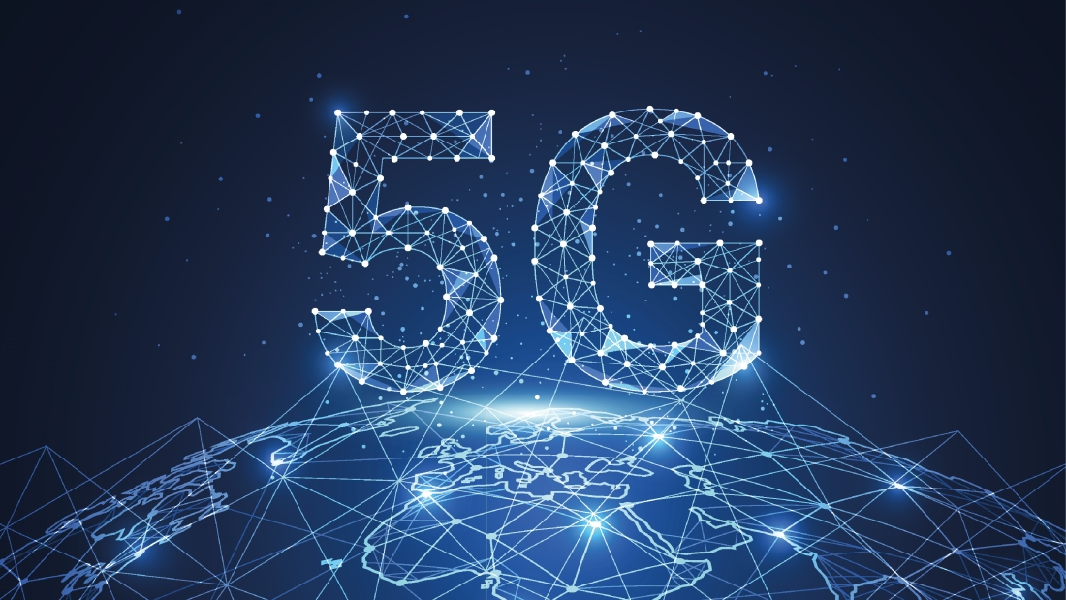
Additional information
Challenges
Future Trends

Slide 8

Conclusion

