Slide 1
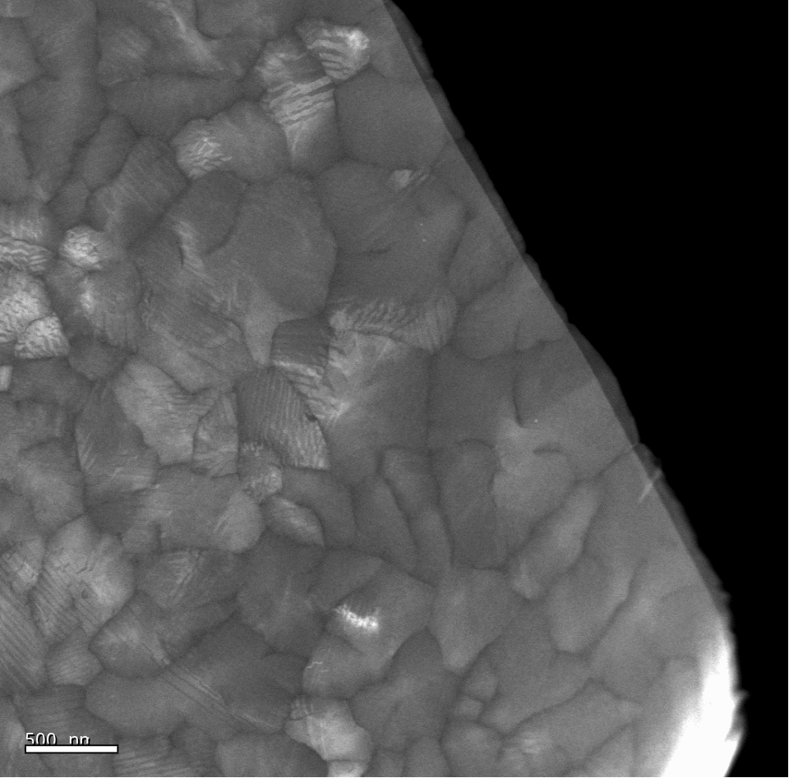
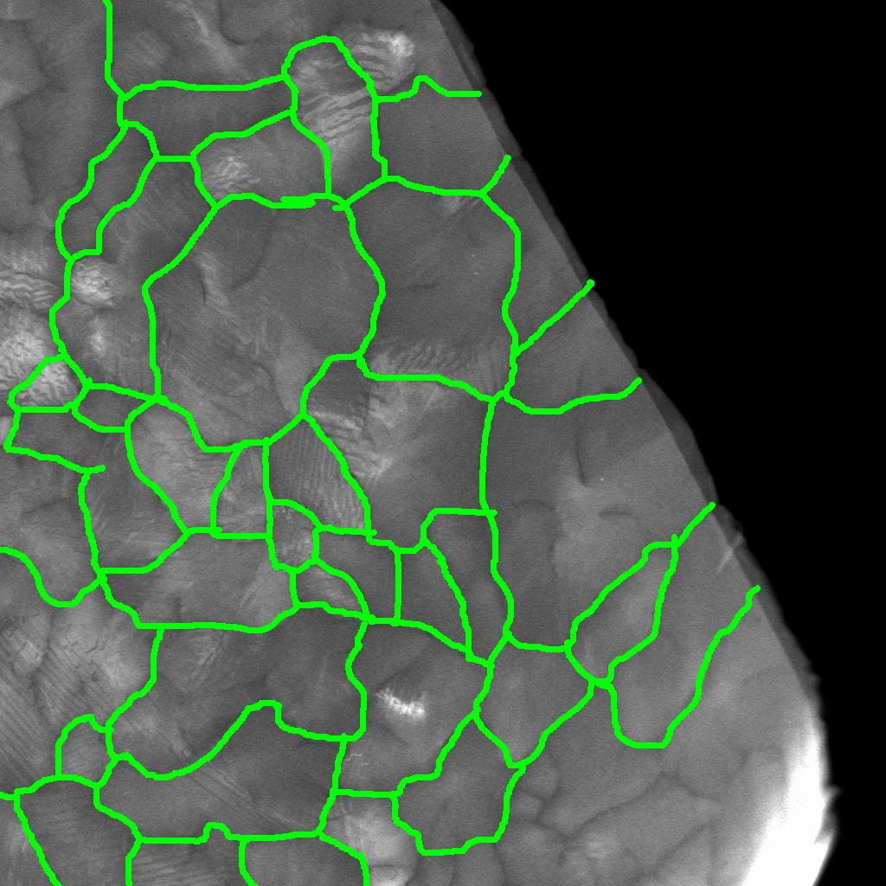
40nm Pentacene on Si₃N₄ Imaged in TECNAI STEM 11/1/05

Slide 2
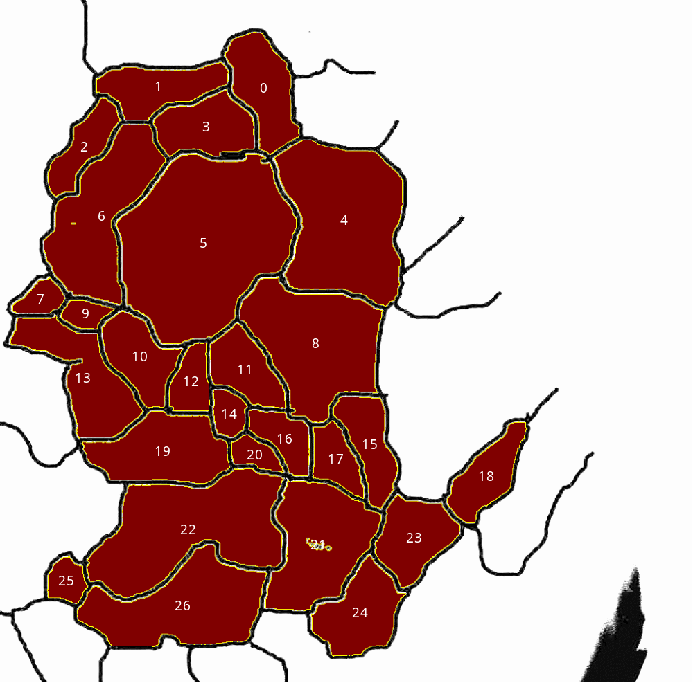
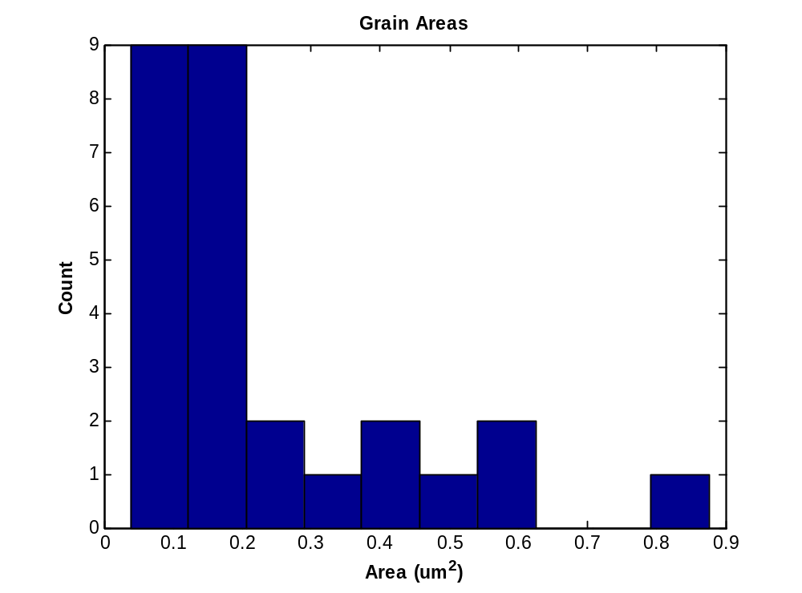
Averages
Area = 0.229µm²
Perimeter = 2.13µm
Circular Diameter = 0.59µm

